Slide 1

CSE 583 – Advanced Compilers Course Overview, Introduction to Control Flow Analysis
Fall 2025, University of Michigan
Aug 25, 2025
https://web.eecs.umich.edu/~mahlke/courses/583f25

Slide 2
Lectures
Class meeting pattern
Mon/Wed 10:30-12:20 (we’ll stop at ~noon)
Scott office hours right after lecture: noon-12:30
In-person lecture: 1500 EECS (Mon/Wed)
Please attend, get much more out of the lecture
Will keep things fast paced and interesting
May have some virtual classes during the semester
Class will also be presented live on Zoom
Should be used as a backup when sick
Zoom videos also available (try to use just for review!)
Bad idea if this is all you do: run 1.5x, multi-task, don’t pay attention
Zoom info
Same link/password for all lectures, posted on course website
Separate link for GSI office hrs – more later

Slide 3
Attending Class Virtually
Lecture is synchronous and recorded
Please try to attend live if you can
We’ll start at 10:35 and end at noonish
Keep your camera and mic muted
Critical to avoid disruptions
Asking questions on Zoom
Type the word “question” in the chat box
GSI will unmute you and you can ask question
If you prefer not to speak, then just type out your question in chat and the GSI can ask it for you
I will also pause regularly to ask if there are questions
Discussion important in a grad class, so don’t be bashful

Slide 4
About Me
Mahlke = mall key
But just call me Scott
Been at Michigan since 2001
Compiler guy who likes hardware
Program optimization to make programs go faster
Building custom hardware for high performance/low power
Before this – HP Labs in Silicon Valley
Before before – Grad student at UIUC
Before ^ 3 – Undergrad at UIUC

Slide 5
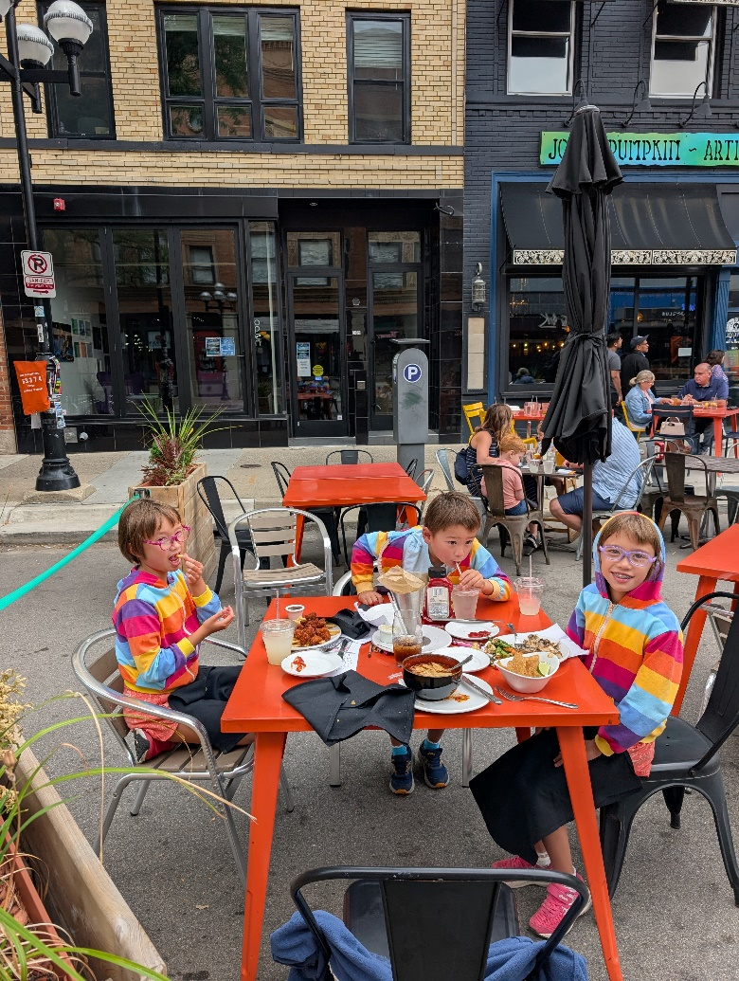
More About Me
3 kids – 9, 9, and 7
So if I show up to lecture half asleep, you know why!

Slide 6
Contact Information
Email: mahlke@umich.edu
Office hours
Mon/Fri 12:00-12:30 in 1500 EECS/1571 GG Brown
Or send me an email for an appointment
Visiting office hrs
Mainly help on classroom material, concepts, etc.
I am an LLVM novice, so likely I cannot answer any non-trivial question
See GSIs for LLVM details

Slide 7

583 GSIs
Rishika Kalidindi (rishikak@umich.edu)
Office hours: Mon 1-3pm, Tue 1-3pm, Thu 1-3pm
Naveen Unnikrishnan (naveenu@umich.edu)
Office hours: Tue 9-10:30am, Wed 2:30-4pm, Thu 9-10:30am, Fri 9-10:30am
Location: Zoom (link on course website, same link for the entire semester, same for both GSIs, passcode = eecs583)

Slide 8
Getting Help from the GSIs
LLVM help/questions
But, you will have to be independent in this class
Read the documentation and look at the code
Come to them when you are really stuck or confused
They cannot and will not debug your code
Helping each other is encouraged
Use the class piazza group (GSIs will monitor)
Virtual office hours on Zoom
Considering having appointments along with open sessions

Slide 9
Class Overview
This class is NOT about:
Programming languages
Parsing, syntax checking, semantic analysis
Handling advanced language features – virtual functions, …
Frontend transformations
Debugging
Simulation
Compiler backend
Mapping applications to processor hardware
Retargetability – work for multiple platforms (not hard coded)
Work at the assembly-code level (but processor independent)
Speed/Efficiency
How to make the application run fast
Use less memory (text, data), efficiently execute
Parallelize, prefetch, optimize using profile information

Slide 10
Background You Should Have
1. Programming
Good C++ programmer (essential)
Linux, gcc, emacs (vi or other editor is ok too)
Debugging experience – hard to debug with printf’s alone – gdb!
Compiler system not ported to Windows, Mac should work
2. Computer architecture
EECS 370 is good, 470 is better but not essential
Basics – caches, pipelining, function units, registers, virtual memory, branches, multiple cores, assembly code
3. Compilers
Frontend stuff is not very relevant for this class, but good to know
Basic backend stuff we will go over fast
Non-EECS 483 people will have to do some supplemental reading

Slide 11
Textbook and Other Classroom Material
No required text – Lecture notes, papers
LLVM compiler system – we will use version 20.1.8
LLVM webpage: http://www.llvm.org
Read the documentation!
LLVM users group
Course webpage + course newsgroup
https://www.eecs.umich.edu/~mahlke/courses/583f25
Lecture notes – available the night before class
Piazza – ask/answer questions, GSIs and I will try to check regularly but may not be able to do so always
http://www.piazza.com

Slide 12

What the Class Will be Like
Core backend stuff
Text book material – some overlap with 483
2 homeworks to apply classroom material
Research papers
Last 1/3rd of the semester, students take over
Select paper related to your project
Each project team - presents 1 paper. 15 min talk + Q&A.
Entire class is expected to watch presentations and grade presentations
You will need to attend live for at least your own presentation

Slide 13

What the Class Will be Like (2)
Learning compilers
No memorizing definitions, terms, formulas, algorithms, etc
Learn by doing – Writing code
Substantial amount of programming
Fair learning curve for LLVM compiler
Reasonable amount of reading
Classroom
Attendance – Best to attend class, lots of examples solved in class
Discussion important
Work out examples, discuss papers, etc
Essential to stay caught up
Extra meetings outside of class to discuss projects

Slide 14

Course Grading
Yes, everyone will get a grade
Distribution of grades, scale, etc - ???
Most (hopefully all) will get A’s and B’s
Slackers will be obvious
Components
Midterm exam – 25%
Project – 45%
Homeworks – 15%
Paper presentation – 10%
Class participation – 5%

Slide 15

Homeworks
1 preliminary (HW0), available on course webpage now
Get LLVM set up, nothing to submit
2 real homeworks
1 small &1 harder programming assignment
Goals
Learn the important concepts
Learn the compiler infrastructure so you can do the project
Grading
Working testcases?, Does anything work? Level of effort?
We have an autograder, more on this with HW1
Working together on the concepts is fine
Make sure you understand things or it will come back to bite you
Everyone must do and turn in their own assignment

Slide 16

Projects – Most Important Part of the Class
Design and implement an “interesting” compiler technique and demonstrate its usefulness using LLVM
Topic/scope/work
3-5 people per project (Other group sizes allowed in some cases)
You will pick the topics (I have to agree)
You will have to
Read background material
Plan and design
Implement and debug
Deliverables
Working implementation
Project report: ~5 page paper describing what you did/results
15 min presentation at end (demo if you want)
Project proposal (late Oct) scheduled with each group during semester

Slide 17
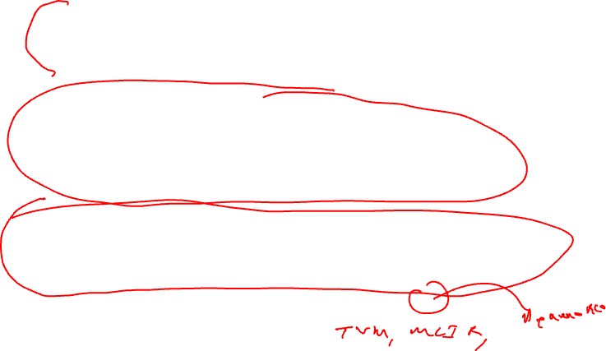
Types of Projects
New idea
Small research idea
Design and implement it, see how it works
Extend existing idea
Take an existing paper, implement their technique
Then, extend it to do something small but interesting
Generalize strategy, make more efficient/effective
Implementation
Take existing idea, create quality implementation in LLVM
Try to get your code released into main LLVM system
Using other compilers/systems (GPUs, JIT, mobile phone, etc.) is possible

Slide 18
Topic Areas (You are Welcome to Propose Others)
Automatic parallelization
Loop parallelization
Vectorization/SIMDization
Transactional memories/speculation
Breaking dependences
Memory system performance
Instruction/data prefetching
Use of scratchpad memories
Data layout
Reliability
Catching transient faults
Reducing AVF
Customized hardware
High level synthesis
HW optimization
Power
Instruction scheduling techniques to reduce power
Identification of narrow computations
Streaming/GPUs
Stream scheduling
Memory management
Optimizing CUDA programs
Security
Program analysis to identify vulnerabilities
Eliminate vulnerabilities via xforms
Dynamic optimization
DynamoRIO
Run-time optimization

Slide 19
Class Participation
Interaction and discussion is essential
Try to join live if you can (we don’t take attendance, but we notice who is here frequently)
If you are here, don’t just stare at the wall
Be prepared to discuss the material
Have something useful to contribute
Opportunities for participation
Research paper presentations – thoughts, comments, questions
Saying what you think during class or in project discussions outside of class
Lectures: Solving class problems, asking questions
Helping answer questions on piazza!

Slide 20

Tentative Class Schedule (on course website)
Week | Date | Topic
1 Mon | Aug 25 | Course intro, Control flow analysis,
Wed | Aug 27 | Control flow analysis, HW #0 out
2 | Sep 1 | No class, Labor Day
 | Sep 3 | Control flow analysis, HW #0 due, HW #1 out
3 | Sep 8 | Control flow analysis
 | Sep 10 | Dataflow analysis
4 | Sep 15 | Dataflow analysis, HW #1 due
 | Sep 17 | SSA form, HW #2 out
5 | Sep 22 | Code optimization
 | Sep 24 | Code optimization
6 | Sep 29 | Code generation
 | Oct 1 | Code generation
7 | Oct 6 | Code generation
 | Oct 8 | Code generation, HW #2 due
8 | Oct 13 | No class – Fall Break!
 | Oct 15 | Code generation, Advanced topics
9 | Oct 20 | No regular class - Project proposals
 | Oct 22 | No regular class - Project proposals
10 | Oct 27 | Midterm Review
 | Oct 29 | Midterm Exam
11 | Nov 3 | Research paper presentations
 | Nov 5 | Research paper presentations
12 | Nov 10 | Research paper presentations
 | Nov 12 | Research paper presentations
13 | Nov 17 | Research paper presentations
 | Nov 19 | Research paper presentations
14 | Nov 24 | Research paper presentations
 | Nov 26 | No class, Thanksgiving break
15 | Dec 1 | Research paper presentations
 | Dec 3 | Research paper presentations
 | Dec 5-12 | Project demos

Slide 21
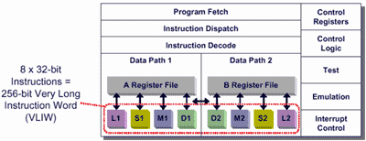

Target Processors: 1) VLIW/EPIC Architectures
VLIW = Very Long Instruction Word
Aka EPIC = Explicitly Parallel Instruction Computing
Compiler managed multi-issue processor
Desktop
IA-64: aka Itanium I and II, Merced, McKinley
Embedded processors
All high-performance DSPs are VLIW
Why? Cost/power of superscalar, more scalability
TI-C6x, Philips Trimedia, Starcore, ST-200

Slide 22
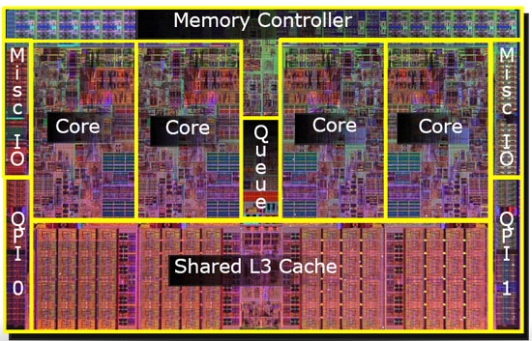

Target Processors: 2) Multicore
Sequential programs – 1 core busy, 3 sit idle
How do we speed up sequential applications?
Switch from ILP to TLP as major source of performance
Memory dependence analysis becomes critical

Slide 23
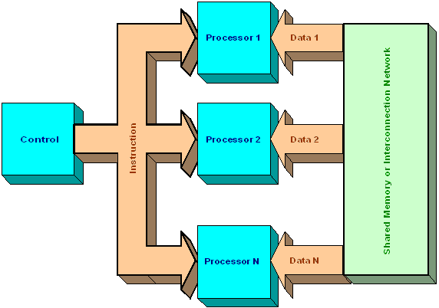

Target Processors: 3) SIMD/GPU
Do the same work on different data: GPU, SSE, etc.
Energy-efficient way to scale performance
Must find “vector parallelism”

Slide 24
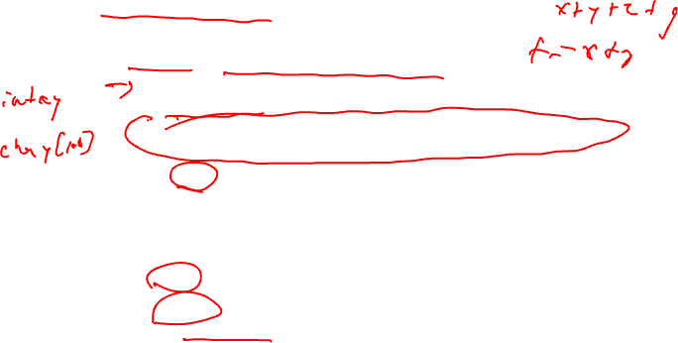
So, lets get started… Compiler Backend IR – Our Input
Variable home location
Frontend – every variable in memory
Backend – maximal but safe register promotion
All temporaries put into registers
All local scalars put into registers, except those accessed via &
All globals, local arrays/structs, unpromotable local scalars put in memory. Accessed via load/store.
Backend IR (intermediate representation)
machine independent assembly code – really resource indep!
aka RTL (register transfer language), 3-address code
r1 = r2 + r3 or equivalently add r1, r2, r3
Opcode (add, sub, load, …)
Operands
Virtual registers – infinite number of these
Literals – compile-time constants

Slide 25

First Topic: Control Flow Analysis
Control transfer = branch (taken or fall-through)
Control flow
Branching behavior of an application
What sequences of instructions can be executed
Execution → Dynamic control flow
Direction of a particular instance of a branch
Predict, speculate, squash, etc.
Compiler → Static control flow
Not executing the program
Input not known, so what could happen
Control flow analysis
Determining properties of the program branch structure
Determining instruction execution properties

Slide 26
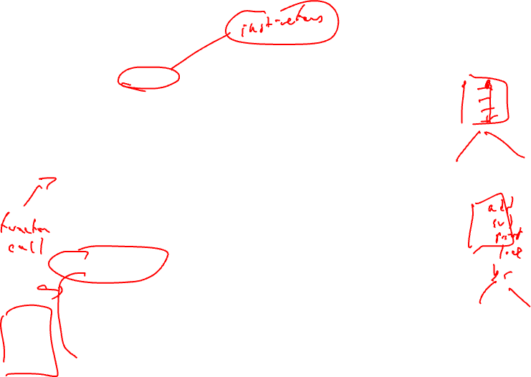
Basic Block (BB)
Group operations into units with equivalent execution conditions
Defn: Basic block – a sequence of consecutive operations in which flow of control enters at the beginning and leaves at the end without halt or possibility of branching except at the end
Straight-line sequence of instructions
If one operation is executed in a BB, they all are
Finding BB’s
The first operation in a function starts a BB
Any operation that is the target of a branch starts a BB
Any operation that immediately follows a branch starts a BB

Slide 27
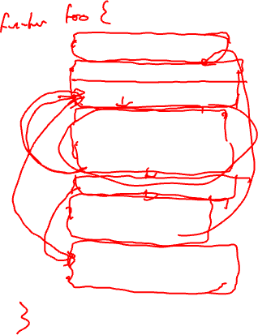
Identifying BBs - Example
L1: r7 = load(r8)
L2: r1 = r2 + r3
L3: beq r1, 0, L10
L4: r4 = r5 * r6
L5: r1 = r1 + 1
L6: beq r1 100 L3
L7: beq r2 100 L10
L8: r5 = r9 + 1
L9: jump L2
L10: r9 = load (r3)
L11: store(r9, r1)
??

Slide 28
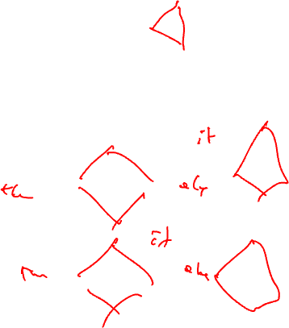
Control Flow Graph (CFG)
Defn Control Flow Graph – Directed graph, G = (V,E) where each vertex V is a basic block and there is an edge E, v1 (BB1) → v2 (BB2) if BB2 can immediately follow BB1 in some execution sequence
A BB has an edge to all blocks it can branch to
Standard representation used by many compilers
Often have 2 pseudo vertices
entry node
exit node
Entry
BB1
BB2
BB3
BB4
BB5
BB6
BB7
Exit

Slide 29

CFG Example
B1
x = z – 2;
y = 2 * z;
if (c) {
x = x + 1;
y = y + 1;
}
else {
x = x – 1;
y = y – 1;
}
z = x + y
x = z – 2;
y = 2 * z;
if (c) B2 else B3
then
(taken)
else
(fallthrough)
B2
B3
x = x + 1;
y = y + 1;
x = x – 1;
y = y – 1;
goto B4;
B4
z = x + y

Slide 30
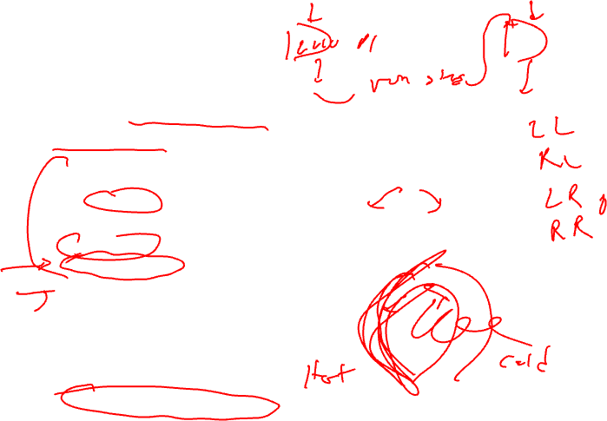
Weighted CFG
Profiling – Run the application on 1 or more sample inputs, record some behavior
Control flow profiling
edge profile
block profile
Path profiling
Cache profiling
Memory dependence profiling
Annotate control flow profile onto a CFG → weighted CFG
Optimize more effectively with profile info!!
Optimize for the common case
Make educated guess
Entry
20
BB1
10
10
BB2
BB3
10
10
BB4
20
0
BB5
BB6
20
0
BB7
20
Exit

Slide 31
Property of CFGs: Dominator (DOM)
Defn: Dominator – Given a CFG(V, E, Entry, Exit), a node x dominates a node y, if every path from the Entry block to y contains x
3 properties of dominators
Each BB dominates itself
If x dominates y, and y dominates z, then x dominates z
If x dominates z and y dominates z, then either x dominates y or y dominates x
Intuition
Given some BB, which blocks are guaranteed to have executed prior to executing the BB

Slide 32
Dominator Example 1
Entry
BB1
BB2
BB3
BB4
Exit

Slide 33
Dominator Example 2
Entry
BB1
BB2
BB3
BB4
BB5
BB6
BB7
Exit

Slide 34
Get Started ASAP!! Homework 0
Go to http://llvm.org
Setup LLVM 20.1.8 on the class server or your favorite Linux box
For server, use the central version that is already set up
For your own system, read the installation instructions
See upcoming GSI post on piazza for detailed instructions
Try to run it on a simple C program
HW1 goes out next week and you need LLVM
We will have 2 dedicated servers for class use
eecs583a/eecs583b.eecs.umich.edu
Everyone should have ssh access later this week

