Slide 1

EECS 583 – Class 15 Exam Review
University of Michigan
October 27, 2025

Slide 2
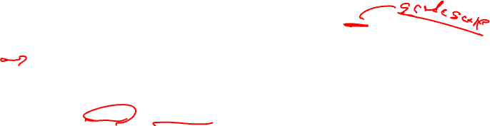
Announcements
Project proposal deadline – Tonight (Monday) midnight
Submit paragraph + reference on your project topic (Email to Naveen, Rishika, Scott, and cc all your group members)
Research paper presentations
Each group sign up for 15 min (presentation) + 2 min (Q&A) slot on the EECS 583 calendar
Mon Nov 3 – Wed Dec 3: presentations during class (4 slots per class)
Midterm Exam
Wednesday, Oct 29, Hybrid format
In person – Send email to Naveen if you want to take the exam in class
10:35am-12:05pm – 1500 EECS
Questions answered in the hallway
Virtual
10:35am-12:05pm + 15 mins extra time for logistics (printing, scanning, etc.)
Questions about exam can be posted on piazza and will be answered ASAP
Covers through register allocation (last lecture)

Slide 3

Research Paper Presentation Logistics
Monday Nov 3 – Wednesday Dec 3
Signup for slot on Google calendar (just like project proposals)
Sign up for earliest slot available on the day you want to present → no gaps
Plan on attending the entire lecture on the day you present
Not all days will be full (max of 4 slots per lecture)
Each group: 15 min slot + 2 mins Q&A
You will be cut off if you go long!
Tag-team presentation – Divide up as you like but everyone must talk
Max of 20 slides (for the group), animations not included in count
Record your paper title on the group sign up sheet (so we can check for conflicts!)
Submit paper (pdf) and slides (pptx or pdf) night before (by 9pm!)
Call your files groupX_paper.pdf, groupX_slides.pdf/pptx
Email to Scott

Slide 4

Research Paper Presentation Format
Make your own slides!!!
Don’t just lift figures from the pdf (graphs/tables ok to lift)
Don’t have too many all text slides
No long sentences on slides, don’t just read the slides
Points to discuss
Intro/Motivation – area + problem + why is it important to solve this problem
How the technique works, examples are super helpful
Some results, but don’t show 10 graphs
Group’s commentary (last slide or 2 of your presentation)
What is best about the paper? Why is the idea so awesome? Don’t focus on results
What are limitations/weaknesses of the approach (be critical!)

Slide 5
Research Paper Presentation – Audience Members
Research presentations != skip class
You should attend or watch the Zoom video
Grading + give comments to your peers
Class + Naveen, Rishika, & I will evaluate each group’s presentation and provide feedback
Each person will submit evaluation sheet for the day’s presentations
Online Google form
3 days (72 hrs) to submit
Naveen/Rishika will anonymize comments and email to each group
Be critical, but constructive with your criticisms
What was good about the talk, what could be improved.
Don’t try to give separate comments for each group member, just evaluate the entire team

Slide 6
Exam Review

Slide 7
Virtual Exam Logistics (see piazza for more details)
Wednesday, Oct 29
10:35-12:05 + 15 minutes for logistics
Gradescope to distribute/collect exams, accessible via canvas
Steps
Download, take exam, scan & submit
Print out and write on exam sheets – then scan your sheets and submit
Use electronic method (ie tablet) to create electronic answers
Exam itself should take ~ 75 mins (90 mins provided)
Some slack time to deal with difficulties, but email course staff if you run into problems
Use piazza to ask private questions and get answers during the exam
We will answer ASAP.

Slide 8
In-person Exam Logistics
Wednesday Oct 29 – 1500 EECS
10:35-12:05
Printed exams available in classroom
Logistics
Take exam in room
Course staff will be outside lecture room to answer questions
Bring whatever you like (open book exam)
Tablet/laptop
Printed materials (old exams, lecture problems, etc.)
Books, etc.

Slide 9
What to Expect
Exam format
Open notes, open internet
Apply techniques we discussed in class
Reason about solving compiler problems – how/why things are done
A couple of thinking problems
No LLVM code
Honor code and cheating
Must sign honor code acknowledging that you have neither given no received aid on the exam – this includes ChatGPT or other LLM
Please do not share answers or talk to other students during the exam
Graduate class, so we don’t expect cheating to be an issue
But we will investigate any anomalies that arise

Slide 10

Studying
10 exams + answer keys (F12, F13, F18, F19, F20, F21, F22, W23, F23, W24) are posted on the course website
Note – Past exams may not accurately predict future exams!!
Fomat will be similar
Work out the problems without looking at the answers!
Exams vary in terms of time/length
Preparing yourself
Yes, you should study even though its open notes
Lots of material that you have likely forgotten from early this semester
Refresh your memories, especially the old topics
No memorization required, but you need to be familiar with the material to finish the exam
Go through lecture notes, especially the examples!
If you are confused on a topic, go through the reading
Go through the practice exams (Don’t look at the answer) as the final step

Slide 11
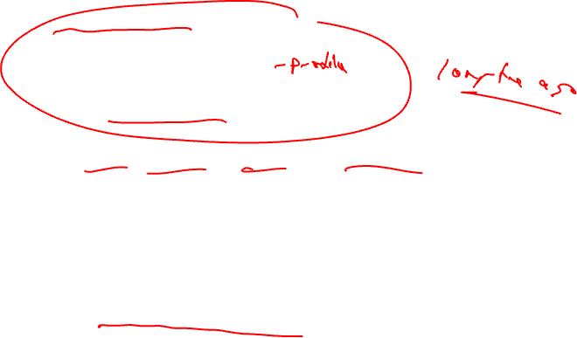
Exam Topics
Control flow analysis
Control flow graphs, Dom/pdom, Loop detection
Trace selection, superblocks
Predicated execution
Control dependence analysis, if-conversion
Dataflow analysis
Liveness, reaching defs, DU/UD chains, available defs/exprs
Static single assignment – Make sure you understand SSA!
Optimizations
Classical: Dead code elim, constant/copy prop, CSE, LICM, induction variable strength reduction
ILP optimizations - unrolling, tree height reduction, induction/accumulator expansion – Just understand the concepts
Speculative optimization – like HW2

Slide 12

Exam Topics - Continued
Acyclic scheduling
Dependence graphs, Estart/Lstart/Slack, list scheduling
Code motion across branches, speculation, exceptions
Software pipelining
DSA form, ResMII, RecMII, modulo scheduling
Make sure you can modulo schedule a loop!
Execution control with LC, ESC
Register allocation
Interference graph, graph coloring

Slide 13
Some Sample Problems

Slide 14
Part I: Short Questions
Fast questions – a couple of minutes each
Don’t waste too much time on any single question
Come back later to questions you don’t know the answer
Basic facts/trends, simple problems
Most should be obvious, but read carefully

Slide 15
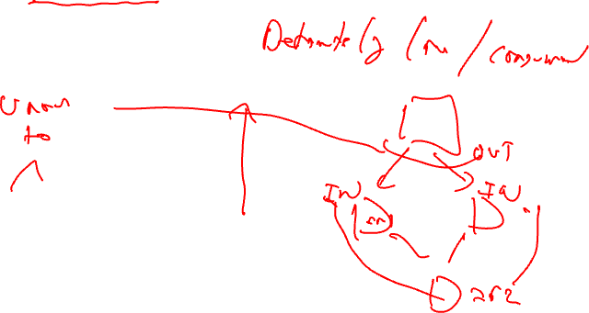
Question 2 - Winter 2023
In liveness analysis, how would the analysis results be changed if the meet function was modified from using union of live variables (IN sets) of the successor blocks to intersection over the same sets of variables? Briefly explain your answer

Slide 16
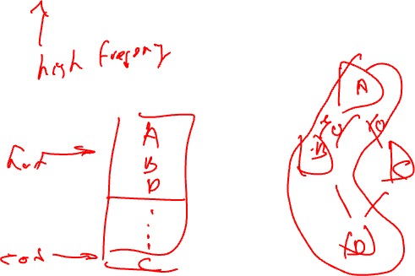
Question 2 – Fall 2022
What is the main purpose of a compiler identifying and co-locating hot blocks of code together as done with trace selection?

Slide 17
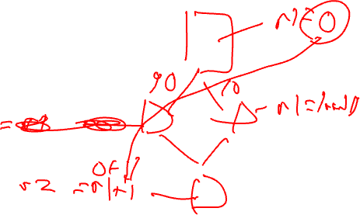
Question 4 – Winter 2024
Using Homework 2 as inspiration, would frequent-path constant propagation provide any advantages over traditional constant propagation? Briefly explain with a small code example

Slide 18
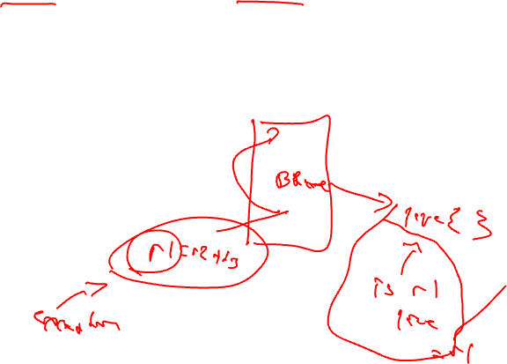
Question 3 – Fall 2018
When a compiler scheduler wants to speculate an instruction, name one issue that it must consider to preserve correctness of the resulting code.

Slide 19
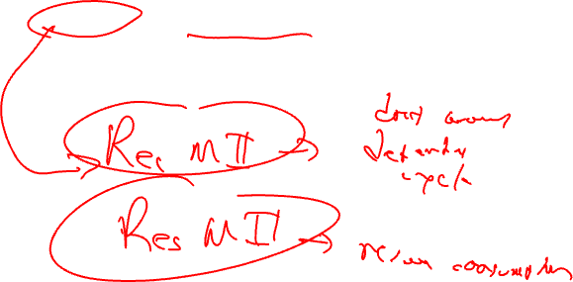
Question 2 – Fall 2020
It is often possible to improve the performance of a loop limited by RecMII by adding resources to the processor. Is the preceding statement True or False? Justify your answer

Slide 20
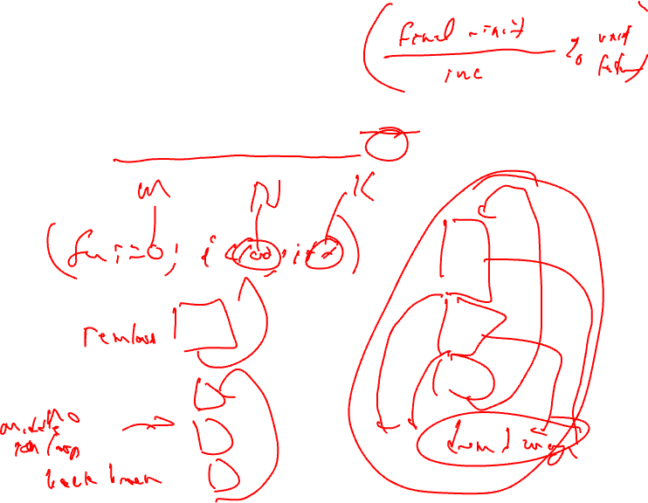
Question 3 – Fall 2021
Is it possible to unroll a loop with a statically (compile-time) unknown number of iterations? Yes/No and briefly explain.

Slide 21

Part II: Medium/Long Questions
Longer questions
Problems that must be worked out: 5-10 mins each
Some questions like lecture examples
But, some have a little twist
Practicing problems ahead of time will make you more comfortable and faster
So, practicing is strongly recommended
Go through the old exams!

Slide 22
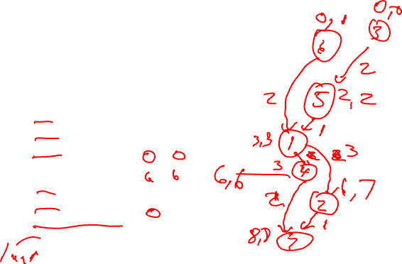
Question 9 – Fall 2022
Due to a corrupt disk, the original order of the instructions was lost and the
instructions got randomly ordered. The student reassigns the number of each
instruction and knows the corresponding partial Estart and Lstart values (see Table
below). It is also known that Instruction 7 (r2 = r6*2) is the last instruction of the BB
and has the largest Estart and Lstart values. Determine the original order of the
instructions using the partial Estart/Lstart values and complete the missing Estart/Lstart values in the table below for the original ordering. Remember, the instruction numbers do not represent the original order.

Slide 23
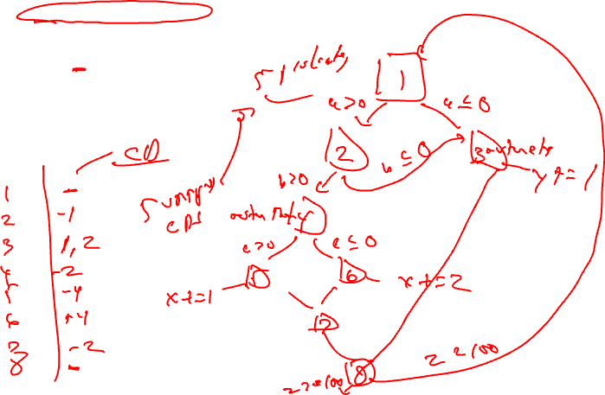
Question 6 – Fall 2019
Draw the control flow graph (CFG) and determine the minimum number of predicates required to if-convert the following code.
do {
if (a>0 && b>0){
if (c>0)
x+=1;
else
x+=2;
z=x/3;
}else{
y+=1;
}
} while(z<100)

Slide 24
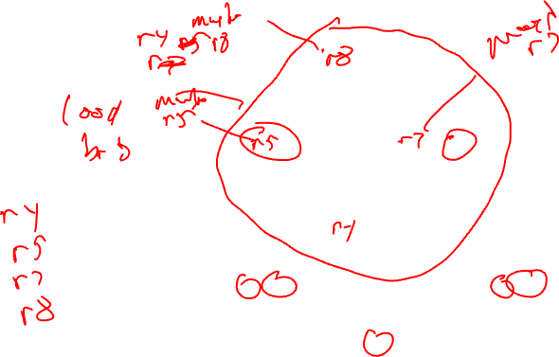
Question 7 – Fall 2023
Fill in the blanks using r4, r5, r7, and r8, so that a maximum number of instructions from BB2, BB3, BB4, and BB6 become eligible for hoisting via LICM

Slide 25
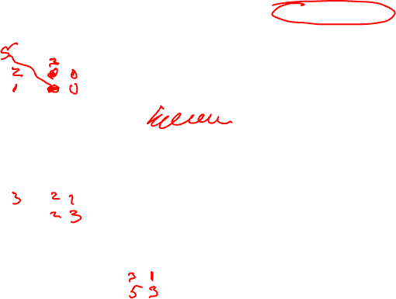
Question 9 – Winter 2024
Fill in the blanks below to put the code into the static single assignment (SSA) form. Leave phi nodes blank when they are unnecessary. Choose operands sequentially from the lists x0, x1, … xn, and y0, y1, … ym, using each operand only after all its preceding operands in the sequence have been used. Repetition of registers used is permitted. For phi nodes, place the operand in the first position if it originates from the left edge, and in the second position if it originatesfrom the right edge.
x0 = load(0x67)
y0 = 1
x_= phi(x_, x_)
y_= phi(y_, y_)
y2 = y1 << 2
x_= phi(x_, x_)
y_= phi(y_, y_)
x1 = x2 + 1
y3 = y2 * 2
x_= phi(x_, x_)
y4 = phi(y_, y_)
y5 = x3 - 1
x4 = phi(x_, x_)
y6 = phi(y_, y_)

