Slide 1

EECS 583 – Class 11 Instruction Scheduling
University of Michigan
October 1, 2025

Slide 2

Announcements & Reading Material
HW 2 – Due Next Wednesday at midnight!
See piazza for answered questions, Talk to Naveen/Rishika for help
Project discussion meetings (Oct 20-24)
Project proposal meeting signup next next week – Signup on Google Calendar
Each group meets 10 mins with Naveen, Rishika, and I
Action items
Need to identify group members
Use piazza to recruit additional group members or express your availability
Think about general project areas that you want to work on
Today’s class
“The Importance of Prepass Code Scheduling for Superscalar and Superpipelined Processors,” P. Chang et al., IEEE Transactions on Computers, 1995, pp. 353-370.
Next class
“Iterative Modulo Scheduling: An Algorithm for Software Pipelining Loops”, B. Rau, MICRO-27, 1994, pp. 63-74.

Slide 3

From Last Time: Data Dependences + Latencies
Data dependences
If 2 operations access the same register, they are dependent
However, only keep dependences to most recent producer/consumer as other edges are redundant
Types of data dependences
Flow
Output
Anti
r1 = r2 + r3
r4 = r1 * 6
r1 = r2 + r3
r1 = r4 * 6
r1 = r2 + r3
r2 = r5 * 6
Latency of producer
1
0

Slide 4
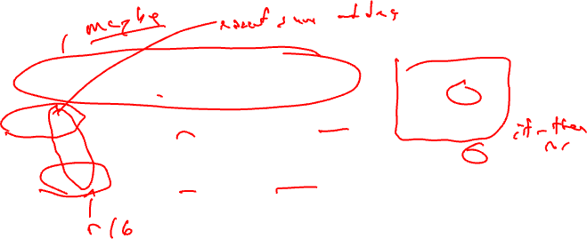
From Last Time: More Dependences + Latencies
Memory dependences
Similar as register, but through memory
Memory dependences may be certain or maybe
Control dependences
Branch determines whether an operation is executed or not
Operation must execute after/before a branch
Control
Mem-flow
Mem-output
Mem-anti
r3 = r4 + r5
if (r1 != 0)
r2 = load(r1)
0
store (r1, r2)
r3 = load(r1)
store (r1, r2)
store (r1, r3)
r2 = load(r1)
store (r1, r3)
1
1
1
1

Slide 5
Homework Problem 1
1. Draw dependence graph
2. Label edges with type and
latencies
machine model
latencies
add: 1
mpy: 3
load: 2
store: 1
1
2
1. r1 = load(r2)
2. r2 = r2 + 1
3. store (r8, r2)
4. r3 = load(r2)
5. r4 = r1 * r3
6. r5 = r5 + r4
7. r2 = r6 + 4
8. store (r2, r5)
3
4
5
6
7
8

Slide 6

Homework Problem 1: Answer
1. Draw dependence graph
2. Label edges with type and
latencies
machine model
latencies
add: 1
mpy: 3
load: 2
store: 1
Store format (addr, data)
rf, 2
1
ra, 0
2
1. r1 = load(r2)
2. r2 = r2 + 1
3. store (r8, r2)
4. r3 = load(r2)
5. r4 = r1 * r3
6. r5 = r5 + r4
7. r2 = r6 + 4
8. store (r2, r5)
rf, 1
ro, 1
3
rf, 1
ra, 0
ra, 0
4
ra, 0
rf, 2
5
rf, 3
6
rf, 1
7
rf, 1
8
Memory deps all with latency =1: 1→3 (ma), 1→8 (ma), 3→4 (mf), 3→8 (mo), 4→8 (ma)
No control dependences

Slide 7
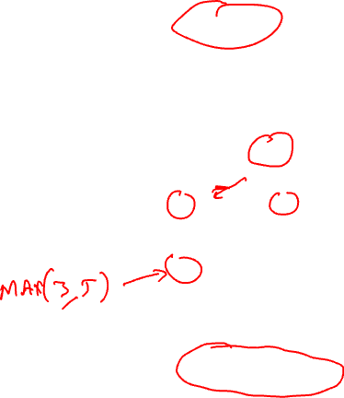
Dependence Graph Properties - Estart
Estart = earliest start time, (as soon as possible - ASAP)
Schedule length with infinite resources (dependence height)
Estart = 0 if node has no predecessors
Estart = MAX(Estart(pred) + latency) for each predecessor node
Example
0
1
1
2
1
2
3
2
3
3
2
2
5
4
5
4
3
1
6
8
2
1
10
7
8
9
0
0
Exit
10

Slide 8
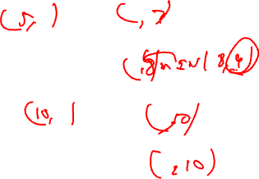
Lstart
Lstart = latest start time, ALAP
Latest time a node can be scheduled s.t. sched length not increased beyond infinite resource schedule length
Lstart = Estart if node has no successors
Lstart = MIN(Lstart(succ) - latency) for each successor node
Example
0
1
1
2
1
2
3
2
3
3
2
2
5
4
5
4
3
1
6
8
2
1
10
7
8
9
0
0
Exit
10

Slide 9
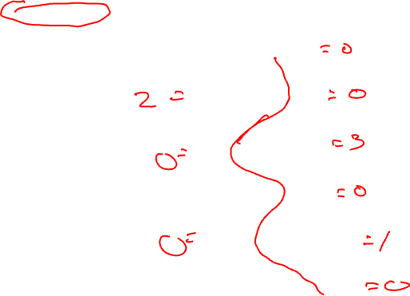
Slack
Slack = measure of the scheduling freedom
Slack = Lstart – Estart for each node
Larger slack means more mobility
Example
0, 0
1
1
2
1, 3
2
3
2, 2
3
3
2
2
5, 5
4
5
4, 7
3
1
6
8, 8
2
1
10, 10
7
8
9, 10
0
0
Exit
10, 10

Slide 10
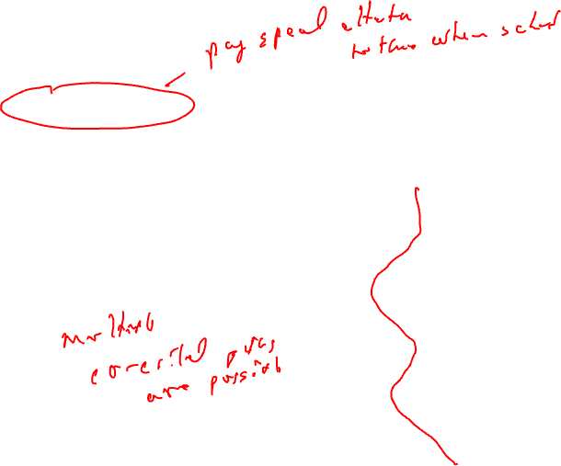
Critical Path
Critical operations = Operations with slack = 0
No mobility, cannot be delayed without extending the schedule length of the block
Critical path = sequence of critical operations from node with no predecessors to exit node, can be multiple crit paths
0, 0
1
1
2
1, 3
2
3
2, 2
3
3
2
2
5, 5
4
5
4, 7
3
1
6
8, 8
2
1
10, 10
7
8
9, 10
0
0
Exit
10, 10

Slide 11

Homework Problem 2
Node Estart Lstart Slack
1
2
3
4
5
6
7
8
9
1
1
2
2
1
3
2
4
3
1
1
2
6
5
1
3
7
1
8
2
9
1
Critical path(s) =

Slide 12
Homework Problem 2 - Answer
Node Estart Lstart Slack
1 0 0 0
2 1 2 2
3 2 2 0
4 0 3 3
5 4 5 1
6 4 4 0
7 5 6 1
8 7 7 0
9 8 8 0
1
1
2
2
1
3
2
4
3
1
1
2
6
5
1
3
7
1
8
2
9
1
Critical path(s) = 1,3,6,8,9

Slide 13
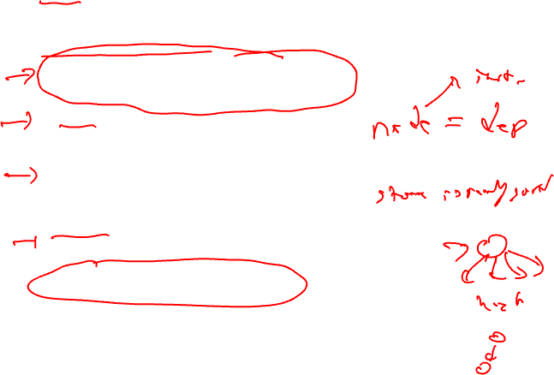
Operation Priority
Priority – Need a mechanism to decide which ops to schedule first (when you have multiple choices)
Common priority functions
Height – Distance from exit node
Give priority to amount of work left to do
Slackness – inversely proportional to slack
Give priority to ops on the critical path
Register use – priority to nodes with more source operands and fewer destination operands
Reduces number of live registers
Uncover – high priority to nodes with many children
Frees up more nodes
Original order – when all else fails

Slide 14
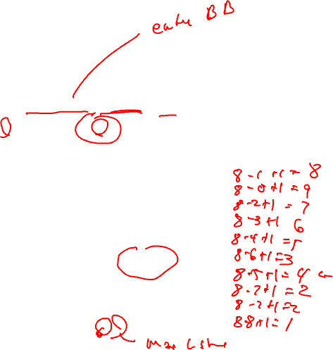
Height-Based Priority
Height-based is the most common
priority(op) = MaxLstart – Lstart(op) + 1
0, 1
1
0, 0
1
2
2
2
op priority
1
2
3
4
5
6
7
8
9
10
2, 2
3
4
2, 3
2
1
5
4, 4
2
2
2
6
6, 6
1
2
7
0, 5
4, 7
8
9
7, 7
1
1
10
8, 8

Slide 15
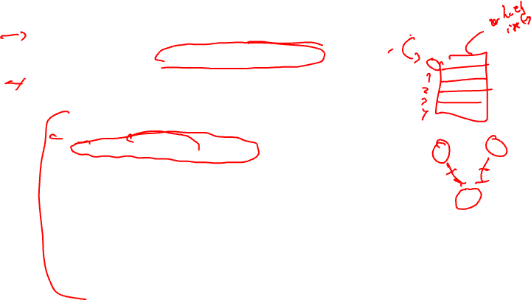
List Scheduling (aka Cycle Scheduler)
Build dependence graph, calculate priority
Add all ops to UNSCHEDULED set
time = -1
while (UNSCHEDULED is not empty)
time++
READY = UNSCHEDULED ops whose incoming dependences have been satisfied
Sort READY using priority function
For each op in READY (highest to lowest priority)
op can be scheduled at current time? (are the resources free?)
Yes, schedule it, op.issue_time = time
Mark resources busy in RU_map relative to issue time
Remove op from UNSCHEDULED/READY sets
No, continue

Slide 16
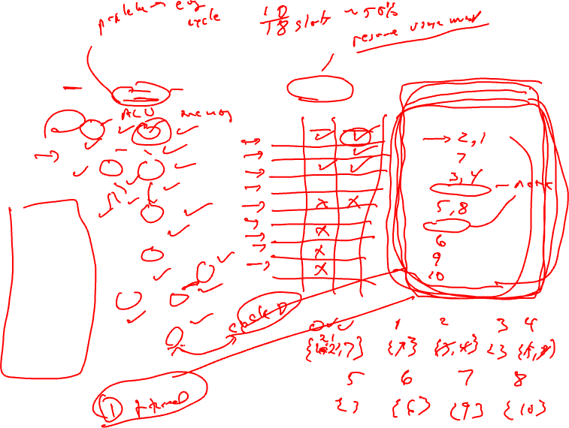
Cycle Scheduling Example
Processor: 2 issue, 1 memory port, 1 ALU
Memory port = 2 cycles, pipelined
ALU = 1 cycle
RU_map
Schedule
0, 1
1
0, 0
time ALU MEM
0
1
2
3
4
5
6
7
8
9
time Instructions
0
1
2
3
4
5
6
7
8
9
1
2
2m
2
2, 2
3m
4
2, 3
2
1
5m
4, 4
op priority
1 8
2 9
3 7
4 6
5 5
6 3
7 4
8 2
9 2
10 1
2
2
2
6
6, 6
1
2
7m
0, 5
4, 7
8
9
7, 7
1
1
10
8, 8
Time =
Ready =

Slide 17
Homework Problem 3
Processor: 2 issue, 1 memory port, 1 ALU
Memory port = 2 cycles, pipelined
ALU = 1 cycle
RU_map
Schedule
time ALU MEM
0
1
2
3
4
5
6
7
8
9
time Instructions
0
1
2
3
4
5
6
7
8
9
0,1
1m
2m
0,0
2
2
2,3
3
4m
2,2
1
1
2
3,5
5
6
3,4
7
4,4
1
1
1
5,5
8
9m
0,4
1
6,6
2
10
Time =
Ready =
Calculate height-based priorities
2. Schedule using cycle scheduler

Slide 18
Homework Problem 3 – Answer
Processor: 2 issue, 1 memory port, 1 ALU
Memory port = 2 cycles, pipelined
ALU = 1 cycle
Op priority
1 6
2 7
3 4
4 5
5 2
6 3
7 3
8 2
9 3
10 1
0,1
1m
2m
0,0
2
2
2,3
3
4m
2,2
RU_map
Schedule
1
1
2
time ALU MEM
0 X
1 X
2 X
3 X X
4 X
5 X
6 X
7 X
8 X
Time Instructions
0 2
1 1
2 4
3 3, 9
4 6
5 7
6 5
7 8
8 10
3,5
5
6
3,4
7
4,4
1
1
1
5,5
8
9m
0,4
1
6,6
2
10
Calculate height-based priorities
2. Schedule using Operation scheduler

Slide 19
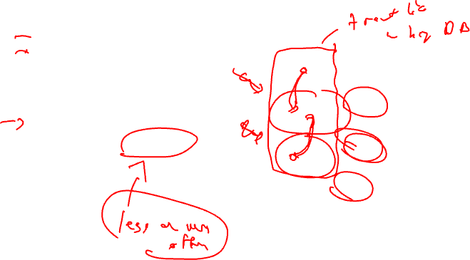
Generalize Beyond a Basic Block
Superblock
Single entry
Multiple exits (side exits)
No side entries
Schedule just like a BB
Priority calculations needs change
Dealing with control deps

Slide 20
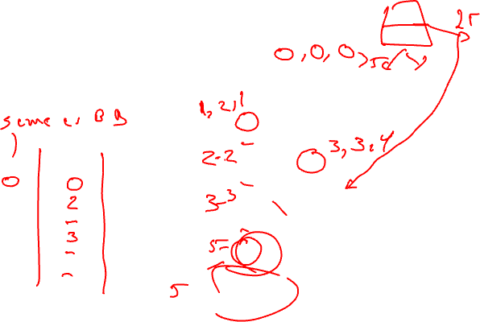
Lstart in a Superblock
Not a single Lstart any more
1 per exit branch (Lstart is a vector!)
Exit branches have probabilities
1
1
2
3
1
1
op Estart Lstart0 Lstart1
1
2
3
4
5
6
3
4
1
1
5
Exit0 (25%)
2
6
Exit1 (75%)

Slide 21
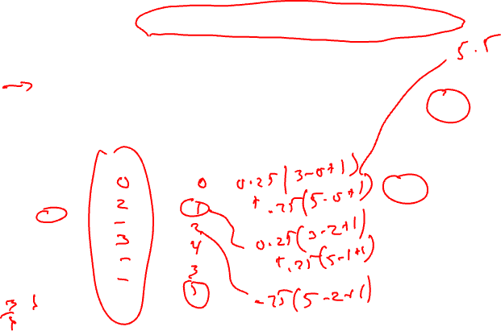
Operation Priority in a Superblock
Priority – Dependence height and speculative yield
Height from op to exit * probability of exit
Sum up across all exits in the superblock
Priority(op) = SUM(Probi * (MAX_Lstart – Lstarti(op) + 1))
valid late times for op
1
1
2
3
op Lstart0 Lstart1 Priority
1
2
3
4
5
6
1
1
3
4
1
1
5
Exit0 (25%)
2
6
Exit1 (75%)

Slide 22
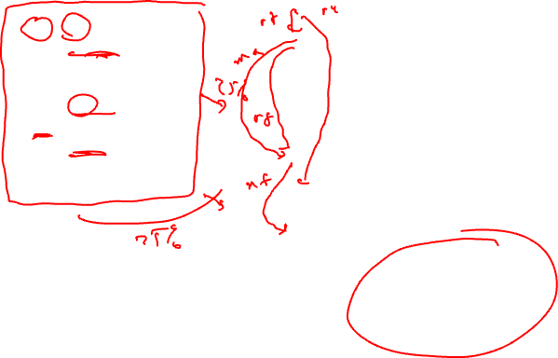
Dependences in a Superblock
Superblock
1
* Data dependences
shown, all are reg flow
except 1→ 6 is reg anti
* Dependences define
precedence ordering of
operations to ensure
correct execution
semantics
* What about control
dependences?
* Control dependences
define precedence of
ops with respect to
branches
1: r1 = r2 + r3
2: r4 = load(r1)
3: p1 = cmpp(r3 == 0)
4: branch p1 Exit1
5: store (r4, -1)
6: r2 = r2 – 4
7: r5 = load(r2)
8: p2 = cmpp(r5 > 9)
9: branch p2 Exit2
2
3
4
5
6
7
Note: Control flow in red bold
8
9

Slide 23

Conservative Approach to Control Dependences
Superblock
* Make branches
barriers, nothing
moves above or below
branches
* Schedule each BB in
SB separately
* Sequential schedules
* Whole purpose of a
superblock is lost
* Need a better solution!
1
1: r1 = r2 + r3
2: r4 = load(r1)
3: p1 = cmpp(r3 == 0)
4: branch p1 Exit1
5: store (r4, -1)
6: r2 = r2 – 4
7: r5 = load(r2)
8: p2 = cmpp(r5 > 9)
9: branch p2 Exit2
2
3
4
5
6
7
Note: Control flow in red bold
8
9

Slide 24
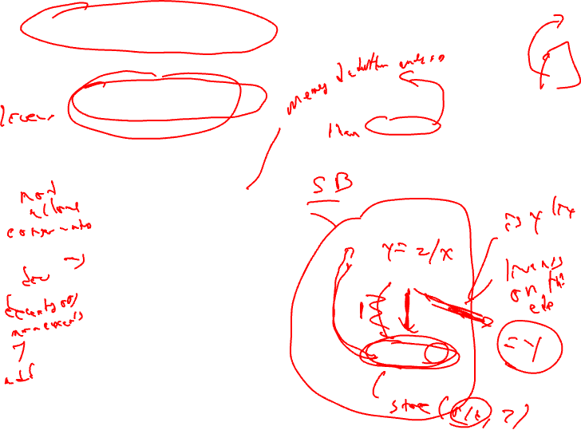
Upward Code Motion Across Branches
Restriction 1a (register op)
The destination of op is not in liveout(br)
Wrongly kill a live value
Restriction 1b (memory op)
Op does not modify the memory
Actually live memory is what matters, but that is often too hard to determine
Restriction 2
Op must not cause an exception that may terminate the program execution when br is taken
Op is executed more often than it is supposed to (speculated)
Page fault or cache miss are ok
Insert control dep when either restriction is violated
…
if (x > 0)
y = z / x
…
control flow graph
1: branch x <= 0
2: y = z / x

Slide 25
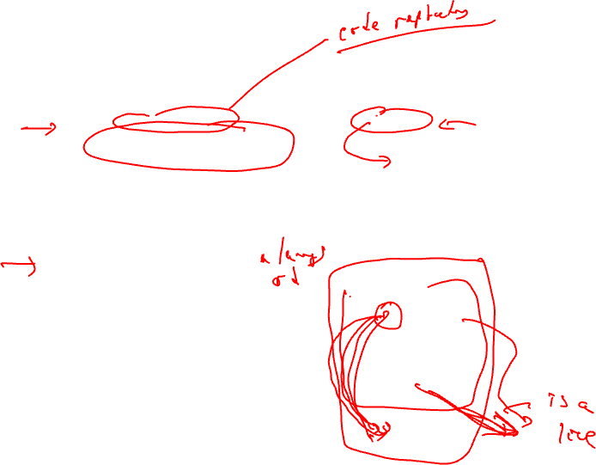
Downward Code Motion Across Branches
Restriction 1 (liveness)
If no compensation code
Same restriction as before, destination of op is not liveout
Else, no restrictions
Duplicate operation along both directions of branch if destination is liveout
Restriction 2 (speculation)
Not applicable, downward motion is not speculation
Again, insert control dep when the restrictions are violated
Part of the philosphy of superblocks is no compensation code insertion hence R1 is enforced!
…
a = b * c
if (x > 0)
else
…
control flow graph
1: a = b * c
2: branch x <= 0

Slide 26
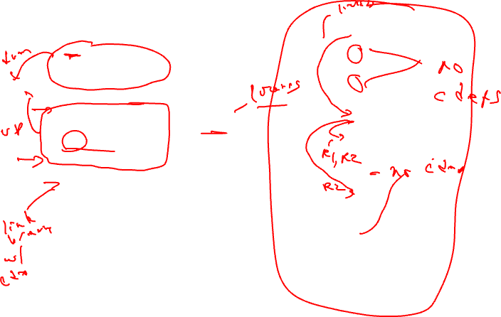
Add Control Dependences to a Superblock
Superblock
Assumed liveout sets
1
1: r1 = r2 + r3
2: r4 = load(r1)
3: p1 = cmpp(r2 == 0)
4: branch p1 Exit1
5: store (r4, -1)
6: r2 = r2 – 4
7: r5 = load(r2)
8: p2 = cmpp(r5 > 9)
9: branch p2 Exit2
2
3
{r1}
4
5
6
{r2}
All ops
have cdep
to op 9!
7
{r5}
Notes: All branches are control
dependent on one another.
If no compensation, all ops dependent
on last branch
8
9

Slide 27
To Be Continued

