Slide 1

EECS 583 – Class 10
ILP Optimization and Intro. to Code Generation
University of Michigan
September 29, 2025

Slide 2
Announcements & Reading Material
Reminder: HW 2
  Due next week Wed (Oct 8)
  You should have started by now
  Talk to GSIs if you are stuck
Class project
  Focus on project team formation and general topic area
Today’s class
  “Machine Description Driven Compilers for EPIC Processors”, B. Rau, V. Kathail, and S. Aditya, HP Technical Report, HPL-98-40, 1998. (long paper but informative)
Next class
  “The Importance of Prepass Code Scheduling for Superscalar and Superpipelined Processors,” P. Chang et al., IEEE Transactions on Computers, 1995, pp. 353-370.

Slide 3
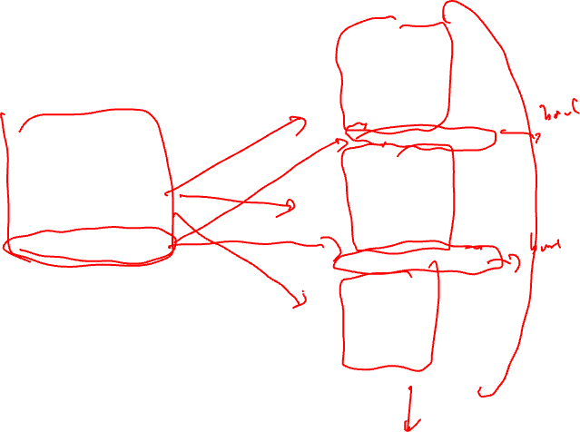
From Last Time: Loop Unrolling
for (i=x; i< 100; i++) {
sum += a[i]*b[i];
}
loop:
r1 = load(r2)
r3 = load(r4)
r5 = r1 * r3
r6 = r6 + r5
r2 = r2 + 4
r4 = r4 + 4
if (r4 >= 400) goto exit
unroll 3 times
iter1
loop:
r1 = load(r2)
r3 = load(r4)
r5 = r1 * r3
r6 = r6 + r5
r2 = r2 + 4
r4 = r4 + 4
if (r4 < 400) goto loop
r1 = load(r2)
r3 = load(r4)
r5 = r1 * r3
r6 = r6 + r5
r2 = r2 + 4
r4 = r4 + 4
if (r4 >= 400) goto exit
iter2
r1 = load(r2)
r3 = load(r4)
r5 = r1 * r3
r6 = r6 + r5
r2 = r2 + 4
r4 = r4 + 4
if (r4 < 400) goto loop
Unroll = replicate loop body
n-1 times.
Hope to enable overlap of
operation execution from
different iterations
iter3
exit:

Slide 4
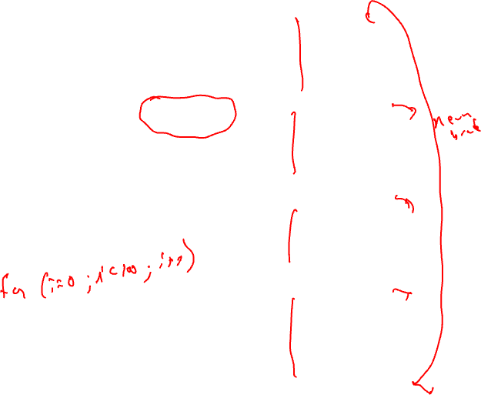
Smarter Loop Unrolling with Known Trip Count
loop:
r1 = load(r2)
r3 = load(r4)
r5 = r1 * r3
r6 = r6 + r5
r2 = r2 + 4
r4 = r4 + 4
Want to remove early exit branches
iter1
Trip count = 400/4 = 100
r4 = 0
r1 = load(r2)
r3 = load(r4)
r5 = r1 * r3
r6 = r6 + r5
r2 = r2 + 4
r4 = r4 + 4
if (r4 < 400) goto loop
unroll multiple
of trip count
r1 = load(r2)
r3 = load(r4)
r5 = r1 * r3
r6 = r6 + r5
r2 = r2 + 4
r4 = r4 + 4
loop:
iter2
r1 = load(r2)
r3 = load(r4)
r5 = r1 * r3
r6 = r6 + r5
r2 = r2 + 4
r4 = r4 + 4
iter3
r1 = load(r2)
r3 = load(r4)
r5 = r1 * r3
r6 = r6 + r5
r2 = r2 + 4
r4 = r4 + 4
if (r4 < 400) goto loop
iter4
exit:

Slide 5
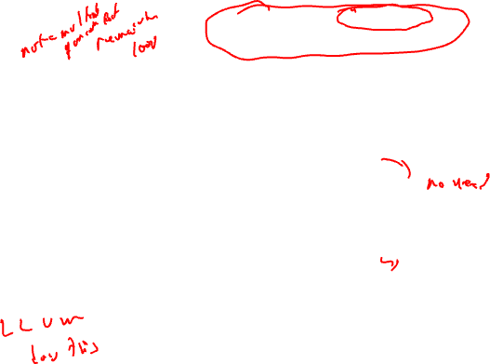
What if the Trip Count is not Statically Known?
preloop
for (i=0; i< ((400-r4)/4)%3; i++) {
sum += a[i]*b[i];
}
loop:
r1 = load(r2)
r3 = load(r4)
r5 = r1 * r3
r6 = r6 + r5
r2 = r2 + 4
r4 = r4 + 4
Create a preloop to
ensure trip count of
unrolled loop is a multiple
of the unroll factor
iter1
r4 = ??
r1 = load(r2)
r3 = load(r4)
r5 = r1 * r3
r6 = r6 + r5
r2 = r2 + 4
r4 = r4 + 4
if (r4 < 400) goto loop
loop:
r1 = load(r2)
r3 = load(r4)
r5 = r1 * r3
r6 = r6 + r5
r2 = r2 + 4
r4 = r4 + 4
iter2
r1 = load(r2)
r3 = load(r4)
r5 = r1 * r3
r6 = r6 + r5
r2 = r2 + 4
r4 = r4 + 4
if (r4 < 400) goto loop
iter3
exit:

Slide 6
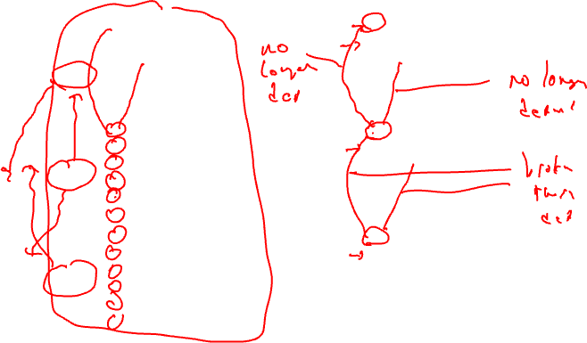
Unrolling Not Enough for Overlapping Iterations: Register Renaming
loop:
r1 = load(r2)
r3 = load(r4)
r5 = r1 * r3
r6 = r6 + r5
r2 = r2 + 4
r4 = r4 + 4
loop:
r1 = load(r2)
r3 = load(r4)
r5 = r1 * r3
r6 = r6 + r5
r2 = r2 + 4
r4 = r4 + 4
iter1
iter1
r1 = load(r2)
r3 = load(r4)
r5 = r1 * r3
r6 = r6 + r5
r2 = r2 + 4
r4 = r4 + 4
r11 = load(r2)
r13 = load(r4)
r15 = r11 * r13
r6 = r6 + r15
r2 = r2 + 4
r4 = r4 + 4
iter2
iter2
r1 = load(r2)
r3 = load(r4)
r5 = r1 * r3
r6 = r6 + r5
r2 = r2 + 4
r4 = r4 + 4
if (r4 < 400) goto loop
r21 = load(r2)
r23 = load(r4)
r25 = r21 * r23
r6 = r6 + r25
r2 = r2 + 4
r4 = r4 + 4
if (r4 < 400) goto loop
iter3
iter3

Slide 7
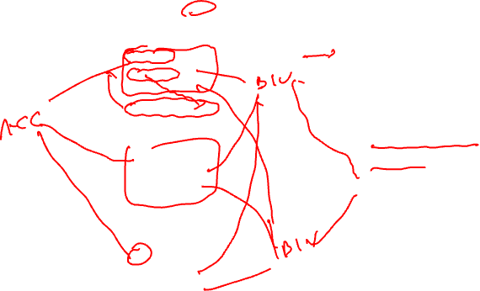
Register Renaming is Not Enough!
loop:
r1 = load(r2)
r3 = load(r4)
r5 = r1 * r3
r6 = r6 + r5
r2 = r2 + 4
r4 = r4 + 4
Still not much overlap possible
Problems
  r2, r4, r6 sequentialize the iterations
  Need to rename these
2 specialized renaming optis
  Accumulator variable expansion (r6)
  Induction variable expansion (r2, r4)
iter1
r11 = load(r2)
r13 = load(r4)
r15 = r11 * r13
r6 = r6 + r15
r2 = r2 + 4
r4 = r4 + 4
iter2
r21 = load(r2)
r23 = load(r4)
r25 = r21 * r23
r6 = r6 + r25
r2 = r2 + 4
r4 = r4 + 4
if (r4 < 400) goto loop
iter3

Slide 8
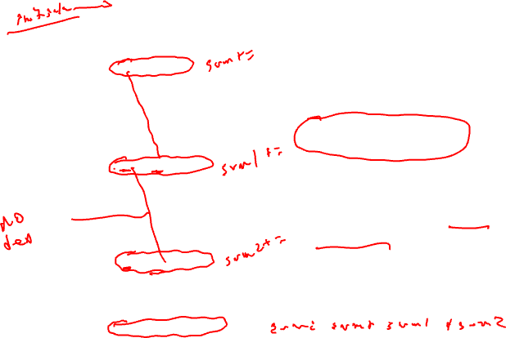
Accumulator Variable Expansion
r16 = r26 = 0
loop:
r1 = load(r2)
r3 = load(r4)
r5 = r1 * r3
r6 = r6 + r5
r2 = r2 + 4
r4 = r4 + 4
Accumulator variable
  x = x + y or x = x – y
  where y is loop variant!!
Create n-1 temporary accumulators
Each iteration targets a different accumulator
Sum up the accumulator variables at the end
May not be safe for floating-point values
iter1
r11 = load(r2)
r13 = load(r4)
r15 = r11 * r13
r16 = r16 + r15
r2 = r2 + 4
r4 = r4 + 4
iter2
r21 = load(r2)
r23 = load(r4)
r25 = r21 * r23
r26 = r26 + r25
r2 = r2 + 4
r4 = r4 + 4
if (r4 < 400) goto loop
iter3
r6 = r6 + r16 + r26

Slide 9
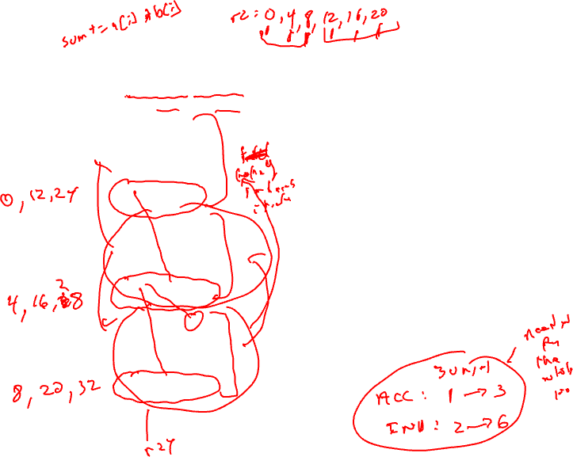
Induction Variable Expansion
r12 = r2 + 4, r22 = r2 + 8
r14 = r4 + 4, r24 = r4 + 8
Induction variable
  x = x + y or x = x – y
  where y is loop invariant!!
Create n-1 additional induction variables
Each iteration uses and modifies a different induction variable
Initialize induction variables to init, init+step, init+2*step, etc.
Step increased to n*original step
Now iterations are completely independent !!
r16 = r26 = 0
loop:
r1 = load(r2)
r3 = load(r4)
r5 = r1 * r3
r6 = r6 + r5
r2 = r2 + 12
r4 = r4 + 12
iter1
r11 = load(r12)
r13 = load(r14)
r15 = r11 * r13
r16 = r16 + r15
r12 = r12 + 12
r14 = r14 + 12
iter2
r21 = load(r22)
r23 = load(r24)
r25 = r21 * r23
r26 = r26 + r25
r22 = r22 + 12
r24 = r24 + 12
if (r4 < 400) goto loop
iter3
r6 = r6 + r16 + r26

Slide 10
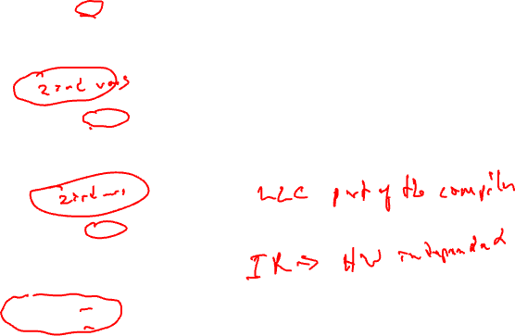
Better Induction Variable Expansion
r16 = r26 = 0
loop:
r1 = load(r2)
r3 = load(r4)
r5 = r1 * r3
r6 = r6 + r5
With base+displacement addressing, often don’t need additional induction variables
  Just change offsets in each iterations to reflect step
  Change final increments to n * original step
iter1
r11 = load(r2+4)
r13 = load(r4+4)
r15 = r11 * r13
r16 = r16 + r15
iter2
r21 = load(r2+8)
r23 = load(r4+8)
r25 = r21 * r23
r26 = r26 + r25
r2 = r2 + 12
r4 = r4 + 12
if (r4 < 400) goto loop
iter3
r6 = r6 + r16 + r26

Slide 11
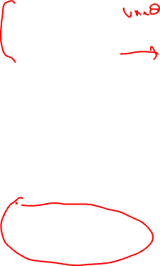
Homework Problem
loop:
loop:
r1 = load(r2)
r5 = r6 + 3
r6 = r5 + r1
r2 = r2 + 4
if (r2 < 400) goto loop
r1 = load(r2)
r5 = r6 + 3
r6 = r5 + r1
r2 = r2 + 4
r1 = load(r2)
r5 = r6 + 3
r6 = r5 + r1
r2 = r2 + 4
r1 = load(r2)
r5 = r6 + 3
r6 = r5 + r1
r2 = r2 + 4
if (r2 < 400) goto loop
Optimize the unrolled
loop
Renaming
Tree height reduction
Ind/Acc expansion

Slide 12
Homework Problem - Answer
loop:
loop:
r16 = r26 = 0
loop:
r1 = load(r2)
r5 = r6 + 3
r6 = r5 + r1
r2 = r2 + 4
if (r2 < 400) goto loop
r1 = load(r2)
r5 = r6 + 3
r6 = r5 + r1
r2 = r2 + 4
loop:
r1 = load(r2)
r5 = r1 + 3
r6 = r6 + r5
r2 = r2 + 4
r11 = load(r2)
r15 = r11 + 3
r6 = r6 + r15
r2 = r2 + 4
r21 = load(r2)
r25 = r21 + 3
r6 = r6 + r25
r2 = r2 + 4
if (r2 < 400)
goto loop
r1 = load(r2)
r5 = r1 + 3
r6 = r6 + r5
r11 = load(r2+4)
r15 = r11 + 3
r16 = r16 + r15
r21 = load(r2+8)
r25 = r21 + 3
r26 = r26 + r25
r2 = r2 + 12
if (r2 < 400)
goto loop
r6 = r6 + r16
r6 = r6 + r26
r1 = load(r2)
r5 = r6 + 3
r6 = r5 + r1
r2 = r2 + 4
r1 = load(r2)
r5 = r6 + 3
r6 = r5 + r1
r2 = r2 + 4
if (r2 < 400)
goto loop
Optimize the unrolled
loop
Renaming
Tree height reduction
Ind/Acc expansion
after renaming and
tree height reduction
after acc and
ind expansion

Slide 13
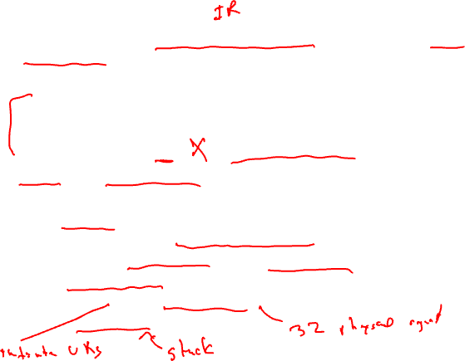
Code Generation
Map optimized “machine-independent” assembly to final assembly code
Input code
  Classical optimizations
  ILP optimizations
  Formed regions (sbs, hbs), applied if-conversion (if appropriate)
Virtual → physical binding
  2 big steps
  1. Scheduling
    Determine when every operation executions
    Create MultiOps (for VLIW) or reorder instructions (for superscalar)
  2. Register allocation
    Map virtual → physical registers
    Spill to memory if necessary

Slide 14
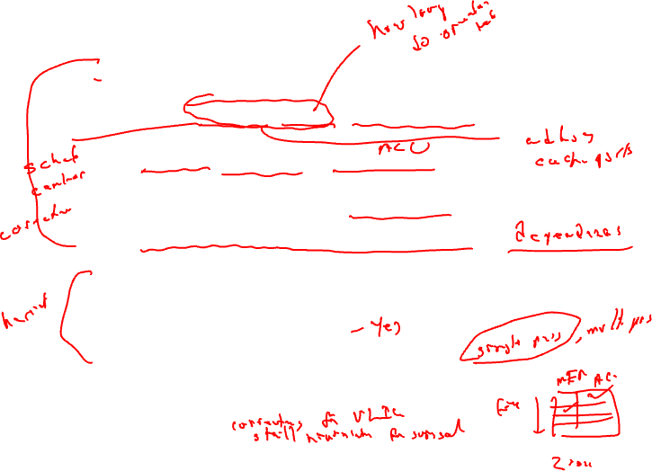
Scheduling Operations
Need information about the processor
  Number of resources, latencies, encoding limitations
  For example:
    2 issue slots, 1 memory port, 1 adder/multiplier
    load = 2 cycles, add = 1 cycle, mpy = 3 cycles; all fully pipelined
    Each operand can be register or 6 bit signed literal
Need ordering constraints amongst operations
  What order defines correct program execution?
Given multiple operations that can be scheduled, how do you pick the best one?
  Is there a best one? Does it matter?
  Are decisions final?, or is this an iterative process?
How do we keep track of resources that are busy/free
  Reservation table: Resources x time

Slide 15
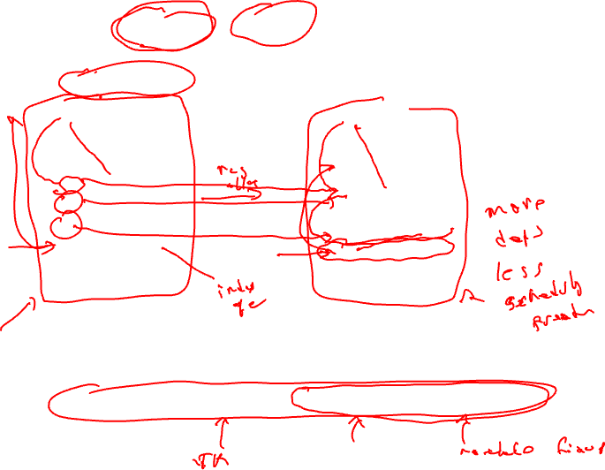
Schedule Before or After Register Allocation?
virtual registers
physical registers
r1 = load(r10)
r2 = load(r11)
r3 = r1 + 4
r4 = r1 – r12
r5 = r2 + r4
r6 = r5 + r3
r7 = load(r13)
r8 = r7 * 23
store (r8, r6)
R1 = load(R1)
R2 = load(R2)
R5 = R1 + 4
R1 = R1 – R3
R2 = R2 + R1
R2 = R2 + R5
R5 = load(R4)
R5 = R5 * 23
store (R5, R2)
Too many artificial ordering constraints if schedule after allocation!!!!
But, need to schedule after allocation to bind spill code
Solution, do both! Prepass schedule, register allocation, postpass schedule

Slide 16
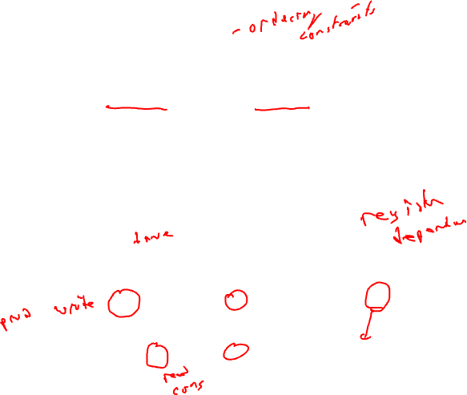
Data Dependences
Data dependences
  If 2 operations access the same register, they are dependent
  However, only keep dependences to most recent producer/consumer as other edges are transitively redundant
  Types of data dependences
Flow
Output
Anti
r1 = r2 + r3
r4 = r1 * 6
r1 = r2 + r3
r1 = r4 * 6
r1 = r2 + r3
r2 = r5 * 6

Slide 17
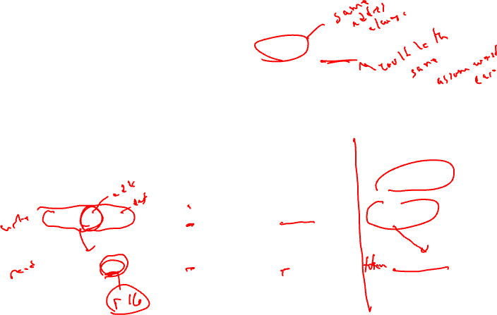
More Dependences
Memory dependences
  Similar as register, but through memory
  Memory dependences may be certain or maybe
Control dependences
  We discussed this earlier
  Branch determines whether an operation is executed or not
  Operation must execute after/before a branch
Mem-flow
Mem-output
Mem-anti
Control
store (r1, r2)
r3 = load(r1)
store (r1, r2)
store (r1, r3)
r2 = load(r1)
store (r1, r3)
if (r1 != 0)
r2 = load(r1)

Slide 18
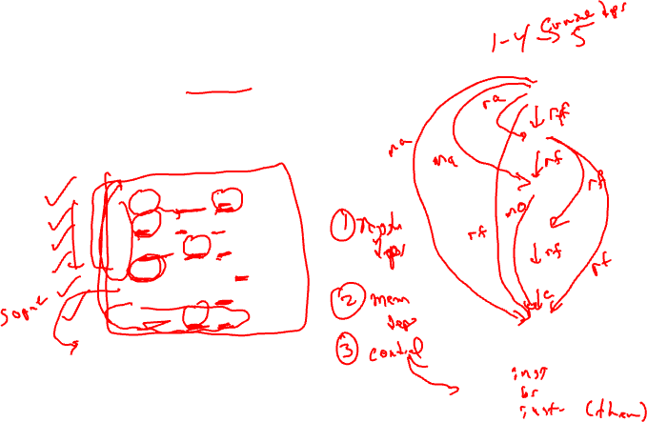
Dependence Graph
Represent dependences between operations in a block via a DAG
  Nodes = operations/instructions
  Edges = dependences
Single-pass traversal required to
insert dependences
Example
1
2
1: r1 = load(r2)
2: r2 = r1 + r4
3: store (r4, r2)
4: p1 = cmpp (r2 < 0)
5: branch if p1 to BB3
6: store (r1, r2)
3
4
5
6
BB3:

Slide 19
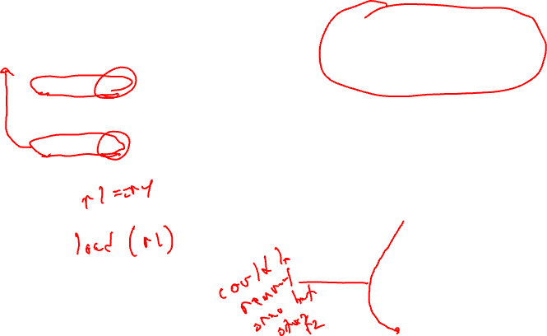
Dependence Graph - Solution
Example
Instructions 1-4 have
control dependence to instruction 5
5→6 control dependence
1: r1 = load(r2)
2: r2 = r1 + r4
3: store (r4, r2)
4: p1 = cmpp (r2 < 0)
5: branch if p1 to BB3
6: store (r1, r2)
1
rf
ra
BB3:
rf
2
ma
rf
3
rf
ma
4
rf
rf
5
mo
6

Slide 20
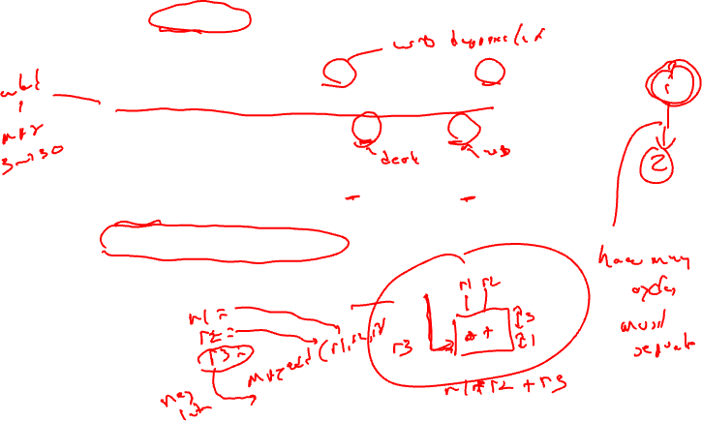
Dependence Edge Latencies
Edge latency = minimum number of cycles necessary between initiation of the predecessor and successor in order to satisfy the dependence
Register flow dependence, a = b + c → d = a + 1
  Latency of producer instruction for most processors
Register anti dependence, a = b + c → b = d + e
  0 cycles for most processors
Register output dependence, a = b + c → a = d + e
  1 cycle for most processors
Is negative latency possible?
  Yes, means successor can start before predecessor
  We will only deal with latency >= 0

Slide 21
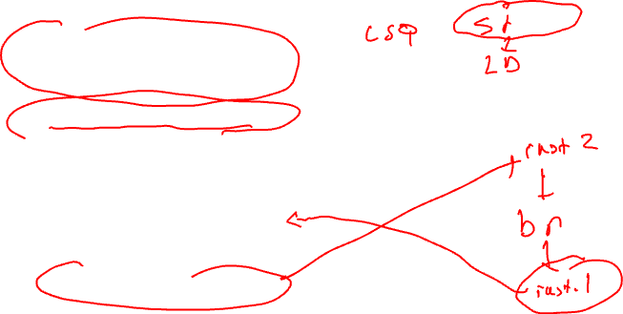
Dependence Edge Latencies (2)
Memory dependences
  Store → load (memory flow)
  Load → Store (memory anti)
  Store → Store (memory output)
  All 1 cycle for most processors
Control dependences
  branch → b
    Instructions inside then/else paths dependent on branch
    1 cycle for most processors
  a → branch
    Op a must be issued before the branch completes
    0 cycles for most processors

Slide 22
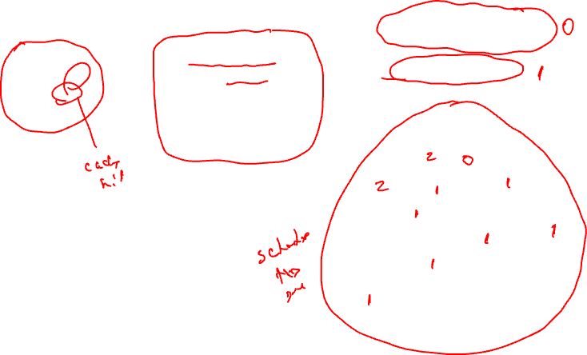
Class Problem – Add Latencies to Dependence Edges
latencies
add: 1
cmpp: 1
load: 2
store: 1
Example
Instructions 1-4 have control
dependence to instruction 5
5→6 control dependence
1: r1 = load(r2)
2: r2 = r1 + r4
3: store (r4, r2)
4: p1 = cmpp (r2 < 0)
5: branch if p1 to BB3
6: store (r1, r2)
1
rf
ra
BB3:
2
rf
ma
rf
3
rf
ma
4
rf
rf
5
mo
6

Slide 23
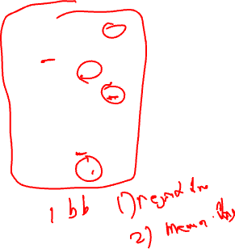
Homework Problem 1 – Answer Next Time
1. Draw dependence graph
2. Label edges with type and
latencies
machine model
latencies
add: 1
mpy: 3
load: 2
store: 1
1
2
1. r1 = load(r2)
2. r2 = r2 + 1
3. store (r8, r2)
4. r3 = load(r2)
5. r4 = r1 * r3
6. r5 = r5 + r4
7. r2 = r6 + 4
8. store (r2, r5)
3
4
5
6
7
8

Slide 24
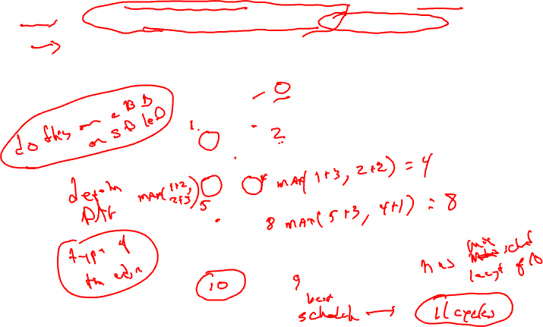
Dependence Graph Properties - Estart
Estart = earliest start time, (as soon as possible - ASAP)
  Schedule length with infinite resources (dependence height)
  Estart = 0 if node has no predecessors
  Estart = MAX(Estart(pred) + latency) for each predecessor node
  Example
1
1
2
2
3
3
3
2
2
4
5
3
1
6
2
1
7
8

Slide 25
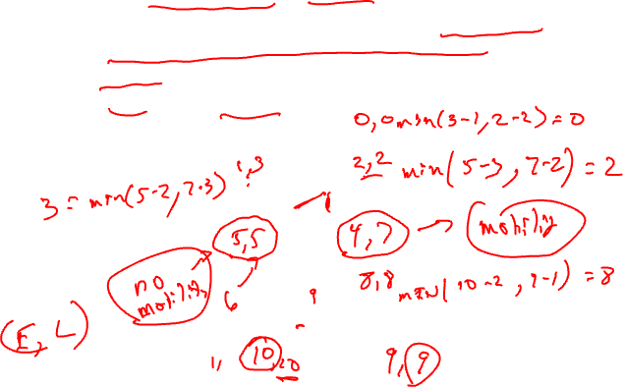
Lstart
Lstart = latest start time, ALAP
  Latest time a node can be scheduled s.t. sched length not increased beyond infinite resource schedule length
  Lstart = Estart if node has no successors
  Lstart = MIN(Lstart(succ) - latency) for each successor node
  Example
1
1
2
2
3
2
3
3
2
4
5
3
1
6
2
1
7
8

Slide 26
Slack
Slack = measure of the scheduling freedom
  Slack = Lstart – Estart for each node
  Larger slack means more mobility
  Example
1
1
2
2
3
3
2
3
2
4
5
3
1
6
2
1
7
8

Slide 27
Critical Path
Critical operations = Operations with slack = 0
  No mobility, cannot be delayed without extending the schedule length of the block
  Critical path = sequence of critical operations from node with no predecessors to exit node, can be multiple crit paths
1
1
2
2
3
3
2
3
2
4
5
3
1
6
2
1
7
8

Slide 28
Homework Problem 2 – Answer Next Time
Node Estart Lstart Slack
1
2
3
4
5
6
7
8
9
1
1
2
2
1
3
2
4
3
1
1
2
6
5
1
3
7
8
2
9
1
Critical path(s) =

