Slide 1
To Pack or Not to Pack: A Generalized Packing Analysis and Transformation
Group 8
Yi Chen, Yuxuan Jiang, Hanchi Li, Minghao Shen, Jiaqi Xu

Slide 2
Introduction
Packing copies a non-contiguous block of data to a contiguous block to reduce the number of Translation Lookaside Buffer (TLB) entries required to access it, avoiding expensive TLB misses.
Pros of packing a non-contiguous subtensor
Fewer cache self-interference misses
Fewer TLB entries
Better vectorization

Slide 3
Motivation
Cons of packing:
If the computation modifies the packed subtensor, then it needs to be unpacked — copied back to the original tensor. Unpacking creates an additional copying overhead. The copy operation overhead can outweigh the benefits of packing.
Packing should only be applied when its performance gains are greater than such overhead.

Slide 4
Example: 2D Tensor Contraction
A_{100x50}, B_{100x60}
...
for (i=0; i<50; i++)
for (j=0; j<60; j++)
for (k=0; k<100; k++)
a = load A[k][i]
b = load B[k][j]
...

Slide 5
Example: 2D Tensor Contraction
A_{100x50}, B_{100x60}
...
for (i=0; i<50; i++)
for (j=0; j<60; j++)
for (k=0; k<100; k++)
a = load A[k][i]
b = load B[k][j]
...
load A[k][i] is invariant to j
A[:][i] will be iterated over for 60 times!
Iterating over A[:][i]has a stride of 50!
Cache Misses and TLB Misses!

Slide 6
Example: 2D Tensor Contraction
A_{100x50}, B_{100x60}
...
for (i=0; i<50; i++)
A’ = alloc(1x100)
for(m=0; m<100; m++)
tmp = load A[m][i]
store tmp, A’[0][m]
for (j=0; j<60; j++)
for (k=0; k<100; k++)
a = load A’[k]
b = load B[k][j]
...
...
for (i=0; i<50; i++)
for (j=0; j<60; j++)
for (k=0; k<100; k++)
a = load A[k][i]
b = load B[k][j]
...

Slide 7
Q: When to Perform Packing?
...
for (i=0; i<50; i++)
A’ = alloc(1x100)
for(m=0; m<100; m++)
tmp = load A[m][i]
store tmp, A’[0][m]
for (j=0; j<60; j++)
for (k=0; k<100; k++)
a = load A’[k]
b = load B[k][j]
...
Pros:
Self-Interference Cache Misses
TLB Entries
Vectorization
Cons:
Copy Overhead
Slow Down
How to determine whether to perform packing?
Overhead
Benefit

Slide 8
Notion
Packing Candidate: Loop Tensor Pairs (L, T)
A_{100x50}, B_{100x60}
...
for (i=0; i<50; i++)
for (j=0; j<60; j++)
for (k=0; k<100; k++)
a = load A[k][i]
b = load B[k][j]
...

Slide 9
Notion
Packing Candidate: Loop Tensor Pairs (L, T)
A_{100x50}, B_{100x60}
Candidates:
(for_j, A)
...
for (i=0; i<50; i++)
for (j=0; j<60; j++)
for (k=0; k<100; k++)
a = load A[k][i]
b = load B[k][j]
...

Slide 10
Notion
Packing Candidate: Loop Tensor Pairs (L, T)
A_{100x50}, B_{100x60}
Candidates:
(for_j, A)
(for_i, B)
...
for (i=0; i<50; i++)
for (j=0; j<60; j++)
for (k=0; k<100; k++)
a = load A[k][i]
b = load B[k][j]
...

Slide 11
Notion
Packing Candidate: Loop Tensor Pairs (L, T)
A_{100x50}, B_{100x60}
Candidates:
(for_j, A)
(for_i, B)
(for_i, A)
…
...
for (i=0; i<50; i++)
for (j=0; j<60; j++)
for (k=0; k<100; k++)
a = load A[k][i]
b = load B[k][j]
...

Slide 12
Notion
Packing Candidate: Loop Tensor Pairs (L, T)
Working Set: The subtensor T’ of T accessed in the loop body.

Slide 13
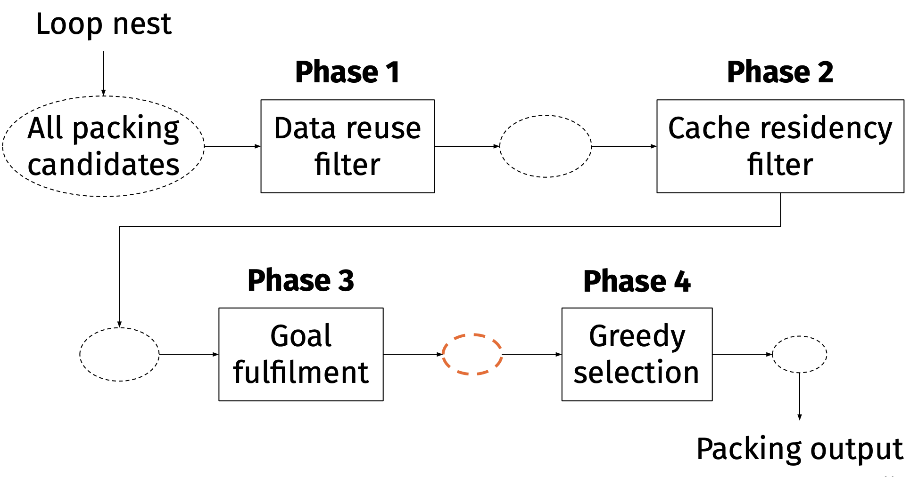
GPAT: Generalized Packing Analysis and Transformation
Statically determine packing candidates without tuning or profiling the code.

Slide 14
GPAT: Generalized Packing Analysis and Transformation
Rep. in MLIR’s affine dialect → Access to loop counts, whether the loop is static, etc.
Statically determine packing candidates without tuning or profiling the code.

Slide 15
Phase 1: Data Reuse Filter
Overcome copying overhead with reuse
...
for (i=0; i<50; i++)
A’ = alloc(1x100)
for(m=0; m<100; m++)
tmp = load A[m][i]
store tmp, A’[0][m]
for (j=0; j<60; j++)
for (k=0; k<100; k++)
a = load A’[k]
b = load B[k][j]
...
Benefit * #reuse > Overhead
Overhead
Benefit
Notes:
The first two analysis ensures that a packed tensor can increase the access efficiency. The third and fourth analysis tries to ensure that gain outweighs the overhead.

Slide 16
Phase 1: Data Reuse Filter
Overcome copying overhead with reuse
A_{100x50}, B_{100x60}
Benefit * #reuse > Overhead
...
for (i=0; i<50; i++)
for (j=0; j<60; j++)
for (k=0; k<100; k++)
a = load A[k][i]
b = load B[k][j]
...
Reuse Requirement: A’ should be invariant to L
A’ is invariant to j → filter out (for_i, A), (for_k, A)
Notes:
The first two analysis ensures that a packed tensor can increase the access efficiency. The third and fourth analysis tries to ensure that gain outweighs the overhead.

Slide 17
Phase 1: Data Reuse Filter
Overcome copying overhead with reuse
A_{100x50}, B_{100x60}
Benefit * #reuse > Overhead
...
for (i=0; i<50; i++)
for (j=0; j<60; j++)
for (k=0; k<100; k++)
a = load A[k][i]
b = load B[k][j]
...
Reuse Requirement: A’ should be invariant to L
A’ is invariant to j → filter out (for_i, A), (for_k, A)
The notion of reuse is quite naive, but can be easily swapped with a more delicate algorithm thanks to the design’s modularity.
Notes:
The first two analysis ensures that a packed tensor can increase the access efficiency. The third and fourth analysis tries to ensure that gain outweighs the overhead.

Slide 18
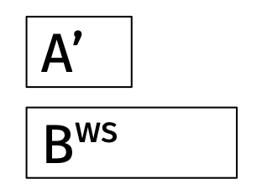
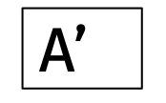
Phase 2: Cache Residency Filter
The packed tensor should not be evicted from cache during execution to maximize benefit.
Execution
Cache
A_{100x50}, B_{100x60}
...
for (i=0; i<50; i++)
for (j=0; j<60; j++)
for (k=0; k<100; k++)
a = load A[k][i]
b = load B[k][j]
...
...

Slide 19
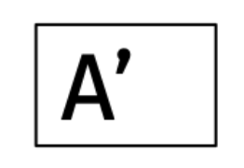
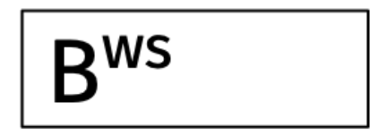
Phase 2: Cache Residency Filter
The packed tensor should not be evicted from cache during execution to maximize benefit.
Requirement: Size of the cache > working set size of all tensors in the loop
Cache

Slide 20
Phase 3: Goal Fulfillment
Generate data-layout changes for each candidate
Generate the permutation that minimizes the stride of consecutive accesses to the tensor
Candidates must fulfill at least one of the two goals
Notes:
After phase 2, now we have a set of candidate which include information about what to pack, that is the tensor and the targeted loop. However, in order to do the following steps, we need to know how to pack.
Thus, at the beginning of phase 3, we need to generate the permutation that minimizes the stride of consecutive accesses to the tensor. The implementation is not very complex, so I won’t elaborate on it.
Then we can perform the core step of phase 3, that is to filter out the candidate that doesn’t fulfill any following goals

Slide 21
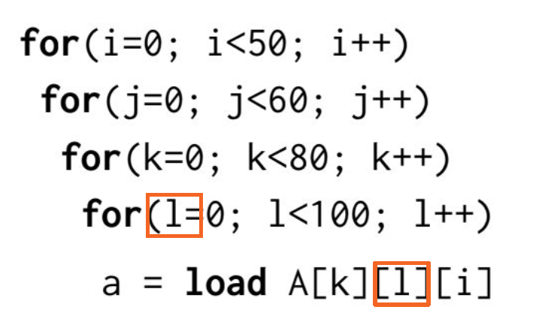
Phase 3: Goal Fulfillment
Candidates must fulfill at least one of the two goals:
Innermost Access Stride Reduction
TLB Miss Reduction
Data-layout change reduces stride at an innermost loop?
Notes:
The first one is whether the data-layout change reduces stride a the innermost loop.
Here’s an example. Before packing, the stride of access to tensor A in the for L loop is the size of the last dimension of A. But after we pack tensor A, the stride is reduced to only one.

Slide 22
Phase 3: Goal Fulfillment
Candidates must fulfill at least one of the two goals:
Innermost Access Stride Reduction
TLB Miss Reduction
Data-layout change reduces stride at an innermost loop?
Cache locality
Vectorization
Notes:
The goal corresponds to two pros of the packing operations. That is to improve cache locality and enable the possibility of vectorization.

Slide 23
Phase 3: Goal Fulfillment
Candidates must fulfill at least one of the two goals:
Innermost Access Stride Reduction
TLB Miss Reduction
Data-layout change reduces stride at an innermost loop?
Cache locality
Vectorization
What about stride reduction at other loops?
Less TLB entries
Notes:
But what about the third pros of packing? That is TLB

Slide 24
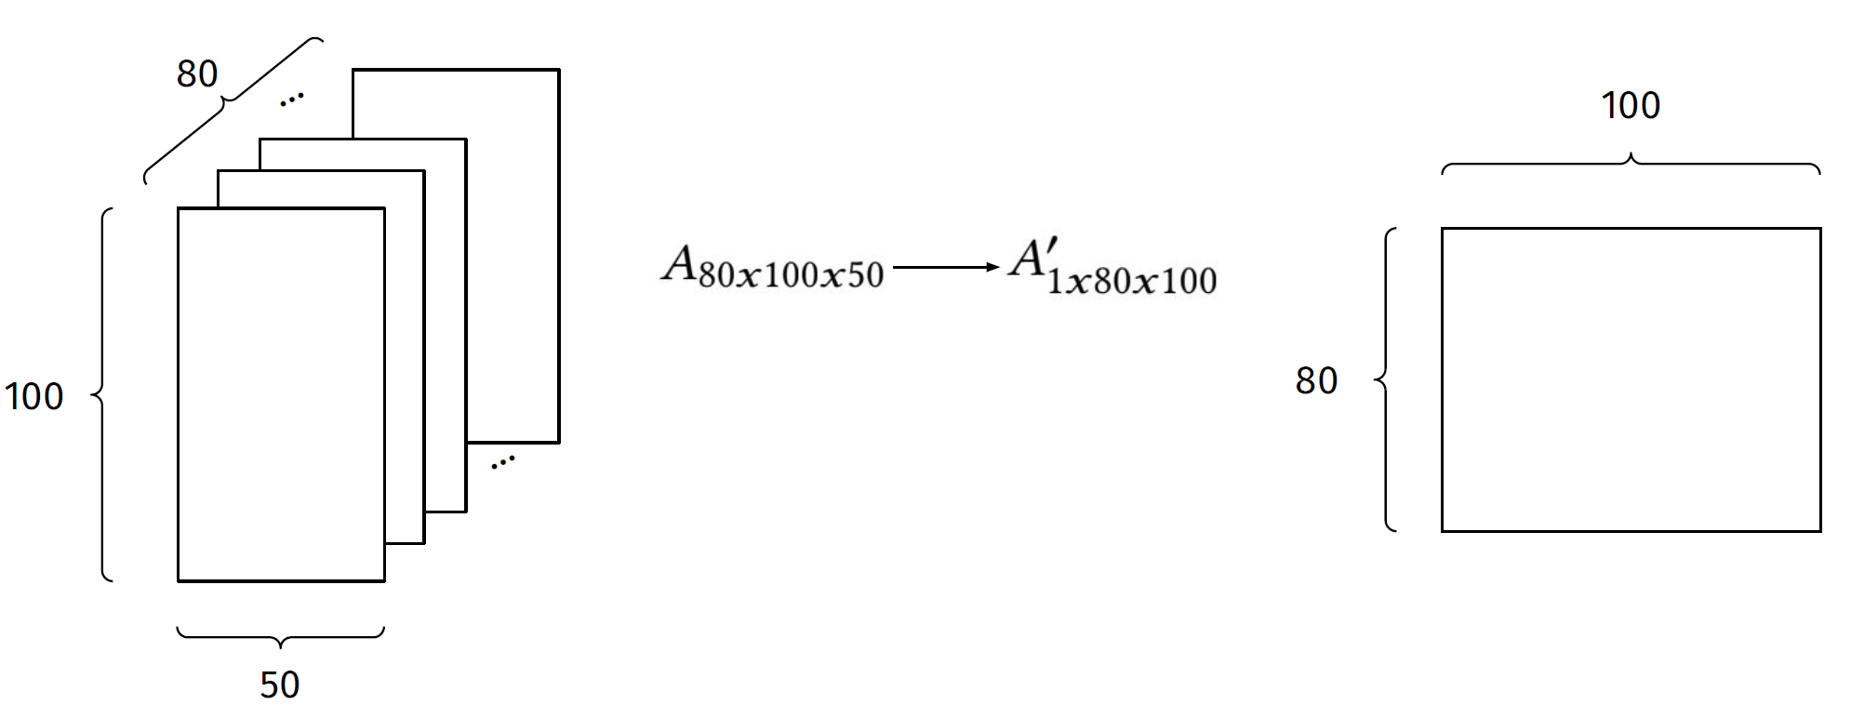
Phase 3: Goal Fulfillment
Candidates must fulfill at least one of the two goals:
Innermost Access Stride Reduction
TLB Miss Reduction
Notes:
Assume that the shape of A is 80×100×50, and that the shape of the packed candidate is 1x80x100

Slide 25
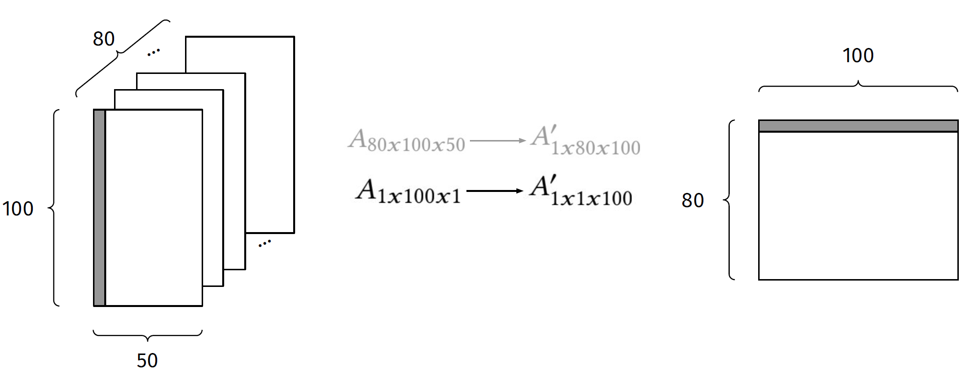
Phase 3: Goal Fulfillment
Candidates must fulfill at least one of the two goals:
Innermost Access Stride Reduction
TLB Miss Reduction
Notes:
For a specific loop, the shape of the working set of A becomes 1x100x1, and the shape of the packed one becomes 1x1x100

Slide 26
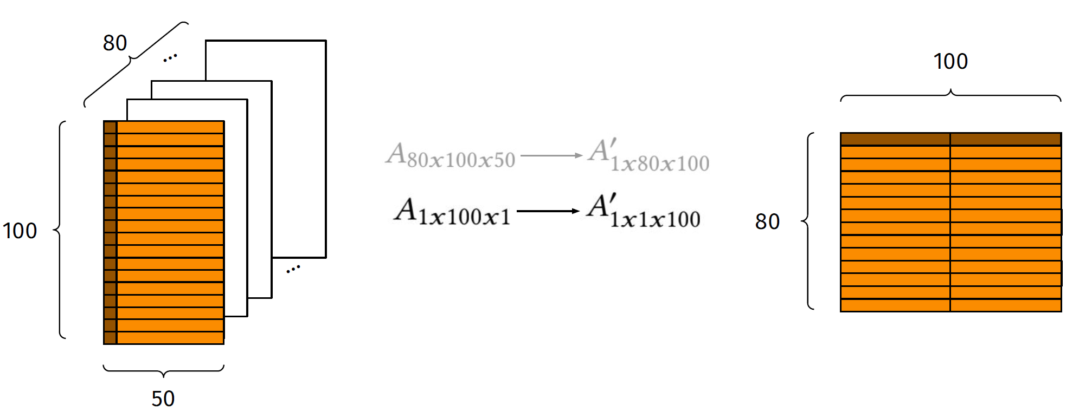
Phase 3: Goal Fulfillment
Candidates must fulfill at least one of the two goals:
Innermost Access Stride Reduction
TLB Miss Reduction
1 TLB entry = 50 elements
-> Reduce from 100 entries to 2 entries
Notes:
Assume that each TLB entry can address 50 elements of A. In this setting, 100 TLB entries are needed to access the working set of 𝐴 in the specific loop, whereas by packing A into A’ the same working set requires only two entries.
So when the dTLB can contain 64 entries, there would be no TLB misses for the packed version while there exist TLB misses for the unpack version.

Slide 27
Phase 4: Greedy Selection
Select the subset of candidates to be applied
Sort
Priority = reduction of TLB entries / packing overhead
Select
Greedily select candidates if
It is not redundant to the committed candidates
It still fulfills at least one goal in Phase 3 after applying the committed candidates
Notes:
Now we have all the packing options that can improve the performance by the filters of the previous phases.
The final phase to do is to select the subset of candidates to be applied. Firstly we sort all the candidates by the GainCostRatio, that is defined as the TLB entries reduction divided by the packing overhead.
Then we greedily commit candidates if it satisfies the two criteria, one is that …, and the second is that ..

Slide 28
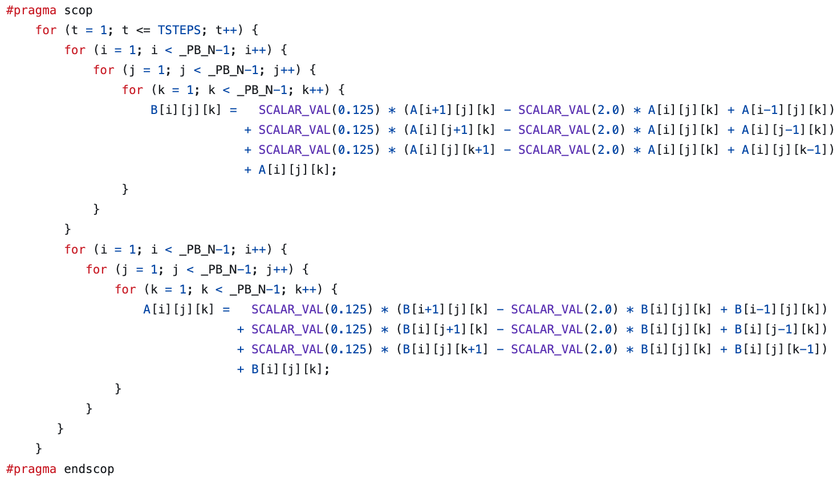
Evaluation
Benchmarks Overview:
Has numerical computations including linear algebra, data mining algorithms
Many contains deep loop nests
5 Evaluation Questions to be answered.

Slide 29
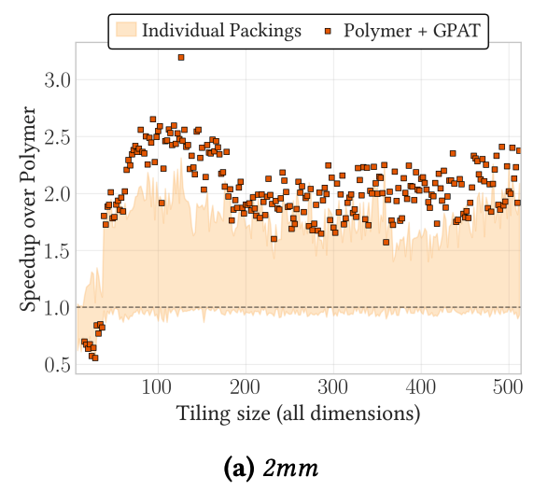
EvalQ1: Can GPAT select an effective combination of packing candidates?
Polymer: a polyhedral optimizer
GPAT takes Polymer-optimized IR as input
Individual Packings: packing candidates identified by GPAT’s phase 1, applied individually
GPAT: select a combination of packing candidates to perform optimization.
Conclusion: indicates an affirmative answer to EvalQ1.

Slide 30
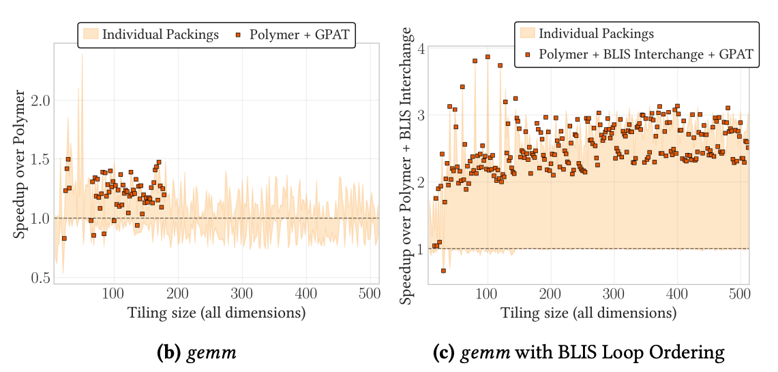
EvalQ2: Is GPAT robust to prior loop transformation strategies?
The BLIS framework will change the loop nesting order, which means a loop transformation.
Fig 1.(b) only uses polymer. Fig 1.(c) uses polymer + BLIS loop ordering, offers better packing opportunities.
Conclusion: An affirmative answer to EvalQ2.

Slide 31
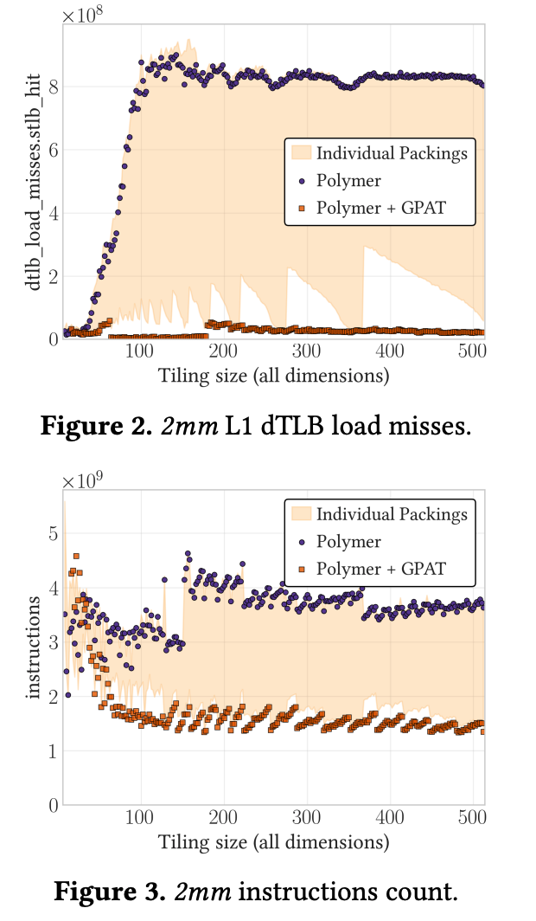
EvalQ3: Can GPAT reduce TLB pressure and increase opportunities for vectorization?
Most times, applying GPAT will get the least misses and the least instructions
Analysis:
GPAT selected packing candidates which substantially reduced TLB misses
GPAT effectively transforms non-contiguous accesses into contiguous ones, leads to a decrease in total instruction count due to better utilization of CPU vector instructions
Conclusion: an affirmative answer to EvalQ3.

Slide 32
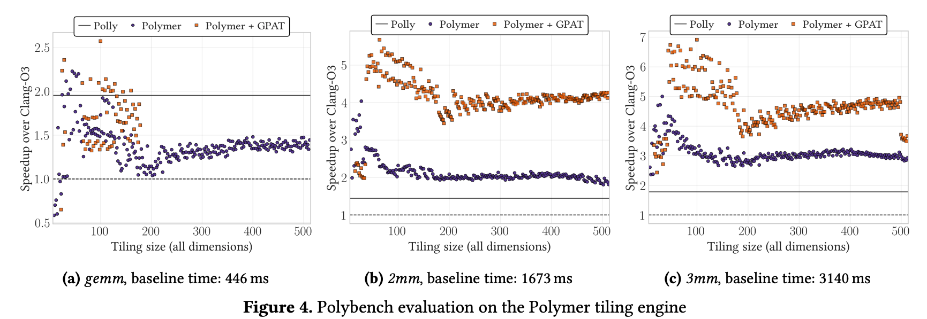
EvalQ4: How does the performance of GPAT compare to previous loop optimization approaches
Baseline: Clang -O3
Previous loop optimization approach: Polly (optimized well for gemm benchmarks), Polymer
3mm benchmark has computation from gemm and 2mm.
Conclusion: EvalQ4 is answered, for the obvious performance gain in fig 4.(b), 4.(c).

Slide 33
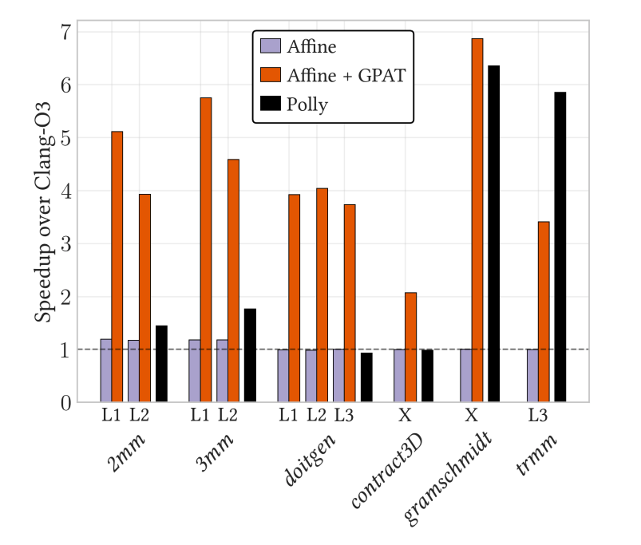
EvalQ5: Is GPAT general? For instance, can it discover packing opportunities in computations other than GEMM?
Baseline: Clang -O3
Affine: the MLIR Affine dialect tiling pass
X: the tiling didn’t affect the performance
Even though Affine failed to tile several benchmarks, GPAT still achieved performance gain
Conclusion: An affirmative answer to EvalQ5.

Slide 34
Conclusion - Pros
Generalization and Modularity
Agnostic to tile size and data layout.
Agnostic to the computation in a target loop nest.
Allows a tensor to be packed at multiple points in computation.
Gets rid of dependence on specific libraries (e.g. BLAS)
Notes:
GPAT is the first general compiler analysis and code transformation that targets TLB utilization through packing.
It applies packing to n-dimensional tensors regardless of tile size, data layout, and the computation in a target loop nest. It allows a tensor to be packed at multiple points in computation.
In addition, packing is mostly used in high-performance BLAS (basic linear algebra subroutines) libraries. A generic packing interface is exposed by these libraries. However, GPAT gets rid of the dependence on BLAS, it makes packing transparently available to all programmers.

Slide 35
Conclusion - Cons / To do
More sophisticated data reuse analysis
More accurate cache residency estimation
Better cost model.
More Parallelism (GPU, TPU…)
Notes:
The current reuse filter and cache residency filter are very conservative, certain cases where it is beneficial to pack may be filtered out. The modularity of the GPAT framework allows further integrations of more sophisticated analysis. In addition, in the last phase we greedily selects the candidates. The cost model estimates the packing overhead, which is empirically chosen at this point.
Moreover, the current work only works on CPU. Due to the limitation of MLIR, parallel code generation is not supported so the experiments are single threaded. When we want more parallelism especially in deep learning, loop optimization on other devices such as GPU/TPU will be important.

Slide 36
Thank you!
Q&A

