Slide 1
Group 2 TAFFO: Tuning Assistant for Floating to Fixed Point Optimization
Stefano Cherubin, Daniele Cattaneo, Michele Chiari,
Antonio Di Bello, and Giovanni Agosta
Presented by Jeongsoo Park, Yichen Tao, Zixuan Pan, Xueqing Wu

Slide 2
Introduction
What is TAFFO?
LLVM-based framework
Auto-converts floating point to fixed point using annotations
Shows up to 366% speedup with <3% less precision in AxBench benchmark
Notes:
What is TAFFO? TAFFO is an LLVM-based framework which automatically converts floating point to fixed point using programmer annotations. In their experiments, they show up to 366% speedup with minimal loss in precision.
But why? How can this conversion provide such impressive speedup?

Slide 3
Introduction
Floating vs Fixed point
- Floating point: - Fixed Point:
Fixed Point:
Faster computation
Doesn’t require FPU(Floating-Point Unit)
Lower dynamic range vs Floating Point
0 0 0 1 0 . 1 1 0
0 0 0 1 0 . 1 1 0
“Floating”
“Fixed”
Notes:
Because of fixed point! Fixed point has “Fixed” point for fractional parts, whereas floating-points, well, floats!
This fixed-point representation allows faster computation and doesn’t require special FPUs. The tradeoff is that they have a lower dynamic range compared to floating points, and because of that, they may lose precision in some cases.

Slide 4
Introduction
Key Contributions:
LLVM-based framework
Allow precision tuning for a wide range of programming languages
Others: only support C
Easily applicable to most embedded systems
Allow easy maintenance and extensions
Performance estimation model
Static analysis, estimates performance after fixed point conversion
Allow compilers to decide whether to convert to a fixed point or not
Notes:
Their paper have two key contributions. First is that this is an LLVM-based framework, and second ins that they provide a performance estimation model for fixed point conversion.
Being an LLVM-based framework, they can provide precision tuning for a wide-range of programming languages. Whereas most other works only supports C. This also allows easier application to most embedded systems, allows easy maintenance and extensions.
Their performance estimation model allows the compiler to decide whether to convert floating points to fixed point or not by analyzing the performance statically.

Slide 5
Related Work
FRIDGE: source-level conversion
TAFFO: compiler-level conversion, more fine-grained
Autoscaler: C-only, conversion using instrumentation and profiling
Precimonious: C-only, doesn’t handle fixed point
Rosa: static analysis, but requires heavy programmer annotations
Proper preconditions & precision requirements for all functions
CRAFT: only converts double to single precision (no fixed-point)
Less flexible, C-only, require heavier annotations, or doesn’t consider fixed-point
Notes:
The authors compare their method to existing works such as Fridge, Autoscaler, and Precimonious. But they claim that they are either less flexible, only supports C, require heavier annotations, or doesn’t consider fixed-point.
So how does TAFFO work? Moving on to method section:

Slide 6
Method

Slide 7
Method (Overview)
User-provided annotations
Data type allocation
Code conversion
Feedback estimation

Slide 8
Method (1): Annotations
Why annotations?
Exhaustive exploration: time-consuming
Solution: rely on programmer's knowledge
How to annotate?
User: specify input value range
TAFFO: propagate to intermediate values

Slide 9
Method (1): Annotations Example
float a __attribute ((annotate("taffo 20 12")));
float b __attribute ((annotate("taffo 7 25 signed 0.4 0.9 1e-8")));
float c __attribute ((annotate("range 0.05 1 0")));

Slide 10
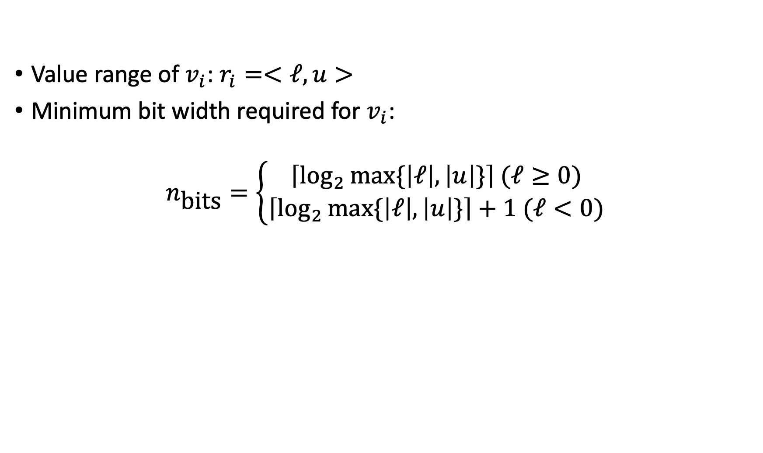
Method (2): Data type allocation

Slide 11
Method (3): Code conversion
Insert fixed point computation alongside the original code.
Perform Dead Code Elimination after the insertion (eliminate floating point code).

Slide 12
Method (4): Feedback estimation
Metric 1: Functional evaluation
Use affine forms to represent the affine error
Approximation other functions with linear functions
Be able to keep track of each single error source
Metric 2: Performance evaluation
Use machine learning tools to train a performance model
Estimate the impact of type cast overhead
Estimate the performance gain due to precision lowering

Slide 13
Experiments

Slide 14
Experiment Settings
Two types of hardwares: HPC-like computer architecture (AMD) & embedded systems’ development board (f207).
Benchmark suites: AxBench. Containing a small set of algorithms using floating point arithmetic.

Slide 15
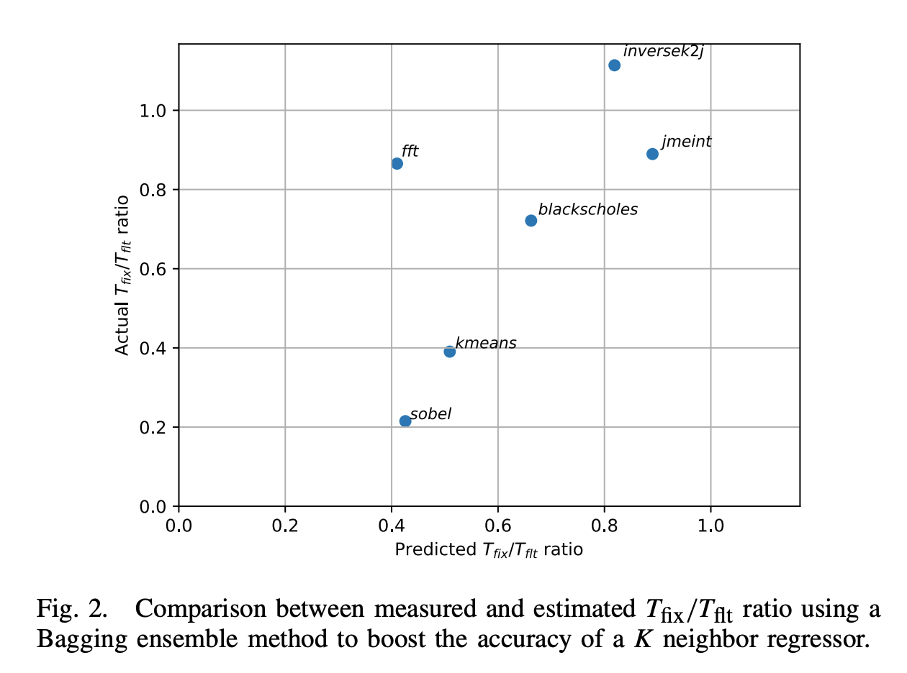
Experiment Results
Validating the effectiveness of performance model.
Ideal
Notes:
Performance model is not accurate – This is the model used by compiler to decide whether or not to apply fixed-point conversion, but the accuracy is far from ideal.

Slide 16
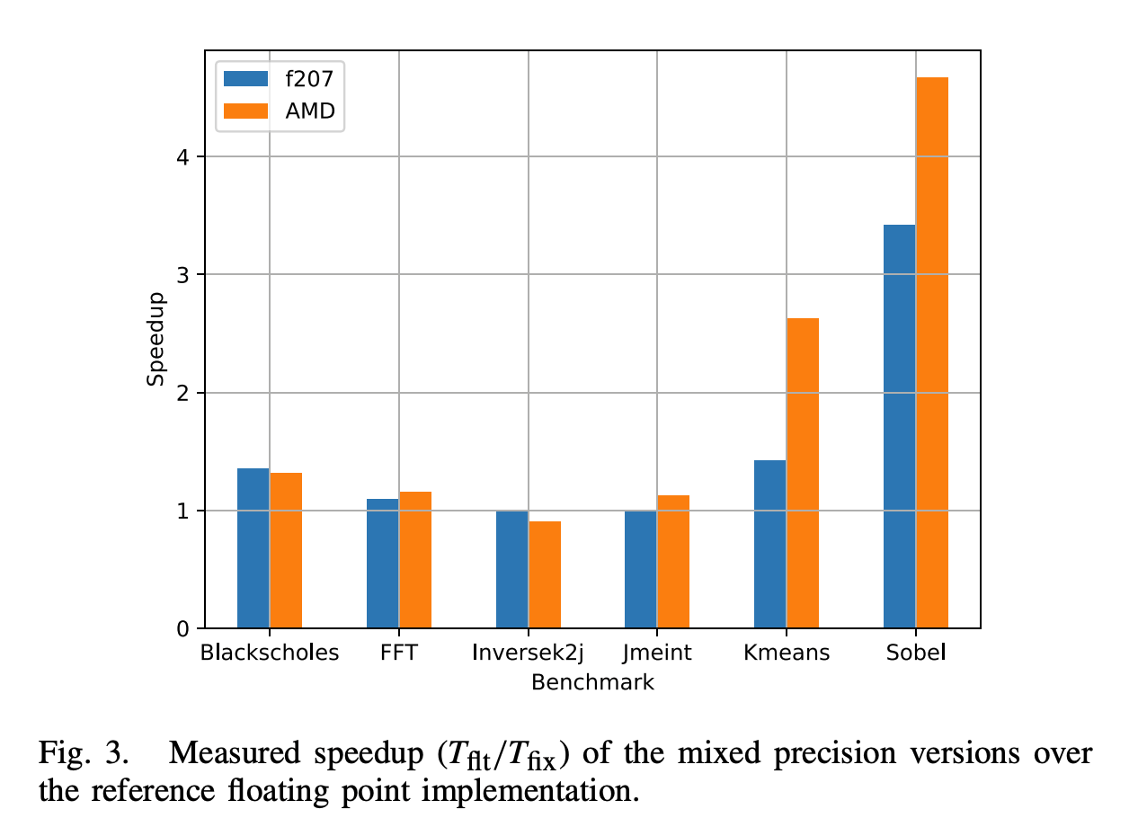
Experiment Results
Measuring speedups by mixed precision TAFFO.
Up to 366.8% speed boost.

Slide 17
Experiment Results
Measuring different types of errors caused by precision lowering.
ARE: Average Relative Error
MR: Missing Rate
RMSE: Root Mean Square Error

Slide 18
Discussion

Slide 19
Who wants a free donut?*
(me!)
*A donut may or maynot be provided by the end of this presentation, the mentioning of a free donut does not constitute a demand from Mr. River to gift everyone a free donut.
Notes:
This is to hype everyone up a bit.

Slide 20
Who wants 366.8% performance boost?*
(me!)
*With up to 3% relative error of course
Notes:
Mention good error bound analysis, good performance trade-off analysis for representation conversion.

Slide 21
Who wants this performance boost with minimal disruption to source code and tool chain?
(me!)
Notes:
Mention other state of the arts frameworks, that this is good because it does not impact the toolchain and does require user to write out-of-spec C/C++ program

Slide 22
Who wants more speedup?
(More free donuts!*)
*DONUTS MAY OR MAYNOT BE PROVIDED BY THE END OF THIS PRESENTATION, THE MENTIONING OF A FREE DONUT DOES NOT CONSTITUTE A DEMAND FROM MR. RIVER TO GIFT EVERYONE A FREE DONUT.
Notes:
Go back to slide 13 –

Slide 23
Let's get back to this slide
Ideal
Notes:
Performance model is not accurate – This is the model used by compiler to decide whether or not to apply fixed-point conversion, but the accuracy is far from ideal.

Slide 24
Who wants duplicated & wasted compilation?
(this is very performant - says the crypto guy)
*I mean I don’t really care about compilation time
Notes:
The point is the approach to duplicate every function for all call sites is not really performant, but a good one to start.
And also compile time performance doesn’t really matter for small projects (which most HPCs are).

Slide 25
Who wants to put
annotate(“taffo 7 25 ….”)
Everywhere in their program?
(let’s just push that to the intern…)
Notes:
Okay we are getting into the main criticism we have, annotation may become excessive, and understanding the propagation behavior maybe a puzzle in itself.

Slide 26
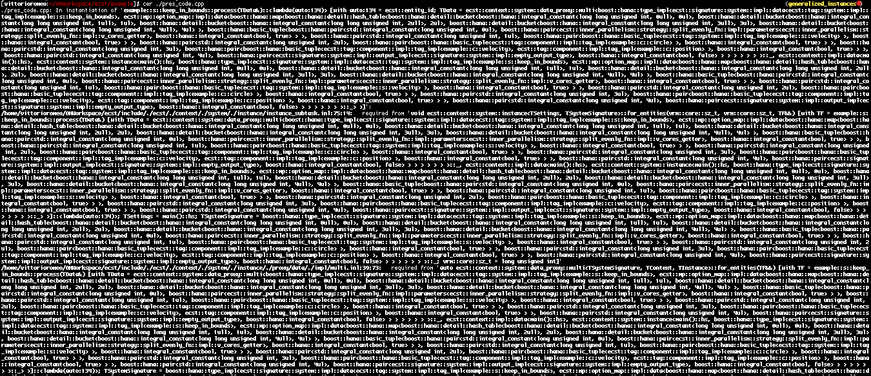
Maybe not really an intern-friendly job
Notes:
Like template propagation, the (implicit) propagation of annotation maybe hard to understand at moderate to large code space.

Slide 27
Who wants to maintain
annotate(“taffo 7 24 ….”)
Everywhere in their program?
(Is it 7 24 or 7 25 or 24 7?)
Notes:
Maintaining tags are hard not only for correctness (coming up), but also for ensuring low error

Slide 28
Who wants to ensure
annotate(“taffo 256 7158 ….”)
Is a correct bound?*
(Let’s fire the intern!)
*Rosa: yes, but you need to write in another language
Notes:
Maintenance -> correctness, program may blow up if the bound is incorrect. Alternatives using more formal annotation is more invasive.

Slide 29
Discussion Summarized
Pros:
Good performance boost
Propagation analysis
Performance cost model
Using widely adopted toolchain
We all love llvm
Con:
Inaccurate performance model
Potentially large impact to compile time
Duplicated compilation to be DCE’d
Manual tagging is not ergonomic
What to tag, how does the propagation work?
Maintaining the tag:
Error range
Correctness
Poor (fired) Intern

Slide 30
Q&A

