Slide 1
Predicting Unroll Factors Using Supervised Classification
Mark Stephenson, Saman Amarasinghe
Presented by: Andrew Zhuang, Ben Zhang, Jaewoo Kim, Daniel Hou

Slide 2
Outline
Motivation
Supervised Learning Overview
Feature & Dataset Generation
Multi-class Classification
Evaluation
Comments
Notes:
Motivation -
Supervised Learning Overview - Andrew
Feature & Dataset Generation -

Slide 3
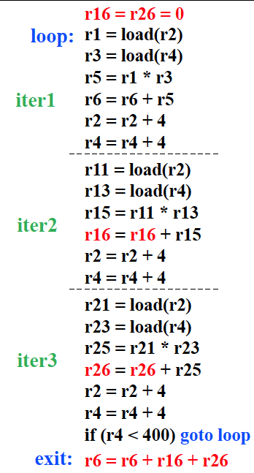
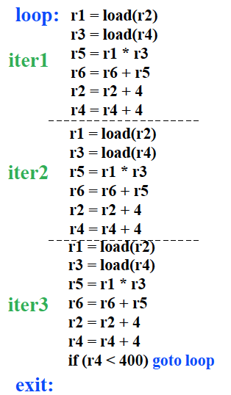
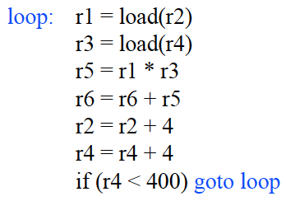
Loop Unrolling Example

Slide 4
Motivation - Loop Unrolling
Advantages | Disadvantages
Reduced Branch Overhead Exposing Instruction Level Parallelism | Code Expansion Increased Register Pressure
Loop unrolling increases the aggressiveness of certain optimizations but may adversely affect other important optimizations and reduce overall performance.
Goal: Train a ML algorithm how to make informed decisions.
Notes:
Compiler can reschedule the operations in the unrolled body to achieve overlap among iterations.
Can degrade instruction cache performance due to increased code size

Slide 5
Why Machine Learning (ML)?
Efficiency in Complex Systems
Automating process of understanding intricate interactions within compiler optimizations
Time and Effort Reduction
Requires expert knowledge of the system and huge amount of trial-and-error tuning
Higher Accuracy
ML techniques can predict loop unrolling factors with high precision
Adaptability
ML models can be quickly retrained to adapt to new architectures or changes

Slide 6
Supervised Learning Overview
Set of training examples (x_{i}, y_{i})
x_{i}: feature vector e.g. characteristics of loop
y_{i}: label e.g. optimal unroll factor
Classifier finds mapping that minimizes training error
Hopefully generalizes to new examples
Trained offline
Compiler runtime:
Extract loop features and feed into classifier → prediction

Slide 7
Feature & Dataset Generation
Collected 38 features, labels determined experimentally from [1…8]
Only use loops that run for >50,000 cycles to reduce noise
Cache miss could be majority of a short loop
Notes:
most features are readily available in ORC (open research compiler)

Slide 8
Feature & Dataset Generation
Not all features are necessary - find the most informative ones
Reduces model complexity and training time
Reduces likelihood of overfitting
Learning too much about the training data
Two methods: Mutual Information Score, Greedy Feature Selection
Final dataset is the union of both methods
Notes:
smart subset of features improves accuracy and reduces overfitting

Slide 9
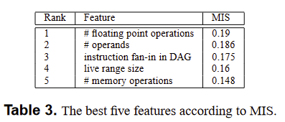
Feature & Dataset Generation
Method 1: Mutual Information Score
Measure reduction in uncertainty of feature 𝑓 given information about u (the optimal unroll factor)
Higher is better
J is the set of possible values of 𝑓

Slide 10
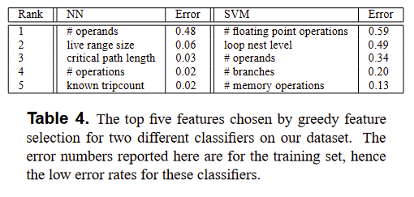
Feature & Dataset Generation
Method 2: Greedy Feature Selection
Choose the best feature that minimizes training error
Choose the next best feature from the remaining features
Continue until 5 features (set by authors)
Notes:
There are several problems with MIS, most notably that it does not tell us anything about how features interact with each other. In addition, even though the score is a metric for information content, it does not guarantee that the features will be useful for a particular classifier.

Slide 11
Multi-class Classification
Treat unroll factors as classes
Use features selected in previous step
How to classify multiple classes?
Near-neighbor classification
Support Vector Machines

Slide 12
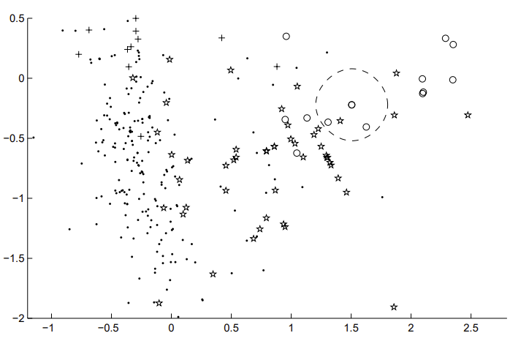
Multi-class Classification: Near-neighbor
Simple and intuitive
Training: construct database of
<x_{i}, y_{i}> <feature vector, label>
For each novel loop classified, simply take majority label of neighbors within radius (based on L2-norm) (overfitting)
Outliers possible

Slide 13
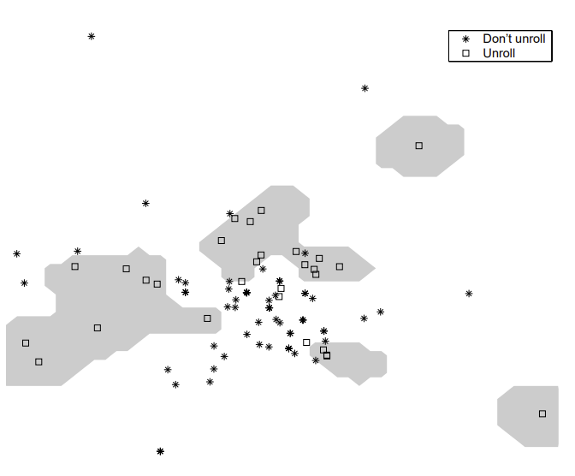
Multi-class Classification: SVM
Normally binary
Map features to higher dimensional space and find maximally separating hyperplane

Slide 14
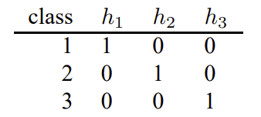
Multi-class Classification: SVM
Normally binary
Map features to higher dimensional space and find maximally separating hyperplane
To use in a multi-class context, use output codes

Slide 15
Evaluation: Accuracy

Slide 16
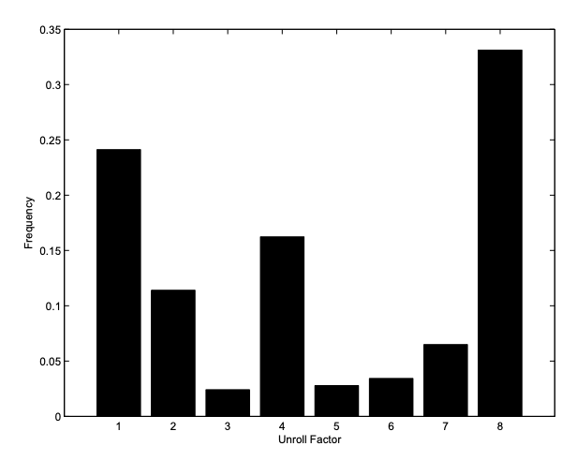
Evaluation Context
Ran various SPEC benchmarks
2000, ‘95, ‘92
Ran each benchmark 30 times
Performance recorded as median runtime for each unroll factor
Explored possible unroll factors from 1 to 8

Slide 17
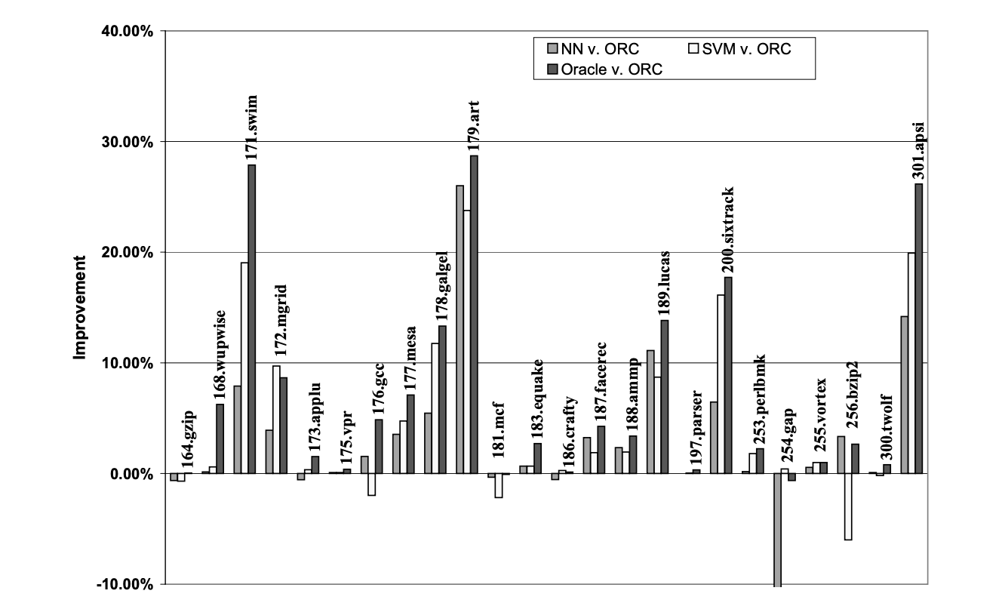
Evaluation: Improvement
SVM and NN experience improvement on 19/24 benchmarks
SVM: 5% speed up
NN: 4% speed up
Oracle: 7.2% speed up
Notes:
19 out of 24

Slide 18
Future Work
Exploring unrolling factors beyond the experimental range
Limit = greatest unroll factor where all loops in training set compile correctly
Possible values outside of this range can lead to greater optimization
One loop in dataset may limit optimal unroll factor for another loop in dataset
Reducing noisy measurements
Granularity vs Noisiness Tradeoff
Not possible to get rid of noise
Possible to reduce noisy measurements
Exploring application of ML into other loop optimizations
Loop tiling, Strip mining, hyperblock formation in loops, etc.

Slide 19
Comments
Simple ML algorithms used with Promising Results
What if we used a more complex model?
What about Decision Tree or Random Forest model for interpretation?
Testing on wider range of loop unrolled factor
5% overall speed up from just loop optimizations
Just one optimization
Speed up could be even more if we apply models to other optimizations
At best, ML is a powerful and time-efficient tool for optimization
At worst, ML can help guide engineers towards right direction
Can help engineers make sense of the many variables at play

