Slide 1
Partial Dead Code Elimination
Knoop, et. al
Team 25: Matt Chandra, John Jepko, Alex Morton, Carter Galbus, Sam Zayko
EECS 583

Slide 2
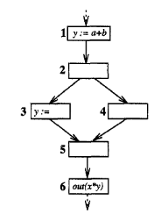
What is partial dead code?
Review: what is totally dead code?
Contents of the LHS of the statement are unused for the rest of the program

Slide 3
What is partial dead code?
Review: what is totally dead code?
Contents of the LHS of the statement are unused for the rest of the program
What makes dead code partial?
If the contents of the LHS are used in some branches, but not in all

Slide 4
What is partial dead code?
Review: what is totally dead code?
Contents of the LHS of the statement are unused for the rest of the program
What makes dead code partial?
If the contents of the LHS are used in some branches, but not in all

Slide 5
Steps for Partial Dead Code Elimination
Do any sequence of:
Assignment sinking
Dead code elimination

Slide 6
Assignment Sinking
For instruction x = t
We eliminate the instruction’s original location
We insert the instruction where the new instruction is still reachable by all the basic blocks that use x

Slide 7
Assignment Sinking
For instruction x = t
We eliminate the instruction’s original location
We insert the instruction where the new instruction is still reachable by all the basic blocks that use x

Slide 8
Dead Code Elimination
Sinking allows some instructions to be eliminated
The assignment we sunk into node 3 is now dead, thus we can eliminate it

Slide 9
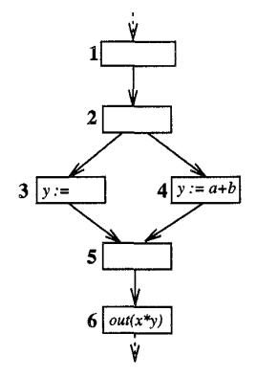
Dead Code Elimination
Sinking allows some instructions to be eliminated
The assignment we sunk into node 3 is now dead, thus we can eliminate it

Slide 10
Second Order Effects of PDE

Slide 11
Sinking-Elimination
This is the desired effect of PDE.
We sink assignments until they can be eliminated by standard DCE.
This was showcased in the previous slides.

Slide 12
Sinking-Sinking
Then sink to entry of 3 and 4
2 blocks 1
Sinking an assignment create opportunities to sink others.
Sinking 2's assignment to 5 allows 1's assignment to sink to 3 and 4.
Otherwise 1's assignment is blocked by 2's since it modifies a source operand of 1.
Sink to entry of 5

Slide 13
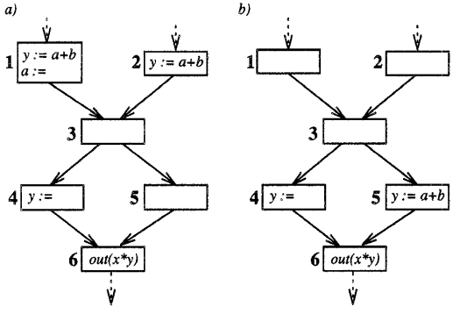
Elimination-Sinking
Dead code may prevent the sinking of assignments.
Eliminating α's dead assignment in 1 allows y's assignment in 1 to sink to 4 and 5.
Otherwise α's assignment blocks y's.
Dead, eliminate

Slide 14
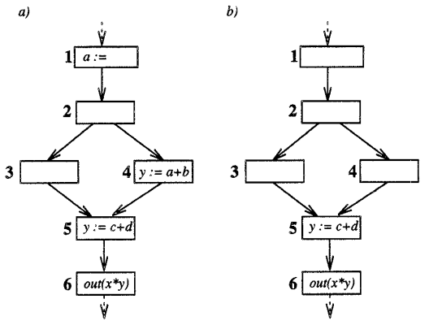
Elimination-Elimination
Now dead, eliminate
Eliminating dead code unblocks others.
Eliminating y's dead assignment in 4 in-turn makes α's in 1 dead, thus eliminated.
Otherwise α's assignment in 1 is used in 4.

Slide 15
PDE Algorithm
Dead Code Elimination and Sinking of Assignments

Slide 16
Algorithm Pseudocode
while change:
dce() # dead/faint code elimination
check_sink_candidates()
“Change” will be false when there are no more eliminations or sinks possible

Slide 17
Faint Variables
A assignment of variable x is faint* if:
All usages of x are preceded by another modification
OR
x is used in an assignment that is also faint
* slightly looser definition than “dead”

Slide 18
Dead Code Elimination Procedure
Dead/faint variables found with backwards DFA
Delete assignments that only have dead/faint variables
Can use bit-vectors or def-use graph (slower)

Slide 19
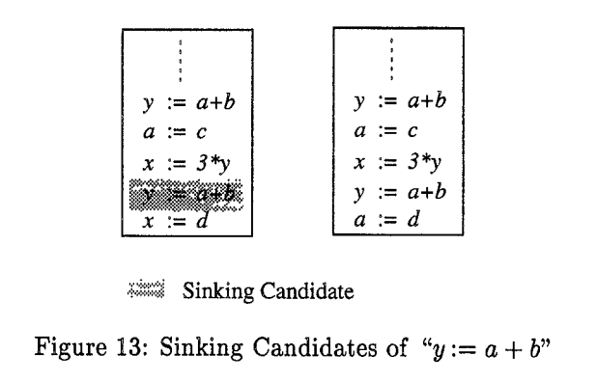
Sinking Assignments Procedure
Move assignments x:=t that aren’t “blocked”, i.e. followed by any of:
Modification of RHS (operand)
Modification of LHS (source)
Usage of LHS
Move candidates to lowest possible insertion point
Can be performed in any order
Only last def can be a candidate

Slide 20
Results
Correctness and Complexity

Slide 21
Correct and Optimal
G =
No better way to eliminate dead code without changing branching structure or semantics
G -> G’ -> G’’ … -> G*

Slide 22
Complexity
N = size of the program
In practice the complexity for PDE is N^2
Only apply this in time-sensitive sections of medium size

Slide 23
Takeaways and Comments

Slide 24
Comments
Pros:
Developed algorithm to optimally remove partially dead code
Captures all second order effects that may result from the optimization
Cons:
Relatively expensive in the average case, limits size of code can be applied on
Very expensive in the worst case, quadratic or quintic depending on dead/faint code
No evaluations on code benchmarks

Slide 25
Thank you!

