Slide 1
Software Prefetching for Indirect Memory Accesses: A Microarchitectual Perspective
Sam Ainsworth and Timothy M.Jones
Group 13: Jianping Shen, Xinchao Zha, Yuchu Wang, Anchen Xue

Slide 2
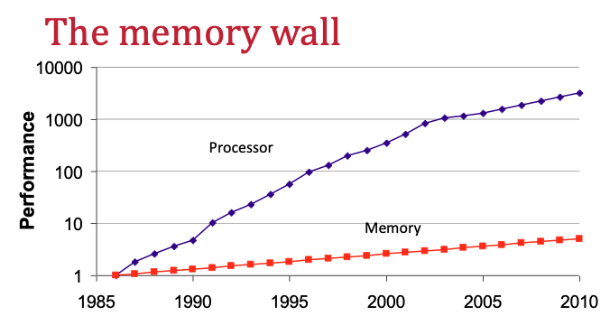
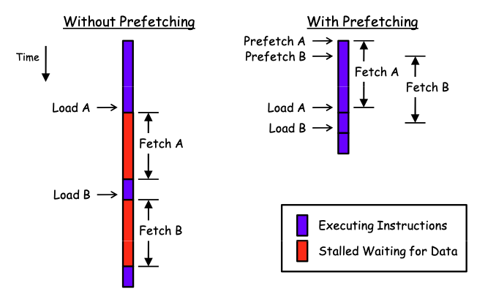
Introduction
Memory wall has significant influence on Processor performance, 1 mem access ≈ 500 arithmetic ops
Multiple Cache hierarchy help to minimize the memory latency by taking advantage of temporal and spatial locality
Prefetch is a way to reduce cache miss

Slide 3
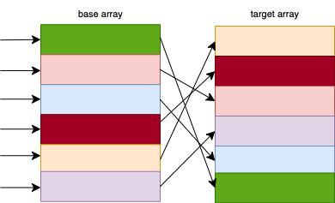
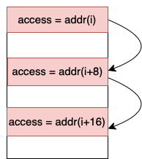
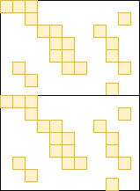
Hardware Prefetch V.S Software Prefetch
Indirect access
Sride access
Sparse correlated access
Hardware Prefetching
Implemented by hardware prefetcher
Hardware prefetching is most effective for predictable, linear memory access patterns
Software Prefetching
Programmer uses data structure and algorithm to insert instructions into program to bring the required data in early
Can support for irregular memory access

Slide 4
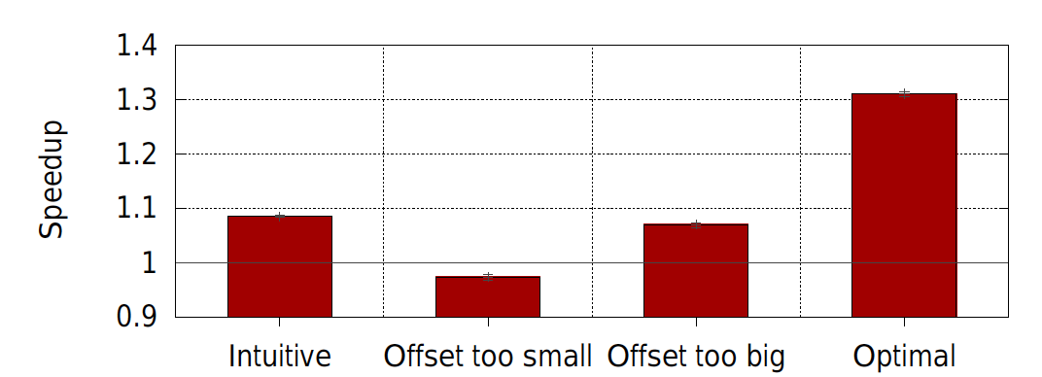
Prefetch Potential
Accesses to indirect_array are data-dependant on accesses to base_array
The Address which used to access target array can be calculated by looking ahead base array in software
Need to have an automatic compiler algorithm to schedule prefetch code
The intuitive approach inserts only the prefetch at line 4, giving a speedup of 1.08x
Prefetches to both the base array key_buff2 and the indirect array key_buff1 can achieve optimal performance, giving a speedup of 1.3x
Choosing Prefetch Offset is important!
Stall execution
Pollute Cache

Slide 5
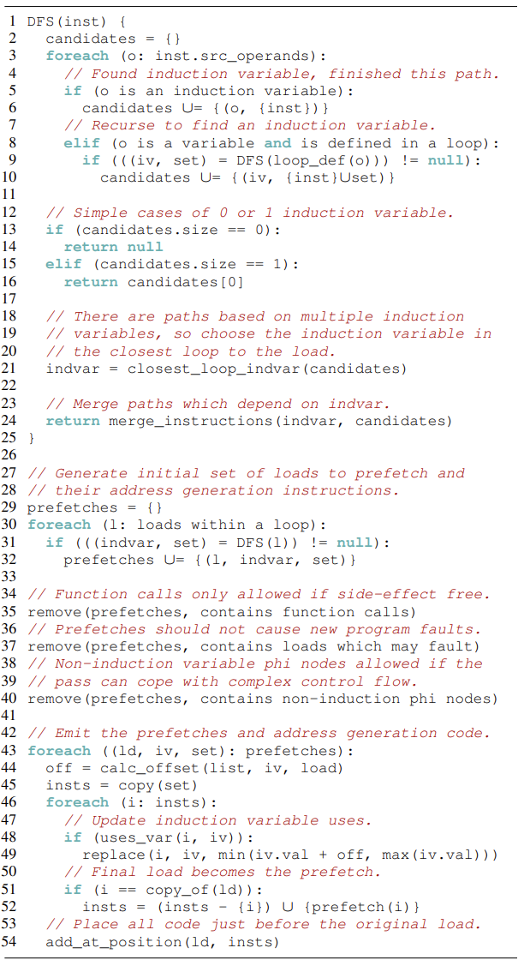
Software Prefetch Generation Algorithm
Analysis
To identify loads that can be profitably prefetched and determine the code required to generate prefetch instructions for them.
Fault Avoidance
software prefetches themselves cannot cause faults，intermediate loads used to calculate addresses can
Prefetch Generation & Scheduling
insert new instructions into the code
schedule prefetches by finding a look-ahead distance that is generous enough to prevent data being fetched too late, yet avoids polluting the cache and extracts sufficient memory parallelism to gain performance.

Slide 6
Analysis
Target loads are those where it is possible to generate a prefetch with lookahead
Example:
A[I] can look ahead: A[I+offset]
When find an induction variable, record all instructions that reference this induction variable (directly or indirectly) along each path to the load.
Multiple paths different variables?
only record innermost one
Start:Target Load
End searching
Induction variable
Alloc
Phi
Dependence graph backwards using a depth-first search
ld
find an induction variable
ld
Start
End:reach out loop Inst in one path

Slide 7
Fault Avoidance
Prefetches themselves cannot cause faults,intermediate loads used to calculate addresses can
Example: the load from A[i+offset] to generate a prefetch of B[A]
Ensure: look-ahead values are valid addresses!! if intermediate loads? contain valid data!!
First: add address bounds checks into our software prefetch code, to limit the range of induction variables to known valid values
Second: analyse the loop containing the load, and only proceed with prefetching if do not find stores to data structures that are used to generated load addresses within the software prefetch code
Example: x[y[z[i]]], if there were stores to z, not be able to safely prefetch x.

Slide 8
Prefetch Generation & Scheduling
increase the induction variable
t: the total number of loads in a prefetch sequence
l: the position of a given load in its sequence
c: a microarchitecture-specific constant, which represents the look-ahead required for a simple loop, and is influenced by a combination of the memory latency and throughput (e.g., instructions-per-cycle (IPC)) of the system. High memory latency requires larger look-ahead distances to overcome, and high IPC means the CPU will move through loop iterations quickly, meaning many iterations will occur within one memory latency of time.
create new copies of the software prefetch code instructions
Take minimum value of the size of the data structure and the offset induction variable
generate a software prefetch instruction instead of the final load

Slide 9
Prefetch Scheduling Continuing
2 prefetches are generated,So t = 2
First, l = 0, so offset = c by eq. (left) so issue a prefetch to key buff2[i+c]. For the second, l = 1, so we issue a prefetch to key buff1(buff2[i+c/2])
After c/t iteration:
using a previously prefetched lookahead value key buff2[i+c] to index into key buff1, and issue a prefetch to key buff2[i+c+c/2]
This has the property that it spaces out the look-ahead for dependent loads equally: each is prefetched c t iterations before it is used

Slide 10
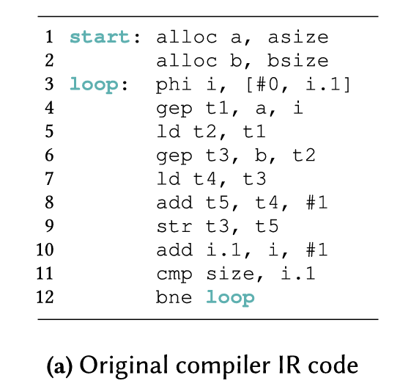
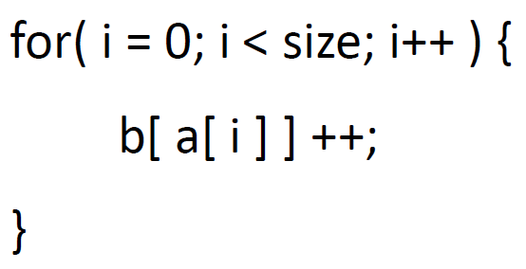
Example

Slide 11
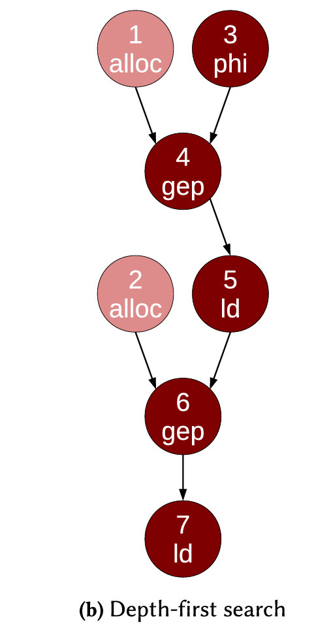
Example
Data Dependency Graph

Slide 12
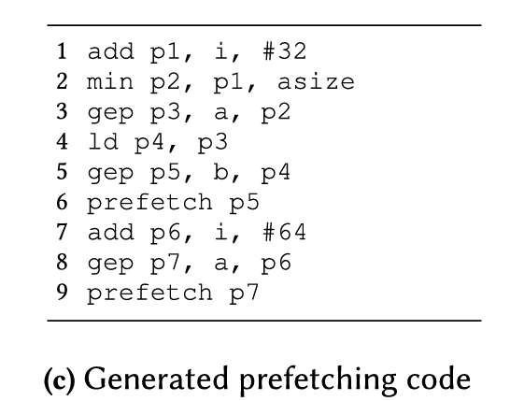
Example
Second ld

Slide 13
Example
First ld

Slide 14
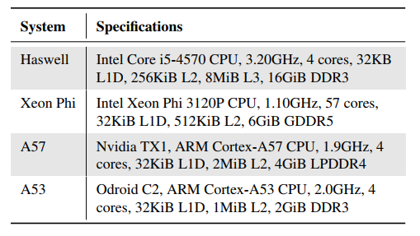
Experimental Setup
Benchmarks for evaluation
Integer Sort (IS)
Conjugate Gradient (CG)
RandomAccess (RA)
Hash Join (HJ-2 & HJ-8)
Graph500 Seq-CSR (G500)
Systems
Haswell (out-of-order)
Xeon Phi (in-order)
A57 (out-of-order)
A53 (in-order)

Slide 15
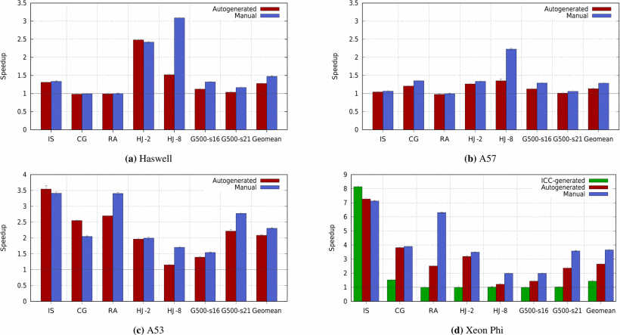
Results and Discussions: Auto-generated Performance
Performance improvement for different systems and benchmarks:

Slide 16
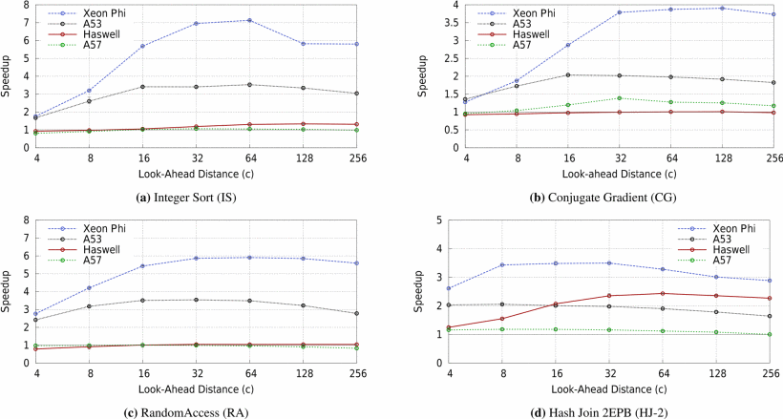
Results and Discussions: Look-Ahead Distance
The speed-up improvement against the look-ahead distance is shown:

Slide 17
Summary
An automated compiler pass is designed for the indirect memory accesses.
Identify loads suitable for prefetching and insert the necessary code to calculate their addresses and prefetch the data;
Look-ahead distances
Speed-up (between 2.1× and 2.7×) is close to optimal manual insertion of prefetches;
Various factors are investigated regarding the software prefetch performance.
Offset = c(t - l) / t

