Slide 1
The Cache Performance and Optimizations of Blocked Algorithms
Monica S. Lam, Edward E. Rothberg, and Michael E. Wolf
Presented By Group 5: Wynn Kaza, Larry Wong, Yuchen Xia

Slide 2
Outline
Motivation
Algorithm
Results
Further Experiments
Commentary

Slide 3
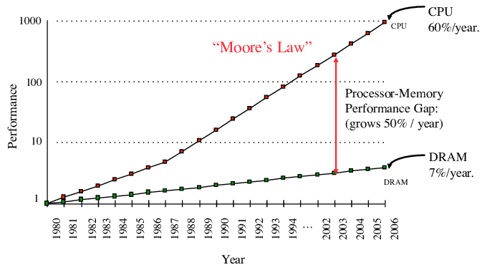
Why is cache performance important?
Faster processor speed, but limited by memory speed
Cache models are not optimized for heavy numerical code such as matrix multiplication

Slide 4
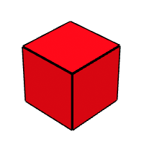
What are Blocked Algorithms?
Goal: Reduce cache misses
How: Make full use of data in cache before evicting

Slide 5
Matrix Multiplication
(1) for row := 1 to N do
(2) for k := 1 to N do
r = X[row][k]
(3) for col := 1 to N do
Z[row][col] += r*Y[k][col]
Given:
X := NxN matrix
Y := NxN matrix
Z := NxN matrix
Goal:
Z = XY
Z
X
Y

Slide 6
Blocked Matrix Multiplication
Z
X
Y
Given: Block size BxB
for kk := 1 to N by B do
for jj := 1 to N by B do
for i := 1 to N do
for k := kk to min(kk+B-1, N) do
r = X[i][k];
for j := jj to min(jj+B-1, N) do
Z[i][j] += r*Y[k][j];
B Wide
B Wide
BxB Block
Notes:
Up to Larry

Slide 7
Types of Cache Misses
Intrinsic Misses
Cross Interference Misses
Self Interference Misses

Slide 8
Types of Cache Misses
Intrinsic Misses
Data that has never been read
E.g., loading from X at start
Cross Interference Misses
Self Interference Misses

Slide 9
Types of Cache Misses
Intrinsic Misses
Cross Interference Misses
Different variables evict each other from the cache
E.g., loads from Z and Y
Self Interference Misses

Slide 10
Types of Cache Misses
Intrinsic Misses
Cross Interference Misses
Important!
Self Interference Misses
Data from the same variable evicts itself
E.g., loads from each row of matrix Y evicts older loads

Slide 11
Matrix Multiplication Cache Model
N = Array dimension
B = Block dimension
C = Cache size
S_{i}(Y) = self interference factor
for variable Y
Intrinsic Misses
Self Interference Misses
Cross Interference Misses

Slide 12
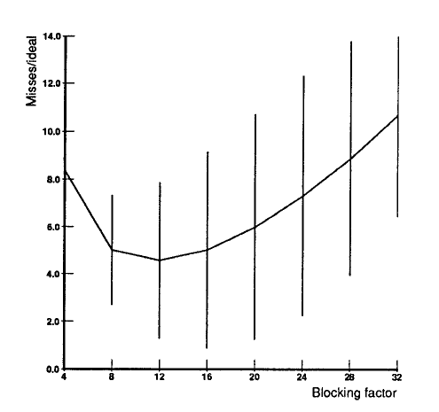
Why Constant Block Factor Doesn’t Work
Easiest Assumption
Take square root of cache size for block factor
New Foresight
Increasing the block factor degrades performance significantly
Notes:
Lots of previous papers assumed constant block factor. Paper is proving this is not the case. Optimal blocking factor is not sqrt(C) which is 32 but at 12

Slide 13
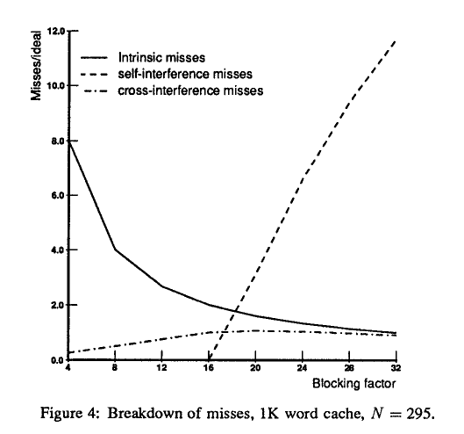
How do Misses Fit In?
What's B₀
B₀ is critical blocking factor
All values greater than B₀ leads to significant self interference
Changes significant even for small differences in matrix size & same cache size
Notes:
Talk about the impact of self-interfence misses and it’s explosion as soon as it occurs (B0)

Slide 14
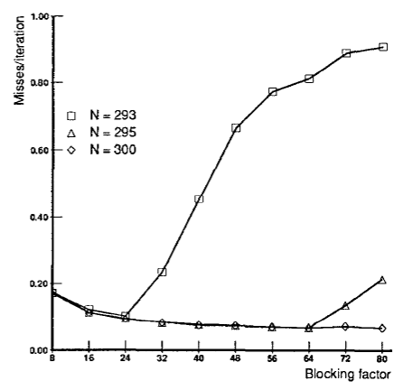
N = 293
Using same cache size!
N = 300
Notes:
Even using the same cache size, very similar matrix have drastically different performance rates

Slide 15
How Self Interference Happens
 |  | X
 |  |  |  |  | X
B1
B2
Notes:
In the matrix, two words both fall into the same cache location. Once these two words interfere, expanding the block factor would only lead to more misses.
Therefore if Y[i,j and Y[i ‘J’] use the same location in the cache, then so must Y[i+a,j+b] and Y[i’+a,j’+b].

Slide 16
Direct Mapped Cache
Conflict!
0xFFF
X1
0x022004
0x022008
0x004
X2
0x054004
0x054008
0x000
Notes:
Just demonstrating the previous slide and how it happens

Slide 17
Dynamic Blocking Algorithm
N = Matrix Size
C = Cache Size
addr = addr + C
D_{i} = addr / N
False
return min(maxWidth, D_{j})
D_{j} = abs((addr % N) - N / 2)
If (D_{i} >= min(maxWidth, D_{j})
True
Notes:
Runtime is O(N/sqrt(C)) because the B0 can never be bigger than sqrt(C). This is small enough to run within a compiler on at runtime if matrix size is not statically known
Di represents what row of the matrix you are at
Dj represents the

Slide 18
Big Idea of Algorithm
Runtime: O(N / √C)
If (&Y[i, j] = &Y[i +D_{i}, j + D_{j}] % (Cache Size))
Then (B₀ can’t be larger than max(D_{i}, D_{j}))
Notes:
Runtime is fast enough to be in compiler ot to run at runtime for dynamic matrix size

Slide 19
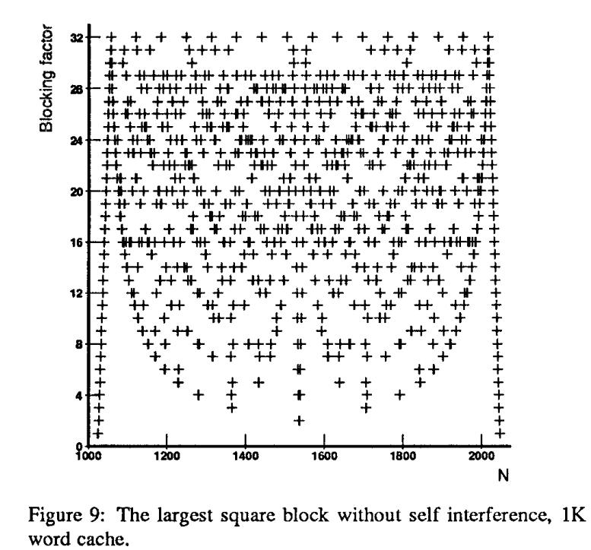
Results
B₀ is sensitive to small changes in matrix dimension N
Optimal fixed block size is quite small
B₀ is large, diminishing return for choosing larger block sizes
B₀ is small, serious self interference for moderate block sizes
Notes:
Fraction of cache used is smaller than 3.2%

Slide 20
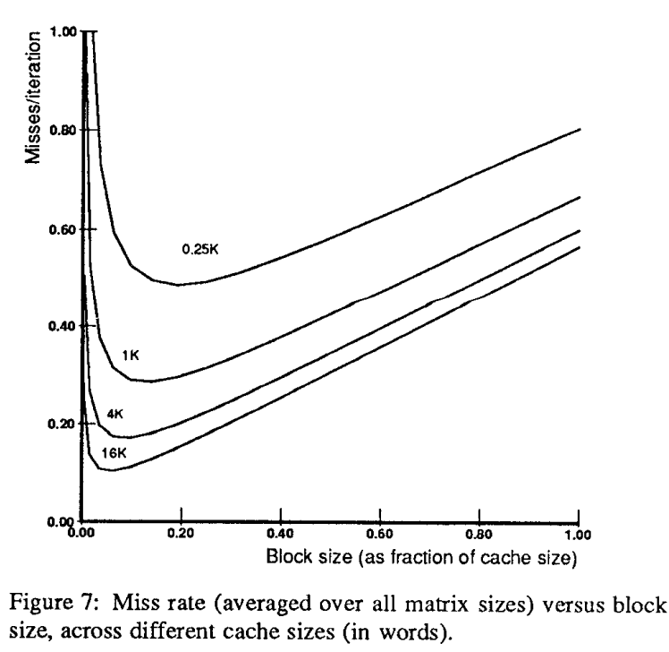
Cross interference limits the optimal blocking factor to √(C/2)
Self interference dominates if B₀ < √(C/2)
Otherwise cross interference is the critical part

Slide 21
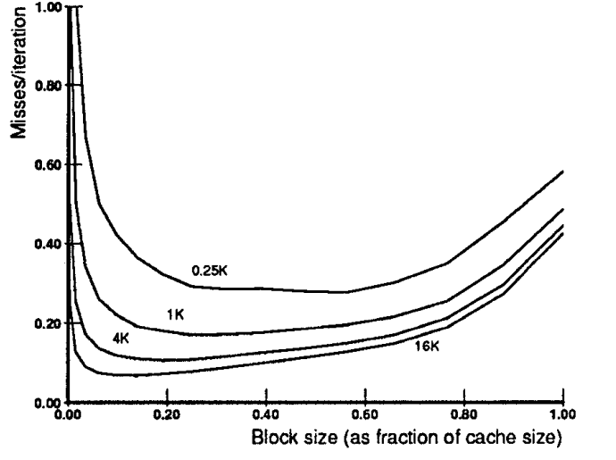
Further Experiments - Set Associativity
Average miss rate remain relatively flat as block size increases
Larger critical blocking factors
Fraction of cache used remains small but larger than direct-mapped cache
Lower average miss rate
Notes:
Set associativity of 4, LRU, the performance of a set-associative cache if a fixed block size is chosen for all problem sizes.

Slide 22
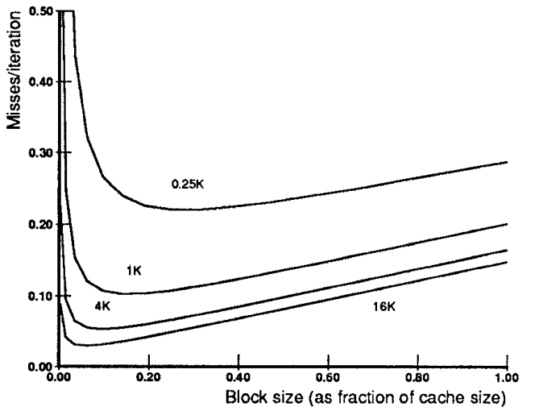
Line Size
Line size of m words >> reduce the miss rate by m ideally
Utilize spatial locality
Smaller reduction on miss rate in practical
Cache line misalignment
Notes:
most caches today have multi-word cache lines

Slide 23
Commentary
One of the first papers to look at cache interference (theoretically and experimentally), and it’s relationship with stride and block size for numerical calculations
However:
A lot of graphs mention Misses/Ideal but hand-wavey on the definition of ideal
Formulas are unintuitive and unmotivated
Mention Cross Interference, but it’s not explained really well. Makes assumption about location of reuse
Models cannot make good predictions in complex situations

