Slide 1
Loop Rolling for Code Size Reduction
Rodrigo C. O. Rocha, Pavlos Petoumenos, Björn Franke, Pramod Bhatotia, Michael O’Boyle
Presented by: Group 1
Christopher Jiang, Wen Plotnick, Keshav Singh, Michael Xi
Notes:
Intro group, group number, paper (skip reading author names)
To understand loop rolling for reducing code size, its helps to first review loop unrolling and its effects on code size

Slide 2
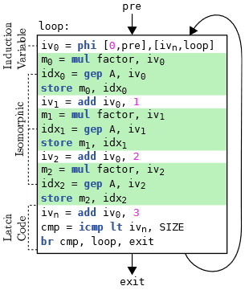
Loop Unrolling and Code Size
Loop unrolling possibly increases execution speed (by removing branches, etc.) at the expense of increased code size
Code size is often a significant consideration
Embedded processors
Resource limitations
Notes:
Loop unrolling is an optimization… can be done by hand, etc.
These optimizations, and styles of coding, cause an increase in code size

Slide 3
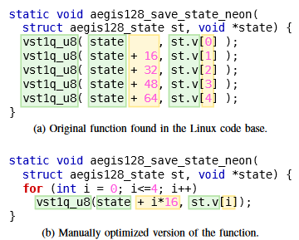
Loop (Re)rolling
A loop can be “(re)rolled” by identifying “unrolled” segments of code
Reverse of the process of loop unrolling
Identify isomorphic segments of code
Isomorphic code may be rewritten in an “unrolled” form
Decreases code size
Notes:
So we can do what is called loop “(re)rolling/rolling”, going from an “unrolled” state to a rolled one, reducing code size.
On the left we see and example of a manually “unrolled” loop and its rolled form.

Slide 4
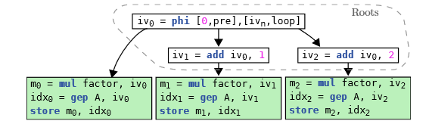
Why Roll Loops for Reducing Code Size?
Why not just never perform the loop unrolling pass?
Loop unrolling may allow for further optimizations (may be worth the code size increase)
The loop rolling process doesn’t just roll loops unrolled by a previous pass, straight line code may also be rolled
LLVM’s loop rolling pass rarely triggers
Only works on partially unrolled loops with simple data dependencies
i.e. very little straight line code
Notes:
The method this paper proposes is stronger than existing loop rolling methods (such as LLVM’s loop rolling pass) in that it can roll straight line code. It doesn’t merely address code unrolled by an LLVM pass.

Slide 5
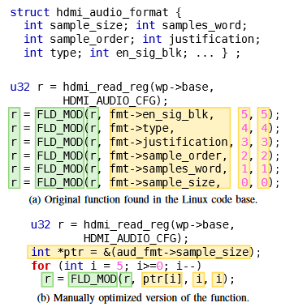
Loop (Re)rolling
An aggressive/surprising application
Code that does not appear to be “unrolled” can be rolled by the technique proposed
The one on the left relies on ordering of struct members, their type, ordering of the accesses, etc.
Notes:
As an example, the code on the right, which doesn’t look like a loop, can be rolled due to ordering of members in a struct, ordering, etc.
The loop rolling pass captures some of the techniques that’d allow for this optimization in code size.

Slide 6
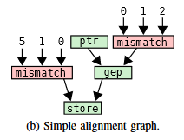
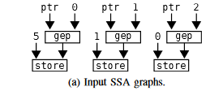
Superword Level Parallelism
Strongly inspired by Superword Level Parallelism (SLP)
Identify “seed instructions”, those likely to lead to vectorization,
Then SLP uses use-def chains to create an SLP graph
This loop rolling method is similar
Identifies isomorphic code by aligning code, from the bottom up,
Number of additional improvements over the original methods proposed in the SLP paper
Notes:
So how does this paper do this? It takes inspiration from the SLP paper we’ve previously seen in class.
As a refresher SLP looks for vectorization (or essentially loop-finding)

Slide 7
RoLAG
Operates on a single basic block
Five Steps:
Seed Collection
Graph Alignment
Scheduling Analysis
Code Generation
Profitability Analysis

Slide 8
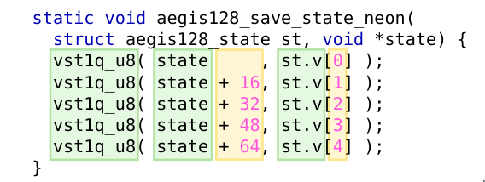
RoLAG: Seed Collection
Scans for instructions which could possibly be rolled into a loop
Store instructions, function calls, reduction trees
Grouped based on similarity
Function calls: function name/return type/operand types
Stores: data type, base pointer
Reduction trees: require special handling

Slide 9
RoLAG: Seed Collection
Scans for instructions which could possibly be rolled into a loop
Store instructions, function calls, reduction trees
Grouped based on similarity
Function calls: function name/return type/operand types
Stores: data type, base pointer
Reduction trees: require special handling
*(ptr + 0) = 5;
*(ptr + 1) = 1;
*(ptr + 2) = 0;
*(aaa + 3) = 0;
%0 = getelementptr i32, ptr %ptr, i64 0
store i32 5, ptr %0
%1 = getelementptr i32, ptr %ptr, i64 1
store i32 1, ptr %1
%2 = getelementptr i32, ptr %ptr, i64 2
store i32 0, ptr %2
%3 = getelementptr i32, ptr %aaa, i64 3
store i32 0, ptr %3

Slide 10
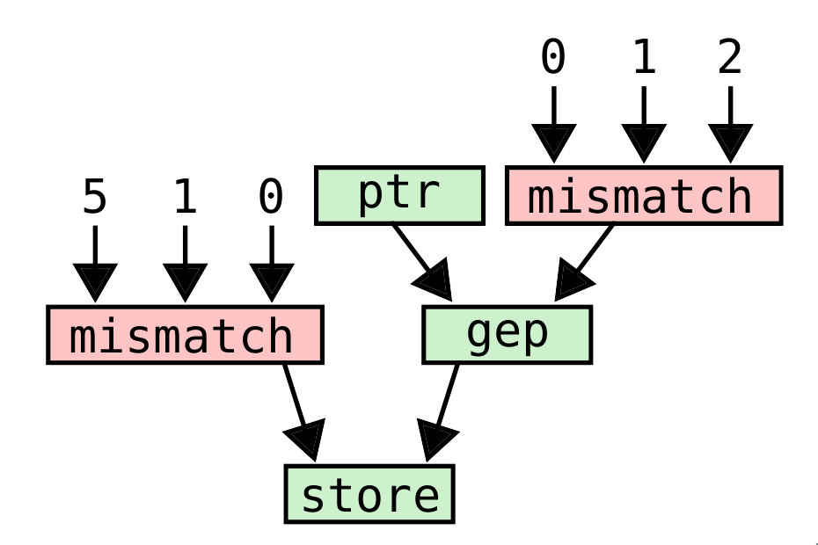
RoLAG: Graph Alignment
Extend grouping of seed instructions to their dependencies
Node of alignment graph corresponds to a group of instructions or variables
Node can be matched or mismatched, depending on whether the group allows a common representation inside a loop

Slide 11
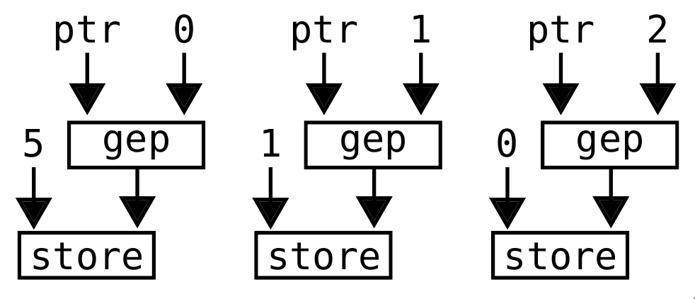
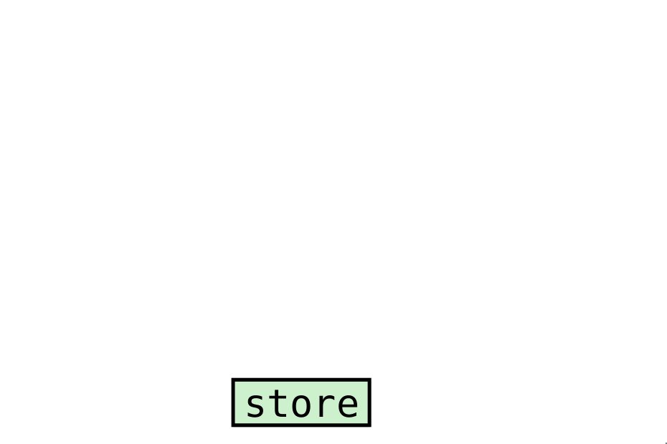
RoLAG: Graph Alignment
Recursively build from the SSA graphs of the seed instructions
Add operands of instructions in a node as a new node in the alignment graph
Analyze node for matching versus mismatching
Naive: instruction equivalence (same opcode, same types)

Slide 12
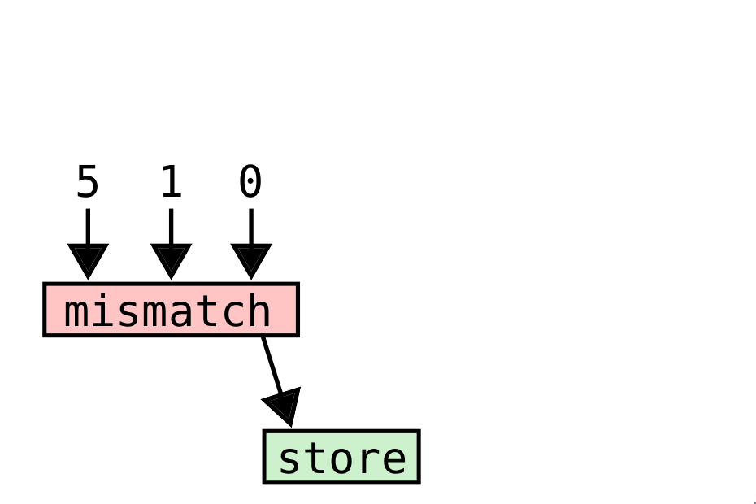
RoLAG: Graph Alignment
Recursively build from the SSA graphs of the seed instructions
Add operands of instructions in a node as a new node in the alignment graph
Analyze node for matching versus mismatching
Naive: instruction equivalence (same opcode, same types)

Slide 13
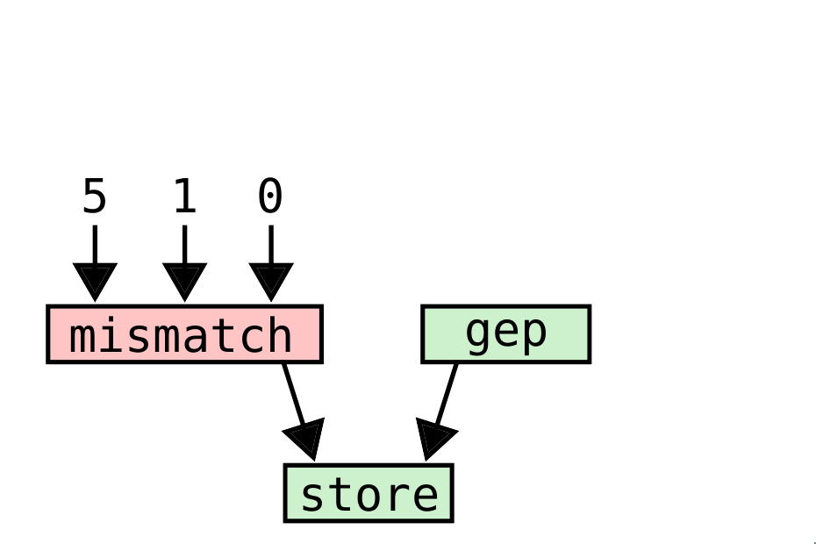
RoLAG: Graph Alignment
Recursively build from the SSA graphs of the seed instructions
Add operands of instructions in a node as a new node in the alignment graph
Analyze node for matching versus mismatching
Naive: instruction equivalence (same opcode, same types)

Slide 14
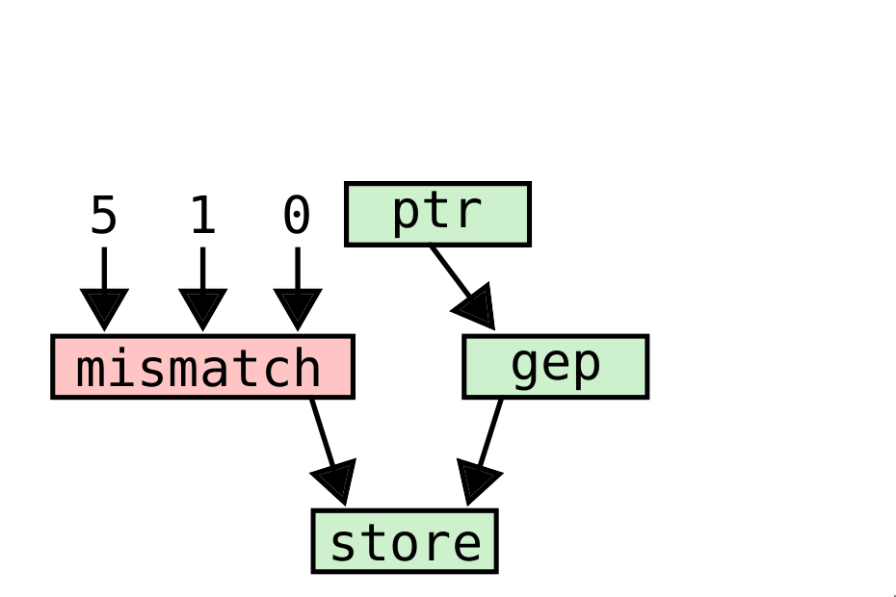
RoLAG: Graph Alignment
Recursively build from the SSA graphs of the seed instructions
Add operands of instructions in a node as a new node in the alignment graph
Analyze node for matching versus mismatching
Naive: instruction equivalence (same opcode, same types)

Slide 15
RoLAG: Graph Alignment
Recursively build from the SSA graphs of the seed instructions
Add operands of instructions in a node as a new node in the alignment graph
Analyze node for matching versus mismatching
Naive: instruction equivalence (same opcode, same types)

Slide 16
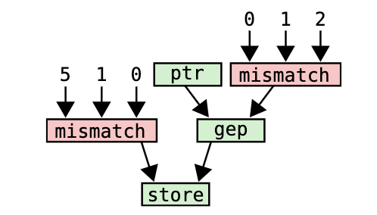
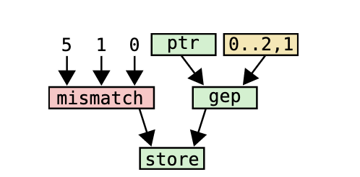
RoLAG: Monotonic Integer Sequences
Improve matched node count by creating special nodes for specific code structures
For example, look for arithmetic pattern in instruction arguments to get BIV for rolled loop

Slide 17
RoLAG: Neutral Pointer Optimization
getelementptr (gep) instruction in LLVM offsets the input pointer returning another pointer
We can further align code by noting that gep with offset 0 returns original pointer
Can be used to fix incorrect instruction mismatches
May be generalized to other types of operations
store i32 5, ptr %ptr
%1 = getelementptr i32, ptr %ptr, i64 1
store i32 1, ptr %1
%2 = getelementptr i32, ptr %ptr, i64 2
store i32 0, ptr %2
%1 = getelementptr i32, ptr %ptr, i64 0
store i32 5, ptr %1
%1 = getelementptr i32, ptr %ptr, i64 1
store i32 1, ptr %1
%2 = getelementptr i32, ptr %ptr, i64 2
store i32 0, ptr %2
*ptr = 5;
*(ptr + 1) = 5;
*(ptr + 2) = 0;

Slide 18
RoLAG: Reduction Trees
Reduction Trees
Can rearrange reduction trees for rolling (must be careful for floating-points)
If inputs for operands of reduction tree follow a pattern, can make reduction tree stick like to permit rolling with an accumulator
c = a1;
c += a2;
c += a3;
c += a4;
t1 = a1 + a2;
t2 = a3 + a4;
c = t1 + t2;

Slide 19
RoLAG: Other Special Code Patterns
Chained dependencies
SSA graphs can be chained together by instruction (e.g call)
Can exploit this to make better alignment graph using phi node in loop
Alternating Code Pattern
Combines alignment graphs of different seed groups when the seed groups alternate
Example is an alternating function-store-function-store pattern
r1 = func(r0);
r2 = func(r1);
r3 = func(r2);
a0 = func(r0);
*(ptr + 0) = a0;
a1 = func(r1);
*(ptr + 1) = a1;
a2 = func(r2);
*(ptr + 1) = a2;

Slide 20
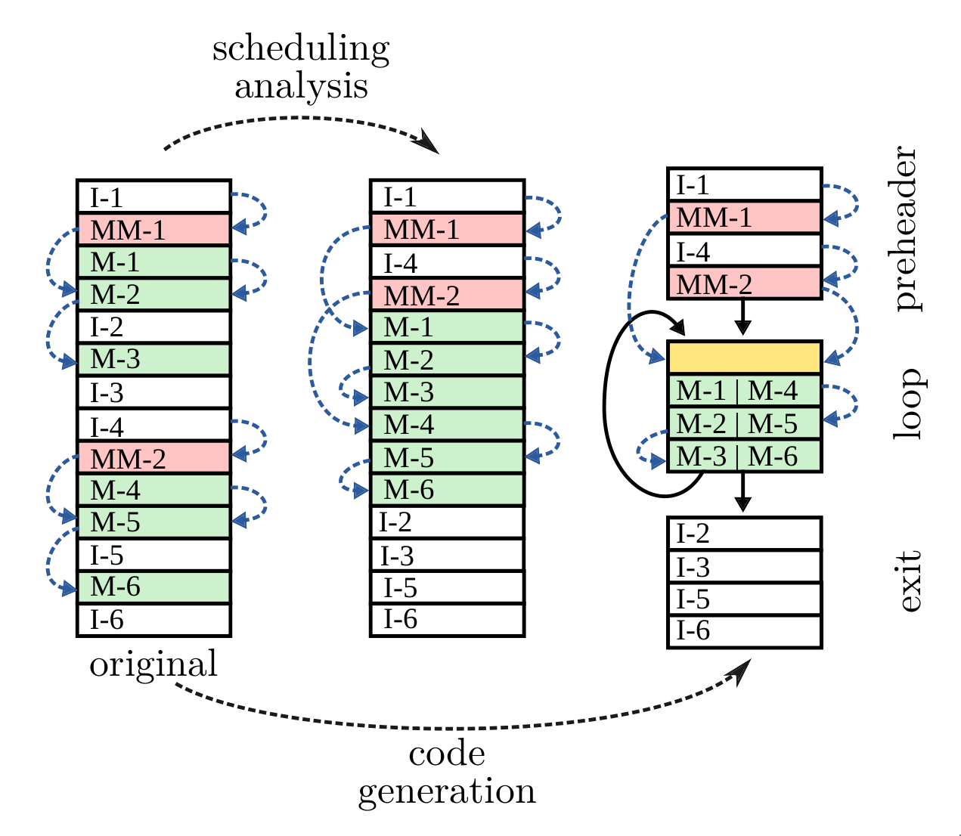
RoLAG: Scheduling Analysis
Determines if the generated loop will result in same computation as original code
Rearrangement limited by various constraints
Loop structure (preheader, loop body, exit)
Side-effects (memory accesses) and value dependencies
Available definitions

Slide 21
RoLAG: Code Generation
Rewrites basic block into the final rolled loop
Preheader
Standard preheader
Code to handle mismatched nodes
Mismatched constant values are stored as an array
Rolled Loop Block
Post-order traversal of alignment graph
Matched nodes copied directly or handled specially as previous
Mismatched nodes use code from preheader
Exit block
Standard loop exit
External value usage fixup

Slide 22
RoLAG: Profitability Analysis
Cost of fixing code when loop rolling can increase code sizes in some cases (i.e. handling mismatching nodes)
Estimated code size of rolled loop compared to code size straight-line code before committing
In paper, LLVM cost model used for estimating size of IR instructions

Slide 23
RoLAG: Evaluation
How effective is RoLAG?
Triggers far more often than LLVM loop re-rolling
Benchmarks:
AnghaBench: functions from real-world code
MiBench/SPEC’17: full programs
TSVC: partially unrolled loops

Slide 24
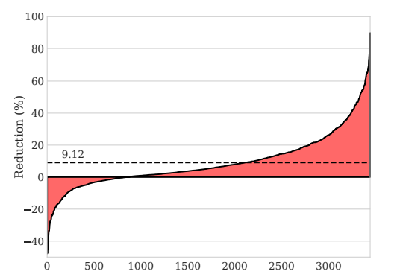
AnghaBench Benchmark Results
Contains 1,000,000 functions from the most popular GitHub repositories
Loop unrolling disabled
LLVM: rerolling affects <50 functions
RoLAG: rerolling affects ~3500 functions
Of the affected functions, 9.12% smaller object file size, on average.

Slide 25
AnghaBench Benchmark False Positives
Code sometimes becomes bigger due to false positives from profitability analysis
Rolling straight-line code into loops can prevent future optimizations
Cost model estimates sizes of individual instructions at IR level and doesn’t instruction scheduling, register allocation, etc.

Slide 26
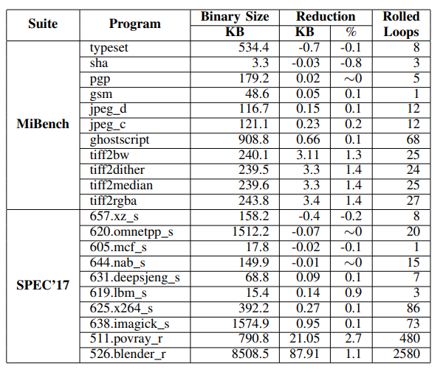
MiBench/SPEC’17
Contains full programs
Loop unrolling disabled
LLVM: loop rerolling never triggers
RoLAG: 2.7% code reduction in the most successful case

Slide 27
TSVC Suite Results
Inner loops unrolled by a factor of 8
LLVM: 13.69% reduction
RoLAG: 23.4% reduction

Slide 28
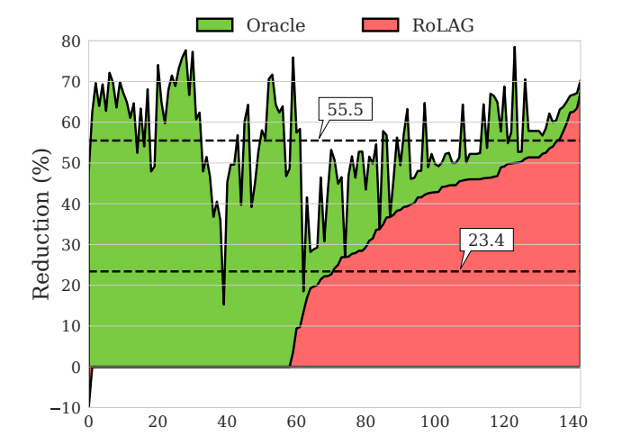
TSVC Suite Comparison with Oracle
Comparison with original source code prior to partial loop unrolling
Oracle: 55.5% reduction
Fails to reroll loops with multiple basic blocks

Slide 29
TSVC Suite Performance Overhead
Average slowdown of 0.8
Expected, since TSVC suite was designed to focus on instruction level parallelism, which benefits from loop unrolling
Ideally, use profiling to disable RoLAG on hot basic blocks

Slide 30
Conclusion
A weakness is the inability to detect alignment in structures larger than a basic block (that is to say, control flow is difficult to align)
Another is RoLAG increasing code size in certain cases
There have been attempts to address this by improving the cost heuristics
Ge et al. - RollBin: reducing code-size via loop rerolling at binary level
https://getianao.github.io/talks/lctes22rollbin-slides.pdf
RoLAG triggers far more often than LLVM loop rerolling, often significantly reducing code size

