Slide 1
Learning to Combine Instructions in LLVM Compiler
Group 11
11/20/2023

Slide 2
Contents
Introduction
Method
Experimental Evaluation
Conclusion

Slide 3
Contents
Introduction
Method
Experimental Evaluation
Conclusion

Slide 4
Intro - Motivation
Instruction Combining pass: a basic compiler optimization pass present in all compilers.
Does local instruction level optimizations on basic blocks (BB)
operates on the Intermediate Representation (IR) and replaces instructions with an optimized and semantically equivalent instruction sequence.
However, IC pass spans thousands of lines can be hard to debug/maintain/enhance.
It’s an ideal target for improvement with ML, but there exists challenges.

Slide 5
Background
Divide by 2
Transformation in IC pass: first, scan the instructions. If matched pattern is found, a sequence of instructions with the same pattern will replace the original instructions.
Cost is huge →a machine learnable IC pass → build a Neural Instruction Combiner (NIC) pass built on the LLVM compiler framework.
Right shift of 2

Slide 6
Contents
Introduction
Method
Experimental Evaluation
Conclusion

Slide 7
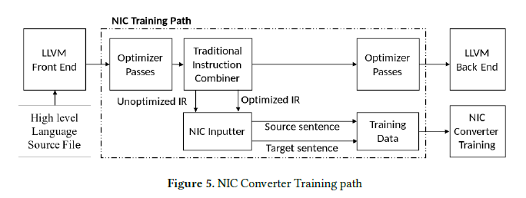
Training Pipeline

Slide 8
Whole Optimization Pipeline

Slide 9
Whole Optimization Pipeline
NIC Inputter
Simple information Extractor
NIC Converter
The ML model
NIC Outputter
Sanity Checker

Slide 10
Whole Optimization Pipeline
ML model optimized code
(maybe buggy)
Unoptimized IR code
(always right)
Single Instruction
Checker
NIC Outputter
ALIVE2
Valid
Invalid
Output

Slide 11
ML-Based Converter
Formulate converting into a Seq2Seq Model
Input is the encoded unoptimized instructions
Output is the optimized instruction
Notes:
I will provide a detailed introduction to the machine learning component, specifically focusing on the converter section. This converter is designed as a sequence-to-sequence model that takes a series of unoptimized instructions as input. The output is will be the optimized instructions. Several examples are shown here, with the input sequence on the right and the corresponding model output on the left.

Slide 12
Model Architecture
Encoder - decoder model
Backbone: LSTM or Transformer
Notes:
This setting is similar to the generating problems in the natural language processing, where a widely utilized architecture for dealing this problem is the Encoder-Decoder model. The authors also utilize this architecture. An LSTM based model is shown in the Figure here. From high level, the input sequence's information is first encoded into embeddings using the encoder, while the decoder will try to use these embeddings to generate the optimized instructions.

Slide 13
Model Architecture
Assembly Language Tokenizer
Distilled representation
Opcode and Type
Add attribute like, CONST
Rename source instruction
Word embedding trained together with the model
Attention block for conditional instruction generation
A matrix guide how each input token contribute to generation
Notes:
Coming to the detail structure , there are two key aspects to highlight. The first is the tokenizer, as the input varies a lot from natural language, it is assembly language. The authors have first encoded the input sequence into a distilled representation. This process involves cleaning the data by removing elements other than the opcodes and their types, adding attributes to constant values, and simplifying the source opcode names. This process reduces noise and enhances the model's ability to learn optimization rules. This also simplifies the word library, easing the task's complexity. Tokenization is straightforward, involving separation by spaces. The tokens are then mapped to word embeddings by an embedding layer, which is trained alongside the model.
Another significant aspect is the attention mechanism used for conditional generation. This is a learned component that determines how each input embedding contributes to the generation of a specific token. This mechanism is further refined by an attention loss, which will be introduced later.

Slide 14
Optimization Targets and detail
Supervision pairs are generated by traditional IC phase at BB level.
Direct Cross Entropy Loss
Compiler Attention Mismatch (CAM) Loss
Generate compiler-guided attention matrix (CA)
1 if target token 'i' is mapped to the source token 'j' by the compiler.
Smoothing by a coefficient
Notes:
The model is trained in a supervised manner, using supervision pairs generated by a traditional IC phase, based on rules at the Basic Block level. Then the original instructions are fed into the model, and the generated instructions are compared with those obtained in the IC phase. This comparison is based on a simple cross-entropy loss, aiming to match each generated token with the ground truth. Additionally, the model employs a 'Compiler Attention Mismatch Loss.' This involves comparing the attention matrix 'A' between the generated and original tokens with a compiler-generated matrix 'CA.' The compiler can give which source instruction tokens correspond to optimized target instruction tokens, informing each element of the 'CA' matrix. Thus we can generate a binary matrix, where it will be 1 if target token is mapped to the source token , or it will be zero. This matrix is further smoothed by adding a small correlation coefficient.

Slide 15
Contents
Introduction
Method
Experimental Evaluation
Conclusion

Slide 16
Dataset
The dataset consists of sentence pairs
Source sentence - Target sentence
Dataset is generated by invoking the LLVM compiler pipeline on the C/C++ application source files
LLVM Application Test / Angha Bench Test Suite
The final dataset contains 367𝐾 basic blocks instruction sequences
66% unoptimized sequences
34% optimized sequences

Slide 17
Results
Train/validation/test data split of 90%, 5% and 5%
BLEU and Rouge
Standard machine translation evaluation metrics
Exact Match (EM)
the proportion of BBs in which the predicted sequence exactly matches the ground truth

Slide 18
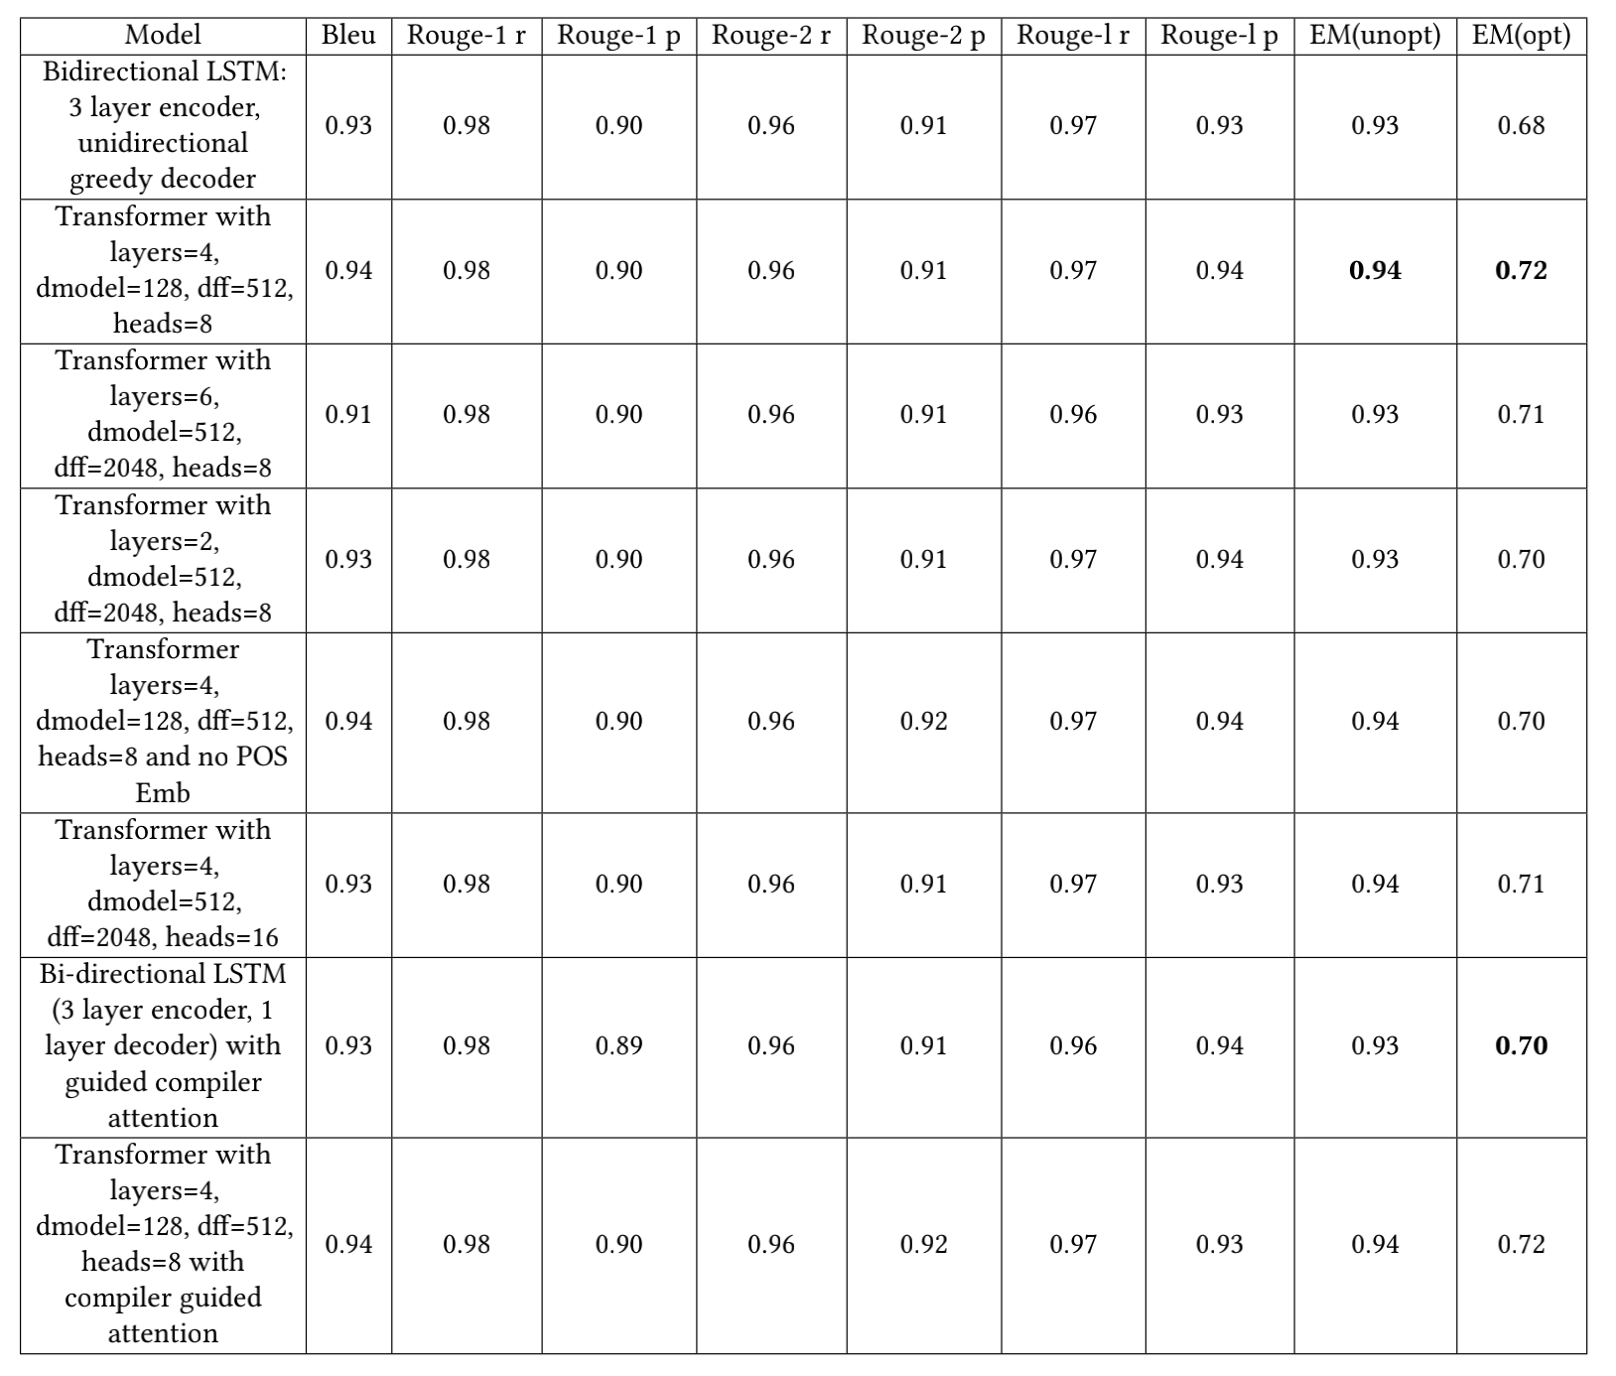
Results

Slide 19
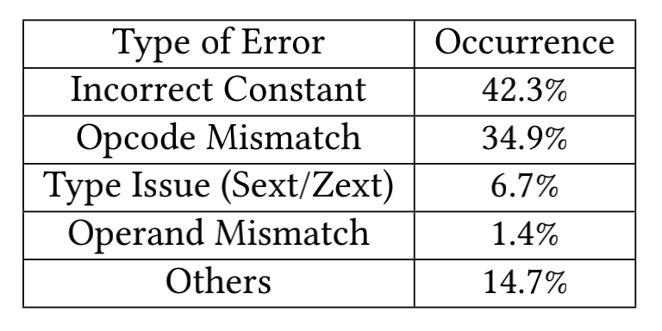
Analysis
Generating correct values for synthesized constants
GetElementPtr
Alloca

Slide 20
Contents
Introduction
Method
Experimental Evaluation
Conclusion

Slide 21
Conclusion
Explored feasibility of replacing traditional Instruction Combiner with a neural instruction combiner
Successfully trained a neural instruction combiner module and integrated it with LLVM compiler’s optimizer pipeline
Realized 72% of optimization opportunities with the Neural Instruction Combiner (NIC)

Slide 22
Thanks for listening
Q & A

