Slide 1
LRPD Test: Speculative Run-Time
Parallelization of Loops with Privatization
and Reduction Parallelization
Written by: Lawrence Rauchwerger and David A. Padua
Presented by: Pranav Bhoopala, Ruoyi Zhan, Yuhao Zhou
Group 23

Slide 2
Agenda
Background Information
Our motivation for researching about loop parallelization
More background knowledge
LRPD Overview
Two Phases of LRPD Test
Marking Phase
Analysis Phase
Results
Group Commentary

Slide 3
Why parallelize?
A single task such as a DO loop can run over multiple processors (threads) with a potentially significant execution speedup
In particular, LRPD provides a way for us to speculatively parallelize a loop with generally higher accuracy than older strategies
More sophisticated analysis techniques
Notes:
Using an inspector to identify potential parallel regions in a loop, and then an executor to generate parallel code for those regions.
Inspector/executor methods are less accurate and less efficient than LRPD, but they have the advantage of being simpler to implement
Loops with array privatization: LRPD can identify and exploit parallelism in loops that privatize arrays. This is because LRPD can keep track of the state of each array element, and it can use this information to generate parallel code that does not violate data dependences.
Loops with reduction parallelization: LRPD can identify and exploit parallelism in loops that perform reductions. This is because LRPD can keep track of the state of the reduction variables, and it can use this information to generate parallel code that does not violate data dependences.

Slide 4
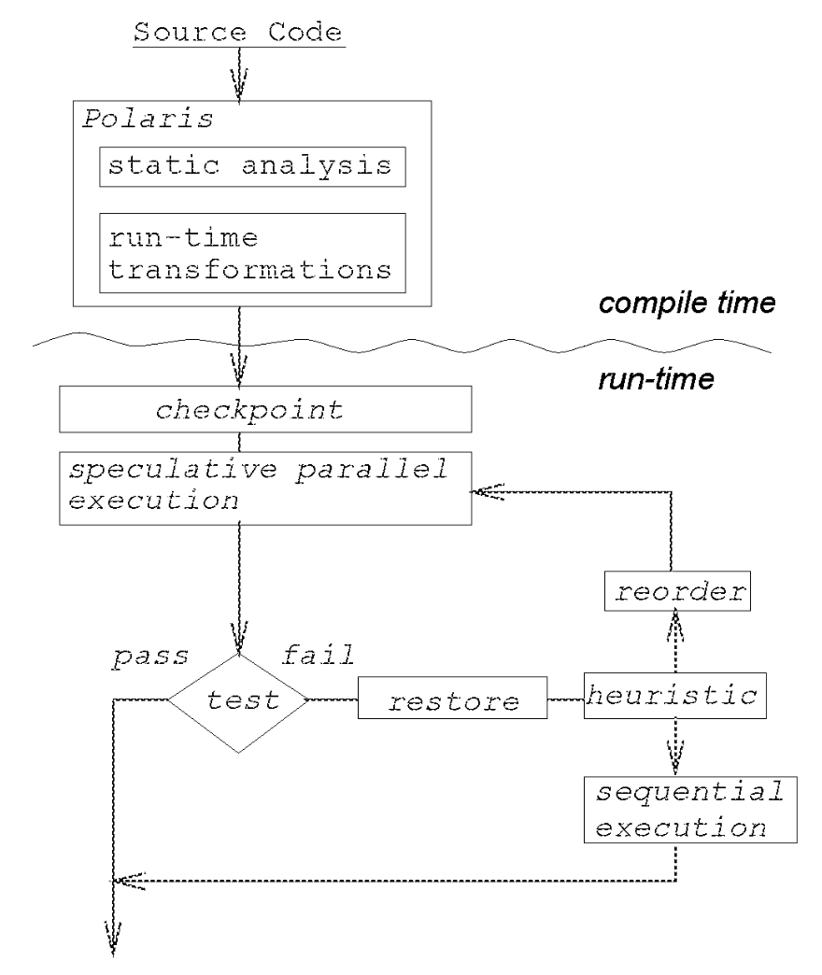
Background Knowledge
What is a Doall loop?
Each iteration of the loop is independent of others
How and where should we use the LRPD test?
For loop parallelization, we speculatively parallel execute the loop as a doall loop and apply the test to check for if there were any cross-iteration dependencies

Slide 5
LRPD Overview
Lazy Reduction and Privatization Doall test
Speculative run-time parallelism algorithm
Speculatively detect and privatize array elements and perform reduction parallelism, parallelizing loop to a doall loop
Extended from the Lazy Privatizing Doall (LPD) test to handle reduction parallelism as well

Slide 6
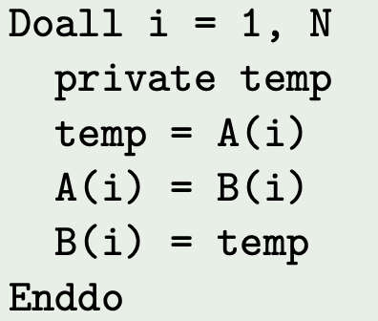
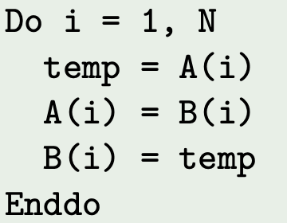
LRPD Overview
Privatization: create private copies of the program variables that give rise to anti or output dependencies

Slide 7
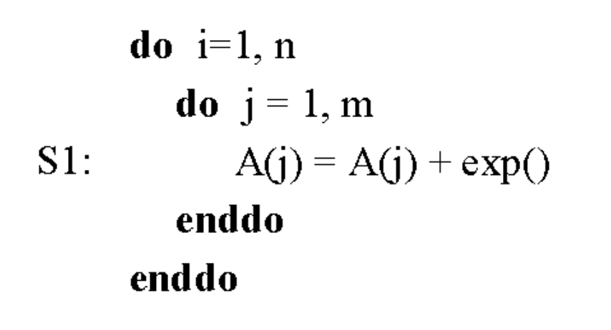
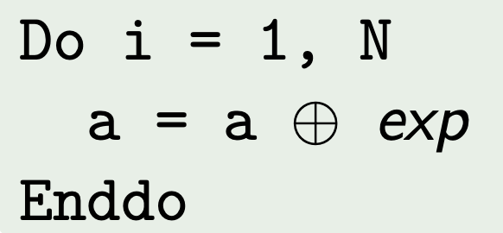
LRPD Overview
Reduction: variable whose value is used in one associative operation in the form x = x ⊗ exp, where ⊗ is the associative operator and x does not occur in exp or anywhere else in the loop

Slide 8
LRPD Overview
Speculatively parallelizes loop taking into account of privatization variables and reduction variables
LRPD provides a novel method for reduction recognition
Essentially detects if the values stored in an array participate in a reduction operation by marking/instrumenting the source program
Completed in two steps: marking and analysis phases

Slide 9
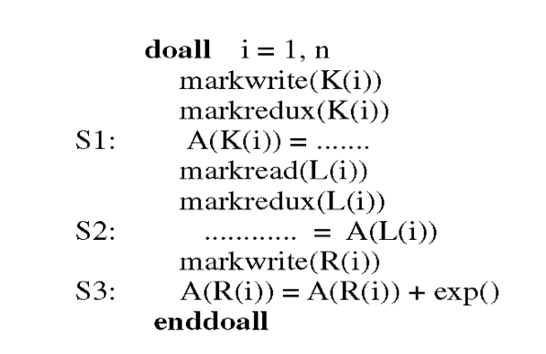
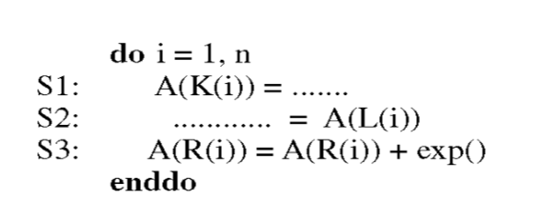
Marking phase
Performed during the speculative parallel execution of the loop.
Ar[1 : s], Aw[1 : s] : read and write shadow arrays.
Anp[1 : s] : shadow array used to flag array elements that cannot be validly privatized.
Anx[1 : s] : shadow array used to mark the element that is not one of the two known references to the reduction variable.

Slide 10
Analysis phase - test using shadow arrays
bool test(Ar[1:s], Aw[1:s], Anp[1:s], Anx[1:s])
if any (Ar[:] AND Aw[:]) == True
return False
else if num(distinct write) == num(write)
return True
else if any (Aw[:] AND Anp[:] AND Anx[:]) == True
return False
else
return True
Indicate flow/anti dependence!
all distinct write => no output dependence!
no output / flow / anti => no data dependence!
Non-privatisable
In “reduction”: A[L[i]] = A[L[i]] + exp
LHS accessed somewhere else, or
exp accesses A
=> not a valid reduction!
Notes:
In LPD, for each use, mark reading shadow arrays elements when upon the current iteration, the element has not been written! Mark non-privatiable shadow array as 1
For each def of A element, mark writing shadows array element, and erase the value of that element in reading arrays. In this way, the pattern of marking Aw and Ar are able to detect cross-iter flow and anti dependency
After that, we further check the number of write to distinct A element and the total number of write to A. If these two number are equal, this means that no cross iter output dependence. Therefore no cross iter memory dependence for A. Therefore, we can directly return True doAll.
If there is cross iter output dependency. We need to make sure that the dependency does not
check the flow/anti

Slide 11
LRPD example
Marking:
idx | 1 | 2 | 3 | 4
Aw | 0 | 1 | 0 | 1
Ar | 1 | 0 | 1 | 0
Anp | 1 | 0 | 1 | 0
Anx | 1 | 1 | 1 | 0
Ar[i] ^ Aw[i] | 0 | 0 | 0 | 0
Aw[i] ^ Anp[i] ^ Anx[i] | 0 | 0 | 0 | 0
Do i = 1, N
z = A(K(i))
if B(i). EQ. 0
A(L(i)) = z + C(i)
A(R(i)) = A(R(i)) + 1
End if
End do
i | 1 | 2 | 3 | 4
B | 0 | 0 | 1 | 1
K | 1 | 3 | 3 | 1
L | 2 | 2 | 3 | 3
R | 4 | 4 | 4 | 4
Analysis:
All Ar[i] ^ Aw[i] == False
num(distinct write) != num(write) // multiple write in R
All Aw[i] ^ Anp[i] ^ Anx[i] == False
Else, return True!! Is a doAll loop!!
Notes:
In there case, the memory access pattern is totally data dependent
During the marking phase, we get a table of shadow arrays like this
After that, we pass these shadows into the test function
we perform a Anti/flow dependency check passed
second, repeated overwritten writing , go to next else if statement
privatisable and valid reduction
therefore it is a doall loop!

Slide 12
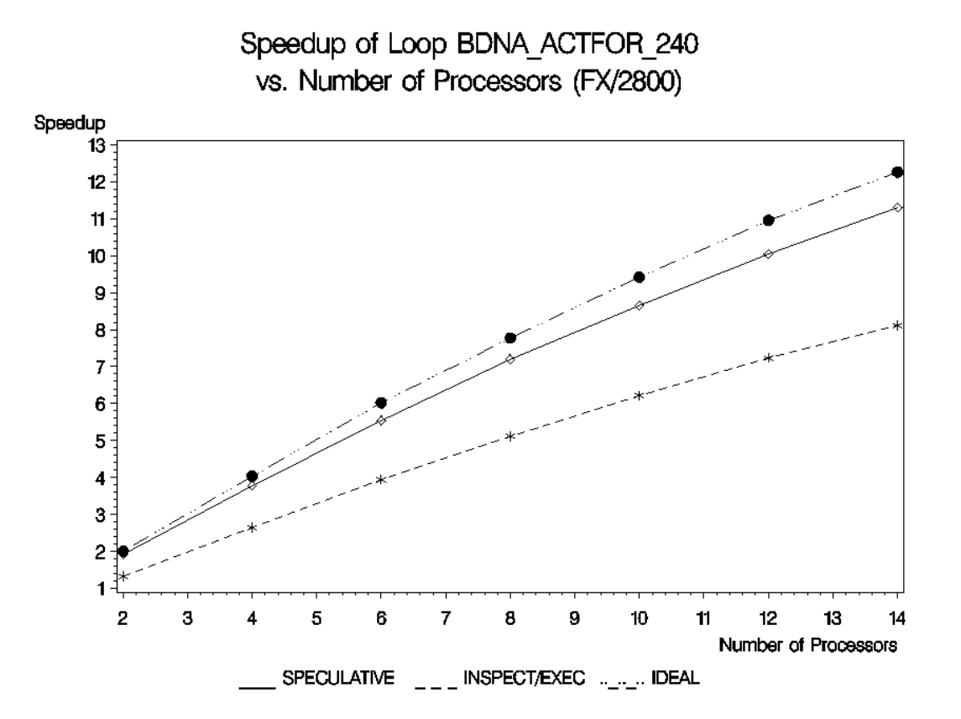
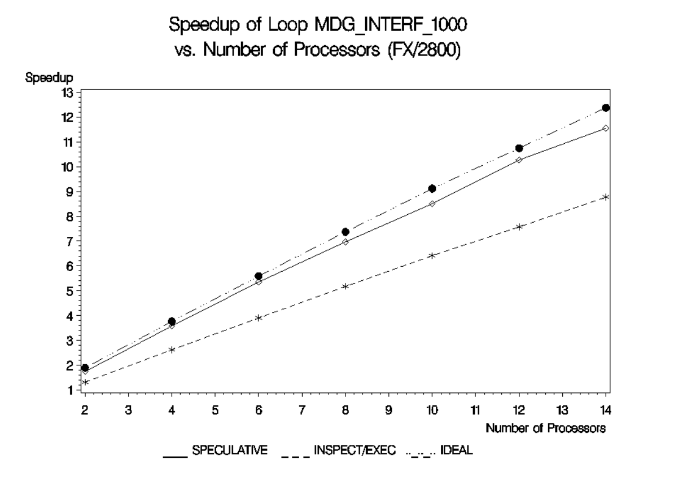
Results
Notes:
Left: accesses privatizable array index by a subscript array computed inside loop
Right: accesses to a privatizable vector guarded by loop computed predicates

Slide 13
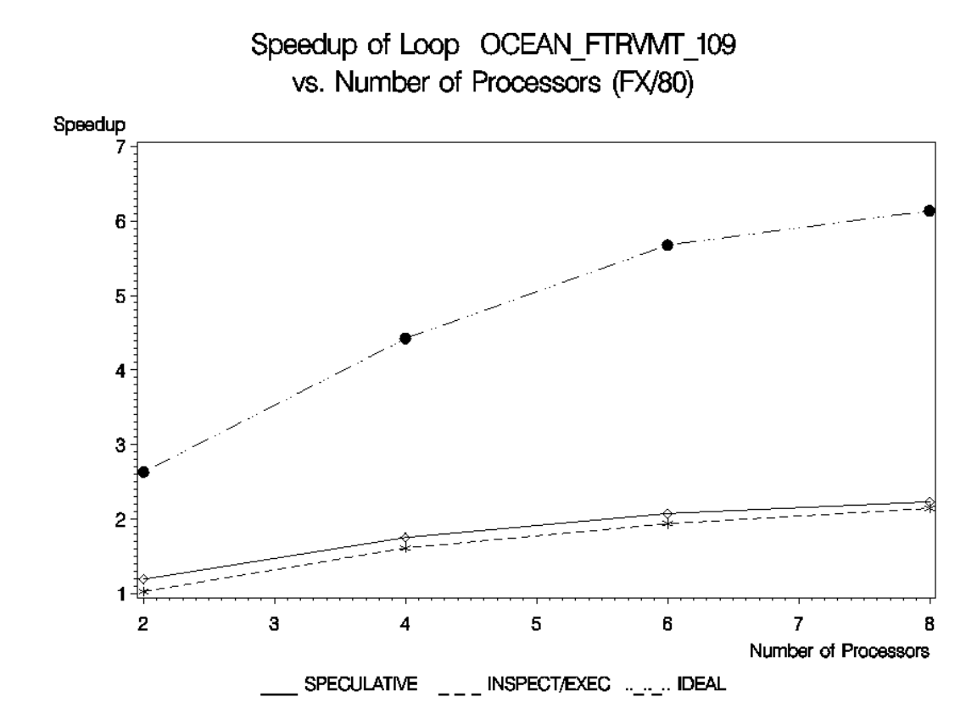
Results
Does not perform well on kernel-like accesses or loops with large overhead
Notes:
kernel-like loop accesses a vector with run-time determined strides

Slide 14
Group commentary
Increased speedup in loops with array privatization and reduction parallelization
Does not perform as in ‘ideal’ conditions when dealing with large overhead or kernel-like accesses
Increased overhead created in the analysis for better accuracy and performance of parallel loops compared to inspector/executor methods
For other types of applications that manipulate pointer-based data structures, may be too strict and will bring frequent roll backs

Slide 15
Resources
Rauchwerger, Lawrence, and David Padua. "The LRPD test: Speculative run-time parallelization of loops with privatization and reduction parallelization." Proceedings of the ACM SIGPLAN 1995 conference on Programming language design and implementation. 1995.
Kulkarni, Milind, et al. "Optimistic parallelism requires abstractions." Proceedings of the 28th ACM SIGPLAN Conference on Programming Language Design and Implementation. 2007
https://www.inf.ed.ac.uk/teaching/courses/copt/lecture-12.pdf
https://docs.oracle.com/cd/E19059-01/stud.9/817-6694/10_parallel.html

