Slide 1
Superblock Formation using Static Program Analysis
Group #14: Riya Agarwal, Meredith Benson, Christina Deng

Slide 2
Introduction
Profile data traditionally used for branch direction information
Time consuming
Not applicable in all environments
Dependent on input sets
Alternative : Static Program Analysis
Faster; feasible in all environments
100% coverage of all branches

Slide 3
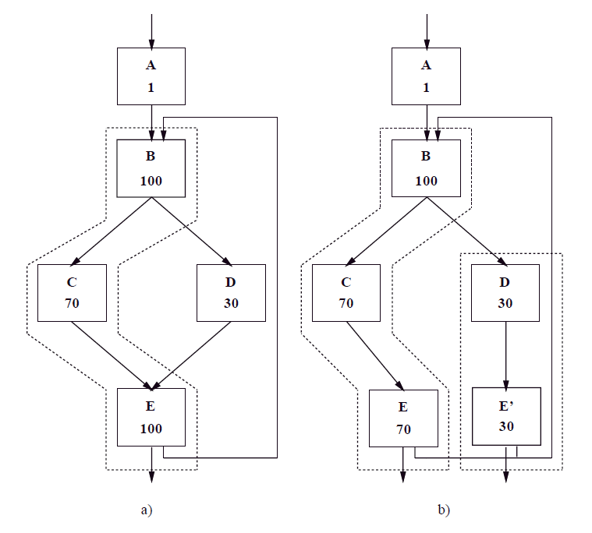
Motivation
Recap: Superblock formation
Step 1: Trace Selection
Step 2: Tail Duplication
Trace selection using profile information

Slide 4
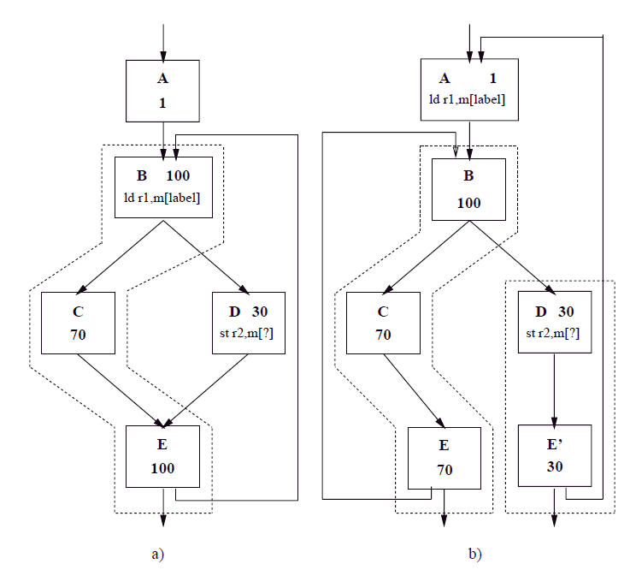
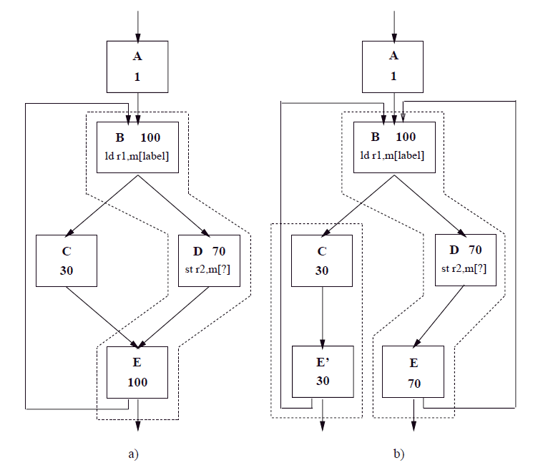
Motivation
Profile information selects hazard free path a) superblock formation, b) optimization
Profile information selects path with hazard a) superblock formation, b) optimization

Slide 5
Motivation
Accurate branch prediction doesn’t mean better optimization
Focus on alternative metrics
Static analysis tends to choose hazard-less paths
Paper compares the optimization benefits against profile information

Slide 6
Static Analysis Heuristics
The most likely direction of a conditional branch is predicted using static analysis heuristics
2 Types of Conditional Branches:
Loop Branches
Non-Loop Branches
Notes:
Click 1st time for Loop branch to appear
Click 2nd time for Non-loop branch to appear

Slide 7
Loop Branches
Loop branches → prediction does not significantly affect compiler optimization and scheduling
Loop back edge → likely taken
Loops usually iterate multiple times
Loop exit → unlikely taken

Slide 8
Non-Loop Branches
Non-Loop Branches → fundamental part of optimization and scheduling
Prediction used to form superblocks
Superblock optimization and scheduling are restricted when hazardous instructions are included in a superblock
Step 1: Select Branches to avoid hazards
Step 2: Use path selection heuristics

Slide 9
Hazard Avoidance
A hazard is an instruction or group of instructions whose side effects may not be completely determined at compile time
Six classes of hazardous instructions:
Act as a barrier → modify part of the program state, may not be predetermined at compile time
I/O instructions
subroutine class
synchronization instructions
ambiguous stores
Must be avoided → succeeding instructions may not be identified
subroutine returns
jumps with indirect target addresses
Notes:
Classes 1-4: mem access can’t be moved above or below a subroutine call without detailed interprocedural analysis.
If you don’t know the address of a store, you can’t do any optimizations with it
Classes 5-6: Jump with indirect address can go to any location whose label has been used as data, so it’s difficult to determine a likely target
Superblocks are terminated when this kind of a jump occurs

Slide 10
Path Selection
The Heuristics predict the direction of a conditional branch using the opcode of the branch, its operands, and/or the contents of the successor blocks
Pointer Heuristic → Highest Priority
Loop Heuristic
Opcode Heuristic
Guard Heuristic
Branch Direction Heuristic
Related Branches → Lowest Priority

Slide 11
Pointer Heuristic
If the branch contains one or more operands which are pointers:
A pointer is not likely to be NULL
Ex. if (ptr != NULL) → Taken
Ex. if (ptr == NULL) → Not Taken
Two pointers are not likely to be equal
Ex. if (ptr1 != ptr2) → Taken
Ex. if (ptr1 == ptr2) → Not Taken

Slide 12
Loop Heuristic
Branch is choosing to enter or avoid a loop
Enter the loop
Ex. For (int i = 0; i < 100; i++)
Guess that i < 100 most of the time → Enter loop
Ex. While (i != 123456789)
Guess that i != 123456789 most of the time

Slide 13
Opcode Heuristic
Negative numbers are unlikely
Ex. if (i < 0) → Not Taken
Floating point comparisons are unlikely to be equal
Ex. if (i == 3.14159) → Not Taken
Notes:
a < 0 is not taken because unlikely that a is a negative
Floating point not likely to be equal because so many decimal places

Slide 14
Guard Heuristic
This heuristic guards a use of one of its branches source operands
Detects exception conditions
Desired path is the one where the operand is used before being redefined
Ex.
If (i > 0) { → Taken
x = x / i;
}
Else { → Not Taken
x = x / 2;
}
Explanation:
(i > 0) guards the division of x from a non-positive number (i) to prevent exceptions
Because x is not a source operand from the branch, it’s not being guarded for exceptions
Notes:
Division of a number by 0 results in exceptions

Slide 15
Branch Direction Heuristic
Selects branch path based on the direction of the path taken
Backwards branches are taken
indicates there may be a loop
Forwards are not taken

Slide 16
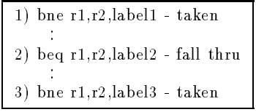
Related Branches
After all the other heuristics are applied, the predicted direction of each branch is made consistent with the predicted directions of any related branches
Branch has the same operands → Related
Made consistent with the strongest individual prediction
Notes:
Fig 5 & 6 and explain
3 → taken → r1 != r2
1 → r1 != r2

Slide 17
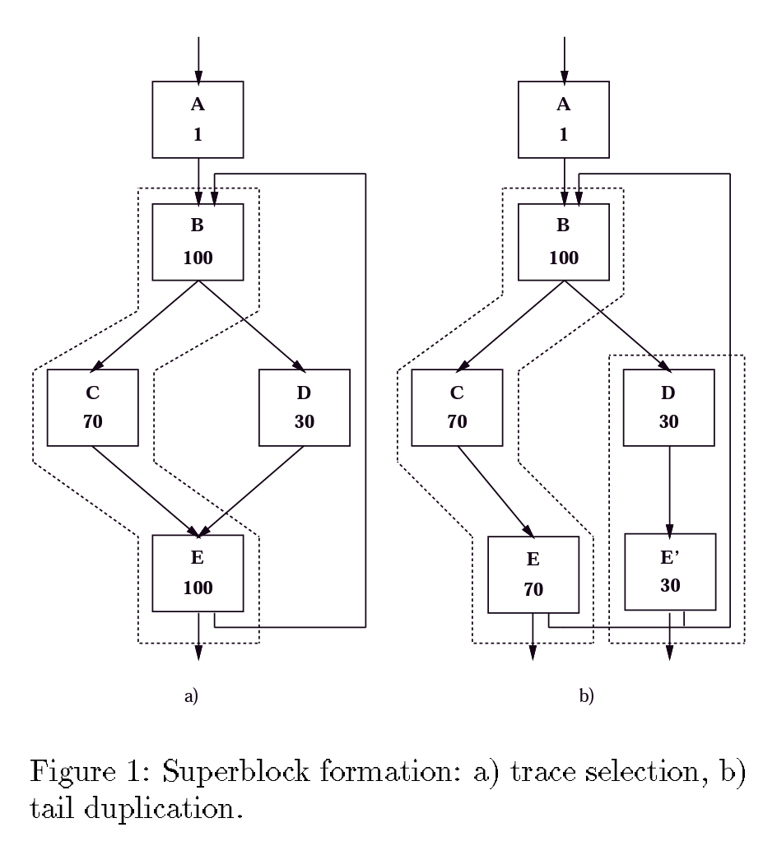
Superblock Formation
Can occur once all branch decisions have been made
Two steps:
Trace Formation
Tail Duplication
Tail duplication was done using IMPACT’s standard tail duplication algorithm

Slide 18
Trace Formation
Trace formation algorithm:
Perform loop detection
Sort loops from most to least nested
For each loop:
Create breadth-first list of BBs in loop
For each unvisited BB in list:
grow_trace(BB)
Create breadth-first list of function blocks
For each univisted BB in list:
grow_trace(BB)
likely
The grow_trace(BB) algorithm uses the static analysis heuristics to add the most desirable destination block of the branch to the trace

Slide 19
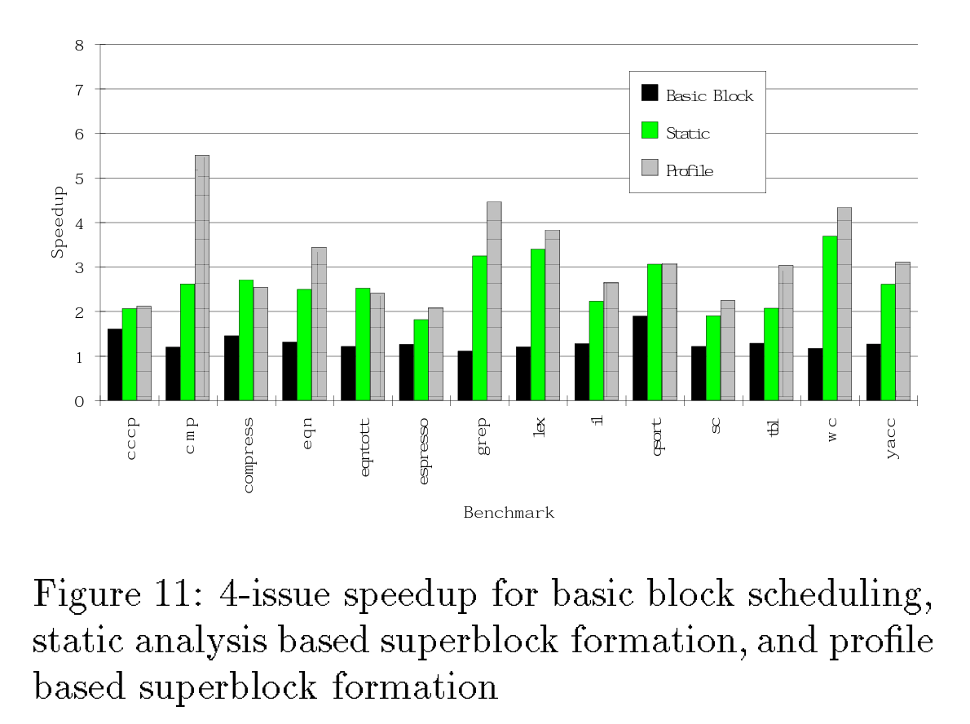
Results
The hazardless paths tend to be frequently executed
Superblock formation using static analysis compared to profile information was found to be comparable
Branch decisions agreed ~86% of the time
In certain cases, static analysis heuristics proved to be even more effective than profile info

Slide 20
Discussion
Strengths:
Addresses limitations of optimization using profile information
Achieves comparable performance
Weaknesses:
Lack of documentation on IMPACT compiler’s tail duplication algorithm
Inadequate details regarding implementation of heuristics
Heuristic performance strongly dependent on strongest individual heuristic performance
Suboptimal resource utilization

Slide 21
Questions?
Group #14: Superblock Formation using Static Program Analysis

