Slide 1
Manage OpenMP GPU Data Environment Under Unified Address Space
Lingda Li, Hal Finkel, Martin Kong, and Barbara Chapman
Presented by: Aakash Patel, Sawan Patel, Shreyas Chandrashekaran
[Group 17]
Li, Lingda, et al. "Manage openmp gpu data environment under unified address space." Evolving OpenMP for Evolving Architectures: 14th International Workshop on OpenMP, IWOMP 2018.
Notes:
GPU offloading to unified memory

Slide 2
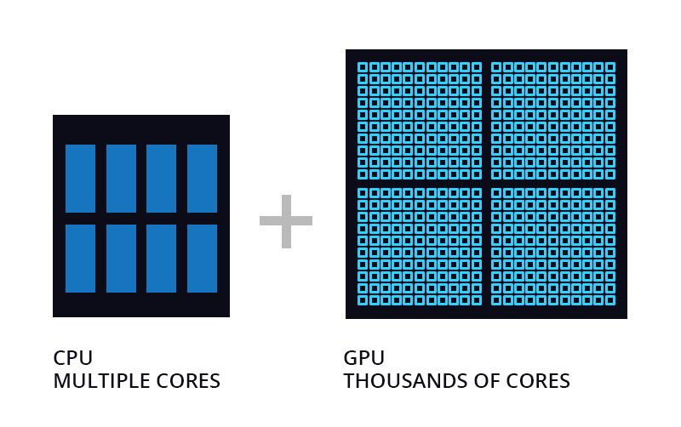
Introduction
Introduction of GPUs → speedup of parallelizable computations
CPUs and GPUs generally maintain separate memory
CPU: low latency
GPU: high bandwidth
Data exchange has to be done by programmers
Unified Memory: solves this by introducing a single memory space covering both CPU and GPU memory
Figure from “An investigation of Unified Memory Access performance in CUDA”

Slide 3
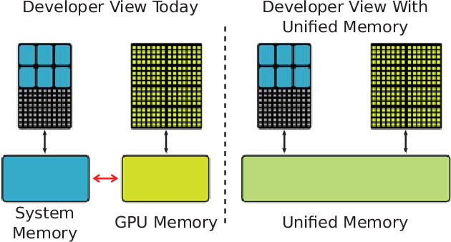
Unified Memory
Benefits of Unified Memory
Software moves data, not user
Can run kernels with larger memory footprint than GPU capacity
Downsides of Unified Memory
Page fault overhead: quite large w/ large volume of transfers
Significant thrashing occurs with larger-footprint working sets

Slide 4
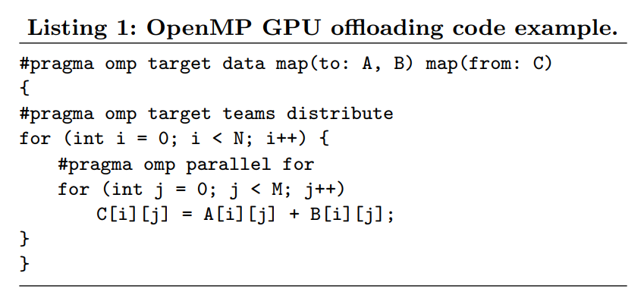
OpenMP
Portable, scalable API that supports shared-memory multiprocessing
Compiler Directives, Library Routines, Env Vars to influence runtime behavior
Notes:
In this code segment, the map clauses instruct OpenMP to copy the values of array A and B from the CPU to GPU at the start of the target data region with the keyword to. It also instructs to copy array C from GPU to CPU at the end of the target data region with the keyword from. Note that the keyword tofrom can be used to enforce data synchronizations both at the beginning and at the end of the data region (i.e., when copying-in and copying-out).
Mention that this is a target region: word target in the code

Slide 5
Summary of Contributions
Analyze Performance of Unified Memory
Seems to depend on data properties such as size, density, reuse situation
Standard unified memory struggles with certain specific configurations
Designed a compiler-runtime framework to optimize UM performance and implemented in Clang / LLVM OpenMP
Analyzes object properties (size, density, reuse) to determine optimization strategies

Slide 6
Static Analysis
Goal: Analyze properties of data objects in unified memory and apply optimization based on analysis
Data Allocation
GPU Usage
Data Access Frequency
Data Reuse
Notes:
Data allocation: object is allocated in unified memory space using CUDA or OpenMP APIs
GPU usage: object’s address used in GPU function (passed to OpenMP target function)

Slide 7
Static Analysis: Data Access Frequency
Calculate access frequency for every OpenMP target region that uses an object (local access frequency)
Use BlockFrequencyInfo to get execution frequency
Add frequencies of each memory instruction in a region to get LAF
Calculate global access frequency across entire program
Combine execution frequency and LAF of all GPU functions that use a unified memory object
Notes:
Data reuse: rank objects by access frequency

Slide 8
Runtime Analysis
Goal: Utilize runtime information, combined with compile-time information, to finalize data analysis results
Data Size
Access Density

Slide 9
Runtime Analysis: Data Size
The size of data objects depends on the input, naturally
In OpenMP offloading runtime interface, size of arguments passed in along with arguments themselves
Problem: Existing data size measured in bytes
Solution: Obtain number of elements by dividing total data size by type of object

Slide 10
Runtime Analysis: Access Density
Object density = (Actual # of elements accessed) / (Total element number)
Assumptions
Typically, small loop body and simple control flow for all target regions
**Uniform memory accesses across elements within the input objects
Compiler-runtime scheme
Runtime: Obtain total number of outer loop iterations
Compiler: Estimate number of accessed elements in single iteration
Local access frequency (LAF)
Example object and its accesses

Slide 11
Runtime Management
Runtime decides:
Where object should be mapped
How it should be transferred if on GPU
Optimization Strategies:
Small size, high density: explicit copy
Large size, high reuse: data pinning

Slide 12
Runtime Management: Data Mapping
Rank all unified memory objects based on reuse after data property collection
Select proper mapping strategy for each object in order
Better locality = higher GPU priority
If GPU is full:
Pin data to CPU memory

Slide 13
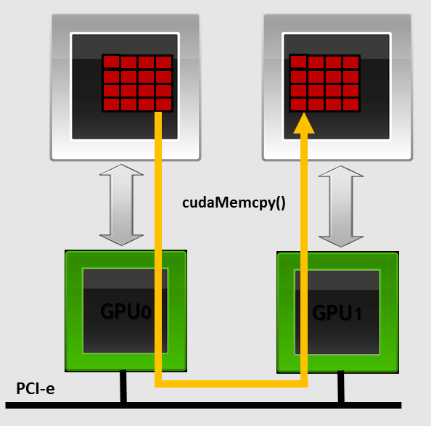
Runtime Management: Data Transfer
Small Density GPU objects (empirically determined threshold of <0.6): implicit transfer
Pass original object to GPU kernels, unified memory driver handles data transfer
All others: explicit transfer
GPU cudaMalloc and cudaMemcpy to create a copy
CPU
GPU

Slide 14
Runtime Management: More
Runtime uses two 64-bit counters for each GPU
Track size of objects transferred implicitly or explicitly to find available GPU memory
Runtime table keeps records of active GPU objects
Records size, reuse, mapping location, transfer mechanism
Overhead
Proposed runtime integrated into LLVM OpenMP target offloading runtime
Performance results include any runtime overhead

Slide 15
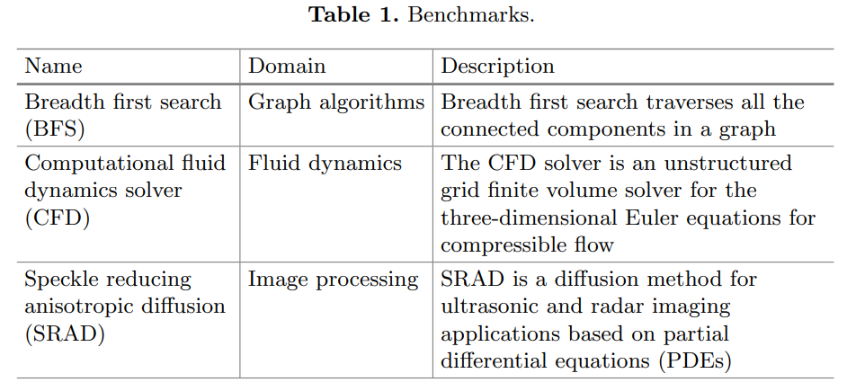
Memory Analysis: Setting
OpenMP offloading versions of BFS, CFD, and SRAD from Rodinia Suite
Notes:
Rodinia benchmark suite is standard benchmarking approach for multi-architecture computing

Slide 16
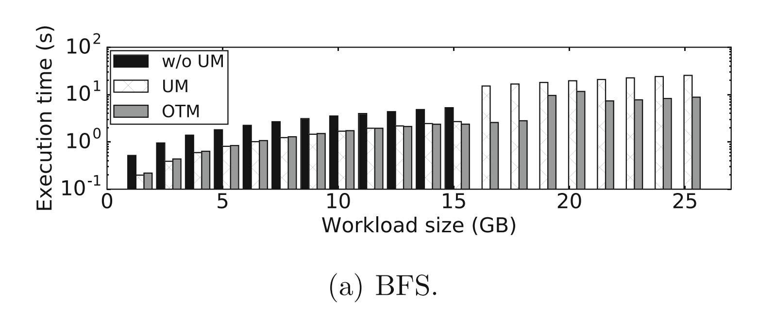
Evaluation
BFS
OTM outperforms w/o UM by 113% on average on fitting workloads
3.37x speedup compared to UM on oversubscribing workloads
Notes:
BFS
Large amount of data reuse since nodes can be accessed across multiple iterations
But this reuse is irregular and can’t be optimized in traditional ways
Whichever data structure stores the edges in the graph is pinned to CPU to avoid thrashing

Slide 17
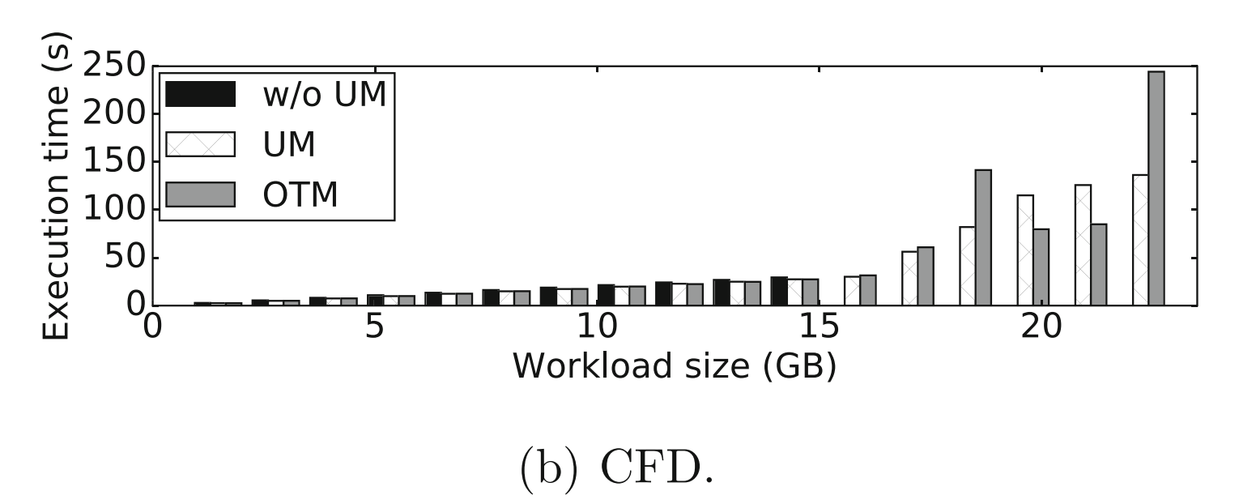
Evaluation
CFD
On average, OTM and UM have similar performance
OTM fails in comparison on some workloads because CFD has more complex data structures and control flow (e.g. interleaving target regions)
Notes:
CFD (Computational Fluid Dynamics Solver)
Much more complex control flow and interleaving target regions (kernels)
Under some workloads, OTM pins data objects in CPU memory which slows down all target regions
Maybe they mean data objects shared across regions?

Slide 18
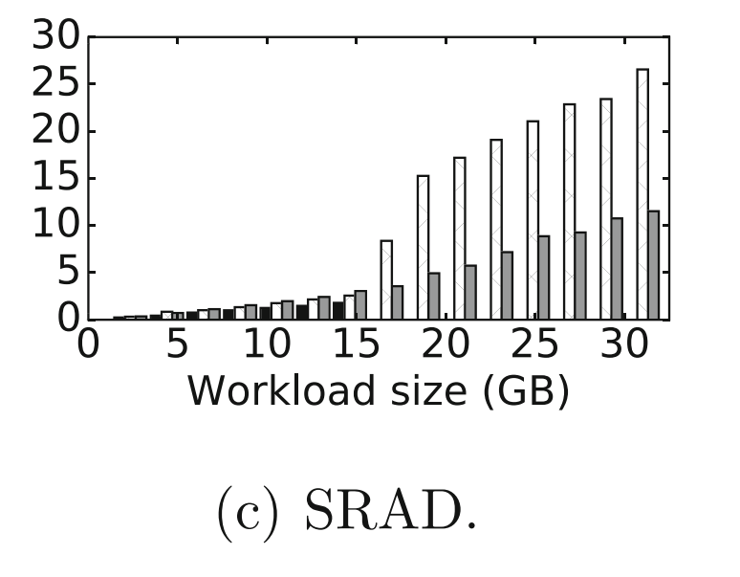
Evaluation
SRAD
OTM helps achieve 2.55x speedup across oversubscribing workloads compared to UM
On smaller workloads, OTM underperforms compared to traditional approach
Implicit transfer of highly reused data objects due to loop nesting
Notes:
SRAD (speckle reducing anisotropic diffusion)
Data reuse is moderate in SRAD compared to BFS so speedup is moderate

Slide 19
Conclusion
Main finding: unified memory performance is good with low density or low reuse, but suffers when:
Data size is small but access density is high (transfer bandwidth)
Solution: Explicit copy
Data size is high and data reuse is high (thrashing)
Solution: Data pinning

Slide 20
Discussion
Demonstrated tangible performance improvement for unified memory usage on standard benchmarks
Low overhead for compiler analysis
Only optimizations applied are explicit copy and data pinning
Some unexpected results in the CFD benchmark are not well-explained
How does this method compare to recent advances in GPU acceleration (e.g. HuggingFace Accelerate library)?
How does unified memory influence memory design choices? E.g. latency vs bandwidth on CPU/GPU
Notes:
Significance to improved UM performance - Apple M3 boasts 128GB unified memory, but it’s not useful if the performance isn’t any better than not using it

