Slide 1
GRANITE A Graph Neural Network Model for Basic Block Throughput Estimation
Zhenyan(Luke) Zhu
Arshdeep Singh
Zhan Shi
Yuxuan Xia

Slide 2
Content
Motivation (Luke 5-6min)
Technical Details (Yuxuan, Zhan, Arshdeep 6-8 min)
Results (Arshdeep 1-2min)
Comments (Luke) (1-2min)
Q&A (1-2min)
Compiler2.0: Towards automatic construction of compiler back-ends (Luke) (if we have time)

Slide 3
What is GRANITE
A learnt X86 basic block cost model
Given an X86 basic block, predict number of cycles for target processor to execute this basic block at steady state

Slide 4
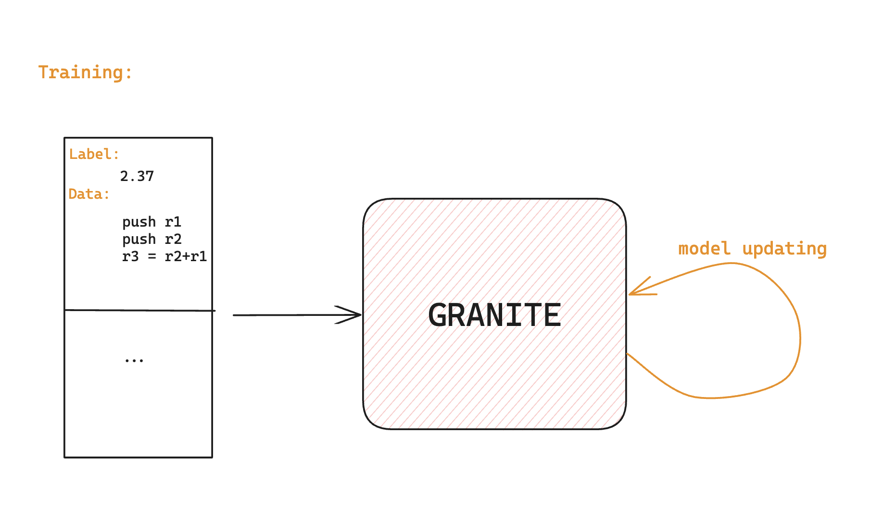
What is GRANITE

Slide 5
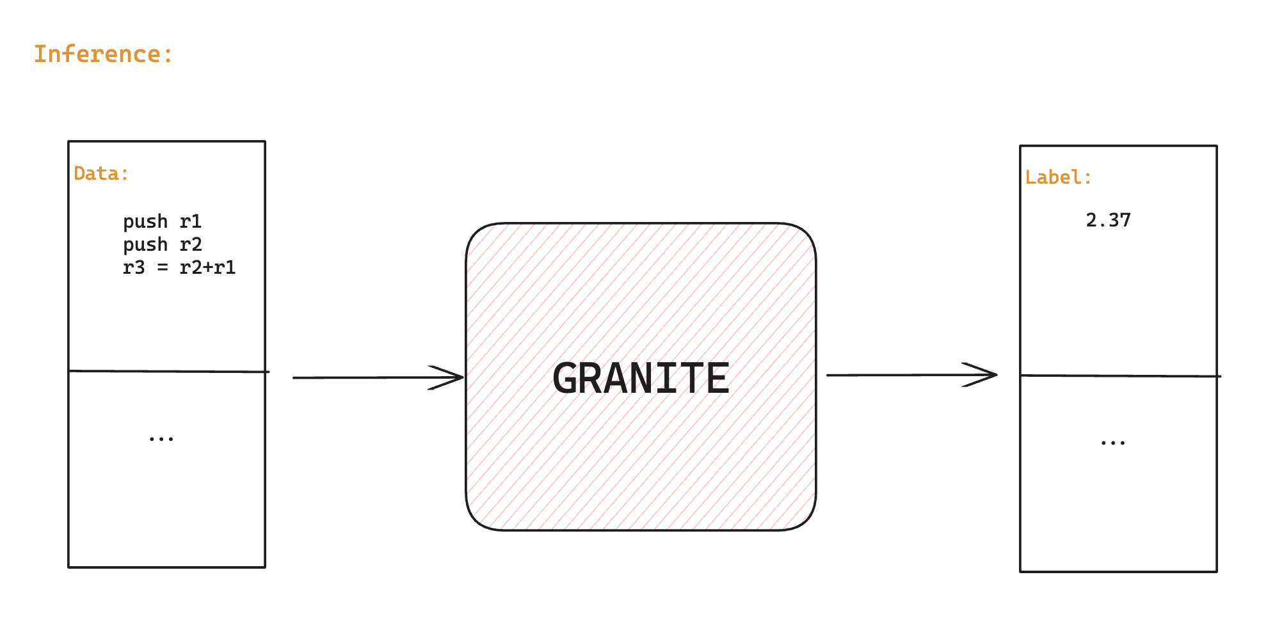
What is GRANITE

Slide 6
Why GRANITE?
Real hardware measurements are expensive and hard to collect
Cache miss/TLB miss/context switch are hard to avoid and influence measurement
Why it’s important for compiler optimization? (An important compiler problem that has not been solved in the past 50 years! Autotuning)

Slide 7
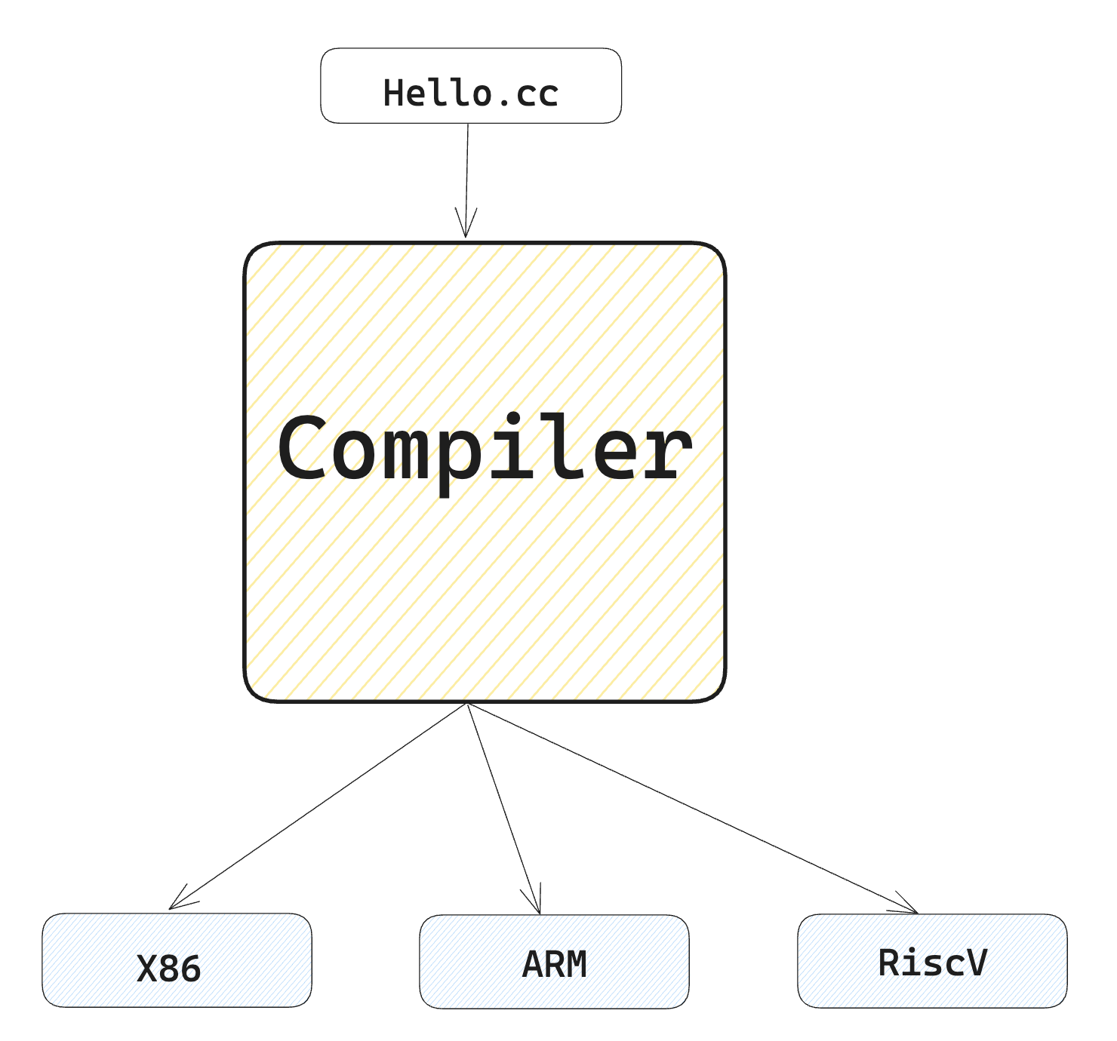
Compiler Big Picture

Slide 8
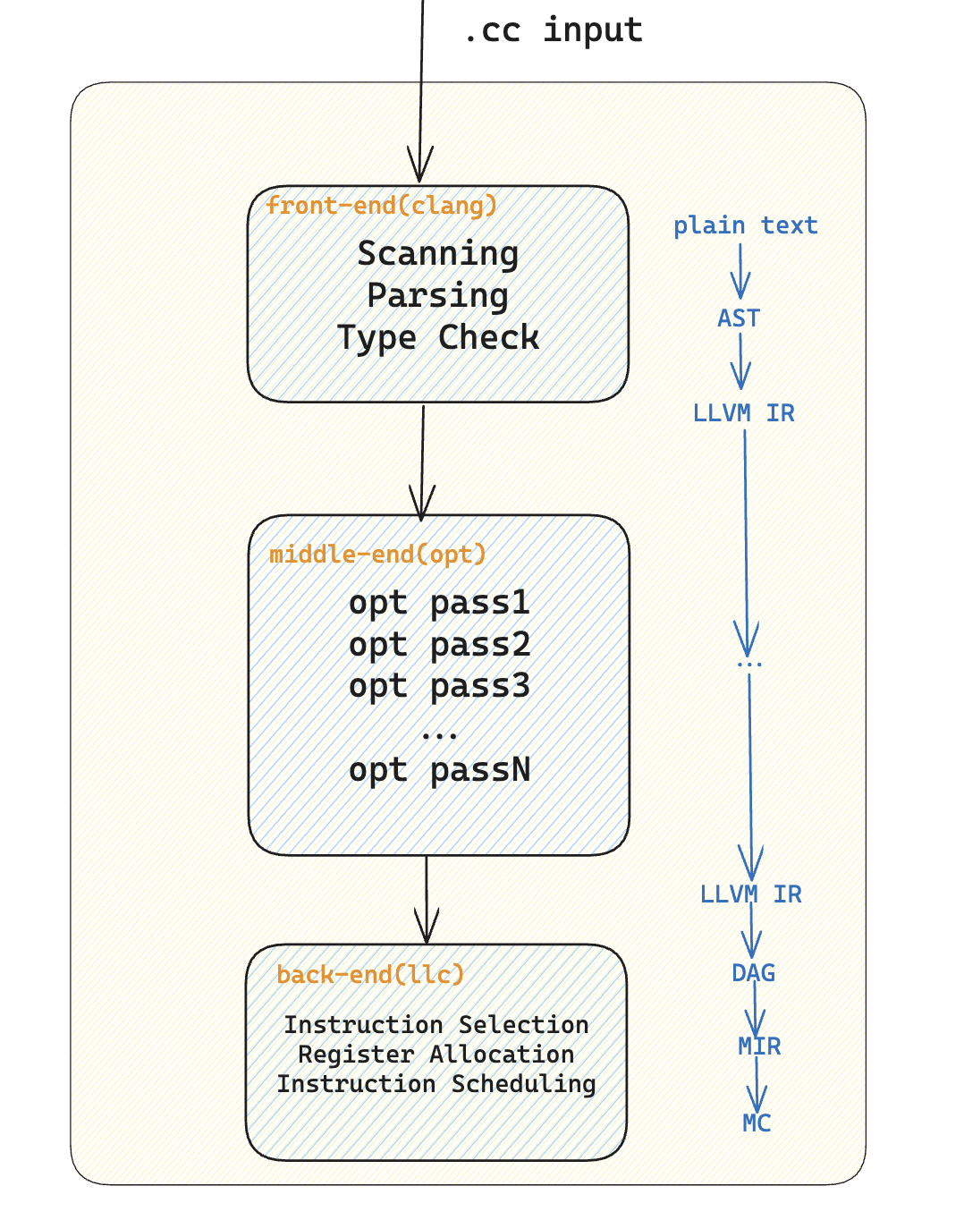
Compiler Big Picture

Slide 9
What’s best order of optimization pass?

Slide 10
Compiler Big Picture

Slide 11
What’s worse…
For each ordering, need to compile all the way to binary, run the code on hardware a lot of times
That’s why a cost model can help! Only need run one time, predicting cost in ideal state
Efficiently querying cost can help explore more search space in autotuning in N!+ space

Slide 12
Types of cost model
Analytical Model: llvm-mca, ICIA
Learnt Model: Ithemal, Granite

Slide 13
Technical Details
Represent Basic Block using Directed Graph
Learn structural/data dependency using Graph Neural Network

Slide 14
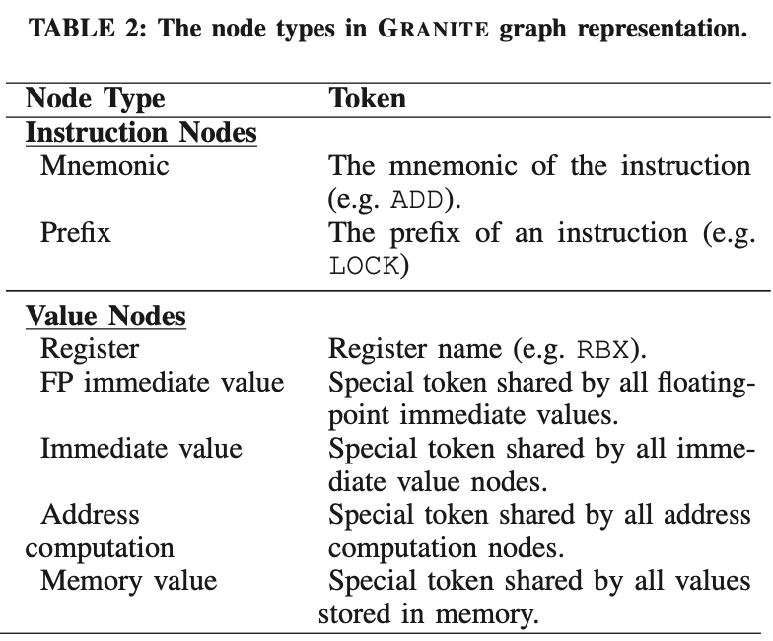
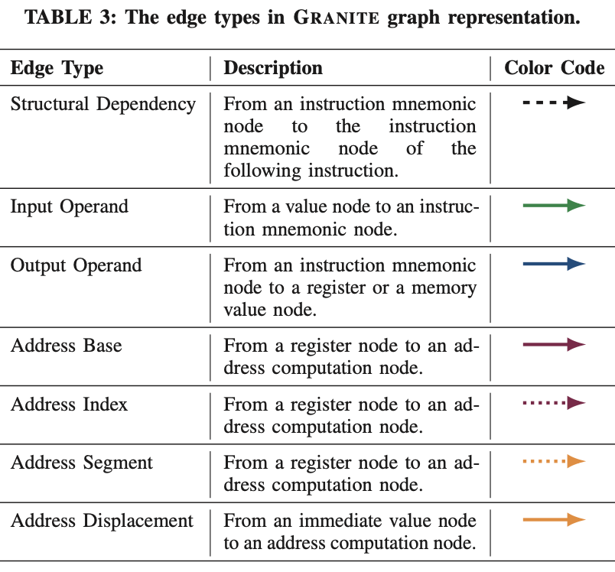
Graph builder
Idea: Break instructions down to operand level for finer representation
Each operand gets a node
Use edges to represent dependencies
For nodes, need to record exact token in addition to type

Slide 15
Graph representation example
MOV RAX, 12345
ADD DWORD PTR [RAX + 16], EBX
Immediate
Address
RAX
RAX
EBX
MOV
ADD
Immediate
Memory
Memory
EFLAGS

Slide 16
Graph Neural Network
Objective : To learn representative feature vectors for graph nodes and edges that in a latent space. Uses multi-layer feed forward ReLU network at nodes, edges and graph level. Learnable embedding vectors initialized as:
Node: n-dim vector corresponds to token associated with node.
Edge: n-dim vector corresponds to type of edge.
Graph: n-dim vector representing relative frequency of token and edges.
*n is a hyper-parameter

Slide 17
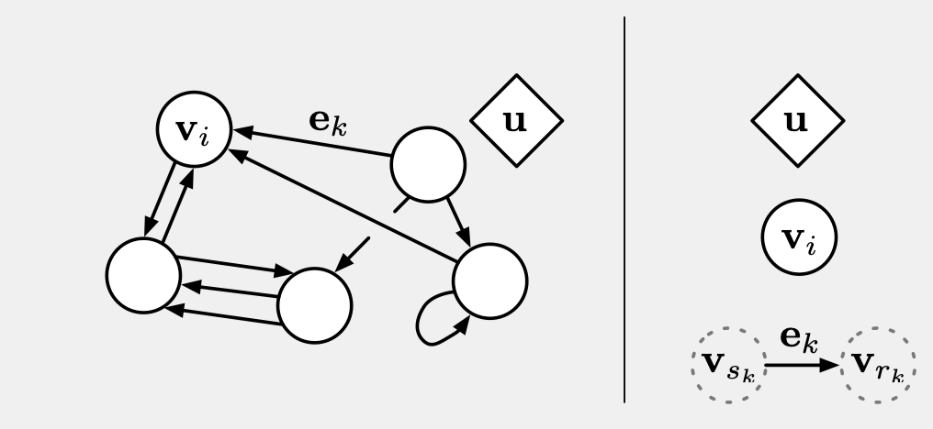
Graph Representation
In Detail:
1. Vertex set V = {v_i}, where i is the number of vertices
2. Edge set E = {(e_k, r_k, s_k)}, where k is the number of edges
e_k: properties of the edge
r_k: receiver node, the node where the edge points to
s_k: sender node, where the edge leave from
3. Global property: u
v_i, e_k and “u” are all called “attributes”: n/k-dim vectors

Slide 18
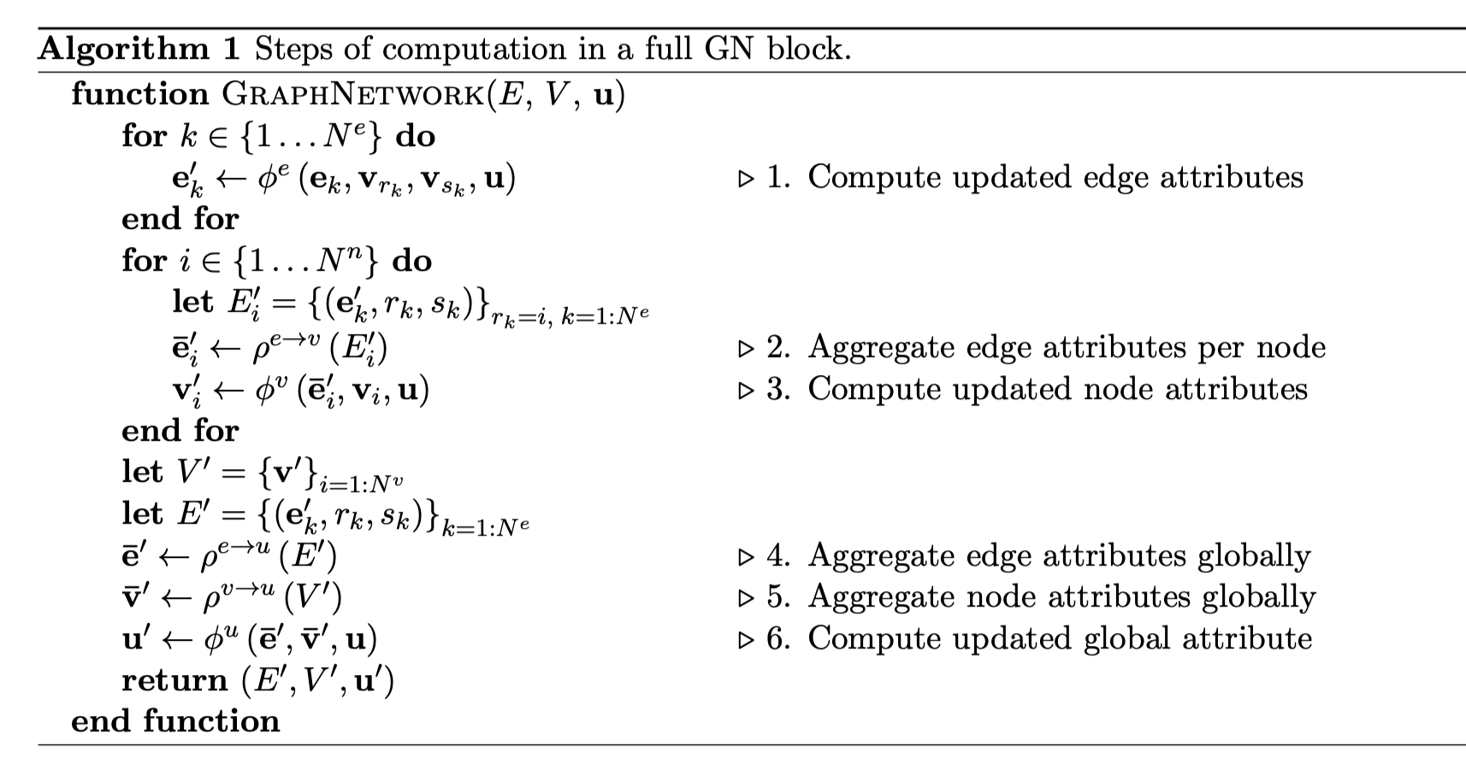
How our Neural network works

Slide 19
A Real life example
Consider a physical spring ball system:
1. Node attribute: Position, velocity and mass of the ball
2. Edge attribute: Spring constant, tension on springs
3. Global attribute: Gravitational potential energy of the whole system

Slide 20
Our Goal
Given old attributes of each node, vertex set and the global attribute
How to update new attribute?
Example:
Given the spring ball-system’s attribute at time frame t = 0.0 second
What is the new state at time t = 0.1
We will proceed with the following steps

Slide 21
Compute updated edge attribute
What does this mean:
1. We are given information of the edge and global attribute
Edge: sender, receiver and edge attribute itself
2. What would the value of edge at the next time frame be?
Example:
Given the tension between two balls and gravitational potential energy
What is the new value of tension?

Slide 22
Aggregate edge attributes per node
Aggregate: put the information together
Combine edges attributes with the same receiver node together
Example:
Given all updated tension for each spring linked to ball j
What is the net force on ball j

Slide 23
Aggregate node attributes globally
Do the same thing for updated node attribute
Example:
Given position of each ball, compute position of the whole system

Slide 24
Compute updated global attribute
Finally given the combined edge and node attributes
Change the value of the global property
Example:
given change of position of the system
How would the gravitational potential energy of the whole system changes?

Slide 25
Afterwards
Repeat this process
Goal: learn representation of the features that is important in classification
Next: Decoder…

Slide 27
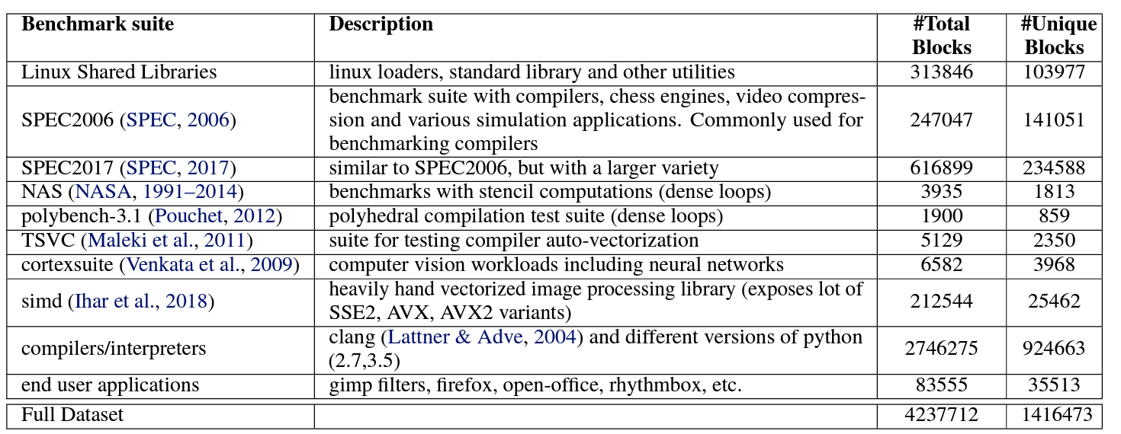
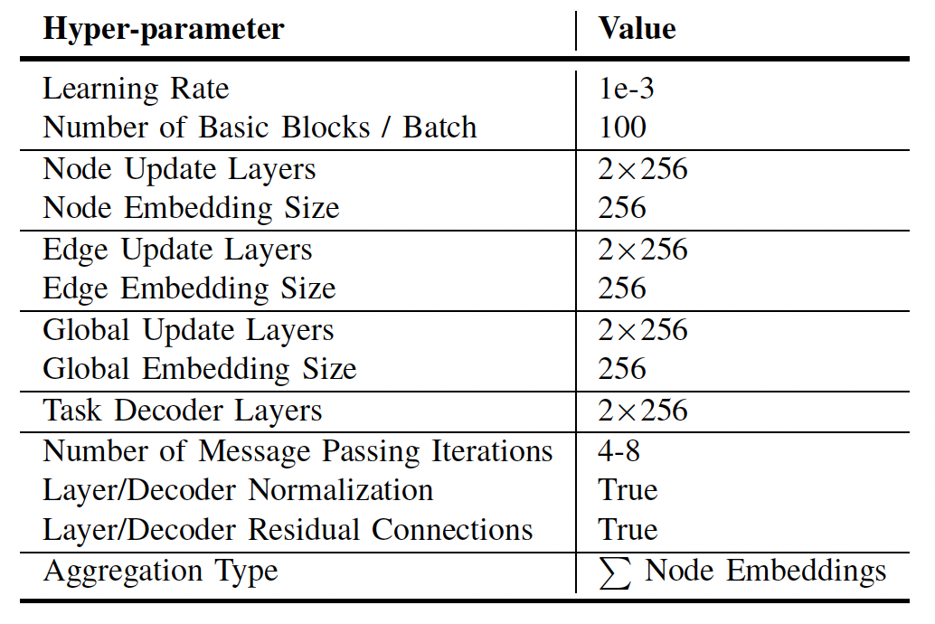
Methodology
Dataset: 1.4M BBs
Training & Validation: 83% BBs ( 98% & 2%)
Testing : 17% BBs
Loss Function: MAPE
Optimizer: Adam

Slide 28
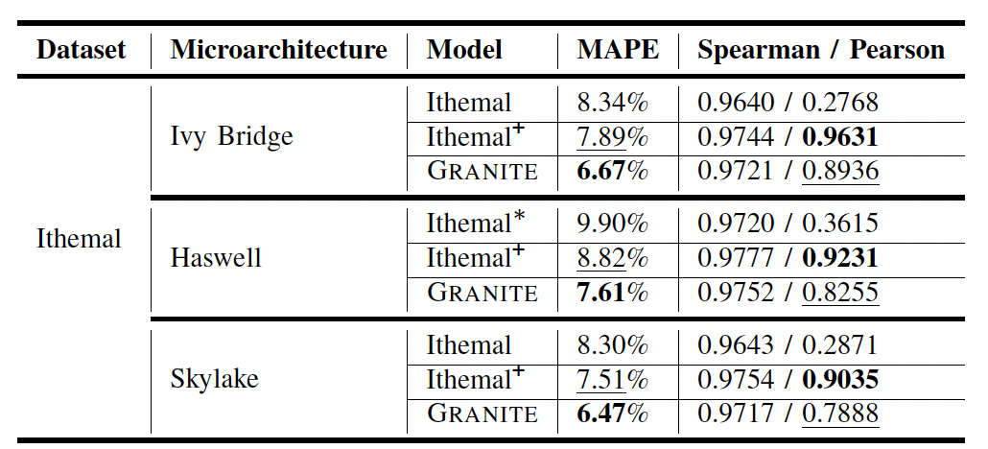
Results - Ithemal
Granite outperforms Ithemal.
1.7% lower MAPE on average.

Slide 29
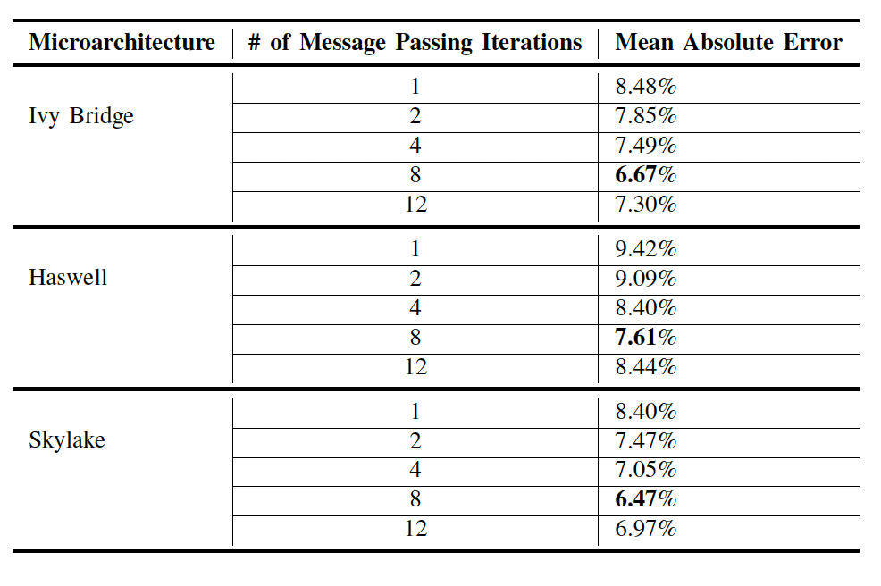
Results - Sensitivity
MAPE v/s # of Msg Pass Iterations.
Iterations = 8 yields best results.

Slide 30
Comments
Pros1: Graph captures data dependency
Pros2: Easy to extend
Cons1: Querying cost need to run all compiler backend (motivation of IR-level cost model)
Cons2: Cost is at basic block level, whole program cost needs more work

Slide 31
Q&A

Slide 32
If we have time…
Did a lot of reading, research, internship, course experience in compiler…
We need Compiler2.0: Automatic Construction of Compiler Back-end!

Slide 33
What topics people today are interested in?
In software:
LLM, Gen-AI (transformer, diffusion, …)
In hardware:
accelerators for domain specific applications (TPU, A100, …)
How to efficiently map those software workload to hardware:
Domain-specific Compiler! (TVM, XLA, Pytorch2.0)

Slide 34
How does Domain-specific Compiler Work

Slide 35
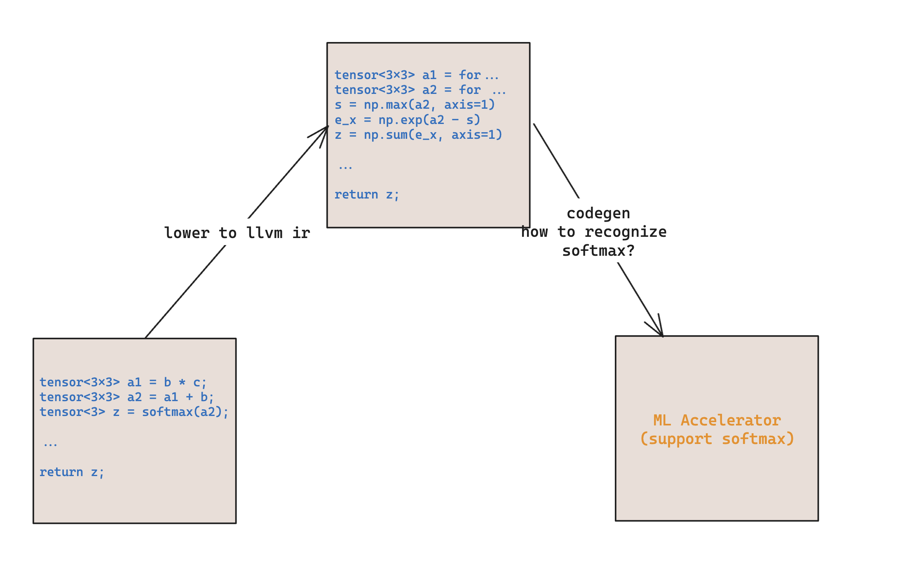
Why

Slide 36
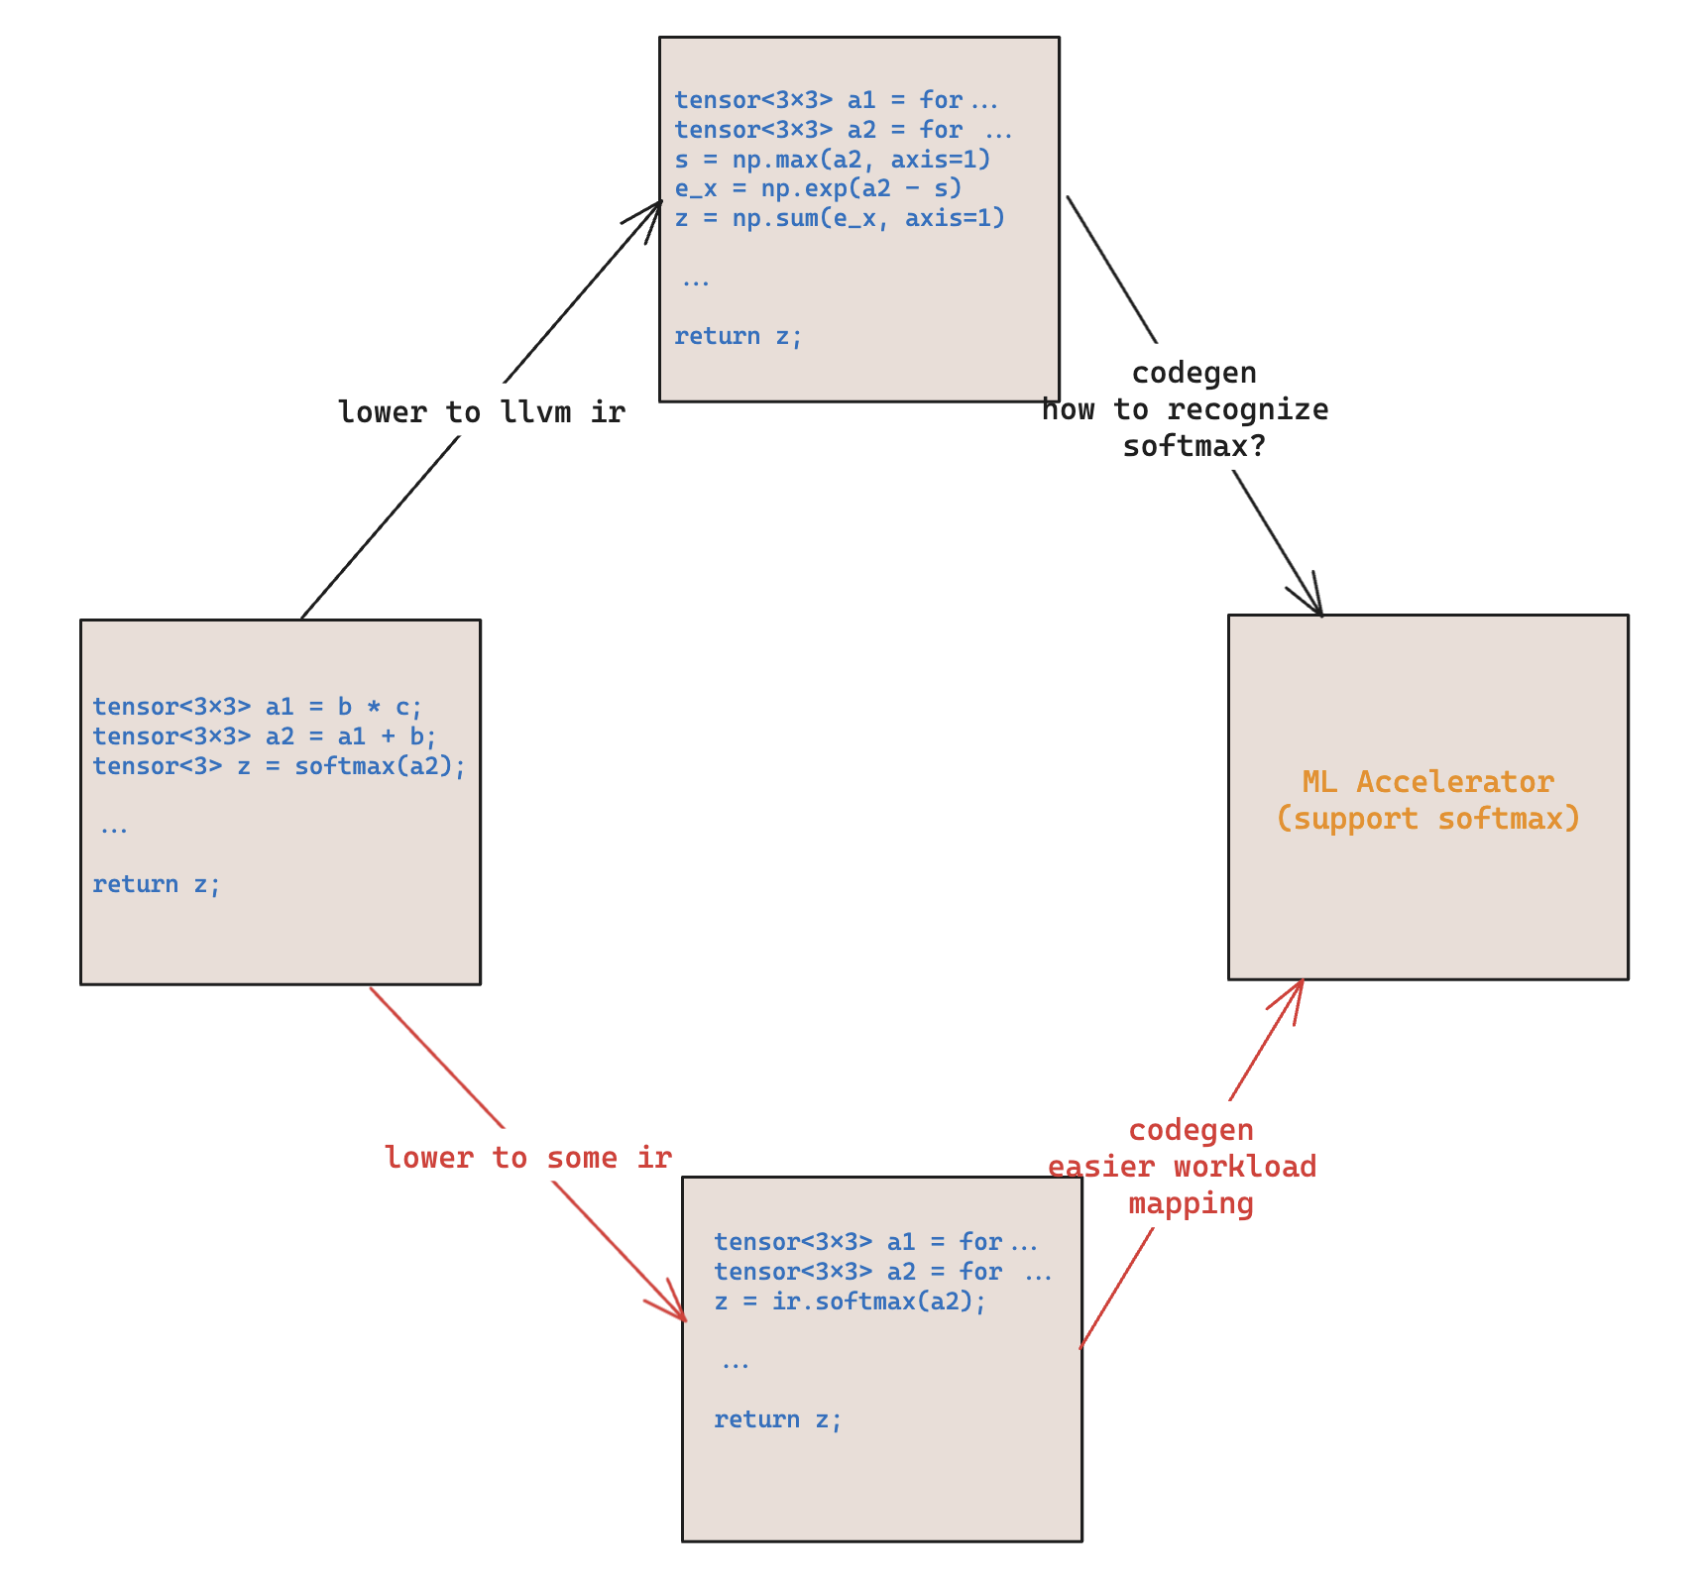

Slide 37
What’s the trend?
People are tending to use:
TVM for ML based optimization, autotuning
MLIR for modular code generation (xla, iree, pytorch2.0, trition, startups)
More and more intermediate representation!

Slide 38
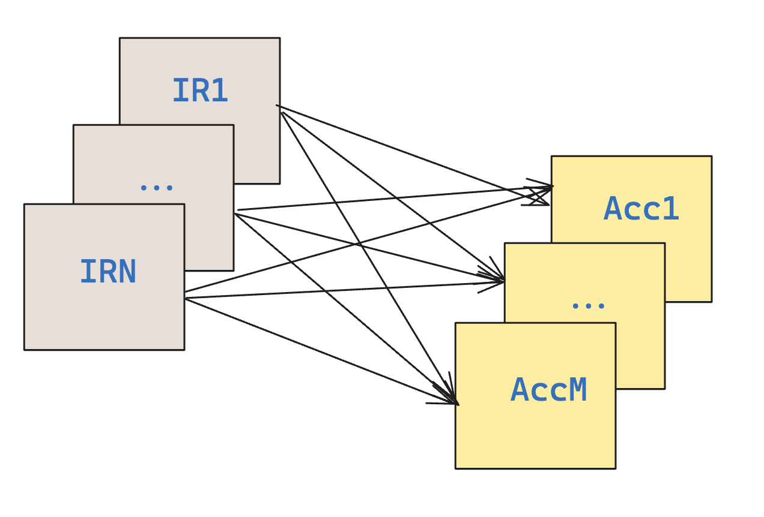
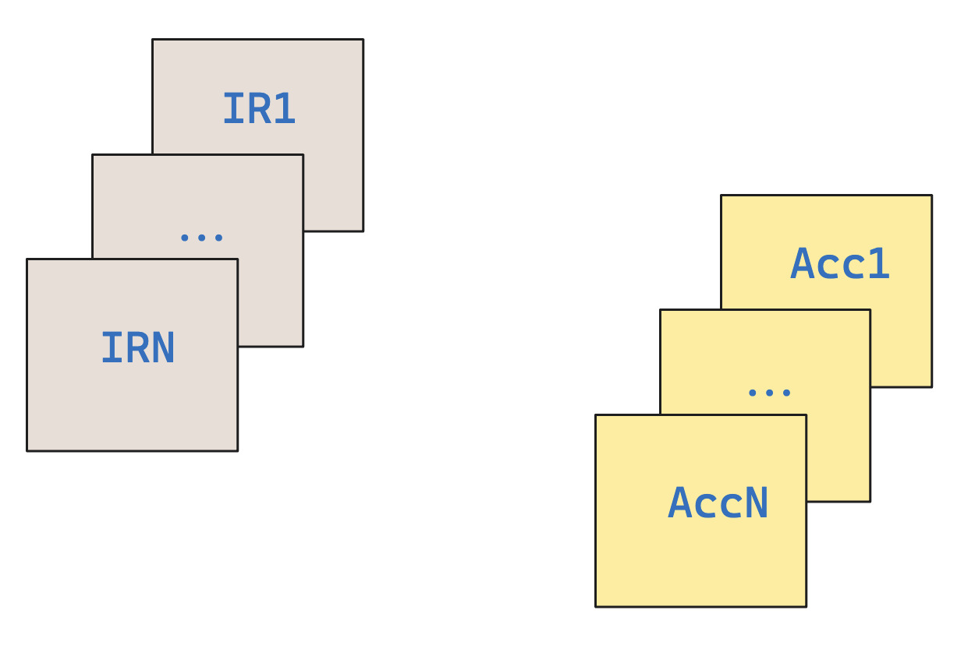
What’s the challenge?
N IR, M Hardware
=> M*M Compiler Back-end

Slide 39
Possible Direction?
S. Buchwald, A. Fried, and S. Hack. Synthesizing an instruction selection rule library from semantic specifications. In Proceedings of the 2018 International Sumposium on Code Generation and Optimization, pages 300-313, 2018. (Instruction Selection)
S. VenkataKeerthy, Siddharth Jain, Rohit Aggarwal, Albert Cohen, and Ramakrishna Upadrasta. 2022. RL4ReAl: Reinforcement Learning for Register Allocation. https://doi.org/10.48550/ARXIV.2204.02013 (Register Allocation)
A. McGovern, E. Moss, and A. G. Barto. Building a basic block instruction scheduler with reinforcement learning and rollouts. Machine learning, 49 (2-3):141-160, 2002 (Instruction Scheduling)
Need a lot of efforts to put everything together…

Slide 40
In Short (If we don’t have time)
Mapping Domain-specific Applications to Domain-specific Accelerators need more IR
If we have N IR, M Accelerators, we need to develop N*M compiler back-end
There are some current work about using ML for register allocation, instruction scheduling, using program synthesis for instruction selection. Put everything together!

Slide 41
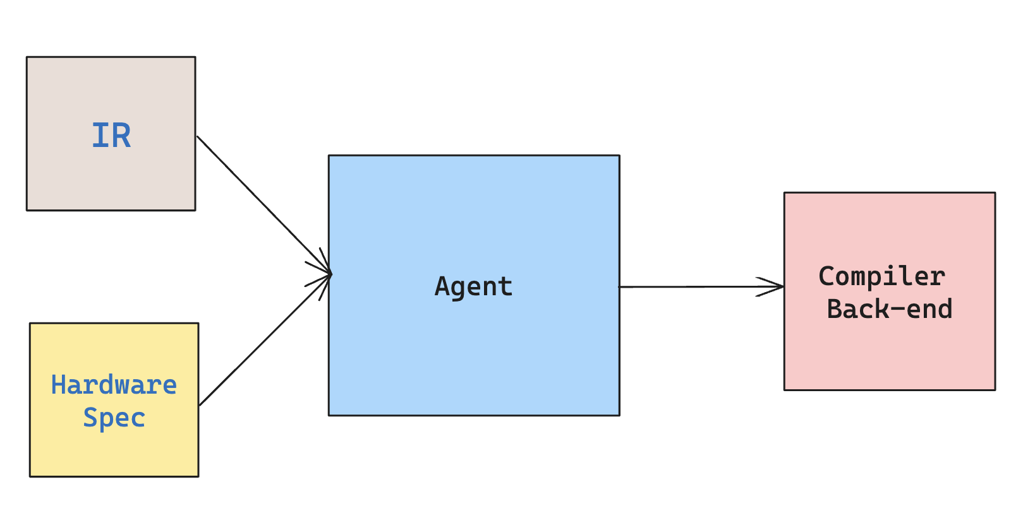
I envision a future of…

