Slide 1
EECS 583 Paper Presentation - Group 15
Deep Learning-based Approximate Graph-Coloring Algorithm for Register Allocation
6th IEEE/ACM Workshop on the LLVM Compiler Infrastructure in HPC (LLVM-HPC) @ Supercomputing 2020
Presenters : Anuj Tambwekar, Austin Nguyen, Creighton Glasscock, and Jacob Sansom
Original Authors: Dibyendu Das, Shahid Asghar Ahmad, and Venkataramanan Kumar | AMD

Slide 2
Motivation & Objective
Register allocation algorithms are primarily heuristic driven
This (relatively) new work shows that deep learning can be used for approximate graph coloring and therefore, be used for register allocation
Model coloring as a Sequence-to-Sequence (Seq2Seq) problem - convert a sequence of adjacency booleans into a coloring
Use this to estimate the minimum number of registers needed
Paper is a preliminary study to determine if a DL graph coloring algorithm is suitable for register allocation
Main objective is to minimize the number of registers used

Slide 3
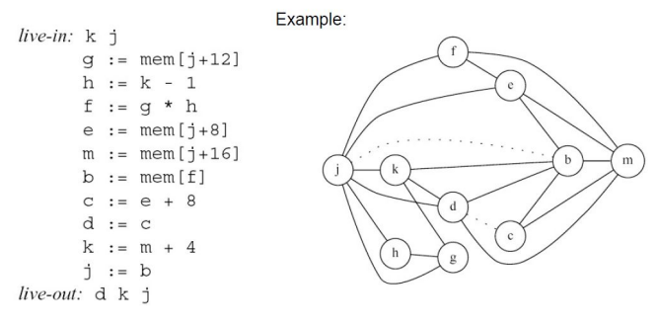
Graph coloring for register allocation
Recap from class!
Registers are live from assignment to use - each register has a live range
Overlapping live ranges indicate that the registers are live at the same time and can possibly interfere
Model register interference as a graph, with each register getting a node, and each edge indicating if interference is present
Color the graph - no adjacent nodes can have the same color. Color corresponds to a register, or a spill

Slide 4
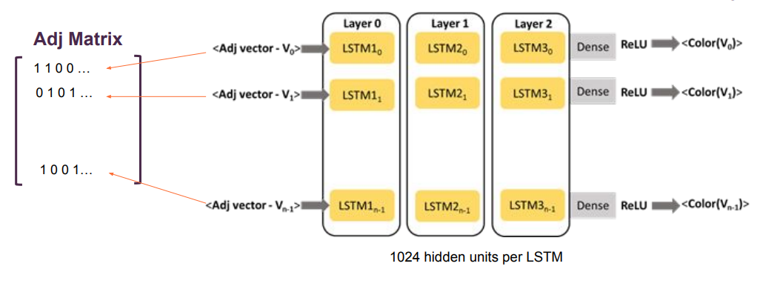
Graph coloring using LSTMs
Authors used a random graph generation library called nauty to generate 10,000 graphs with chromatic numbers computed, and used that to train an LSTM-based network.

Slide 5
LSTM Model Isn’t Enough
The output of the LSTM model is an assignment of colors. However, there is no guarantee that the assignment is valid
No constraints imposed on the output!
The model just learns based on the training data it sees
Authors use a simple, greedy algorithm they called the Color Correction Pass to ensure the coloring is valid

Slide 6
Step II - Color Correction Pass
Loop through all nodes:
For the current node, look at all neighbours
Check if any of them have the same color as the current node
If any of them do:
First see if there is a color for the current node that isn’t in the neighborhood. If there is, recolor the current node with this color
If the current node can’t be recolored, try recoloring the neighbor with the conflicting color
If neither can be colored an existing color, use a new color
Simple approach, but guaranteed to be a valid coloring
Need not be the smallest one though!

Slide 7
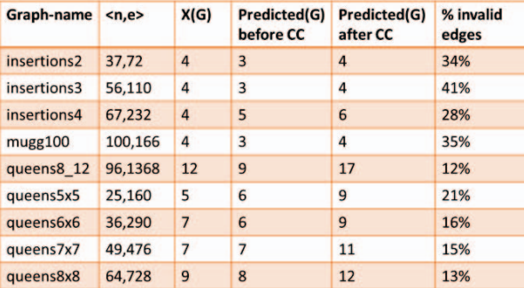
Results on some standard graphs
Note : These are not interference graphs

Slide 8
Comparison baseline - LLVM’s GRA
LLVM has a basic allocator that uses a linear scan algorithm, and a greedy allocator called GRA (Greedy Register Allocator)
GRA uses a priority queue
Priority depends on various factors - size of the live range, number of uses in succession etc.
One interesting factor is Rematerialization - the opposite of common-subexpression elimination & loop-invariant hoisting
Doing CSE/Hoisting can increase live range, so instead of reading from memory, recompute the value. More CPU usage but reduces register pressure.
Uses priority queue to assign registers. After assignment, it recomputes priorities and splits live ranges to increase efficiency.
Many more factors, and pretty complex. (Video Reference)
Notes:
Benchmark we are using
We won’t be going over this too much simply because this is our baseline comparison. For more details…
High level overview of GRA
Priority queue explanation
Rematerialization

Slide 9
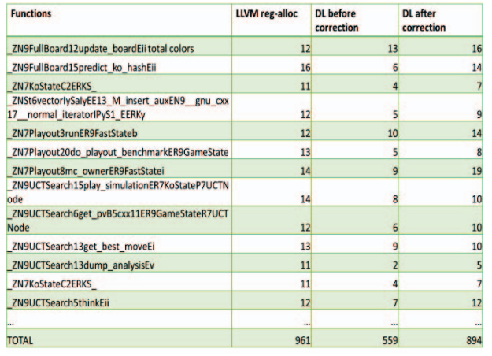
Results
Authors measured the number of registers allocated by their approach vs GRA on 5 benchmarks from the SPEC CPU 2017 benchmark set.
Benchmark | Avg % Change
505.mcf_r | -2%
557.xz_r | -2.5%
508.namd_r | +5%
541.leela_r | -7%
502.gcc_r | -5%
Aggregated Results for all benchmarks tested by the authors
Sample of the results for 541.leela_r (13/80 functions shown)
Notes:
Go over the metrics they use to compare the approaches (number of registers used)
Explain the two charts and precisely what they refer to (dataset vs singular graphs)
What is the percent change they are referring to
What is “DL” explanation

Slide 10
Highlights
ML model objective is abstracted from the main task!
No dependency on large codebases to get datasets - any graph coloring task works
Though we do suspect using interference graphs will give better performance
Easy to use/swap new models
Guaranteed to be valid with the correction pass
Might be useful in cases where we want to guarantee 0 spills
Reminder - GRA makes no guarantees on not spilling. This method will not spill, provided you have a sufficient number of registers
Easy to bring into a pass and use alongside existing methods. Need not replace GRA, but can instead be used in tandem with it.
Notes:
What is the main task? What is our ML model objective? They are decoupled
Guarantee to be valid. Is 0 spills necessarily better? No. There are some cases where having fewer registers with a few spills is better than more registers with no spills
The ML model, at its core, is trained on a dataset consisting of adjacency matrices and output color labels. This kind of implies that we could bring in existing methods to generate new output color labels for it to be trained on or help correct such labels etc.

Slide 11
Weaknesses - Author Identified
Authors limited size of graphs to at most 100 nodes
Found that this was good enough for most cases
Performance on random graphs was better than the interference graphs used for evaluation
In skewed graphs (see 508.namd_r), GRA just does better in terms of register usage
Not very surprising, since the training data was random graphs, though they did vary sparsity

Slide 12
Weaknesses we identified - I
Possible to (somewhat) model constraints by adding a penalty to the loss
Is a Seq2Seq approach really the right call for this kind of problem?
We want a valid coloring, but we don’t really care about the names of the colors used
Current Seq2Seq approach is trained on the premise that the color assigned is important!
The paper would treat the graphs above as different sequences, but to us it doesn’t matter
Our objective is to group/label the nodes in the best way possible
This is better represented as an embedding/clustering problem!

Slide 13
Weaknesses we identified - II
No way to restrict/limit the number of registers available
No way to allow/decide who spills!
LSTM model can perform a coloring that might not be valid - Color correction can cross the register limit
If we’d rather use fewer registers, there is no way to decide which register spills
No utilization of costs either, so no way to do prioritization if we had a register limit!
Results only talked about the number of registers assigned
Not necessarily reflective of true performance, but was the main objective of the paper
No standard baseline using a random coloring + color correction pass!
Poor reproducibility
Not all results were explicitly listed/No appendix
No code/artifact. That said, authors are from industry, so not surprising

Slide 14
Thank you! Questions?

