Slide 1
Memory Safe Computations with XLA Compiler
NeurIPs 2022 Paper Authors: Artem Artemev, Yuze An, Tilman Roeder, Mark van der Wilk
Presenters(Group 7): Jim Mao, Akhil Goel, Hsi Ger Chen, Soo Ryu

Slide 2
Overview
Introduction & Motivation
Methods
Results
Discussion

Slide 3
Introduction to XLA
XLA (Accelerated Linear Algebra) compiler for machine learning
Tensorflow, Pytorch
Supports various backends including GPUs, CPUs, and ML accelerators

Slide 4
Motivation
Programmers to change source code for memory optimization
Exceeding memory constraints can lead to code termination
Some linear algebra computations needs significant memory
sparse Gaussian process regression, nearest neighbour, transformers
Current methods optimize speed, not always memory conscious
Memory is expensive, especially on GPUs
Notes:
Cannot be batched

Slide 5
Problem Example
Approximating Gaussian Process
Using sparse Gaussian process regression method
Old method sometimes known for lack of scalability
Matrix size grows quadratically with number of data points
Large datasets causes memory overflow before time constraints

Slide 6
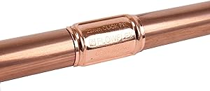
Match and Replace
Match
Look for a pattern in the graph
Replace
Replace the matched pattern with a better one
Image credits: Amazon

Slide 7
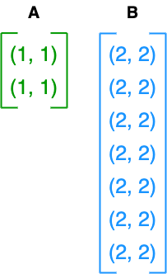
Match and Replace (Euclidean Distance)
A 𝞊 Ｒ^{m x d}
B 𝞊 Ｒ^{n x d}

Slide 8
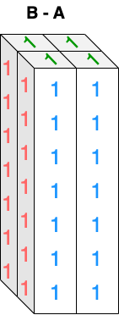
Match and Replace (Euclidean Distance)
B - A 𝞊 Ｒ^{m x n x d}

Slide 9
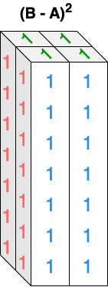
Match and Replace (Euclidean Distance)

Slide 10
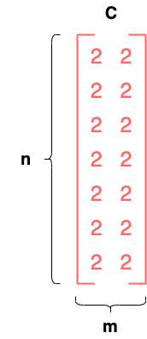
Match and Replace (Euclidean Distance)

Slide 11
Match and Replace (Euclidean Distance)

Slide 12
Reordering
Reorder operations to remove memory footprint
Works for associative operators
Eg: Matrix Multiplication

Slide 13
Reordering (Matrix Multiplication)
B =
A =
C =
Compute X = ABC

Slide 14
Reordering (Matrix Multiplication)
Option 1
AB =
C =

Slide 15
Reordering (Matrix Multiplication)
Option 1
ABC =

Slide 16
Reordering (Matrix Multiplication)
B =
A =
C =
Compute X = ABC

Slide 17
Reordering (Matrix Multiplication)
Option 2
A =
BC =

Slide 18
Reordering (Matrix Multiplication)
Option 2
ABC =

Slide 19
Data-flow graph splitting
Process (aka MapReduce):
Split a computational data-flow graph into independent copies.
Each copy handles a slice of the input tensor.
Combine results afterwards.
Goal:
Reducing total memory consumption.

Slide 20
Data-flow graph splitting
G: generator operation
R: reducer operation
S: slicing operation

Slide 21
Data-flow graph splitting - Algorithm
Use depth-first search to identify dot or reduce_* operations in XLA HLO( (High Level Optimizer) graph.
Recursively search for large tensors in the traversed path until a small enough operand is reached.
Track applied operations and along which axes they are parallelizable.
Turn the computation into a while loop.
Now each iteration computes a manageable part of the final result.

Slide 22
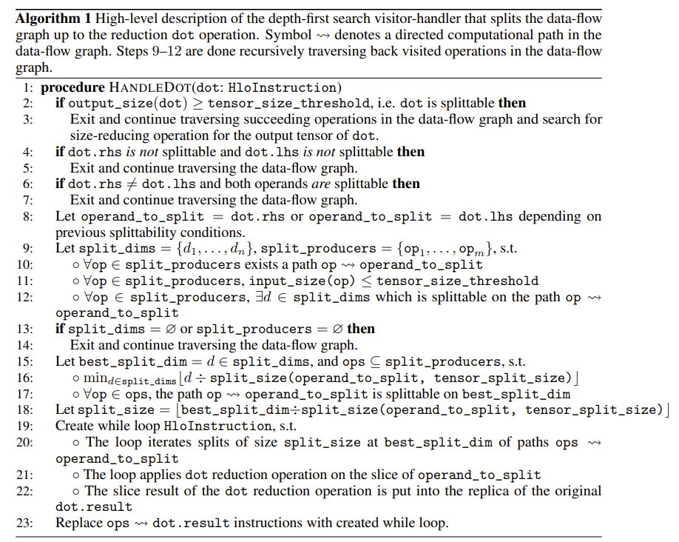

Slide 23
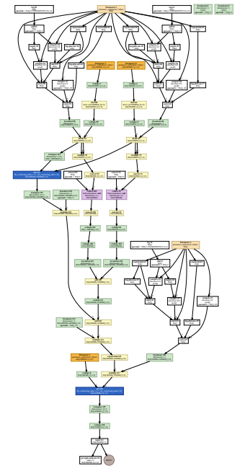
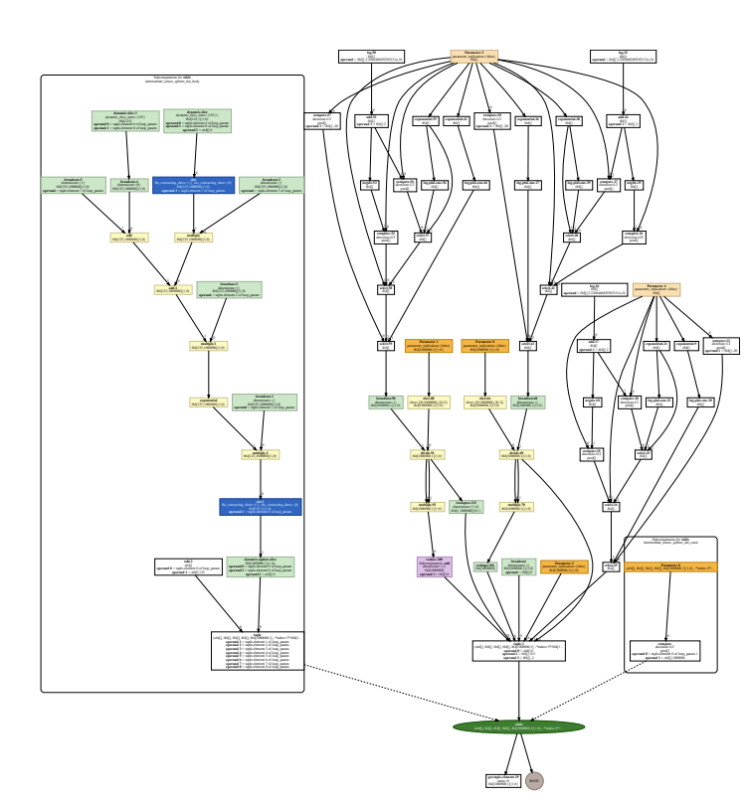

Slide 24
Results from experiments
Case 1. Matrix vector multiplication
Motivation: To demonstrate the improved efficiency that eXLA offers to large-scale matrix-vector multiplications of the form y = Kv, where K is an n × n kernel matrix, and y, v ∈ R^n
Results:
Without eXLA, running on large datasets infeasible;
Running with eXLA enabled, which allows a user to control the memory of an algorithm memory constraints are not violated even with n becomes as large as 10^6

Slide 25
Results from experiments
Case 2. K-Nearest Neighbors
Motivation: To show eXLA could scales the brute force kNN approach and does not fail for large problems Results:
With eXLA, memory overflow is prevented in JAX and Tensorflow with comparable or even higher performance

Slide 26
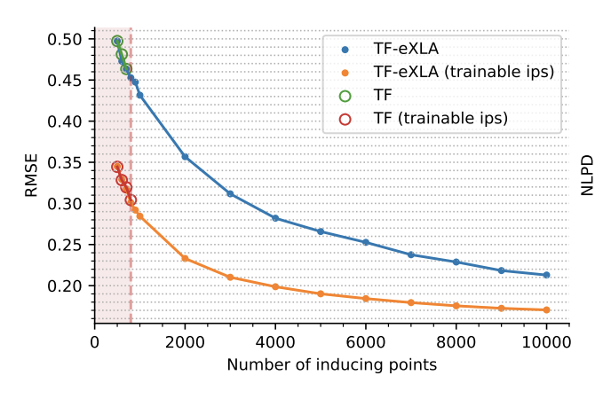
Results from experiments
Case 3. Sparse Gaussian Process Regression
Motivation:
Large datasets cause memory overflows far before long runtimes become an obstacle im SGPR. Could eXLA be the solution?
Results:
Without eXLA, it fails after about having 800 inducing points
With eXLA optimisations, SGPR was able to scale to much larger datasets (e.g., 10,000 inducing points)

Slide 27
Discussion
The extended XLA (eXLA) prevented memory overflows in algorithms that handle large tensors or linear algebra operations (e.g., vector multiplication, kNN and attention computation in Transformers)
With eXLA, machine learning models can run at greater scale even with limited memory size that makes out-of-the-box implementations fail with Out of Memory errors
This is especially valuable because the present framework does not required modification of previous code (unlike previous works such as KeOps)

Slide 28
Commentary & Future directions
Pros
This approach would enable many scaled-up experiments that were not possible previously
Convenient to use without modification
Solves the issue that XLA is not aware of memory limits
Cons
The range of algorithms that eXLA can handle could be extended
Might have been interesting to discuss how the present approach would affect time efficiency more deeply
Authors focus only on memory optimization that can sometimes come at a cost of higher model latency

Slide 29
Thank you!

