Slide 1
Compiler-Based Prefetching for Recursive Data Structures
Paper by:
Chi-Keung Luk and Todd C. Mowry
Presented by:
Ashutosh Bhown, Jeremy Flics, Zachary Goldston, Ankith Udupa (Group 6)

Slide 2
Introduction
Prefetching: Loading a resource before it is needed
Reduces cache miss rate
Prefetching has already been effective in code speed up to bridge the memory-performance gap
Most common methods are only for arrays and more linear data structures
Issues arise for recursive data structures (RDS)
How can we perform prefetching for these types?

Slide 3
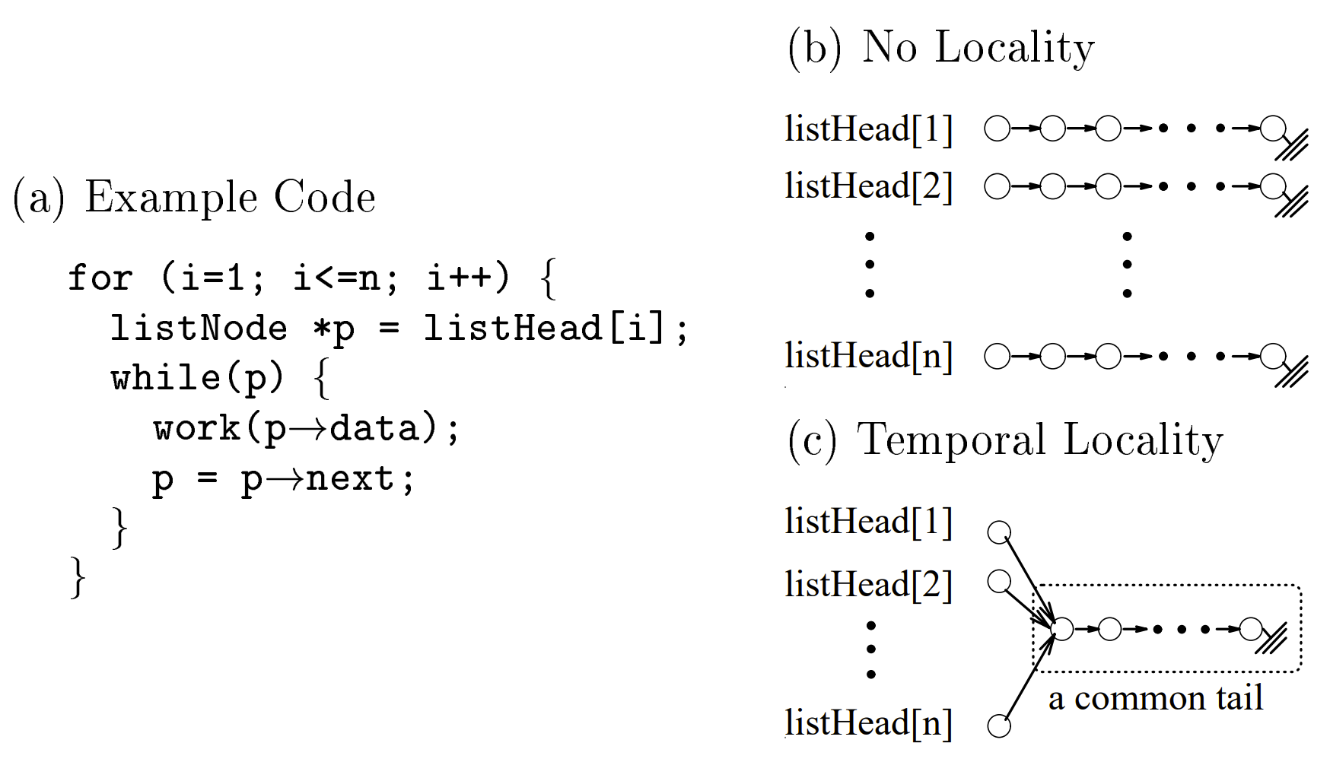
What is a RDS (Recursive Data Struct)?
Data structures that rely on nodes/pointers
Examples: Trees, linked lists, graphs
Rely on dereferencing
pointers to get to next
elements of structure

Slide 4
Prefetching w/ Contiguous Memory
Values stored in caches are addresses in memory
With array-based structures, any A[i] address can be calculated (and prefetched) in O(1), since memory is contiguous
But what about RDS?
https://medium.com/@sadhna.narayansadhna/array-basics-before-you-start-coding-f9fa10e77cea
Notes:
TODO: also discuss the shared chain stuff for analysis

Slide 5
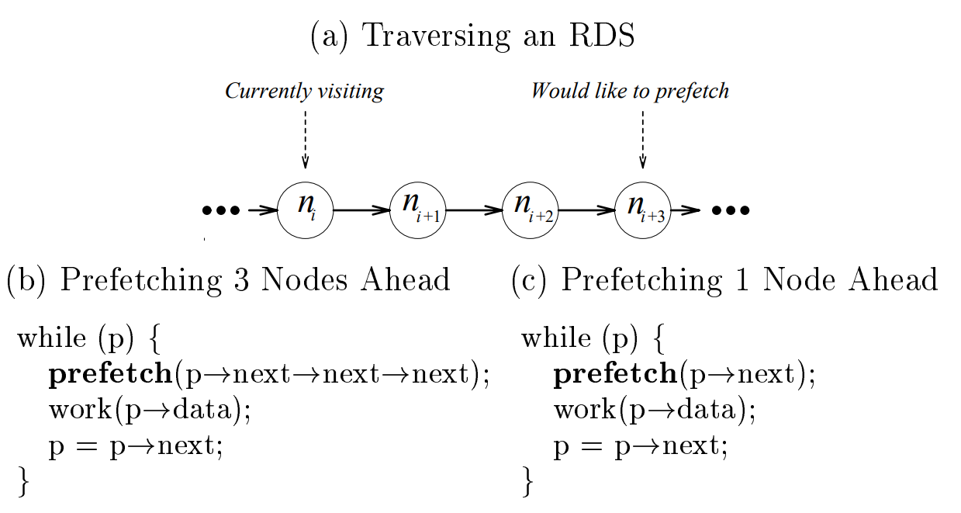
The Pointer-Chasing Problem
To prefetch address A[i + d], A[i + 1], A[i + 2], … A[i + d] all need to be accessed
# of accessed addresses between
A[i] and A[i + d] is represented by
|F|, where F maps an address A[i]
and a distance d to a set of addresses
How do we minimize |F|?

Slide 6
Proposed Solutions
Three potential solutions are described
Greedy Prefetching
History-Pointer Prefetching
Data-Linearization Prefetching

Slide 7
Greedy Prefetching
Corresponds to |F| = 1
Prefetch all neighboring nodes
Only one will be followed by immediate control flow
Hope we will visit other neighbors later
Idea: We want to get to some distance d (away from current “node”)
Prefetch something at d’
If d’ < d, we can partially hide latency!
If d’ >= d, we can completely hide latency since it’s possible we had fetched it!
Provided node is not removed from cache
Low cost, easy to implement, and generalizable
No precise control over distances

Slide 8
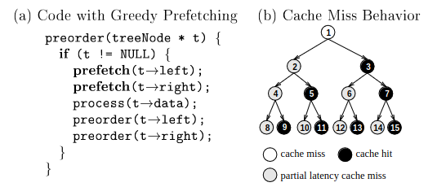
Greedy Prefetching
Cache Miss
Partially Hidden
Fully Hidden
1
2
3
4
5
6
7
Not Reached yet
Example of Greedy Prefetching with d = 2
Notes:
Mention how 1 prefetches 2 and 3, 2 does 4 and 5 - Maybe step through examples

Slide 9
Greedy Prefetching
1
Partially Hidden
2
3
4
5
6
7
Fully Hidden
Example of Greedy Prefetching with d = 2
Notes:
Mention how 1 prefetches 2 and 3, 2 does 4 and 5 - Maybe step through examples

Slide 10
Greedy Prefetching
1
2
3
4
5
6
7
Partially Hidden
Fully Hidden
Example of Greedy Prefetching with d = 2
Notes:
Mention how 1 prefetches 2 and 3, 2 does 4 and 5 - Maybe step through examples

Slide 11
Greedy Prefetching
Full example of insertion with Greedy Method (d = 2) and the miss/partial miss/hit behavior
Notes:
Mention how 1 prefetches 2 and 3, 2 does 4 and 5 - Maybe step through examples

Slide 12
History-Pointer Prefetching
Corresponds to |F| = 1
Try to synthesize more accurate jump-pointer(s) (“history pointer”) containing recently seen values
Maintain a queue of a length d to contain last d visited nodes
Visiting a new node, oldest node becomes updated to point to it
More control over prefetching distances, at the cost of complexity (added time and space for pointer construction)
Cache behavior worsens (due to space overhead)
Also, no performance increase on first traversal, subsequent end up hiding nearly all latency

Slide 13
History-Pointer Prefetching
To be inserted node
1
5
2
3
4
2
1
4
5
6
7
Oldest node in queue
Example of the FIFO queue (d = 3) from History-Pointer method
Notes:
Show steps of what happens as stuff is populated

Slide 14
History-Pointer Prefetching
To be inserted node
1
5
2
Newly generated pointer!
3
4
2
1
4
5
6
7
Oldest node in queue
Example of the FIFO queue (d = 3) from History-Pointer method
Notes:
Show steps of what happens as stuff is populated

Slide 15
History-Pointer Prefetching
To be inserted node
1
3
2
3
5
4
2
4
5
6
7
Oldest node in queue
Example of the FIFO queue (d = 3) from History-Pointer method
Notes:
Show steps of what happens as stuff is populated

Slide 16
History-Pointer Prefetching
To be inserted node
1
3
2
Newly generated pointer!
3
5
4
2
4
5
6
7
Oldest node in queue
Example of the FIFO queue (d = 3) from History-Pointer method
Notes:
Show steps of what happens as stuff is populated

Slide 17
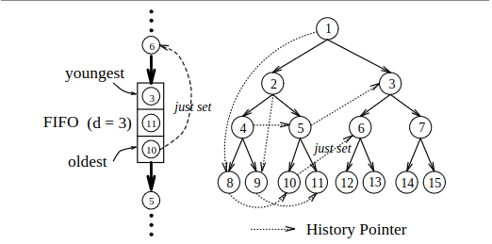
History-Pointer Prefetching
Full example of the FIFO queue (d = 3) from History-Pointer method
Notes:
Show steps of what happens as stuff is populated

Slide 18
Data-Linearization Prefetching
Corresponds to |F| = 0
Now, what if we did History-Pointer, but we reduce space overhead?
Avoid pointer differences, improve spatial locality
Idea: Map heap-allocated nodes that are accessed close to each other in time to memory locations
Then prefetch early!
Recall how array elements can be accessed
Can map at creation time
Appropriate if creation order matches traversal order
Or if can safely be reordered to match it (dynamic remapping costly though)

Slide 19
Data-Linearization Prefetching
Example of Data-Linearization (d = 3) mapping into an array from a pre-order traversal

Slide 20
Summary of Methods
Method | Control over Distance | Applicable Use for RDS | Overhead | Implementation
Greedy | None | Can be applied to any RDS | None | Easy (details given next)
History-Pointer | More precise | Must be revisited and RDS changes only slowly | Space and Time for synthesizing new pointers | Difficult
Data-Linearization | More precise | RDS needs a major traversal order and RDS changes only slowly | Small bit for the allocation at the beginning | Difficult
Greedy is the most implementable, generalizable, requires no overhead, and does not rely on earlier traverals/passes through an RDS

Slide 21
Greedy Prefetch Implementation
Done in two phases:
Analysis identifies RDS types and recurrent pointer updates
Scheduling inserts prefetches into code
Notes:
The idea behind greedy prefetching is pretty simple, and doing it by hand when you have one homogenous RDS (say a binary tree) seems straightforward as well. But what about full automation? This is the more general framework the paper gives for adding greedy prefetching at compile-time.

Slide 22
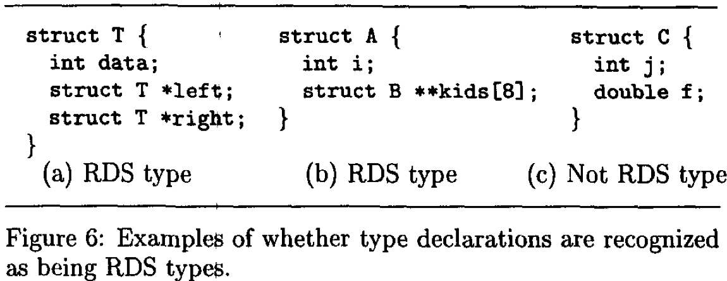
Identifying Recursive Data Structures
RDSs identified by type declaration
An RDS type is a record type that contains a pointer to another record type
Homogenous RDS type
Heterogeneous RDS type
Not an RDS type
Notes:
Mention RDS pointers can be direct or indirect

Slide 23
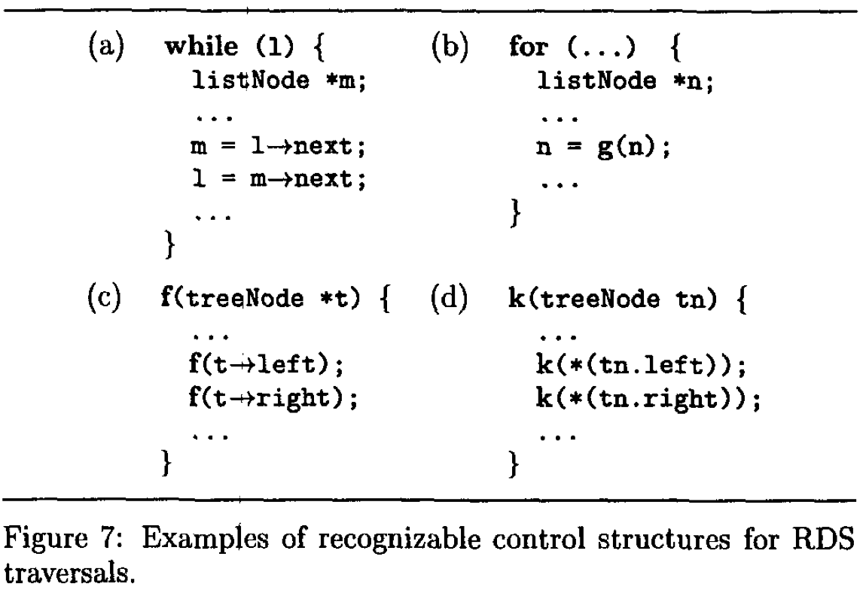
Identifying Recurrent Pointer Updates
Identifies instances of pointers being assigned to a value obtained by dereferencing the pointer
Does this only in loops and recursive procedures.
Pretty good heuristic for RDS traversals
Notes:
For bullet 1 mention this can be direct or indirect (uses some ptr analysis that they don’t discuss)
TODO: ADD highlighting (Maybe)

Slide 24
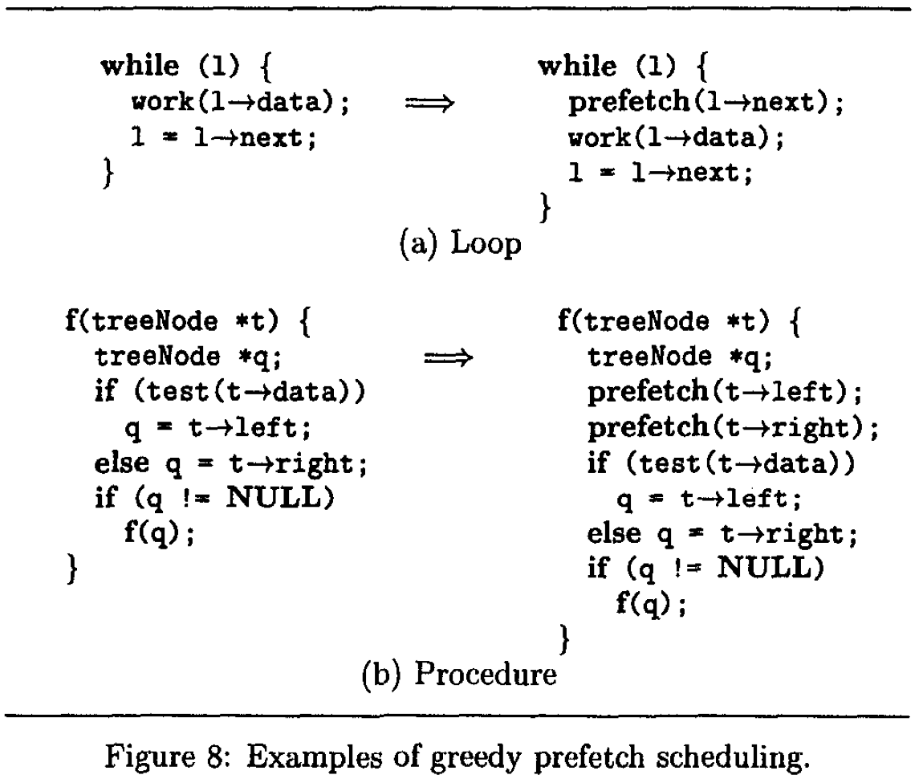
Scheduling Greedy Prefetches
Uses previous analysis
Propagates pointer updates to find earliest possible scope where prefetches can be added
Inserts prefetches for all RDS-type objects stored

Slide 25
Experimental Setup
Variety of benchmarks, 10 pointer based applications written in C.
Cycle by cycle simulation on dynamically scheduled superscalar processor similar to MIPS R10000
Simulator models details of processor such as branch prediction, pipelining, branching penalties, memory hierarchy, etc.
Tested implementation of greedy prefetching with hand-inserted prefetches for history pointer and data-linearization prefetching

Slide 26
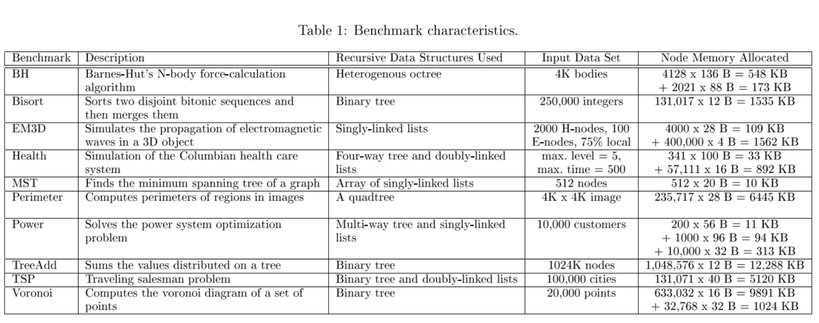
Experimental Setup

Slide 27
Greedy Prefetching Results
Applications enjoy a 4% to 45% speed up

Slide 28
Additional Metrics
nopf_miss = original cache miss that was never pre-fetched
pf_miss = original cache miss that was prefetched
pf_hit = original cache miss that was prefetched and hit

Slide 29
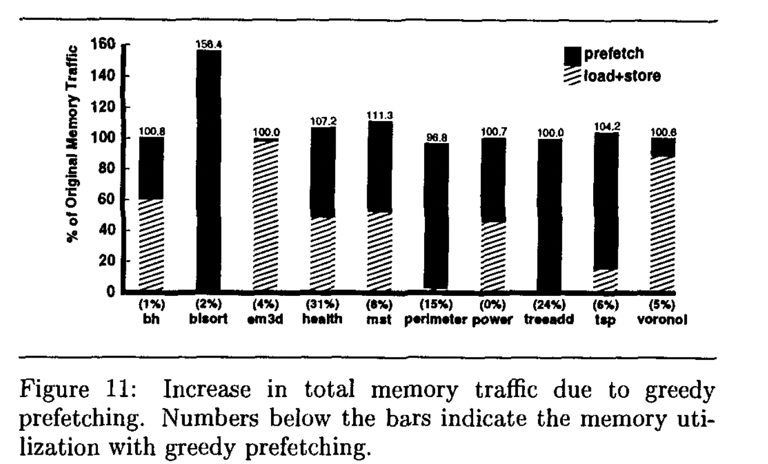
Memory Usage
Does Greedy prefetching cause increased memory bandwidth utilization?

Slide 30
Analysis
Ideally pf_miss, unnecessary prefetching are as low as possible
Applications such as mst involve arrays of short singly linked lists and thus prefetches don’t happen early enough leading to increased overhead and minimal gain
Memory bandwidth is not significantly affected except in a few applications (bisort) that cause prefetches to data not later accessed

Slide 31
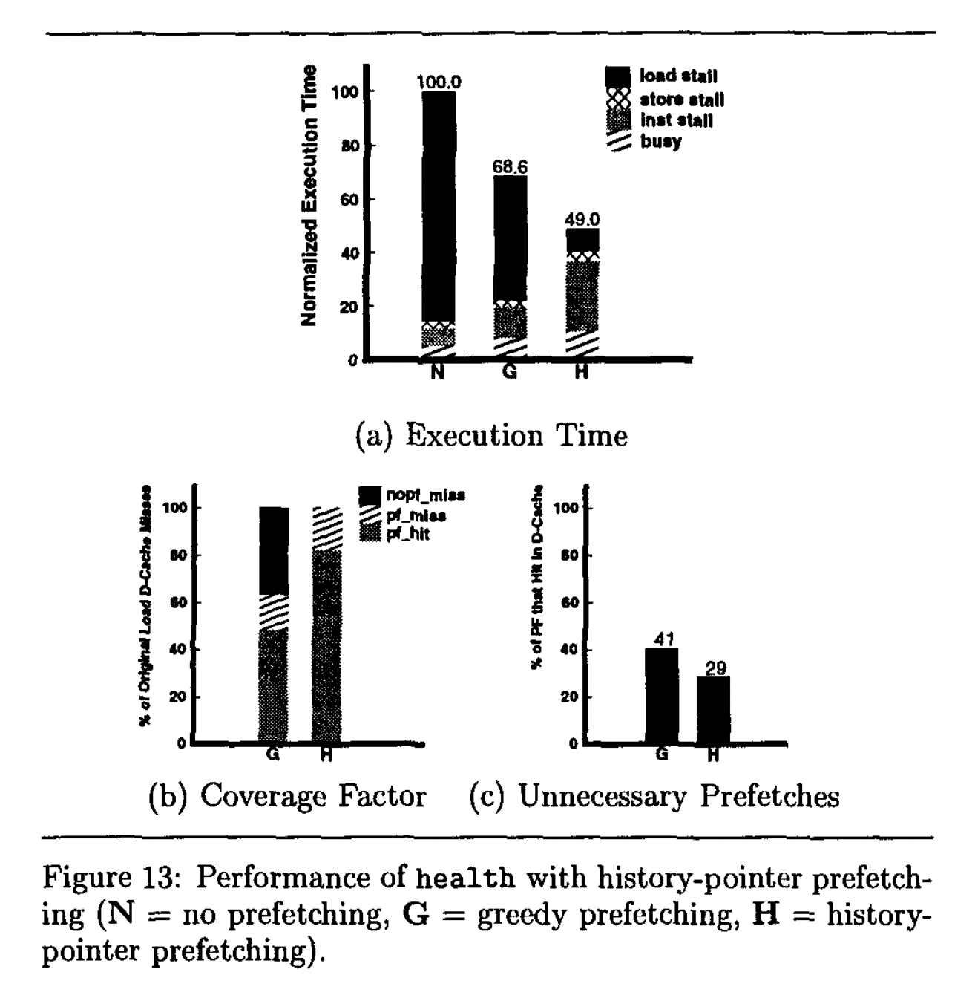
History Pointer Prefetching Results

Slide 32
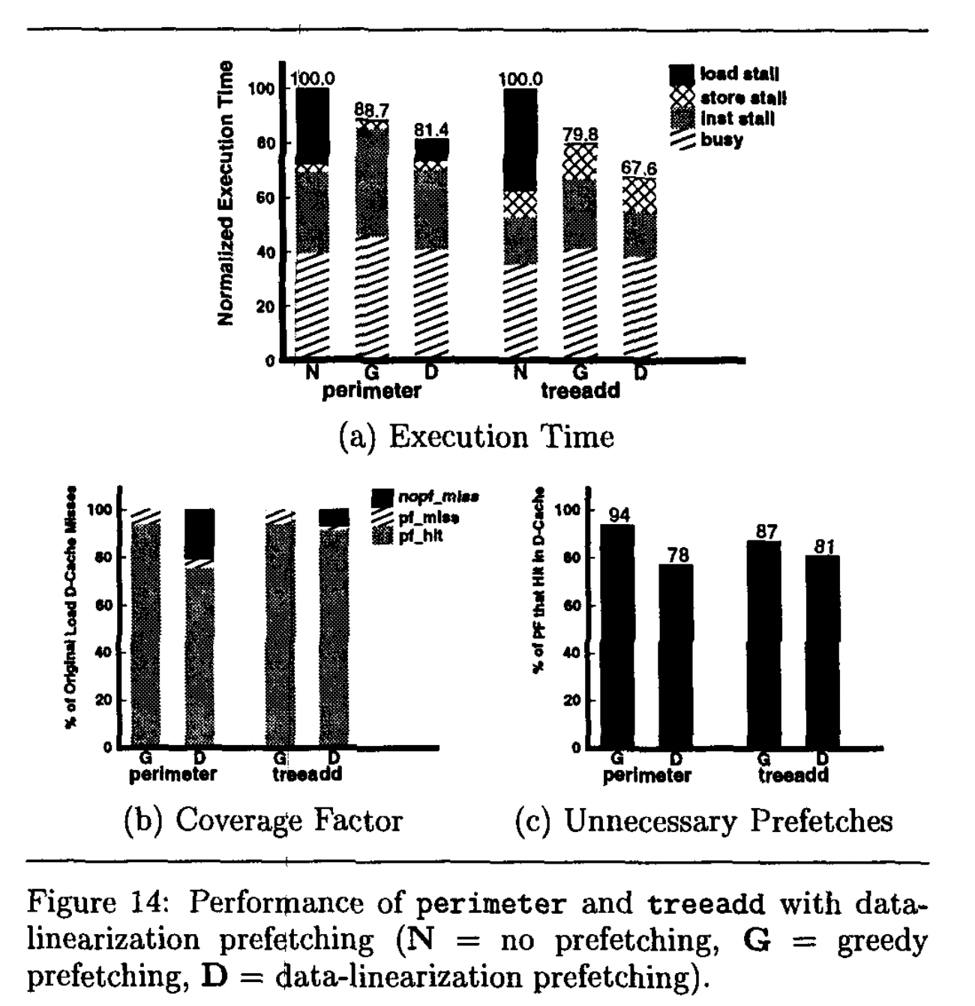
Data-linearization Prefetching Results

Slide 33
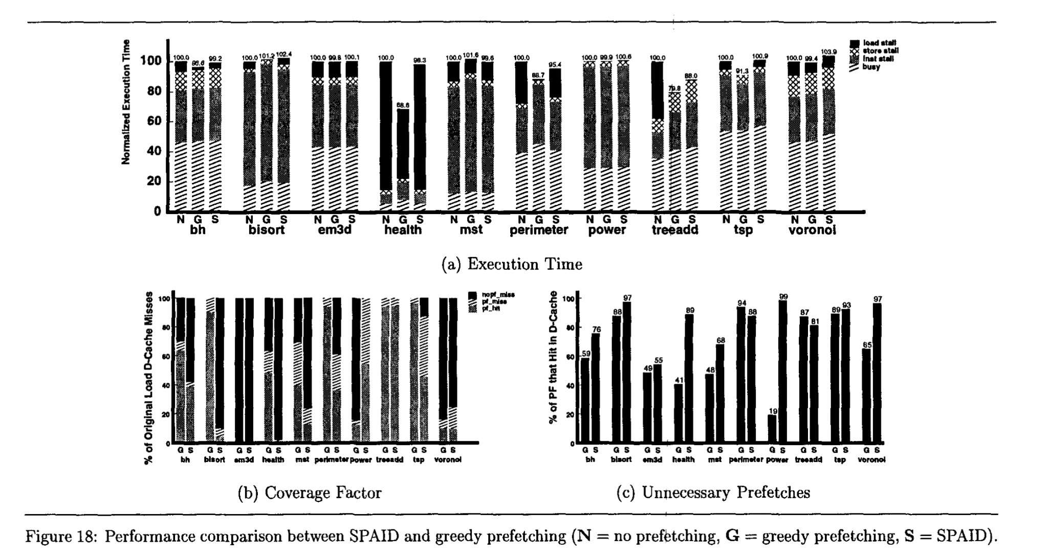
Comparison to SPAID

Slide 34
Reflection - Positive Aspects
Explanation of pointer chasing problem and 3 methods for prefetching was clear and well structured
Greedy prefetching is straightforward to implement and results are quite promising for variety of workloads
Evaluation went beyond simply measuring latency, analyzed specific contributors to latency and the fundamental problem - cache misses

Slide 35
Reflection - Negative Aspects
Only one prefetching scheme (greedy) is actually implemented, difficult to truly compare
While history pointer and data linearization are sketched the implementation difficulty seems high and no true results for performance, hand placed prefetches come with a huge grain of salt
Data linearization seems better achieved via a custom allocator on the software side, seems infeasible from the compiler side
Greedy prefetching has cases with many unnecessary prefetches

Slide 36
Questions?

