Slide 1
EECS 583 – Class 9 Classic + ILP Optimization
University of Michigan
October 2, 2023

Slide 2
Announcements & Reading Material
Lecture schedule this week
Makeup lecture on Wednes, 10:30-12 on Zoom
Regular Friday lecture, may need to adjust time (will announce on Wednes)
Hopefully everyone is making some progress on HW 2
Due Oct 13
Today’s class
“Compiler Code Transformations for Superscalar-Based High-Performance Systems,” S. Mahlke, W. Chen, J. Gyllenhaal, W. Hwu, P, Chang, and T. Kiyohara, Proceedings of Supercomputing '92, Nov. 1992, pp. 808-817
Next class (code generation)
“Machine Description Driven Compilers for EPIC Processors”, B. Rau, V. Kathail, and S. Aditya, HP Technical Report, HPL-98-40, 1998. (long paper but informative)

Slide 3
Course Project – Time to Start Thinking About This
Mission statement: Design and implement something “interesting” in a compiler
LLVM preferred, but others are fine
Groups of 3-5 people (other group sizes are possible in some cases)
Extend existing research paper or go out on your own
Topic areas (Not in any priority order)
Automatic parallelization/SIMDization
High level synthesis/FPGAs
Approximate computing
Memory system optimization
Reliability
Energy
Security
Dynamic optimization
Machine learning for compilers
Optimizing for GPUs

Slide 4
Course Projects – Timetable
Now - Start thinking about potential topics, identify group members
Use piazza to recruit group members
Oct 23-27: Project proposal discussions, No class Oct 23/27, Regular class resumes Mon Oct 30
Aditya, Tarun and I will meet with each group virtually for 5-10 mins, slot signups the week before, Oct 13-16
Ideas/proposal discussed at meeting – don’t come into the meeting with too many ideas (1-2 only)
Short written proposal (a paragraph plus 1-2 references) due Mon, Oct 30 from each group, submit via email
Nov 6 – End of semester: Research presentations (details later)
Each group presents a research paper related to their project (15 mins)
Late Nov - Optional quick discussion with groups on progress
Dec 6 - 13: Project demos
Each group, 15 min slot - Presentation/Demo/whatever you like
Turn in short report on your project

Slide 5
Sample Project Ideas (Traditional)
Memory system
Cache profiler for LLVM IR – miss rates, stride determination
Data cache prefetching, cache bypassing, scratch pad memories
Data layout for improved cache behavior
Advanced loads – move up to hide latency
Control/Dataflow optimization
Superblock formation
Make an LLVM optimization smarter with profile data
Implement optimization not in LLVM
Reliability
AVF profiling, vulnerability analysis
Selective code duplication for soft error protection
Low-cost fault detection and/or recovery
Efficient soft error protection on GPUs/SIMD

Slide 6
Sample Project Ideas (Traditional cont)
Energy
Minimizing instruction bit flips
Deactivate parts of processor (FUs, registers, cache)
Use different processors (e.g., big.LITTLE)
Security/Safety
Efficient taint/information flow tracking
Automatic mitigation methods – obfuscation for side channels
Preventing control flow exploits
Rule compliance checking (driving rules for AV software)
Run-time safety verification
Dealing with pointers
Memory dependence analysis – try to improve on LLVM
Using dependence speculation for optimization or code reordering

Slide 7
Sample Project Ideas (Parallelism)
Optimizing for GPUs
Dumb OpenCL/CUDA → smart OpenCL/CUDA – selection of threads/blocks and managing on-chip memory
Reducing uncoalesced memory accesses – measurement of uncoalesced accesses, code restructuring to reduce these
Matlab → CUDA/OpenCL
Kernel partitioning, data partitioning across multiple GPUs
Parallelization/SIMDization
DOALL loop parallelization, dependence breaking transformations
DSWP parallelization
Access-execute program decomposition
Automatic SIMDization, Superword level parallelism

Slide 8
More Project Ideas
Dynamic optimization (Dynamo, LLVM, Dalvik VM)
Run-time DOALL loop parallelization
Run-time program analysis for reliability/security
Run-time profiling tools (cache, memory dependence, etc.)
Binary optimizer
Arm binary to LLVM IR, de-register allocation
High level synthesis
Custom instructions - finding most common instruction patterns, constrained by inputs/outputs
Int/FP precision analysis, Float to fixed point
Custom data path synthesis
Customized memory systems (e.g., sparse data structs)

Slide 9
And Yet a Few More
Approximate computing
New approximation optimizations (lookup tables, loop perforation, tiling)
Impact of local approximation on global program outcome
Program distillation - create a subset program with equivalent memory/branch behavior
Machine learning for compilers
Using ML/search to guide optimizations (e.g., unroll factors)
Using ML/search to guide optimization choices (which optis/order)
Be careful with low compiler content!!
Remember, don’t be constrained by my suggestions, you can pick other topics!

Slide 10
Back to Code Optimization
Classical (machine independent, done at IR level)
Reducing operation count (redundancy elimination)
Simplifying operations
Generally good for any kind of machine
We went through
Dead code elimination
Constant propagation
Constant folding
Copy propagation
CSE
LICM

Slide 11
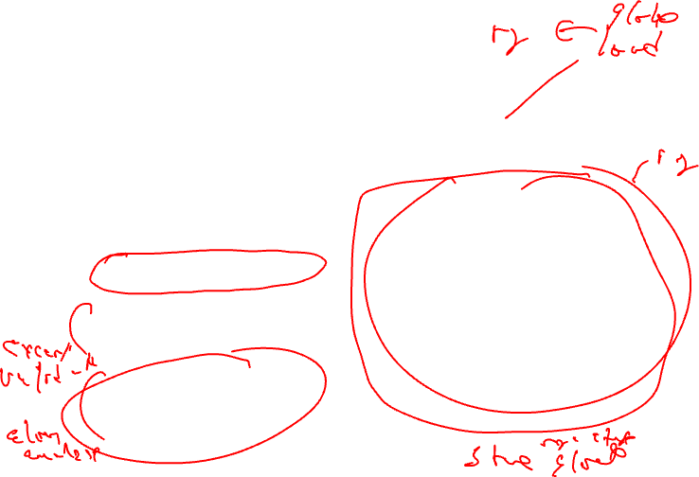
Global Variable Migration
Assign a global variable temporarily to a register for the duration of the loop
Load in preheader
Store at exit points
Rules
X is a load or store
address(X) not modified in the loop
if X not executed on every iteration, then X must provably not cause an exception
All memory ops in loop whose address can equal address(X) must always have the same address as X
BB1
BB2
1. r4 = load(r5)
2. r4 = r4 + 1
BB3
BB4
3. r8 = load(r5)
4. r7 = r8 * r4
5. store(r5, r4)
BB5
6. store(r5,r7)
BB6

Slide 12
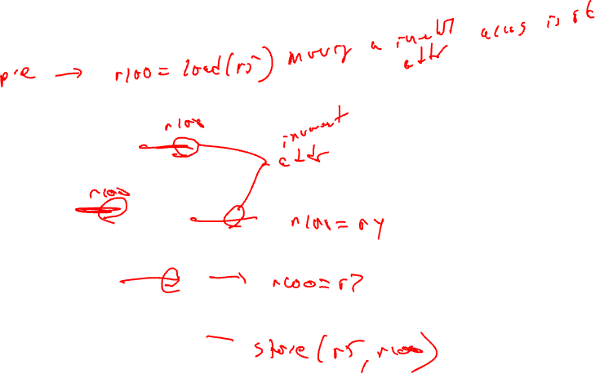
Global Variable Migration Example
BB1
BB2
1. r4 = load(r5)
2. r4 = r4 + 1
BB3
BB4
3. r8 = load(r5)
4. r7 = r8 * r4
5. store(r5, r4)
BB5
6. store(r5,r7)
BB6

Slide 13
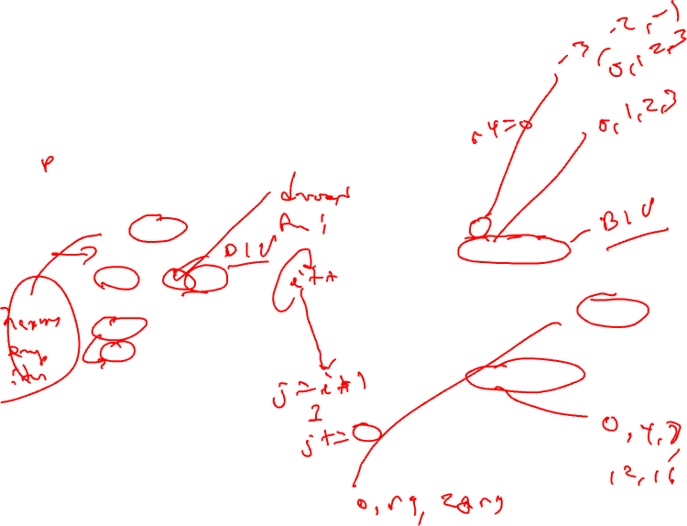
Induction Variable Strength Reduction
Create basic induction variables from derived induction variables
Induction variable
BIV (i++)
0,1,2,3,4,...
DIV (j = i * 4)
0, 4, 8, 12, 16, ...
DIV can be converted into a BIV that is incremented by 4
Issues
Initial and increment vals
Where to place increments
BB1
BB2
1. r5 = r4 - 3
2. r4 = r4 + 1
BB3
BB4
3. r7 = r4 * r9
BB5
4. r6 = r4 << 2
BB6

Slide 14
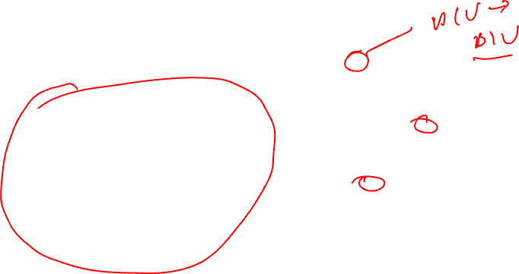
Induction Variable Strength Reduction (2)
Rules
X is a *, <<, + or – operation
src1(X) is a basic ind var
src2(X) is invariant
No other ops modify dest(X)
dest(X) != src(X) for all srcs
dest(X) is a register
Transformation
Insert the following into the preheader
new_reg = RHS(X)
If opcode(X) is not add/sub, insert to the bottom of the preheader
new_inc = inc(src1(X)) opcode(X) src2(X)
else
new_inc = inc(src1(X))
Insert the following at each update of src1(X)
new_reg += new_inc
Change X → dest(X) = new_reg
BB1
BB2
1. r5 = r4 - 3
2. r4 = r4 + 1
BB3
BB4
3. r7 = r4 * r9
BB5
4. r6 = r4 << 2
BB6

Slide 15
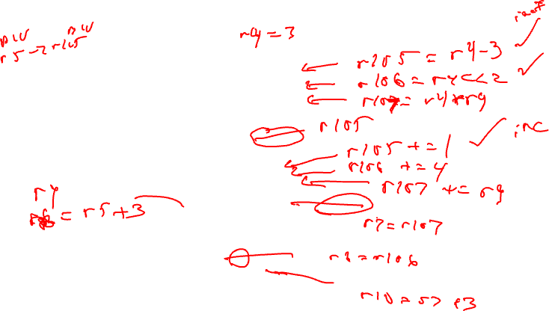
Induction Variable Strength Reduction - Example
BB1
BB2
1. r5 = r4 - 3
2. r4 = r4 + 1
BB3
BB4
3. r7 = r4 * r9
BB5
4. r6 = r4 << 2
BB6

Slide 16
Class Problem
Optimize this applying
induction var str
reduction
BB1
1. r1 = 0
2. r2 = 0
BB2
3. r5 = r5 + 1
4. r11 = r5 * 2
5. r10 = r11 + 2
6. r12 = load (r10+0)
7. r9 = r1 << 1
8. r4 = r9 - 10
9. r3 = load(r4+4)
10. r3 = r3 + 1
11. store(r4+0, r3)
12. r7 = r3 << 2
13. r6 = load(r7+0)
14. r13 = r2 - 1
15. r1 = r1 + 1
16. r2 = r2 + 1
BB3
r13, r12, r6, r10
liveout

Slide 17
Class Problem Solution
r1 = 0
r2 = 0
r111 = r5 * 2
r109 = r1 << 1
r113 = r2 -1
Optimize this applying
induction var str reduction
r1 = 0
r2 = 0
r5 = r5 + 1
r11 = r5 * 2
r10 = r11 + 2
r12 = load (r10+0)
r9 = r1 << 1
r4 = r9 - 10
r3 = load(r4+4)
r3 = r3 + 1
store(r4+0, r3)
r7 = r3 << 2
r6 = load(r7+0)
r13 = r2 - 1
r1 = r1 + 1
r2 = r2 + 1
r5 = r5 + 1
r111 = r111 + 2
r11 = r111
r10 = r11 + 2
r12 = load (r10+0)
r9 = r109
r4 = r9 - 10
r3 = load(r4+4)
r3 = r3 + 1
store(r4+0, r3)
r7 = r3 << 2
r6 = load(r7+0)
r13 = r113
r1 = r1 + 1
r109 = r109 + 2
r2 = r2 + 1
r113 = r113 + 1
Note, after copy propagation, r10 and r4 can be strength reduced as well.
r13, r12, r6, r10
liveout
r13, r12, r6, r10
liveout

Slide 18
ILP Optimization
Traditional optimizations
Redundancy elimination
Reducing operation count
ILP (instruction-level parallelism) optimizations
Increase the amount of parallelism and the ability to overlap operations
Operation count is secondary, often trade parallelism for extra instructions (avoid code explosion)
ILP increased by breaking dependences
True or flow = read after write dependence
False or (anti/output) = write after read, write after write

Slide 19
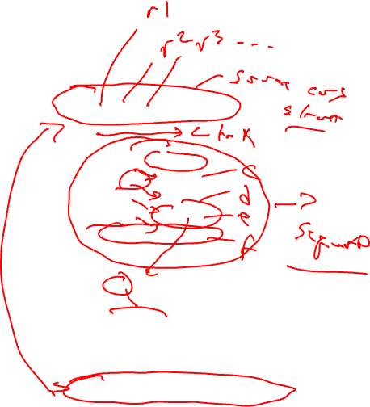
Back Substitution
Generation of expressions by compiler frontends is very sequential
Account for operator precedence
Apply left-to-right within same precedence
Back substitution
Create larger expressions
Iteratively substitute RHS expression for LHS variable
Note – may correspond to multiple source statements
Enable subsequent optis
Optimization
Re-compute expression in a more favorable manner
y = a + b + c – d + e – f;
1. r9 = r1 + r2
2. r10 = r9 + r3
3. r11 = r10 - r4
4. r12 = r11 + r5
5. r13 = r12 – r6
Subs r12:
r13 = r11 + r5 – r6
Subs r11:
r13 = r10 – r4 + r5 – r6
Subs r10
r13 = r9 + r3 – r4 + r5 – r6
Subs r9
r13 = r1 + r2 + r3 – r4 + r5 – r6

Slide 20
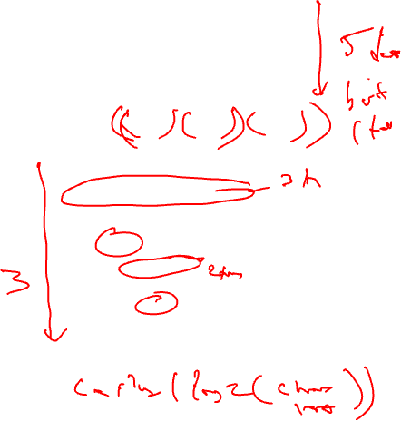
Tree Height Reduction
Re-compute expression as a balanced binary tree
Obey precedence rules
Essentially re-parenthesize
Combine literals if possible
Effects
Height reduced (n terms)
n-1 (assuming unit latency)
ceil(log2(n))
Number of operations remains constant
Cost
Temporary registers “live” longer
Watch out for
Always ok for integer arithmetic
Floating-point – may not be!!
original:
r9 = r1 + r2
r10 = r9 + r3
r11 = r10 - r4
r12 = r11 + r5
r13 = r12 – r6
after back subs:
r13 = r1 + r2 + r3 – r4 + r5 – r6
r1 + r2
r3 – r4
r5 – r6
final code:
+
t1 = r1 + r2
t2 = r3 – r4
t3 = r5 – r6
t4 = t1 + t2
r13 = t4 + t3
+
r13

Slide 21
Class Problem
Assume: + = 1, * = 3
operand
arrival times
0
r1
0
r2
0
r3
1
r4
2
r5
0
r6
1. r10 = r1 * r2
2. r11 = r10 + r3
3. r12 = r11 + r4
4. r13 = r12 – r5
5. r14 = r13 + r6
Back susbstitute
Re-express in tree-height reduced form
Account for latency and arrival times

Slide 22
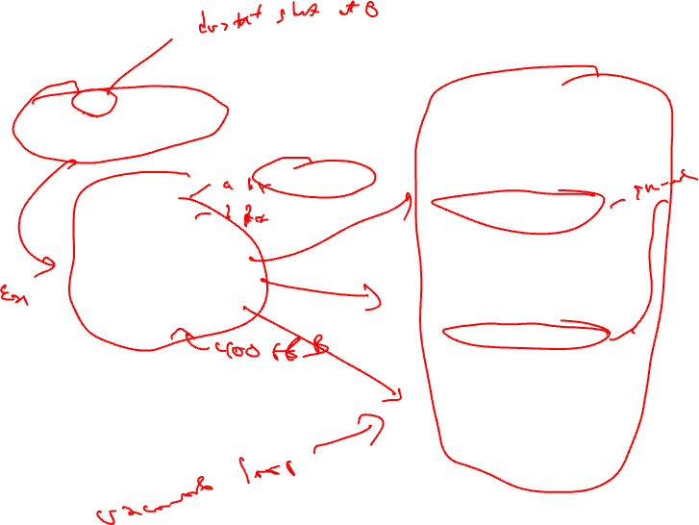
Loop Unrolling
for (i=x; i< 100; i++) {
sum += a[i]*b[i];
}
loop:
r1 = load(r2)
r3 = load(r4)
r5 = r1 * r3
r6 = r6 + r5
r2 = r2 + 4
r4 = r4 + 4
if (r4 >= 400) goto exit
unroll 3 times
iter1
loop:
r1 = load(r2)
r3 = load(r4)
r5 = r1 * r3
r6 = r6 + r5
r2 = r2 + 4
r4 = r4 + 4
if (r4 < 400) goto loop
r1 = load(r2)
r3 = load(r4)
r5 = r1 * r3
r6 = r6 + r5
r2 = r2 + 4
r4 = r4 + 4
if (r4 >= 400) goto exit
iter2
r1 = load(r2)
r3 = load(r4)
r5 = r1 * r3
r6 = r6 + r5
r2 = r2 + 4
r4 = r4 + 4
if (r4 < 400) goto loop
Unroll = replicate loop body
n-1 times.
Hope to enable overlap of
operation execution from
different iterations
iter3
exit:

Slide 23
Smarter Loop Unrolling with Known Trip Count
loop:
r1 = load(r2)
r3 = load(r4)
r5 = r1 * r3
r6 = r6 + r5
r2 = r2 + 4
r4 = r4 + 4
Want to remove early exit branches
iter1
Trip count = 400/4 = 100
r4 = 0
r1 = load(r2)
r3 = load(r4)
r5 = r1 * r3
r6 = r6 + r5
r2 = r2 + 4
r4 = r4 + 4
if (r4 < 400) goto loop
unroll multiple
of trip count
r1 = load(r2)
r3 = load(r4)
r5 = r1 * r3
r6 = r6 + r5
r2 = r2 + 4
r4 = r4 + 4
loop:
iter2
r1 = load(r2)
r3 = load(r4)
r5 = r1 * r3
r6 = r6 + r5
r2 = r2 + 4
r4 = r4 + 4
iter3
r1 = load(r2)
r3 = load(r4)
r5 = r1 * r3
r6 = r6 + r5
r2 = r2 + 4
r4 = r4 + 4
if (r4 < 400) goto loop
iter4
exit:

Slide 24
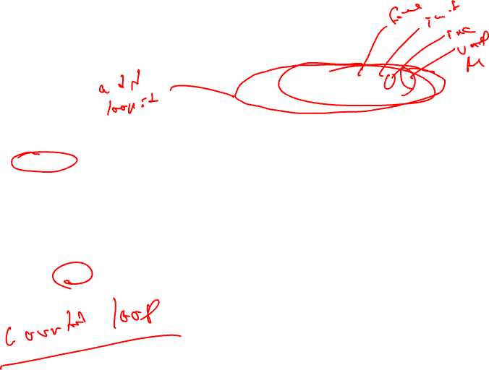
What if the Trip Count is not Statically Known?
preloop
for (i=0; i< ((400-r4)/4)%3; i++) {
sum += a[i]*b[i];
}
loop:
r1 = load(r2)
r3 = load(r4)
r5 = r1 * r3
r6 = r6 + r5
r2 = r2 + 4
r4 = r4 + 4
Create a preloop to ensure trip count of unrolled loop is a multiple of the unroll factor
iter1
r4 = ?? r1 = load(r2)
r3 = load(r4)
r5 = r1 * r3
r6 = r6 + r5
r2 = r2 + 4
r4 = r4 + 4
if (r4 < 400) goto loop
loop:
r1 = load(r2)
r3 = load(r4)
r5 = r1 * r3
r6 = r6 + r5
r2 = r2 + 4
r4 = r4 + 4
iter2
r1 = load(r2)
r3 = load(r4)
r5 = r1 * r3
r6 = r6 + r5
r2 = r2 + 4
r4 = r4 + 4
if (r4 < 400) goto loop
iter3
exit:

Slide 25
Unrolling Not Enough for Overlapping Iterations: Register Renaming
loop:
r1 = load(r2)
r3 = load(r4)
r5 = r1 * r3
r6 = r6 + r5
r2 = r2 + 4
r4 = r4 + 4
loop:
r1 = load(r2)
r3 = load(r4)
r5 = r1 * r3
r6 = r6 + r5
r2 = r2 + 4
r4 = r4 + 4
iter1
iter1
r1 = load(r2)
r3 = load(r4)
r5 = r1 * r3
r6 = r6 + r5
r2 = r2 + 4
r4 = r4 + 4
r11 = load(r2)
r13 = load(r4)
r15 = r11 * r13
r6 = r6 + r15
r2 = r2 + 4
r4 = r4 + 4
iter2
iter2
r1 = load(r2)
r3 = load(r4)
r5 = r1 * r3
r6 = r6 + r5
r2 = r2 + 4
r4 = r4 + 4
if (r4 < 400) goto loop
r21 = load(r2)
r23 = load(r4)
r25 = r21 * r23
r6 = r6 + r25
r2 = r2 + 4
r4 = r4 + 4
if (r4 < 400) goto loop
iter3
iter3

Slide 26
Register Renaming is Not Enough!
loop:
r1 = load(r2)
r3 = load(r4)
r5 = r1 * r3
r6 = r6 + r5
r2 = r2 + 4
r4 = r4 + 4
Still not much overlap possible
Problems
r2, r4, r6 sequentialize the iterations
Need to rename these
2 specialized renaming optis
Accumulator variable expansion (r6)
Induction variable expansion (r2, r4)
iter1
r11 = load(r2)
r13 = load(r4)
r15 = r11 * r13
r6 = r6 + r15
r2 = r2 + 4
r4 = r4 + 4
iter2
r21 = load(r2)
r23 = load(r4)
r25 = r21 * r23
r6 = r6 + r25
r2 = r2 + 4
r4 = r4 + 4
if (r4 < 400) goto loop
iter3

Slide 27
Accumulator Variable Expansion
r16 = r26 = 0
loop:
r1 = load(r2)
r3 = load(r4)
r5 = r1 * r3
r6 = r6 + r5
r2 = r2 + 4
r4 = r4 + 4
Accumulator variable
x = x + y or x = x – y
where y is loop variant!!
Create n-1 temporary accumulators
Each iteration targets a different accumulator
Sum up the accumulator variables at the end
May not be safe for floating-point values
iter1
r11 = load(r2)
r13 = load(r4)
r15 = r11 * r13
r16 = r16 + r15
r2 = r2 + 4
r4 = r4 + 4
iter2
r21 = load(r2)
r23 = load(r4)
r25 = r21 * r23
r26 = r26 + r25
r2 = r2 + 4
r4 = r4 + 4
if (r4 < 400) goto loop
iter3
exit:
r6 = r6 + r16 + r26

Slide 28
Induction Variable Expansion
r12 = r2 + 4, r22 = r2 + 8
r14 = r4 + 4, r24 = r4 + 8
Induction variable
x = x + y or x = x – y
where y is loop invariant!!
Create n-1 additional induction variables
Each iteration uses and modifies a different induction variable
Initialize induction variables to init, init+step, init+2*step, etc.
Step increased to n*original step
Now iterations are completely independent !!
r16 = r26 = 0
loop:
r1 = load(r2)
r3 = load(r4)
r5 = r1 * r3
r6 = r6 + r5
r2 = r2 + 12
r4 = r4 + 12
iter1
r11 = load(r12)
r13 = load(r14)
r15 = r11 * r13
r16 = r16 + r15
r12 = r12 + 12
r14 = r14 + 12
iter2
r21 = load(r22)
r23 = load(r24)
r25 = r21 * r23
r26 = r26 + r25
r22 = r22 + 12
r24 = r24 + 12
if (r4 < 400) goto loop
iter3
exit:
r6 = r6 + r16 + r26

Slide 29
Better Induction Variable Expansion
r16 = r26 = 0
loop:
r1 = load(r2)
r3 = load(r4)
r5 = r1 * r3
r6 = r6 + r5
With base+displacement addressing, often don’t need additional induction variables
Just change offsets in each iterations to reflect step
Change final increments to n * original step
iter1
r11 = load(r2+4)
r13 = load(r4+4)
r15 = r11 * r13
r16 = r16 + r15
iter2
r21 = load(r2+8)
r23 = load(r4+8)
r25 = r21 * r23
r26 = r26 + r25
r2 = r2 + 12
r4 = r4 + 12
if (r4 < 400) goto loop
iter3
exit:
r6 = r6 + r16 + r26

Slide 30
Homework Problem
loop:
loop:
r1 = load(r2)
r5 = r6 + 3
r6 = r5 + r1
r2 = r2 + 4
if (r2 < 400) goto loop
r1 = load(r2)
r5 = r6 + 3
r6 = r5 + r1
r2 = r2 + 4
r1 = load(r2)
r5 = r6 + 3
r6 = r5 + r1
r2 = r2 + 4
r1 = load(r2)
r5 = r6 + 3
r6 = r5 + r1
r2 = r2 + 4
if (r2 < 400) goto loop
Optimize the unrolled
loop
Renaming
Tree height reduction
Ind/Acc expansion

Slide 31
Homework Problem - Answer
loop:
loop:
r16 = r26 = 0
loop:
r1 = load(r2)
r5 = r6 + 3
r6 = r5 + r1
r2 = r2 + 4
if (r2 < 400) goto loop
r1 = load(r2)
r5 = r6 + 3
r6 = r5 + r1
r2 = r2 + 4
loop:
r1 = load(r2)
r5 = r1 + 3
r6 = r6 + r5
r2 = r2 + 4
r11 = load(r2)
r15 = r11 + 3
r6 = r6 + r15
r2 = r2 + 4
r21 = load(r2)
r25 = r21 + 3
r6 = r6 + r25
r2 = r2 + 4
if (r2 < 400)
goto loop
r1 = load(r2)
r5 = r1 + 3
r6 = r6 + r5
r11 = load(r2+4)
r15 = r11 + 3
r16 = r16 + r15
r21 = load(r2+8)
r25 = r21 + 3
r26 = r26 + r25
r2 = r2 + 12
if (r2 < 400)
goto loop
r6 = r6 + r16
r6 = r6 + r26
r1 = load(r2)
r5 = r6 + 3
r6 = r5 + r1
r2 = r2 + 4
r1 = load(r2)
r5 = r6 + 3
r6 = r5 + r1
r2 = r2 + 4
if (r2 < 400)
goto loop
Optimize the unrolled
loop
Renaming
Tree height reduction
Ind/Acc expansion
after renaming and
tree height reduction
after acc and
ind expansion

