Slide 1
EECS 583 – Class 8 Classic Optimization
University of Michigan
September 25, 2023

Slide 2
Announcements & Reading Material
HW2 – Get busy on it ASAP!
Talk about course projects next class – Start thinking about forming/joining a group (3-5 students)
Today’s class
Compilers: Principles, Techniques, and Tools, A. Aho, R. Sethi, and J. Ullman, Addison-Wesley, 1988, 9.9, 10.2, 10.3, 10.7 Edition 1; 8.5, 8.7, 9.1, 9.4, 9.5 Edition 2
Material for next Monday
“Compiler Code Transformations for Superscalar-Based High-Performance Systems,” S. Mahlke, W. Chen, J. Gyllenhaal, W. Hwu, P. Chang, and T. Kiyohara, Proceedings of Supercomputing '92, Nov. 1992, pp. 808-817
And if you want more on ILP optimizations: D. J. Kuck, The Structure of Computers and Computations. New York, NY: John Wiley and Sons, 1978. (optional!)

Slide 3
Code Optimization
Make the code run faster on the target processor
My (Scott’s) favorite topic !!
Other objectives: Power, code size
Classes of optimization
1. Classical (machine independent, done at IR level)
Reducing operation count (redundancy elimination)
Simplifying operations
Generally good for any kind of machine
2. Machine specific (done in llc)
Peephole optimizations
Take advantage of specialized hardware features
3. Parallelism enhancing (IR level often, but sometimes llc)
Increasing parallelism (ILP or TLP)
Possibly increase instructions

Slide 4
A Tour Through the Classical Optimizations
For this class – Go over concepts of a small subset of the optimizations
What it is, why its useful
When can it be applied (set of conditions that must be satisfied)
How it works
Give you the flavor but don’t want to beat you over the head
Challenges
Register pressure?
Parallelism verses operation count

Slide 5
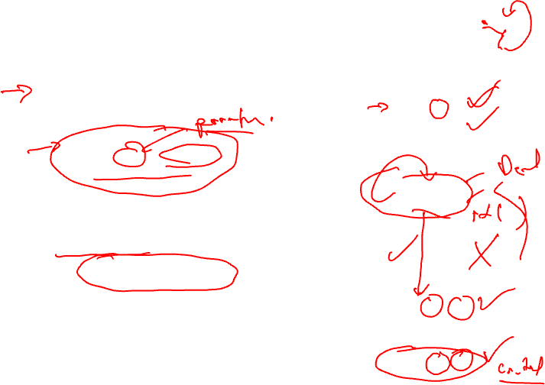
Dead Code Elimination
Remove any operation who’s result is never consumed
Rules
X can be deleted
no stores or branches
DU chain empty or dest register not live
This misses some dead code!!
Especially in loops
Better Algorithm
Critical operation
store or branch operation
Any operation that does not directly or indirectly feed a critical operation is dead
Trace UD chains backwards from critical operations
Any op not visited is dead
1. r1 = 3
2. r2 = 10
BB1
3. r4 = r4 + 1
4. r7 = r1 * r4
BB2
BB3
BB4
5. r2 = 0
6. r3 = r3 + 1
BB5
7. r3 = r2 + r1
BB6
8. store (r1, r3)

Slide 6
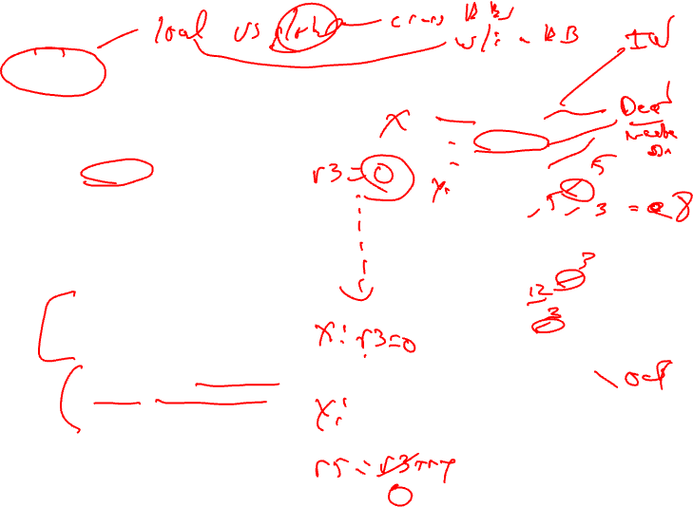
Local Constant Propagation
Forward propagation of moves of the form
rx = L (where L is a literal)
Maximally propagate
Consider 2 ops, X and Y in a BB, X is before Y
1. X is a move
2. src1(X) is a literal
3. Y consumes dest(X)
4. There is no definition of dest(X) between X and Y (local available defs)
BB1
1. r1 = 5
2. r2 = 3
3. r3 = 7
4. r4 = r4 + r1
5. r1 = r1 + r2
6. r1 = r1 + 1
7. r3 = 12
8. r8 = r1 - r2
9. r9 = r3 + r5
10. r3 = r2 + 1
11. r10 = r3 – r1
Note, ignore operation format issues, so all operations can have literals in either operand position

Slide 7
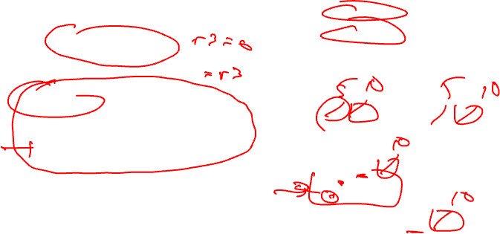
Global Constant Propagation
Consider 2 ops, X and Y in different BBs
1. X is a move
2. src1(X) is a literal
3. Y consumes dest(X)
4. X is in a_in(BB(Y)) (global available defs)
5. Dest(x) is not modified between the top of BB(Y) and Y (local available defs)
BB1
1. r1 = 5
2. r2 = 10
BB2
BB3
3. r1 = r1 + r2
4. r7 = r1 – r2
BB4
5. r8 = r1 * r2
BB5
6. r9 = r1 + r2

Slide 8
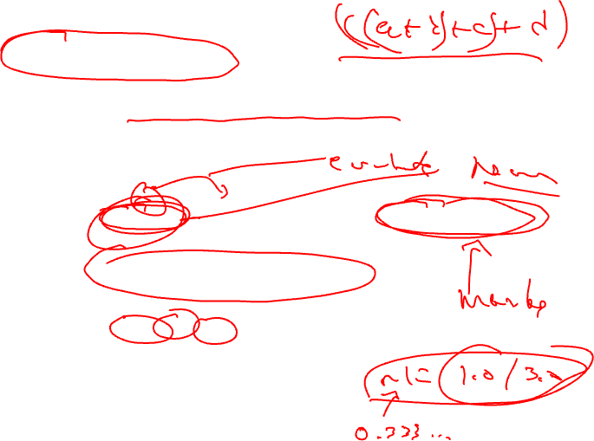
Constant Folding
Simplify 1 operation based on values of src operands
Constant propagation creates opportunities for this
All constant operands
Evaluate the op, replace with a move
r1 = 3 * 4 → r1 = 12
r1 = 3 / 0 → ??? Don’t evaluate excepting ops !, what about floating-point?
Evaluate conditional branch, replace with BRU or noop
if (1 < 2) goto BB2 → BRU BB2
if (1 > 2) goto BB2 → convert to a noop
Algebraic identities
r1 = r2 + 0, r2 – 0, r2 | 0, r2 ^ 0, r2 << 0, r2 >> 0
r1 = r2
r1 = 0 * r2, 0 / r2, 0 & r2
r1 = 0
r1 = r2 * 1, r2 / 1
r1 = r2

Slide 9
Class Problem
Optimize this applying
1. constant propagation
2. constant folding
1. r1 = 0
2. r2 = 10
3. r3 = 0
BB1
BB2
4. r4 = 1
5. r7 = r1 * 4
6. r6 = 8
7. if (r3 > 0)
BB3
BB4
8. r2 = 0
9. r6 = r6 * r7
10. r3 = r2 / r6
11. r3 = r4
12. r3 = r3 + r2
13. r1 = r6
BB5
14. r2 = r2 + 1
15. r1 = r1 + 1
16. if (r1 < 100)
BB6
17. store (r1, r3)

Slide 10
Class Problem - Solution
Optimize this applying
1. constant propagation
2. constant folding
1. r1 = 0
2. r2 = 10
3. r3 = 0
1. r1 = 0
2. r2 = 10
3. r3 = 0
BB1
BB1
BB2
4. r4 = 1
5. r7 = r1 * 4
6. r6 = 8
7. if (r3 > 0)
BB2
4. r4 = 1
5. r7 = r1 * 4
6. r6 = 8
7. if (r3 > 0)
BB3
BB4
BB3
BB4
8. r2 = 0
9. r6 = r6 * r7
10. r3 = r2 / r6
11. r3 = r4
12. r3 = r3 + r2
13. r1 = r6
8. r2 = 0
9. r6 = r7 << 3
10. r3 = 0
11. r3 = 1
12. r3 = 1 + r2
13. r1 = 8
BB5
14. r2 = r2 + 1
15. r1 = r1 + 1
16. if (r1 < 100)
BB5
14. r2 = r2 + 1
15. r1 = r1 + 1
16. if (r1 < 100)
BB6
17. store (r1, r3)
BB6
17. store (r1, r3)
Red instructions can be deleted by
subsequent dead code elimination

Slide 11
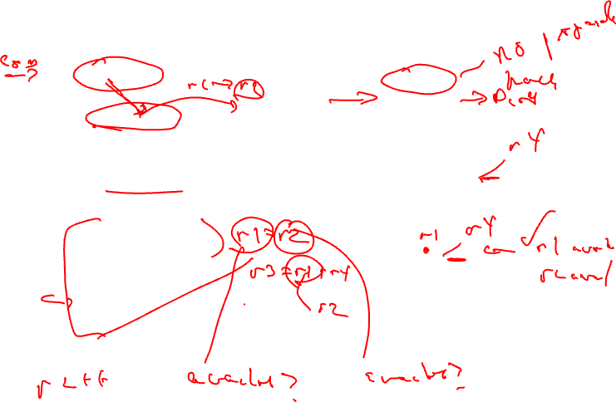
Forward Copy Propagation
Forward propagation of the RHS of moves
r1 = r2
…
r4 = r1 + 1 → r4 = r2 + 1
Benefits
Reduce chain of dependences
Eliminate the move
Rules (ops X and Y)
X is a move
src1(X) is a register
Y consumes dest(X)
X.dest is an available def at Y
X.src1 is an available expr at Y
BB1
1. r1 = r2
2. r3 = r4
BB2
BB3
3. r2 = 0
4. r6 = r3 + 1
BB4
5. r5 = r2 + r3

Slide 12
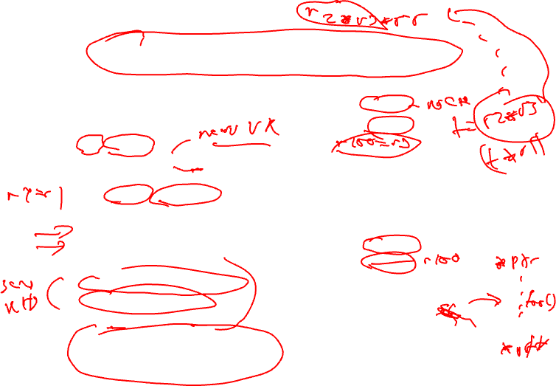
CSE – Common Subexpression Elimination
Eliminate recomputation of an expression by reusing the previous result
r1 = r2 * r3
→ r100 = r1
…
r4 = r2 * r3 → r4 = r100
Benefits
Reduce work
Moves can get copy propagated
Rules (ops X and Y)
X and Y have the same opcode
src(X) = src(Y), for all srcs
expr(X) is available at Y
if X is a load, then there is no store that may write to address(X) along any path between X and Y
BB1
1. r1 = r2 * r6
2. r3 = r4 / r7
BB2
BB3
3. r2 = r2 + 1
4. r6 = r3 * 7
BB4
5. r5 = r2 * r6
6. r8 = r4 / r7
7. r9 = r3 * 7
if op is a load, call it redundant
load elimination rather than CSE,
Redundant store elimination also possible,
but applied a bit differently – think about it!

Slide 13
Class Problem
Optimize this applying
1. dead code elimination
2. forward copy propagation
3. CSE
BB1
1. r4 = r1
2. r6 = r15
3. r2 = r3 * r4
4. r8 = r2 + r5
5. r9 = r3
6. r7 = load(r2)
7. if (r2 > r8)
BB2
BB3
8. r5 = r9 * r4
9. r11 = r2
10. r12 = load(r11)
11. if (r12 != 0)
12. r3 = load(r2)
13. r10 = r3 / r6
14. r11 = r8
15. store (r11, r7)
BB4
16. store (r12, r3)

Slide 14
Class Problem Solution
Optimize this applying
1. dead code elimination
2. forward copy propagation
3. CSE
r4 = r1
r6 = r15
r2 = r3 * r4
r8 = r2 + r5
r9 = r3
r7 = load(r2)
if (r2 > r8)
r2 = r3 * r1
r8 = r2 + r5
r7 = load(r2)
if (r2 > r8)
r5 = r9 * r4
r11 = r2
r12 = load(r11)
if (r12 != 0)
r3 = load(r2)
r10 = r3 / r6
r11 = r8
store (r11, r7)
if (r7 != 0)
r3 = r7
store (r8, r7)
store (r12, r3)
store (r12, r3)

Slide 15
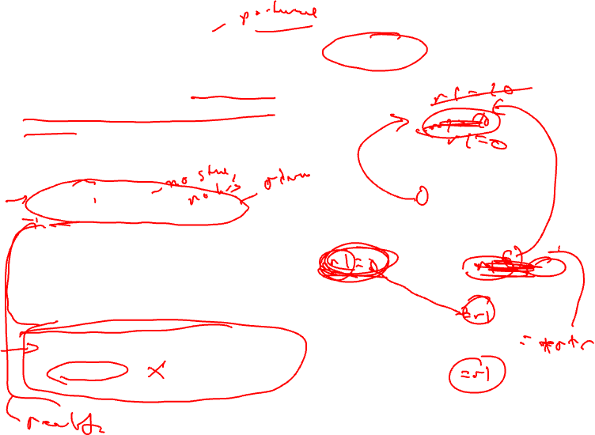
Loop Invariant Code Motion (LICM)
Move operations whose source operands do not change within the loop to the loop preheader
Execute them only 1x per invocation of the loop
Rules
X can be moved
src(X) not modified in loop body
X is the only op to modify dest(X)
for all uses of dest(X), X is in the available defs set
for all exit BB, if dest(X) is live on the exit edge, X is in the available defs set on the edge
if X not executed on every iteration, then X must provably not cause exceptions
if X is a load or store, then there are no writes to address(X) in loop
BB1
BB2
BB3
BB4
BB5
BB6

Slide 16
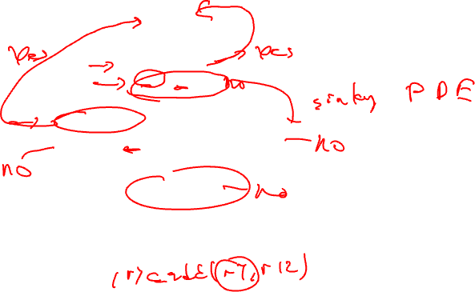
LICM Example
BB1
1. r1 = 3
2. r5 = &A
BB2
3. r4 = load(r5)
4. r7 = r4 * 3
BB3
BB4
5. r8 = r2 + 1
6. r7 = r8 * r4
7. r3 = r2 + 1
BB5
8. r1 = r1 + r7
BB6
9. store (r1, r3)

Slide 17
Global Variable Migration
Assign a global variable temporarily to a register for the duration of the loop
Load in preheader
Store at exit points
Rules
X is a load or store
address(X) not modified in the loop
if X not executed on every iteration, then X must provably not cause an exception
All memory ops in loop whose address can equal address(X) must always have the same address as X
BB1
BB2
1. r4 = load(r5)
2. r4 = r4 + 1
BB3
BB4
3. r8 = load(r5)
4. r7 = r8 * r4
5. store(r5, r4)
BB5
6. store(r5,r7)
BB6

Slide 18
Global Variable Migration Example
BB1
BB2
1. r4 = load(r5)
2. r4 = r4 + 1
BB3
BB4
3. r8 = load(r5)
4. r7 = r8 * r4
5. store(r5, r4)
BB5
6. store(r5,r7)
BB6

Slide 19
Induction Variable Strength Reduction
Create basic induction variables from derived induction variables
Induction variable
BIV (i++)
0,1,2,3,4,...
DIV (j = i * 4)
0, 4, 8, 12, 16, ...
DIV can be converted into a BIV that is incremented by 4
Issues
Initial and increment vals
Where to place increments
BB1
BB2
1. r5 = r4 - 3
2. r4 = r4 + 1
BB3
BB4
3. r7 = r4 * r9
BB5
4. r6 = r4 << 2
BB6

Slide 20
Induction Variable Strength Reduction (2)
Rules
X is a *, <<, + or – operation
src1(X) is a basic ind var
src2(X) is invariant
No other ops modify dest(X)
dest(X) != src(X) for all srcs
dest(X) is a register
Transformation
Insert the following into the preheader
new_reg = RHS(X)
If opcode(X) is not add/sub, insert to the bottom of the preheader
new_inc = inc(src1(X)) opcode(X) src2(X)
else
new_inc = inc(src1(X))
Insert the following at each update of src1(X)
new_reg += new_inc
Change X → dest(X) = new_reg
BB1
BB2
1. r5 = r4 - 3
2. r4 = r4 + 1
BB3
BB4
3. r7 = r4 * r9
BB5
4. r6 = r4 << 2
BB6

Slide 21
Induction Variable Strength Reduction - Example
BB1
BB2
1. r5 = r4 - 3
2. r4 = r4 + 1
BB3
BB4
3. r7 = r4 * r9
BB5
4. r6 = r4 << 2
BB6

Slide 22
Class Problem
Optimize this applying
induction var str
reduction
BB1
1. r1 = 0
2. r2 = 0
BB2
3. r5 = r5 + 1
4. r11 = r5 * 2
5. r10 = r11 + 2
6. r12 = load (r10+0)
7. r9 = r1 << 1
8. r4 = r9 - 10
9. r3 = load(r4+4)
10. r3 = r3 + 1
11. store(r4+0, r3)
12. r7 = r3 << 2
13. r6 = load(r7+0)
14. r13 = r2 - 1
15. r1 = r1 + 1
16. r2 = r2 + 1
BB3
r13, r12, r6, r10
liveout

Slide 23
Class Problem Solution
r1 = 0
r2 = 0
r111 = r5 * 2
r109 = r1 << 1
r113 = r2 -1
Optimize this applying
induction var str reduction
r1 = 0
r2 = 0
r5 = r5 + 1
r11 = r5 * 2
r10 = r11 + 2
r12 = load (r10+0)
r9 = r1 << 1
r4 = r9 - 10
r3 = load(r4+4)
r3 = r3 + 1
store(r4+0, r3)
r7 = r3 << 2
r6 = load(r7+0)
r13 = r2 - 1
r1 = r1 + 1
r2 = r2 + 1
r5 = r5 + 1
r111 = r111 + 2
r11 = r111
r10 = r11 + 2
r12 = load (r10+0)
r9 = r109
r4 = r9 - 10
r3 = load(r4+4)
r3 = r3 + 1
store(r4+0, r3)
r7 = r3 << 2
r6 = load(r7+0)
r13 = r113
r1 = r1 + 1
r109 = r109 + 2
r2 = r2 + 1
r113 = r113 + 1
Note, after copy propagation, r10 and r4 can be strength reduced as well.
r13, r12, r6, r10
liveout
r13, r12, r6, r10
liveout

