Slide 1
EECS 583 – Class 6 Dataflow Analysis II
University of Michigan
September 18, 2023

Slide 2
Announcements & Reading Material
HW 1 – Due tonight at midnight
See piazza/GSIs if you are stuck
HW 2 coming out Friday
Today’s class
Compilers: Principles, Techniques, and Tools, A. Aho, R. Sethi, and J. Ullman, Addison-Wesley, 1988. (Sections: 10.5, 10.6, 10.9, 10.10 Edition 1; 9.2, 9.3 Edition 2)
Next class
“Practical Improvements to the Construction and Destruction of Static Single Assignment Form,” P. Briggs, K. Cooper, T. Harvey, and L. Simpson, Software--Practice and Experience, 28(8), July 1998, pp. 859-891.

Slide 3
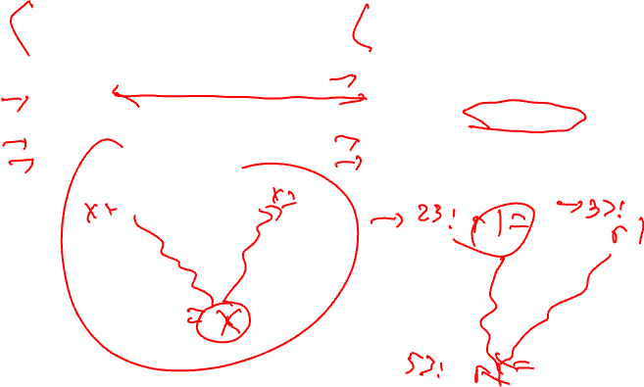
Recap: Liveness vs Reaching Defs
Liveness
Reaching Definitions/DU/UD
OUT = Union(IN(succs))
IN = GEN + (OUT – KILL)
IN = Union(OUT(preds))
OUT = GEN + (IN – KILL)
Bottom-up dataflow
Any path
Keep track of variables/registers
Uses of variables → GEN
Defs of variables → KILL
Top-down dataflow
Any path
Keep track of instruction IDs
Defs of variables → GEN
Defs of variables → KILL

Slide 4
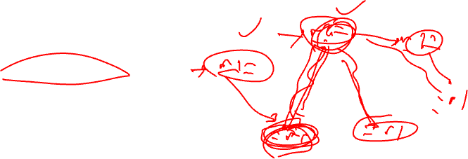
DU/UD Chains
Convenient way to access/use reaching defs info
Def-Use chains
Given a def, what are all the possible consumers of the operand produced
Maybe consumer
Use-Def chains
Given a use, what are all the possible producers of the operand consumed
Maybe producer

Slide 5
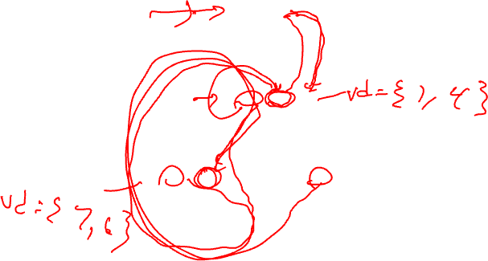
Example – DU/UD Chains
1. r1 = 3
2. r2 = r3
3. r3 = r4
4. r1 = r1 + 1
5. r7 = r1 * r2
6. r4 = r4 + 1
7. r4 = r3
8. r8 = 8
9. r9 = r7 + r8

Slide 6
Generalizing Dataflow Analysis
Transfer function
How information is changed by “something” (BB)
OUT = GEN + (IN – KILL) /* forward analysis, e.g., rdefs */
IN = GEN + (OUT – KILL) /* backward analysis, e.g., liveness */
Meet function
How information from multiple paths is combined
IN = Union(OUT(predecessors)) /* forward analysis */
OUT = Union(IN(successors)) /* backward analysis */
Generalized dataflow algorithm
while (change)
change = false
for each BB
apply meet function
apply transfer functions
if any changes → change = true

Slide 7
What About All Path Problems?
Up to this point
Any path problems (maybe relations)
Definition reaches along some path
Some sequence of branches in which def reaches
Lots of defs of the same variable may reach a point
Use of Union operator in meet function
All-path: Definition guaranteed to reach
Regardless of sequence of branches taken, def reaches
Can always count on this
Only 1 def can be guaranteed to reach
Availability (as opposed to reaching)
Available definitions
Available expressions (could also have reaching expressions, but not that useful)

Slide 8
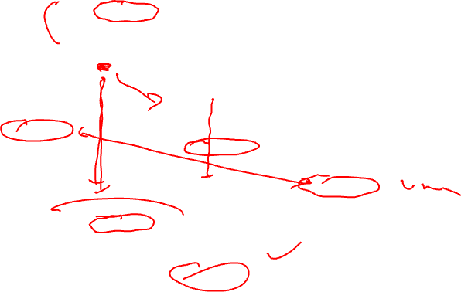
Reaching vs Available Definitions
1:r1 = r2 + r3
2:r6 = r4 – r5
1,2 reach
1,2 available
3:r4 = 4
4:r6 = 8
1,2 reach
1,2 available
1,3,4 reach
1,3,4 available
5:r6 = r2 + r3
6:r7 = r4 – r5
1,2,3,4 reach
1 available

Slide 9
Available Definition Analysis (Adefs)
A definition d is available at a point p if along all paths from d to p, d is not killed
Remember, a definition of a variable is killed between 2 points when there is another definition of that variable along the path
r1 = r2 + r3 kills previous definitions of r1
Algorithm
Forward dataflow analysis as propagation occurs from defs downwards
Use the Intersect function as the meet operator to guarantee the all-path requirement
GEN/KILL/IN/OUT similar to reaching defs
Initialization of IN/OUT is the tricky part

Slide 10
Compute GEN/KILL Sets for each BB (Adefs)
Exactly the same as reaching defs !!!
for each basic block in the procedure, X, do
GEN(X) = 0
KILL(X) = 0
for each operation in sequential order in X, op, do
for each destination operand of op, dest, do
G = op
K = {all ops which define dest – op}
GEN(X) = G + (GEN(X) – K)
KILL(X) = K + (KILL(X) – G)
endfor
endfor
endwhile

Slide 11
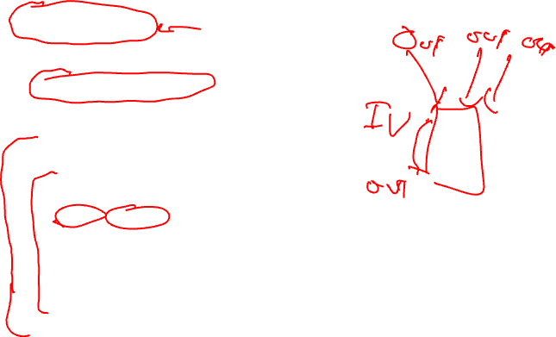
Compute IN/OUT Sets for all BBs (Adefs)
U = universal set of all operations in the Procedure
IN(0) = 0
OUT(0) = GEN(0)
for each basic block in procedure, W, (W != 0), do
IN(W) = 0
OUT(W) = U – KILL(W)
change = 1
while (change) do
change = 0
for each basic block in procedure, X, do
old_OUT = OUT(X)
IN(X) = Intersect(OUT(Y)) for all predecessors Y of X
OUT(X) = GEN(X) + (IN(X) – KILL(X))
if (old_OUT != OUT(X)) then
change = 1
endif
endfor
endwhile

Slide 12
Example Adef Calculation
G = op
K = {all ops which define dest – op}
GEN(X) = G + (GEN(X) – K)
KILL(X) = K + (KILL(X) – G)
BB1
1. r1 = MEM[r2+0]
2. r2 = MEM[r1 + 1]
3. r8 = r1 * r2
BB2
4. r1 = r1 + 5
5. r3 = r5 – r1
6. r7 = r3 * 2
BB3
7. r2 = 0
8. r7 = r1 + r2
9. r3 = 4
BB4
10. r3 = r3 + r7
11. r1 = r2 – r8
12. r3 = r1 * 2

Slide 13
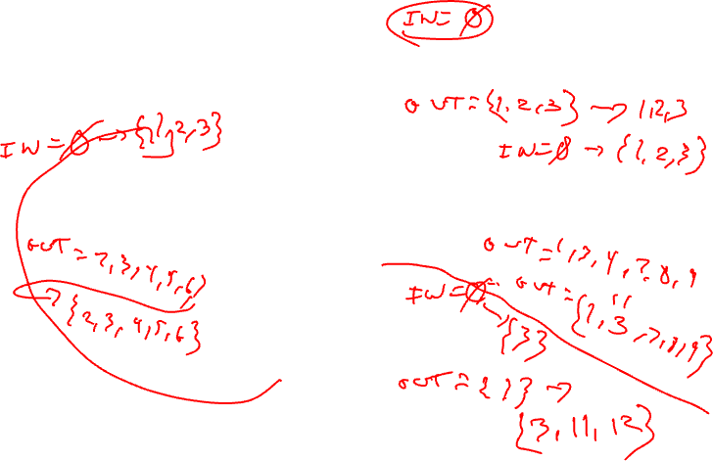
Example Adef Calculation - Continued
IN = Intersect(OUT(preds))
OUT = GEN + (IN – KILL)
BB1
1. r1 = MEM[r2+0]
2. r2 = MEM[r1 + 1]
3. r8 = r1 * r2
GEN = 1, 2, 3
KILL = 4, 7, 11
BB2
4. r1 = r1 + 5
5. r3 = r5 – r1
6. r7 = r3 * 2
BB3
7. r2 = 0
8. r7 = r1 + r2
9. r3 = 4
GEN = 4, 5, 6
KILL = 1, 8, 9, 10, 11, 12
GEN = 7, 8, 9
KILL = 2, 5, 6, 10, 12
BB4
10. r3 = r3 + r7
11. r1 = r2 – r8
12. r3 = r1 * 2
GEN = 11, 12
KILL = 1,4,5,9,10

Slide 14
Example Adef Calculation - Answer
IN = Intersect(OUT(preds))
OUT = GEN + (IN – KILL)
BB1
1. r1 = MEM[r2+0]
2. r2 = MEM[r1 + 1]
3. r8 = r1 * r2
IN = 0 → 0
GEN = 1, 2, 3
KILL = 4, 7, 11
OUT = 1,2,3 → 1,2,3
IN = 0 → 1,2,3
BB2
4. r1 = r1 + 5
5. r3 = r5 – r1
6. r7 = r3 * 2
BB3
7. r2 = 0
8. r7 = r1 + r2
9. r3 = 4
IN = 0 → 1,2,3
GEN = 4, 5, 6
KILL = 1, 8, 9, 10, 11, 12
GEN = 7, 8, 9
KILL = 2, 5, 6, 10, 12
OUT = 2,3,4,5,6,7 → 2,3,4,5,6
OUT = 1,3,4,7,8,9,11 → 1,3,7,8,9
BB4
10. r3 = r3 + r7
11. r1 = r2 – r8
12. r3 = r1 * 2
IN = 0 → 3
GEN = 11, 12
KILL = 1,4,5,9,10
OUT = 2,3,6,7,8,11,12 → 3,11,12

Slide 15
Available Expression Analysis (Aexprs)
An expression is a RHS of an operation
r2 = r3 + r4, r3+r4 is an expression
An expression e is available at a point p if along all paths from e to p, e is not killed
An expression is killed between 2 points when one of its source operands are redefined
r1 = r2 + r3 kills all expressions involving r1
Algorithm
Forward dataflow analysis as propagation occurs from defs downwards
Use the Intersect function as the meet operator to guarantee the all-path requirement
Looks exactly like adefs, except GEN/KILL/IN/OUT are the RHS’s of operations rather than the LHS’s

Slide 16
Computation of Aexpr GEN/KILL Sets
We can also formulate the GEN/KILL slightly differently so you do not
need to break up instructions like “r2 = r2 + 1”.
for each basic block in the procedure, X, do
GEN(X) = 0
KILL(X) = 0
for each operation in sequential order in X, op, do
K = 0
for each destination operand of op, dest, do
K += {all ops which use dest}
endfor
if (op not in K)
G = op
else
G = 0
GEN(X) = G + (GEN(X) – K)
KILL(X) = K + (KILL(X) – G)
endfor
endfor

Slide 17
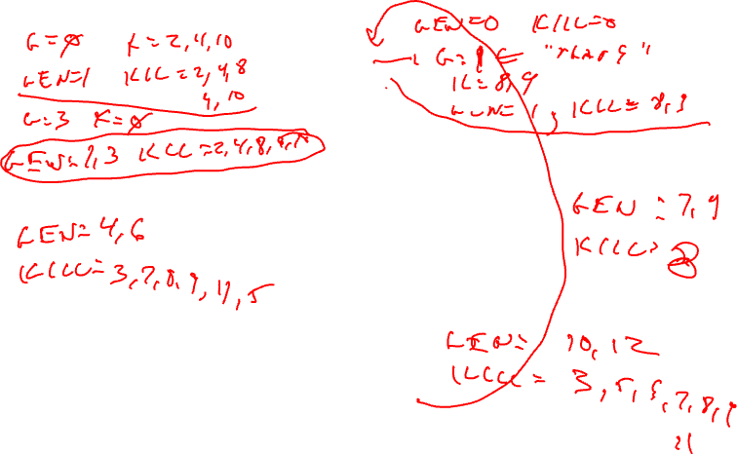
Example Aexpr Calculation
1: r1 = r6 * r9
2: r2 = r2 + 1
3: r5 = r3 * r4
4: r1 = r2 + 1
5: r3 = r3 * r4
6: r8 = r3 * 2
7: r7 = r3 * r4
8: r1 = r1 + 5
9: r7 = r1 - 6
10: r8 = r2 + 1
11: r1 = r3 * r4
12: r3 = r6 * r9

Slide 18
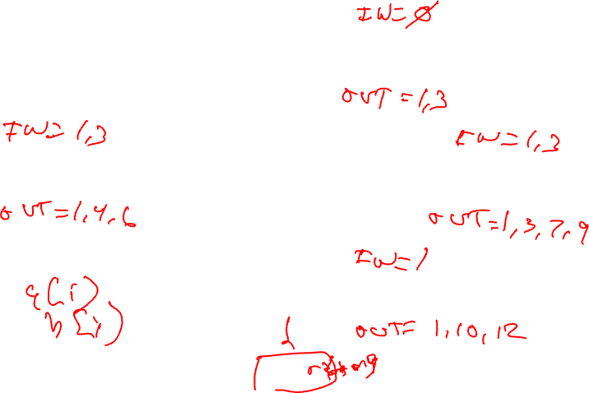
Example Aexpr Calculation - Continued
1: r1 = r6 * r9
2: r2 = r2 + 1
3: r5 = r3 * r4
GEN = 1,3 (remember {1, 3} means {“r6*r9”, “r3*r4”})
KILL = 2, 4, 8, 9, 10
4: r1 = r2 + 1
5: r3 = r3 * r4
6: r8 = r3 * 2
7: r7 = r3 * r4
8: r1 = r1 + 5
9: r7 = r1 - 6
GEN = 4, 6
KILL = 3, 5, 7, 8, 9, 11
GEN = 7, 9
KILL = 8
10: r8 = r2 + 1
11: r1 = r3 * r4
12: r3 = r6 * r9
GEN = 10, 12
KILL = 3, 5, 6, 7, 8, 9, 11

Slide 19
Example Aexpr Calculation - Answer
IN/OUT sets
A → B
A = initial state
B = after first iteration
IN = - → -
1: r1 = r6 * r9
2: r2 = r2 + 1
3: r5 = r3 * r4
GEN = 1,3 (remember {1, 3} means {“r6*r9”, “r3*r4”})
KILL = 2, 4, 8, 9, 10
OUT = 1,3,5,6,7,11,12 → 1,3
IN = - → 1,3
4: r1 = r2 + 1
5: r3 = r3 * r4
6: r8 = r3 * 2
7: r7 = r3 * r4
8: r1 = r1 + 5
9: r7 = r1 - 6
IN = - → 1,3
GEN = 4, 6
KILL = 3, 5, 7, 8, 9, 11
GEN = 7, 9
KILL = 8
OUT = 1,2,4,6,10,12 → 1,4,6
OUT = 1,2,3,4,5,6,7,9,10,11,12 → 1,3,7,9
10: r8 = r2 + 1
11: r1 = r3 * r4
12: r3 = r6 * r9
IN = - → 1
GEN = 10, 12
KILL = 3, 5, 6, 7, 8, 9, 11
OUT = 1,2,4,10,12 → 1,10,12

Slide 20
Dataflow Summary
Liveness
Reaching Definitions/DU/UD
OUT = Union(IN(succs))
IN = GEN + (OUT – KILL)
IN = Union(OUT(preds))
OUT = GEN + (IN – KILL)
Bottom-up dataflow
Any path
Keep track of variables/registers
Uses of variables → GEN
Defs of variables → KILL
Top-down dataflow
Any path
Keep track of instruction IDs
Defs of variables → GEN
Defs of variables → KILL
Available Expressions
Available Definitions
IN = Intersect(OUT(preds))
OUT = GEN + (IN – KILL)
IN = Intersect(OUT(preds))
OUT = GEN + (IN – KILL)
Top-down dataflow
All path
Keep track of instruction IDs
Expressions of variables → GEN
Defs of variables → KILL
Top-down dataflow
All path
Keep track of instruction IDs
Defs of variables → GEN
Defs of variables → KILL

