Slide 1

EECS 583 – Class 13
Software Pipelining
University of Michigan
October 18, 2023

Slide 2
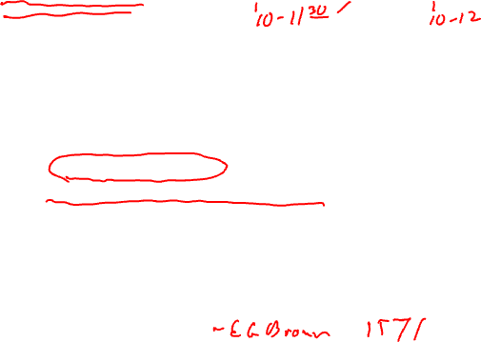
Announcements + Reading Material
Project discussion meetings – Oct 23 (M), Oct 25 (W), Oct 26 (Th) (slots 10am-noon each day)
  Each group meets 10 mins with Aditya, Tarun, and I on Zoom, use GSI office hour link
  Action items
    Form or join a team (3-5 people per team)
    Use piazza to recruit additional group members or express your availability
    Project areas, start looking for research papers, think about the specifics
  Google calendar signup available – see piazza post by Aditya – Please just sign up once!
Project proposals
  Due Monday, Oct 30, midnight
  1 paragraph summary of what you plan to work on
    Topic, what are you going to do, what is the goal, 1-2 references
  Email to me & Aditya & Tarun, cc all your group members
Today’s class reading
  “Code Generation Schema for Modulo Scheduled Loops”, B. Rau, M. Schlansker, and P. Tirumalai, MICRO-25, Dec. 1992.
Next class (Fri, Oct 20)
  “Register Allocation and Spilling Via Graph Coloring,” G. Chaitin, Proc. 1982 SIGPLAN Symposium on Compiler Construction, 1982.

Slide 3
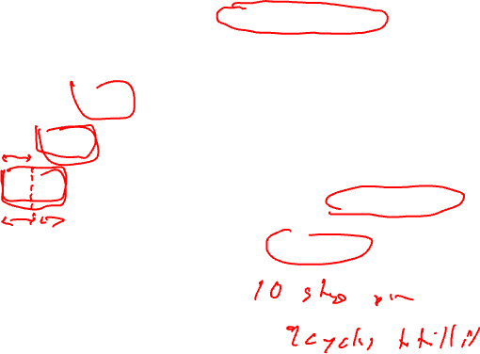
Recap: Software Pipelining Terminology
Initiation Interval (II) = fixed delay
between the start of successive iterations
Each iteration can be divided
into stages consisting of II cycles
each
Number of stages in 1 iteration
is termed the stage count (SC)
Takes SC-1 cycles to fill/drain the pipe
time
Iter 3
II
Iter 2
Iter 1

Slide 4
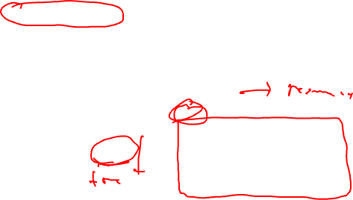
Recap: Resource Usage Legality
Need to guarantee that
  No resource is used at 2 points in time that are separated by an interval which is a multiple of II
  I.E., within a single iteration, the same resource is never used more than 1x at the same time modulo II
  Known as modulo constraint, where the name modulo scheduling comes from
  Modulo reservation table solves this problem
    To schedule an op at time T needing resource R
      The entry for R at T mod II must be free
    Mark busy at T mod II if schedule
alu1
alu2
mem
bus0
bus1
br
0
II = 3
1
2

Slide 5
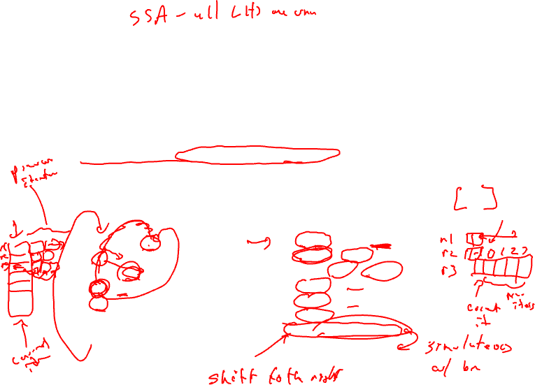
Dynamic Single Assignment (DSA) Form
Impossible to overlap iterations because each iteration writes to the same
register. So, we’ll have to remove the anti and output dependences.
Virtual rotating registers
* Each register is an infinite push down array (Expanded virtual reg or EVR)
* Write to top element, but can reference any element
* Remap operation slides everything down → r[n] changes to r[n+1]
A program is in DSA form if the same virtual register (EVR element) is never
assigned to more than 1x on any dynamic execution path
1: r3 = load(r1)
2: r4 = r3 * 26
3: store (r2, r4)
4: r1 = r1 + 4
5: r2 = r2 + 4
6: p1 = cmpp (r1 < r9)
7: brct p1 Loop
1: r3[-1] = load(r1[0])
2: r4[-1] = r3[-1] * 26
3: store (r2[0], r4[-1])
4: r1[-1] = r1[0] + 4
5: r2[-1] = r2[0] + 4
6: p1[-1] = cmpp (r1[-1] < r9)
remap r1, r2, r3, r4, p1
7: brct p1[-1] Loop
DSA
conversion

Slide 6
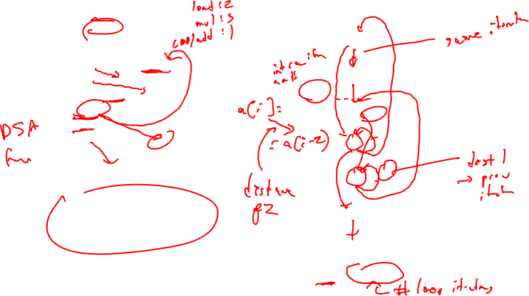
Loop Dependence Example
r1 = &A
r2 = &B
1,1
1
Loop:
1: r3[-1] = load(r1[0])
2: r4[-1] = r3[-1] * 26
3: store (r2[0], r4[-1])
4: r1[-1] = r1[0] + 4
5: r2[-1] = r2[0] + 4
6: p1[-1] = cmpp (r1[-1] < r9)
remap r1, r2, r3, r4, p1
7: brct p1[-1] Loop
2,0
2
0,0
3,0
3
0,0
1,1
1,1
4
1,0
5
1,1
In DSA form, there are no
inter-iteration anti or output
dependences!
Assume compiler can prove load
and store are never dependent
6
1,0
7
<delay, distance>

Slide 7
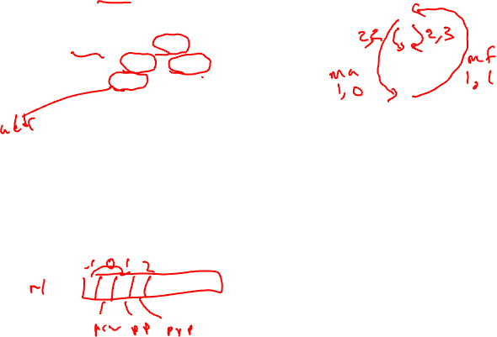
Class Problem
Latencies: ld = 2, st = 1, add = 1, cmpp = 1, br = 1
1
1: r1[-1] = load(r2[0])
2: r3[-1] = r1[1] – r1[2]
3: store (r3[-1], r2[0])
4: r2[-1] = r2[0] + 4
5: p1[-1] = cmpp (r2[-1] < 100)
remap r1, r2, r3
6: brct p1[-1] Loop
2
3
4
5
Draw the dependence graph
showing both intra and inter
iteration dependences
6

Slide 8
Class Problem Answer
Latencies: ld = 2, st = 1, add = 1, cmpp = 1, br = 1
1
1
<1,1>
1: r1[-1] = load(r2[0])
2: r3[-1] = r1[1] – r1[2]
3: store (r3[-1], r2[0])
4: r2[-1] = r2[0] + 4
5: p1[-1] = cmpp (r2[-1] < 100)
remap r1, r2, r3
6: brct p1[-1] Loop
<1,0>
<2,2>
<2,3>
2
<0,0>
2
<1,1>
<1,0>
3
3
<0,0>
<1,1>
4
<1,1>
4
<1,0>
5
5
Draw the dependence graph
showing both intra and inter
iteration dependences
<1,0>
6
6
Red edges are memory anti and
flow dependences
Instructions 1-5 have <0,0>
control dependences to 6.

Slide 9
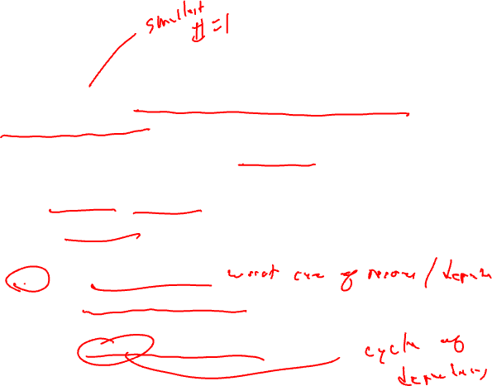
Minimum Initiation Interval (MII)
Remember, II = number of cycles between the start of successive iterations
Modulo scheduling requires a candidate II be selected before scheduling is attempted
  Try candidate II, see if it works
  If not, increase by 1, try again repeating until successful
MII is a lower bound on the II
  MII = Max(ResMII, RecMII)
  ResMII = resource constrained MII
    Resource usage requirements of 1 iteration
  RecMII = recurrence constrained MII
    Latency of the circuits in the dependence graph

Slide 10
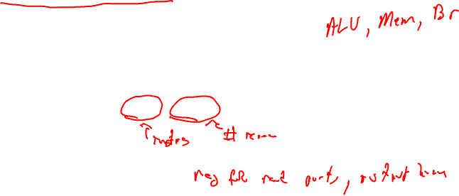
ResMII
Concept: If there were no dependences between the operations, what
is the the shortest possible schedule?
Simple resource model
A processor has a set of resources R. For each resource r in R
there is count(r) specifying the number of identical copies
ResMII = MAX (uses(r) / count(r))
for all r in R
uses(r) = number of times the resource is used in 1 iteration
In reality its more complex than this because operations can have
multiple alternatives (different choices for resources it could be
assigned to), but we will ignore this for now

Slide 11
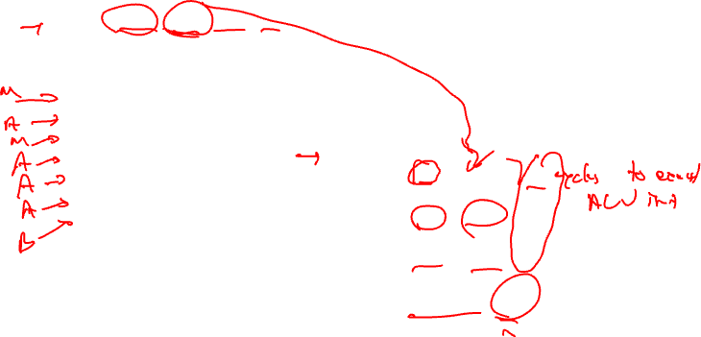
ResMII Example
ResMII = MAX (uses(r) / count(r))
resources: 4 issue, 2 alu, 1 mem, 1 br
latencies: add=1, mpy=3, ld = 2, st = 1, br = 1
uses(r) = number of times the resource is used
in 1 iteration
1: r3 = load(r1)
2: r4 = r3 * 26
3: store (r2, r4)
4: r1 = r1 + 4
5: r2 = r2 + 4
6: p1 = cmpp (r1 < r9)
7: brct p1 Loop
ALU: used by 2, 4, 5, 6
→ 4 ops / 2 units = 2
Mem: used by 1, 3
→ 2 ops / 1 unit = 2
Br: used by 7
→ 1 op / 1 unit = 1
ResMII = MAX(2,2,1) = 2

Slide 12
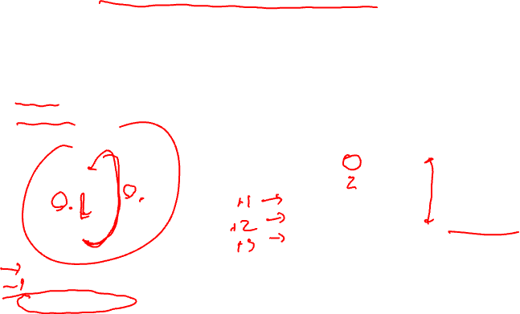
RecMII
Approach: Enumerate all irredundant elementary circuits in the
dependence graph
RecMII = MAX (delay(c) / distance(c))
for all c in C
delay(c) = total latency in dependence cycle c (sum of delays)
distance(c) = total iteration distance of cycle c (sum of distances)
cycle
k 1
k+1 2
k+2
k+3
k+4 1
k+5 2
1
1
3,1
1,0
3
4 cycles,
RecMII = 4
2
delay(c) = 1 + 3 = 4
distance(c) = 0 + 1 = 1
RecMII = 4/1 = 4

Slide 13
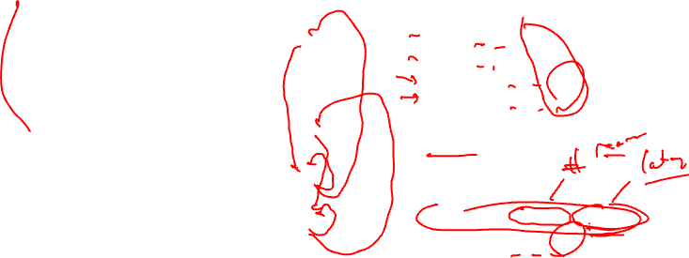
RecMII Example
1: r3 = load(r1)
2: r4 = r3 * 26
3: store (r2, r4)
4: r1 = r1 + 4
5: r2 = r2 + 4
6: p1 = cmpp (r1 < r9)
7: brct p1 Loop
1,1
1
4 → 4: 1 / 1 = 1
5 → 5: 1 / 1 = 1
4 → 1 → 4: 1 / 1 = 1
5 → 3 → 5: 1 / 1 = 1
RecMII = MAX(1,1,1,1) = 1
Then,
MII = MAX(ResMII, RecMII)
MII = MAX(2,1) = 2
2,0
2
0,0
3,0
3
0,0
1,1
1,1
4
RecMII = MAX(delay(c) / distance(c))
1,0
5
1,1
delay(c) = total latency in dependence
cycle c (sum of delays)
distance(c) = total iteration distance
of cycle c (sum of distances)
6
1,0
7
<delay, distance>

Slide 14

Homework Problem
Latencies: ld = 2, st = 1, add = 1, cmpp = 1, br = 1
Resources: 1 ALU, 1 MEM, 1 BR
1
<2,2>
<2,3>
<0,0>
1: r1[-1] = load(r2[0])
2: r3[-1] = r1[1] – r1[2]
3: store (r3[-1], r2[0])
4: r2[-1] = r2[0] + 4
5: p1[-1] = cmpp (r2[-1] < 100)
remap r1, r2, r3
6: brct p1[-1] Loop
<1,1>
2
<1,0>
3
<0,0>
<1,1>
<1,1>
4
<1,0>
5
Calculate RecMII, ResMII, and MII
<1,0>
6

Slide 15

Modulo Scheduling Process
Use list scheduling but we need a few twists
  II is predetermined – starts at MII, then is incremented
  Cyclic dependences complicate matters
    Estart/Priority/etc.
    Consumer scheduled before producer is considered
      There is a window where something can be scheduled!
  Guarantee the repeating pattern
2 constraints enforced on the schedule
  Each iteration begin exactly II cycles after the previous one
  Each time an operation is scheduled in 1 iteration, it is tentatively scheduled in subsequent iterations at intervals of II
    MRT used for this

Slide 16
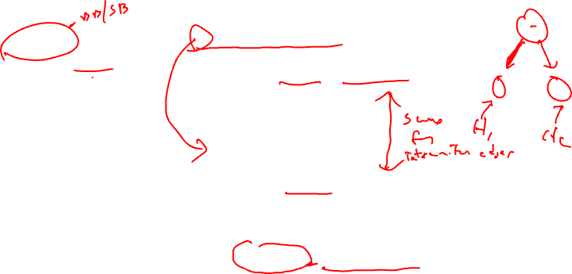
Priority Function
Height-based priority worked well for acyclic scheduling, makes sense
that it will work for loops as well
Acyclic:
Height(X) =
0, if X has no successors
MAX ((Height(Y) + Delay(X,Y)), otherwise
for all Y = succ(X)
Cyclic:
HeightR(X) =
0, if X has no successors
MAX ((HeightR(Y) + EffDelay(X,Y)), otherwise
for all Y = succ(X)
EffDelay(X,Y) = Delay(X,Y) – II*Distance(X,Y)

Slide 17
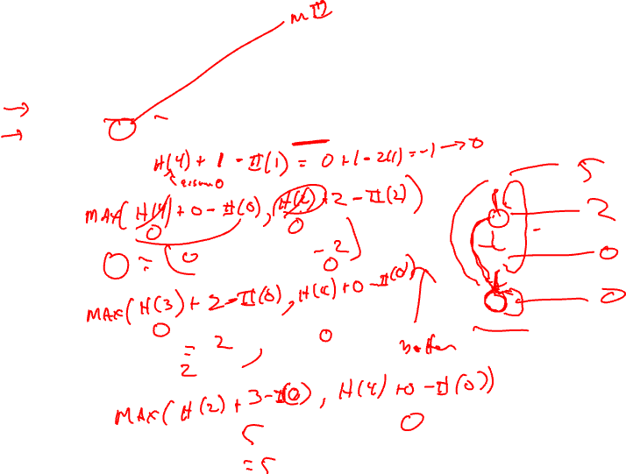
Calculating Height
Insert pseudo edges from all nodes to branch with
latency = 0, distance = 0 (dotted edges)
Compute II, For this example assume II = 2
HeightR(4) =
HeightR(3) =
HeightR(2) =
HeightR(1)
1
0,0
3,0
0,0
2
2,2
2,0
3
0,0
4
1,1

Slide 18

Calculating Height Solution
Insert pseudo edges from all nodes to branch with latency = 0, distance = 0 (dotted edges)
Compute II, For this example assume II = 2
HeightR(4) = H(4) + (1 – II*1) (Assume H(4) is 0 since not calculated yet
0 + 1-2 = -1 → 0 (Always MAX answer with 0)
HeightR(3) = MAX(H(4) + 0 – II*0 = 0 + 0 – 2*0 = 0,
H(2) + 2 – II*2 = 0 + 2 – 2*2 = -2)
Assume H(2) is 0 since not calculated yet
= 0
HeightR(2) = MAX(H(4) + 0 – II*0 = 0 + 0 – 2*0 = 0,
H(3) + 2 – II*0 = 0 + 2 – 2*0 = 2)
= 2
HeightR(1) = MAX(H(4) + 0 – II*0 = 0 + 0 – 2*0 = 0,
H(2) + 3 – II*0 = 2 + 3 – 2*0 = 5)
= 5
Now recalculate the heights to see if anything changes since HeightR(3) assumed wrong value for node 2
HeightR(3) = MAX(H(4) + 0 – II*0 = 0 + 0 – 2*0 = 0,
H(2) + 2 – II*2 = 2 + 2 – 2*2 = 0)
= 0 → Unchanged, so no need to compute any other heights again
1
0,0
3,0
0,0
2
2,2
2,0
3
0,0
4
1,1

Slide 19
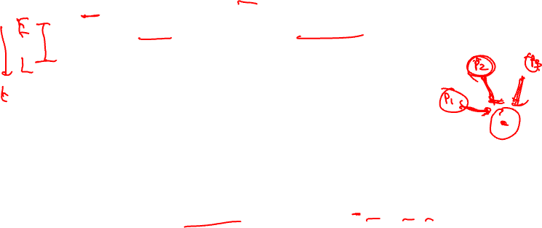
The Scheduling Window
With cyclic scheduling, not all the predecessors may be scheduled,
so a more flexible earliest schedule time is:
E(Y) =
0, if X is not scheduled
MAX
for all X = pred(Y)
MAX (0, SchedTime(X) + EffDelay(X,Y)),
otherwise
where EffDelay(X,Y) = Delay(X,Y) – II*Distance(X,Y)
Every II cycles a new loop iteration will be initialized, thus every II
cycles the pattern will repeat. Thus, you only have to look in a
window of size II, if the operation cannot be scheduled there, then
it cannot be scheduled.
Latest schedule time(Y) = L(Y) = E(Y) + II – 1

Slide 20
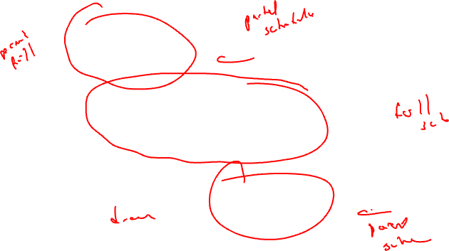
Loop Prolog and Epilog
Prolog
II = 3
Kernel
Epilog
Only the kernel involves executing full width of operations
Prolog and epilog execute a subset (ramp-up and ramp-down)

Slide 21
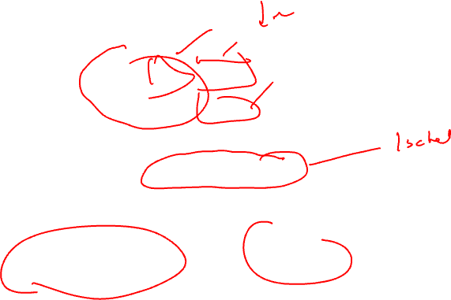
Removing Prolog/Epilog
Prolog
II = 3
Kernel
Disable using
predicated execution
Epilog
Execute loop kernel on every iteration, but for prolog and epilog
selectively disable the appropriate operations to fill/drain the pipeline

Slide 22
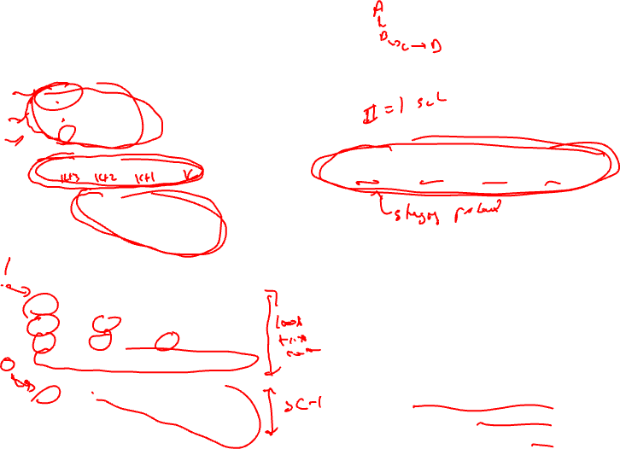
Kernel-only Code Using Rotating Predicates
A0
A1 B0
A2 B1 C0
A B C D
Bn Cn-1 Dn-2
Cn Dn-1
Dn
A if P[0] B if P[1] C if P[2] D if P[3]
P referred to as the staging predicate
P[0] P[1] P[2] P[3]
1 0 0 0
1 1 0 0
1 1 1 0
1 1 1 1
…
0 1 1 1
0 0 1 1
0 0 0 1
A - - -
A B - -
A B C -
A B C D
…
- B C D
- - C D
- - - D

Slide 23
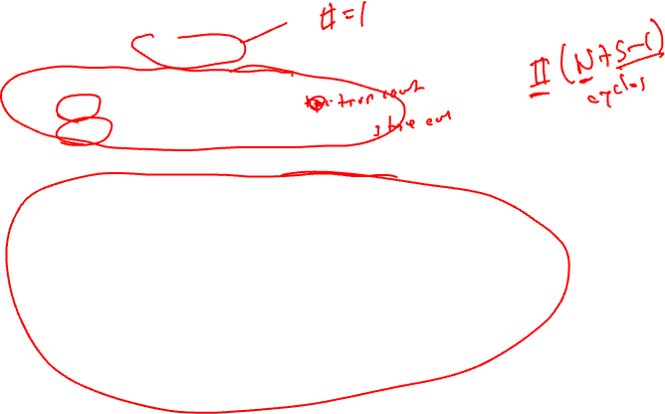
Modulo Scheduling Architectural Support
Loop requiring N iterations
  Will take N + (S – 1) where S is the number of stages
2 special registers created
  LC: loop counter (holds N)
  ESC: epilog stage counter (holds S)
Software pipeline branch operations
  Initialize LC = N, ESC = S in loop preheader
  All rotating predicates are cleared
  SWP-BR (BRF)
    While LC > 0, decrement LC and RRB, P[0] = 1, branch to top of loop
      This occurs for prolog and kernel
    If LC = 0, then while ESC > 0, decrement RRB and write a 0 into P[0], and branch to the top of the loop
      This occurs for the epilog

Slide 24
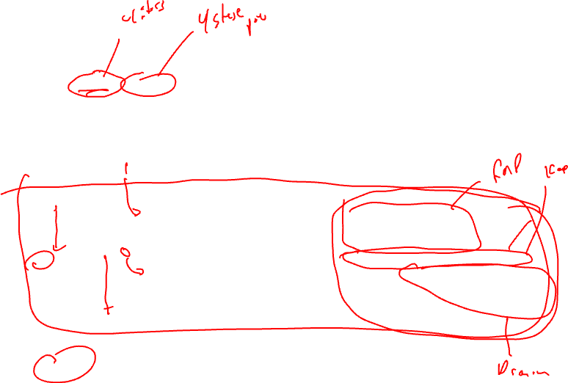
Execution History With LC/ESC
LC = 3, ESC = 3 /* Remember 0 relative!! */
Clear all rotating predicates
P[0] = 1
A if P[0]; B if P[1]; C if P[2]; D if P[3]; P[0] = BRF;
LC ESC P[0] P[1] P[2] P[3]
3 3 1 0 0 0 A
2 3 1 1 0 0 A B
1 3 1 1 1 0 A B C
0 3 1 1 1 1 A B C D
0 2 0 1 1 1 - B C D
0 1 0 0 1 1 - - C D
0 0 0 0 0 1 - - - D
4 iterations, 4 stages, II = 1, Note 4 + 4 –1 iterations of kernel executed

Slide 25
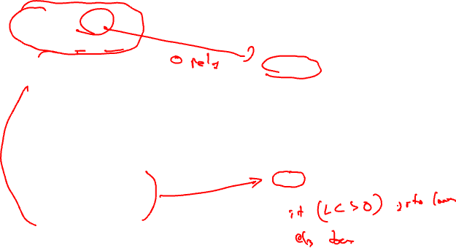
Modulo Scheduling Example
resources: 4 issue, 2 alu, 1 mem, 1 br
latencies: add=1, mpy=3, ld = 2, st = 1, br = 1
Step1: Compute to loop into
form that uses LC
for (j=0; j<100; j++)
b[j] = a[j] * 26
LC = 99
Loop:
1: r3 = load(r1)
2: r4 = r3 * 26
3: store (r2, r4)
4: r1 = r1 + 4
5: r2 = r2 + 4
6: p1 = cmpp (r1 < r9)
7: brct p1 Loop
Loop:
1: r3 = load(r1)
2: r4 = r3 * 26
3: store (r2, r4)
4: r1 = r1 + 4
5: r2 = r2 + 4
7: brlc Loop

Slide 26

Example – Step 2
resources: 4 issue, 2 alu, 1 mem, 1 br
latencies: add=1, mpy=3, ld = 2, st = 1, br = 1
Step 2: DSA convert
LC = 99
LC = 99
Loop:
1: r3 = load(r1)
2: r4 = r3 * 26
3: store (r2, r4)
4: r1 = r1 + 4
5: r2 = r2 + 4
7: brlc Loop
Loop:
1: r3[-1] = load(r1[0])
2: r4[-1] = r3[-1] * 26
3: store (r2[0], r4[-1])
4: r1[-1] = r1[0] + 4
5: r2[-1] = r2[0] + 4
remap r1, r2, r3, r4
7: brlc Loop

Slide 27
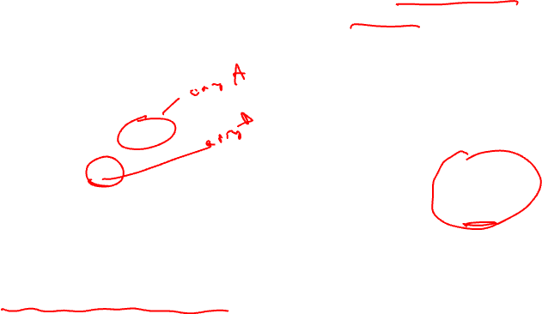
Example – Step 3
resources: 4 issue, 2 alu, 1 mem, 1 br
latencies: add=1, mpy=3, ld = 2, st = 1, br = 1
Step3: Draw dependence graph
Calculate MII
1,1
1
LC = 99
2,0
0,0
Loop:
1: r3[-1] = load(r1[0])
2: r4[-1] = r3[-1] * 26
3: store (r2[0], r4[-1])
4: r1[-1] = r1[0] + 4
5: r2[-1] = r2[0] + 4
remap r1, r2, r3, r4
7: brlc Loop
2
3,0
RecMII = 1
RESMII = 2
MII = 2
3
1,1
1,1
0,0
4
5
1,1
1,1
No memory dependences since load
and store refer to distinct arrays
7

Slide 28
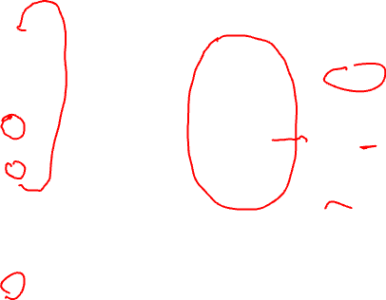
Example – Step 4
Step 4 – Calculate priorities (MAX height
to pseudo stop node)
1,1
0,0
1
0,0
2,0
Iter1
Iter2
2
1: H = 5
2: H = 3
3: H = 0
4: H = 0
5: H = 0
7: H = 0
1: H = 5
2: H = 3
3: H = 0
4: H = 4
5: H = 0
7: H = 0
0,0
3,0
0,0
3
1,1
1,1
0,0
0,0
4
5
1,1
0,0
1,1
7

Slide 29
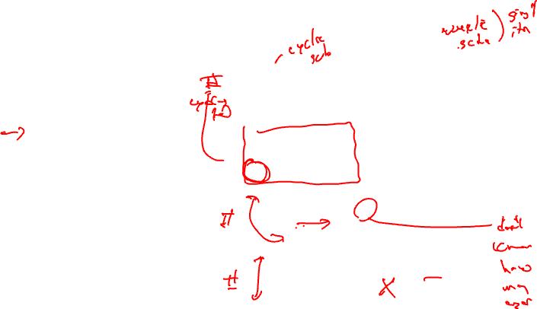
Example – Step 5
resources: 4 issue, 2 alu, 1 mem, 1 br
latencies: add=1, mpy=3, ld = 2, st = 1, br = 1
Schedule brlc at time II - 1
Unrolled
Schedule
Rolled
Schedule
LC = 99
0
1
Loop:
1: r3[-1] = load(r1[0])
2: r4[-1] = r3[-1] * 26
3: store (r2[0], r4[-1])
4: r1[-1] = r1[0] + 4
5: r2[-1] = r2[0] + 4
remap r1, r2, r3, r4
7: brlc Loop
2
0
3
1
7
4
5
6
alu0
alu1
mem
br
0
MRT
1
X

Slide 30
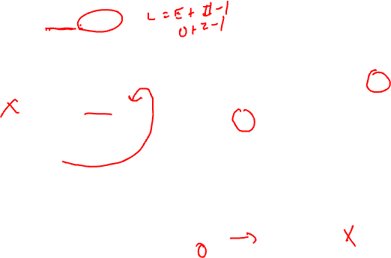
Example – Step 6
Step6: Schedule the highest priority op
Op1: E = 0, L = 1
Place at time 0 (0 % 2)
Unrolled
Schedule
Rolled
Schedule
LC = 99
0
1
Loop:
1: r3[-1] = load(r1[0])
2: r4[-1] = r3[-1] * 26
3: store (r2[0], r4[-1])
4: r1[-1] = r1[0] + 4
5: r2[-1] = r2[0] + 4
remap r1, r2, r3, r4
7: brlc Loop
1
0
1
2
3
1
7
4
5
6
alu0
alu1
mem
br
0
X
MRT
1
X

Slide 31
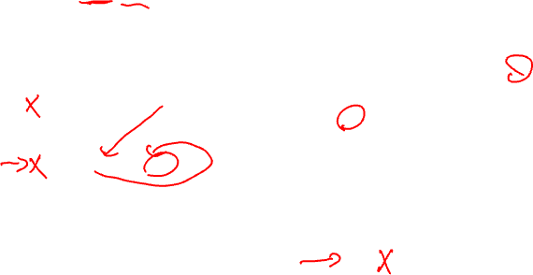
Example – Step 7
Step7: Schedule the highest priority op
Op4: E = 0, L = 1
Place at time 0 (0 % 2)
Unrolled
Schedule
Rolled
Schedule
LC = 99
0
1
4
Loop:
1: r3[-1] = load(r1[0])
2: r4[-1] = r3[-1] * 26
3: store (r2[0], r4[-1])
4: r1[-1] = r1[0] + 4
5: r2[-1] = r2[0] + 4
remap r1, r2, r3, r4
7: brlc Loop
1
0
1
4
2
3
1
7
4
5
6
alu0
alu1
mem
br
0
X
X
MRT
1
X

Slide 32
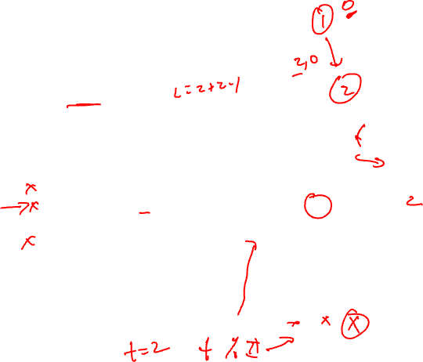
Example – Step 8
Step8: Schedule the highest priority op
Op2: E = 2, L = 3
Place at time 2 (2 % 2)
Unrolled
Schedule
Rolled
Schedule
LC = 99
0
1
4
Loop:
1: r3[-1] = load(r1[0])
2: r4[-1] = r3[-1] * 26
3: store (r2[0], r4[-1])
4: r1[-1] = r1[0] + 4
5: r2[-1] = r2[0] + 4
remap r1, r2, r3, r4
7: brlc Loop
1
0
1
4
2
2
2
3
1
7
4
5
6
alu0
alu1
mem
br
0
X
X
X
MRT
1
X

Slide 33
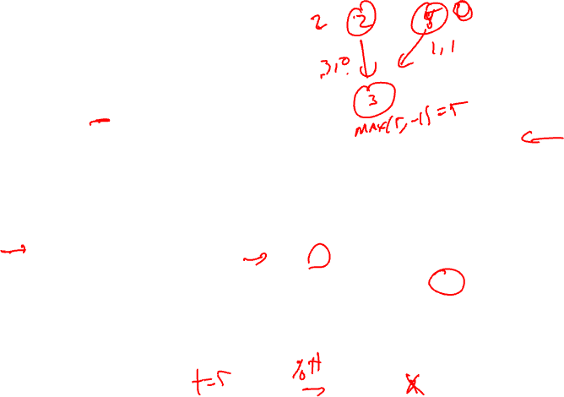
Example – Step 9
Step9: Schedule the highest priority op
Op3: E = 5, L = 6
Place at time 5 (5 % 2)
Unrolled
Schedule
Rolled
Schedule
LC = 99
0
1
4
Loop:
1: r3[-1] = load(r1[0])
2: r4[-1] = r3[-1] * 26
3: store (r2[0], r4[-1])
4: r1[-1] = r1[0] + 4
5: r2[-1] = r2[0] + 4
remap r1, r2, r3, r4
7: brlc Loop
1
0
1
2
4
2
2
3
1
7
3
4
5
3
6
alu0
alu1
mem
br
0
X
X
X
MRT
1
X
X

Slide 34
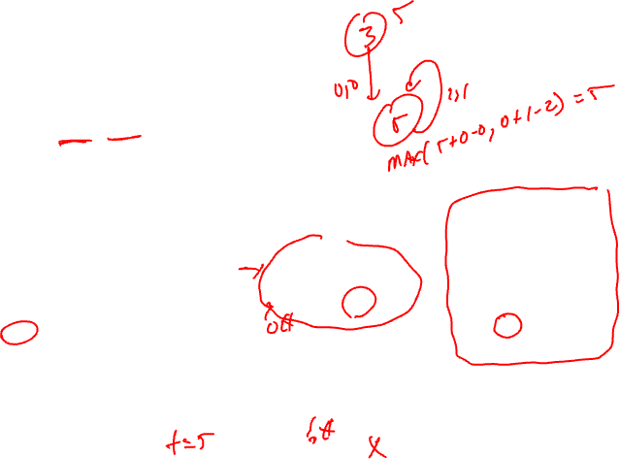
Example – Step 10
Step10: Schedule the highest priority op
Op5: E = 5, L = 6
Place at time 5 (5 % 2)
Unrolled
Schedule
Rolled
Schedule
LC = 99
0
1
4
Loop:
1: r3[-1] = load(r1[0])
2: r4[-1] = r3[-1] * 26
3: store (r2[0], r4[-1])
4: r1[-1] = r1[0] + 4
5: r2[-1] = r2[0] + 4
remap r1, r2, r3, r4
7: brlc Loop
1
0
1
2
4
2
2
3
1
7
3
5
4
5
3
5
6
alu0
alu1
mem
br
0
X
X
X
MRT
1
X
X
X

Slide 35
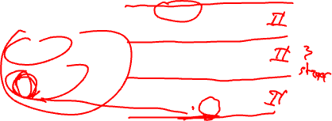
Example – Step 11
Step11: calculate ESC, SC = ceiling(max unrolled sched length / ii)
unrolled sched time of branch = rolled sched time of br + (ii*esc)
SC = 6 / 2 = 3, ESC = SC – 1
time of br = 1 + 2*2 = 5
Unrolled
Schedule
Rolled
Schedule
LC = 99
0
1
4
Loop:
1: r3[-1] = load(r1[0])
2: r4[-1] = r3[-1] * 26
3: store (r2[0], r4[-1])
4: r1[-1] = r1[0] + 4
5: r2[-1] = r2[0] + 4
remap r1, r2, r3, r4
7: brlc Loop
1
0
1
2
4
2
2
3
1
7
3
5
4
5
3
5
7
6
alu0
alu1
mem
br
0
X
X
X
MRT
1
X
X
X

Slide 36
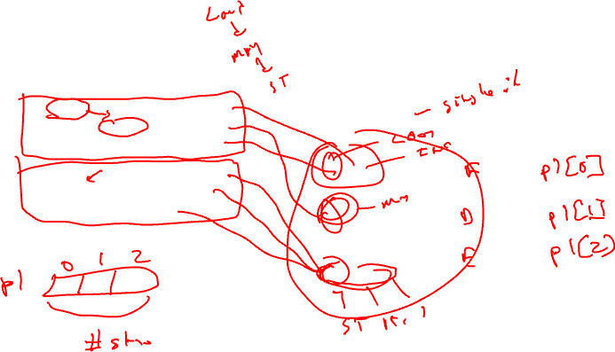
Example – Step 12
Finishing touches - Sort ops, initialize ESC, insert BRF and staging predicate,
initialize staging predicate outside loop
Staging predicate, each
successive stage increment
the index of the staging predicate
by 1, stage 1 gets px[0]
LC = 99
ESC = 2
p1[0] = 1
Loop:
1: r3[-1] = load(r1[0]) if p1[0]
2: r4[-1] = r3[-1] * 26 if p1[1]
4: r1[-1] = r1[0] + 4 if p1[0]
3: store (r2[0], r4[-1]) if p1[2]
5: r2[-1] = r2[0] + 4 if p1[2]
7: brlc Loop if p1[2]
Unrolled
Schedule
0
1
4
Stage 1
1
2
2
Stage 2
3
4
Stage 3
5
3
5
7
6

Slide 37
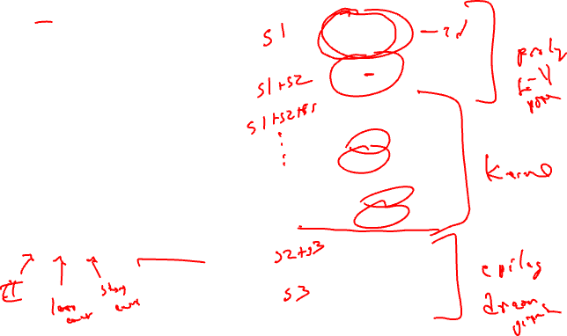
Example – Dynamic Execution of the Code
LC = 99
ESC = 2
p1[0] = 1
time: ops executed
0: 1, 4
1:
2: 1,2,4
3:
4: 1,2,4
5: 3,5,7
6: 1,2,4
7: 3,5,7
…
198: 1,2,4
199: 3,5,7
200: 2
201: 3,5,7
202: -
203 3,5,7
Loop:
1: r3[-1] = load(r1[0]) if p1[0]
2: r4[-1] = r3[-1] * 26 if p1[1]
4: r1[-1] = r1[0] + 4 if p1[0]
3: store (r2[0], r4[-1]) if p1[2]
5: r2[-1] = r2[0] + 4 if p1[2]
7: brlc Loop if p1[2]
Total time = II(num_iteration + num_stages – 1)
= 2(100 + 3 – 1) = 204 cycles

