Slide 1

EECS 583 – Class 12
Superblock Scheduling, Intro to Modulo Scheduling
University of Michigan
October 9, 2023

Slide 2
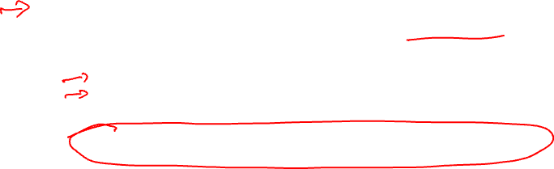
Announcements & Reading Material
Homework 2 – Due Friday midnight
Project discussion meetings – signup next week, meetings week of Oct 23
  Each group meets 10 mins with Aditya, Tarun, and I
  Action items
    Need to identify group members
    Use piazza to recruit additional group members or express your availability
    Think about project areas that you want to work on
Today’s class
  “Iterative Modulo Scheduling: An Algorithm for Software Pipelining Loops”, B. Rau, MICRO-27, 1994, pp. 63-74.
Next class
  “Code Generation Schema for Modulo Scheduled Loops”, B. Rau, M. Schlansker, and P. Tirumalai, MICRO-25, Dec. 1992.

Slide 3
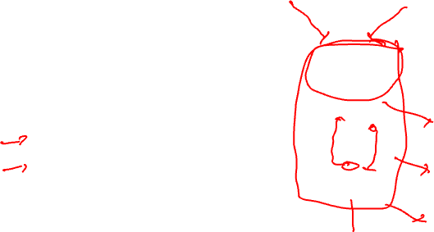
Recap: Generalize Scheduling Beyond a Basic Block
Superblock
  Single entry
  Multiple exits (side exits)
  No side entries
Schedule just like a BB
  Priority calculations needs change
  Dealing with control deps

Slide 4
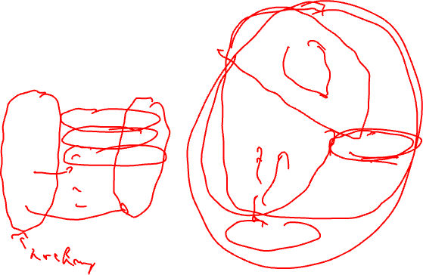
Recap: Lstart in a Superblock
Not a single Lstart any more
  1 per exit branch (Lstart is a vector!)
  Exit branches have probabilities
1
1
2
3
1
1
op Estart Lstart0 Lstart1
1 0 0 0
2 1 2 1
3 2 - 2
4 3 3 4
5 3 - 3
6 5 - 5
3
4
1
1
5
Exit0 (25%)
2
6
Exit1 (75%)

Slide 5
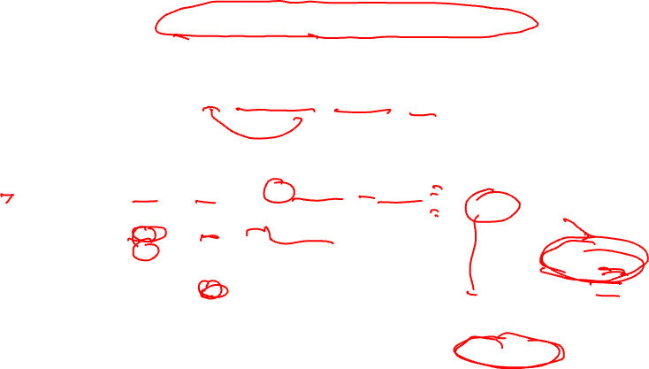
Recap: Operation Priority in a Superblock
Priority – Dependence height and speculative yield
  Height from op to exit * probability of exit
  Sum up across all exits in the superblock
Priority(op) = SUM(Probi * (MAX_Lstarti – Lstarti(op) + 1))
valid late times for op
1
1
2
3
op Estart Lstart0 Lstart1 Priority
1 0 0 0 .25(3-0+1) + .75(5-0+1)
2 1 2 1 .25(3-2+1) + .75(5-1+1)
3 2 - 2 .75(5-2+1)
4 3 3 4 .25(3-3+1) + .75(5-4+1)
5 3 - 3 .75(5-3+1)
6 5 - 5 .75(5-5+1)
1
1
3
4
1
1
5
Exit0 (25%)
2
6
Exit1 (75%)

Slide 6
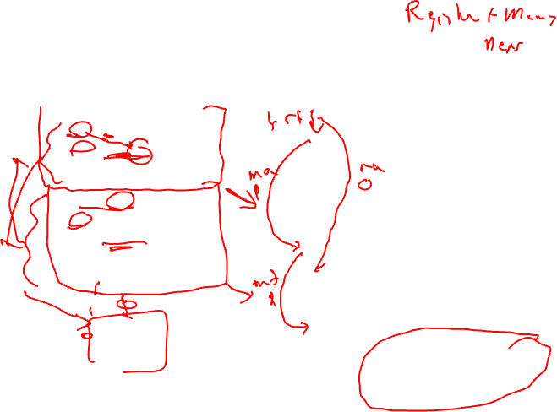
Dependences in a Superblock
Superblock
1
* Data dependences
shown, all are reg flow
except 1→ 6 is reg anti
* Dependences define
precedence ordering of
operations to ensure
correct execution
semantics
* What about control
dependences?
* Control dependences
define precedence of
ops with respect to
branches
1: r1 = r2 + r3
2: r4 = load(r1)
3: p1 = cmpp(r3 == 0)
4: branch p1 Exit1
5: store (r4, -1)
6: r2 = r2 – 4
7: r5 = load(r2)
8: p2 = cmpp(r5 > 9)
9: branch p2 Exit2
2
3
4
5
6
7
Note: Control flow in red bold
8
9

Slide 7
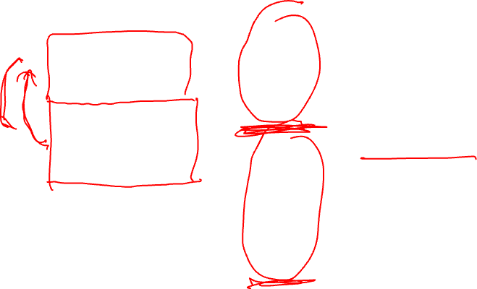
Conservative Approach to Control Dependences
Superblock
* Make branches
barriers, nothing
moves above or below
branches
* Schedule each BB in
SB separately
* Sequential schedules
* Whole purpose of a
superblock is lost
* Need a better solution!
1
1: r1 = r2 + r3
2: r4 = load(r1)
3: p1 = cmpp(r3 == 0)
4: branch p1 Exit1
5: store (r4, -1)
6: r2 = r2 – 4
7: r5 = load(r2)
8: p2 = cmpp(r5 > 9)
9: branch p2 Exit2
2
3
4
5
6
7
Note: Control flow in red bold
8
9

Slide 8
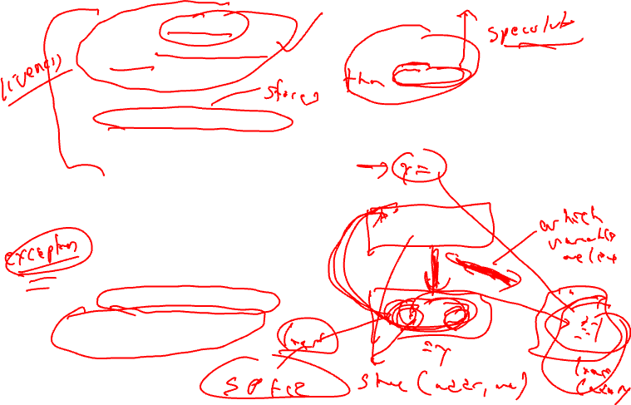
Upward Code Motion Across Branches
Restriction 1a (register op)
  The destination of op is not in liveout(br)
  Wrongly kill a live value
Restriction 1b (memory op)
  Op does not modify the memory
  Actually live memory is what matters, but that is often too hard to determine
Restriction 2
  Op must not cause an exception that may terminate the program execution when br is taken
  Op is executed more often than it is supposed to (speculated)
  Page fault or cache miss are ok
Insert control dep when either restriction is violated
…
if (x > 0)
y = z / x
…
control flow graph
1: branch x <= 0
2: y = z / x

Slide 9
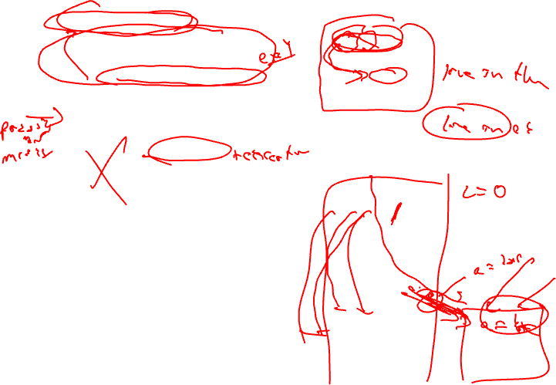
Downward Code Motion Across Branches
Restriction 1 (liveness)
  If no compensation code
    Same restriction as before, destination of op is not liveout
  Else, no restrictions
    Duplicate operation along both directions of branch if destination is liveout
Restriction 2 (speculation)
  Not applicable, downward motion is not speculation
Again, insert control dep when the restrictions are violated
Part of the philosphy of superblocks is no compensation code insertion hence R1 is enforced!
…
a = b * c
if (x > 0)
else
…
control flow graph
1: a = b * c
2: branch x <= 0

Slide 10
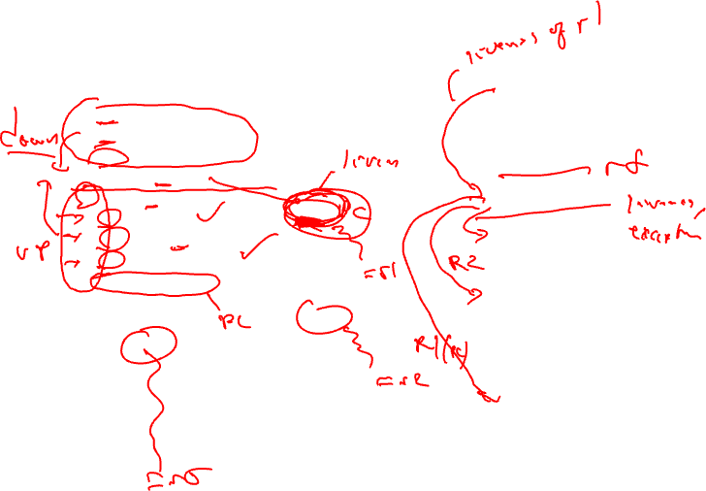
Add Control Dependences to a Superblock
Superblock
Assumed liveout sets
1
1: r1 = r2 + r3
2: r4 = load(r1)
3: p1 = cmpp(r2 == 0)
4: branch p1 Exit1
5: store (r4, -1)
6: r2 = r2 – 4
7: r5 = load(r2)
8: p2 = cmpp(r5 > 9)
9: branch p2 Exit2
2
3
{r1}
4
5
6
{r2}
All ops
have cdep
to op 9!
7
{r5}
Notes: All branches are control
dependent on one another.
If no compensation, all ops dependent
on last branch
8
9

Slide 11
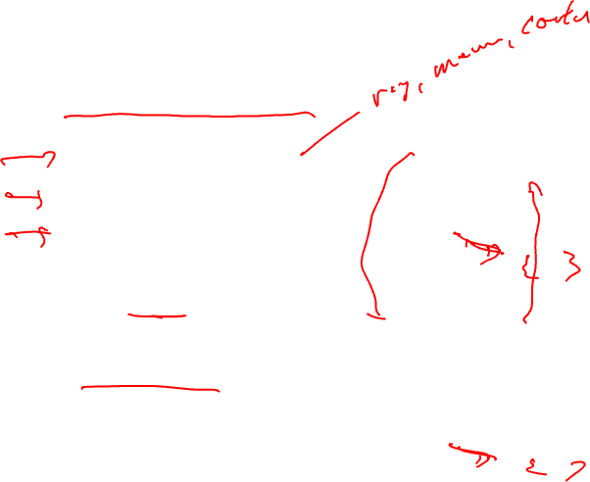
List Scheduling on Superblocks
Follow same algorithm as BBs
Steps
  Draw data dependence graph
  Compute Estart, all Lstarts, priority
  Perform list scheduling
Scheduling process
  Ignore side exits – treat SB just like a BB
  Control dependences prevent illegal code motion across branches
1
2
3
4
5
6
7
All ops
have cdep
to op 9!
8
9

Slide 12
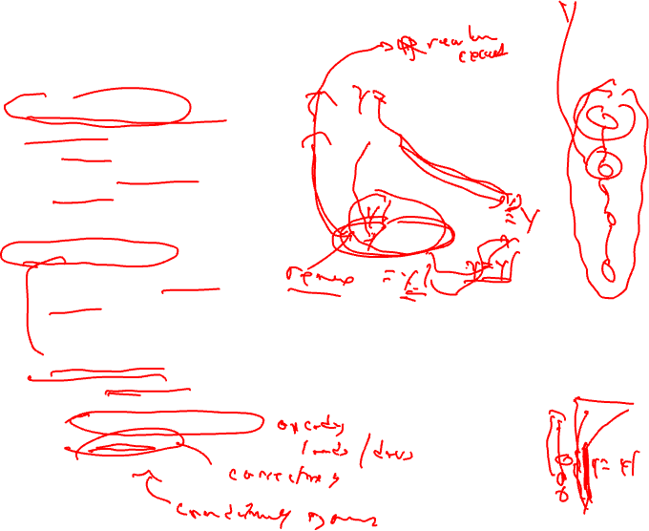
Relaxing Code Motion Restrictions
Upward code motion is generally more effective
  Speculate that an op is useful (just like an out-of-order processor with branch pred)
  Start ops early, hide latency, overlap execution, more parallelism
Removing restriction 1
  For register ops – use register renaming
  Could rename memory too, but generally not worth it
Removing restriction 2
  Need hardware support (aka speculation models)
    Some ops don’t cause exceptions
    Ignore exceptions
    Delay exceptions
1: branch x <= 0
2: y = z / x
R1: y is not in liveout(1)
R2: op 2 will never cause
an exception when op1
is taken

Slide 13
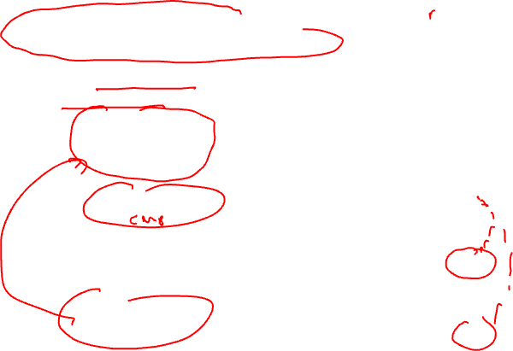
Restricted Speculation Model
Most processors have 2 classes of opcodes
  Potentially exception causing
    load, store, integer divide, floating-point
  Never excepting
    Integer add, multiply, etc.
    Overflow is detected, but does not terminate program execution
Restricted model
  R2 only applies to potentially exception causing operations
  Can freely speculate all never exception ops (still limited by R1 however)
1: r1 = r2 + r3
2: r4 = load(r1)
3: p1 = cmpp(r2 == 0)
4: branch p1 Exit1
5: store (r4, -1)
6: r2 = r2 – 4
7: r5 = load(r2)
8: p2 = cmpp(r5 > 9)
9: branch p2 Exit2
1
2
{r1}
We assumed
restricted
speculation
when this
graph was
drawn.
This is why
there is no
cdep between
4 → 6 and
4→ 8
3
4
{r5}
{r2}
5
6
7
8
9

Slide 14
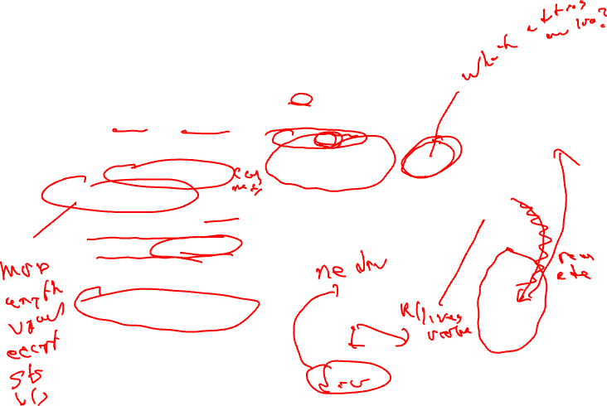
General Speculation Model
Remove
edge from
4 to 7
2 types of exceptions
  Program terminating (traps)
    Div by 0, illegal address
  Fixable (normal and handled at run time)
    Page fault, TLB miss
General speculation
  Processor provides non-trapping versions of all operations (div, load, etc)
  Return some bogus value (0) when error occurs
  R2 is completely ignored, only R1 limits speculation
  Speculative ops converted into non-trapping version
  Fixable exceptions handled as usual for non-trapping ops
1: r1 = r2 + r3
2: r4 = load(r1)
3: p1 = cmpp(r2 == 0)
4: branch p1 Exit1
5: store (r4, -1)
6: r2 = r2 – 4
7: r5 = load(r2)
8: p2 = cmpp(r5 > 9)
9: branch p2 Exit2
1
2
{r1}
3
4
{r2}
5
{r5}
6
7
8
9

Slide 15
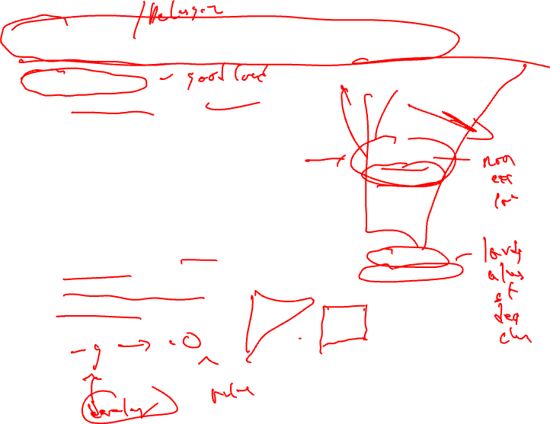
Programming Implications of General Spec
Correct program
  No problem at all
  Exceptions will only result when branch is taken
  Results of excepting speculative operation(s) will not be used for anything useful (R1 guarantees this!)
Program debugging
  Non-trapping ops make this almost impossible
  Disable general speculation during program debug phase
1: branch x == 0
2: y = *x
3: z = y + 4
4: *w = z
2’: y = *x
3’: z = y + 4
1: branch x == 0
4: *w = z

Slide 16
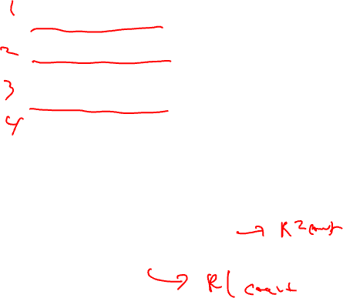
Homework Problem
1: r1 = r7 + 4
2: branch p1 Exit1
3: store (r1, -1)
4: branch p2 Exit2
5: r2 = load(r7)
6: r3 = r2 – 4
7: branch p3 Exit3
8: r4 = r3 / r8
1
{r4}
2
{r1}
3
4
{r2}
5
{r4, r8}
6
1. Draw the dep graph assuming restricted speculation
2. What edges can be removed if
general speculation support is provided?
3. With more renaming, what dependences could
be removed?
7
8

Slide 17

Homework Problem – Solution
1. Dependence graph with restricted speculation
1: r1 = r7 + 4
2: branch p1 Exit1
3: store (r1, -1)
4: branch p2 Exit2
5: r2 = load(r7)
6: r3 = r2 – 4
7: branch p3 Exit3
8: r4 = r3 / r8
1
{r4}
2
{r1}
3
4
{r2}
5
{r4, r8}
6
1. Draw the dep graph assuming restricted speculation
2. What edges can be removed if
general speculation support is provided?
3. With more renaming, what dependences could
be removed?
7
8
Additional control deps: 2→4, 2→7, 4→7
No memory dependence between 3 and 5 since
can prove the addresses are always 4 apart

Slide 18
Homework Problem – Solution (continued)
1: r1 = r7 + 4
2: branch p1 Exit1
3: store (r1, -1)
4: branch p2 Exit2
5: r2 = load(r7)
6: r3 = r2 – 4
7: branch p3 Exit3
8: r4 = r3 / r8
2. With general speculation, edges from
2→5, 4→5, 4→8, 7→8 can be removed
3. With further renaming, the edge from 2→8
can be removed.
Note, the edge from 2→3 cannot be removed
since we conservatively do not allow stores to
speculate.
Note2, you do not need general speculation to
remove edges from 2→6 and 4→6 since integer
subtract never causes exception.
{r4}
{r1}
{r2}
{r4, r8}
1. Draw the dep graph assuming restricted speculation
2. What edges can be removed if
general speculation support is provided?
3. With more renaming, what dependences could
be removed?

Slide 19
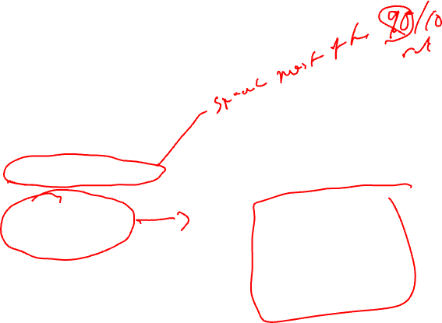
Change Focus to Scheduling Loops
Most of program execution
time is spent in loops
Problem: How do we achieve
compact schedules for loops
r1 = _a
r2 = _b
r9 = r1 * 4
1: r3 = load(r1)
2: r4 = r3 * 26
3: store (r2, r4)
4: r1 = r1 + 4
5: r2 = r2 + 4
6: p1 = cmpp (r1 < r9)
7: brct p1 Loop
Loop:
for (j=0; j<100; j++)
b[j] = a[j] * 26

Slide 20
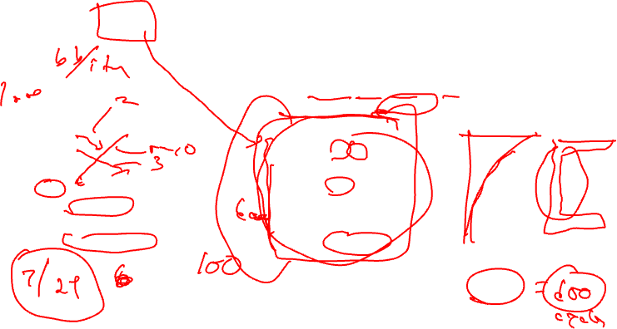
Basic Approach – List Schedule the Loop Body
time
Iteration
1
2
3
n
Schedule each iteration
resources: 4 issue, 2 alu, 1 mem, 1 br
latencies: add=1, mpy=3, ld = 2, st = 1, br = 1
1: r3 = load(r1)
2: r4 = r3 * 26
3: store (r2, r4)
4: r1 = r1 + 4
5: r2 = r2 + 4
6: p1 = cmpp (r1 < r9)
7: brct p1 Loop
time ops
0 1, 4
1 6
2 2
3 -
4 -
5 3, 5, 7
Total time = 6 * n

Slide 21
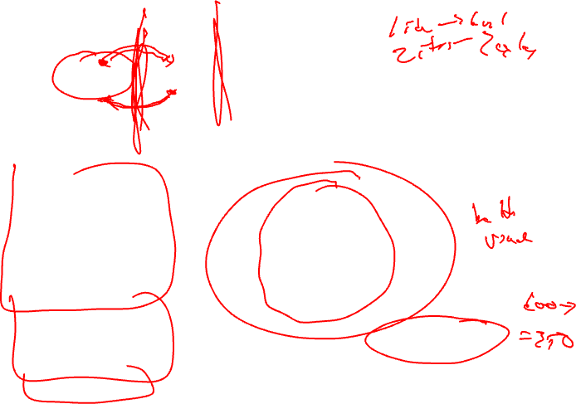
Unroll Then Schedule Larger Body
time
Iteration
1,2
3,4
5,6
n-1,n
Schedule each iteration
resources: 4 issue, 2 alu, 1 mem, 1 br
latencies: add=1, cmpp = 1, mpy=3, ld = 2, st = 1, br = 1
1: r3 = load(r1)
2: r4 = r3 * 26
3: store (r2, r4)
4: r1 = r1 + 4
5: r2 = r2 + 4
6: p1 = cmpp (r1 < r9)
7: brct p1 Loop
time ops
0 1, 4
1 1’, 6, 4’
2 2, 6’
3 2’
4 -
5 3, 5, 7
6 3’,5’,7’
Total time = 7 * n/2

Slide 22
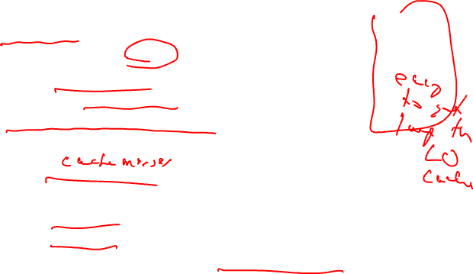
Problems With Unrolling
Code bloat
  Typical unroll is 4-16x
  Use profile statistics to only unroll “important” loops
  But still, code grows fast
Barrier after across unrolled bodies
  I.e., for unroll 2, can only overlap iterations 1 and 2, 3 and 4, …
Does this mean unrolling is bad?
  No, in some settings its very useful
    Low trip count
    Lots of branches in the loop body
  But, in other settings, there is room for improvement

Slide 23
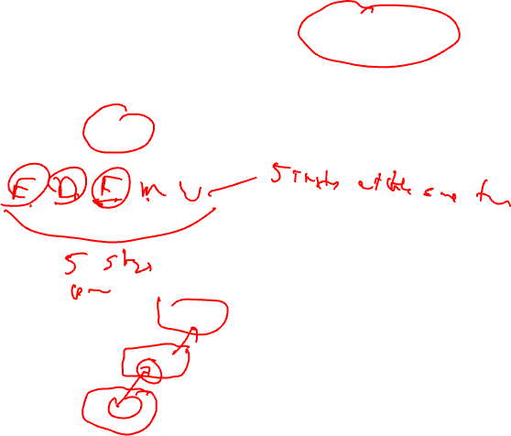
Overlap Iterations Using Pipelining
time
Iteration
1
2
3
n
n
3
With hardware pipelining, while one instruction is in fetch, another is in decode, another in execute. Same thing here, multiple iterations are processed simultaneously, with each instruction in a separate stage. 1 iteration still takes the same time, but time to complete n iterations is reduced!
2
1

Slide 24
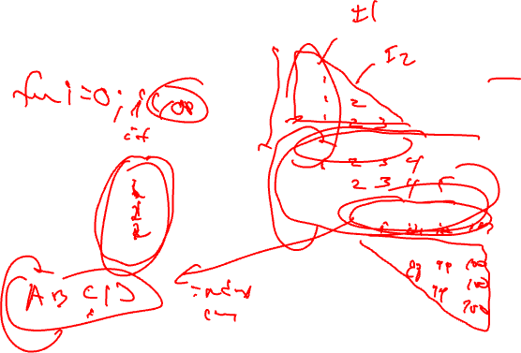
A Software Pipeline
time
Prologue -
fill the
pipe
A
B A
C B A
D C B A
D C B A
…
D C B A
D C B
D C
D
A
B
C
D
Kernel –
steady
state
Loop body
with 4 ops
Epilogue -
drain the
pipe
Steady state: 4 iterations executed
simultaneously, 1 operation from each
iteration. Every cycle, an iteration starts
and finishes when the pipe is full.

Slide 25
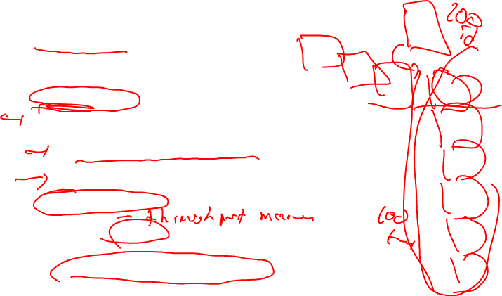
Creating Software Pipelines
Lots of software pipelining techniques out there
Modulo scheduling
  Most widely adopted
  Practical to implement, yields good results
Conceptual strategy
  Unroll the loop completely
  Then, schedule the code completely with 2 constraints
    All iteration bodies have identical schedules
    Each iteration is scheduled to start some fixed number of cycles later than the previous iteration
  Initiation Interval (II) = fixed delay between the start of successive iterations
  Given the 2 constraints, the unrolled schedule is repetitive (kernel) except the portion at the beginning (prologue) and end (epilogue)
    Kernel can be re-rolled to yield a new loop

Slide 26
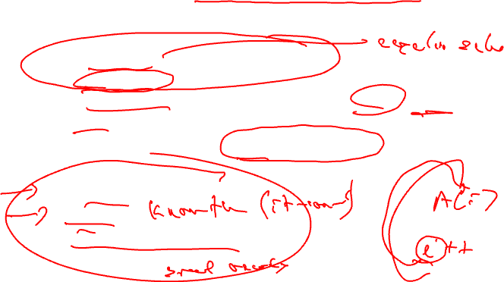
Creating Software Pipelines (2)
Create a schedule for 1 iteration of the loop such that when the same schedule is repeated at intervals of II cycles
  No intra-iteration dependence is violated
  No inter-iteration dependence is violated
  No resource conflict arises between operation in same or distinct iterations
We will start out assuming Intel Itanium-style hardware support, then remove it later
  Rotating registers
  Predicates
  Software pipeline loop branch

Slide 27
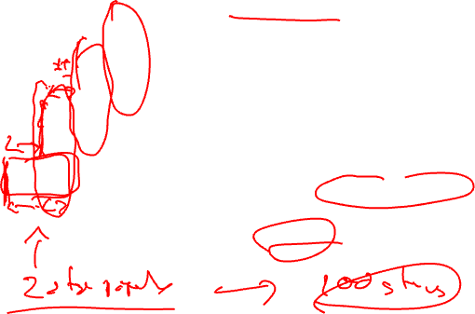
Terminology
Initiation Interval (II) = fixed delay
between the start of successive iterations
Each iteration can be divided
into stages consisting of II cycles
each
Number of stages in 1 iteration
is termed the stage count (SC)
Takes SC-1 cycles to fill/drain the pipe
time
Iter 3
II
Iter 2
Iter 1

Slide 28
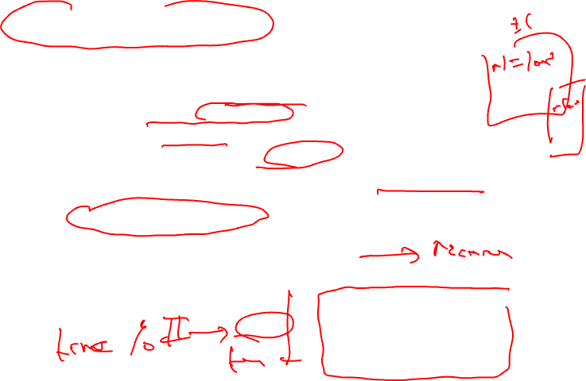
Resource Usage Legality
Need to guarantee that
  No resource is used at 2 points in time that are separated by an interval which is a multiple of II
  I.E., within a single iteration, the same resource is never used more than 1x at the same time modulo II
  Known as modulo constraint, where the name modulo scheduling comes from
  Modulo reservation table solves this problem
    To schedule an op at time T needing resource R
      The entry for R at T mod II must be free
    Mark busy at T mod II if schedule
alu1
alu2
mem
bus0
bus1
br
0
II = 3
1
2

Slide 29
Dependences in a Loop
Need worry about 2 kinds
  Intra-iteration
  Inter-iteration
Delay
  Minimum time interval between the start of operations
  Operation read/write times
Distance
  Number of iterations separating the 2 operations involved
  Distance of 0 means intra-iteration
Recurrence manifests itself as a circuit in the dependence graph
1
<1,2>
<1,1>
2
<1,0>
<1,2>
3
<1,0>
4
Edges annotated with tuple
<delay, distance>

Slide 30
Dynamic Single Assignment (DSA) Form
Impossible to overlap iterations because each iteration writes to the same
register. So, we’ll have to remove the anti and output dependences.
Virtual rotating registers
* Each register is an infinite push down array (Expanded virtual reg or EVR)
* Write to top element, but can reference any element
* Remap operation slides everything down → r[n] changes to r[n+1]
A program is in DSA form if the same virtual register (EVR element) is never
assigned to more than 1x on any dynamic execution path
1: r3 = load(r1)
2: r4 = r3 * 26
3: store (r2, r4)
4: r1 = r1 + 4
5: r2 = r2 + 4
6: p1 = cmpp (r1 < r9)
7: brct p1 Loop
1: r3[-1] = load(r1[0])
2: r4[-1] = r3[-1] * 26
3: store (r2[0], r4[-1])
4: r1[-1] = r1[0] + 4
5: r2[-1] = r2[0] + 4
6: p1[-1] = cmpp (r1[-1] < r9)
remap r1, r2, r3, r4, p1
7: brct p1[-1] Loop
DSA
conversion

Slide 31
Physical Realization of EVRs
EVR may contain an unlimited number values
  But, only a finite contiguous set of elements of an EVR are ever live at any point in time
  These must be given physical registers
Conventional register file
  Remaps are essentially copies, so each EVR is realized by a set of physical registers and copies are inserted
Rotating registers
  Direct support for EVRs
  No copies needed
  File “rotated” after each loop iteration is completed

Slide 32
Loop Dependence Example
1,1
1
1: r3[-1] = load(r1[0])
2: r4[-1] = r3[-1] * 26
3: store (r2[0], r4[-1])
4: r1[-1] = r1[0] + 4
5: r2[-1] = r2[0] + 4
6: p1[-1] = cmpp (r1[-1] < r9)
remap r1, r2, r3, r4, p1
7: brct p1[-1] Loop
2,0
2
0,0
3,0
3
0,0
1,1
1,1
4
1,0
5
1,1
6
In DSA form, there are no
inter-iteration anti or output
dependences!
1,0
7
<delay, distance>

Slide 33
Class Problem
Latencies: ld = 2, st = 1, add = 1, cmpp = 1, br = 1
1
1: r1[-1] = load(r2[0])
2: r3[-1] = r1[1] – r1[2]
3: store (r3[-1], r2[0])
4: r2[-1] = r2[0] + 4
5: p1[-1] = cmpp (r2[-1] < 100)
remap r1, r2, r3
6: brct p1[-1] Loop
2
3
4
5
Draw the dependence graph
showing both intra and inter
iteration dependences
6

