Slide 1
Compiler Code Transformations for Superscalar-Based High-Performance Systems
Scott A. Mahlke | William Y. Chen | John C. Gyllenhaal
Wen-mei W. Hwu | Pohua P. Chang | Tokuzo Kiyohara
EECS 583 Fall 2021
Brendan Freeman, Sri Cherukuri, Sahas Dendukuri

Slide 2
Motivation
Parallel hardware is becoming increasingly popular
Want compiler transformations that can maximize ILP to fully utilize superscalar processors

Slide 3
Relevance to our project
Use of processor specifications (i.e superscalar size) as metric for loop unroll factor
Use ILP optimizations presented here to support loop unrolling
Compare performance of n-scale against other heuristics as an unrolling factor

Slide 4
Presented Code Transformations
Loop unrolling
Register renaming
Accumulator variable expansion
Induction variable expansion
Strength reduction
Tree height reduction
Search variable expansion (new!)
Operation combining (new!)

Slide 5
Optimization Levels
Accumulator Variable Expansion, Induction Variable Expansion, Search Variable Expansion
Level 4
Operation Combining, Strength Reduction,
Height Reduction
Level 3
Register Renaming
Level 2
Loop Unrolling
Level 1

Slide 6
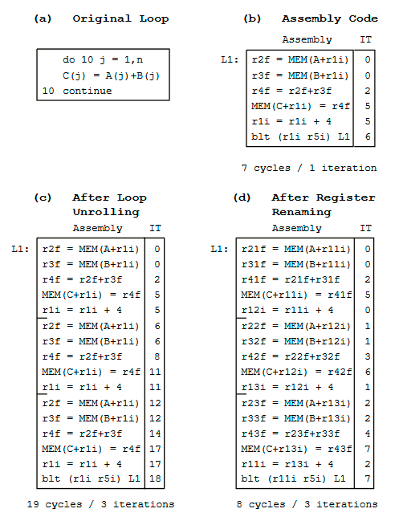
Level 1: Loop Unrolling (review)
Replicating loop body n times
Overlap execution of instructions across loops

Slide 7
Level 2: Register Renaming (review)
Rename registers to reduce data dependencies

Slide 8
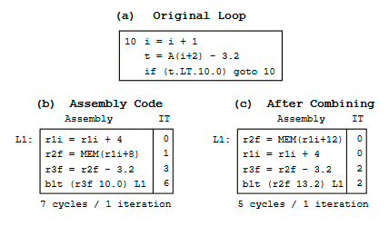
Level 3: Operation Combining (new!)
Eliminates flow dependencies between pairs of instructions with compile-time constant source operands
Often arises between:
address calculation and memory access instructions
loop variable increments and loop exit branches

Slide 9
Level 3: Operation Combining (new!)
Combinations limited to same precedence and data type
op1 and/or op3 => op2

Slide 10
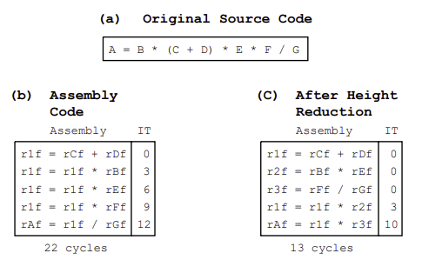
Level 3: Strength Reduction, Height Reduction (review)
Start with back substitution
Create balanced tree
High will be ceil(log₂(n))
May not work with floats
r2 = r1 * 10
// can be strength reduced
temp1 = r1 << 3
temp2 = r1 << 1
r2 = temp1 + temp2
r1 = 0
L1: r1 = r1 + 1
r2 = r1 * 10
r3 = MEM(r2)
r4 = r4 + r3
blt (r1 100) L1
// can be strength reduced
r1 = 0
r2 = 0
L2: r1 = r1 + 1
r2 = r2 + 10
r3 = MEM(r2)
r4 = r4 + r3
blt (r1 100) L2

Slide 11
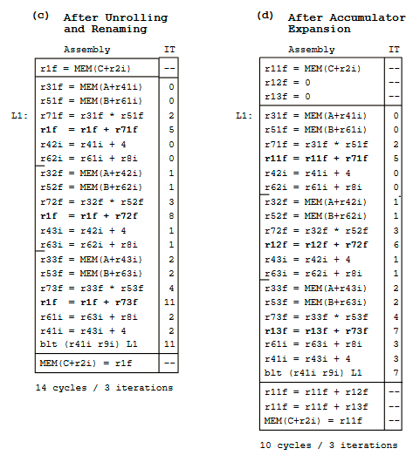
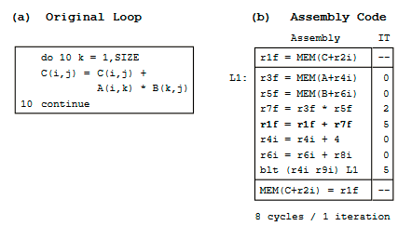
Level 4: Accumulator Variable Expansion (review)

Slide 12
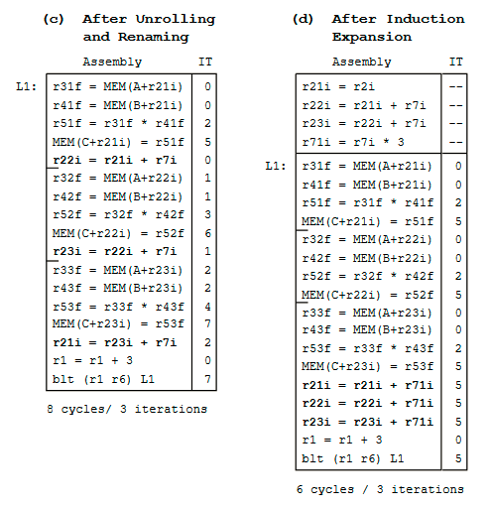
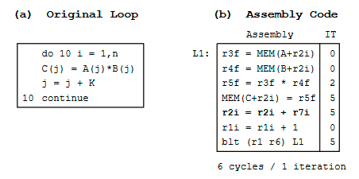
Level 4: Induction Variable Expansion (review)

Slide 13
Level 4: Search variable expansion (new!)
Eliminate the chain of flow dependencies in a loop body between successive tests and updates of a search variable by creating temporary search variables
Arises often for iterative search values, like finding the maximum or minimum value of matrices or arrays
Similar to accumulator expansion but for comparison instead of accumulation
// assume r5 is a multiple of 3
r3 = MEM(r1)
L1: r2 = MEM(4+r1)
r3 = max(r3,r2)
r1 = r1 + 4
blt (r1 r5) L1
// can be loop unrolled/inducted/op-combo-ed by factor = 3
r3 = MEM(r1)
L2: r12 = MEM(4+r1)
r3 = max(r3,r12)
r22 = MEM(8+r1)
r3 = max(r3,r22)
r32 = MEM(12+r1)
r3 = max(r3,r32)
r1 = r1 + 12
blt (r1 r5) L2
// can be search variable expanded
r3 = MEM(r1)
L3: r12 = MEM(4+r1)
r13 = max(r13,r2)
r22 = MEM(8+r1)
r23 = max(r23,r22)
r32 = MEM(12+r1)
r33 = max(r33,r32)
r1 = r1 + 12
blt (r1 r5) L3
r3 = max(r13,r23,r33)

Slide 14
Experimental Evaluation
Transformations incorporated into IMPACT-I compiler
Assumed microarchitecture:
RISC instruction set
Infinite registers (counted)
100% cache hit rate
Simulated with 2,4, and 8 way superscalar
In order processor
40 different test cases
13-6000 iterations
1-71 instructions in loop body

Slide 15
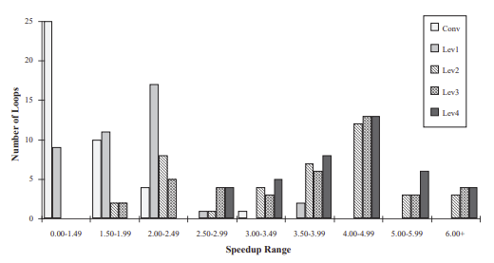
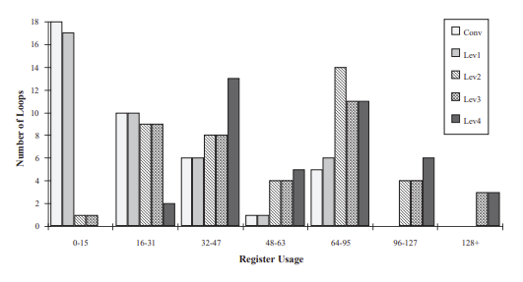
Results
Loop unroll
Moderately ineffective by itself
Register renaming & induction
Biggest speedup
Accumulator & search
Next best
Only apply to some loops
Tree height & operation combining
Slight help
Apply to most loops
Strength reduction
Smallest impact
Partially due to test processor

Slide 16
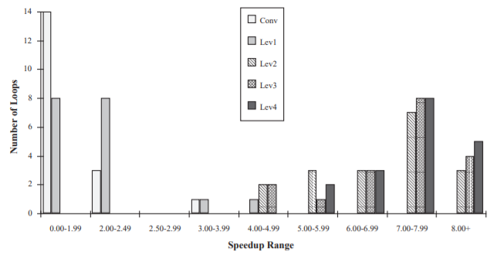
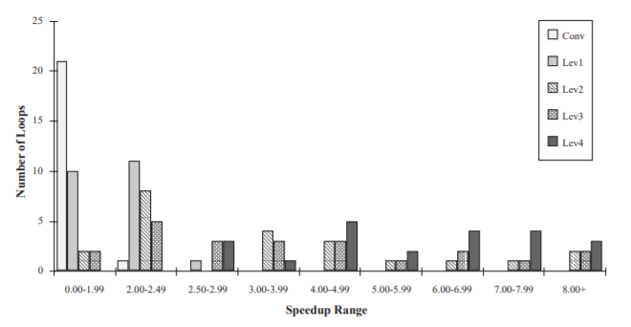
DOALL vs non-DOALL
DOALL
DOALL
Iterations independant
Renaming very helpful
non-DOALL
Step 3 helps some
Step 4 helps a lot
Better register usage
non-DOALL

