Slide 1
LLAMA (LLVM Pass and Library for Automatically Determining Memory Allocations)
Eric Giovannini, Frederick Zhang, Mollie Bakal, Sara Mahdizadeh Shahri Group 8

Slide 2
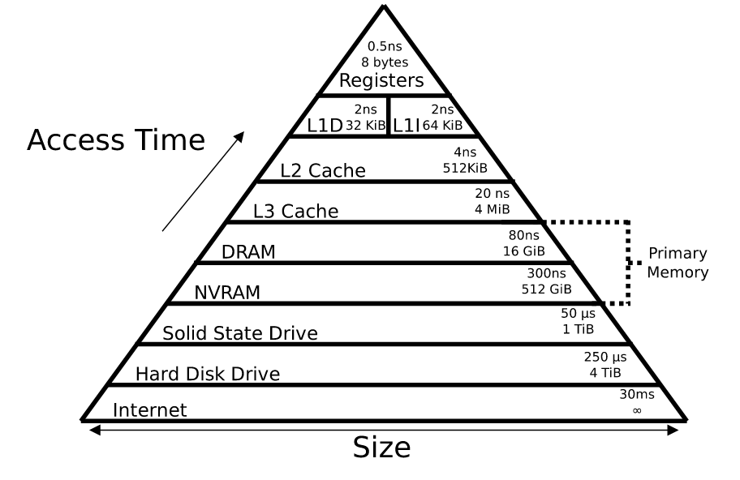
Background and Motivation
Memory hierarchy
DRAM vs NVRAM
Goal: simulate MLM compilation
At present, specialized hardware
Notes:
1st) Give high level design--w/o programmer assigning memory, let program.
DRAM most common memory. Heterogeneity -- dual data rate dynamic random-access memory (DDR DRAM), and newer "slow" non-volatile memory (NVRAM).
goals: At core, THE PROBLEM IS WHERE WHAT GOES and automatic rather than manual ass.
In this, simulates into two levels via automatic realloc of Malloc calls

Slide 3
Design Overview
DRAM
(Level 0)
NVM
(Level 1)
Two portions of LLAMA:
LLVM pass
Library
< threshold
>= threshold
setLLVMScore()
LLVM Pass
Library
Score
Final Scores
Function Redefinitions

Slide 4
LLVM Pass
The main contribution of LLAMA
Two parts: analysis phase and modifying phase
Analysis phase: analyze code and score individual memory allocations
Modifying phase: Informs the library of the scores computed by LLVM pass by inserting calls to the setLLVMScore() function
...
setLLVMScore(score₁)
malloc₁()
...
setLLVMScore(score₂)
malloc₂()
...
setLLVMScore(score₃)
malloc₃()
...
...
malloc₁()
...
malloc₂()
...
malloc₃()
...
score₁
score₂
score₃
Notes:
The picture shows the code before and after the LLVM pass

Slide 5
LLVM Pass: Analysis Phase
Goal: Assign a score to each memory allocation function call
Idea: the score assigned to each memory allocation call determines where the corresponding value will live in the memory hierarchy
(Higher score ⇒ lower in memory hierarchy)
These scores are used by the modifying phase of the LLVM pass, which inserts calls to setLLVMScore() before each memory allocation function call

Slide 6
Analysis Phase: Intuition for Computing the Score
The more times a value is accessed, the lower the memory should be in the hierarchy (because the lower memory levels are faster)
Accesses within a loop are assumed to be more important than accesses outside of a loop
⇒ Accesses at a deeper loop nesting level should get a higher score
The more operations there are between accesses of the same memory address, the less important that access is, so the less it contributes to the score
15 or more instructions between memory accesses ⇒ no contribution at all
Notes:
The more times a value is used, the lower the memory should be in the hierarchy (because the lower memory levels are faster)
Accesses within a loop are assumed to be more important than accesses outside of a loop
The 15 seems somewhat arbitrary, and the paper doesn’t explain why they chose this value

Slide 7
Analysis Phase: Formula for Score
Explanation:
Remember: We are computing the score of a memory allocation instruction
T is the number of instructions that access the address allocated by this instruction
depth_{n} is the depth of the loop in which the n-th access to this address occurs
inst_{n} is the number of operations between access n and access n+1
Notes:
Each of the T accesses to the memory location allocated by this instruction contributes a value (potentially 0) to the score of this instruction
In the first case: the more instructions there are between this access and the next, the lower the contribution to the score
Second case: if there are 15 or more instructions between this access and the next, then the contribution of this access to the score is 0
Third case: if the loop depth of the access is 0, then the contribution is 0.
Slight technical issue: What is inst_T? It should be zero since there are only T total accesses
LaTex source:
\textbf{score} = T + \sum_{n=1}^T \begin{cases}
(15 - \textbf{inst}_n)^{2 \cdot \textbf{depth}_n} & \text{if } 15 - \textbf{inst}_n > 0 \\
0 & \text{if } 15 - \textbf{inst}_n \le 0 \\
0 & \text{if } \textbf{depth}_n = 0
\end{cases}

Slide 8
Library
Goal: Compute whether or not a particular memory allocation should occur in one memory level or another. (Assume there are only two levels)
Step 1: Function Intercepts
Goal: Traditional memory allocation => internal memory allocation functions
E.g., malloc() => _internal_malloc()
Implementation: Utilization of mlm_malloc(size_t,int) call
Allocate a block of data to the memory level specified by 2nd argument.
E.g., mlm_malloc(size_t,int) can simulate malloc()
Notes:
Traditional memory allocation => internal memory allocation functions to allow for dynamic analysis.

Slide 9
Library (cont.)
Step 2: Insertion of setLLVMScore()
The LLVM pass inserts the function call setLLVMScore(int thisScore) immediately before the memory allocation function calls.
Step 3: Allocation Calculation
Final Allocation:
Level = 1 if finalscore ≤ threshold
Level = 0 if finalscore > threshold

Slide 10
Methodology
DRAM
(Level 0)
NVM
(Level 1)
Benchmarks
Memory Allocator
Matrix Multiplier
XSBench
SimpleMOC Kernel
DC
DC
NoC
L2
L2
L2
L2
System Configuration
L1
L1
L1
L1
C
C
C
C

Slide 11
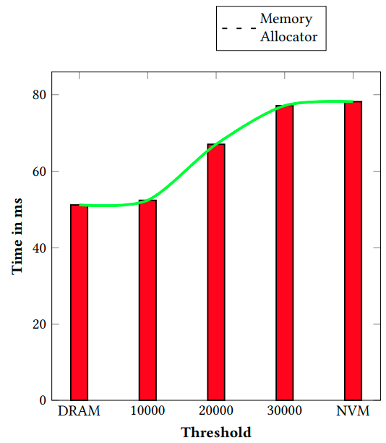
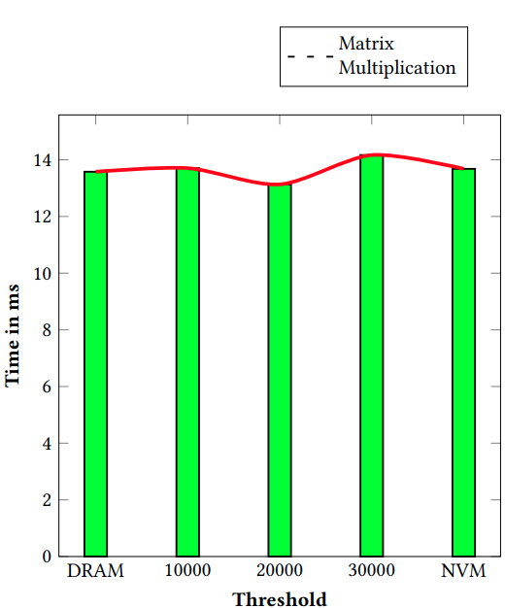
Performance by Threshold
better
Notes:
As a reminder if the score is higher than the threshold memory would be placed in fast memory (DRAM) so in the graph with higher threshold, more and more memory allocations are placed in the slower non-volatile memory and as it is shown the execution time increases

Slide 12
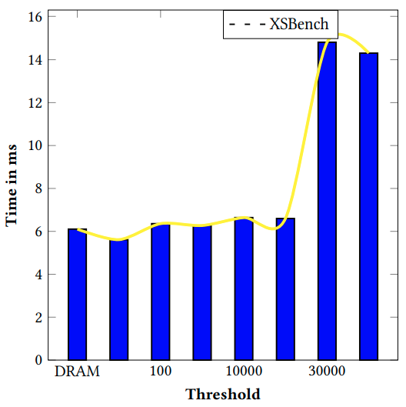
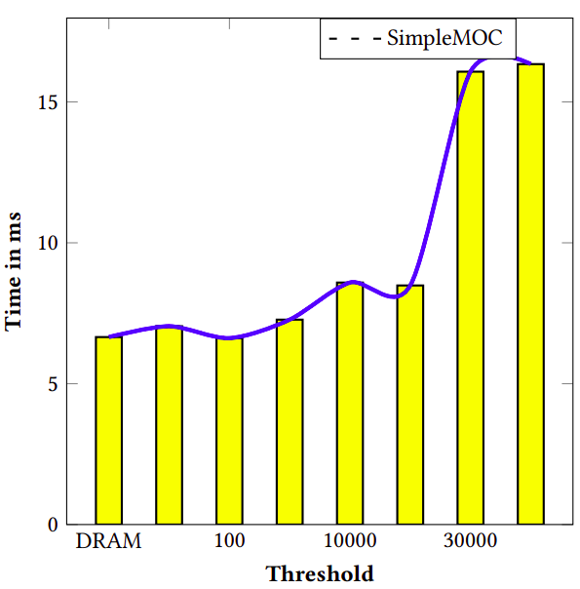
Performance by Threshold (cont)
better
Notes:
Recall the definition of the threshold

Slide 13
Strengths and Weaknesses
Strengths
Automatically places data based on size and access behaviour in “fast” or “slow” memory
Heuristic makes sense; more frequent access should be faster
Requires no modification to hardware
Weaknesses
Not clear how to deal with code with large memory footprint
Constants that appear in the formula for the score of a memory allocation are not well explained
Requires manually finding the effective threshold
Unrealistic simulation configuration
Only supports C

Slide 14
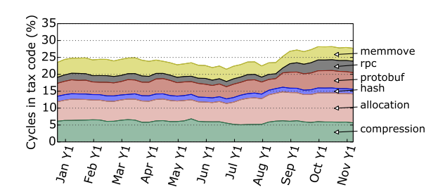
Project Parallels with LLAMA
Project motivation vs LLAMA’s goal
Both: Memory allocation, leveraging llvm pass and a library to track memory locations, methodology
[1] Profiling a warehouse-scale computer
Notes:
The goal of our project is to modify the cycle percentage of memory allocation for a program to be able to use it as a tool to mimic the behaviour of what is predicted for that program in the future and inspect the hardware implications of it.

Slide 15
Thank You!
Questions?

