Slide 1
Using Decision Trees to Improve Program-Based Static Branch Prediction
Group 25: Nicholas Huang (ncchuang), Alice Ying (acying)

Slide 2
Introduction: What is Static Branch Prediction?
Static Branch Prediction: A fixed prediction on whether a branch is 'taken' or 'not taken'
Two Types
Profile-based
Uses information from previous runs with different inputs
High accuracy
Think HW 2!
Program-based
Uses structural information of the program
Cost effective

Slide 3
Motivation: Why is Static Branch Prediction Important?
Compiler optimizations often depend on accurate branch prediction 1. Instruction Scheduling 2. LLVM 3. Predication 4. Register Allocation
Reduces the load on dynamic branch predictors
Some embedded microprocessors lack dynamic branch prediction altogether, relying on static branch prediction
Notes:
What is a dynamic branch predictor: uses runtime information for branch prediction

Slide 4
Paper Overview
Goal 1: Use decision trees to optimize the ordered application of program-based Ball and Larus Heuristics in branch prediction.
Goal 2: Use decision trees to find additional heuristics that further improve the performance of Ball and Larus Heuristics.

Slide 5
Background: Ball and Larus Heuristics
Heuristic | Coverage | Compound Coverage | Misprediction Rate
Loop | 35% | 35% | 19%
Pointer | 21% | 13% | 39%
Opcode | 9% | 13% | 27%
Guard | 13% | 4.5% | 37%
Loop Header | 26% | 7% | 25%
Call | 22% | 8% | 33%
Store | 25% | 1.5% | 48%
Return | 22% | 1% | 29%
Notes:
First classify branches as loop and non-loop branches, loop branches are predicted accurately by the loop heuristic
Other heuristics for non-loop branches
Pointer: Predicts that pointers are mostly non-null and usually not equal, comparing pointers us usually an inequality
Opcode: Comparisons of integers for < 0 and <= 0 are usually false, >0 and >= are usually true. This exists because negative values are often used for errors.
Guard: Applies if the register used in the branch is also used in the successor basic block, and the successor does not post-dominate the branch. If this applies, we predict the successor to be the next block executed.
Loop Header: Predict that loops are executed rather than avoided
Call: Predict the successor that contains a call is not taken, this will predict that a branch will avoid a function call
Store: Predict the successor containing a store as not taken
Return: Predict the successor containing a return is not taken
Evaluating the Ball and Larus Heuristics
Coverage: The number of static branches to which the heuristic applies
Misprediction Rate: The rate of branch misprediction of individual heuristics
Ordering of Heuristics has a large effect on the overall misprediction rate
Loop -> Pointer -> Call -> Opcode -> Return -> Store -> Loop Header -> Guard
When one heuristic applies, the branch is predicted along that heuristic and all other heuristics are ignored
If no heuristics, then a random prediction is made
Instruction Per Mispredicted Branch 31.3
83% Heuristic coverage, 17% Random prediction
Determining optimal ordering for one ISA Instruction set architecture does not guarantee optimal ordering for all programs
Evaluating n heuristics takes n! time, which is not feasible with more heuristics
We can to use decision trees to find the optimal ordering

Slide 6
Background: Ball and Larus Heuristics
Optimal Ordering: 31.3 IPM Loop, Pointer, Call, Opcode, Return, Store, Loop Header, Guard
83% Heuristic Coverage
17% Random Prediction
Heuristic | Coverage | Compound Coverage | Misprediction Rate
Loop | 35% | 35% | 19%
Pointer | 21% | 13% | 39%
Opcode | 9% | 13% | 27%
Guard | 13% | 4.5% | 37%
Loop Header | 26% | 7% | 25%
Call | 22% | 8% | 33%
Store | 25% | 1.5% | 48%
Return | 22% | 1% | 29%
Notes:
First classify branches as loop and non-loop branches, loop branches are predicted accurately by the loop heuristic
Other heuristics for non-loop branches
Pointer: Predicts that pointers are mostly non-null and usually not equal, comparing pointers us usually an inequality
Opcode: Comparisons of integers for < 0 and <= 0 are usually false, >0 and >= are usually true. This exists because negative values are often used for errors.
Guard: Applies if the register used in the branch is also used in the successor basic block, and the successor does not post-dominate the branch. If this applies, we predict the successor to be the next block executed.
Loop Header: Predict that loops are executed rather than avoided
Call: Predict the successor that contains a call is not taken, this will predict that a branch will avoid a function call
Store: Predict the successor containing a store as not taken
Return: Predict the successor containing a return is not taken
Evaluating the Ball and Larus Heuristics
Coverage: The number of static branches to which the heuristic applies
Misprediction Rate: The rate of branch misprediction of individual heuristics
Ordering of Heuristics has a large effect on the overall misprediction rate
Loop -> Pointer -> Call -> Opcode -> Return -> Store -> Loop Header -> Guard
When one heuristic applies, the branch is predicted along that heuristic and all other heuristics are ignored
If no heuristics, then a random prediction is made
Instruction Per Mispredicted Branch 31.3
83% Heuristic coverage, 17% Random prediction
Determining optimal ordering for one ISA Instruction set architecture does not guarantee optimal ordering for all programs
Evaluating n heuristics takes n! time, which is not feasible with more heuristics
We can to use decision trees to find the optimal ordering

Slide 7
Background: Ball and Larus Heuristics
Optimal Ordering: 31.3 IPM Loop, Pointer, Call, Opcode, Return, Store, Loop Header, Guard
83% Heuristic Coverage
17% Random Prediction
Not feasible to evaluate all heuristic orderings (takes factorial time)
Heuristic | Coverage | Compound Coverage | Misprediction Rate
Loop | 35% | 35% | 19%
Pointer | 21% | 13% | 39%
Opcode | 9% | 13% | 27%
Guard | 13% | 4.5% | 37%
Loop Header | 26% | 7% | 25%
Call | 22% | 8% | 33%
Store | 25% | 1.5% | 48%
Return | 22% | 1% | 29%
Notes:
First classify branches as loop and non-loop branches, loop branches are predicted accurately by the loop heuristic
Other heuristics for non-loop branches
Pointer: Predicts that pointers are mostly non-null and usually not equal, comparing pointers us usually an inequality
Opcode: Comparisons of integers for < 0 and <= 0 are usually false, >0 and >= are usually true. This exists because negative values are often used for errors.
Guard: Applies if the register used in the branch is also used in the successor basic block, and the successor does not post-dominate the branch. If this applies, we predict the successor to be the next block executed.
Loop Header: Predict that loops are executed rather than avoided
Call: Predict the successor that contains a call is not taken, this will predict that a branch will avoid a function call
Store: Predict the successor containing a store as not taken
Return: Predict the successor containing a return is not taken
Evaluating the Ball and Larus Heuristics
Coverage: The number of static branches to which the heuristic applies
Misprediction Rate: The rate of branch misprediction of individual heuristics
Ordering of Heuristics has a large effect on the overall misprediction rate
Loop -> Pointer -> Call -> Opcode -> Return -> Store -> Loop Header -> Guard
When one heuristic applies, the branch is predicted along that heuristic and all other heuristics are ignored
If no heuristics, then a random prediction is made
Instruction Per Mispredicted Branch 31.3
83% Heuristic coverage, 17% Random prediction
Determining optimal ordering for one ISA Instruction set architecture does not guarantee optimal ordering for all programs
Evaluating n heuristics takes n! time, which is not feasible with more heuristics
We can to use decision trees to find the optimal ordering

Slide 8
Goal 1: Evaluating and Ordering Ball and Larus Heuristics
Benchmark Programs: gzip, vpr, gcc, parser, perl, etc. (16 total)
Algorithm
For each benchmark:
Learn a decision tree with Ball and Larus Heuristics as nodes using information from other 15 benchmarks
Cross-validate on the benchmark not included in training
Loop
Opcode
Follow Heuristic
Call
Follow Heuristic
Return
Follow Heuristic
Loop
Header
Follow Heuristic
Store
Follow Heuristic
Pointer
Follow Heuristic
Notes:
Loop → Pointer → Call → Opcode → Return → Store → LoopHeader → Guard

Slide 9
Goal 1: Evaluating and Ordering Ball and Larus Heuristics
Loop
Loop
vpr
Call
Follow Heuristic
gcc
Opcode
Follow Heuristic
Opcode
Follow Heuristic
Call
Follow Heuristic
Store
Follow Heuristic
Store
Follow Heuristic
Loop
Header
Follow Heuristic
Loop
Header
Follow Heuristic
Return
Follow Heuristic
Return
Follow Heuristic
Pointer
Follow Heuristic
Pointer
Follow Heuristic

Slide 10
Goal 1: Evaluating and Ordering Ball and Larus Heuristics
Loop
Loop
vpr
Call
Follow Heuristic
gcc
Opcode
Follow Heuristic
Opcode
Follow Heuristic
Call
Follow Heuristic
Store
Follow Heuristic
Store
Follow Heuristic
Loop
Header
Follow Heuristic
Loop
Header
Follow Heuristic
Return
Follow Heuristic
Return
Follow Heuristic
Pointer
Follow Heuristic
Pointer
Follow Heuristic

Slide 11
Goal 1: Results - Optimal Ordering
Heuristic | Ball and Larus Proposed | Decision Tree Optimal
Loop | 35% | 35%
Pointer | 13% | 4%
Opcode | 13% | 5.5%
Loop Header | 7% | 4%
Call | 8% | 16.5%
Store | 1.5% | 18%
Return | 1% | 9%
Loop
Opcode
Follow Heuristic
Call
Follow Heuristic
Return
Follow Heuristic
Loop
Header
Follow Heuristic
Store
Follow Heuristic
Pointer
Follow Heuristic
Notes:
Optimal ordering found from decision trees
Ball and Larus IPM: 31.3
New IPM: 32.1 2% improvement
Moving pointer heuristic to the end allows other heuristics to predict other branches more accurately

Slide 12
Goal 1: Results - Optimal Ordering
Heuristic | Ball and Larus Proposed | Decision Tree Optimal
Loop | 35% | 35%
Pointer | 13% | 4%
Opcode | 13% | 5.5%
Loop Header | 7% | 4%
Call | 8% | 16.5%
Store | 1.5% | 18%
Return | 1% | 9%
Loop
Opcode
Follow Heuristic
Call
Follow Heuristic
Return
Follow Heuristic
Loop
Header
Follow Heuristic
Store
Follow Heuristic
Pointer
Follow Heuristic
Notes:
Optimal ordering found from decision trees
Ball and Larus IPM: 31.3
New IPM: 32.1 2% improvement
Moving pointer heuristic to the end allows other heuristics to predict other branches more accurately

Slide 13
Goal 1: Results - Optimal Ordering
Heuristic | Ball and Larus Proposed | Decision Tree Optimal
Loop | 35% | 35%
Pointer | 13% | 4%
Opcode | 13% | 5.5%
Loop Header | 7% | 4%
Call | 8% | 16.5%
Store | 1.5% | 18%
Return | 1% | 9%
IPM | 31.3 | 32.1
Loop
Opcode
Follow Heuristic
Call
Follow Heuristic
Return
Follow Heuristic
Loop
Header
Follow Heuristic
Store
Follow Heuristic
Pointer
Follow Heuristic
Notes:
Optimal ordering found from decision trees
Ball and Larus IPM: 31.3
New IPM: 32.1 2.5% improvement
Moving pointer heuristic to the end allows other heuristics to predict other branches more accurately

Slide 14
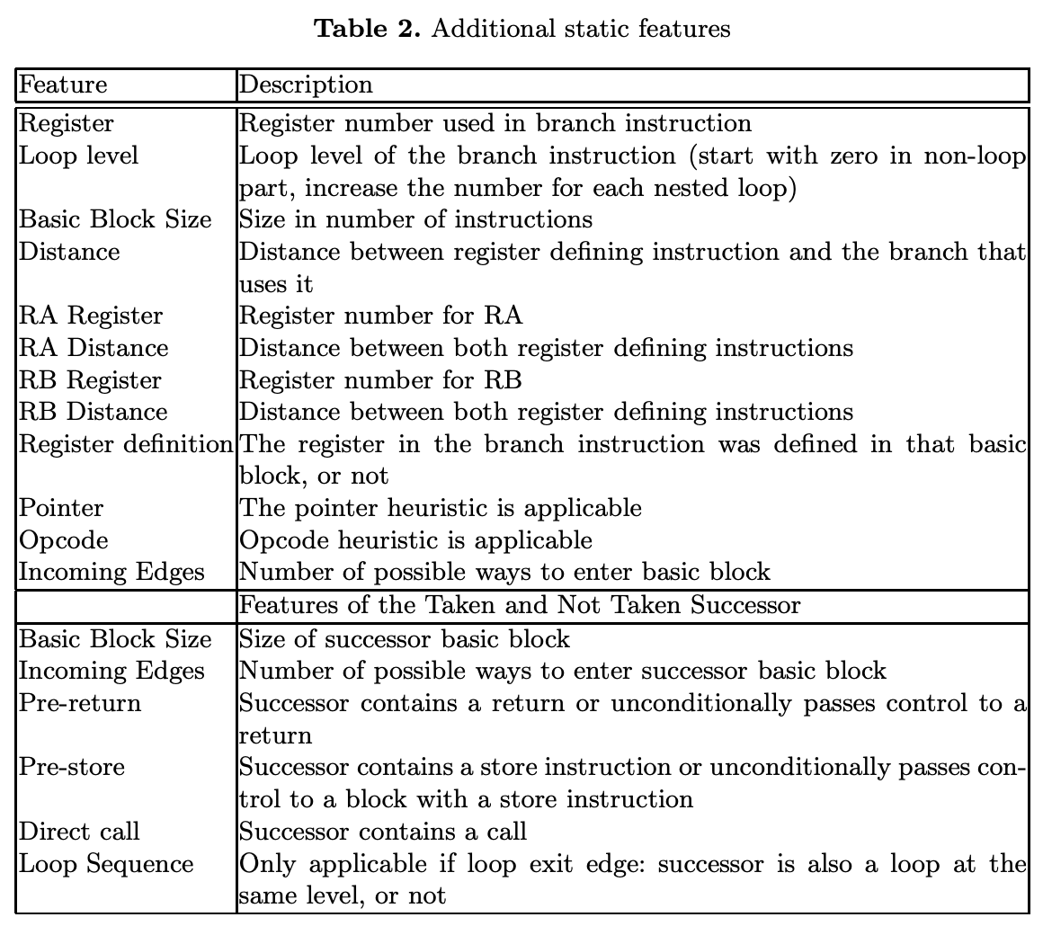
Background: Other Static Features and Heuristics
Motivation: Automated ordering means adding heuristics is less computationally expensive (no longer factorial)

Slide 15
Background: Other Static Features and Heuristics
Motivation: Automated ordering means adding heuristics is less computationally expensive (no longer factorial)
Feature Types
Properties of branch's BB

Slide 16
Background: Other Static Features and Heuristics
Motivation: Automated ordering means adding heuristics is less computationally expensive (no longer factorial)
Feature Types
Properties of branch's BB
Properties of successor BB

Slide 17
Goal 2: Adding New Heuristics
Loop
Opcode
Follow Heuristic
Modify original Ball and Larus Heuristics by...
Call
Follow Heuristic
Return
Follow Heuristic
Loop
Header
Follow Heuristic
Store
Follow Heuristic
Pointer
Follow Heuristic
Original Ball and Larus Heuristics
Notes:
Loop → Opcode → Call → Return → LoopHeader → Store → Pointer.

Slide 18
Goal 2: Adding New Heuristics
Loop
Opcode
Follow Heuristic
Modify original Ball and Larus Heuristics by...
Add additional heuristics one by one and calculate prediction accuracy
Call
Follow Heuristic
Return
Follow Heuristic
Loop
Header
Follow Heuristic
Store
Follow Heuristic
Pointer
Follow Heuristic
Post Dominator
Follow Heuristic
True
False
not-taken
taken
Notes:
Loop → Opcode → Call → Return → LoopHeader → Store → Pointer.

Slide 19
Goal 2: Adding New Heuristics
Loop
Opcode
Follow Heuristic
Modify original Ball and Larus Heuristics by...
Add additional heuristics one by one and calculate prediction accuracy
Call
Follow Heuristic
Return
Follow Heuristic
Loop
Header
Follow Heuristic
Store
Follow Heuristic
Pointer
Follow Heuristic
Dep Distance
Follow Heuristic
not short
short
not-taken
taken
Notes:
Loop → Opcode → Call → Return → LoopHeader → Store → Pointer.

Slide 20
Goal 2: Adding New Heuristics
Loop
Opcode
Follow Heuristic
Modify original Ball and Larus Heuristics by...
Add additional heuristics one by one and calculate prediction accuracy
Call
Follow Heuristic
Return
Follow Heuristic
Loop
Header
Follow Heuristic
Store
Follow Heuristic
Pointer
Follow Heuristic
...
(for all features )
Dep Distance
Follow Heuristic
not short
short
not-taken
taken
Notes:
Loop → Opcode → Call → Return → LoopHeader → Store → Pointer.

Slide 21
Goal 2: Adding New Heuristics
Loop
Opcode
Follow Heuristic
Modify original Ball and Larus Heuristics by...
Add additional heuristics one by one and calculate prediction accuracy
Permanently include heuristic with highest prediction accuracy
Call
Follow Heuristic
Return
Follow Heuristic
Loop
Header
Follow Heuristic
Store
Follow Heuristic
Post Dominator
Follow Heuristic
not-taken
taken
New Tree After 1 Iteration
Notes:
Loop → Opcode → Call → Return → LoopHeader → Store → Pointer.

Slide 22
Goal 2: Adding New Heuristics
Loop
Opcode
Follow Heuristic
Modify original Ball and Larus Heuristics by...
Add additional heuristics one by one and calculate prediction accuracy
Permanently include heuristic with highest prediction accuracy
Repeat 1-3 with extended set until accuracy no longer improves
Call
Follow Heuristic
Return
Follow Heuristic
Loop
Header
Follow Heuristic
Store
Follow Heuristic
Post Dominator
Follow Heuristic
Dep Distance
Follow Heuristic
not short
short
not-taken
taken
Notes:
Loop → Opcode → Call → Return → LoopHeader → Store → Pointer.

Slide 23
Goal 2: Adding New Heuristics
Loop
Opcode
Follow Heuristic
Modify original Ball and Larus Heuristics by...
Add additional heuristics one by one and calculate prediction accuracy
Permanently include heuristic with highest prediction accuracy
Repeat 1-3 with extended set until accuracy no longer improves
Call
Follow Heuristic
Return
Follow Heuristic
Loop
Header
Follow Heuristic
Store
Follow Heuristic
Post Dominator
Follow Heuristic
...
(for all features )
Dep Distance
Follow Heuristic
not short
short
not-taken
taken
Notes:
Loop → Opcode → Call → Return → LoopHeader → Store → Pointer.

Slide 24
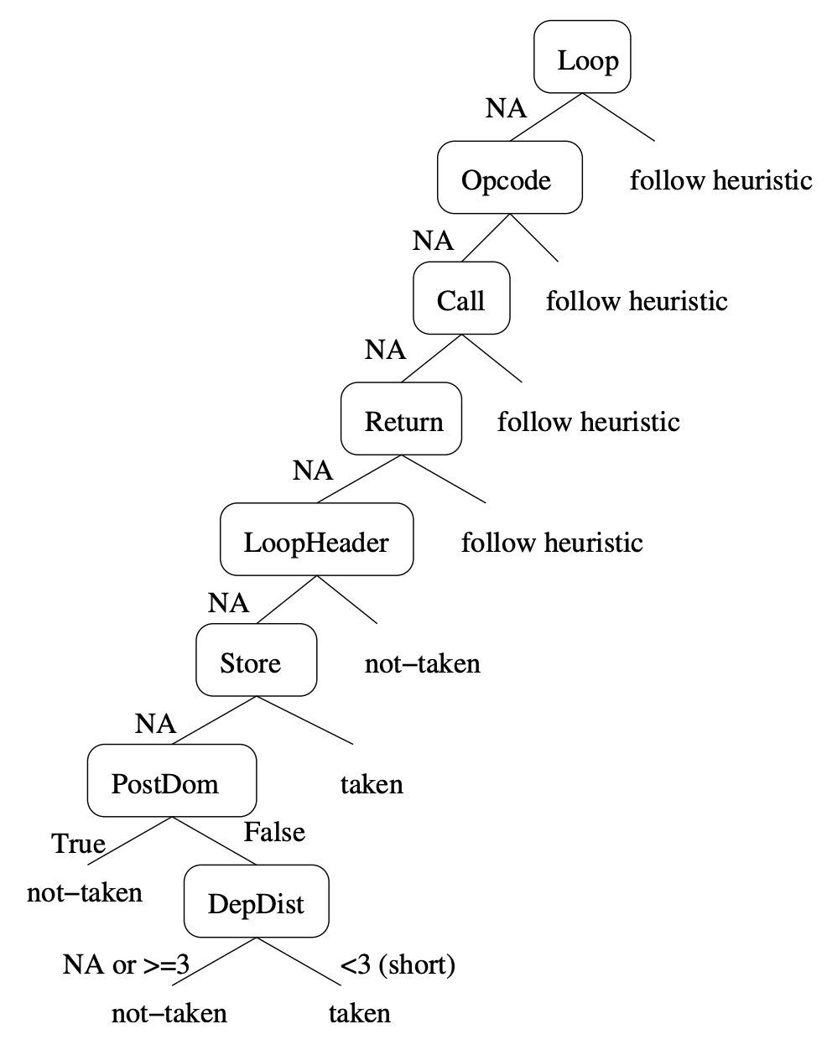
Goal 2: Adding New Heuristics
Modify original Ball and Larus Heuristics by...
Add additional heuristics one by one and calculate prediction accuracy
Permanently include heuristic with highest prediction accuracy
Repeat 1-3 with extended set until accuracy no longer improves
Final Tree

Slide 25
Goal 2: Predict Non Post-Dominating Successor Heuristic
Definition
If a branch has two successors where one post-dominates the current BB, predict the non post-dominating successor as taken

Slide 26
Goal 2: Predict Non Post-Dominating Successor Heuristic
Definition
If a branch has two successors where one post-dominates the current BB, predict the non post-dominating successor as taken
Example
int i = 0
if(i < 100){
printf("inside")
}
printf("outside")

Slide 27
Goal 2: Predict Non Post-Dominating Successor Heuristic
Definition
If a branch has two successors where one post-dominates the current BB, predict the non post-dominating successor as taken
Example
int i = 0
if(i < 100){
printf("inside")
}
printf("outside")
BB1
i = 0
BB2
printf("inside")
BB3
printf("outside")

Slide 28
Goal 2: Predict Non Post-Dominating Successor Heuristic
Definition
If a branch has two successors where one post-dominates the current BB, predict the non post-dominating successor as taken
Example
int i = 0
if(i < 100){
printf("inside")
}
printf("outside")
BB1
i = 0
BB2
printf("inside")
BB3
printf("outside")

Slide 29
Goal 2: Distance Dependency Heuristic
Definition
If the number of instructions between producing a register value and consuming it is >3 or undefined, predict the branch as not-taken.
Notes:
Undefined: operand defining instruction is not part of the branch’s basic block

Slide 30
Goal 2: Distance Dependency Heuristic
Definition
If the number of instructions between producing a register value and consuming it is >3 or undefined, predict the branch as not-taken.
Example
int i = 0
int j = 1
if(i < 100){
...
}
Notes:
Undefined: operand defining instruction is not part of the branch’s basic block

Slide 31
Goal 2: Distance Dependency Heuristic
Definition
If the number of instructions between producing a register value and consuming it is >3 or undefined, predict the branch as not-taken.
Example
int i = 0 operand defining instruction
int j = 1
if(i < 100){ branch
...
}
Notes:
Undefined: operand defining instruction is not part of the branch’s basic block

Slide 32
Goal 2: Distance Dependency Heuristic
Definition
If the number of instructions between producing a register value and consuming it is >3 or undefined, predict the branch as not-taken.
Example
int i = 0
int j = 1 distance = 2
if(i < 100){
...
}
Notes:
Undefined: operand defining instruction is not part of the branch’s basic block

Slide 33
Goal 2: Distance Dependency Heuristic
Definition
If the number of instructions between producing a register value and consuming it is >3 or undefined, predict the branch as not-taken.
Example
int i = 0
int j = 1 distance = 2 predict taken
if(i < 100){
...
}
Notes:
Undefined: operand defining instruction is not part of the branch’s basic block

Slide 34
Goal 2: Results
Predict Non Post-Dominating Successor
Replaces Pointer heuristic, increasing coverage by 2%
IPM increases from 32.1 → 34.7
Dependency Distance
Non-random prediction of previously unseen branches i.e. 100% coverage
IPM further increases from 34.7 → 37.1
i.e. 18.5% overall

Slide 35
Commentary
Strengths
Automatic generation and optimization of static branch predictors
High transparency as a machine learning model
Weaknesses
Experimental results are dependent upon the compiler, ISA, and benchmarks

Slide 36
Thank You!
Questions?

