Slide 1
Optimal and Efficient Speculation-Based Partial Redundancy Elimination
Qiong Cai and Jingling Xue (CGO’03)
Presented by Jing Zhu, Yihao Huang, Yuanli Zhu, Yujian Liu
Group 11

Slide 2
Partial Redundancy
100
Common Subexpression Elimination (CSE): Eliminate recomputation of an expression by reusing the previous result (e.g. r4 = r2*r3 -> r4 = r100)
Partial Redundancy: such r2*r3 expression only exist in one path
But it still worth optimizing!
99
1
r4 = r2 * r3
r2 = 7
99
1
r5 = r2 * r3

Slide 3
Partial Redundancy Elimination (PRE)
100
Insert where needed to make it fully redundant!
Eliminate it just as CSE
It adds more instructions to the program but profitable in general
99
1
r4 = r2 * r3
r100 = r4
r2 = 7
r100 = r2 * r3
99
1
r5 = r100

Slide 4
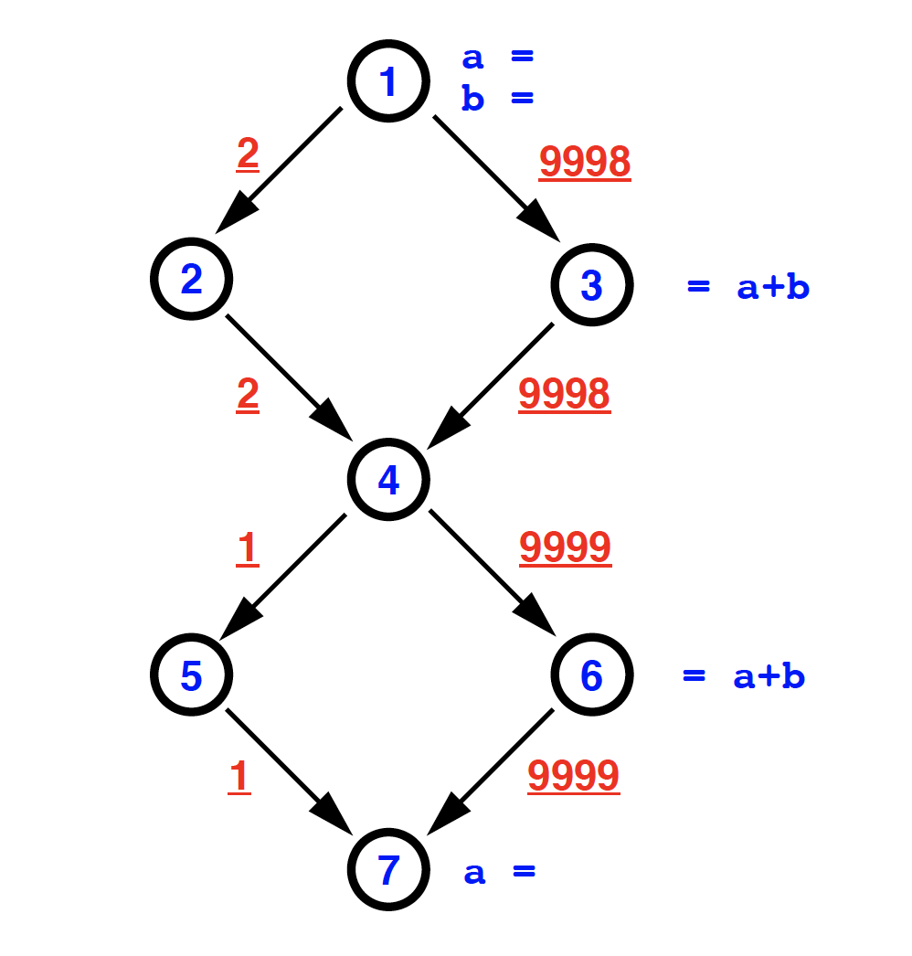
PRE vs. Speculation based PRE
Classic PRE:
independent of execution frequencies
But sometimes we can be more aggressive and use runtime information for PRE optimizations!
This paper is about using edge profiling information to do speculation based PRE
t = a+ b
t = a+ b
= t
R. Horspool and H. Ho. Partial redundancy elimination driven by a cost-benefit analysis

Slide 5
MC-PRE
Key Insight
Removing the non-essential edges (and consequently, all resulting non-essential nodes) from a flow graph so that the problem of finding an optimal insertion set becomes one of finding a minimal cut on the reduced flow graph thus obtained
Notes:
So now let's talk about the algorithm, MC-PRE, that the paper presents to find an optimal insertion set for an expression pi. The key insight of this algorithm is to remove the non-essential edges (and consequently, all resulting non-essential nodes) from a flow graph so that the problem of finding an optimal insertion set becomes one of finding a minimal cut on the reduced flow graph thus obtained.

Slide 6
Step 1: Constructing a Reduced Graph
Assumptions
Each node n contains only a single assignment of the form v = π, where v is a variable and π is an expression built in terms of variables, constants and operators.
Each node cannot both compute and modify π at the same time, i.e., disallowing assignments of the form a = a + b.
Notes:
To begin with, we need to construct a reduced graph. A few assumptions are made about the basic block nodes in a program for simplification. First, each node contains only a single assignment of the form v = pi, where v is a variable and pi is an expression built in terms of variables, constants and operators. Second, each node cannot both compute and modify pi at the same time, that is, we are disallowing assignments of the form a = a + b

Slide 7
Step 1: Constructing a Reduced Graph
Definitions
Notes:
Now, let's talk about some definitions that we will use later.

Slide 8
Step 1: Constructing a Reduced Graph
Definitions
COMP(n): n contains a computation of π
TRANSP(n): n does not modify any operands of π
Notes:
The first two are local predicates, which are COMP(n), deciding whether n contains a computation of pi, and TRANSP(n), meaning n does not modify any operands of pi.

Slide 9
Step 1: Constructing a Reduced Graph
Definitions
COMP(n): n contains a computation of π
TRANSP(n): n does not modify any operands of π
N-AVAL(n): availability of π on the entry of a node n
X-AVAL(n): availability of π at the exit of a node n
Notes:
We are pretty familiar with the next set of definitions, which are just IN and OUT of available expressions we have learnt from lectures.

Slide 10
Step 1: Constructing a Reduced Graph
Definitions
COMP(n): n contains a computation of π
TRANSP(n): n does not modify any operands of π
N-AVAL(n): availability of π on the entry of a node n
X-AVAL(n): availability of π at the exit of a node n
N-PANT(n): partial anticipability of π on the entry of a node n
X-PANT(n): partial anticipability of π at the exit of a node n
Notes:
The last set of definitions are N-PANT and X-Pant, indicating partial anticipability of pi on the entry of a node n and at the exit of a node n.

Slide 11
Step 1: Constructing a Reduced Graph
Definitions
COMP(n): n contains a computation of π
TRANSP(n): n does not modify any operands of π
N-AVAL(n): availability of π on entry of a node n
X-AVAL(n): availability of π at the exit of a node n
N-PANT(n)
X-PANT(n)
Definition of Partial Anticipability: An expression π is anticipable at a program point p if π will be computed along at least one path from p to end, and no variable in π is redefined until its computation.
Notes:
We haven't talked about partial anticipability in class. So an expression pi is anticipable at a program point p if pi will be computed along at least one path from p to end, and no variable in pi is redefined until its computation.

Slide 12
Step 1: Constructing a Reduced Graph
Solve the standard forward availability analysis
Notes:
We first do a normal standard forward availability analysis. This is just the same as what we have learnt in lectures.

Slide 13
Step 1: Constructing a Reduced Graph
Solve the backward partial anticipability analysis
Notes:
Then we will do a backward partial anticipability analysis, which is similar to the liveness analysis.

Slide 14
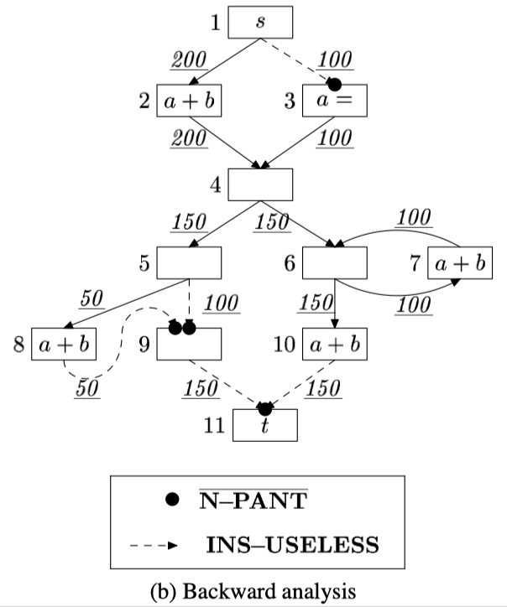
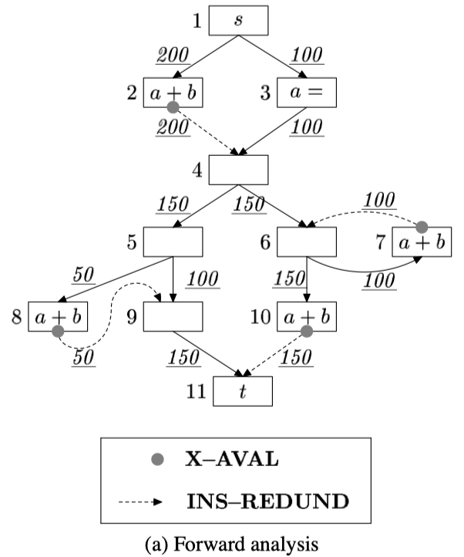
Step 1: Constructing a Reduced Graph
Define four predicates on the edges of (u, v)
Notes:
Then, four predicates will be computed on the edges. The first is called insertion-redundant. The intuition here is that an insertion on the edge would be redundant if the value of the insertion is already available on the edge. The second is called insertion-useless, which is true when an insertion on the edge can never make the value of the insertion to any computation node of pi in the graph. They are then combined to form non-essential, from which we take the opposite to find out all the essential edges.

Slide 15
Step 1: Constructing a Reduced Graph
Construct a graph as follows
Notes:
Then, we construct a graph, with all the nodes that are incident to essential edges, all the essential edges, and weights related to these essential edges.

Slide 16
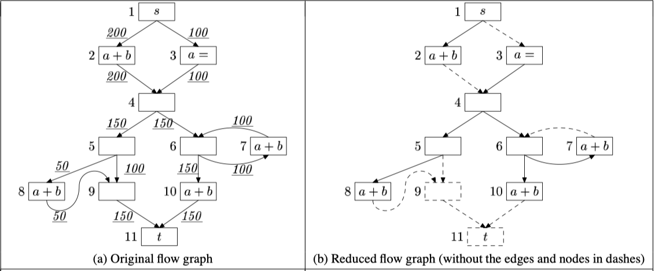
Step 1: Constructing a Reduced Graph
Notes:
Here is the result from a last example. You can see that several nodes and edges are taken from the original flow graph.

Slide 17
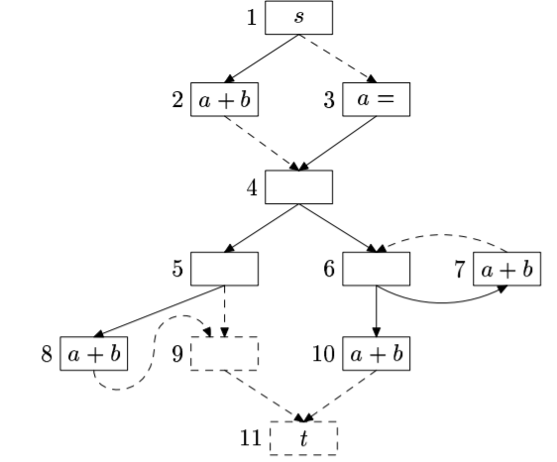
Step 2: Obtaining a Single-Source, Single-Sink Graph
∞
Source
∞
∞
∞
∞
∞
Sink

Slide 18
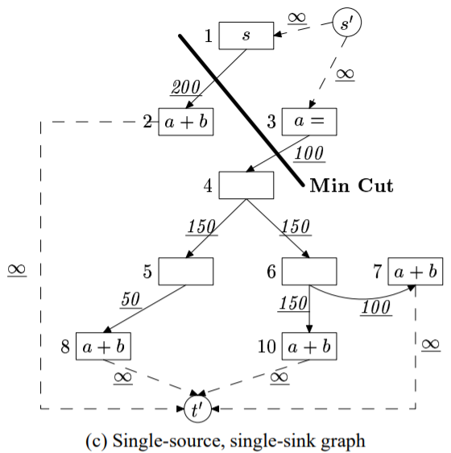
Step 3: Finding an Optimal Insertion Set
Minimum Cut:
Separates the source and sink vertices and minimizes the total weight on the edges
Paper used Goldberg’s push-relabel HIPR algorithm
Insertion Set:
Edges we insert computation node

Slide 19
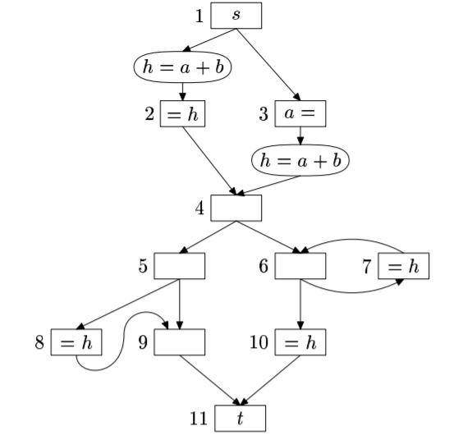
Step 3: Finding an Optimal Insertion Set
For expression h, an insertion set Sh is
Correct iff
Every path from entry node s to use of h includes at least one insertion edge (u,v)
No killing of h from v to use of h
Guaranteed by reduced flow graph
Optimal iff
Sh is correct
Sum of the weight of edges in Sh is smallest possible among all correct insertion sets
Guaranteed by min-cut

Slide 20
Experiment and conclusion
Evaluation benchmarks: SPEC JVM98, SciMark2, Linpack and JavaG
Baseline: inst -- standard optimization, e.g., loop-invariant motion, common subexpression elimination
spre: loop invariant code motion → MC-PRE
Evaluation metrics
Compilation time
Execution time
Run time: compilation time + execution time

Slide 21
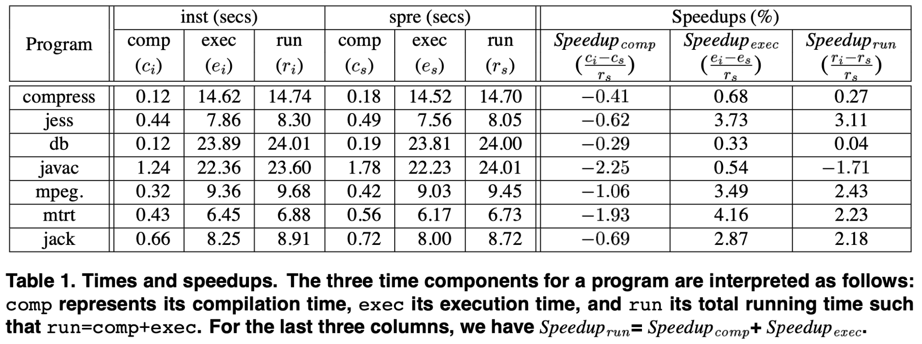
Experiment and conclusion

Slide 22
Experiment and conclusion

Slide 23
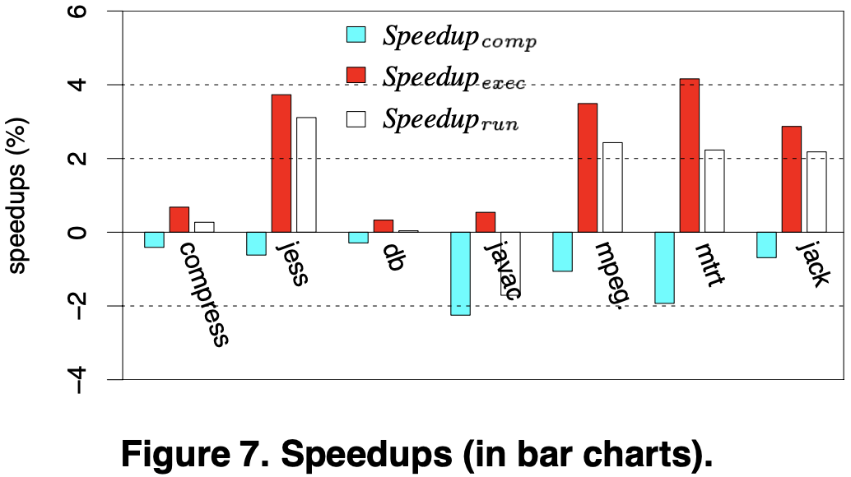
Experiment and conclusion

Slide 24
Experiment and conclusion
javac: many of the methods have few exception-free expressions with little optimization opportunities.

Slide 25
Experiment and conclusion
In many cases, edge profiling information is already provided for standard optimizations
Remove edge profiling time from spre and compare again

Slide 26
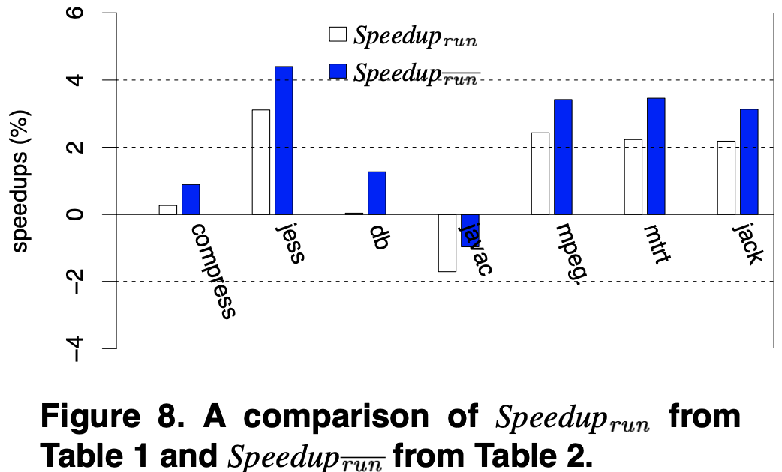
Experiment and conclusion

Slide 27
Strength
Improve on classic PRE: more opportunities to optimize
Efficiently find speculative PRE

Slide 28
Weakness
They only compare spre with LICM, no comparison with other PRE methods
When looking for redundancy, only look at lexically equivalent expressions, instead of their values
E.g., a = r1 + r2; b = r2 + r1; c = a * 4; d = 4 * b
Possible direction: value numbering
Use too many assumptions, might not be applicable

Slide 29
Relevance to our project
We plan to implement this algorithm in LLVM, but there are a few challenges:
How to convert the algorithm to SSA form?
How to find value based redundancy

