Slide 1
“TVM: An Automated End-to-End Optimizing
Compiler for Deep Learning”
Group 24 - Andrew McMullin, Morgan Ruffner, and Yuan Zeng

Slide 2
Overview of TVM
Growing demand to use machine learning in a wide spectrum of devices, ranging from cloud servers to self-driving cars and embedded devices
Complicated due to diverse hardware characteristics
Solution: TVM, a compiler that takes a high-level specification of a deep learning program from existing frameworks and generates low-level optimized code for a diverse set of hardware back-ends
Notes:
Morgan
embedded CPUs, GPUs, FPGAs, and ASICs - diff memory organization, etc.
Deploying deep learning workloads to new platforms – such as mobile phones, embedded devices, and accelerators – currently requires significant manual effort.

Slide 3
Execution Steps
System takes input model from existing framework and transforms into computational graph representation
Performs high-level dataflow rewriting to generate optimized graph
Identifies possible code optimizations and uses ML to find optimized operators
Packs generated code into deployable model

Slide 4
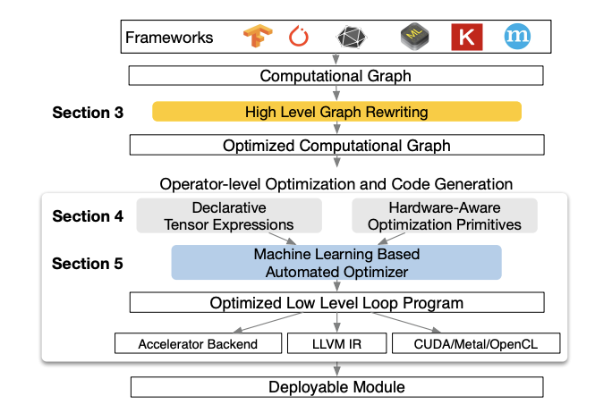
Notes:
Frameworks: keras, tensorflow, pytorch
TVM supports multiple deployment back-ends in languages such as C++, Java and Python.
Steps for reference:
System takes input model from existing framework and transforms into computational graph representation
Performs high-level dataflow rewriting to generate optimized graph
Identifies possible code optimizations and uses ML to find optimized operators
Packs generated code into deployable model
Section labels 3, 4, and 5 correspond to the main topics me, andrew, and yuan will be discussing

Slide 5
Optimizing Computational Graphs
Computation graph representation:
Node = operation on tensors or program inputs
Edges = data dependencies between operations
Graph level optimizations include operator fusion, constant-folding, static memory planning pass, and data layout transformations
Notes:
Morgan
Computational graphs are a common way to represent programs in DL frameworks
Image: Example computational graph of a two-layer convolutional neural network. Each node in the graph represents an operation that consumes one or more tensors and produces one or more tensors.

Slide 6
Operator Fusion
Combines multiple operators into a single kernel without saving intermediate results in memory
Can greatly reduce execution time - 1.2x to 2x speedup
Set of rules as to which operators can be fused
Ex. Multiple injective operators can be fused into another injective operator
Notes:
Injective = one to one map, ex. Add
This optimization is what we plan to focus on in our project

Slide 7
Data Layout Transformations
There are multiple ways to store a given tensor in the computational graph
Converts graph into one that can use better internal data layouts for execution on target hardware
First specify the preferred data layout for each operator given memory hierarchy constraints
Then perform layout transformation between a producer & consumer if their preferred layouts do not match

Slide 8
Generating Tensor Operations
Tensor Expression and Schedule Space
TVM introduces a tensor expression language for automatic code generation.
This language supports common operations and common DL operator patterns.
Provides flexibility for adding hardware-aware optimizations for various backends.
Notes:
Andrew
allows to build more operator patterns
And build more hardware implementations for various backends

Slide 9
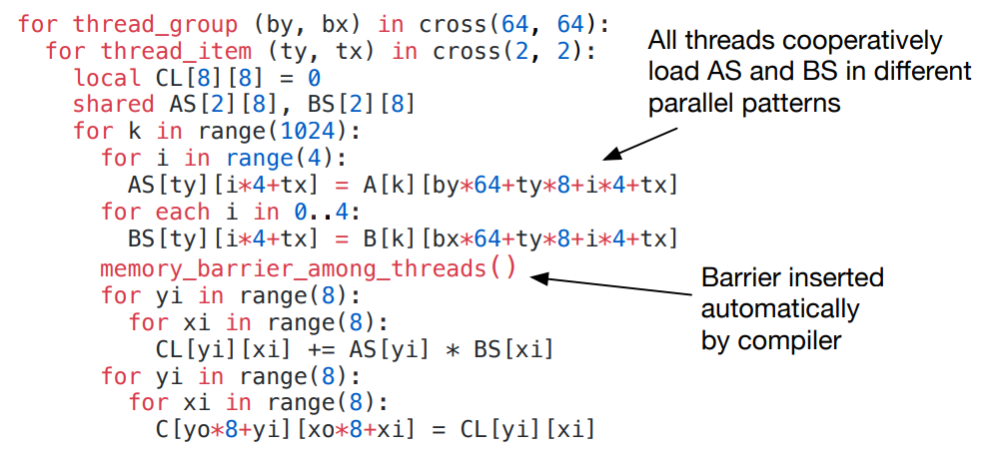
Nested Parallelism (w/ Cooperation)
Tensorization
Introduces Memory Scopes to the schedule space so that a compute stage can be marked as shared.
default: thread-local.
Tensorization decouples the schedule, making it easy to extend TVM to new hardware architectures.
ex: low-precision operators for mobile CPUs

Slide 10
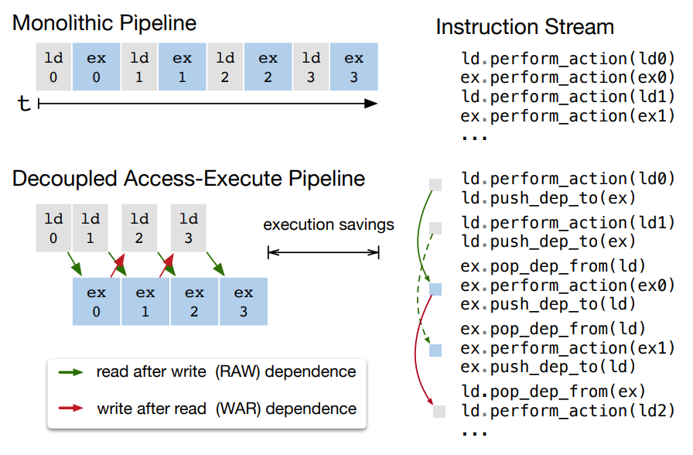
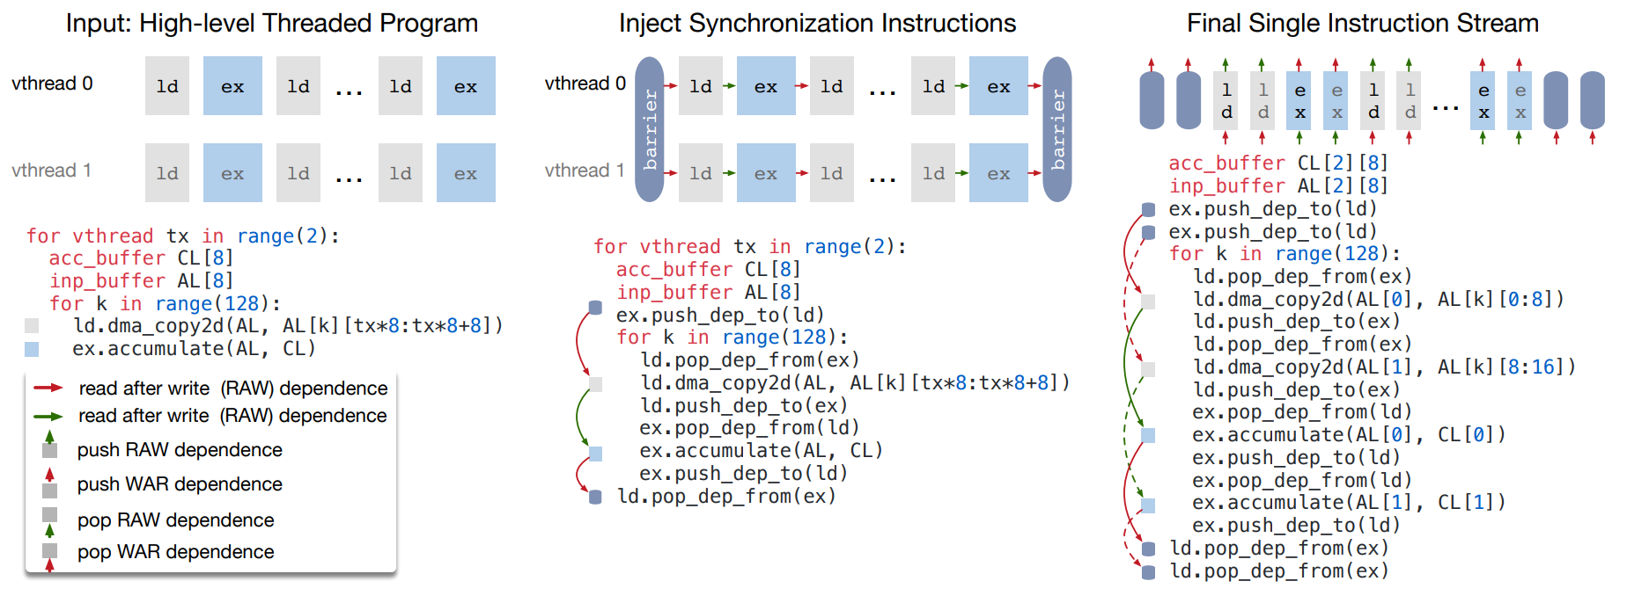
Explicit Memory Latency Hiding
Latency hiding is specific to TPU-like accelerators.
TVM lowers the program to a single instruction stream with low-level explicit synchronization
Peak compute utilization increased from 70% with no latency hiding to 88% with latency hiding.
Notes:
Just Schedulting ALU and MEM
Latency hiding refers to the process of overlapping memory operations with computation to maximize utilization of memory and compute resources.
It requires different strategies depending on the target hardware back-end:
On CPUs, memory latency hiding is achieved implicitly with simultaneous multithreading or hardware prefetching.
CPUs memory latency hiding is achieved with multithreading (and common implementations)
GPUs rely on rapid context switching of many warps of threads.
GPUs (do rapid context switching between warps of threads)
In contrast, specialized DL accelerators such as the TPU usually favor leaner control with a decoupled access-execute (DAE) architecture and offload the problem of fine-grained synchronization to software.
TPUs favor decoupled access-execute(DAE) :: offloading the fine-grained synchronization to the software.
The algorithm starts with a high level multi-threaded program schedule,
and then inserts the necessary low-level synchronization operations to guarantee correct execution within each thread.
Next, it interleaves operations of all virtual threads into a single instruction stream.
Finally, the hardware recovers the memory bound compute bound available pipeline parallelism dictated by the low-level synchronizations in the instruction stream.

Slide 11
Automating Optimization
Find optimal operator implementations for each layer of a DL model.
Schedule explorer: proposes promising new configurations.
Notes:
yuan

Slide 12
How to evaluate a configuration?
Blackbox auto-tuning.
Requires millions trials to identify a good configuration.
Predefined cost model.
Modern hardware too complicated to build a accurate cost model.

Slide 13
ML-Based Cost Model
Can adapt to different hardware.
Make very fast prediction.

Slide 14
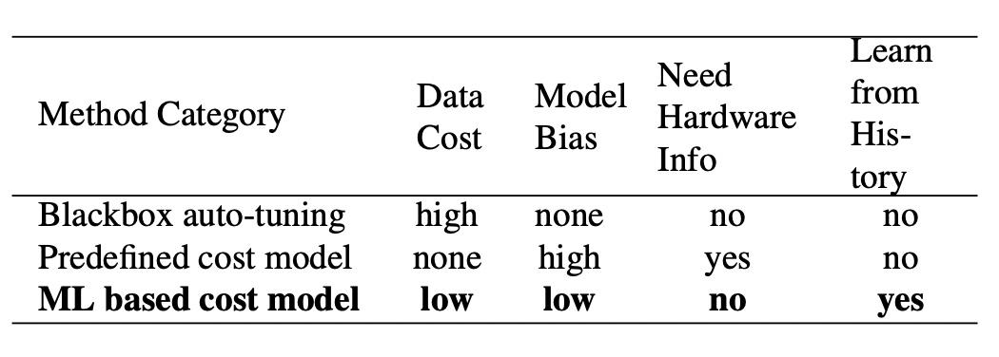

Slide 15
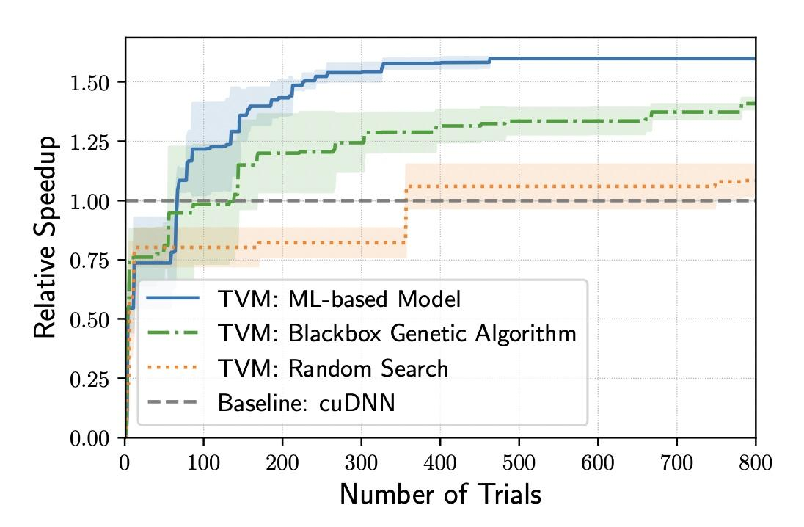

Slide 16
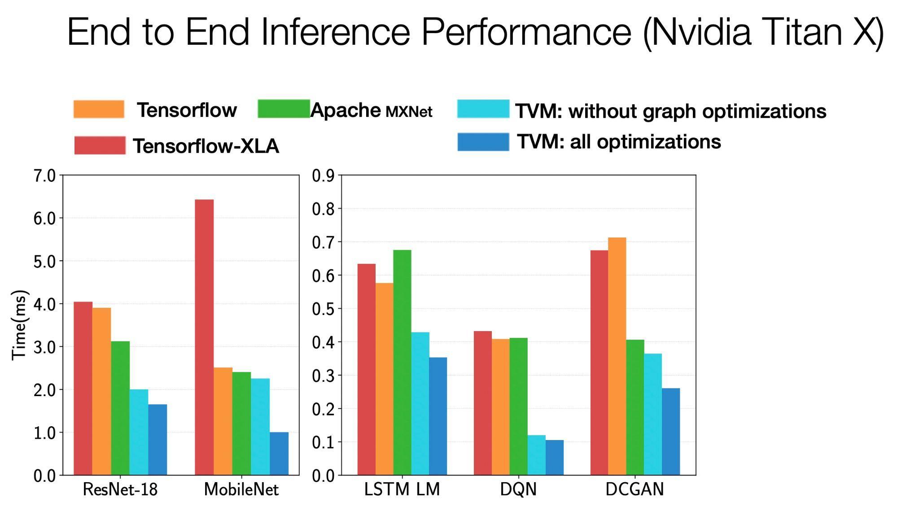
Evaluation

