Slide 1

EECS 583 – Class 7
Static Single Assignment Form
University of Michigan
September 22, 2021

Slide 2
Announcements & Reading Material
HW2 out this past Monday
  Spec and starting code are available on course webpage
  Also check out piazza
Today’s class
  “Practical Improvements to the Construction and Destruction of Static Single Assignment Form,” P. Briggs, K. Cooper, T. Harvey, and L. Simpson, Software--Practice and Experience, 28(8), July 1998, pp. 859-891.
Next class – Optimization, Yay!
  Compilers: Principles, Techniques, and Tools,
  A. Aho, R. Sethi, and J. Ullman, Addison-Wesley, 1988,
  9.9, 10.2, 10.3, 10.7 Edition 1; 8.5, 8.7, 9.1, 9.4, 9.5 Edition 2

Slide 3
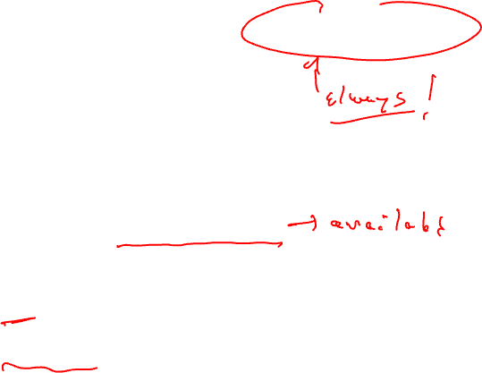
From Last Time: What About All Path Problems?
Up to this point
  Any path problems (maybe relations)
    Definition reaches along some path
    Some sequence of branches in which def reaches
    Lots of defs of the same variable may reach a point
  Use of Union operator in meet function
All-path: Definition guaranteed to reach
  Regardless of sequence of branches taken, def reaches
  Can always count on this
  Only 1 def can be guaranteed to reach
  Availability (as opposed to reaching)
    Available definitions
    Available expressions (could also have reaching expressions, but not that useful)

Slide 4

Available Definition Analysis (Adefs)
A definition d is available at a point p if along all paths from d to p, d is not killed
Remember, a definition of a variable is killed between 2 points when there is another definition of that variable along the path
  r1 = r2 + r3 kills previous definitions of r1
Algorithm
  Forward dataflow analysis as propagation occurs from defs downwards
  Use the Intersect function as the meet operator to guarantee the all-path requirement
  GEN/KILL/IN/OUT similar to reaching defs
    Initialization of IN/OUT is the tricky part

Slide 5

Compute GEN/KILL Sets for each BB (Adefs)
Exactly the same as reaching defs !!!
for each basic block in the procedure, X, do
GEN(X) = 0
KILL(X) = 0
for each operation in sequential order in X, op, do
for each destination operand of op, dest, do
G = op
K = {all ops which define dest – op}
GEN(X) = G + (GEN(X) – K)
KILL(X) = K + (KILL(X) – G)
endfor
endfor
endwhile

Slide 6
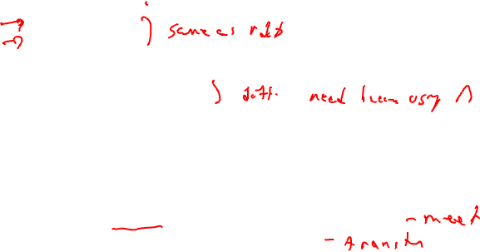
Compute IN/OUT Sets for all BBs (Adefs)
U = universal set of all operations in the Procedure
IN(0) = 0
OUT(0) = GEN(0)
for each basic block in procedure, W, (W != 0), do
IN(W) = 0
OUT(W) = U – KILL(W)
change = 1
while (change) do
change = 0
for each basic block in procedure, X, do
old_OUT = OUT(X)
IN(X) = Intersect(OUT(Y)) for all predecessors Y of X
OUT(X) = GEN(X) + (IN(X) – KILL(X))
if (old_OUT != OUT(X)) then
change = 1
endif
endfor
endwhile

Slide 7
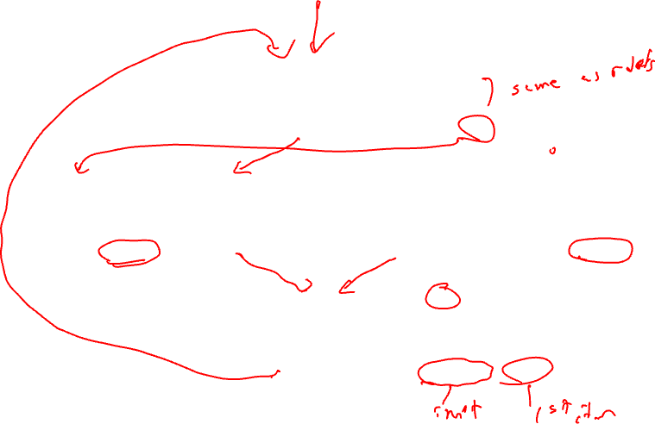
Example Adef Calculation
IN = Intersect(OUT(preds))
OUT = GEN + (IN – KILL)
BB1
1. r1 = MEM[r2+0]
2. r2 = MEM[r1 + 1]
3. r8 = r1 * r2
IN = 0 → 0
GEN = 1, 2, 3
KILL = 4, 7, 11
OUT = 1,2,3 → 1,2,3
IN = 0 → 1,2,3
BB2
4. r1 = r1 + 5
5. r3 = r5 – r1
6. r7 = r3 * 2
BB3
7. r2 = 0
8. r7 = r1 + r2
9. r3 = 4
IN = 0 → 1,2,3
GEN = 4, 5, 6
KILL = 1, 8, 9, 10, 11, 12
GEN = 7, 8, 9
KILL = 2, 5, 6, 10, 12
OUT = 2,3,4,5,6,7 → 2,3,4,5,6
OUT = 1,3,4,7,8,9,11 → 1,3,7,8,9
BB4
10. r3 = r3 + r7
11. r1 = r2 – r8
12. r3 = r1 * 2
IN = 0 → 3
GEN = 11, 12
KILL = 1,4,5,9,10
OUT = 2,3,6,7,8,11,12 → 3,11,12

Slide 8

Available Expression Analysis (Aexprs)
An expression is a RHS of an operation
  r2 = r3 + r4, r3+r4 is an expression
An expression e is available at a point p if along all paths from e to p, e is not killed
An expression is killed between 2 points when one of its source operands are redefined
  r1 = r2 + r3 kills all expressions involving r1
Algorithm
  Forward dataflow analysis as propagation occurs from defs downwards
  Use the Intersect function as the meet operator to guarantee the all-path requirement
  Looks exactly like adefs, except GEN/KILL/IN/OUT are the RHS’s of operations rather than the LHS’s

Slide 9
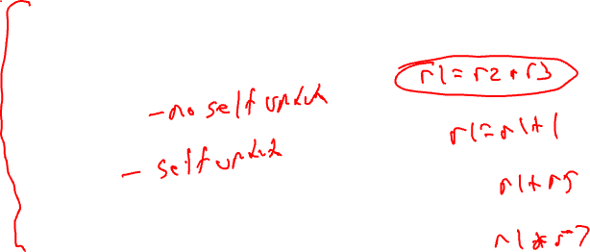
Computation of Aexpr GEN/KILL Sets
We can also formulate the GEN/KILL slightly differently so you do not
need to break up instructions like “r2 = r2 + 1”.
for each basic block in the procedure, X, do
GEN(X) = 0
KILL(X) = 0
for each operation in sequential order in X, op, do
K = 0
for each destination operand of op, dest, do
K += {all ops which use dest}
endfor
if (op not in K)
G = op
else
G = 0
GEN(X) = G + (GEN(X) – K)
KILL(X) = K + (KILL(X) – G)
endfor
endfor

Slide 10
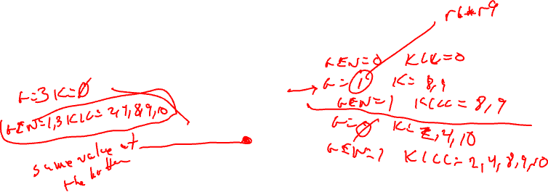
Homework Problem - Aexprs Calculation
Answer on the Next Slide
1: r1 = r6 * r9
2: r2 = r2 + 1
3: r5 = r3 * r4
4: r1 = r2 + 1
5: r3 = r3 * r4
6: r8 = r3 * 2
7: r7 = r3 * r4
8: r1 = r1 + 5
9: r7 = r1 - 6
10: r8 = r2 + 1
11: r1 = r3 * r4
12: r3 = r6 * r9

Slide 11
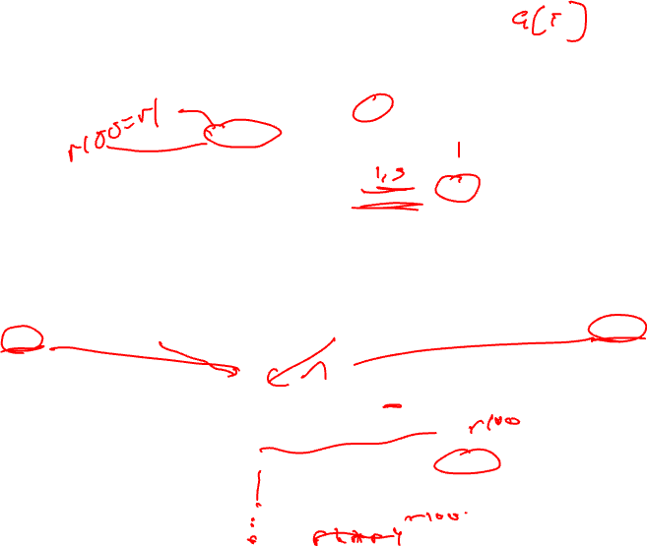
Homework Problem - Answer
IN/OUT sets
A → B
A = initial state
B = after first iteration
IN = - → -
1: r1 = r6 * r9
2: r2 = r2 + 1
3: r5 = r3 * r4
GEN = 1,3 (remember {1, 3} means {“r6*r9”, “r3*r4”})
KILL = 2, 4, 8, 9, 10
OUT = 1,3,5,6,7,11,12 → 1,3
IN = - → 1,3
4: r1 = r2 + 1
5: r3 = r3 * r4
6: r8 = r3 * 2
7: r7 = r3 * r4
8: r1 = r1 + 5
9: r7 = r1 - 6
IN = - → 1,3
GEN = 4, 6
KILL = 3, 5, 7, 8, 9, 11
GEN = 7, 9
KILL = 8
OUT = 1,2,4,6,10,12 → 1,4,6
OUT = 1,2,3,4,5,6,7,9,10,11,12 → 1,3,7,9
10: r8 = r2 + 1
11: r1 = r3 * r4
12: r3 = r6 * r9
IN = - → 1
GEN = 10, 12
KILL = 3, 5, 6, 7, 8, 9, 11
OUT = 1,2,4,10,12 → 1,10,12

Slide 12
Dataflow Summary Analyses in 1 Slide
Liveness
Reaching Definitions/DU/UD
OUT = Union(IN(succs))
IN = GEN + (OUT – KILL)
IN = Union(OUT(preds))
OUT = GEN + (IN – KILL)
Bottom-up dataflow
Any path
Keep track of variables/registers
Uses of variables → GEN
Defs of variables → KILL
Top-down dataflow
Any path
Keep track of instruction IDs
Defs of variables → GEN
Defs of variables → KILL
Available Expressions
Available Definitions
IN = Intersect(OUT(preds))
OUT = GEN + (IN – KILL)
IN = Intersect(OUT(preds))
OUT = GEN + (IN – KILL)
Top-down dataflow
All path
Keep track of instruction IDs
Expressions of variables → GEN
Defs of variables → KILL
Top-down dataflow
All path
Keep track of instruction IDs
Defs of variables → GEN
Defs of variables → KILL

Slide 13
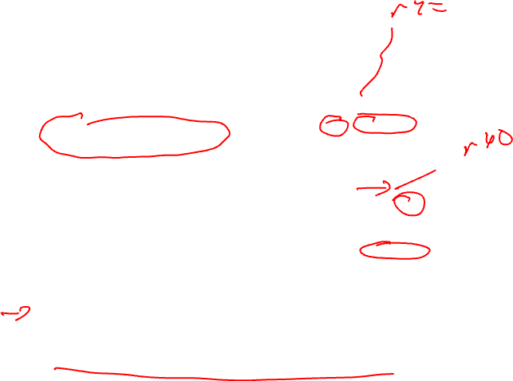
Static Single Assignment (SSA) Form
Difficulty with optimization
  Multiple definitions of the
  same register
  Which definition reaches
  Is expression available?
Static single assignment
  Each assignment to a variable is given a unique name
  All of the uses reached by that assignment are renamed
  DU chains become obvious based on the register name!
r1 = r2 + r3
r6 = r4 – r5
r4 = r6
r6 = 8
r7 = r4 – r5
r8 = r2 + r3

Slide 14
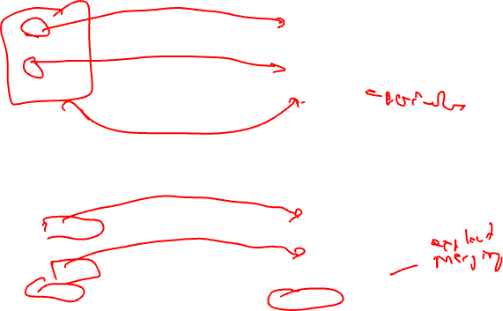
Converting to SSA Form
Trivial for straight line code
More complex with control flow – Must use Phi nodes
x = -1
y = x
x = 5
z = x
x0 = -1
y = x0
x1 = 5
z = x1
if ( ... )
x = -1
else
x = 5
y = x
if ( ... )
x0 = -1
else
x1 = 5
x2 = Phi(x0,x1)
y = x2

Slide 15

Converting to SSA Form (2)
What about loops?
  No problem!, use Phi nodes again
i = 0
do {
i = i + 1
}
while (i < 50)
i0 = 0
do {
i1 = Phi(i0, i2)
i2 = i1 + 1
}
while (i2 < 50)

Slide 16

SSA Plusses and Minuses
Advantages of SSA
  Explicit DU chains – Trivial to figure out what defs reach a use
    Each use has exactly 1 definition!!!
  Explicit merging of values
  Makes optimizations easier
Disadvantages
  When transform the code, must either recompute (slow) or incrementally update (tedious)

Slide 17

Phi Nodes (aka Phi Functions)
Special kind of copy that selects one of its inputs
Choice of input is governed by the CFG edge along which control flow reached the Phi node
Phi nodes are required when 2 non-null paths X→Z and Y→Z converge at node Z, and nodes X and Y contain assignments to V
x0 =
x1 =
x2 = Phi(x0,x1)

Slide 18

SSA Construction
High-level algorithm
  Insert Phi nodes
  Rename variables
A dumb algorithm
  Insert Phi functions at every join for every variable
  Solve reaching definitions
  Rename each use to the def that reaches it (will be unique)
Problems with the dumb algorithm
  Too many Phi functions (precision)
  Too many Phi functions (space)
  Too many Phi functions (time)

Slide 19

Need Better Phi Node Insertion Algorithm
A definition at n forces a Phi node at m iff n not in DOM(m), but n in DOM(p) for some predecessors p of m
BB0
def in BB4 forces Phi in BB6
def in BB6 forces Phi in BB7
def in BB7 forces Phi in BB1
BB1
BB2
BB3
Phi is placed in the block that
is just outside the dominated region
of the definition BB
BB4
BB5
BB6
Dominance frontier
The dominance frontier of node X is the
set of nodes Y such that
* X dominates a predecessor of Y, but
* X does not strictly dominate Y
BB7

Slide 20

Recall: Dominator Tree
First BB is the root node, each node
dominates all of its descendants
BB DOM
0 0
1 0,1
2 0,1,2
3 0,1,3
BB DOM
4 0,1,3,4
5 0,1,3,5
6 0,1,3,6
7 0,1,7
BB0
BB1
BB0
BB2
BB3
BB1
BB2
BB3
BB4
BB5
BB4
BB5
BB6
BB6
BB7
BB7
Dom tree

Slide 21
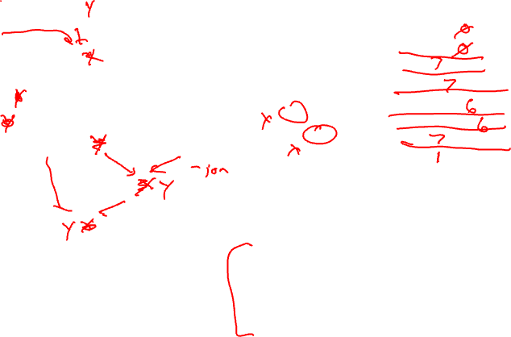
Computing Dominance Frontiers
BB0
BB0
BB DF
0
1
2
3
4
5
6
7
BB1
BB1
BB2
BB3
BB2
BB3
BB4
BB5
BB4
BB5
BB6
BB6
BB7
BB7
For each join point X in the CFG
For each predecessor, Y, of X in the CFG
Run up to the IDOM(X) in the dominator tree,
adding X to DF(N) for each N between Y and
IDOM(X) (or X, whichever is encountered first)

Slide 22
Homework Problem – Compute DF for each BB
Answer on Slide 24
Dominator Tree
BB0
BB0
a =
b =
c =
BB1
BB1
BB2
BB3
BB4
BB5
BB2
c = b + a
BB3
b = a + 1
a = b * c
BB4
b = c - a
BB5
a = a - c
c = b * c
For each join point X in the CFG
For each predecessor, Y, of X in the CFG
Run up to the IDOM(X) in the dominator tree,
adding X to DF(N) for each N between Y and
IDOM(X) (or X, whichever is encountered first)

Slide 23
SSA Step 1 - Phi Node Insertion
Compute dominance frontiers
Find global names (aka virtual registers)
  Global if name live on entry to some block
  For each name, build a list of blocks that define it
Insert Phi nodes
  For each global name n
    For each BB b in which n is defined
      For each BB d in b’s dominance frontier
        Insert a Phi node for n in d
        Add d to n’s list of defining BBs

Slide 24

Phi Node Insertion - Example
BB DF
0 -
1 -
2 7
3 7
4 6
5 6
6 7
7 1
a is defined in 0,1,3
need Phi in 7
then a is defined in 7
need Phi in 1
b is defined in 0, 2, 6
need Phi in 7
then b is defined in 7
need Phi in 1
c is defined in 0,1,2,5
need Phi in 6,7
then c is defined in 7
need Phi in 1
d is defined in 2,3,4
need Phi in 6,7
then d is defined in 7
need Phi in 1
i is defined in BB7
need Phi in BB1
a =
b =
c =
i =
BB0
a = Phi(a,a)
b = Phi(b,b)
c = Phi(c,c)
d = Phi(d,d)
i = Phi(i,i)
BB1
a =
c =
BB2
b =
c =
d =
BB3
a =
d =
BB4
d =
BB5
c =
BB6
b =
c = Phi(c,c)
d = Phi(d,d)
BB7
i =
a = Phi(a,a)
b = Phi(b,b)
c = Phi(c,c)
d = Phi(d,d)

Slide 25
Homework Problem – Insert Phi Nodes
Answer on Slide 36
Dominator tree
BB0
a =
b =
c =
BB0
BB1
BB1
BB2
BB3
BB4
BB5
BB2
c = b + a
BB3
b = a + 1
a = b * c
Dominance frontier
BB4
b = c - a
BB DF
0 -
1 -
2 4
3 4, 5
4 5
5 1
BB5
a = a - c
c = b * c

Slide 26

SSA Step 2 – Renaming Variables
Use an array of stacks, one stack per global variable (VR)
Algorithm sketch
  For each BB b in a preorder traversal of the dominator tree
    Generate unique names for each Phi node
    Rewrite each operation in the BB
      Uses of global name: current name from stack
      Defs of global name: create and push new name
    Fill in Phi node parameters of successor blocks
    Recurse on b’s children in the dominator tree
    <on exit from b> pop names generated in b from stacks

Slide 27
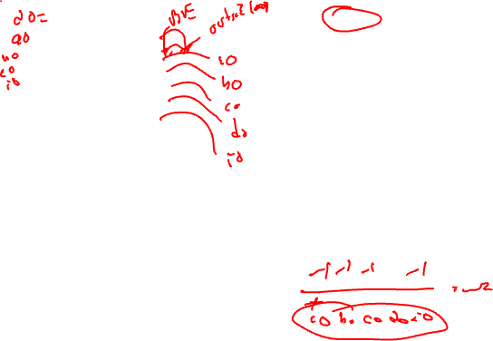
Renaming – Example (Initial State)
BB0
a =
b =
c =
i =
a = Phi(a,a)
b = Phi(b,b)
c = Phi(c,c)
d = Phi(d,d)
i = Phi(i,i)
BB1
BB0
BB2
BB3
BB1
a =
c =
BB4
BB5
BB6
BB2
b =
c =
d =
BB3
a =
d =
BB4
d =
BB5
c =
BB7
c = Phi(c,c)
d = Phi(d,d)
var: a b c d i
ctr: 0 0 0 0 0
stk: a0 b0 c0 d0 i0
BB6
b =
BB7
i =
a = Phi(a,a)
b = Phi(b,b)
c = Phi(c,c)
d = Phi(d,d)

Slide 28
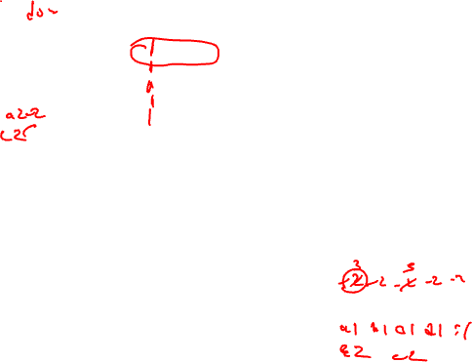
Renaming – Example (After BB0)
BB0
a0 =
b0 =
c0 =
i0 =
BB0
a = Phi(a0,a)
b = Phi(b0,b)
c = Phi(c0,c)
d = Phi(d0,d)
i = Phi(i0,i)
BB1
BB2
BB3
BB1
a =
c =
BB4
BB5
BB2
b =
c =
d =
BB3
a =
d =
BB6
BB4
d =
BB5
c =
BB7
c = Phi(c,c)
d = Phi(d,d)
var: a b c d i
ctr: 1 1 1 1 1
stk: a0 b0 c0 d0 i0
BB6
b =
BB7
i =
a = Phi(a,a)
b = Phi(b,b)
c = Phi(c,c)
d = Phi(d,d)

Slide 29
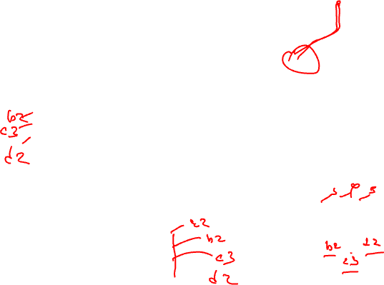
Renaming – Example (After BB1)
BB0
a0 =
b0 =
c0 =
i0 =
BB0
a1 = Phi(a0,a)
b1 = Phi(b0,b)
c1 = Phi(c0,c)
d1 = Phi(d0,d)
i1 = Phi(i0,i)
BB1
BB2
BB3
BB1
a2 =
c2 =
BB4
BB5
BB2
b =
c =
d =
BB3
a =
d =
BB6
BB4
d =
BB5
c =
BB7
c = Phi(c,c)
d = Phi(d,d)
var: a b c d i
ctr: 3 2 3 2 2
stk: a0 b0 c0 d0 i0
a1 b1 c1 d1 i1
a2 c2
BB6
b =
BB7
i =
a = Phi(a,a)
b = Phi(b,b)
c = Phi(c,c)
d = Phi(d,d)

Slide 30
Renaming – Example (After BB2)
BB0
a0 =
b0 =
c0 =
i0 =
BB0
a1 = Phi(a0,a)
b1 = Phi(b0,b)
c1 = Phi(c0,c)
d1 = Phi(d0,d)
i1 = Phi(i0,i)
BB1
BB2
BB3
BB1
a2 =
c2 =
BB4
BB5
BB2
b2 =
c3 =
d2 =
BB3
a =
d =
BB6
BB4
d =
BB5
c =
BB7
c = Phi(c,c)
d = Phi(d,d)
var: a b c d i
ctr: 3 3 4 3 2
stk: a0 b0 c0 d0 i0
a1 b1 c1 d1 i1
a2 b2 c2 d2
c3
BB6
b =
BB7
i =
a = Phi(a2,a)
b = Phi(b2,b)
c = Phi(c3,c)
d = Phi(d2,d)

Slide 31
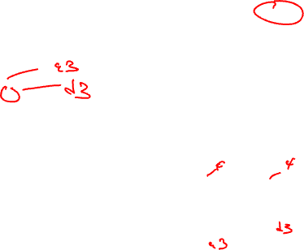
Renaming – Example (Before BB3)
This just updates
the stack to remove the
stuff from the left path
out of BB1
BB0
a0 =
b0 =
c0 =
i0 =
BB0
a1 = Phi(a0,a)
b1 = Phi(b0,b)
c1 = Phi(c0,c)
d1 = Phi(d0,d)
i1 = Phi(i0,i)
BB1
BB2
BB3
BB1
a2 =
c2 =
BB4
BB5
BB2
b2 =
c3 =
d2 =
BB3
a =
d =
BB6
BB4
d =
BB5
c =
BB7
c = Phi(c,c)
d = Phi(d,d)
var: a b c d i
ctr: 3 3 4 3 2
stk: a0 b0 c0 d0 i0
a1 b1 c1 d1 i1
a2 c2
BB6
b =
BB7
i =
a = Phi(a2,a)
b = Phi(b2,b)
c = Phi(c3,c)
d = Phi(d2,d)

Slide 32
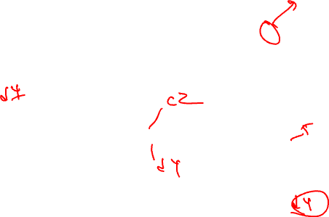
Renaming – Example (After BB3)
BB0
a0 =
b0 =
c0 =
i0 =
BB0
a1 = Phi(a0,a)
b1 = Phi(b0,b)
c1 = Phi(c0,c)
d1 = Phi(d0,d)
i1 = Phi(i0,i)
BB1
BB2
BB3
BB1
a2 =
c2 =
BB4
BB5
BB2
b2 =
c3 =
d2 =
BB3
a3 =
d3 =
BB6
BB4
d =
BB5
c =
BB7
c = Phi(c,c)
d = Phi(d,d)
var: a b c d i
ctr: 4 3 4 4 2
stk: a0 b0 c0 d0 i0
a1 b1 c1 d1 i1
a2 c2 d3
a3
BB6
b =
BB7
i =
a = Phi(a2,a)
b = Phi(b2,b)
c = Phi(c3,c)
d = Phi(d2,d)

Slide 33
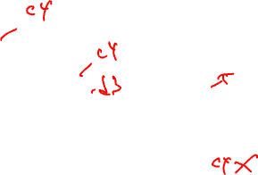
Renaming – Example (After BB4)
BB0
a0 =
b0 =
c0 =
i0 =
BB0
a1 = Phi(a0,a)
b1 = Phi(b0,b)
c1 = Phi(c0,c)
d1 = Phi(d0,d)
i1 = Phi(i0,i)
BB1
BB2
BB3
BB1
a2 =
c2 =
BB4
BB5
BB2
b2 =
c3 =
d2 =
BB3
a3 =
d3 =
BB6
BB4
d4 =
BB5
c =
BB7
c = Phi(c2,c)
d = Phi(d4,d)
var: a b c d i
ctr: 4 3 4 5 2
stk: a0 b0 c0 d0 i0
a1 b1 c1 d1 i1
a2 c2 d3
a3 d4
BB6
b =
BB7
i =
a = Phi(a2,a)
b = Phi(b2,b)
c = Phi(c3,c)
d = Phi(d2,d)

Slide 34
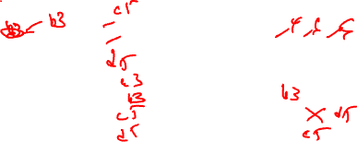
Renaming – Example (After BB5)
BB0
a0 =
b0 =
c0 =
i0 =
BB0
a1 = Phi(a0,a)
b1 = Phi(b0,b)
c1 = Phi(c0,c)
d1 = Phi(d0,d)
i1 = Phi(i0,i)
BB1
BB2
BB3
BB1
a2 =
c2 =
BB4
BB5
BB2
b2 =
c3 =
d2 =
BB3
a3 =
d3 =
BB6
BB4
d4 =
BB5
c4 =
BB7
c = Phi(c2,c4)
d = Phi(d4,d3)
var: a b c d i
ctr: 4 3 5 5 2
stk: a0 b0 c0 d0 i0
a1 b1 c1 d1 i1
a2 c2 d3
a3 c4
BB6
b =
BB7
i =
a = Phi(a2,a)
b = Phi(b2,b)
c = Phi(c3,c)
d = Phi(d2,d)

Slide 35
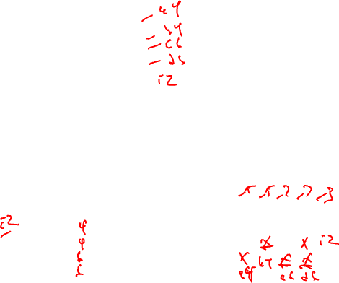
Renaming – Example (After BB6)
BB0
a0 =
b0 =
c0 =
i0 =
BB0
a1 = Phi(a0,a)
b1 = Phi(b0,b)
c1 = Phi(c0,c)
d1 = Phi(d0,d)
i1 = Phi(i0,i)
BB1
BB2
BB3
BB1
a2 =
c2 =
BB4
BB5
BB2
b2 =
c3 =
d2 =
BB3
a3 =
d3 =
BB6
BB4
d4 =
BB5
c4 =
BB7
c5 = Phi(c2,c4)
d5 = Phi(d4,d3)
var: a b c d i
ctr: 4 4 6 6 2
stk: a0 b0 c0 d0 i0
a1 b1 c1 d1 i1
a2 b3 c2 d3
a3 c5 d5
BB6
b3 =
BB7
i =
a = Phi(a2,a3)
b = Phi(b2,b3)
c = Phi(c3,c5)
d = Phi(d2,d5)

Slide 36
Renaming – Example (After BB7)
BB0
a0 =
b0 =
c0 =
i0 =
BB0
a1 = Phi(a0,a4)
b1 = Phi(b0,b4)
c1 = Phi(c0,c6)
d1 = Phi(d0,d6)
i1 = Phi(i0,i2)
BB1
BB2
BB3
BB1
a2 =
c2 =
BB4
BB5
BB2
b2 =
c3 =
d2 =
BB3
a3 =
d3 =
BB6
BB4
d4 =
BB5
c4 =
BB7
c5 = Phi(c2,c4)
d5 = Phi(d4,d3)
var: a b c d i
ctr: 5 5 7 7 3
stk: a0 b0 c0 d0 i0
a1 b1 c1 d1 i1
a2 b4 c2 d6 i2
a4 c6
BB6
b3 =
BB7
i2 =
a4 = Phi(a2,a3)
b4 = Phi(b2,b3)
c6 = Phi(c3,c5)
d6 = Phi(d2,d5)
Fin!

Slide 37
Homework Problem – Rename the Variables
Dominator tree
BB0
BB0
a =
b =
c =
a = Phi(a,a)
b = Phi(b,b)
c = Phi(c,c)
BB1
BB2
BB3
BB4
BB5
BB1
a = Phi(a,a)
b = Phi(b,b)
c = Phi(c,c)
BB2
c = b + a
BB3
b = a + 1
a = b * c
BB4
b = c - a
a = Phi(a,a)
b = Phi(b,b)
c = Phi(c,c)
BB5
a = a - c
c = b * c

Slide 38
Homework Problem – Final Answer
Rename the variables
Dominator tree
Dominance frontier
BB0
BB DF
0 -
1 -
2 4
3 4, 5
4 5
5 1
BB0
a0 =
b0 =
c0 =
a1 = Phi(a0,a5)
b1 = Phi(b0,b5)
c1 = Phi(c0,c5)
BB1
BB2
BB3
BB4
BB5
BB1
a3 = Phi(a1,a2)
b3 = Phi(b1,b2)
c3= Phi(c2,c1)
BB2
c2 = b1 + a1
BB3
b2 = a1 + 1
a2 = b2 * c1
BB4
b4 = c3 – a3
a4 = Phi(a2,a3)
b5 = Phi(b2,b4)
c4 = Phi(c1,c3)
BB5
a5 = a4 – c4
c5 = b5 * c4

