Slide 1
EECS 583 – Class 5
Finish Control Flow Analysis, Dataflow Analysis Intro
University of Michigan
September 15, 2021

Slide 2

Reading Material + Announcements
Reminder – HW 1 due tonight at midnight
  Submit uniquename_hw1.tgz file to:
    eecs583a.eecs.umich.edu:/hw1_submissions
  Before asking questions: 1) Read all threads on piazza, 2) Think a bit
    Then, post question or talk to Yunjie/Ze if you are stuck
Today’s class
  Compilers: Principles, Techniques, and Tools,
  A. Aho, R. Sethi, and J. Ullman, Addison-Wesley, 1988.
  (Chapters: 10.5, 10.6 Edition 1; Chapters 9.2 Edition 2)
Material for next Monday
  Compilers: Principles, Techniques, and Tools,
  A. Aho, R. Sethi, and J. Ullman, Addison-Wesley, 1988.
  (Chapters: 10.5, 10.6, 10.9, 10.10 Edition 1; Chapters 9.2, 9.3 Edition 2)

Slide 3
From Last Time: Homework Problem
if (a > 0) {
r = t + s
if (b > 0 || c > 0)
u = v + 1
else if (d > 0)
x = y + 1
else
z = z + 1
}
Draw the CFG
Compute CD
If-convert the code

Slide 4
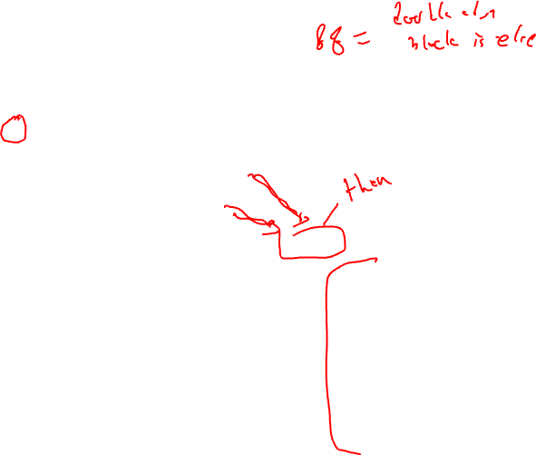
Homework Problem Answer
if (a > 0) {
r = t + s
if (b > 0 || c > 0)
u = v + 1
else if (d > 0)
x = y + 1
else
z = z + 1
}
BB1
BB CD
1 -
2 1
3 -2
4 -3
5 2,3
6 -4
7 4
8 -
a <= 0
a > 0
BB2
b <= 0
BB3
b > 0
c <= 0
c > 0
BB4
BB5
d <= 0
d > 0
p3 = 0
p1 = CMPP.UN (a > 0) if T
r = t + s if p1
p2,p3 = CMPP.UC.ON (b > 0) if p1
p4,p3 = CMPP.UC.ON (c > 0) if p2
u = v + 1 if p3
p5,p6 = CMPP.UC.UN (d > 0) if p4
x = y + 1 if p6
z = z + 1 if p5
BB6
BB7
BB8
Draw the CFG
Compute CD
If-convert the code

Slide 5

When to Apply If-conversion?
Positives
  Remove branch
    No disruption to sequential fetch
    No prediction or mispredict
    No draining of pipeline for mispredict
    No use of branch resource
  Increase potential for operation overlap
    Creates larger basic blocks
    Convert control dependences into data dependences
  Enable more aggressive compiler xforms
    Software pipelining
    Height reduction
What about the negatives?
10
BB1
90
80
20
BB2
BB3
80
20
BB4
10
BB5
90
10
BB6
10

Slide 6
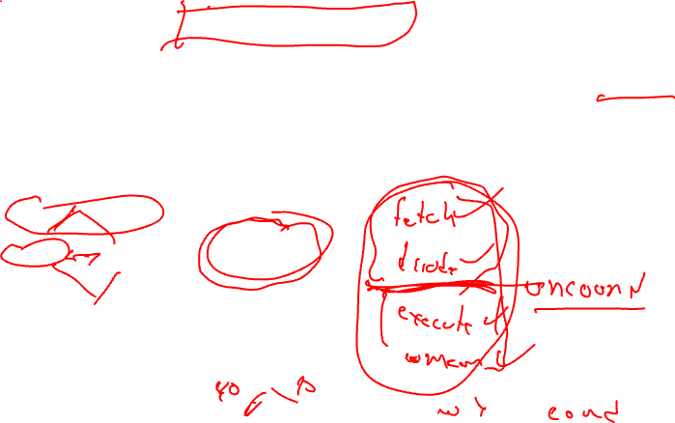
Negative 1: Resource Usage
Instruction execution is additive
for all BBs that are if-converted, thus
require more processor resources
Be careful applying if-conversion too liberally
when processor resources constrained OR
blocks have large numbers of instructions
100
BB1
BB1
60
40
BB2 if p1
BB2
BB3
BB3 if p2
60
40
BB4
BB4
100

Slide 7
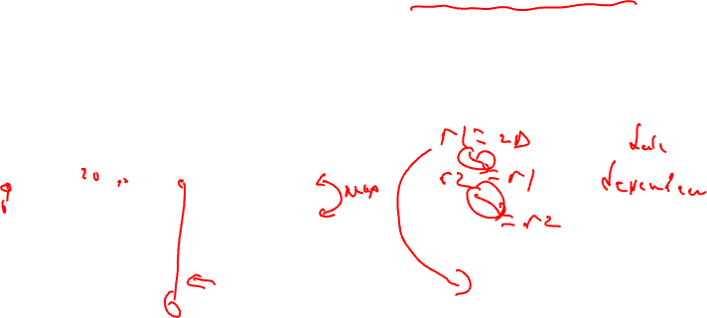
Negative 2: Dependence Height
Dependence height is max of
for all BBs that are if-converted
(dep height = schedule length
with infinite resources)
Be careful with if-converting blocks with
mismatched dependence heights
100
BB1
BB1
60
40
BB2 if p1
BB2
BB3
BB3 if p2
60
40
BB4
BB4
100

Slide 8
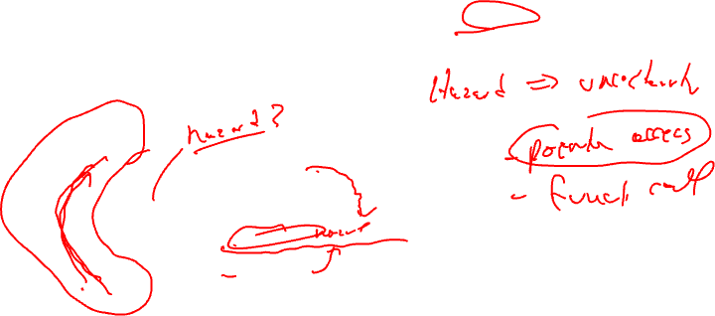
Negative 3: Hazard Presence
Hazard = operation that forces
the compiler to be conservative,
so limited reordering or optimization,
e.g., subroutine call, pointer store, …
Hazards should be avoided except
on the “main path”
100
BB1
BB1
60
40
BB2 if p1
BB2
BB3
BB3 if p2
60
40
BB4
BB4
100

Slide 9
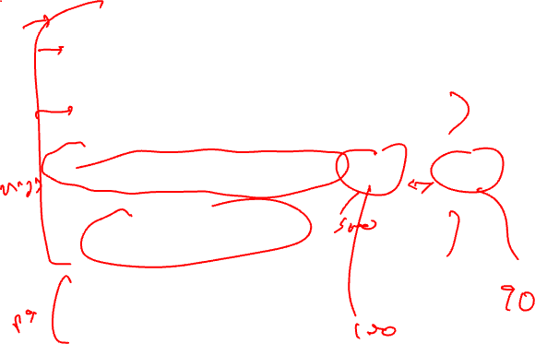
Deciding When/What To If-convert
Resources
  Small resource usage ideal for less important paths
Dependence height
  Matched heights are ideal
  Close to same heights is ok
Remember everything is relative for resources and dependence height !
Hazards
  Avoid hazards unless on most important path
Estimate of benefit
  Branches/Mispredicts removed
  Increased instruction overlap
100
BB1
BB1
60
40
BB2 if p1
BB2
BB3
BB3 if p2
60
40
BB4
BB4
100

Slide 10

The Hyperblock
Hyperblock - Collection of basic blocks in which control flow may only enter at the first BB. All internal control flow is eliminated via if-conversion
  “Likely control flow paths”
  Acyclic (outer backedge ok)
  Multiple intersecting traces with no side entrances
  Side exits still exist
Hyperblock formation
  1. Block selection
  2. Tail duplication
  3. If-conversion
10
BB1
90
80
20
BB2
BB3
80
20
BB4
10
BB5
90
10
BB6
10

Slide 11
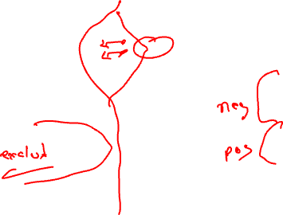
Block Selection
10
Block selection
  Select subset of BBs for inclusion in HB
  Difficult problem
  Weighted cost/benefit function
    Height overhead
    Resource overhead
    Hazard overhead
    Branch elimination benefit
    Weighted by frequency
BB1
90
80
20
BB2
BB3
80
20
BB4
10
BB5
90
10
BB6
10

Slide 12
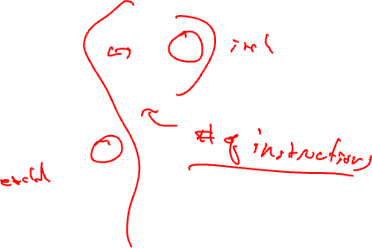
Example - Step 1 - Block Selection
10
main path = BB1,BB2,BB4,BB6
Consider adding BB3 and BB5
BB1 - 5
90
80
20
BB2 - 8
BB3 – 2
80
20
BB4 - 3
10
BB5 - 10
90
10
BB6 - 2
10

Slide 13
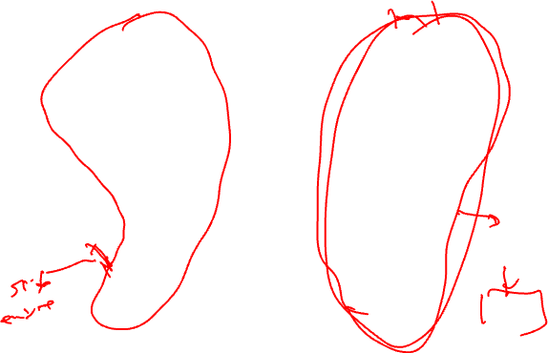
Example - Step 2 - Tail Duplication
10
Tail duplication same as with Superblock formation
10
BB1
BB1
80
20
80
20
BB2
BB3
BB2
BB3
80
20
80
20
BB4
BB4
10
10
BB5
90
90
BB5
10
10
BB6
BB6
90
BB6’
81
10
9
9
1

Slide 14
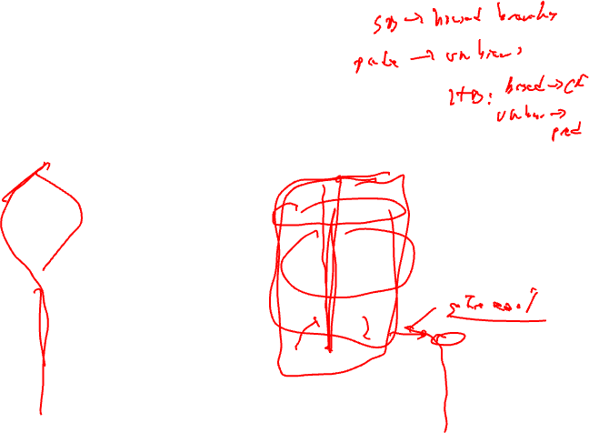
Example - Step 3 – If-conversion
If-convert intra-HB branches only!!
10
BB1
10
80
20
BB1
p1,p2 = CMPP
BB2
BB3
80
20
BB2 if p1
BB4
BB3 if p2
10
BB4
90
BB5
BB6
BB5
10
BB6
BB6’
81
9
10
81
BB6’
9
9
1
1
9

Slide 15

For More on Predicates/Hyperblocks
See
  "Effective Compiler Support for Predicated Execution using the Hyperblock", S. Mahlke et al., MICRO-25, 1992.
  "Control CPR: A Branch Height Reduction Optimization for EPIC Processors", M. Schlansker et al., PLDI-99, 1999.

Slide 16
New Topic
Dataflow Analysis!

Slide 17
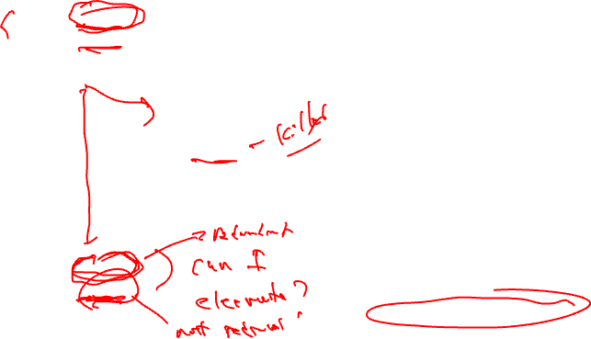
Looking Inside the Basic Blocks:
Dataflow Analysis + Optimization
r1 = r2 + r3
r6 = r4 – r5
Control flow analysis
  Treat BB as black box
  Just care about branches
Now
  Start looking at ops in BBs
  What’s computed and where
Classical optimizations
  Want to make the computation more efficient
Ex: Common Subexpression Elimination (CSE)
  Is r2 + r3 redundant?
  Is r4 – r5 redundant?
  What if there were 1000 BB’s
  Dataflow analysis !!
r4 = 4
r6 = 8
r6 = r2 + r3
r7 = r4 – r5

Slide 18
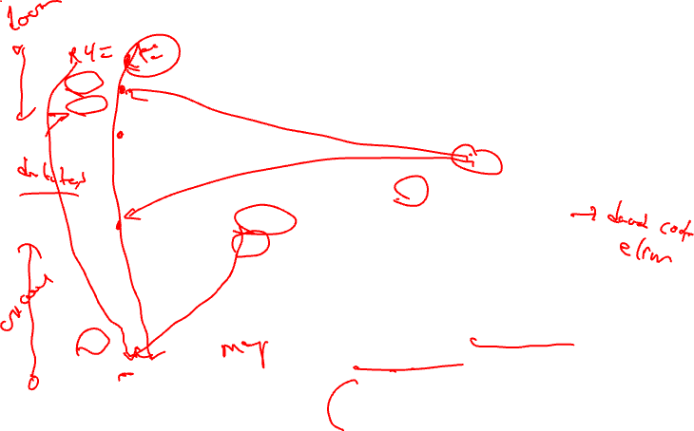
Dataflow Analysis Introduction
Dataflow analysis – Collection of information
that summarizes the creation/destruction of
values in a program. Used to identify legal
optimization opportunities.
r1 = r2 + r3
r6 = r4 – r5
Pick an arbitrary point in the program
r4 = 4
r6 = 8
Which VRs contain useful
data values? (liveness or upward
exposed uses)
Which definitions may reach
this point? (reaching defns)
Which definitions are guaranteed
to reach this point? (available defns)
Which uses below are exposed?
(downward exposed uses)
r6 = r2 + r3
r7 = r4 – r5

Slide 19
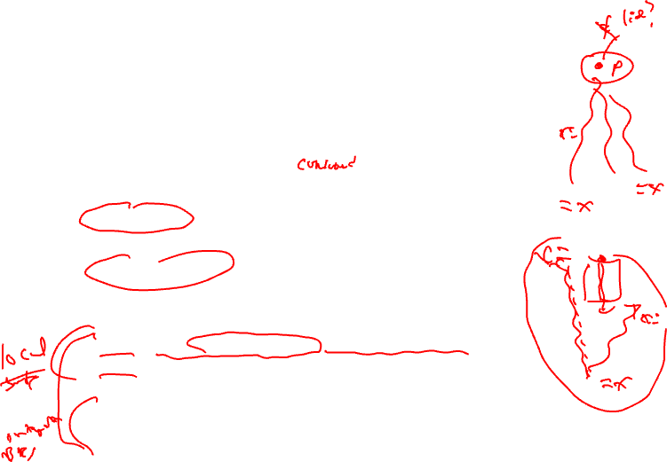
Live Variable (Liveness) Analysis
Defn: For each point p in a program and each variable y, determine whether y can be used before being redefined starting at p
Algorithm sketch
  For each BB, y is live if it is used before defined in the BB or it is live leaving the block
  Backward dataflow analysis as propagation occurs from uses upwards to defs
4 sets
  GEN = set of external variables consumed in the BB
  KILL = set of external variable uses killed by the BB
    equivalent to set of variables defined by the BB
  IN = set of variables that are live at the entry point of a BB
  OUT = set of variables that are live at the exit point of a BB

Slide 20

Computing GEN/KILL Sets For Each BB
for each basic block in the procedure, X, do
GEN(X) = 0
KILL(X) = 0
for each operation in reverse sequential order in X, op, do
for each destination operand of op, dest, do
GEN(X) -= dest
KILL(X) += dest
endfor
for each source operand of op, src, do
GEN(X) += src
KILL(X) -= src
endfor
endfor
endfor

Slide 21
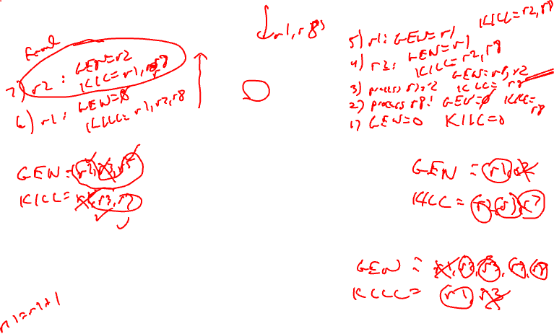
Example – GEN/KILL Liveness Computation
BB1
1. r1 = MEM[r2+0]
2. r2 = MEM[r1 + 1]
3. r8 = r1 * r2
BB2
4. r1 = r1 + 5
5. r3 = r5 – r1
6. r7 = r3 * 2
BB3
7. r2 = 0
8. r7 = r1 + r2
9: r3 = 4
BB4
10: r3 = r3 + r7
11: r1 = r2 – r8
12: r3 = r1 * 2

Slide 22
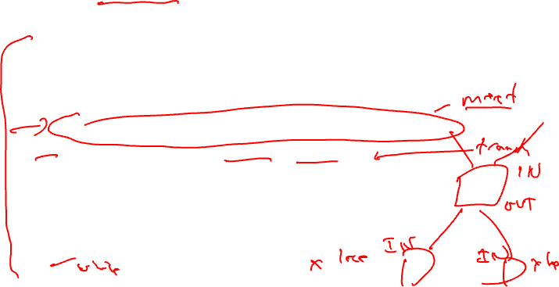
Compute IN/OUT Sets for all BBs
initialize IN(X) to 0 for all basic blocks X
change = 1
while (change) do
change = 0
for each basic block in procedure, X, do
old_IN = IN(X)
OUT(X) = Union(IN(Y)) for all successors Y of X
IN(X) = GEN(X) + (OUT(X) – KILL(X))
if (old_IN != IN(X)) then
change = 1
endif
endfor
endfor

Slide 23
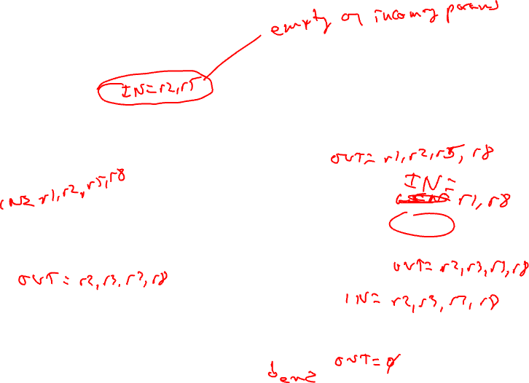
Example – Liveness Computation
OUT = Union(IN(succs))
IN = GEN + (OUT – KILL)
BB1
1. r1 = MEM[r2+0]
2. r2 = MEM[r1 + 1]
3. r8 = r1 * r2
GEN = r2
KILL = r1,r8
BB2
4. r1 = r1 + 5
5. r3 = r5 – r1
6. r7 = r3 * 2
BB3
7. r2 = 0
8. r7 = r1 + r2
9: r3 = 4
GEN = r1,r5
KILL = r3,r7
GEN = r1
KILL = r2,r3,r7
BB4
10: r3 = r3 + r7
11: r1 = r2 – r8
12: r3 = r1 * 2
GEN = r2,r3,r7,r8
KILL = r1

Slide 24
Class Problem
Compute liveness
Calculate GEN/KILL for each BB
Calculate IN/OUT for each BB
1. r1 = 3
2. r2 = r3
3. r3 = r4
4. r1 = r1 + 1
5. r7 = r1 * r2
6. r4 = r4 + 1
7. r4 = r3 + r2
8. r8 = 8
9. r9 = r7 + r8

