Slide 1
EECS 583 – Class 4
If-conversion
University of Michigan
September 13, 2021

Slide 2

Announcements & Reading Material
HW 1 – Deadline Wednesday Sept 15, midnight
  Talk to Yunjie/Ze this week if you are having troubles with LLVM
  Refer to EECS 583 piazza group for tips and answers to questions
Today’s class
  “The Program Dependence Graph and Its Use in Optimization”,
  J. Ferrante, K. Ottenstein, and J. Warren, ACM TOPLAS, 1987
    This is a long paper – the part we care about is the control dependence stuff. The PDG is interesting and you should skim it over.
  “On Predicated Execution”, Park and Schlansker, HPL Technical Report, 1991.
Material for Wednesday
  Compilers: Principles, Techniques, and Tools,
  A. Aho, R. Sethi, and J. Ullman, Addison-Wesley, 1988.
  (Sections: 10.5, 10.6 Edition 1) (Sections 9.2 Edition 2)

Slide 3

An Alternative to Branches: Predicated Execution
Hardware mechanism that allows operations to be conditionally executed
Add an additional boolean source operand (predicate)
  ADD r1, r2, r3 if p1
    if (p1 is True), r1 = r2 + r3
    else if (p1 is False), do nothing (Add treated like a NOP)
    p1 referred to as the guarding predicate
    Predicated on True means always executed
    Omitted predicated also means always executed
Provides compiler with an alternative to using branches to selectively execute operations
  If statements in the source
  Realize with branches in the assembly code
  Could also realize with conditional instructions
  Or use a combination of both

Slide 4
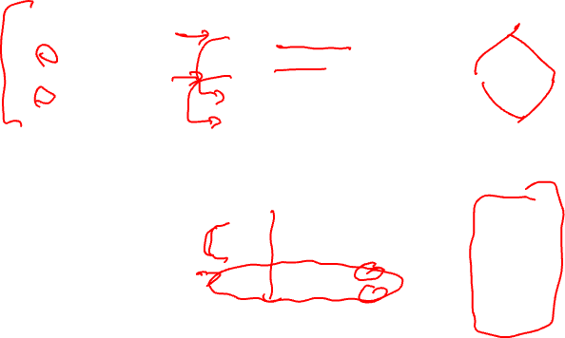
Predicated Execution Example
a = b + c
if (a > 0)
e = f + g
else
e = f / g
h = i - j
BB1
BB1
BB3
BB3
BB2
BB4
add a, b, c
bgt a, 0, L1
div e, f, g
jump L2
L1: add e, f, g
L2: sub h, i, j
BB1
BB2
BB3
BB4
Traditional branching code
BB1
BB1
BB1
BB3
BB2
BB4
add a, b, c if T
p2 = a > 0 if T
p3 = a <= 0 if T
div e, f, g if p3
add e, f, g if p2
sub h, i, j if T
BB1
BB2
BB3
BB4
p2 → BB2
p3 → BB3
Predicated code

Slide 5

What About Nested If-then-else’s?
a = b + c
if (a > 0)
if (a > 25)
e = f + g
else
e = f * g
else
e = f / g
h = i - j
BB1
BB1
BB3
BB3
BB2
BB6
BB6
BB5
BB4
add a, b, c
bgt a, 0, L1
div e, f, g
jump L2
L1: bgt a, 25, L3
mpy e, f, g
jump L2
L3: add e, f, g
L2: sub h, i, j
BB1
BB2
BB3
BB5
BB6
BB4
Traditional branching code

Slide 6
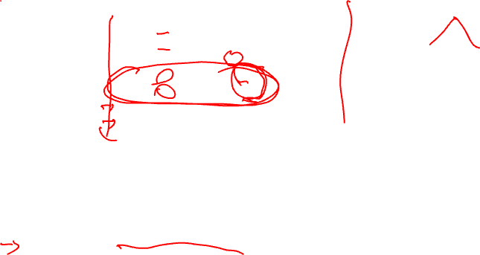
Nested If-then-else’s – No Problem
a = b + c
if (a > 0)
if (a > 25)
e = f + g
else
e = f * g
else
e = f / g
h = i - j
BB1
BB1
BB1
BB3
BB3
BB3
BB6
BB5
BB4
add a, b, c if T
p2 = a > 0 if T
p3 = a <= 0 if T
div e, f, g if p3
p5 = a > 25 if p2
p6 = a <= 25 if p2
mpy e, f, g if p6
add e, f, g if p5
sub h, i, j if T
BB1
BB2
BB3
BB4
BB5
BB6
Predicated code
What do we assume to make this work ??
if p2 is False, both p5 and p6 are False
So, predicate setting instruction should set result to False if guarding
predicate is false!!!

Slide 7
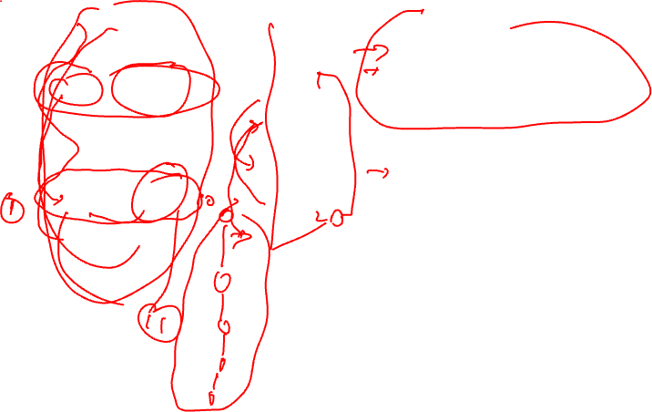
Benefits/Costs of Predicated Execution
BB1
BB1
BB2
BB3
BB4
BB5
BB6
BB7
Benefits:
- No branches, no mispredicts
- Can freely reorder independent
operations in the predicated block
- Overlap BB2 with BB5 and BB6
Costs (execute all paths)
worst case schedule length
worst case resources required
BB2
BB3
BB4
BB5
BB6
BB7

Slide 8
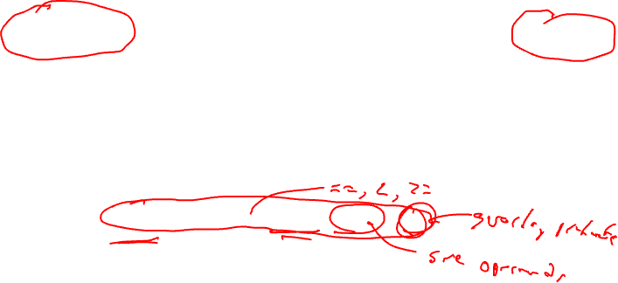
HPL-PD Compare-to-Predicate Operations (CMPPs)
How do we compute predicates
  Compare registers/literals like a branch would do
  Efficiency, code size, nested conditionals, etc
2 targets for computing taken/fall-through conditions with 1 operation
p1, p2 = CMPP.cond.D1a.D2a (r1, r2) if p3
p1 = first destination predicate
p2 = second destination predicate
cond = compare condition (ie EQ, LT, GE, …)
D1a = action specifier for first destination
D2a = action specifier for second destination
(r1,r2) = data inputs to be compared (ie r1 < r2)
p3 = guarding predicate

Slide 9
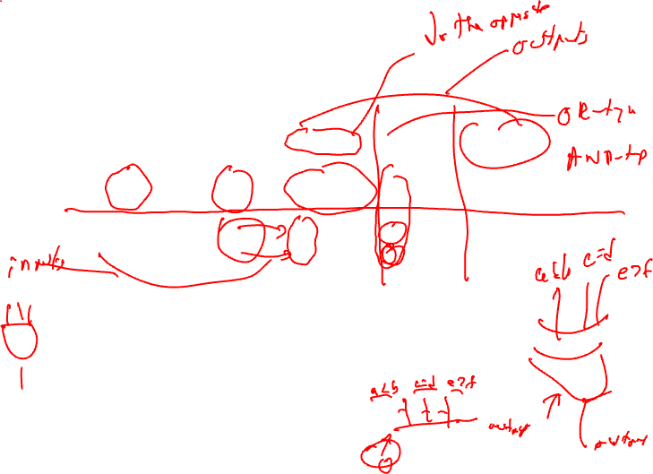
CMPP Action Specifiers
Guarding
predicate
0
0
1
1
Compare
Result
0
1
0
1
UN
0
0
0
1
UC
0
0
1
0
ON
-
-
-
1
OC
-
-
1
-
AN
-
-
0
-
AC
-
-
-
0
UN/UC = Unconditional normal/complement
This is what we used in the earlier examples
guard = 0, both outputs are 0
guard = 1, UN = Compare result, UC = opposite
ON/OC = OR-type normal/complement
AN/AC = AND-type normal/complement

Slide 10
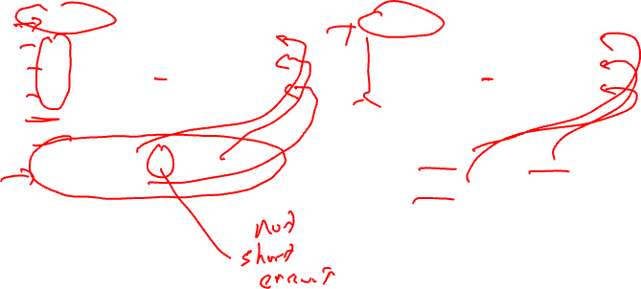
OR-type, AND-type Predicates
p1 = 0
p1 = cmpp_ON (r1 < r2) if T
p1 = cmpp_OC (r3 < r4) if T
p1 = cmpp_ON (r5 < r6) if T
p1 = (r1 < r2) | (!(r3 < r4)) |
(r5 < r6)
Wired-OR into p1
p1 = 1
p1 = cmpp_AN (r1 < r2) if T
p1 = cmpp_AC (r3 < r4) if T
p1 = cmpp_AN (r5 < r6) if T
p1 = (r1 < r2) & (!(r3 < r4)) &
(r5 < r6)
Wired-AND into p1
Generating predicated code
for some source code requires
OR-type predicates
Talk about these later – used
for control height reduction

Slide 11
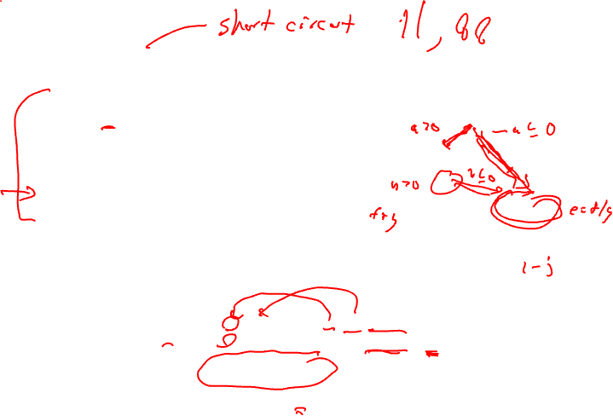
Use of OR-type Predicates
a = b + c
if (a > 0 && b > 0)
e = f + g
else
e = f / g
h = i - j
BB1
BB1
BB5
BB2
BB2
BB3
BB4
add a, b, c
ble a, 0, L1
ble b, 0, L1
add e, f, g
jump L2
L1: div e, f, g
L2: sub h, i, j
BB1
BB5
BB2
BB3
Traditional branching code
BB4
BB1
BB1
BB5
BB3
BB2
BB4
add a, b, c if T
p3, p5 = cmpp.ON.UC a <= 0 if T
p3, p2 = cmpp.ON.UC b <= 0 if p5
div e, f, g if p3
add e, f, g if p2
sub h, i, j if T
BB1
BB5
BB2
BB3
BB4
p2 → BB2
p3 → BB3
p5 → BB5
Predicated code

Slide 12

Homework Problem – Answer on next slide but don’t cheat!
if (a > 0) {
if (b > 0)
r = t + s
else
u = v + 1
y = x + 1
}
Draw the CFG
Predicate the code removing
all branches

Slide 13
Homework Problem Answer
if (a > 0) {
if (b > 0)
r = t + s
else
u = v + 1
y = x + 1
}
a > 0
p1 = cmpp.UN(a > 0) if T
p2, p3 = cmpp.UNUC(b > 0) if p1
r = t + s if p2
u = v + 1 if p3
y = x + 1 if p1
a <= 0
b > 0
b <= 0
r = t + s
u = v + 1
y = x + 1
Draw the CFG
Predicate the code removing
all branches

Slide 14

If-conversion
Algorithm for generating predicated code
  Automate what we’ve been doing by hand
  Handle arbitrary complex graphs
    But, acyclic subgraph only!!
    Need a branch to get you back to the top of a loop
  Efficient
Roots are from Vector computer days
  Vectorize a loop with an if-statement in the body
4 steps
  1. Loop backedge coalescing
  2. Control dependence analysis
  3. Control flow substitution
  4. CMPP compaction
My version of Park & Schlansker

Slide 15
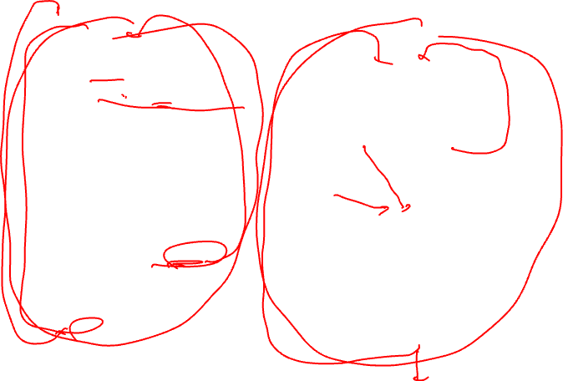
Running Example – Initial State
do {
b = load(a)
if (b < 0) {
if ((c > 0) && (b > 13))
b = b + 1
else
c = c + 1
d = d + 1
}
else {
e = e + 1
if (c > 25) continue
}
a = a + 1
} while (e < 34)
BB1
b < 0
b >= 0
BB2
BB3
e++
c > 0
c <= 0
c > 25
BB4
c <= 25
b > 13
b <= 13
b++
BB5
BB6
c++
BB7
d++
BB8
a++
e < 34
e >= 34

Slide 16
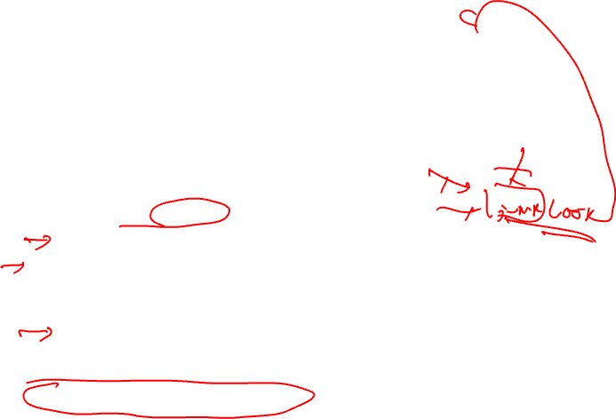
Step 1: Backedge Coalescing
Recall – Loop backedge is branch from inside the loop back to the loop header
This step only applicable for a loop body
  If not a loop body → skip this step
Process
  Create a new basic block
    New BB contains an unconditional branch to the loop header
  Adjust all other backedges to go to new BB rather than header
Why do this?
  Heuristic step – Not essential for correctness
    If-conversion cannot remove backedges (only forward edges)
    But this allows the control logic to figure out which backedge you take to be eliminated
  Generally this is a good thing to do

Slide 17
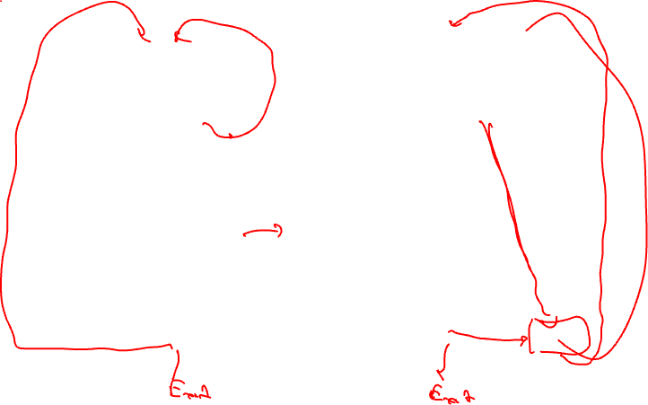
Running Example – Backedge Coalescing
BB1
BB1
b < 0
b >= 0
b < 0
b >= 0
BB2
BB3
BB2
BB3
e++
e++
c > 0
c > 0
c <= 0
c <= 0
c > 25
BB4
c <= 25
c > 25
BB4
c <= 25
b <= 13
b > 13
b <= 13
b > 13
BB5
BB6
b++
BB5
BB6
c++
b++
c++
BB7
BB7
d++
d++
BB8
a++
BB8
e < 34
a++
e < 34
BB9
e >= 34
e >= 34

Slide 18
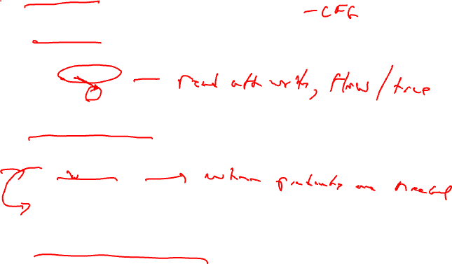
Step 2: Control Dependence Analysis (CD)
Control flow – Execution transfer from 1 BB to another via a taken branch or fallthrough path
Dependence – Ordering constraint between 2 operations
  Must execute in proper order to achieve the correct result
  O1: a = b + c
  O2: d = a – e
  O2 dependent on O1
Control dependence – One operation controls the execution of another
  O1: blt a, 0, SKIP
  O2: b = c + d
  SKIP:
  O2 control dependent on O1
Control dependence analysis derives these dependences

Slide 19
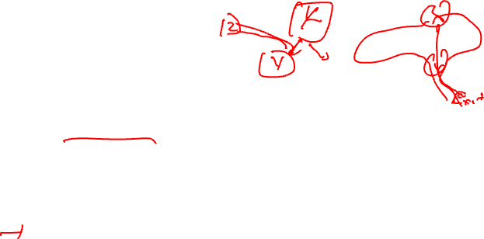

Control Dependences
Recall
  Post dominator – BBX is post dominated by BBY if every path from BBX to EXIT contains BBY
  Immediate post dominator – First breadth first successor of a block that is a post dominator
Control dependence – BBY is control dependent on BBX iff
  1. There exists a directed path P from BBX to BBY with any BBZ in P (excluding BBX and BBY) post dominated by BBY
  2. BBX is not post dominated by BBY
In English,
  A BB is control dependent on the closest BB(s) that determine(s) its execution
  Its actually not a BB, it’s a control flow edge coming out of a BB

Slide 20
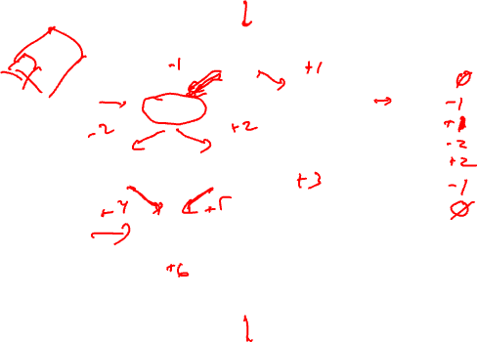
Control Dependence Example
BB1
Control dependences
BB1:
BB2:
BB3:
BB4:
BB5:
BB6:
BB7:
T
F
BB2
BB3
T
F
BB4
BB5
BB6
Notation
positive BB number = fallthru direction
negative BB number = taken direction
BB7

Slide 21
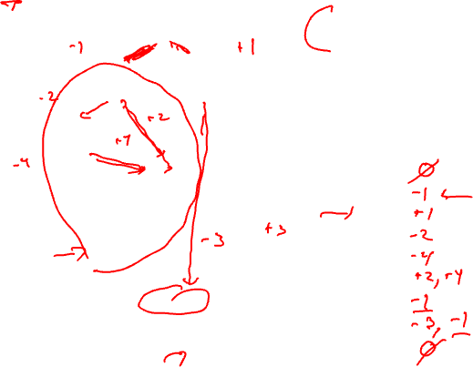
Running Example – CDs
Entry
BB1
First, nuke backedge(s)
Second, nuke exit edges
Then, Add pseudo entry/exit nodes
- Entry → nodes with no predecessors
- Exit → nodes with no successors
b < 0
b >= 0
BB2
BB3
e++
c > 0
c <= 0
BB4
c <= 25
c > 25
b <= 13
Control deps (left is taken)
BB1:
BB2:
BB3:
BB4:
BB5:
BB6:
BB7:
BB8:
BB9:
b > 13
b++
BB5
BB6
c++
BB7
d++
a++
BB8
e < 34
BB9
Exit

Slide 22
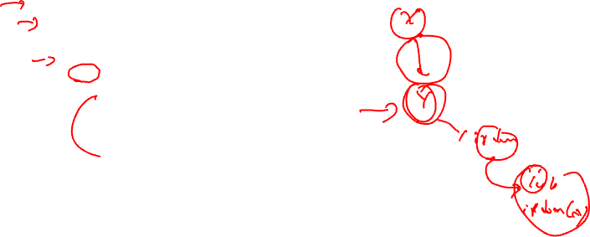
Algorithm for Control Dependence Analysis
for each basic block x in region
for each outgoing control flow edge e of x
y = destination basic block of e
if (y not in pdom(x)) then
lub = ipdom(x)
if (e corresponds to a taken branch) then
x_id = -x.id
else
x_id = x.id
endif
t = y
while (t != lub) do
cd(t) += x_id;
t = ipdom(t)
endwhile
endif
endfor
endfor
Notes
Compute cd(x) which contains those
BBs which x is control dependent on
Iterate on per edge basis, adding
edge to each cd set it is a member of

Slide 23
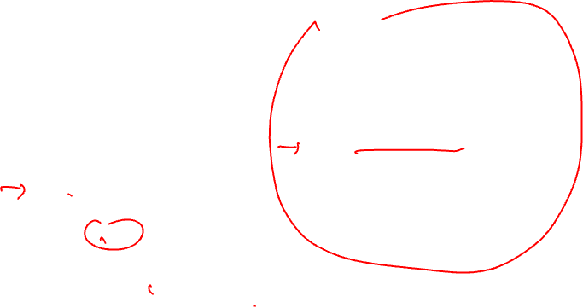
Running Example – Post Dominators
Entry
BB1
pdom ipdom
BB1: 1, 9, ex 9
BB2: 2, 7, 8, 9, ex 7
BB3: 3, 9, ex 9
BB4: 4, 7, 8, 9, ex 7
BB5: 5, 7, 8, 9, ex 7
BB6: 6, 7, 8, 9, ex 7
BB7: 7, 8, 9, ex 8
BB8: 8, 9, ex 9
BB9: 9, ex ex
b < 0
b >= 0
BB2
BB3
e++
c > 0
c <= 0
BB4
c <= 25
c > 25
b > 13
b <= 13
b++
BB5
BB6
c++
BB7
d++
a++
BB8
e < 34
BB9
Exit

Slide 24
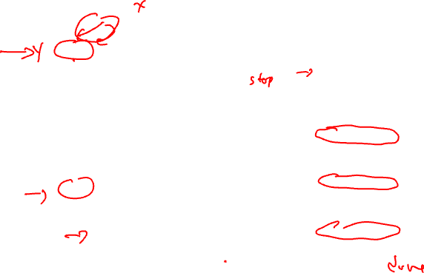
Running Example – CDs Via Algorithm
Entry
1 → 2 edge (aka –1)
BB1
x = 1
e = taken edge 1 → 2
y = 2
y not in pdom(x)
lub = 9
x_id = -1
t = 2
2 != 9
cd(2) += -1
t = 7
7 != 9
cd(7) += -1
t = 8
8 != 9
cd(8) += -1
t = 9
9 == 9
b < 0
b >= 0
BB2
BB3
e++
c > 0
c <= 0
BB4
c <= 25
c > 25
b > 13
b <= 13
b++
BB5
BB6
c++
BB7
d++
a++
BB8
e < 34
BB9
Exit

Slide 25
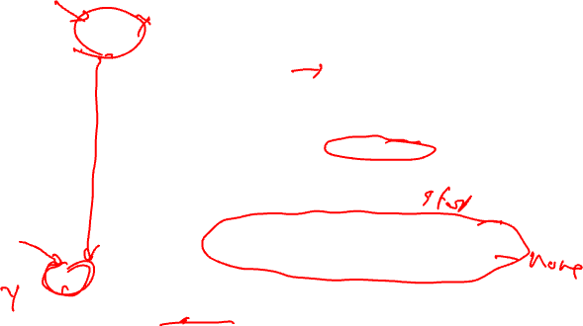
Running Example – CDs Via Algorithm (2)
Entry
3 → 8 edge (aka -3)
BB1
x = 3
e = taken edge 3 → 8
y = 8
y not in pdom(x)
lub = 9
x_id = -3
t = 8
8 != 9
cd(8) += -3
t = 9
9 == 9
b < 0
b >= 0
BB2
BB3
e++
c > 0
c <= 0
BB4
c <= 25
c > 25
b > 13
b <= 13
b++
BB5
BB6
c++
BB7
d++
Class ProblemA: 1 → 3 edge (aka 1)
Class ProblemB: 7 → 8 edge (aka -7)
a++
BB8
e < 34
BB9
Exit

Slide 26

Running Example – CDs Via Algorithm (3)
Entry
BB1
b < 0
b >= 0
Control deps (left is taken)
BB1: none
BB2: -1
BB3: 1
BB4: -2
BB5: -4
BB6: 2, 4
BB7: -1
BB8: -1, -3
BB9: none
BB2
BB3
e++
c > 0
c <= 0
BB4
c <= 25
c > 25
b > 13
b <= 13
b++
BB5
BB6
c++
BB7
d++
a++
BB8
e < 34
BB9
Exit

Slide 27

Step 3: Control Flow Substitution
Go from branching code → sequential predicated code
5 baby steps
  1. Create predicates
  2. CMPP insertion
  3. Guard operations
  4. Remove branches
  5. Initialize predicates

Slide 28

Predicate Creation
R/K calculation – Mapping predicates to blocks
  Paper more complicated than it really is
  K = unique sets of control dependences
  Create a new predicate for each element of K
  R(bb) = predicate that represents CD set for bb, ie the bb’s assigned predicate (all ops in that bb guarded by R(bb))
K = {{-1}, {1}, {-2}, {-4}, {2,4}, {-1,-3}}
predicates = p1, p2, p3, p4, p5, p6
bb = 1, 2, 3, 4, 5, 6, 7, 8, 9
CD(bb) = {{none}, {-1}, {1}, {-2}, {-4}, {2,4}, {-1}, {-1,-3}, {none}
R(bb) = T p1 p2 p3 p4 p5 p1 p6 T

Slide 29

CMPP Creation/Insertion
For each control dependence set
  For each edge in the control dependence set
    Identify branch condition that causes edge to be traversed
    Create CMPP to compute corresponding branch condition
      OR-type – handles worst case
      guard = True
      destination = predicate assigned to that CD set
      Insert at end of BB that is the source of the edge
K = {{-1}, {1}, {-2}, {-4}, {2,4}, {-1,-3}}
predicates = p1, p2, p3, p4, p5, p6
Example: p1 = cmpp.ON (b < 0) if T
BB1
b < 0
b >= 0

Slide 30
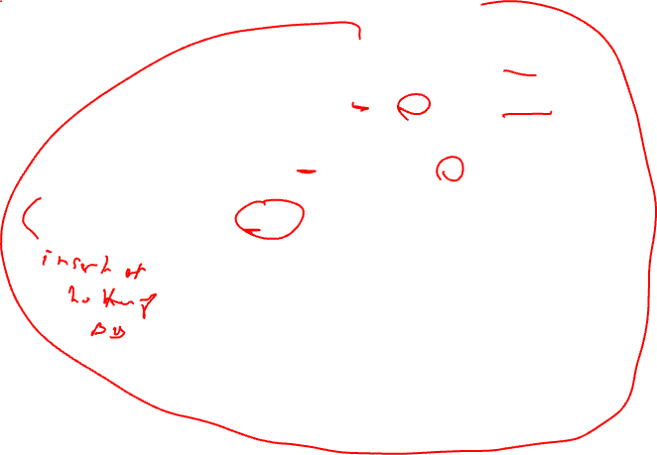
Running Example – CMPP Creation
K = {{-1}, {1}, {-2}, {-4}, {2,4}, {-1,-3}}
p’s = p1, p2, p3, p4, p5, p6
p1 = cmpp.ON (b < 0) if T
p2 = cmpp.ON (b >= 0) if T
p6 = cmpp.ON (b < 0) if T
Entry
BB1
b < 0
b >= 0
p3 = cmpp.ON (c > 0) if T
p5 = cmpp.ON (c <= 0) if T
BB2
BB3
e++
p6 = cmpp.ON (c <= 25) if T
c > 0
c <= 0
p4 = cmpp.ON (b > 13) if T
p5 = cmpp.ON (b <= 13) if T
BB4
c <= 25
c > 25
b > 13
b <= 13
b++
BB5
BB6
c++
BB7
d++
a++
BB8
e < 34
BB9
Exit

Slide 31

Control Flow Substitution – The Rest
Guard all operations in each bb by R(bb)
  Including the newly inserted CMPPs
Nuke all the branches
  Except exit edges and backedges
Initialize each predicate to 0 in first BB
bb = 1, 2, 3, 4, 5, 6, 7, 8, 9
CD(bb) = {{none}, {-1}, {1}, {-2}, {-4}, {2,4}, {-1}, {-1,-3}, {none}
R(bb) = T p1 p2 p3 p4 p5 p1 p6 T

Slide 32
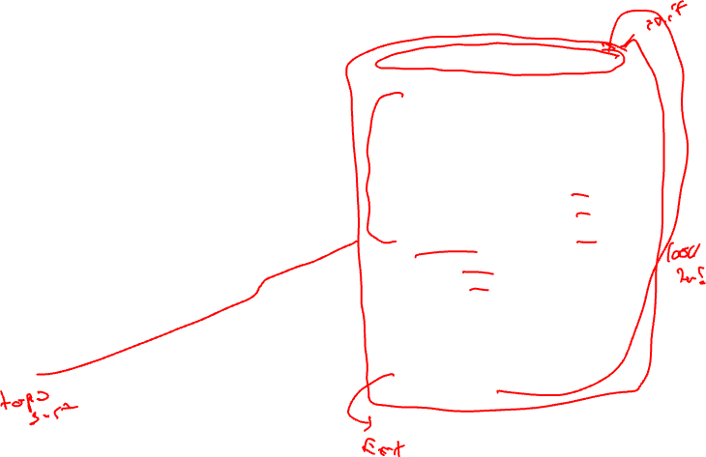
Running Example – Control Flow Substitution
Loop:
p1 = p2 = p3 = p4 = p5 = p6 = 0
b = load(a) if T
p1 = cmpp.ON (b < 0) if T
p2 = cmpp.ON (b >= 0) if T
p6 = cmpp.ON (b < 0) if T
p3 = cmpp.ON (c > 0) if p1
p5 = cmpp.ON (c <= 0) if p1
p4 = cmpp.ON (b > 13) if p3
p5 = cmpp.ON (b <= 13) if p3
b = b + 1 if p4
c = c + 1 if p5
d = d + 1 if p1
p6 = cmpp.ON (c <= 25) if p2
e = e + 1 if p2
a = a + 1 if p6
bge e, 34, Done if p6
jump Loop if T
Done:
BB1
b < 0
b >= 0
BB2
BB3
e++
c > 0
c <= 0
BB4
c <= 25
c > 25
b > 13
b <= 13
b++
BB5
BB6
c++
BB7
d++
a++
BB8
e < 34
BB9
e >= 34

Slide 33

Step 4: CMPP Compaction
Convert ON CMPPs to UN
  All singly defined predicates don’t need to be OR-type
  OR of 1 condition → Just compute it !!!
  Remove initialization (Unconditional don’t require init)
Reduce number of CMPPs
  Utilize 2nd destination slot
  Combine any 2 CMPPs with:
    Same source operands
    Same guarding predicate
    Same or opposite compare conditions

Slide 34
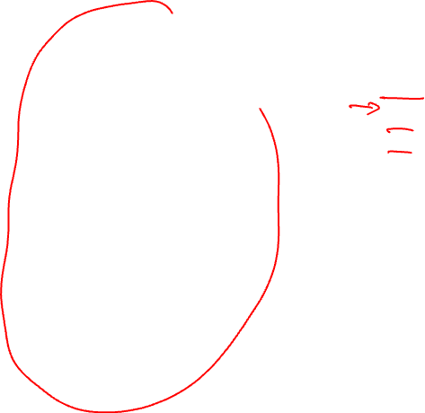
Running Example - CMPP Compaction
Loop:
p1 = p2 = p3 = p4 = p5 = p6 = 0
b = load(a) if T
p1 = cmpp.ON (b < 0) if T
p2 = cmpp.ON (b >= 0) if T
p6 = cmpp.ON (b < 0) if T
p3 = cmpp.ON (c > 0) if p1
p5 = cmpp.ON (c <= 0) if p1
p4 = cmpp.ON (b > 13) if p3
p5 = cmpp.ON (b <= 13) if p3
b = b + 1 if p4
c = c + 1 if p5
d = d + 1 if p1
p6 = cmpp.ON (c <= 25) if p2
e = e + 1 if p2
a = a + 1 if p6
bge e, 34, Done if p6
jump Loop if T
Done:
Loop:
p5 = p6 = 0
b = load(a) if T
p1,p2 = cmpp.UN.UC (b < 0) if T
p6 = cmpp.ON (b < 0) if T
p3,p5 = cmpp.UN.OC (c > 0) if p1
p4,p5 = cmpp.UN.OC (b > 13) if p3
b = b + 1 if p4
c = c + 1 if p5
d = d + 1 if p1
p6 = cmpp.ON (c <= 25) if p2
e = e + 1 if p2
a = a + 1 if p6
bge e, 34, Done if p6
jump Loop if T
Done:

Slide 35

Homework Problem – Answer Next Time
if (a > 0) {
r = t + s
if (b > 0 || c > 0)
u = v + 1
else if (d > 0)
x = y + 1
else
z = z + 1
}
Draw the CFG
Compute CD
If-convert the code

