Slide 1
EECS 583 – Class 17
Automatic Parallelization Via
Decoupled Software Pipelining
University of Michigan
November 10, 2021

Slide 2
Announcements + Reading Material
Research paper presentations
  3 more today + my last presentation today
  Fill out quizzes (feedback forms) on canvas
Reading material
  “Revisiting the Sequential Programming Model for Multi-Core,” M. J. Bridges, N. Vachharajani, Y. Zhang, T. Jablin, and D. I. August, Proc 40th IEEE/ACM International Symposium on Microarchitecture, December 2007.
  “Automatic Thread Extraction with Decoupled Software Pipelining,” G. Ottoni, R. Rangan, A. Stoler, and D. I. August, Proceedings of the 38th IEEE/ACM International Symposium on Microarchitecture, Nov. 2005

Slide 3

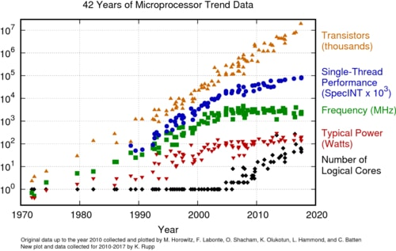
Moore’s Law
Source: Intel/Wikipedia
Notes:
2

Slide 4
Compilers are the Answer? - Proebsting’s Law
“Compiler Advances Double Computing Power Every 18 Years”
Run your favorite set of benchmarks with your favorite state-of-the-art optimizing compiler. Run the benchmarks both with and without optimizations enabled. The ratio of of those numbers represents the entirety of the contribution of compiler optimizations to speeding up those benchmarks. Let's assume that this ratio is about 4X for typical real-world applications, and let's further assume that compiler optimization work has been going on for about 36 years. Therefore, compiler optimization advances double computing power every 18 years. QED.
Conclusion – Compilers not about performance!
Notes:
3

Slide 5
DOALL Coverage – Provable and Profiled
Still not good enough!
Notes:
Pointer analysis is done in the provable… successful in many applications like specfp… but even a single dependence ruins everything
People have used profiling to find more parallel loops
This figure shows the coverage of doall loops using compiler analysis and profile information.
Y-axis shows..
Blue bar: time spent in loops can be proved to be doall by compiler
Red bar: doall loops identified by profiler
Compiler analysis limited for general applications. Profiled can identify more loops.
Good but still need to improve
Either remove or isolate dependeces

Slide 6
What About Non-Scientific Codes???
Scientific Codes (FORTRAN-like)
General-purpose Codes (legacy C/C++)
for(i=1; i<=N; i++) // C
a[i] = a[i] + 1; // X
while(ptr = ptr->next) // LD
ptr->val = ptr->val + 1; // X
Core 1
Core 2
Core 1
Core 2
Independent
Multithreading
(IMT)
Example: DOALL
parallelization
Cyclic Multithreading
(CMT)
Example: DOACROSS
[Cytron, ICPP 86]
0
0
C:1
C:2
LD:1
1
1
X:1
X:2
X:1
LD:2
2
2
C:3
C:4
LD:3
X:2
3
3
X:3
X:4
X:3
LD:4
4
4
C:5
C:6
LD:5
X:4
5
5
X:5
X:6
X:5
LD:6
Notes:
5

Slide 7
Alternative Parallelization Approaches
while(ptr = ptr->next) // LD
ptr->val = ptr->val + 1; // X
Core 1
Core 2
Core 1
Core 2
Cyclic
Multithreading
(CMT)
Pipelined
Multithreading (PMT)
Example: DSWP
[PACT 2004]
0
0
LD:1
LD:1
1
1
X:1
LD:2
LD:2
X:1
2
2
LD:3
X:2
LD:3
X:2
3
3
X:3
LD:4
LD:4
X:3
4
4
LD:5
X:4
LD:5
X:4
5
5
X:5
LD:6
LD:6
X:5
Notes:
6

Slide 8
Comparison: IMT, PMT, CMT
IMT
PMT
CMT
Core 1
Core 2
Core 1
Core 2
Core 1
Core 2
0
0
0
C:1
C:2
LD:1
LD:1
1
1
1
X:1
X:2
LD:2
X:1
2
2
2
C:3
C:4
LD:3
X:1
LD:2
3
3
3
X:3
X:4
LD:4
X:2
X:2
4
4
4
C:5
C:6
LD:5
X:3
LD:3
5
5
5
X:5
X:6
LD:6
X:4
X:3
lat(comm) = 1:
1 iter/cycle
1 iter/cycle
1 iter/cycle
lat(comm) = 2:
1 iter/cycle
1 iter/cycle
0.5 iter/cycle
Notes:
7

Slide 9
Comparison: IMT, PMT, CMT
Thread-local Recurrences ➔ Fast Execution
IMT
PMT
CMT
Core 1
Core 2
Core 1
Core 2
Core 1
Core 2
0
0
0
C:1
C:2
LD:1
LD:1
1
1
1
X:1
X:2
LD:2
X:1
2
2
2
C:3
C:4
LD:3
X:1
LD:2
3
3
3
X:3
X:4
LD:4
X:2
X:2
4
4
4
C:5
C:6
LD:5
X:3
LD:3
5
5
5
X:5
X:6
LD:6
X:4
X:3
Cross-thread Dependences ➔ Wide Applicability
Notes:
8

Slide 10
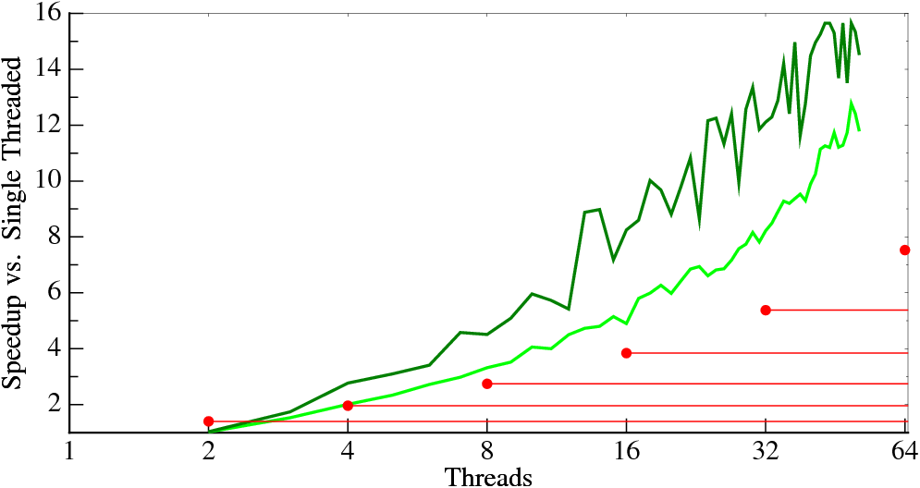
Our Objective: Automatic Extraction of Pipeline Parallelism using DSWP
197.parser
Find
English
Sentences
Parse
Sentences
(95%)
Emit
Results
Decoupled Software Pipelining
PS-DSWP (Spec DOALL Middle Stage)
Notes:
9
This is parser with two input sets shown in green. The red dots are the historic performance trend lines, our goal, shown the first slide. We can automatically parallelize parser in a scalable way - all we need is to have the programmer remove or mark the custom allocator. That is so much easier than rewriting parser in a new language.

Slide 11
Decoupled Software Pipelining

Slide 12
[MICRO 2005]
Decoupled Software Pipelining (DSWP)
A: while(node)
B: ncost = doit(node);
C: cost += ncost;
D: node = node->next;
Dependence
Graph
D
DAG_{SCC}
A D
Thread 1
Thread 2
A
A
B
B
D
B
C
C
C
register
control
intra-iteration
loop-carried
Inter-thread communication
latency is a one-time cost
communication queue
Notes:
11

Slide 13
Implementing DSWP
L1:
DFG
Aux:
register
control
memory
intra-iteration
loop-carried
Notes:
Choose a valid partitioning
Goals: balance load, reduce sync
Transform the code

Slide 14
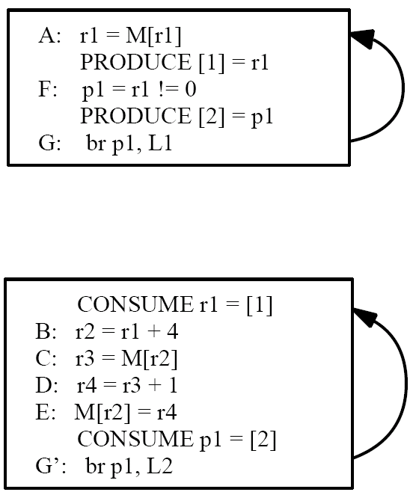
Optimization: Node Splitting
To Eliminate Cross Thread Control
L1
L2
register
control
memory
intra-iteration
loop-carried

Slide 15
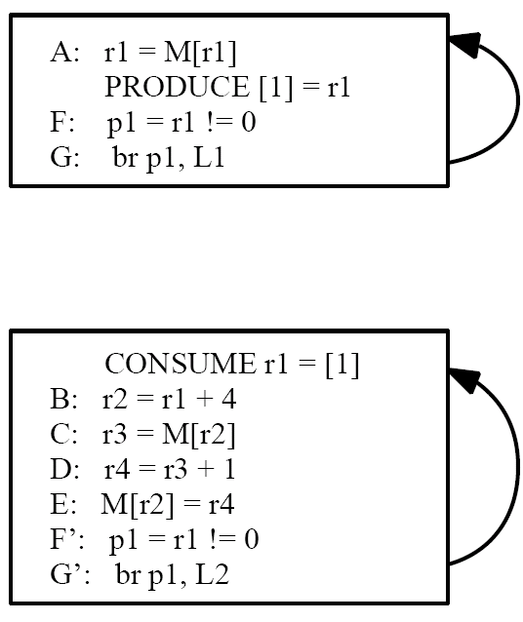
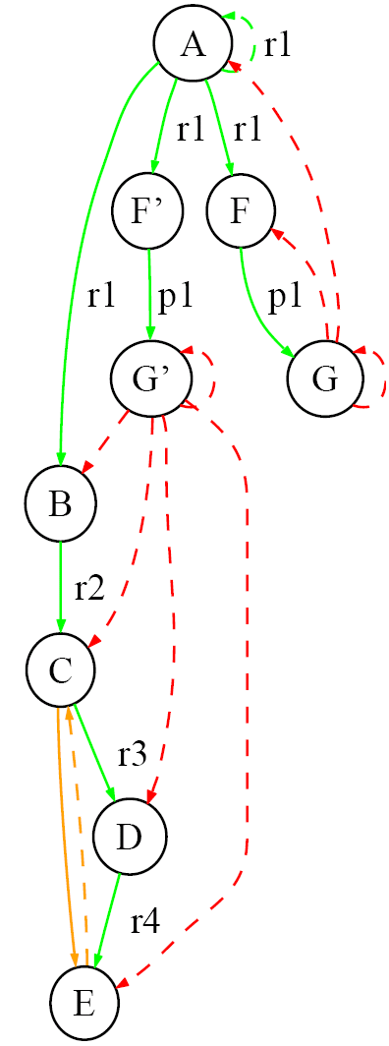
Optimization: Node Splitting To Reduce Communication
L1
L2
register
control
memory
intra-iteration
loop-carried

Slide 16
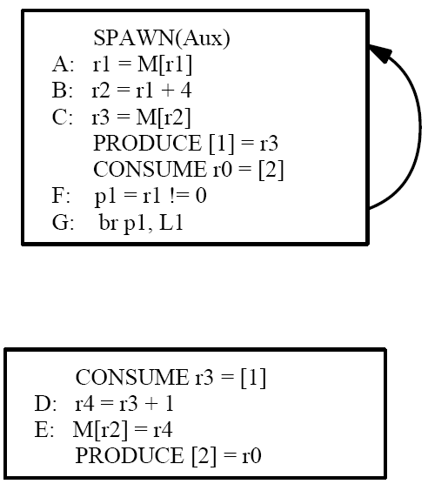
Constraint: Strongly Connected Components
Consider:
Solution: DAG_{SCC}
register
control
memory
Eliminates pipelined/decoupled property
intra-iteration
loop-carried
Notes:
Choose a valid partitioning
Goals: balance load, reduce sync
Transform the code

Slide 17
2 Extensions to the Basic Transformation
Speculation
  Break statistically unlikely dependences
  Form better-balanced pipelines
Parallel Stages
  Execute multiple copies of certain “large” stages
  Stages that contain inner loops perfect candidates

Slide 18
Why Speculation?
A: while(node)
B: ncost = doit(node);
C: cost += ncost;
D: node = node->next;
Dependence
Graph
DAG_{SCC}
A D
D
A
B
B
register
C
C
control
intra-iteration
loop-carried
communication queue

Slide 19
Why Speculation?
A: while(cost < T && node)
B: ncost = doit(node);
C: cost += ncost;
D: node = node->next;
Dependence
Graph
DAG_{SCC}
A D
D
B
A
B
A B C D
register
C
C
control
intra-iteration
Predictable
Dependences
loop-carried
communication queue

Slide 20
Why Speculation?
A: while(cost < T && node)
B: ncost = doit(node);
C: cost += ncost;
D: node = node->next;
Dependence
Graph
DAG_{SCC}
D
D
B
A
B
C
register
C
control
intra-iteration
Predictable
Dependences
A
loop-carried
communication queue

Slide 21
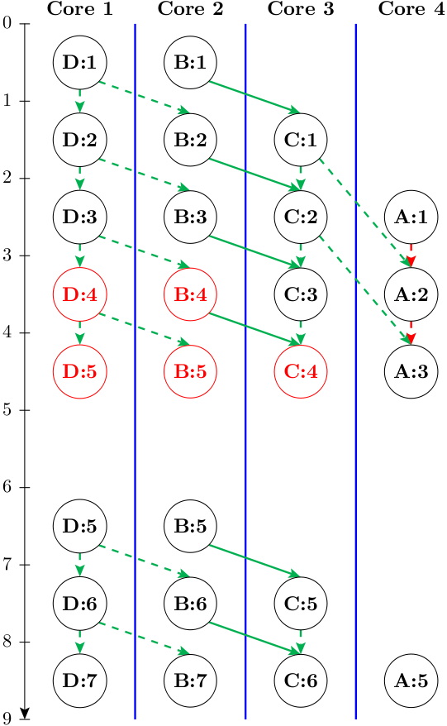
Execution Paradigm
DAG_{SCC}
D
B
Misspeculation
detected
C
Misspeculation Recovery
Rerun Iteration 4
A
register
control
intra-iteration
loop-carried
communication queue
Notes:
20

Slide 22
Understanding PMT Performance
Core 1
Core 2
Core 1
Core 2
0
0
A:1
A:1
B:1
1
1
A:2
B:1
2
2
A:3
B:2
A:2
B:2
C:1
Rate t_{i} is at least as large as the longest dependence recurrence.
NP-hard to find longest recurrence.
Large loops make problem difficult in practice.
3
3
A:4
B:3
Idle
Time
4
4
A:5
B:4
A:3
B:3
C:3
5
5
A:6
B:5
Slowest thread:
1 cycle/iter
2 cycle/iter
Iteration Rate:
1 iter/cycle
0.5 iter/cycle

Slide 23
Selecting Dependences To Speculate
A: while(cost < T && node)
B: ncost = doit(node);
C: cost += ncost;
D: node = node->next;
Dependence
Graph
DAG_{SCC}
D
Thread 1
D
B
Thread 2
A
B
C
Thread 3
register
C
control
intra-iteration
A
loop-carried
Thread 4
communication queue

Slide 24
Detecting Misspeculation
A¹: while(consume(4))
D : node = node->next
produce({0,1},node);
Thread 1
A²: while(consume(5))
B : ncost = doit(node);
produce(2,ncost);
D²: node = consume(0);
DAG_{SCC}
D
Thread 2
B
A³: while(consume(6))
B³: ncost = consume(2);
C : cost += ncost;
produce(3,cost);
Thread 3
C
A : while(cost < T && node)
B⁴: cost = consume(3);
C⁴: node = consume(1);
produce({4,5,6},cost < T
&& node);
A
Thread 4

Slide 25
Detecting Misspeculation
A¹: while(TRUE)
D : node = node->next
produce({0,1},node);
Thread 1
A²: while(TRUE)
B : ncost = doit(node);
produce(2,ncost);
D²: node = consume(0);
DAG_{SCC}
D
Thread 2
B
A³: while(TRUE)
B³: ncost = consume(2);
C : cost += ncost;
produce(3,cost);
Thread 3
C
A
A : while(cost < T && node)
B⁴: cost = consume(3);
C⁴: node = consume(1);
produce({4,5,6},cost < T
&& node);
Thread 4

Slide 26
Detecting Misspeculation
A¹: while(TRUE)
D : node = node->next
produce({0,1},node);
Thread 1
A²: while(TRUE)
B : ncost = doit(node);
produce(2,ncost);
D²: node = consume(0);
DAG_{SCC}
D
Thread 2
B
A³: while(TRUE)
B³: ncost = consume(2);
C : cost += ncost;
produce(3,cost);
Thread 3
C
A
A : while(cost < T && node)
B⁴: cost = consume(3);
C⁴: node = consume(1);
if(!(cost < T && node))
FLAG_MISSPEC();
Thread 4

Slide 27
Adding Parallel Stages to DSWP
Core 1
Core 2
Core 3
0
LD:1
1
LD:2
while(ptr = ptr->next) // LD
ptr->val = ptr->val + 1; // X
2
LD:3
X:1
3
LD:4
X:2
LD = 1 cycle
X = 2 cycles
4
LD:5
X:3
5
Comm. Latency = 2 cycles
LD:6
X:4
Throughput
DSWP: 1/2 iteration/cycle
DOACROSS: 1/2 iteration/cycle
PS-DSWP: 1 iteration/cycle
6
LD:7
X:5
7
LD:8
Notes:
26
The schedule here shows how PS-DSWP would operate when the latency of X and the inter-core communication latencies are both 2 cycles. PS-DSWP replicaes the stage containing X into two cores. Thus, two Xs from two different iterations can be executed concurrently in two different cores. This helps PS-DSWP to achieve a throughput of 1 iteration per cycle. This is in contrast to the ½ iteration per cycle throughput provided by DOACROSS and DSWP.
While in the example, we have shown X as a single statement with a ltency of 2, X could be a stage with varying latency. For instance, X could be an inner loop with varying number of iterations which could not be partitioned by DSWP if it is a single recurrence. As we will see later, one of the key observations that enable PS-DSWP to perform well is that a recurrence in a loop does not necessarily imply the presence of loop carried dependences.

Slide 28
Things to Think About
How do you decide what dependences to speculate?
  Look solely at profile data?
  How do you ensure enough profile coverage?
  What about code structure?
  What if you are wrong? Undo speculation decisions at run-time?
How do you manage speculation in a pipeline?
  Traditional definition of a transaction is broken
  Transaction execution spread out across multiple cores
How many cores can DSWP realistically scale to?
  Can a pipeline be adjusted when the number of available cores increases/decreases, or based on what else is running on the processor?

