Slide 1

EECS 583 – Class 14
Modulo Scheduling Reloaded
University of Michigan
October 27, 2021

Slide 2
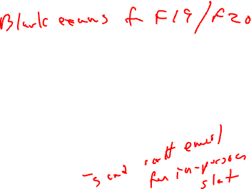
Announcements + Reading Material
Project proposals
  Due tonight, 11:59pm
  1 paragraph summary of what you plan to work on, 1-2 references
  Email to me & Yunjie & Ze, cc all your group members
Exam – Next Wednes, Nov 3 10:30-12:30
  Exam review – next Monday
  Exam scope: Covers all lecture material through today’s class
  Exam format: Hybrid (Virtual or in-person) – Would anyone want in-person?
    In-person: 10:30-12:15 + 15 mins extra time, walk outside to get questions answered
    Virtual: 10:30-12:15 + 30 mins extra time (15 mins extra for printing, scanning, uploading), post private questions on piazza to get answers
    Questions answered up to 12:30
Today’s class reading
  “Code Generation Schema for Modulo Scheduled Loops”, B. Rau, M. Schlansker, and P. Tirumalai, MICRO-25, Dec. 1992.
Next class reading - None

Slide 3
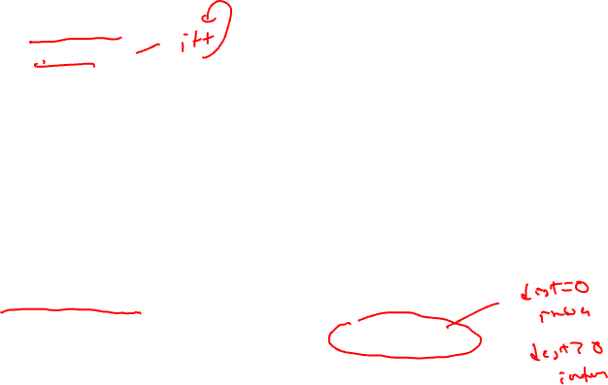
From Last Time: Dependences in a Loop
Need worry about 2 kinds
  Intra-iteration
  Inter-iteration
Delay
  Minimum time interval between the start of operations
  Operation read/write times
Distance
  Number of iterations separating the 2 operations involved
  Distance of 0 means intra-iteration
Recurrence manifests itself as a circuit in the dependence graph
1
<1,2>
<1,1>
2
<1,0>
<1,2>
3
<1,0>
4
Edges annotated with tuple
<delay, distance>

Slide 4

From Last Time: Dynamic Single Assignment (DSA) Form
Impossible to overlap iterations because each iteration writes to the same
register. So, we’ll have to remove the anti and output dependences.
Virtual rotating registers
* Each register is an infinite push down array (Expanded virtual reg or EVR)
* Write to top element, but can reference any element
* Remap operation slides everything down → r[n] changes to r[n+1]
A program is in DSA form if the same virtual register (EVR element) is never
assigned to more than 1x on any dynamic execution path
1: r3 = load(r1)
2: r4 = r3 * 26
3: store (r2, r4)
4: r1 = r1 + 4
5: r2 = r2 + 4
6: p1 = cmpp (r1 < r9)
7: brct p1 Loop
1: r3[-1] = load(r1[0])
2: r4[-1] = r3[-1] * 26
3: store (r2[0], r4[-1])
4: r1[-1] = r1[0] + 4
5: r2[-1] = r2[0] + 4
6: p1[-1] = cmpp (r1[-1] < r9)
remap r1, r2, r3, r4, p1
7: brct p1[-1] Loop
DSA
conversion

Slide 5
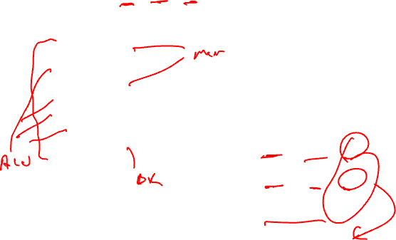
From Last Time: ResMII Example
ResMII = MAX (uses(r) / count(r))
resources: 4 issue, 2 alu, 1 mem, 1 br
latencies: add=1, mpy=3, ld = 2, st = 1, br = 1
uses(r) = number of times the resource is used
in 1 iteration
1: r3 = load(r1)
2: r4 = r3 * 26
3: store (r2, r4)
4: r1 = r1 + 4
5: r2 = r2 + 4
6: p1 = cmpp (r1 < r9)
7: brct p1 Loop
ALU: used by 2, 4, 5, 6
→ 4 ops / 2 units = 2
Mem: used by 1, 3
→ 2 ops / 1 unit = 2
Br: used by 7
→ 1 op / 1 unit = 1
ResMII = MAX(2,2,1) = 2

Slide 6

From Last Time: RecMII Example
1: r3 = load(r1)
2: r4 = r3 * 26
3: store (r2, r4)
4: r1 = r1 + 4
5: r2 = r2 + 4
6: p1 = cmpp (r1 < r9)
7: brct p1 Loop
1,1
1
4 → 4: 1 / 1 = 1
5 → 5: 1 / 1 = 1
4 → 1 → 4: 1 / 1 = 1
5 → 3 → 5: 1 / 1 = 1
RecMII = MAX(1,1,1,1) = 1
Then,
MII = MAX(ResMII, RecMII)
MII = MAX(2,1) = 2
2,0
2
0,0
3,0
3
0,0
1,1
1,1
4
RecMII = MAX(delay(c) / distance(c))
1,0
5
1,1
delay(c) = total latency in dependence
cycle c (sum of delays)
distance(c) = total iteration distance
of cycle c (sum of distances)
6
1,0
7
<delay, distance>

Slide 7
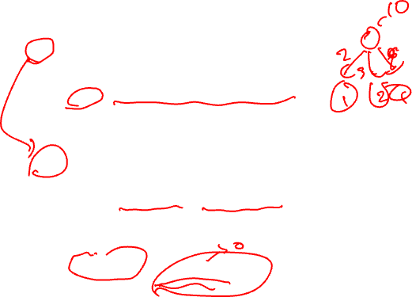
From Last Time: Priority Function
Height-based priority worked well for acyclic scheduling, makes sense
that it will work for loops as well
Acyclic:
Height(X) =
0, if X has no successors
MAX ((Height(Y) + Delay(X,Y)), otherwise
for all Y = succ(X)
Cyclic:
HeightR(X) =
0, if X has no successors
MAX ((HeightR(Y) + EffDelay(X,Y)), otherwise
for all Y = succ(X)
EffDelay(X,Y) = Delay(X,Y) – II*Distance(X,Y)

Slide 8

From Last Time: Calculating Height
Insert pseudo edges from all nodes to branch with latency = 0, distance = 0 (dotted edges)
Compute II, For this example assume II = 2
HeightR(4) = H(4) + (1 – II*1) (Assume H(4) is 0 since not calculated yet
0 + 1-2 = -1 → 0 (Always MAX answer with 0)
HeightR(3) = MAX(H(4) + 0 – II*0 = 0 + 0 – 2*0 = 0,
H(2) + 2 – II*2 = 0 + 2 – 2*2 = -2)
Assume H(2) is 0 since not calculated yet
= 0
HeightR(2) = MAX(H(4) + 0 – II*0 = 0 + 0 – 2*0 = 0,
H(3) + 2 – II*0 = 0 + 2 – 2*0 = 2)
= 2
HeightR(1) = MAX(H(4) + 0 – II*0 = 0 + 0 – 2*0 = 0,
H(2) + 3 – II*0 = 2 + 3 – 2*0 = 5)
= 5
Now recalculate the heights to see if anything changes since HeightR(3) assumed wrong value for node 2
HeightR(3) = MAX(H(4) + 0 – II*0 = 0 + 0 – 2*0 = 0,
H(2) + 2 – II*2 = 2 + 2 – 2*2 = 0)
= 0 → Unchanged, so no need to compute any other heights again
1
0,0
3,0
0,0
2
2,2
2,0
3
0,0
4
1,1

Slide 9
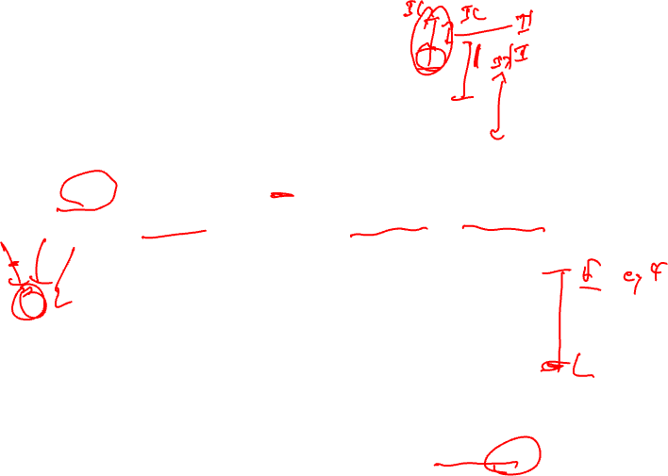
The Scheduling Window
With cyclic scheduling, not all the predecessors may be scheduled,
so a more flexible earliest schedule time is:
E(Y) =
0, if X is not scheduled
MAX
for all X = pred(Y)
MAX (0, SchedTime(X) + EffDelay(X,Y)),
otherwise
where EffDelay(X,Y) = Delay(X,Y) – II*Distance(X,Y)
Every II cycles a new loop iteration will be initialized, thus every II
cycles the pattern will repeat. Thus, you only have to look in a
window of size II, if the operation cannot be scheduled there, then
it cannot be scheduled.
Latest schedule time(Y) = L(Y) = E(Y) + II – 1

Slide 10
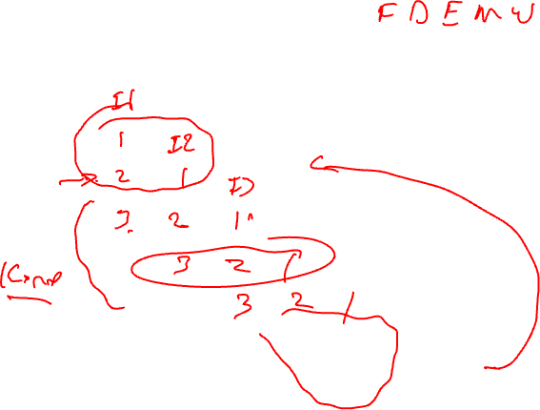
Loop Prolog and Epilog
Prolog
II = 3
Kernel
Epilog
Only the kernel involves executing full width of operations
Prolog and epilog execute a subset (ramp-up and ramp-down)

Slide 11
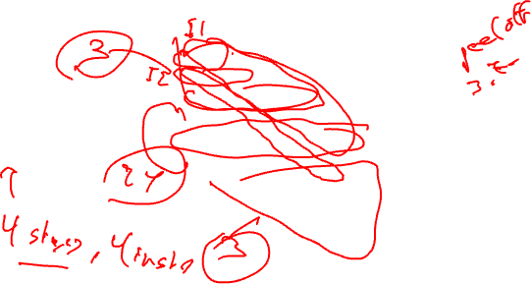
Separate Code for Prolog and Epilog
A0
A1 B0
A2 B1 C0
A B C D
Bn Cn-1 Dn-2
Cn Dn-1
Dn
Prolog -
fill the
pipe
A
B
C
D
Loop body
with 4 ops
Kernel
Epilog -
drain the
pipe
Generate special code before the loop (preheader) to fill the pipe
and special code after the loop to drain the pipe.
Peel off II-1 iterations for the prolog. Complete II-1 iterations
in epilog

Slide 12

Removing Prolog/Epilog
Prolog
II = 3
Kernel
Disable using
predicated execution
Epilog
Execute loop kernel on every iteration, but for prolog and epilog
selectively disable the appropriate operations to fill/drain the pipeline

Slide 13
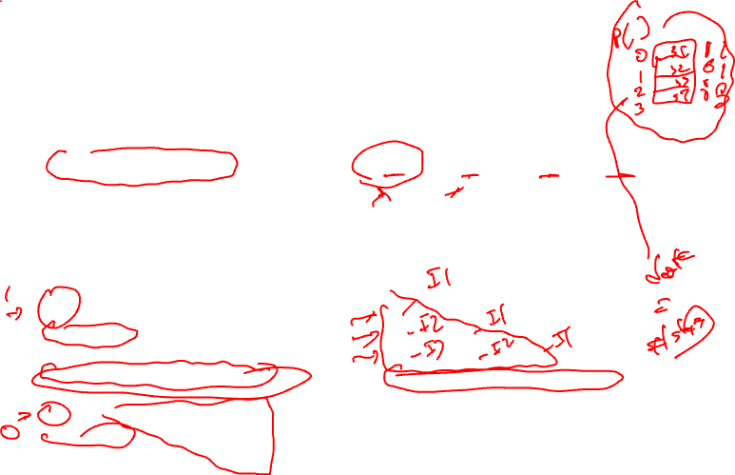
Kernel-only Code Using Rotating Predicates
A0
A1 B0
A2 B1 C0
A B C D
Bn Cn-1 Dn-2
Cn Dn-1
Dn
A if P[0] B if P[1] C if P[2] D if P[3]
P referred to as the staging predicate
P[0] P[1] P[2] P[3]
1 0 0 0
1 1 0 0
1 1 1 0
1 1 1 1
…
0 1 1 1
0 0 1 1
0 0 0 1
A - - -
A B - -
A B C -
A B C D
…
- B C D
- - C D
- - - D

Slide 14
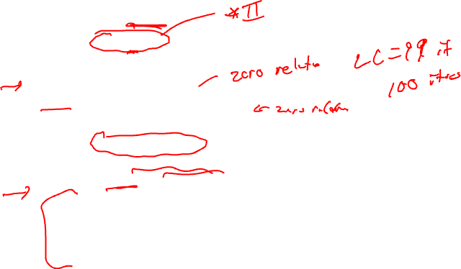
Modulo Scheduling Architectural Support
Loop requiring N iterations
  Will take N + (S – 1) where S is the number of stages
2 special registers created
  LC: loop counter (holds N)
  ESC: epilog stage counter (holds S)
Software pipeline branch operations
  Initialize LC = N, ESC = S in loop preheader
  All rotating predicates are cleared
  SWP-BR (BRLC)
    While LC > 0, decrement LC and RRB, P[0] = 1, branch to top of loop
      This occurs for prolog and kernel
    If LC = 0, then while ESC > 0, decrement RRB and write a 0 into P[0], and branch to the top of the loop
      This occurs for the epilog

Slide 15
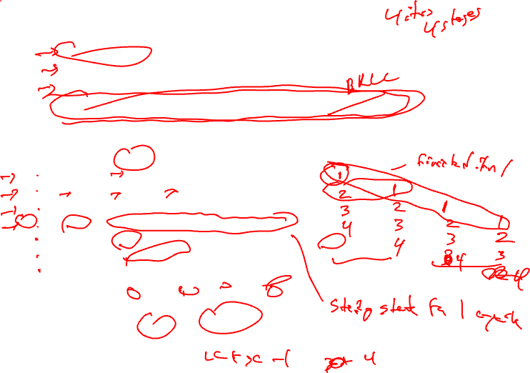
Execution History With LC/ESC
LC = 3, ESC = 3 /* Remember 0 relative!! */
Clear all rotating predicates
P[0] = 1
A if P[0]; B if P[1]; C if P[2]; D if P[3]; P[0] = BRF.B.B.F;
LC ESC P[0] P[1] P[2] P[3]
3 3 1 0 0 0 A
2 3 1 1 0 0 A B
1 3 1 1 1 0 A B C
0 3 1 1 1 1 A B C D
0 2 0 1 1 1 - B C D
0 1 0 0 1 1 - - C D
0 0 0 0 0 1 - - - D
4 iterations, 4 stages, II = 1, Note 4 + 4 –1 iterations of kernel executed

Slide 16
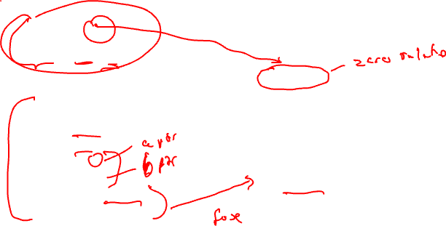
Modulo Scheduling Example
resources: 4 issue, 2 alu, 1 mem, 1 br
latencies: add=1, mpy=3, ld = 2, st = 1, br = 1
Step1: Compute to loop into
form that uses LC
for (j=0; j<100; j++)
b[j] = a[j] * 26
LC = 99
Loop:
1: r3 = load(r1)
2: r4 = r3 * 26
3: store (r2, r4)
4: r1 = r1 + 4
5: r2 = r2 + 4
6: p1 = cmpp (r1 < r9)
7: brct p1 Loop
Loop:
1: r3 = load(r1)
2: r4 = r3 * 26
3: store (r2, r4)
4: r1 = r1 + 4
5: r2 = r2 + 4
7: brlc Loop

Slide 17
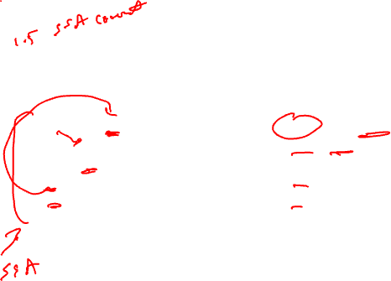
Example – Step 2
resources: 4 issue, 2 alu, 1 mem, 1 br
latencies: add=1, mpy=3, ld = 2, st = 1, br = 1
Step 2: DSA convert
LC = 99
LC = 99
Loop:
1: r3 = load(r1)
2: r4 = r3 * 26
3: store (r2, r4)
4: r1 = r1 + 4
5: r2 = r2 + 4
7: brlc Loop
Loop:
1: r3[-1] = load(r1[0])
2: r4[-1] = r3[-1] * 26
3: store (r2[0], r4[-1])
4: r1[-1] = r1[0] + 4
5: r2[-1] = r2[0] + 4
remap r1, r2, r3, r4
7: brlc Loop

Slide 18
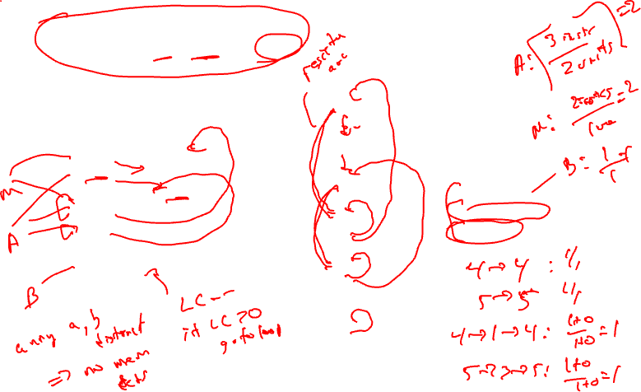
Example – Step 3
resources: 4 issue, 2 alu, 1 mem, 1 br
latencies: add=1, mpy=3, ld = 2, st = 1, br = 1
Step3: Draw dependence graph
Calculate MII
1,1
1
LC = 99
2,0
0,0
Loop:
1: r3[-1] = load(r1[0])
2: r4[-1] = r3[-1] * 26
3: store (r2[0], r4[-1])
4: r1[-1] = r1[0] + 4
5: r2[-1] = r2[0] + 4
remap r1, r2, r3, r4
7: brlc Loop
2
3,0
RecMII = 1
RESMII = 2
MII = 2
3
1,1
1,1
0,0
4
5
1,1
1,1
7

Slide 19
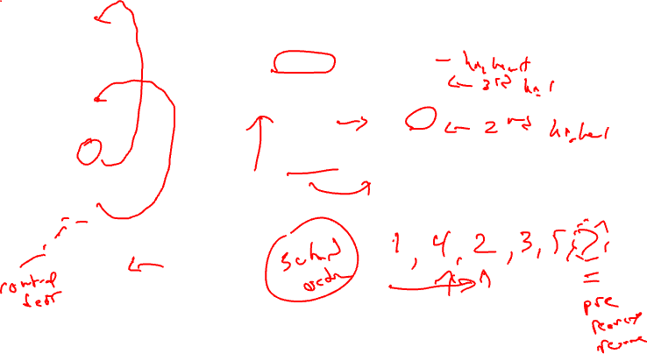
Example – Step 4
Step 4 – Calculate priorities (MAX height
to pseudo stop node)
1,1
0,0
1
0,0
2,0
Iter1
Iter2
2
1: H = 5
2: H = 3
3: H = 0
4: H = 0
5: H = 0
7: H = 0
1: H = 5
2: H = 3
3: H = 0
4: H = 4
5: H = 0
7: H = 0
0,0
3,0
0,0
3
1,1
1,1
0,0
0,0
4
5
1,1
0,0
1,1
7

Slide 20
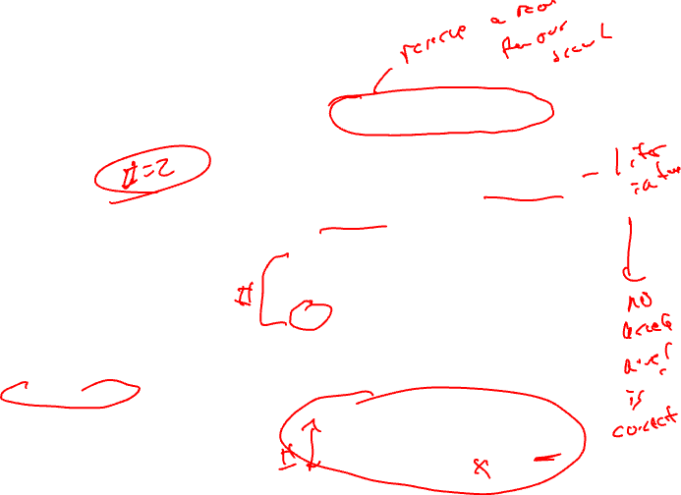
Example – Step 5
resources: 4 issue, 2 alu, 1 mem, 1 br
latencies: add=1, mpy=3, ld = 2, st = 1, br = 1
Schedule brlc at time II - 1
Unrolled
Schedule
Rolled
Schedule
LC = 99
0
1
Loop:
1: r3[-1] = load(r1[0])
2: r4[-1] = r3[-1] * 26
3: store (r2[0], r4[-1])
4: r1[-1] = r1[0] + 4
5: r2[-1] = r2[0] + 4
remap r1, r2, r3, r4
7: brlc Loop
2
0
3
1
7
4
5
6
alu0
alu1
mem
br
0
MRT
1
X

Slide 21
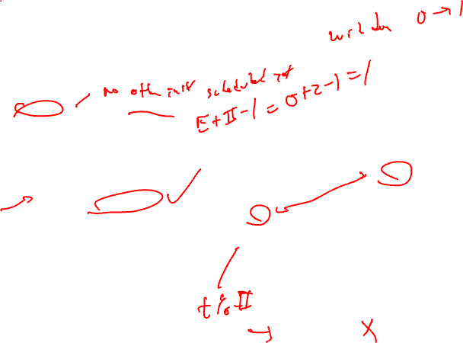
Example – Step 6
Step6: Schedule the highest priority op
Op1: E = 0, L = 1
Place at time 0 (0 % 2)
Unrolled
Schedule
Rolled
Schedule
LC = 99
0
1
Loop:
1: r3[-1] = load(r1[0])
2: r4[-1] = r3[-1] * 26
3: store (r2[0], r4[-1])
4: r1[-1] = r1[0] + 4
5: r2[-1] = r2[0] + 4
remap r1, r2, r3, r4
7: brlc Loop
1
0
1
2
3
1
7
4
5
6
alu0
alu1
mem
br
0
X
MRT
1
X

Slide 22
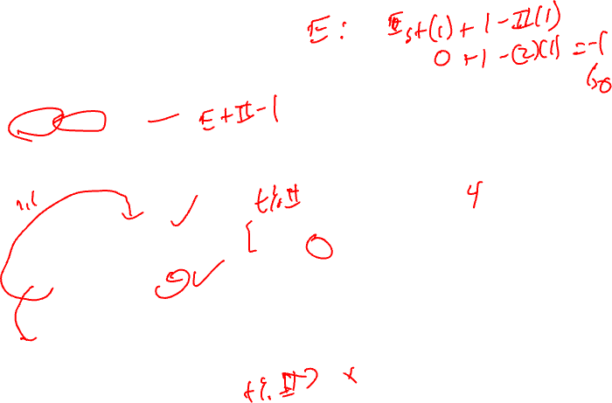
Example – Step 7
Step7: Schedule the highest priority op
Op4: E = 0, L = 1
Place at time 0 (0 % 2)
Unrolled
Schedule
Rolled
Schedule
LC = 99
0
1
4
Loop:
1: r3[-1] = load(r1[0])
2: r4[-1] = r3[-1] * 26
3: store (r2[0], r4[-1])
4: r1[-1] = r1[0] + 4
5: r2[-1] = r2[0] + 4
remap r1, r2, r3, r4
7: brlc Loop
1
0
1
4
2
3
1
7
4
5
6
alu0
alu1
mem
br
0
X
X
MRT
1
X

Slide 23
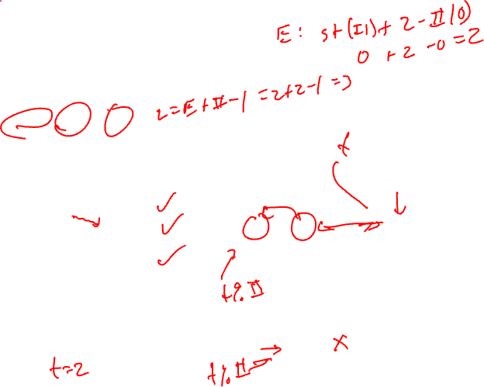
Example – Step 8
Step8: Schedule the highest priority op
Op2: E = 2, L = 3
Place at time 2 (2 % 2)
Unrolled
Schedule
Rolled
Schedule
LC = 99
0
1
4
Loop:
1: r3[-1] = load(r1[0])
2: r4[-1] = r3[-1] * 26
3: store (r2[0], r4[-1])
4: r1[-1] = r1[0] + 4
5: r2[-1] = r2[0] + 4
remap r1, r2, r3, r4
7: brlc Loop
1
0
1
4
2
2
2
3
1
7
4
5
6
alu0
alu1
mem
br
0
X
X
X
MRT
1
X

Slide 24
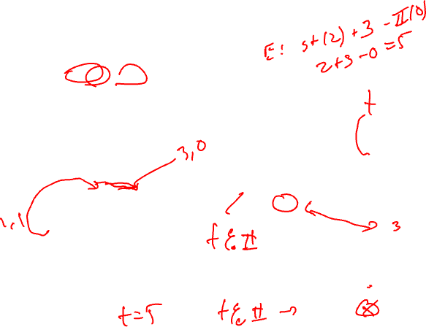
Example – Step 9
Step9: Schedule the highest priority op
Op3: E = 5, L = 6
Place at time 5 (5 % 2)
Unrolled
Schedule
Rolled
Schedule
LC = 99
0
1
4
Loop:
1: r3[-1] = load(r1[0])
2: r4[-1] = r3[-1] * 26
3: store (r2[0], r4[-1])
4: r1[-1] = r1[0] + 4
5: r2[-1] = r2[0] + 4
remap r1, r2, r3, r4
7: brlc Loop
1
0
1
2
4
2
2
3
1
7
3
4
5
3
6
alu0
alu1
mem
br
0
X
X
X
MRT
1
X
X

Slide 25
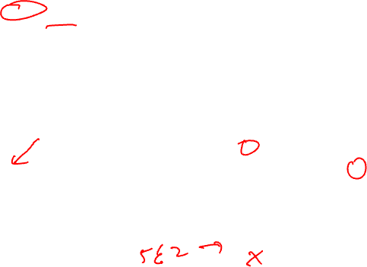
Example – Step 10
Step10: Schedule the highest priority op
Op5: E = 5, L = 6
Place at time 5 (5 % 2)
Unrolled
Schedule
Rolled
Schedule
LC = 99
0
1
4
Loop:
1: r3[-1] = load(r1[0])
2: r4[-1] = r3[-1] * 26
3: store (r2[0], r4[-1])
4: r1[-1] = r1[0] + 4
5: r2[-1] = r2[0] + 4
remap r1, r2, r3, r4
7: brlc Loop
1
0
1
2
4
2
2
3
1
7
3
5
4
5
3
5
6
alu0
alu1
mem
br
0
X
X
X
MRT
1
X
X
X

Slide 26
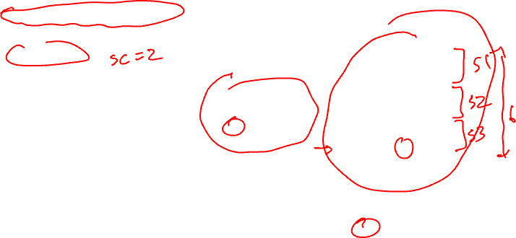
Example – Step 11
Step11: calculate ESC, SC = ceiling(max unrolled sched length / ii)
unrolled sched time of branch = rolled sched time of br + (ii*esc)
SC = 6 / 2 = 3, ESC = SC – 1
time of br = 1 + 2*2 = 5
Unrolled
Schedule
Rolled
Schedule
LC = 99
0
1
4
Loop:
1: r3[-1] = load(r1[0])
2: r4[-1] = r3[-1] * 26
3: store (r2[0], r4[-1])
4: r1[-1] = r1[0] + 4
5: r2[-1] = r2[0] + 4
remap r1, r2, r3, r4
7: brlc Loop
1
0
1
2
4
2
2
3
1
7
3
5
4
5
3
5
7
6
alu0
alu1
mem
br
0
X
X
X
MRT
1
X
X
X

Slide 27
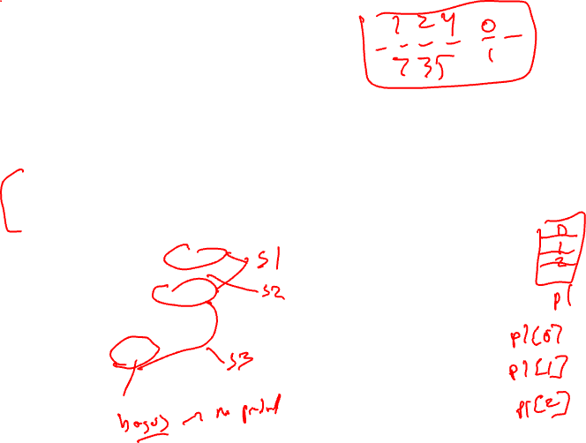
Example – Step 12
Finishing touches - Sort ops, initialize ESC, insert BRF and staging predicate,
initialize staging predicate outside loop
Staging predicate, each
successive stage increment
the index of the staging predicate
by 1, stage 1 gets px[0]
LC = 99
ESC = 2
p1[0] = 1
Loop:
1: r3[-1] = load(r1[0]) if p1[0]
2: r4[-1] = r3[-1] * 26 if p1[1]
4: r1[-1] = r1[0] + 4 if p1[0]
3: store (r2[0], r4[-1]) if p1[2]
5: r2[-1] = r2[0] + 4 if p1[2]
7: brlc Loop if p1[2]
Unrolled
Schedule
0
1
4
Stage 1
1
2
2
Stage 2
3
4
Stage 3
5
3
5
7
6

Slide 28
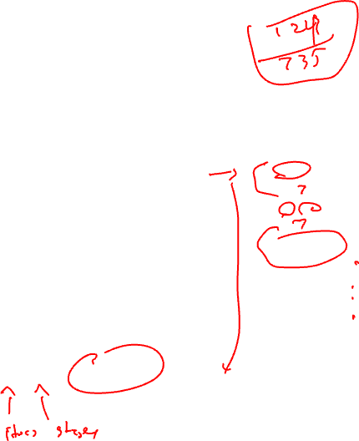
Example – Dynamic Execution of the Code
LC = 99
ESC = 2
p1[0] = 1
time: ops executed
0: 1, 4
1:
2: 1,2,4
3:
4: 1,2,4
5: 3,5,7
6: 1,2,4
7: 3,5,7
…
198: 1,2,4
199: 3,5,7
200: 2
201: 3,5,7
202: -
203 3,5,7
Loop:
1: r3[-1] = load(r1[0]) if p1[0]
2: r4[-1] = r3[-1] * 26 if p1[1]
4: r1[-1] = r1[0] + 4 if p1[0]
3: store (r2[0], r4[-1]) if p1[2]
5: r2[-1] = r2[0] + 4 if p1[2]
7: brlc Loop if p1[2]
Total time = II(num_iteration + num_stages – 1)
= 2(100 + 3 – 1) = 204 cycles

Slide 29

Homework Problem
latencies: add=1, mpy=3, ld = 2, st = 1, br = 1
How many resources of each type are
required to achieve an II=1 schedule?
If the resources are non-pipelined,
how many resources of each type are
required to achieve II=1
Assuming pipelined resources, generate
the II=1 modulo schedule.
for (j=0; j<100; j++)
b[j] = a[j] * 26
LC = 99
Loop:
1: r3 = load(r1)
2: r4 = r3 * 26
3: store (r2, r4)
4: r1 = r1 + 4
5: r2 = r2 + 4
7: brlc Loop

Slide 30
Homework Problem – Answers in Red
latencies: add=1, mpy=3, ld = 2, st = 1, br = 1
How many resources of each type are
required to achieve an II=1 schedule?
For II=1, each operation needs a dedicated resource,
so: 3 ALU, 2 MEM, 1 BR
If the resources are non-pipelined,
how many resources of each type are
required to achieve II=1
Instead of 1 ALU to do the multiplies, 3 are needed,
and instead of 1 MEM to do the loads, 2 are needed.
Hence: 5 ALU, 3 MEM, 1 BR
Assuming pipelined resources, generate
the II=1 modulo schedule.
See next few slides
for (j=0; j<100; j++)
b[j] = a[j] * 26
LC = 99
Loop:
1: r3 = load(r1)
2: r4 = r3 * 26
3: store (r2, r4)
4: r1 = r1 + 4
5: r2 = r2 + 4
7: brlc Loop

Slide 31
Problem continued
Assume II=1 so resources are: 3 ALU, 2 MEM, 1 BR
Dependence graph (same as example in class)
DSA converted code below (same
as example in class)
1,1
1
RecMII = 1
RESMII = 1
MII = MAX(1,1) = 1
LC = 99
2,0
0,0
Loop:
1: r3[-1] = load(r1[0])
2: r4[-1] = r3[-1] * 26
3: store (r2[0], r4[-1])
4: r1[-1] = r1[0] + 4
5: r2[-1] = r2[0] + 4
remap r1, r2, r3, r4
7: brlc Loop
2
3,0
3
Priorities
1: H = 5
2: H = 3
3: H = 0
4: H = 4
5: H = 0
7: H = 0
1,1
1,1
0,0
4
5
1,1
1,1
7

Slide 32
Problem continued
resources: 3 alu, 2 mem, 1 br
latencies: add=1, mpy=3, ld = 2, st = 1, br = 1
LC = 99
Unrolled
Schedule
Loop:
1: r3[-1] = load(r1[0])
2: r4[-1] = r3[-1] * 26
3: store (r2[0], r4[-1])
4: r1[-1] = r1[0] + 4
5: r2[-1] = r2[0] + 4
remap r1, r2, r3, r4
7: brlc Loop
Rolled
Schedule
0
1
4
stage 1
0
7
1
4
2
3
5
1
stage 2
2
2
stage 3
3
stage 4
4
stage 5
5
3
5
7
stage 6
Scheduling steps:
Schedule brlc at time II-1
Schedule op1 at time 0
Schedule op4 at time 0
Schedule op2 at time 2
Schedule op3 at time 5
Schedule op5 at time 5
Schedule op7 at time 5
6
alu0
alu1
alu2
m1
m2
br
0
X
X
X
X
X
X
MRT

Slide 33
Problem continued
The final loop consists of a single MultiOp containing 6 operations,
each predicated on the appropriate staging predicate. Note register allocation
still needs to be performed.
LC = 99
Loop:
r3[-1] = load(r1[0]) if p1[0]; r4[-1] = r3[-1] * 26 if p1[2]; store (r2[0], r4[-1]) if p1[5]; r1[-1] = r1[0] + 4 if p1[0]; r2[-1] = r2[0] + 4 if p1[5]; brlc Loop

Slide 34
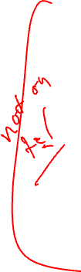
What if We Don’t Have Hardware Support for Modulo Scheduling?
No predicates
  Predicates enable kernel-only code by selectively enabling/disabling operations to create prolog/epilog
  Now must create explicit prolog/epilog code segments
No rotating registers
  Register names not automatically changed each iteration
  Must unroll the body of the software pipeline, explicitly rename
    Consider each register lifetime i in the loop
    Kmin = min unroll factor = MAXi (ceiling((Endi – Starti) / II))
    Create Kmin static names to handle maximum register lifetime
  Apply modulo variable expansion

