Slide 1

EECS 583 – Class 11
Instruction Scheduling
University of Michigan
October 6, 2021

Slide 2
Announcements & Reading Material
Next lecture, Monday Oct 11, will be only on Zoom at the usual time
HW 2 – Due Friday at midnight!
  Talk to Ze & Yunjie for last minute help
Project discussion meetings
  No class Oct 18 (Fall Break), 20, 25
  Each group meets 10 mins with Yunjie/Ze and I, signup next week for timeslot
  Action item
    Need to identify group members
    Use piazza to recruit additional group members or express your availability
    Think about project areas that you want to work on
Today’s class
  “The Importance of Prepass Code Scheduling for Superscalar and Superpipelined Processors,” P. Chang et al., IEEE Transactions on Computers, 1995, pp. 353-370.
Next class
  “Iterative Modulo Scheduling: An Algorithm for Software Pipelining Loops”, B. Rau, MICRO-27, 1994, pp. 63-74.

Slide 3
From Last Time: Data Dependences + Latencies
Data dependences
  If 2 operations access the same register, they are dependent
  However, only keep dependences to most recent producer/consumer as other edges are redundant
  Types of data dependences
Flow
Output
Anti
r1 = r2 + r3
r4 = r1 * 6
r1 = r2 + r3
r1 = r4 * 6
r1 = r2 + r3
r2 = r5 * 6
Latency of
producer
1
0

Slide 4
From Last Time: More Dependences + Latencies
Memory dependences
  Similar as register, but through memory
  Memory dependences may be certain or maybe
Control dependences
  Branch determines whether an operation is executed or not
  Operation must execute after/before a branch
Control
Mem-flow
Mem-output
Mem-anti
r3 = r4 + r5
if (r1 != 0)
r2 = load(r1)
0
store (r1, r2)
r3 = load(r1)
store (r1, r2)
store (r1, r3)
r2 = load(r1)
store (r1, r3)
1
1
1
1

Slide 5
Class Problem From Last Time: Answer
1. Draw dependence graph
2. Label edges with type and
latencies
machine model
latencies
add: 1
mpy: 3
load: 2
store: 1
Store format (addr, data)
rf, 2
1
ra, 0
2
1. r1 = load(r2)
2. r2 = r2 + 1
3. store (r8, r2)
4. r3 = load(r2)
5. r4 = r1 * r3
6. r5 = r5 + r4
7. r2 = r6 + 4
8. store (r2, r5)
rf, 1
ro, 1
3
rf, 1
ra, 0
ra, 0
4
ra, 0
rf, 2
5
rf, 3
6
rf, 1
7
rf, 1
8
Memory deps all with latency =1: 1→3 (ma), 1→8 (ma),
3→4 (mf), 3→8 (mo), 4→8 (ma)
No control dependences

Slide 6
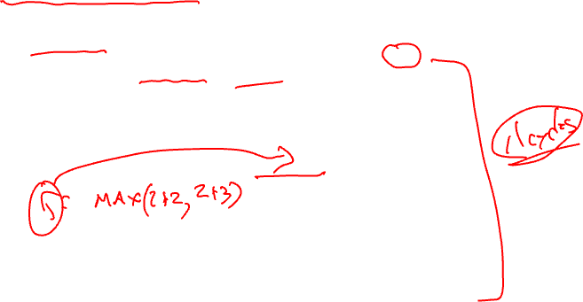
Dependence Graph Properties - Estart
Estart = earliest start time, (as soon as possible - ASAP)
  Schedule length with infinite resources (dependence height)
  Estart = 0 if node has no predecessors
  Estart = MAX(Estart(pred) + latency)
  for each predecessor node
  Example
0
1
1
2
1
2
3
2
3
3
2
2
5
4
5
4
3
1
6
8
2
1
10
7
8
9
0
0
Exit
10

Slide 7
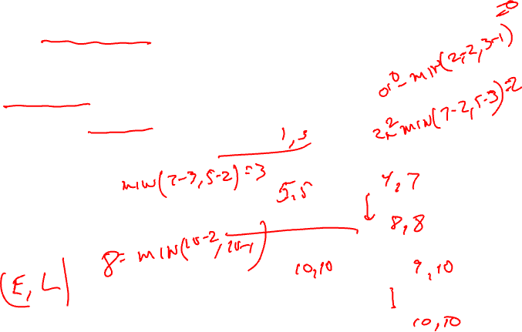
Lstart
Lstart = latest start time, ALAP
  Latest time a node can be scheduled s.t. sched length not increased beyond infinite resource schedule length
  Lstart = Estart if node has no successors
  Lstart = MIN(Lstart(succ) - latency)
  for each successor node
  Example
1
1
2
2
3
2
3
3
2
4
5
3
1
6
2
1
7
8
0
0
Exit

Slide 8
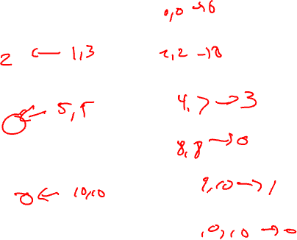
Slack
Slack = measure of the scheduling freedom
  Slack = Lstart – Estart for each node
  Larger slack means more mobility
  Example
1
1
2
2
3
2
3
3
2
4
5
3
1
6
2
1
7
8
0
0
Exit

Slide 9
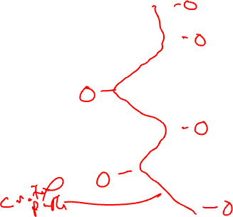
Critical Path
Critical operations = Operations with slack = 0
  No mobility, cannot be delayed without extending the schedule length of the block
  Critical path = sequence of critical
  operations from node with no
  predecessors to exit node, can
  be multiple crit paths
1
1
2
2
3
2
3
3
2
4
5
3
1
6
2
1
7
8
0
0
Exit

Slide 10
Homework Problem
Node Estart Lstart Slack
1
2
3
4
5
6
7
8
9
1
1
2
2
1
3
2
4
3
1
1
2
6
5
1
3
7
1
8
2
9
1
Critical path(s) =

Slide 11
Homework Problem - Answer
Node Estart Lstart Slack
1 0 0 0
2 1 2 2
3 2 2 0
4 0 3 3
5 4 5 1
6 4 4 0
7 5 6 1
8 7 7 0
9 8 8 0
1
1
2
2
1
3
2
4
3
1
1
2
6
5
1
3
7
1
8
2
9
1
Critical path(s) = 1,3,6,8,9

Slide 12
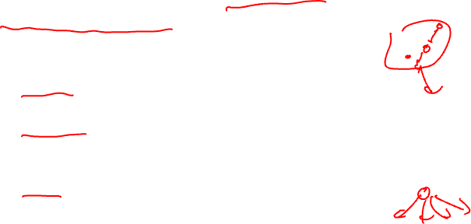
Operation Priority
Priority – Need a mechanism to decide which ops to schedule first (when you have multiple choices)
Common priority functions
  Height – Distance from exit node
    Give priority to amount of work left to do
  Slackness – inversely proportional to slack
    Give priority to ops on the critical path
  Register use – priority to nodes with more source operands and fewer destination operands
    Reduces number of live registers
  Uncover – high priority to nodes with many children
    Frees up more nodes
  Original order – when all else fails

Slide 13
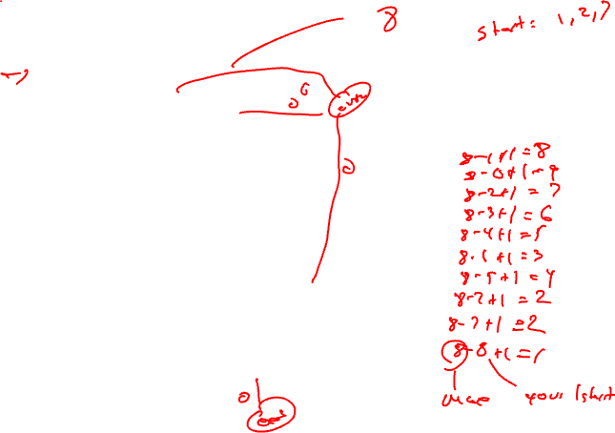
Height-Based Priority
Height-based is the most common
  priority(op) = MaxLstart – Lstart(op) + 1
0, 1
1
0, 0
1
2
2
2
op priority
1
2
3
4
5
6
7
8
9
10
2, 2
3
4
2, 3
2
1
5
4, 4
2
2
2
6
6, 6
1
2
7
0, 5
4, 7
8
9
7, 7
1
1
10
8, 8

Slide 14
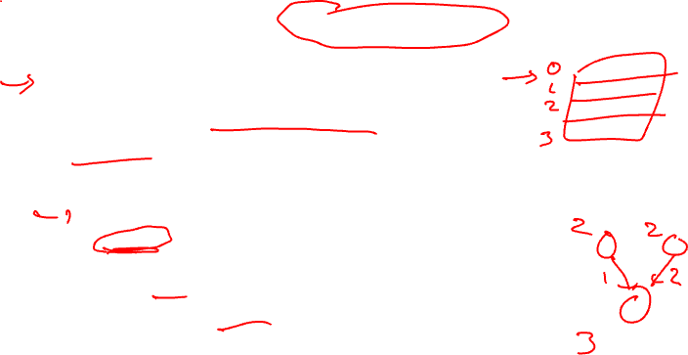
List Scheduling (aka Cycle Scheduler)
Build dependence graph, calculate priority
Add all ops to UNSCHEDULED set
time = -1
while (UNSCHEDULED is not empty)
  time++
  READY = UNSCHEDULED ops whose incoming dependences have been satisfied
  Sort READY using priority function
  For each op in READY (highest to lowest priority)
    op can be scheduled at current time? (are the resources free?)
      Yes, schedule it, op.issue_time = time
        Mark resources busy in RU_map relative to issue time
        Remove op from UNSCHEDULED/READY sets
      No, continue

Slide 15
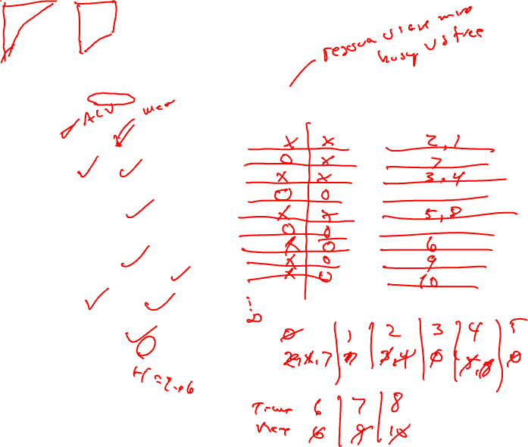
Cycle Scheduling Example
Processor: 2 issue, 1 memory port, 1 ALU
Memory port = 2 cycles, pipelined
ALU = 1 cycle
RU_map
Schedule
0, 1
1
0, 0
time ALU MEM
0
1
2
3
4
5
6
7
8
9
time Instructions
0
1
2
3
4
5
6
7
8
9
1
2
2m
2
2, 2
3m
4
2, 3
2
1
5m
4, 4
op priority
1 8
2 9
3 7
4 6
5 5
6 3
7 4
8 2
9 2
10 1
2
2
2
6
6, 6
1
2
7m
0, 5
4, 7
8
9
7, 7
1
1
10
8, 8
Time =
Ready =

Slide 16
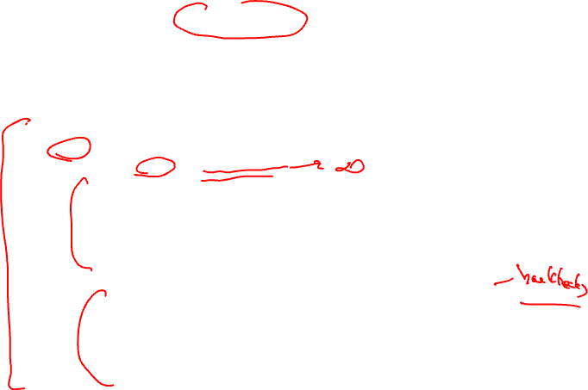
List Scheduling (Operation Scheduler)
Build dependence graph, calculate priority
Add all ops to UNSCHEDULED set
while (UNSCHEDULED not empty)
  op = operation in UNSCHEDULED with highest priority
  For time = estart to some deadline
    Op can be scheduled at current time? (are resources free?)
      Yes, schedule it, op.issue_time = time
        Mark resources busy in RU_map relative to issue time
        Remove op from UNSCHEDULED
      No, continue
  Deadline reached w/o scheduling op? (could not be scheduled)
      Yes, unplace all conflicting ops at op.estart, add them to UNSCHEDULED
      Schedule op at estart
        Mark resources busy in RU_map relative to issue time
        Remove op from UNSCHEDULED

Slide 17
Homework Problem – Operation Scheduling
Processor: 2 issue, 1 memory port, 1 ALU
Memory port = 2 cycles, pipelined
ALU = 1 cycle
RU_map
Schedule
time ALU MEM
0
1
2
3
4
5
6
7
8
9
time Instructions
0
1
2
3
4
5
6
7
8
9
0,1
1m
2m
0,0
2
2
2,3
3
4m
2,2
1
1
2
3,5
5
6
3,4
7
4,4
1
1
1
5,5
8
9m
0,4
1
6,6
2
10
Time =
Ready =
Calculate height-based priorities
2. Schedule using Operation scheduler

Slide 18
Homework Problem – Answer
Processor: 2 issue, 1 memory port, 1 ALU
Memory port = 2 cycles, pipelined
ALU = 1 cycle
Op priority
1 6
2 7
3 4
4 5
5 2
6 3
7 3
8 2
9 3
10 1
0,1
1m
2m
0,0
2
2
2,3
3
4m
2,2
RU_map
Schedule
1
1
2
time ALU MEM
0 X
1 X
2 X
3 X X
4 X
5 X
6 X
7 X
8 X
Time Instructions
0 2
1 1
2 4
3 3, 9
4 6
5 7
6 5
7 8
8 10
3,5
5
6
3,4
7
4,4
1
1
1
5,5
8
9m
0,4
1
6,6
2
10
Calculate height-based priorities
2. Schedule using Operation scheduler

Slide 19
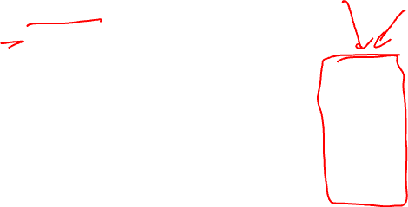
Generalize Beyond a Basic Block
Superblock
  Single entry
  Multiple exits (side exits)
  No side entries
Schedule just like a BB
  Priority calculations needs change
  Dealing with control deps

Slide 20
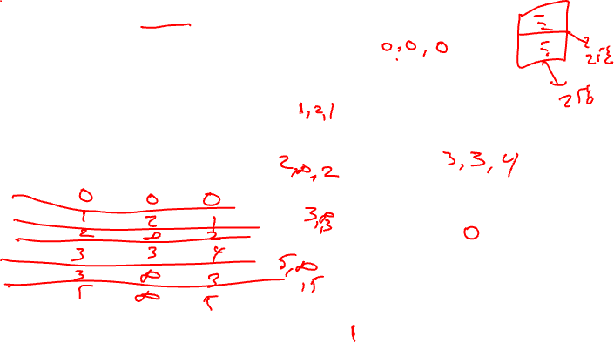
Lstart in a Superblock
Not a single Lstart any more
  1 per exit branch (Lstart is a vector!)
  Exit branches have probabilities
1
1
2
3
1
1
op Estart Lstart0 Lstart1
1
2
3
4
5
6
3
4
1
1
5
Exit0 (25%)
2
6
Exit1 (75%)

Slide 21
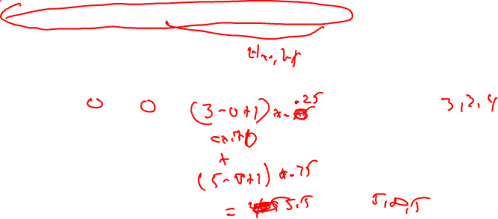
Operation Priority in a Superblock
Priority – Dependence height and speculative yield
  Height from op to exit * probability of exit
  Sum up across all exits in the superblock
Priority(op) = SUM(Probi * (MAX_Lstart – Lstarti(op) + 1))
valid late times for op
1
1
2
3
op Lstart0 Lstart1 Priority
1
2
3
4
5
6
1
1
3
4
1
1
5
Exit0 (25%)
2
6
Exit1 (75%)

Slide 22
Dependences in a Superblock
Superblock
1
* Data dependences
shown, all are reg flow
except 1→ 6 is reg anti
* Dependences define
precedence ordering of
operations to ensure
correct execution
semantics
* What about control
dependences?
* Control dependences
define precedence of
ops with respect to
branches
1: r1 = r2 + r3
2: r4 = load(r1)
3: p1 = cmpp(r3 == 0)
4: branch p1 Exit1
5: store (r4, -1)
6: r2 = r2 – 4
7: r5 = load(r2)
8: p2 = cmpp(r5 > 9)
9: branch p2 Exit2
2
3
4
5
6
7
Note: Control flow in red bold
8
9

Slide 23
Conservative Approach to Control Dependences
Superblock
* Make branches
barriers, nothing
moves above or below
branches
* Schedule each BB in
SB separately
* Sequential schedules
* Whole purpose of a
superblock is lost
* Need a better solution!
1
1: r1 = r2 + r3
2: r4 = load(r1)
3: p1 = cmpp(r3 == 0)
4: branch p1 Exit1
5: store (r4, -1)
6: r2 = r2 – 4
7: r5 = load(r2)
8: p2 = cmpp(r5 > 9)
9: branch p2 Exit2
2
3
4
5
6
7
Note: Control flow in red bold
8
9

Slide 24
Upward Code Motion Across Branches
Restriction 1a (register op)
  The destination of op is not in liveout(br)
  Wrongly kill a live value
Restriction 1b (memory op)
  Op does not modify the memory
  Actually live memory is what matters, but that is often too hard to determine
Restriction 2
  Op must not cause an exception that may terminate the program execution when br is taken
  Op is executed more often than it is supposed to (speculated)
  Page fault or cache miss are ok
Insert control dep when either restriction is violated
…
if (x > 0)
y = z / x
…
control flow graph
1: branch x <= 0
2: y = z / x

Slide 25
Downward Code Motion Across Branches
Restriction 1 (liveness)
  If no compensation code
    Same restriction as before, destination of op is not liveout
  Else, no restrictions
    Duplicate operation along both directions of branch if destination is liveout
Restriction 2 (speculation)
  Not applicable, downward motion is not speculation
Again, insert control dep when the restrictions are violated
Part of the philosphy of superblocks is no compensation code insertion hence R1 is enforced!
…
a = b * c
if (x > 0)
else
…
control flow graph
1: a = b * c
2: branch x <= 0

Slide 26
Add Control Dependences to a Superblock
Superblock
Assumed liveout sets
1
1: r1 = r2 + r3
2: r4 = load(r1)
3: p1 = cmpp(r2 == 0)
4: branch p1 Exit1
5: store (r4, -1)
6: r2 = r2 – 4
7: r5 = load(r2)
8: p2 = cmpp(r5 > 9)
9: branch p2 Exit2
2
3
{r1}
4
5
6
{r2}
All ops
have cdep
to op 9!
7
{r5}
Notes: All branches are control
dependent on one another.
If no compensation, all ops dependent
on last branch
8
9

Slide 27
Class Problem
1
1: r1 = r7 + 4
2: branch p1 Exit1
3: store (r1, -1)
4: branch p2 Exit2
5: r2 = load(r7)
6: r3 = r2 – 4
7: branch p3 Exit3
8: r4 = r3 / r8
2
{r4}
3
{r1}
4
{r2}
5
6
{r4, r8}
7
8
Draw the dependence graph

Slide 28
Relaxing Code Motion Restrictions
Upward code motion is generally more effective
  Speculate that an op is useful (just like an out-of-order processor with branch pred)
  Start ops early, hide latency, overlap execution, more parallelism
Removing restriction 1
  For register ops – use register renaming
  Could rename memory too, but generally not worth it
Removing restriction 2
  Need hardware support (aka speculation models)
    Some ops don’t cause exceptions
    Ignore exceptions
    Delay exceptions
1: branch x <= 0
2: y = z / x
R1: y is not in liveout(1)
R2: op 2 will never cause
an exception when op1
is taken

Slide 29
Restricted Speculation Model
Most processors have 2 classes of opcodes
  Potentially exception causing
    load, store, integer divide, floating-point
  Never excepting
    Integer add, multiply, etc.
    Overflow is detected, but does not terminate program execution
Restricted model
  R2 only applies to potentially exception causing operations
  Can freely speculate all never exception ops (still limited by R1 however)
1: r1 = r2 + r3
2: r4 = load(r1)
3: p1 = cmpp(r2 == 0)
4: branch p1 Exit1
5: store (r4, -1)
6: r2 = r2 – 4
7: r5 = load(r2)
8: p2 = cmpp(r5 > 9)
9: branch p2 Exit2
1
2
{r1}
We assumed
restricted
speculation
when this
graph was
drawn.
This is why
there is no
cdep between
4 → 6 and
4→ 8
3
4
{r5}
{r2}
5
6
7
8
9

Slide 30
General Speculation Model
Remove
edge from
4 to 7
2 types of exceptions
  Program terminating (traps)
    Div by 0, illegal address
  Fixable (normal and handled at run time)
    Page fault, TLB miss
General speculation
  Processor provides non-trapping versions of all operations (div, load, etc)
  Return some bogus value (0) when error occurs
  R2 is completely ignored, only R1 limits speculation
  Speculative ops converted into non-trapping version
  Fixable exceptions handled as usual for non-trapping ops
1: r1 = r2 + r3
2: r4 = load(r1)
3: p1 = cmpp(r2 == 0)
4: branch p1 Exit1
5: store (r4, -1)
6: r2 = r2 – 4
7: r5 = load(r2)
8: p2 = cmpp(r5 > 9)
9: branch p2 Exit2
1
2
{r1}
3
4
{r2}
5
{r5}
6
7
8
9

Slide 31
Programming Implications of General Spec
Correct program
  No problem at all
  Exceptions will only result when branch is taken
  Results of excepting speculative operation(s) will not be used for anything useful (R1 guarantees this!)
Program debugging
  Non-trapping ops make this almost impossible
  Disable general speculation during program debug phase
1: branch x == 0
2: y = *x
3: z = y + 4
4: *w = z
2’: y = *x
3’: z = y + 4
1: branch x == 0
4: *w = z

Slide 32
Class Problem
1: r1 = r7 + 4
2: branch p1 Exit1
3: store (r1, -1)
4: branch p2 Exit2
5: r2 = load(r7)
6: r3 = r2 – 4
7: branch p3 Exit3
8: r4 = r3 / r8
1
{r4}
2
{r1}
3
4
{r2}
5
{r4, r8}
6
1. Starting with the graph assuming restricted
speculation, what edges can be removed if
general speculation support is provided?
2. With more renaming, what dependences could
be removed?
7
8

