Slide 1
Look-Ahead SLP
Auto-vectorization in the Presence of Commutative Operations (CGO18)
Vasileios Porpodas, Rodrigo C. O. Rocha, Luis F. W. Goes
Presented by Jian Guo, Zhaoheng Zheng, Tiancheng Jin, Zhehao Li

Slide 2
Content
Motivation: Why another vectorization?
Analysis: What are the issues of SLP?
Implementation: How to implement a better SLP?
Evaluation: Is Look-ahead SLP correct, effective and usable?

Slide 3
Auto Parallelization Overview: ILP vs VP vs SLP
Why Parallelization? Reduce trip counts, less branches, more resources
ILP: Schedule the instructions to utilize hardware pipeline parallelism
VP: Reduce loop trip counts by doing iterations together as a vector
SLP: Find parallelism in straight-line code and transform into vector operation

Slide 4
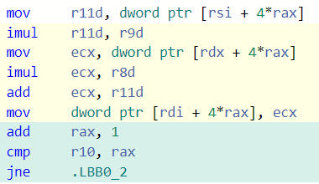
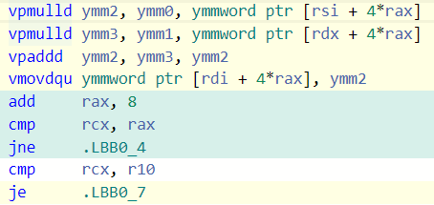
Vector Parallelization
Calculate Z = aX + bY ?
for (int i=0; i<n; i++) {
Z[i] = a*X[i] + b*Y[i];
}
for (int i=0; i<n/4; X+=4,Y+=4,Z+=4) {
Z[0] = a*X[0] + b*Y[0];
Z[1] = a*X[1] + b*Y[1];
Z[2] = a*X[2] + b*Y[2];
Z[3] = a*X[3] * b*Y[3];
}
for (int i=0; i<n; i+=4) {
Z[i..i+3] = a*X[i..i+3] + b*Y[i..i+3];
}

Slide 5
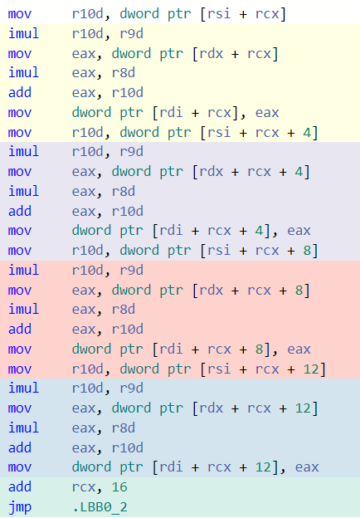
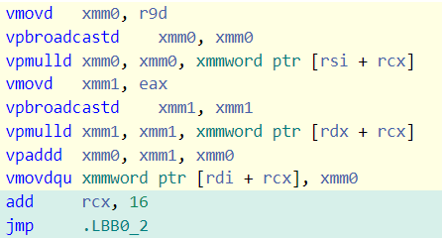
Superword Level Parallelization (SLP)
Calculate Z = aX + bY ?
Packable Sets
for (int i=0; i<n/4; X+=4,Y+=4,Z+=4) {
Z[0] = a*X[0] + b*Y[0];
Z[1] = a*X[1] + b*Y[1];
Z[2] = a*X[2] + b*Y[2];
Z[3] = a*X[3] * b*Y[3];
}
Seed
Straight-line code
for (int i=0; i<n; i+=4) {
Z[i..i+3] = a*X[i..i+3] + b*Y[i..i+3];
}

Slide 6
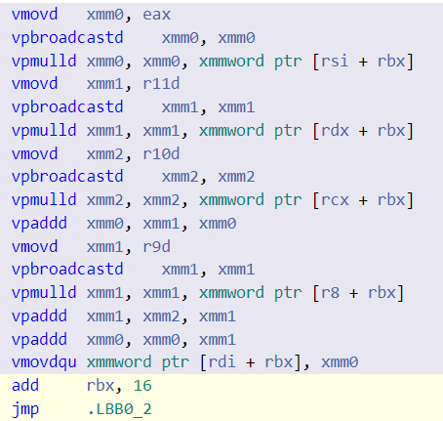
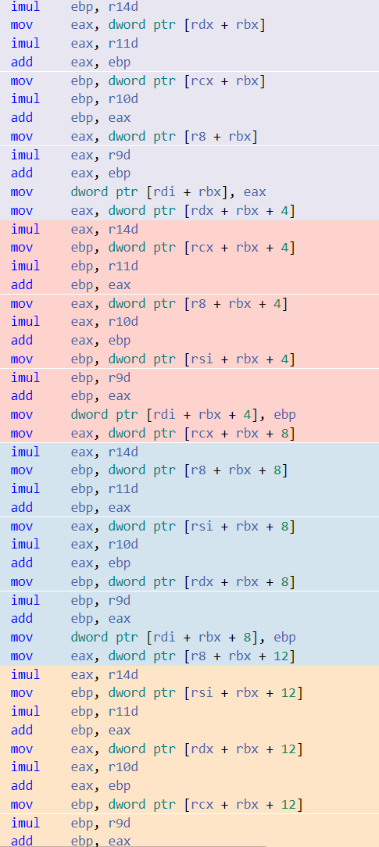
SLP Still Fails
Calculate Z = aX1 + bX2 + cX3 + dX4 ?
for (int i=0; i<n/4; Z+=4,X.+=4) {
Z[0] = a*X1[0] + b*X2[0] + c*X3[0] + d*X4[0];
Z[1] = a*X1[1] + b*X2[1] + c*X3[1] + d*X4[1];
Z[2] = a*X1[2] + b*X2[2] + c*X3[2] + d*X4[2];
Z[3] = a*X1[3] + b*X2[3] + c*X3[3] + d*X4[3];
}
Packable Sets
for (int i=0; i<n/4; Z+=4,X.+=4) {
Z[0] = a*X1[0] + b*X2[0] + c*X3[0] + d*X4[0];
Z[1] = a*X2[1] + b*X3[1] + c*X4[1] + d*X1[1];
Z[2] = a*X3[2] + b*X4[2] + c*X1[2] + d*X2[2];
Z[3] = a*X4[3] + b*X1[3] + c*X2[3] + d*X3[3];
}
Too greedy!
Need to reorder CFG
Need to look further

Slide 7
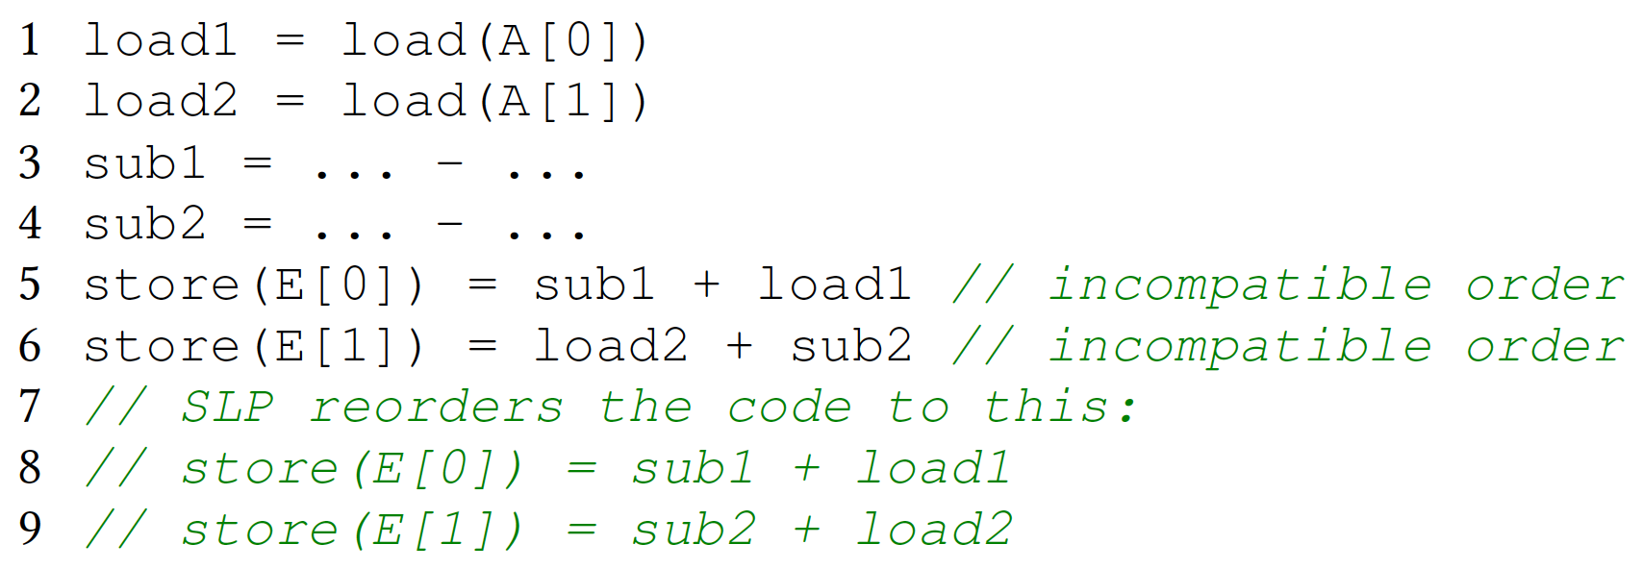
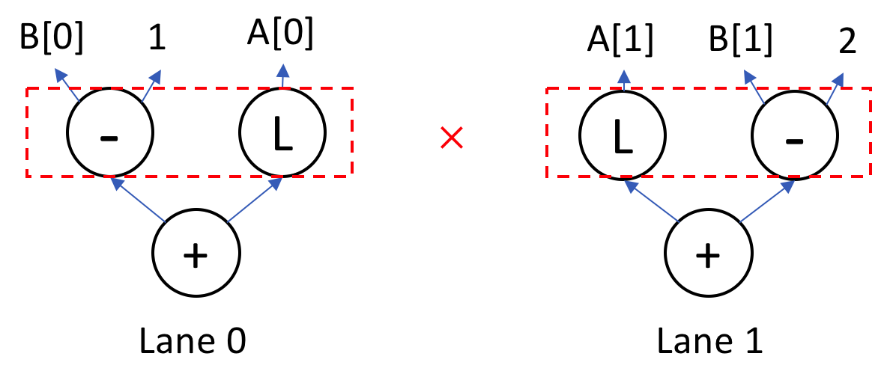
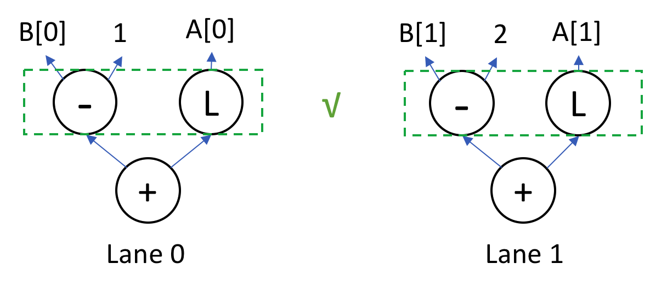
SLP Attempts to Reorder (but only 1-Step)
Commutative instructions are vectorizable,
But operands are in wrong order
Reordering enables vectorization

Slide 8
Limitations on SLP Reordering
Only one-step greedy reordering!
SLP reordering is not effective for:
Load address mismatch
Opcode mismatch
Associativity mismatch
Solved by Look-ahead SLP (LSLP)

Slide 9
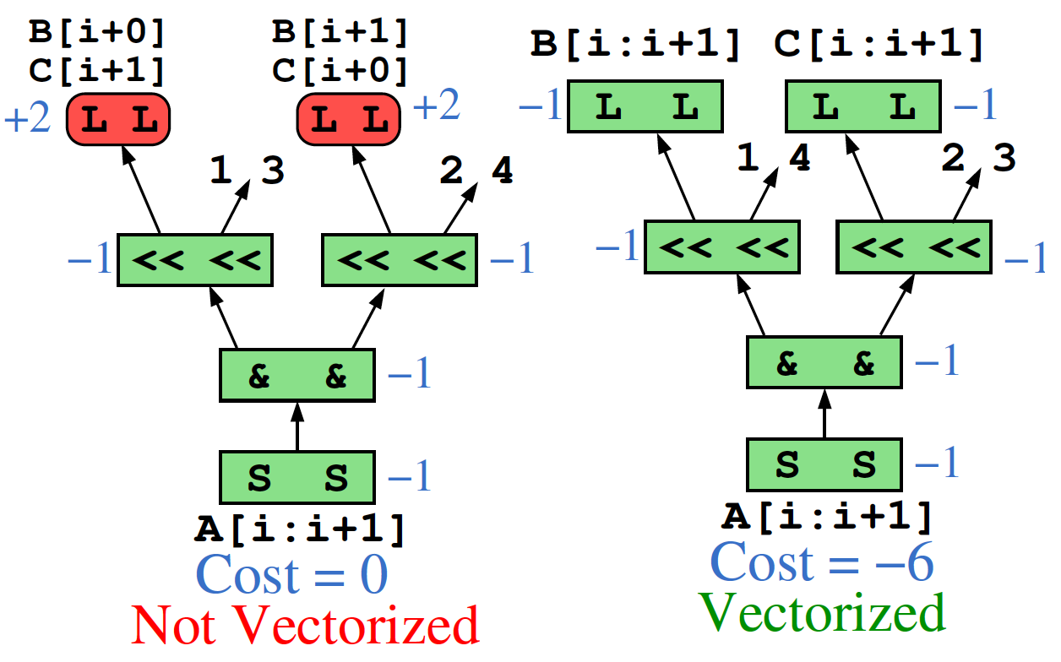
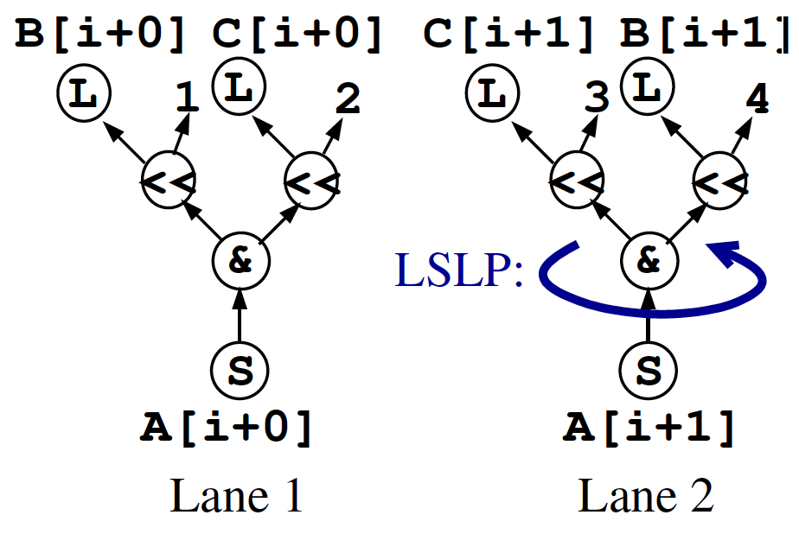
Load Address Mismatch
SLP
LSLP

Slide 10
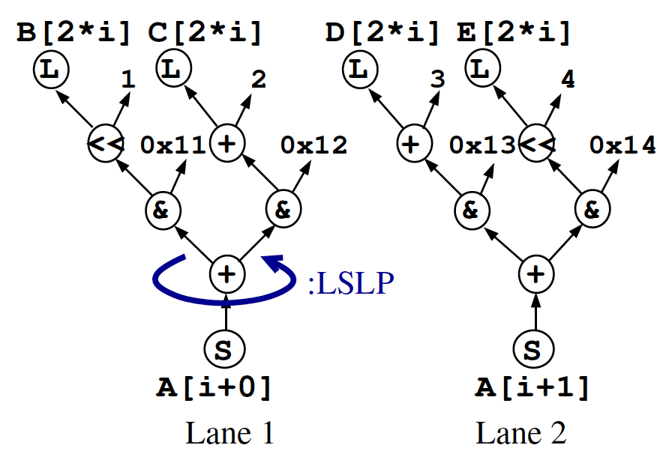
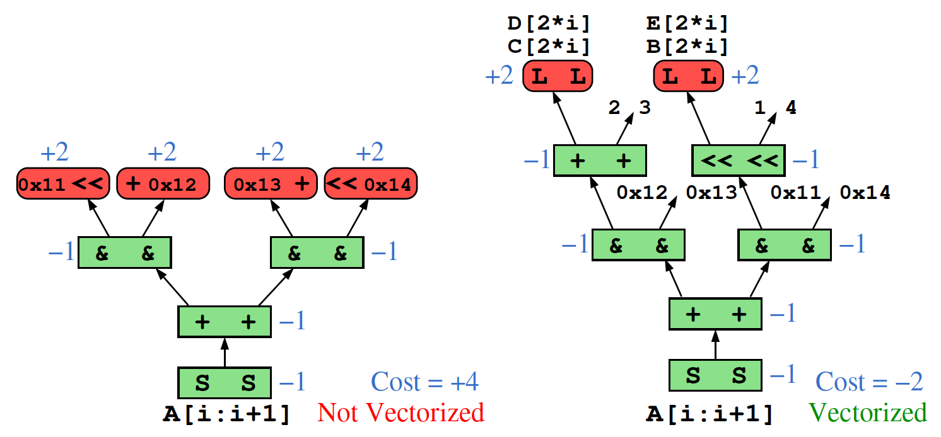
Opcode Mismatch
SLP
LSLP

Slide 11
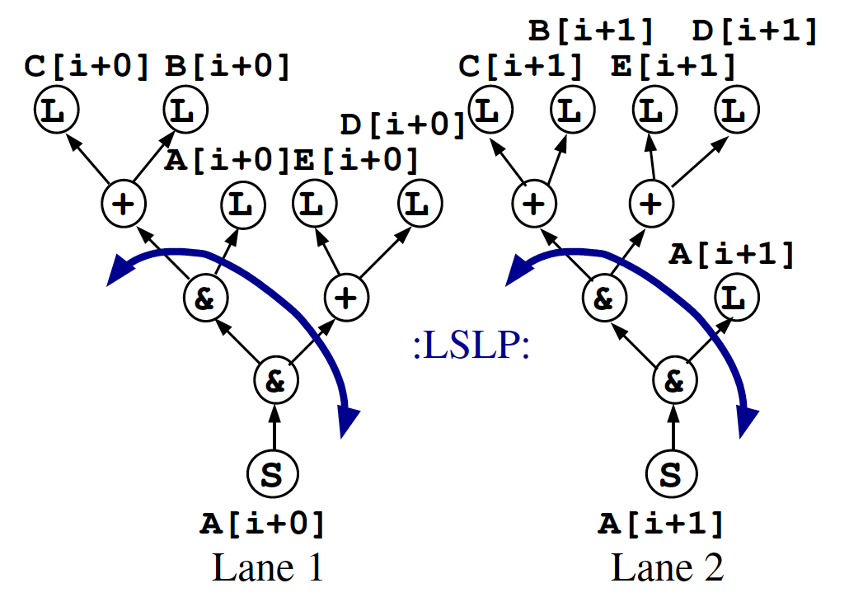
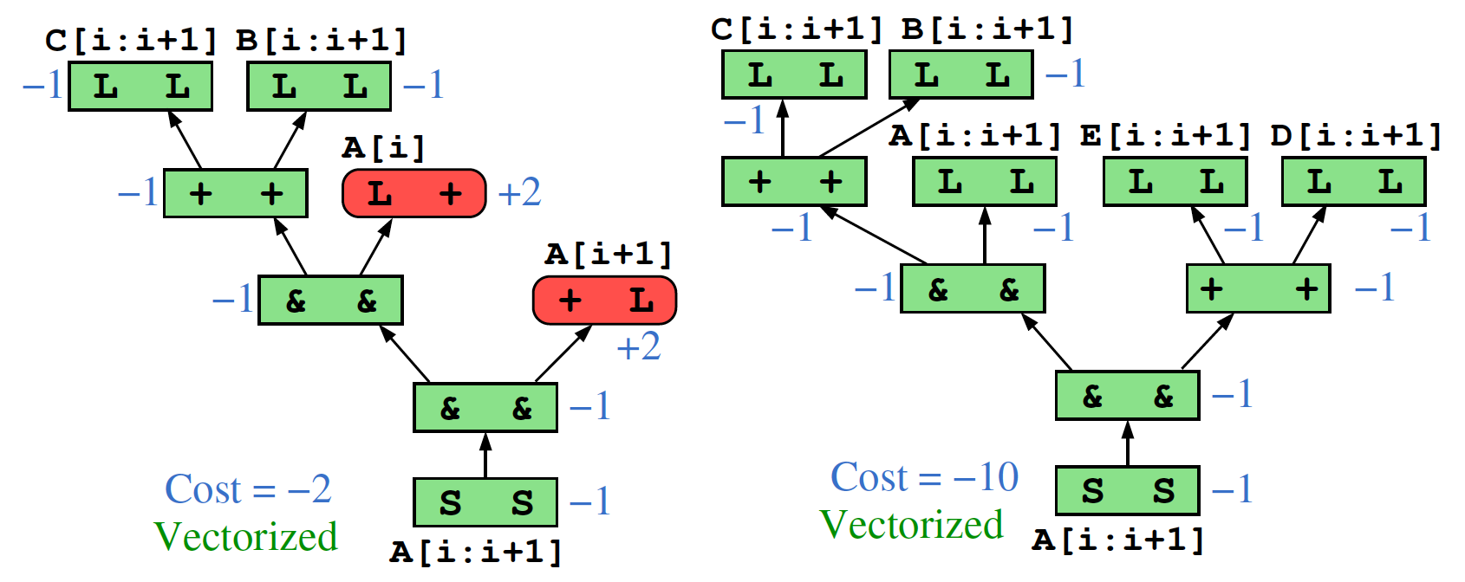
Associativity Mismatch
SLP
LSLP

Slide 12
Ideas to Implementation: SLP -> Look-Ahead SLP
Chained associativity
Group commutable operations
Form “big” multi-node
Load address/Opcode Mismatch
Prefer consecutive or matched op
Cost model for reordering
Greedy 1-step reordering
Look-further and try every choice
Calculate cost for multi levels

Slide 13
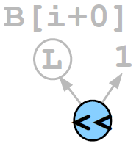
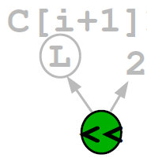
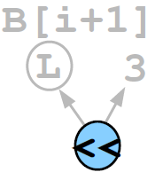
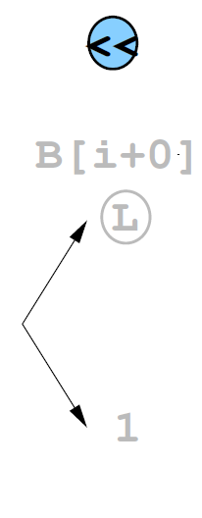
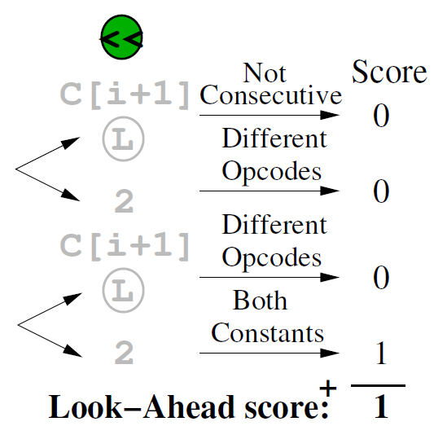
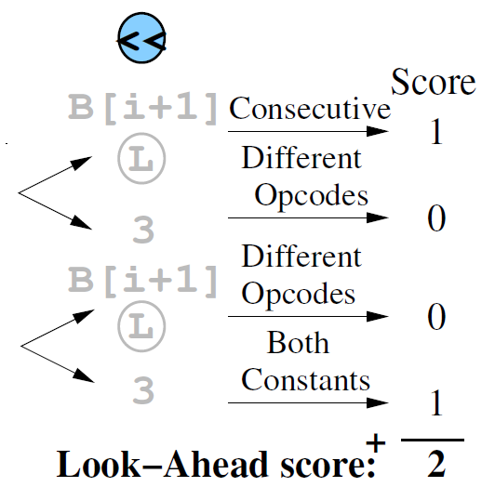
Look-Ahead Cost Model
Q: How to select an order? Match the previous order

Slide 14
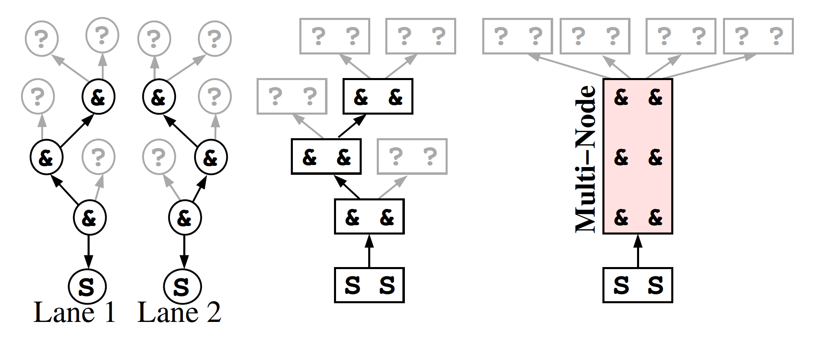
Multi-Node Formation
Coarsen adjacent nodes with same opcode as a multi-node
Enable vectorization for long chains of commutative operations
SLP
LSLP

Slide 15
Look-Ahead SLP in Action

Slide 16
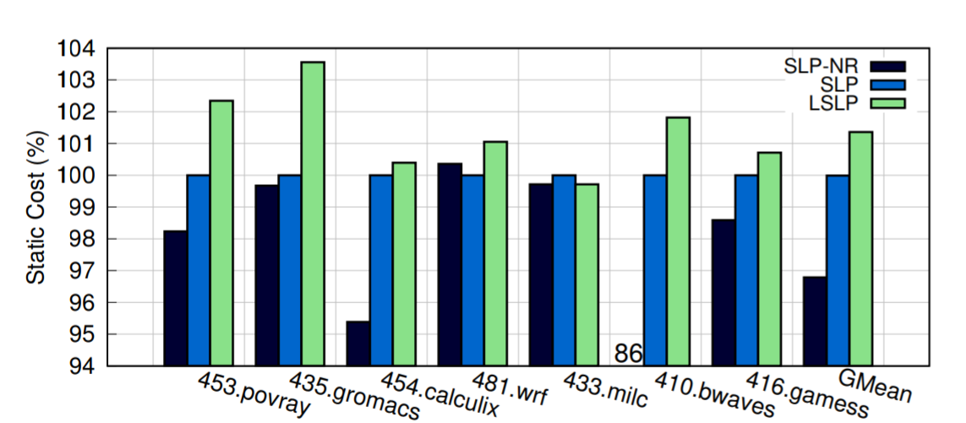
Evaluation: Static Vectorization Cost
Q: Does LSLP reduce cost?
Yes!
NR (No-Rotation): Even rotation is very useful!
LSLP: Find better packable sets, more profitable to vectorize
O3 on Skylake
SLP as baseline(100%)
SLP-NR: SLP minus rotation (1-step reorder)

Slide 17
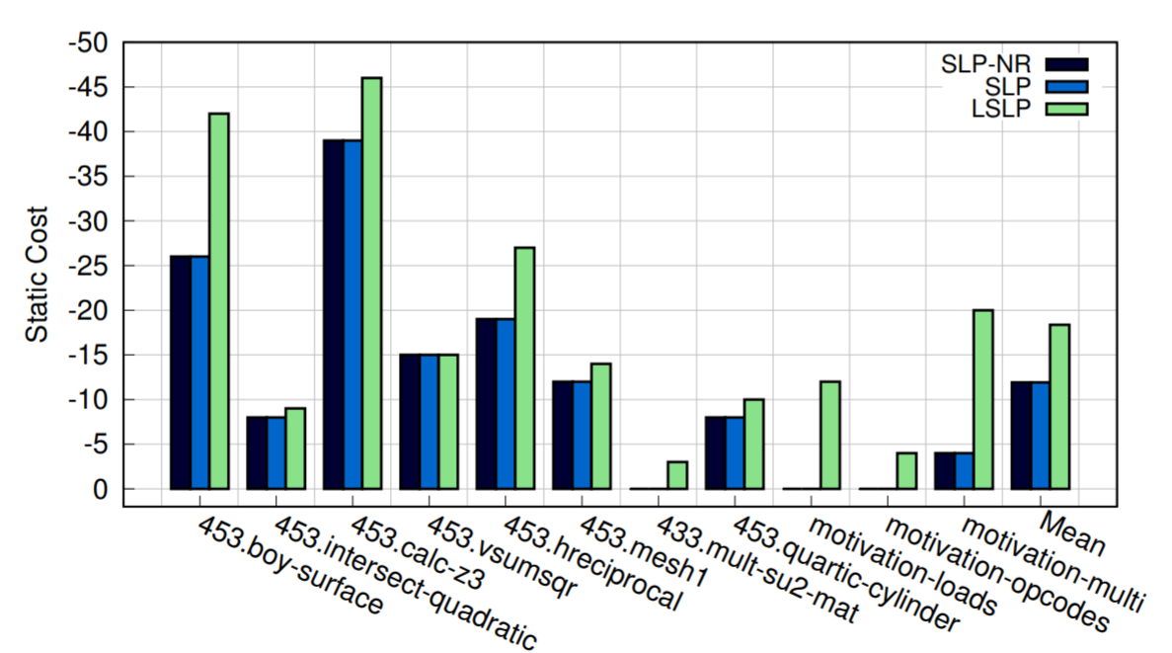
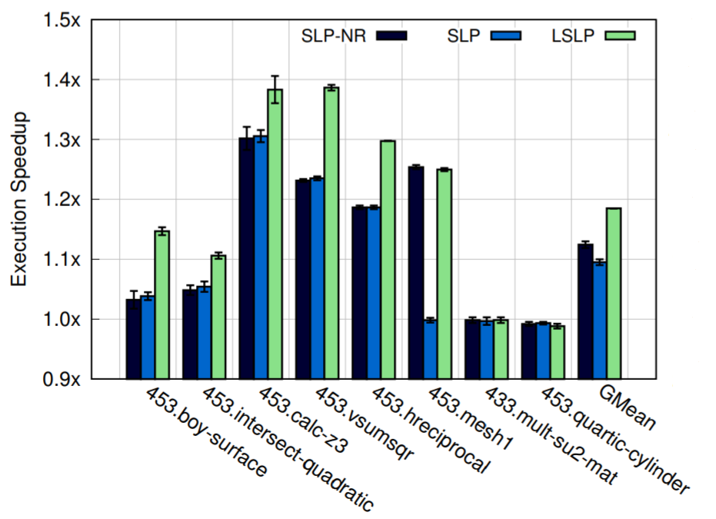
Evaluation: Select Kernels
Q: Got any faster on kernels where LSLP are triggered?
Most likely!
Not always because the hardware cost model may be inaccurate
Note the static cost is identical, but actual performance varies

Slide 18
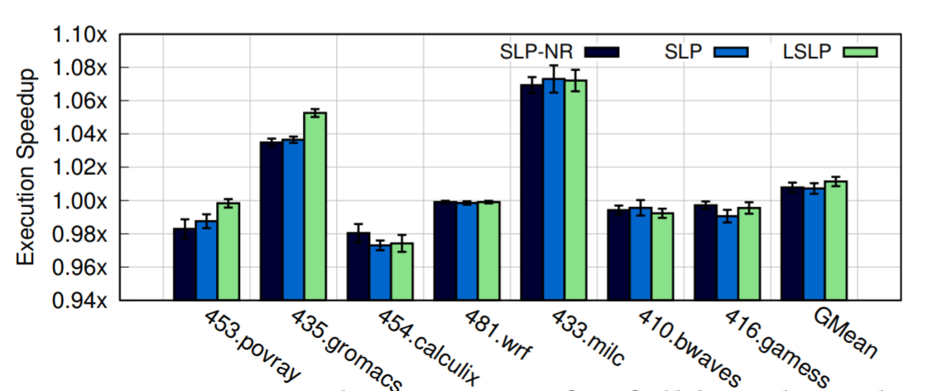
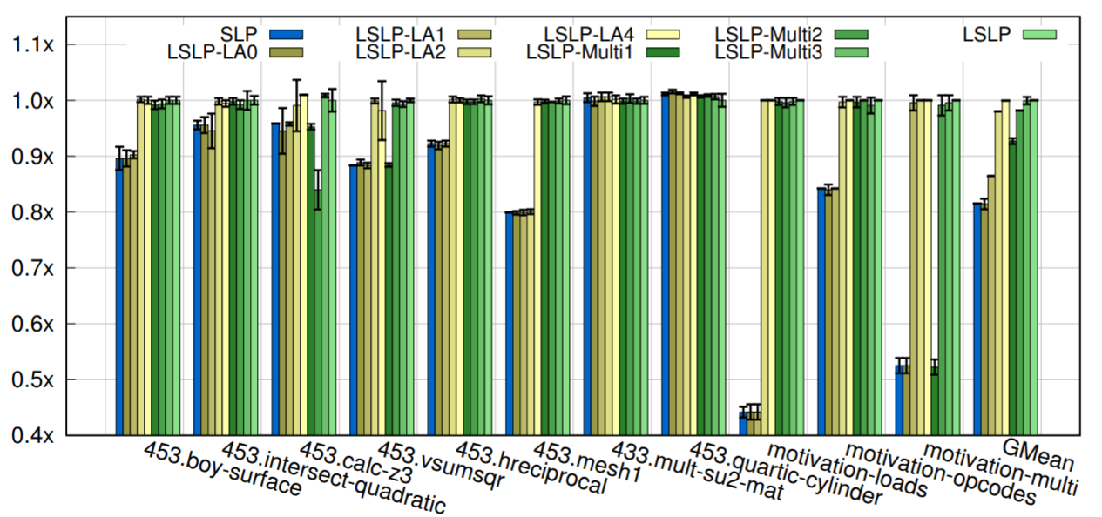
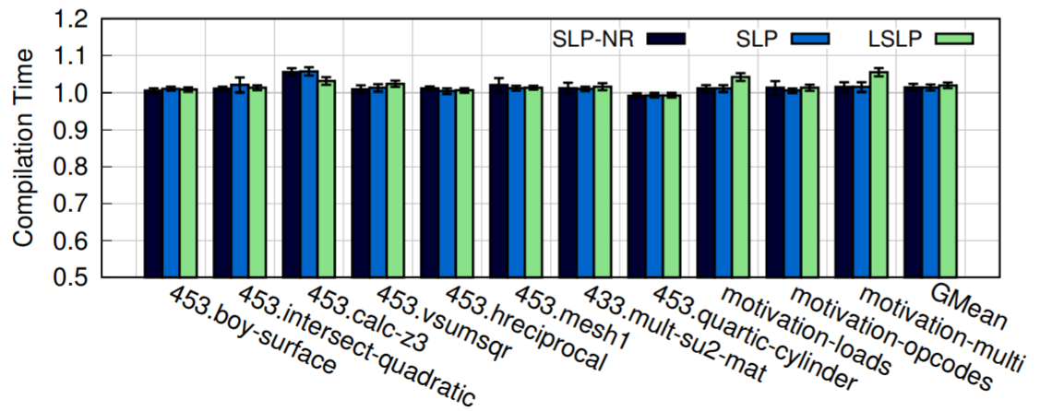
Evaluation: Overall
Q: Is LSLP useful or not?
Yes!
1% better after O3
Insensitive to params (look-ahead depth or multi-node size)
Negligible compile time overhead

