Slide 1
A Trusted Safety Verifier for Process Controller Code
Stephen McLaughlin, Saman Zonouz, Devin Pohly, Patrick McDaniel
Presented by Xumiao Zhang and Shenghao Lin
Notes:
1-9 10-18 19-21 22-26 27-28

Slide 2
Overview
Programmable logic controller (PLC)
Threat model
Trusted Safety Verifier (TSV)
PLC code analysis
Implementation
Evaluation
Conclusion

Slide 3
Programmable Logic Controller
A Programmable Logic Controller (PLC) is a digital, multi- input multi-output computer used for real-time automation of physical machinery.
A PLC’s program is executed continuously as long as the PLC is running.

Slide 4
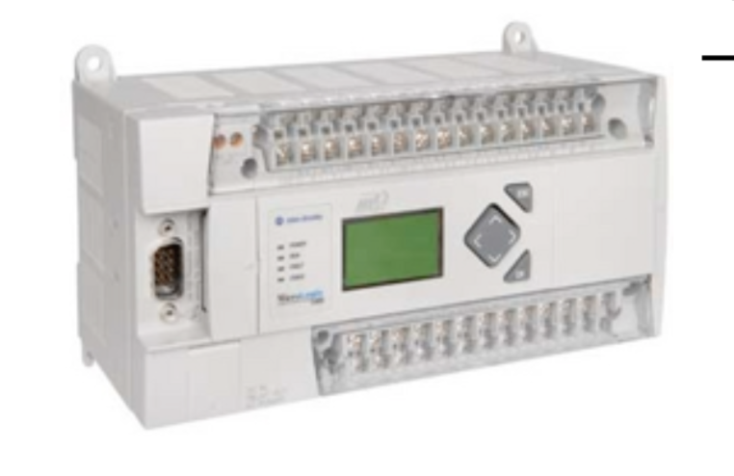
A PLC’s Life
Turn left 2˚
Turn left!

Slide 5
A PLC’s Life
Turn left 2˚
Turn left!
1º

Slide 6
A PLC’s Life
Not quite...
Turn left!
1º

Slide 7
A PLC’s Life
Not quite...
Turn left!
2º

Slide 8
A PLC’s Life
BINGO!
Stop!
2º

Slide 9
A PLC’s Life
Control Logic
L DW2 ;; Degrees
< ID255
ST Q 3.2
Control Signal
Scan Cycle
Sensor Measurements

Slide 10
Bad news...
Programmable Controllers are insecure by design
Control systems are not robust enough for security patches (i.e. stuxnet)

Slide 11
A PLC’s Life
Control Logic
;; Spin out
;; of control!
S Q 3.2

Slide 12
Safety Properties
Bounds on numerical device parameters (e.g. maximum drive velocity and acceleration)
Safety interlocks, which ensure physically conflicting events do not occur.

Slide 13
Trusted Safety Verifier (TSV)
Goal: Only allow code to be run on a PLC if it satisfies a set of engineer-supplied safety properties.

Slide 14
TSV - Challenges
Existing tools not up to the task.
Control systems are stateful, requiring temporal properties.
State space explosion with existing analysis techniques.

Slide 15
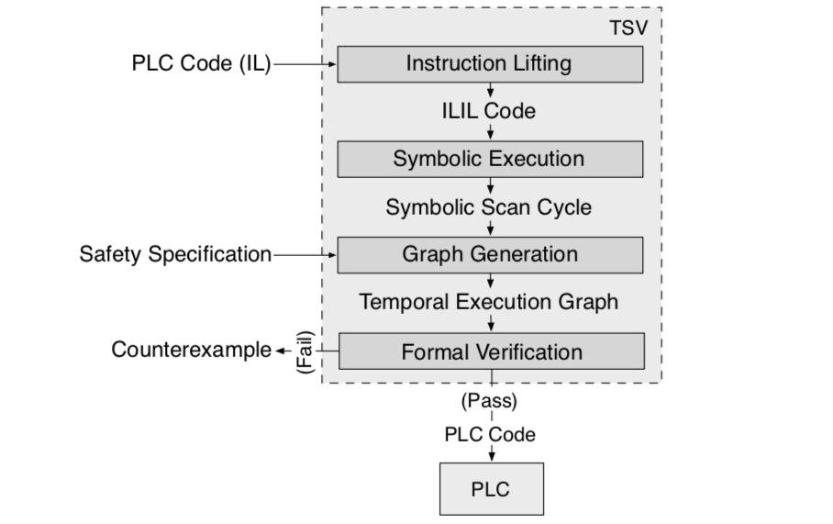
TSV - Architecture

Slide 16
Sample PLC Code
AI 0.5 ;; And input bit 5
=Q 0.1 ;; Store at output bit 1

Slide 17
Instruction List Intermediate Language
Side effects
PLC special features
Architecture dependent

Slide 18
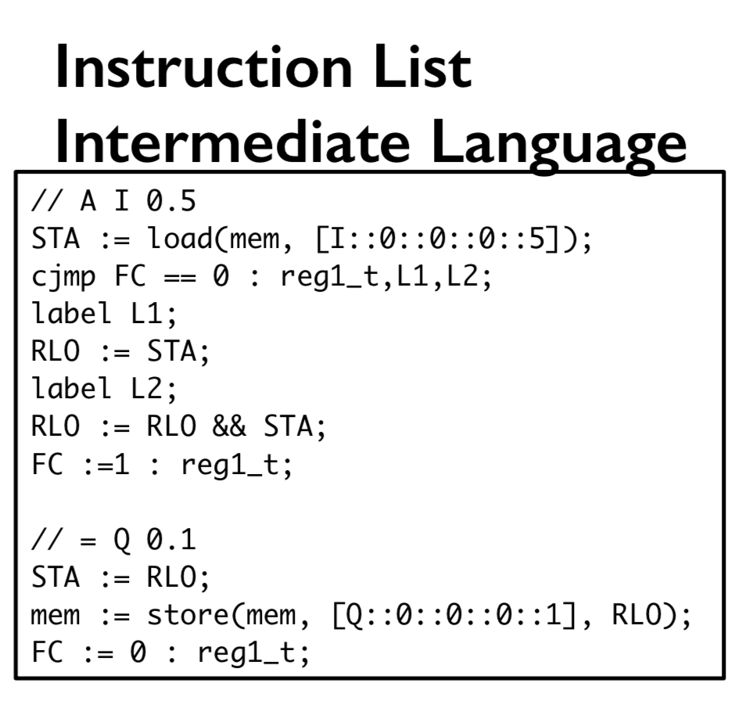
Instruction List Intermediate Language
PLC Code

Slide 19
Symbolic Execution
TSV symbolically executes an ILIL program to produce a mapping from path predicates to symbolic outputs.
Symbolic execution follows all possible paths through a single scan cycle of the program.
Lump together all inputs that produce that same output.

Slide 20
Symbolic Execution - Example
if input > 10 then output input + 6
else output 2 * input + 6
Without symbolic execution, an unsigned integer input can generate 2^32 different states.
With symbolic execution, only 2 states.
Notes:
We will see its use later.

Slide 21
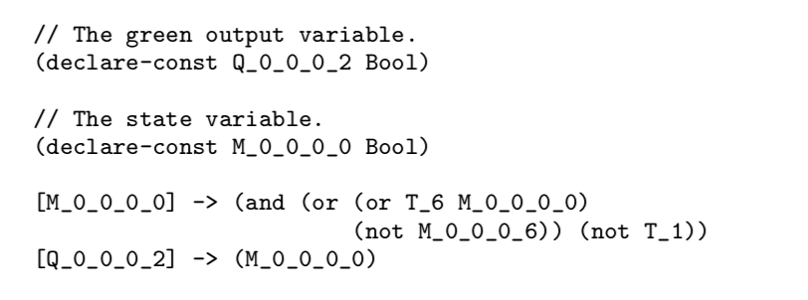
Symbolic Execution - Expression

Slide 22
Checking Temporal Properties
PLCs use stateful variables, which retain their values across the scan cycles.
TEG (temporal execution graph) is applied for model checking.

Slide 23
Temporal Execution Graph (TEG)
A state machine in which each state transition represents a single scan cycle.
Each state in the TEG contains the state and output variables.

Slide 24
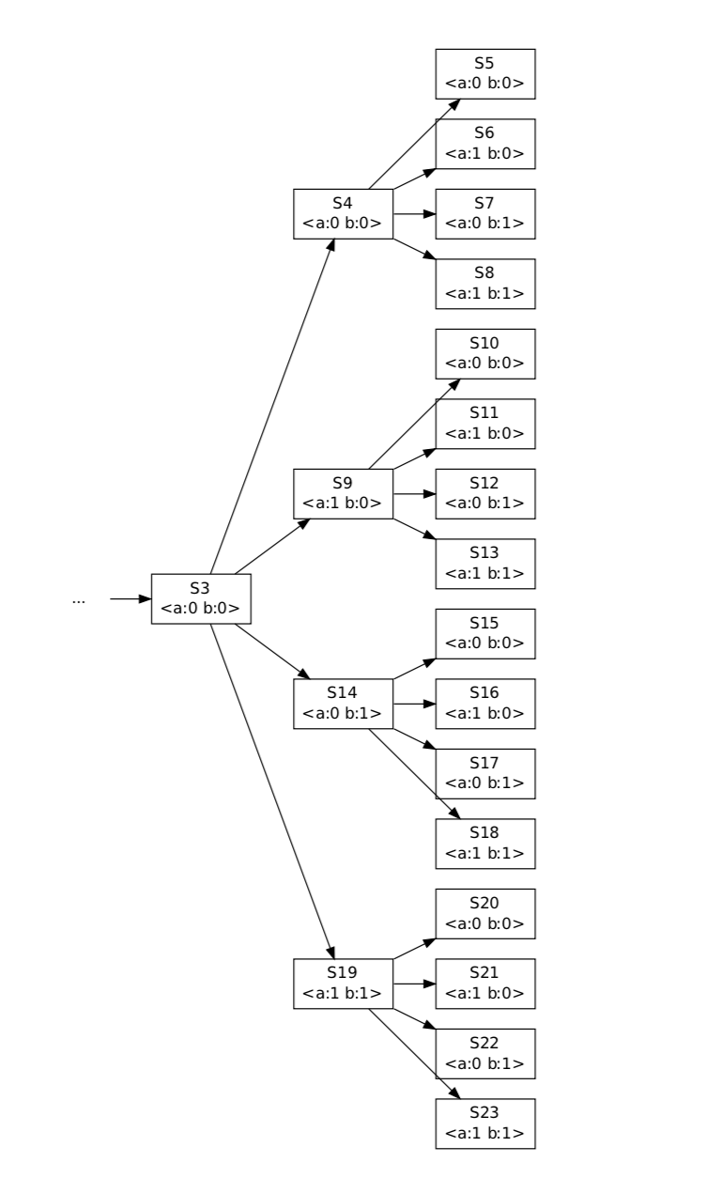
TEG

Slide 25
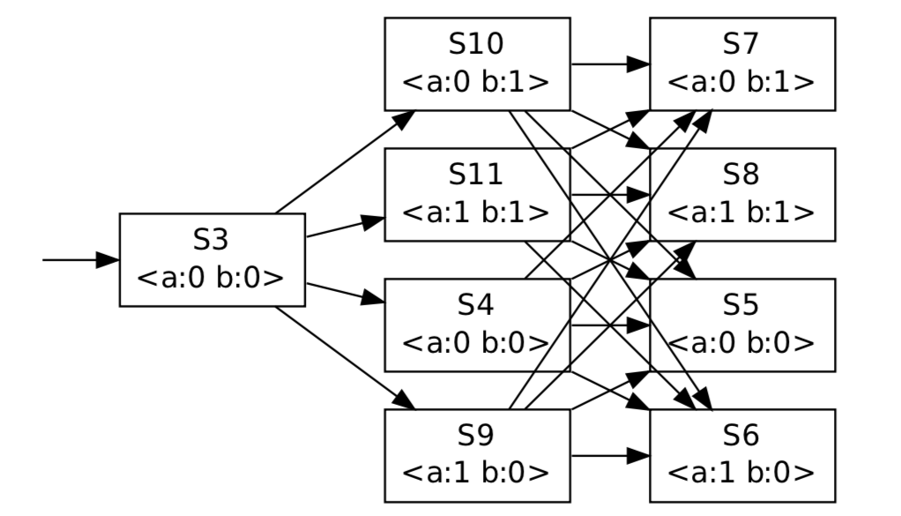
TEG with Symbolic Execution

Slide 26
TSV - A Full Run

Slide 27
Conclusion
Developed Trusted Safety Verifier (TSV), a trusted verification platform for programmable logic controllers.
last-step security verification of control commands
Combination of symbolic execution and model checking
Implemented a real-world prototype of the TSV framework on an independent Raspberry PI chip with minimal attack surface.
Demonstrated performance in checking various properties in control systems

