Slide 1
Code-Pointer Integrity
Team member: Po-Jen Lai, Timmy Lin, Chun-Yu Hsiung, Hung-Lin Wu
Instructor: Scott Mahlke
Notes:
Our team is planning on implementing code pointer integrity, which in short is to guarantee the integrity of all code pointer in the program. Thereby is able to prevent control flow hijacking.
I will explain what control flow hijacking in the following slides

Slide 2
What is Control flow hijack?
Attacker corrupts a data pointer
Overwrite the code pointer
Control-flow transferred to undesired code segment
Attacker’s shell code
Gadgets (Undesired functions)
Notes:
Is a way for the attacker to gain remote control of victim’s systems
How does the attacker achieve that?
First corrupt the code pointer
Give attacker control of the instruction pointer
The attackers are able to divert the program flow to where they desire

Slide 3
Control flow hijack
Memory
q
buf
func_ptr
gadget
char * buf = malloc(10)
...
void * (func_ptr) ();
char *q = buf + input1
…
func_ptr = &foo
...
*q = input2
(*func_ptr)()
Notes:
Define a funtion pointer
Assign q as buf + some attacker control input, where attacker can carefully control to input to make it points to its desired location
Later on function ptr is assign to function foo
Then in the end, attacker controlled pointer q is overwrite with some input2
Then it points to some attacker control gadget. The attacker can then soon to gain advantage once the pointer is dereference.
As soon as that happen, attack can run whatever they want.

Slide 4
Control flow hijack protect (Softbound)
Metadata
Memory
q
buf
func_ptr
gadget
char * buf = malloc(10)
buf_lo = p; buf_hi = p + 10;
...
void * (func_ptr) ();
char *q = buf + input1
q_lo = buf_lo; q_hi = buf_hi;
…
func_ptr = &foo
...
if ((q < q_lo) || (q >= q_hi))
abort()
*q = input2
(*func_ptr)()
Propagate Metadata
Check Metadata
Notes:
Softbound (119%) overhead, and where it comes from
A lot even from this small program. It adds a lot of additional checks in the background and execute at runtime.
Allocate memory, add lower and upper bound
Assign meta-data to all the pointers
Assignment across pointers
Propagate meta-data
Can be use for further protection
Check meta data whenever use
Protect us from having the data pointing to undesired location

Slide 5
Motivation
Existing code safety methods are with high overhead.
Memory safety method | Overhead
SoftBound | 116%
CCured | 56%
AddressSanitizer | 73%
Notes:
From the previous example you are able to see the high overhead even with such a short C program, which is 116% overhead in general when you have a sufficient amount of code bases.
CCured: Retrofit memory safety also has stronger type systems. 56% price tag.
AddressSanitizer: A great tool for debugging, it’s only probabilistic. But still 73% of price tag.

Slide 6
New approach
Protect all data → protect selected data
116 % overhead → 2% - 8% overhead
Notes:
We no longer want to protect all the datas, otherwise we are going to run into the same problem with high overhead
We are only going to focus on a small subset of data and protect it completely
Couple code pointers on the heap, couple pointers on the stack we deemed protection worthy
Therefore we offer strong protection for a select subset of data

Slide 7
Threat Model (Attackers’ capabilities)
Read / Write on process image (Memory)
Read code but not write code
No control over the program loading process
Notes:
Attacker can read/write data in the process image
Can read the written code, yet can not modify the code as it’s being executed
Input data contain executable code would not be executed
Attacker could only use existing code to hijack.
If attacker has the ability to control the program loading process,
If they are able to gain control the program before we set up the defense mechanism, then there’s nothing we can do
In the following slides, we are gonna explain how we do our defense mechanism.

Slide 8
Safe Region vs Regular Region
Protected vs unprotected
Safe vs fast
Hardware-based instruction-level isolation
The mechanism for the isolation is architecture-dependent.
Safe Memory
Regular Memory
Hardware-based
isolation

Slide 9
Safe Region vs Regular Region
Safe region
Safe_ptr 2
Safe_ptr 1
Regular region
Regular_ptr 2
Regular_ptr 1

Slide 10
Safe Region vs Regular Region
Safe region
Safe_ptr 2
Safe_ptr 1
Regular region
Regular_ptr 2
Regular_ptr 1
Check!

Slide 11
Safe Region vs Regular Region
User modified data
Safe region
Safe_ptr 2
Safe_ptr 1
Regular region
Regular_ptr 2
Regular_ptr 1
Check!

Slide 12
Safe Stack
Safely access local
Guaranteed safe variables
int foo(){
char buf[10];
int r = scanf(“%s”, buf);
return r;
}
Safe Stack
r
return address
Regular Stack
buf

Slide 13
Safe Stack
arrays or objects whose address is passed to other functions
Safely access local
Guaranteed safe variables
int foo(){
char buf[10];
int r = scanf(“%s”, buf);
return r;
}
Safe Stack
r
return address
Regular Stack
buf

Slide 14
Safe Stack
arrays or objects whose address is passed to other functions
Safely access local
Guaranteed safe variables
int foo(){
char buf[10];
int r = scanf(“%s”, buf);
return r;
}
Anything might be corrupted
Safe Stack
r
return address
Regular Stack
buf

Slide 15
Safe Stack
All return instruction pointers are protected
No ROP (return oriented programming)
Zero performance overhead

Slide 16
Code-Pointer Integrity
Sensitive pointer: code ptrs and ptrs that may later be used to access sensitive ptrs
Only a small subset of all pointers are responsible for making control-flow transfers
Enforcing memory safety only for control-sensitive data
Over approximation at compile time
Notes:
Sensitive types are: pointers to functions, pointers to sensitive types, pointers to composite types (such as struct or array) that contains one or more members of sensitive types, or universal pointers (i.e., void*, char* and opaque pointers to forward-declared structs or classes).
All code pointers that a compiler or runtime creates implicitly (such as return addresses, C++ virtual table pointers, and setjmp buffers) are sensitive as well.

Slide 17
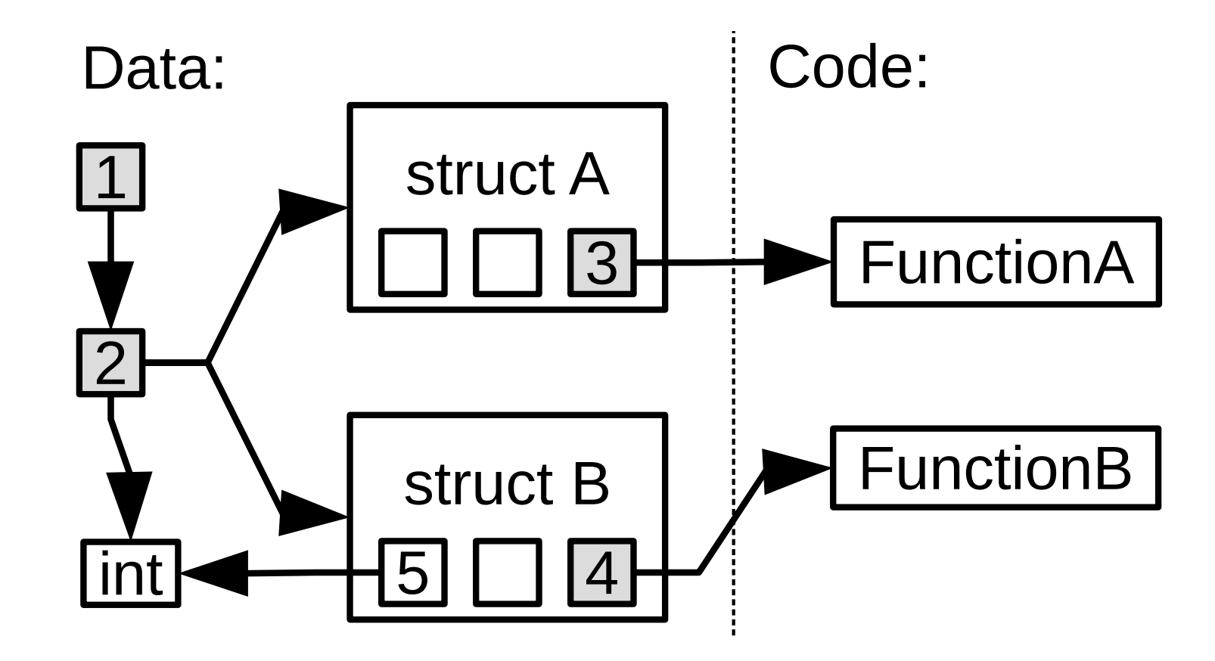
Sensitive Pointers

Slide 18
Instrumentation
Ensure all sensitive pointers are stored in a safe region
Create and propagate metadata at runtime
Check the metadata on dereferences
Metadata: bound, temporal ID
Load/store → CPI intrinsic instructions
Notes:
Instructions that explicitly take addresses of a statically allocated memory object or a function, allocate a new object on the heap, or take an address of a sub-object are instrumented to create metadata that describe the corresponding object. Instructions that compute pointer expressions are instrumented to propagate the metadata accordingly. Instructions that load or store sensitive pointers to memory are replaced with CPI intrinsic instructions (§3.2.3) that load or store both the pointer values and their metadata from/to the safe pointer store.

Slide 19
Memory Layout
Hardware-based instruction level isolation

Slide 20
Code-Pointer Separation (CPS)
Simplified version of Code-Pointer Integrity
Main Difference
Sensitive pointer = code pointer only
No need to store metadata
No runtime check
Fewer security guarantees
Lower performance overhead
Notes:
Basically, code-pointer separation is a simplified version of code-pointer integrity. There are some differences between CPS and CPI.
The first one is, for sensitive pointer, CPS only stores code pointer into safe region. The second one is no metadata information. Control-flow destinations do not have bound, because the pointer value must always match the destination exactly. And the last one is, CPS does not have runtime check.
The code pointer will be based only on a control flow destination. This restriction prevents attackers from “forging” a code pointer from a value of another type, but still allows them to trick the program into reading or updating wrong code pointers. (redirecting existing function)
This is particularly relevant to C++ programs with many virtual functions, where the fraction of sensitive pointers instrumented by CPI can become high, since every pointer to an object that contains virtual functions is sensitive.

Slide 21
Redirect object pointer
Safe Memory
func_ptr2
func_ptr1
Regular Memory
obj1.pointer
Point_to_obj2
obj2.pointer

Slide 22
Redirect object pointer
Safe Memory
func_ptr2
func_ptr1
Regular Memory
obj1.pointer
Rewrite Point to obj1
obj2.pointer

Slide 23
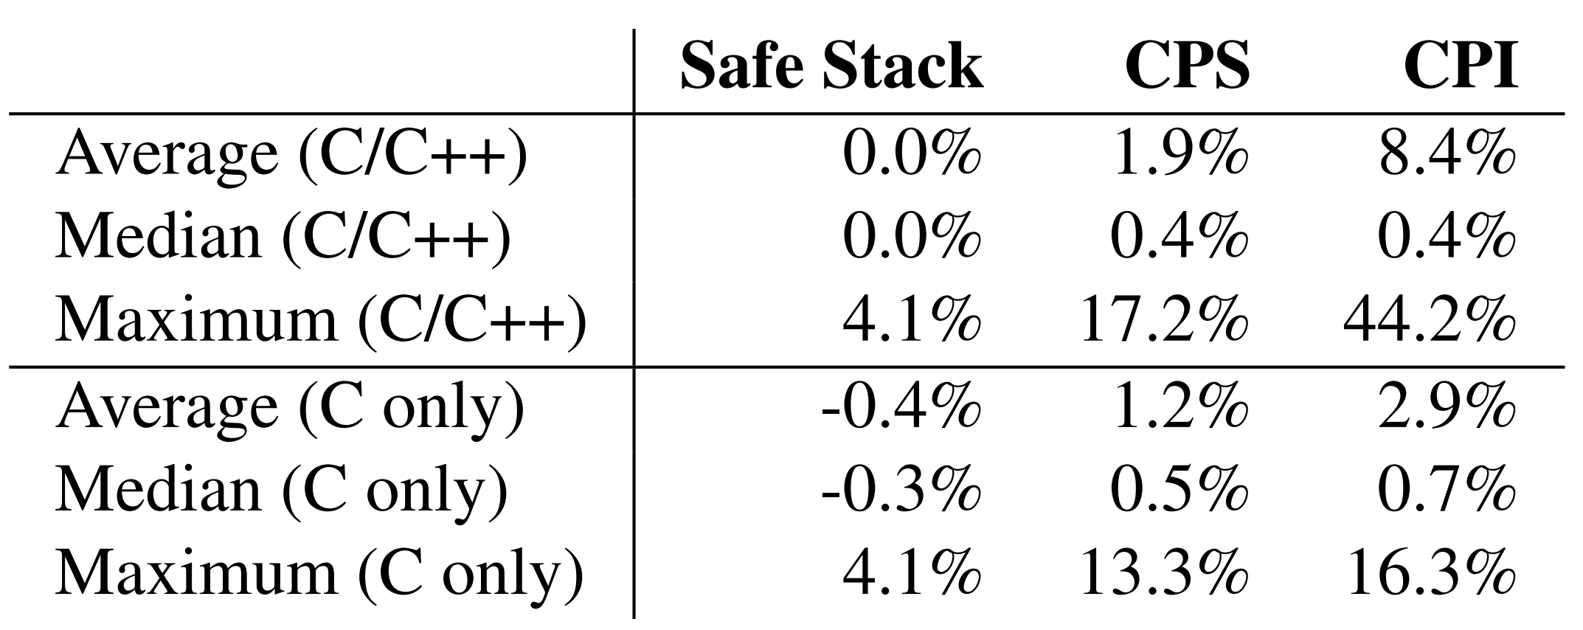
Security Guarantee
Code-Pointer Integrity: formally guaranteed protection, 8.4% - 10.5% overhead (~6.5% of memory access)
Code-Pointer Separation: strong protection in practice, 0.5% - 1.9% overhead (~2.5% of memory access)
Safe Stack: Full ROP protection, negligible overhead

Slide 24
Current Status
The latest version of LLVM only integrates Safe Stack
Our proposed goals
CPS sensitive pointer detections
CPI sensitive pointer detections
Memory separation
Code generation
Notes:
code generation is not the main focus of the class and it is platform dependant, so we do not plan to implement it.

Slide 25
Thank you
Notes:
code generation is not the main focus of the class and it is platform dependant, so we do not plan to implement it.

