Slide 1
LegUp High-Level Synthesis for FPGA-Based Processor/Accelerator Systems
Andrew Canis, Jongsok Choi, etl
University of Toronto
Presented by: Hasan Al Muraf, Harisankar Sadasivan, Sheng Chong, Fan Lai
Andrew Canis, Jongsok Choi, Mark Aldham, Victor Zhang, Ahmed Kammoona, Jason Anderson, Stephen Brown, and Tomasz Czajkowski
Presented by: Hasan Al Maruf, Harisankar Sadasivan, Sheng Chong, Fan Lai

Slide 2
Hardware design has advantages over software
Reason: Significant performance/energy-efficiency boost from hardware accelerators
Notes:
As we know that OpenCL is an open standard for programing heterogeneous computing systems,
and these systems are becoming more and more popular in the Top500 list.
People are putting accelerators like GPU/Xeon PHI into they supercomputers
because these accelerators deliver better performance and energy-efficiency

Slide 3
Issues
Hardware design is difficult and skills are rare:
Complex RTL codes
Difficult to debug
Costly
Unique Accelerator for a single application?

Slide 4
Application-Specific Accelerator with FPGA
Only provides primitive building blocks for computation
Register, add/mul, memories, boolean operations and connections
Build application-specific accelerator from primitives building blocks
Interconnection between primitive functional units
Timing of data movement between primitive functional units
Opportunities for optimizations for a specific application
Maximizing efficiency while throwing away redundancy
Notes:
And FPGAs allow us to create such accelerators,
<next>
Specifically, FPGAs provides primitive building blocks for computation,
<next>
from these building blocks, the users can build they own accelerator for their applications
With this fine-grain programmability
<next>
Such a fine-grain programmability from those primitive building blocks,
Provide the opportunities to optimize the accelerator for a given application,
For every single bit and every single clock cycle
This allow the users to maximize efficiency while minimizing redundancy in the accelerator

Slide 5
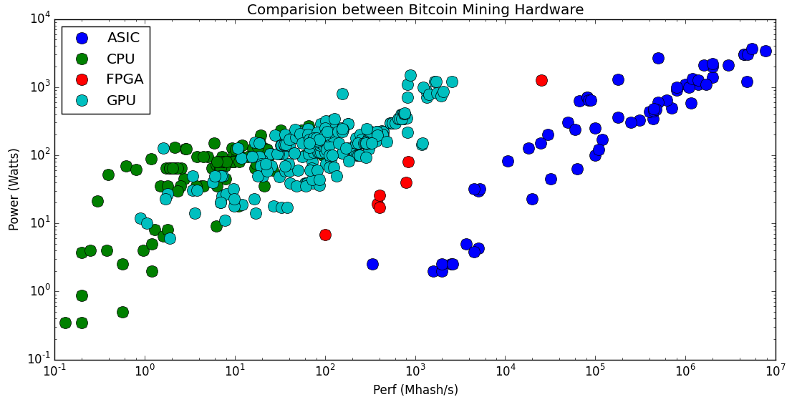
Performance/Power at different levels of specialization
FPGA
ASIC
(not programmable)
GPU
CPU
https://en.bitcoin.it/wiki/Non-specialized_hardware_comparison
https://en.bitcoin.it/wiki/Mining_hardware_comparison
Notes:
Lets takes the bitcoin mining hardware as an example, We should the power and performance comparison in this graph
We have CPU, GPU, FPGA and the application-specific integrated-circuit, which also known as ASIC
And among all those programmable devices, FPGAs deliver the best performance and energy-efficiency.
Because people built optimal processing pipeline for bitcoin mining from FPGAs,
In such a pipeline, almost every bit, every computations are designed to do bitcoin mining only,
And this application-level specialization deliver the best performance and and energy-efficiency
-------
As we can see that the ASIC delivers the best performance and energy-efficiency.
FPGA provide the best performance and energy-efficiency
It is how you design that matter
CNN five years ago?
CNN two years ago?

Slide 6
Challenges of promoting FPGAs among software engineers
Require tremendous efforts
Extensive knowledge of digital circuit design
The potential of FPGAs is not easily accessible by common software engineers
Solution? - High Level Synthesis (HLS) frameworks
AXI Master
Timing Closure
Burst inference
DSP48
Stable interface
Loop rewind
Notes:
But designing such an optimal pipeline for a given application requires tremendous efforts,
<next>
As well as extensive digital circuit design knowledge
<next>
For example, all these words,
<next>
Just sounds like magical spells for most of the software developers
<next>
As a result, the potential of FPGAs is not easily accessible by common software engineers,
And we want to change this
---
Fpga – spatial expension – pipeline parallelism, internal memory bandwidth – advantage over gpu – and weakness – memory band width

Slide 7
Existing Frameworks
Framework | Non Commercial License | Source Code Modifiable | Domain Independent
Trident
ROCCC
xPilot
GAUT
WrapProcessor
LiquidMetal
CHiMPS
LegUp
Notes:
But designing such an optimal pipeline for a given application requires tremendous efforts,
<next>
As well as extensive digital circuit design knowledge
<next>
For example, all these words,
<next>
Just sounds like magical spells for most of the software developers
<next>
As a result, the potential of FPGAs is not easily accessible by common software engineers,
And we want to change this
---
Fpga – spatial expension – pipeline parallelism, internal memory bandwidth – advantage over gpu – and weakness – memory band width

Slide 8
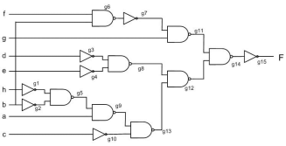
LegUP
int FIR(int ntaps, int sum) {
int i;
for (i=0; i < ntaps; i++)
sum += h[i] * z[i];
return (sum);
}
....
Self-Profiling
Processor
Processor
(MIPS)
C Compiler
Program code
Altered SW binary (calls HW accelerators)
Profiling Data:
Execution Cycles
Power
Cache Misses
High-level synthesis
Suggested
program segments to target to HW
mP
Hardened program segments
FPGA fabric

Slide 9
System Architecture
FPGA
Hardware Accelerator
Hardware Accelerator
MIPS Processor
AVALON INTERFACE
On-Chip Cache Memory
Memory Controller
Off-Chip Memory

Slide 10
High-Level Synthesis Flow
C Compiler (LLVM)
Optimized LLVM IR
C Program
Target H/W Characterization
Allocation
Hardware pre-characterization
Scheduling
User Constraints
Timing
Resource
Assign operations to states
Binding
Decide sharing strategies
RTL Generation
Synthesizable Verilog

Slide 11
LLVM Compiler
Compile C code into IR
Simple enough to correspond to HW operations
LLVM performs standard optimizations
SSA & Alias analysis for dependency analysis.
Data
Memory
Notes:
The advantage of stalling is energy consumption – the processor is in a low-power state while the accelerator operates. we use only mode #2 (stalling) for the results in this paper

Slide 12
Allocation: Profile the H/W
Goal: Set-up constraints for subsequent synthesis steps
Characterize HW resource
Read HW information from configuration TCL files
Pre-characterize hardware operation for each instruction
Make early predictions for scheduling and binding
Circuit speed, area for HW accelerators
Notes:
The advantage of stalling is energy consumption – the processor is in a low-power state while the accelerator operates. we use only mode #2 (stalling) for the results in this paper

Slide 13
Scheduling: CFG to FSM
Goal: assign operations to clock cycles (states) & build FSM.
Legup schedules basic blocks individually
ASAP scheduling policy
Operation chaining
Schedule an instruction into the same state as its operand
When estimated delay of chain operations doesn’t exceed clock period
Reduce HW latency, save registers w/o impacting final clock period
1 CLK period
OP 1
OP 2
Notes:
The advantage of stalling is energy consumption – the processor is in a low-power state while the accelerator operates. we use only mode #2 (stalling) for the results in this paper

Slide 14
Binding: Map operation to FU
Goal: save area as much as possible
Sharing functional units between actions -> operation assignment
Sharing registers/memories between variables -> register allocation
FPGA fabric is register rich, but multiplexers are expensive
How to bind?
Weighted bipartite matching problem
Notes:
The advantage of stalling is energy consumption – the processor is in a low-power state while the accelerator operates. we use only mode #2 (stalling) for the results in this paper

Slide 15
Binding: Weighted bipartite Matching Problem
LLVM operation
Functional Units
How to assign weights?
Notes:
The advantage of stalling is energy consumption – the processor is in a low-power state while the accelerator operates. we use only mode #2 (stalling) for the results in this paper

Slide 16
Binding
Goal: Assign penalty weights in following priority to derive a cost function
New MUX I/P (+1)
Existing MUX I/P (+0.1)
Sharing O/P register (-0.1)
How do you optimize the cost Function?
Use bipartite Matching

Slide 17
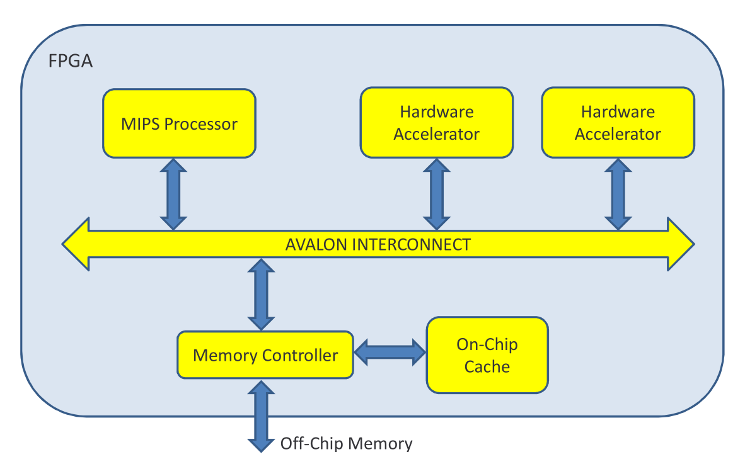
Local Accelerator Memories
Shared memory between processor and accelerators
Create local memory for constants/local variables
Avoid contentions
Multiple memories for better parallelism

Slide 18
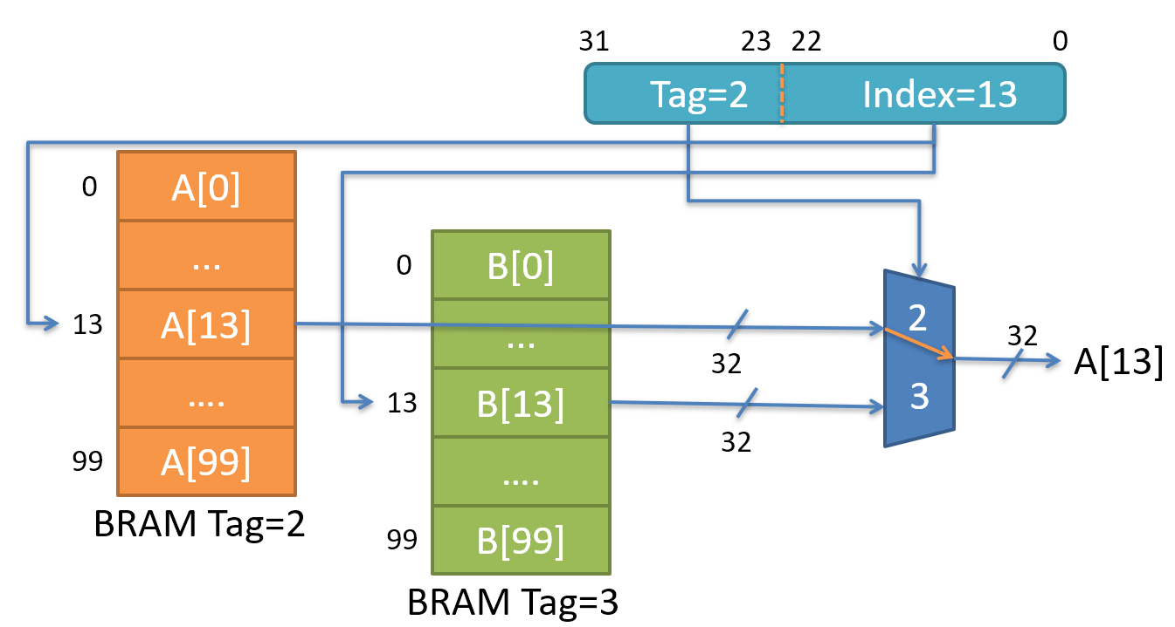
Pointer Example
Each local memory is assigned a 9-bit tag
Top 9 bits of the 32-bit address space
To steer memory access

Slide 19
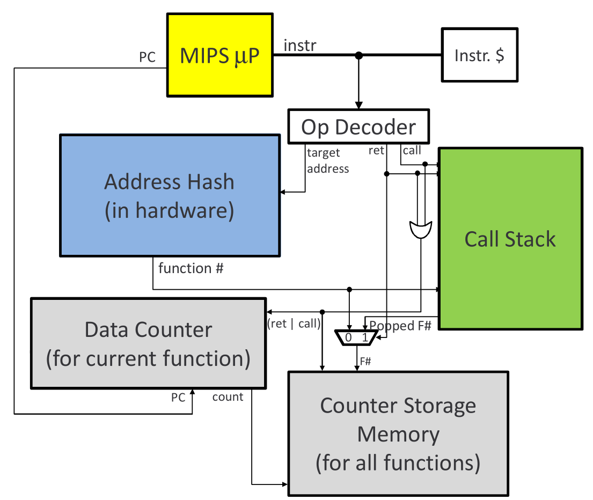
Non-intrusive & Real-time Hardware Profiling
Performs analysis at function level
Works by associating an index and a counter with a function
6.7% overhead on MIPS processor area

Slide 20
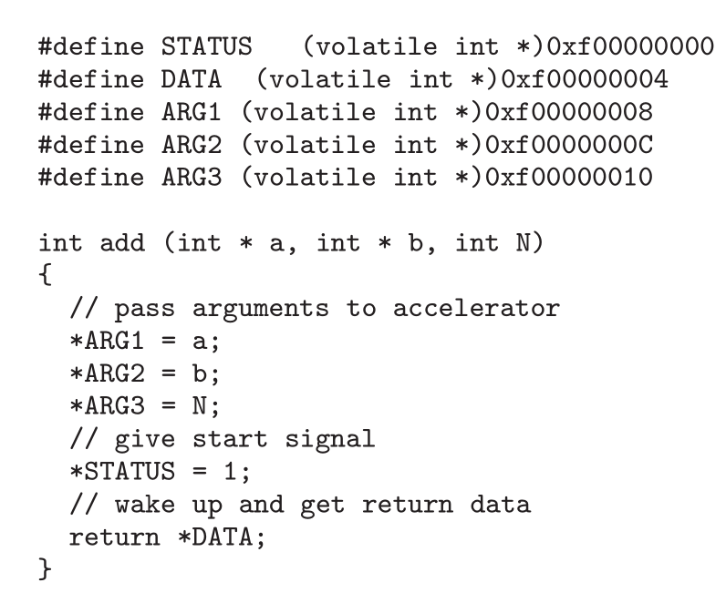
Processor/Accelerator Communication
Wrapper
Replace target function for HW implementation
Pass arguments to HW
Assert start signal
Wait for return data
While waiting, the processor
Continue running but periodically check
Or totally stall
Notes:
The advantage of stalling is energy consumption – the processor is in a low-power state while the accelerator operates. we use only mode #2 (stalling) for the results in this paper

Slide 21
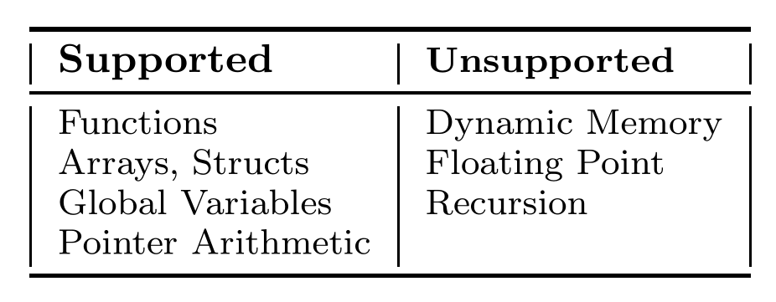
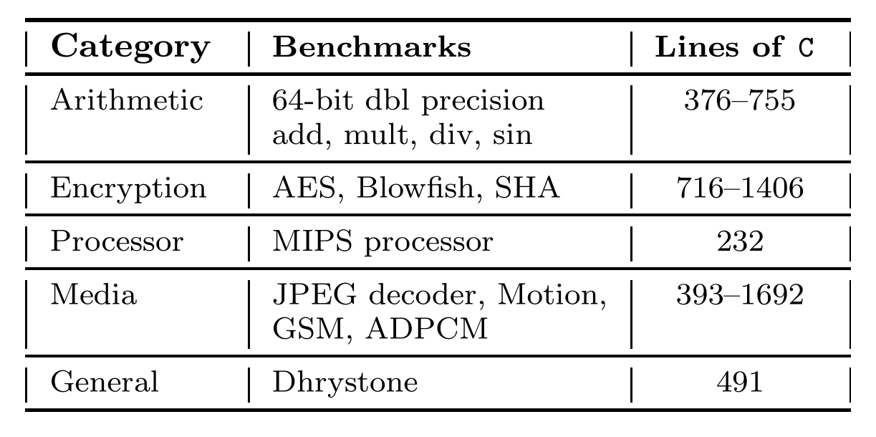
Benchmarks
More supports than existing HLS
Additional support for structs, global variables, pointer arithmetic
64-bit double precision are implemented using integer types
Various categories in benchmarks

Slide 22
Evaluations
Metrics
Speed: total execution time
Area: # of used logic elements, memory bits, multipliers
Energy cost
Baselines
Pure H/W implementation
eXcite-based Hardware, Legup-based Hardware
Pure Software
Hybrid implementation: Legup-based Software & Hardware

Slide 23
Evaluations: Execution Time
Pure HW implementation outperforms SW
Legup is comparable to eXCite
Benchmark | Pure SW
Dfadd | 222
Motion | 495
Gsm | 527
JPEG decoder | 401328
Legup-based Hybrid
68
203
303
342511
eXCite | Legup
15 | 19
53 | 93
113 | 137
143358 | 124475
Pure SW
SW + HW
Pure HW

Slide 24
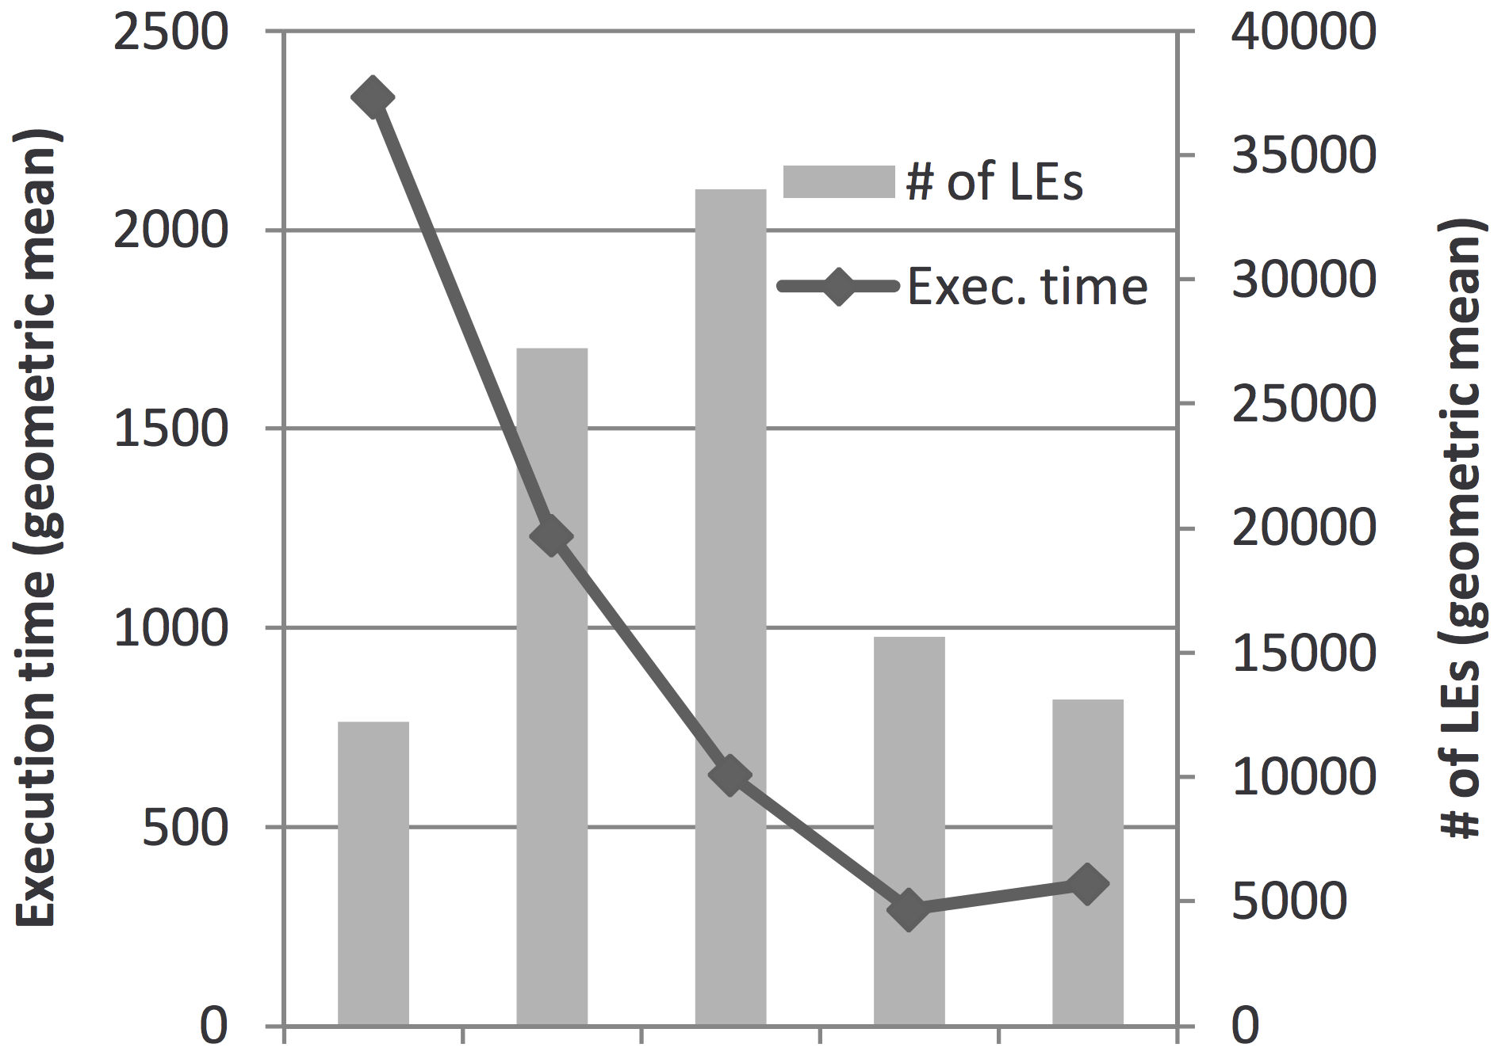
Evaluations: Execution Time & Area
Two SW-HW hybrids
H1: offload the most comp-utation intensive function
H2: offload the 2nd most computation intensive func
Less execution time with more HW implementations
Legup ~ eXCite
SW
H2
H1
Legup
eXCite

Slide 25
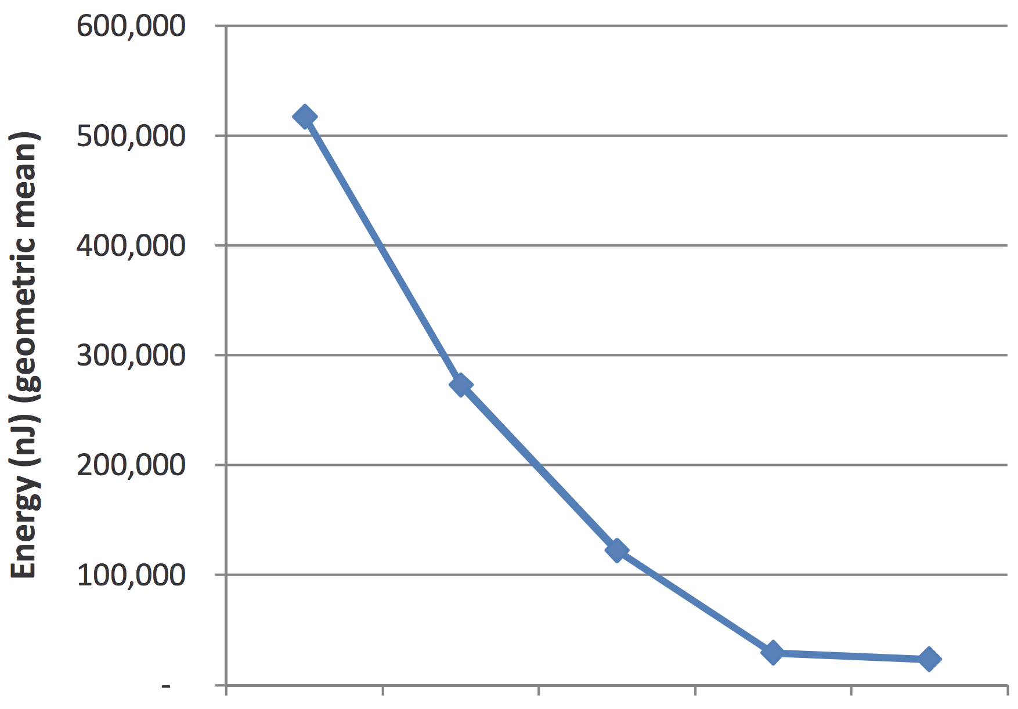
Evaluations: Energy Cost
Two SW-HW hybrids
H1: offload the most comp-utation intensive function
H2: offload the 2nd most computation intensive func
Less energy cost as more HW-based implementations
Legup ~ eXCite
18x less energy than software
SW
H2
H1
Legup
eXCite

Slide 26
Contribution & Weakness
A powerful open source platform for HLS research
Great improvement for energy cost & speed
Custom HLS passes add-on option
Domain-generalized
Weakness
Still limited support
Performance is decent, but not impressive

Slide 27
Open questions
Pure HW implementation is the best in evaluations
Any concerns on this ?
Difficult to debug in HW
Performance-budget trade-off

Slide 28
Thanks! Q&A

Slide 29
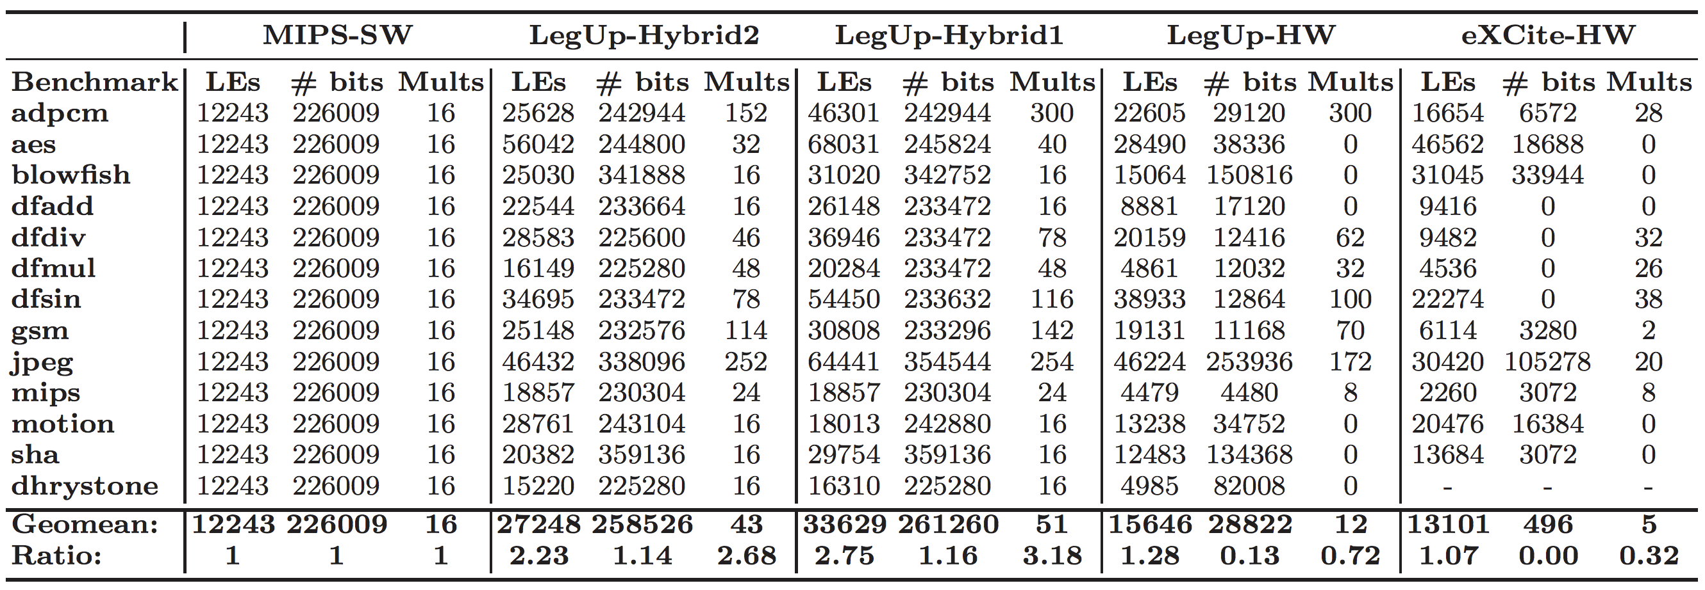
Evaluation

Slide 30
Binding: Bipartite Matching
How do you optimize the cost for the party

Slide 31
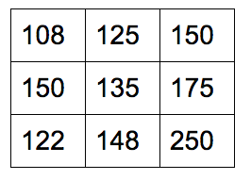
Binding: Hungarian Method for BP Subtract the smallest value in each row from the other values in the row:
1. Form an adjacency matrix.

Slide 32
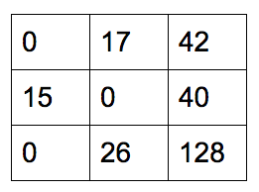
Binding: Hungarian Method for BP
2. Subtract the smallest value in each row from the other values in the row.

Slide 33
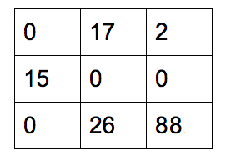
Binding: Hungarian Method for BP
3. Subtract the smallest value in each column from the other values in the column.

Slide 34
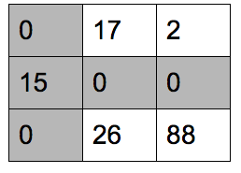
Binding: Hungarian Method for BP
4. Draw lines through the rows and columns that have the 0 entries
such that fewest possible lines are drawn.
Two lines drawn & 2 < 3, hence there is not yet the optimal no. of zeroes.

Slide 35
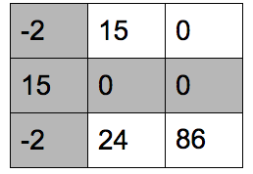
Binding: Hungarian Method for BP
5. Find smallest entry not covered by any line.
Subtract this from uncovered rows.

Slide 36
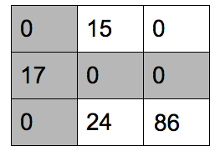
Binding: Hungarian Method for BP
6. Add the same value to the covered columns.

Slide 37
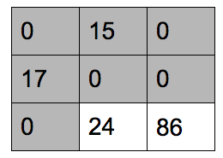
Binding: Hungarian Method for BP
7. Draw minimum lines through rows and columns of 0

Slide 38
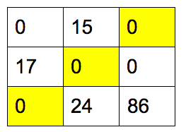
Binding: Hungarian Method for BP
8. 3 lines, so done.
Assignments are where only 1 zero per row and column
Is a part of assignment.

Slide 39
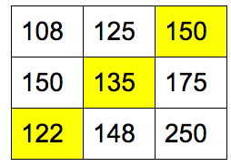
Binding: Hungarian Method for BP
9. Replace original values.

