Slide 1
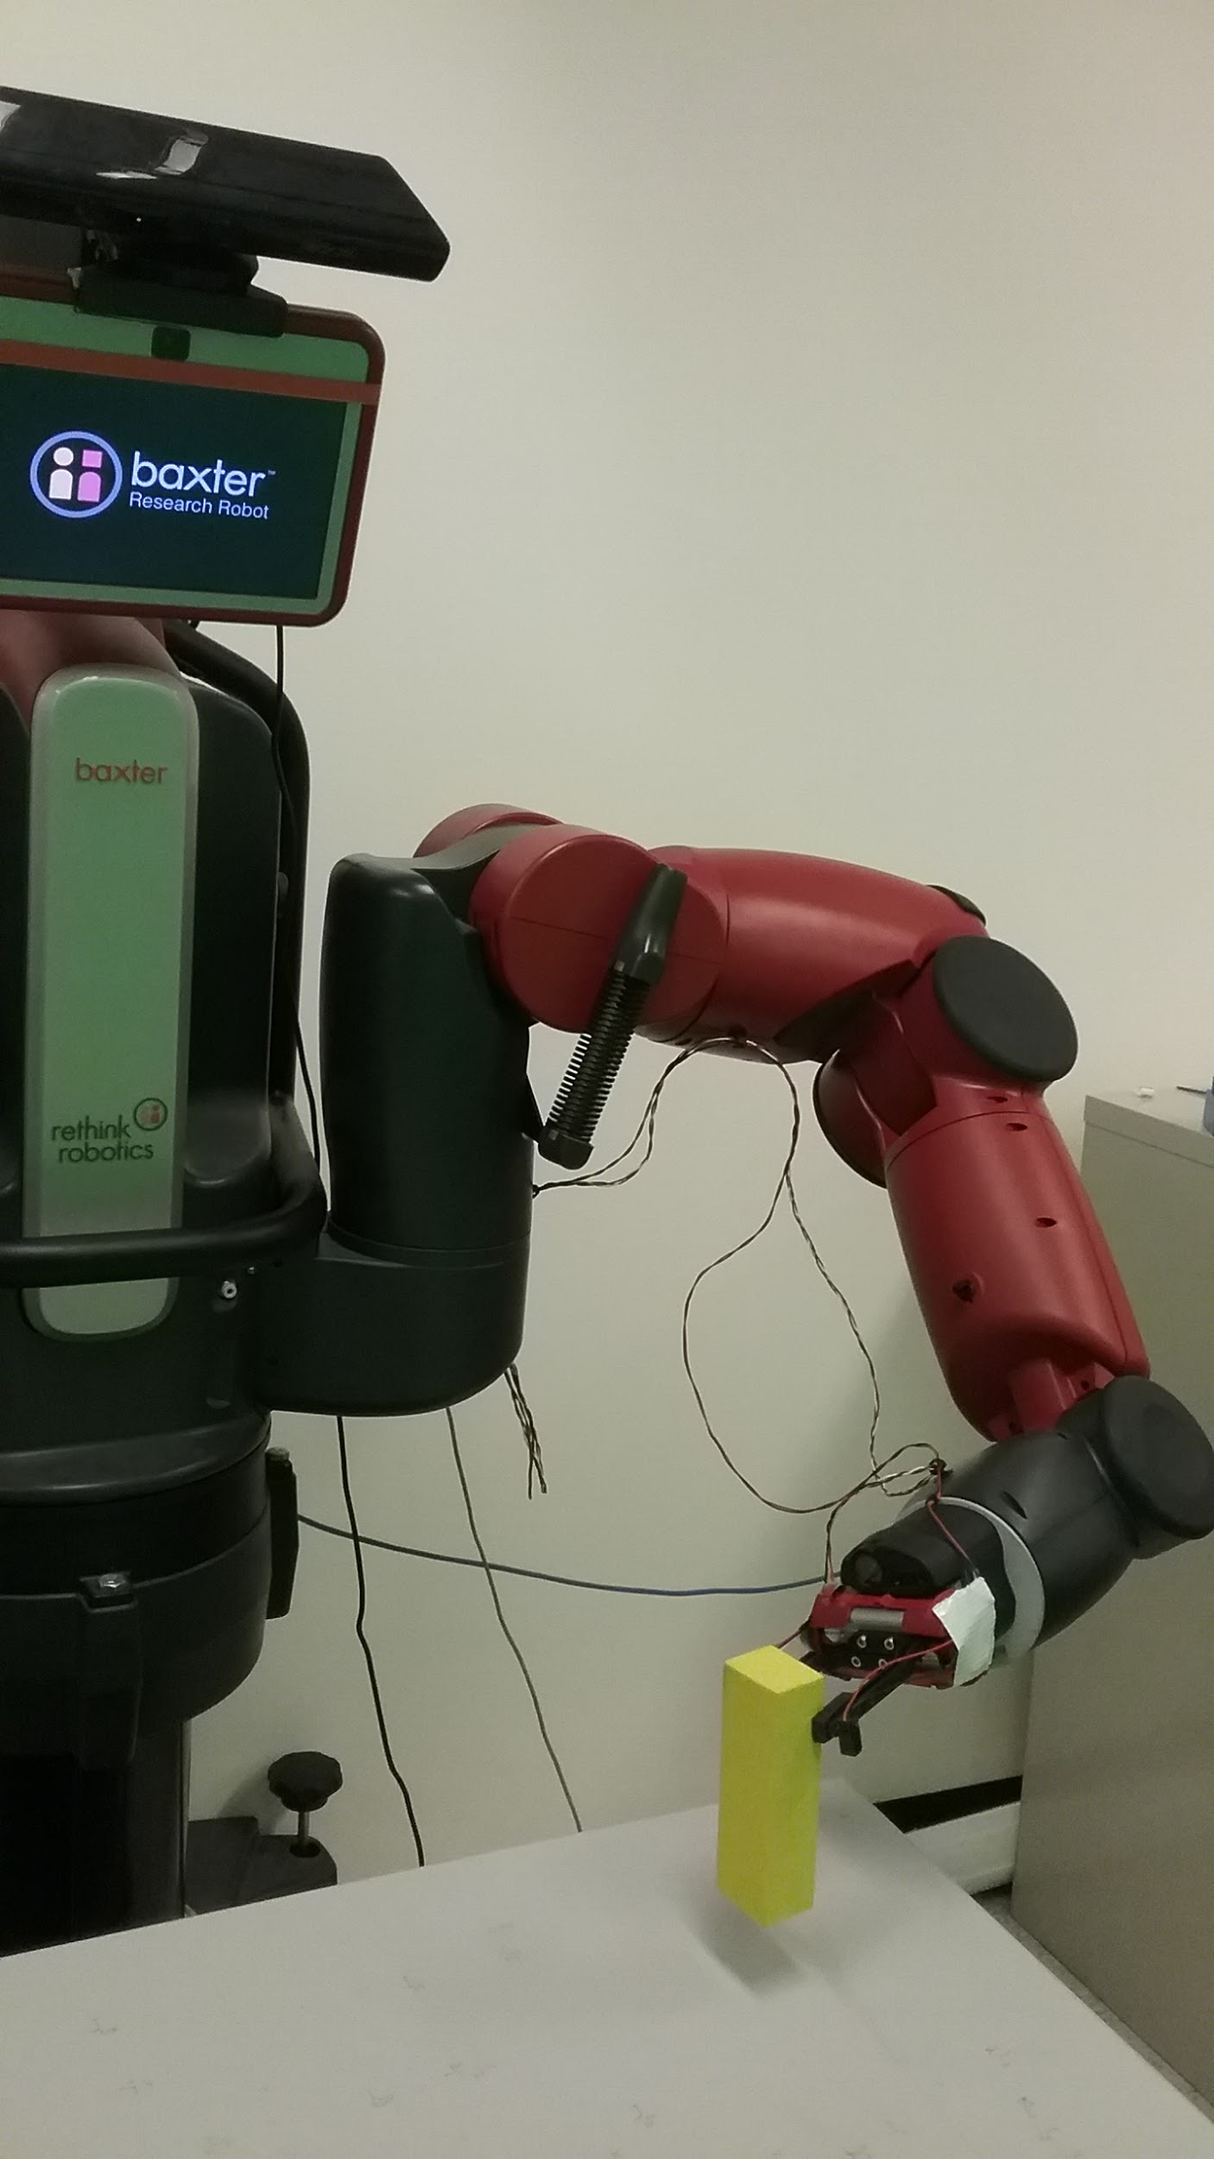
Towards Learning the Foundations of Manipulation Actions from Unguided Exploration
Jon Juett
Thesis Defense
Computer Science and Engineering
University of Michigan
July 19, 2021

Slide 2
What Problem Are We Solving?
Human infants learn to reach, grasp, and place objects.
Infants are not born with these capabilities.
In well under a year, infants learn to perform these actions reliably.
(Berthier, 2011)
We have developed a computational model of how an embodied learning agent can learn to reach, grasp, and place objects.
We have implemented and evaluated it on a physical robot.
Notes:
The problem we focus on is based on a phenomenon that can be observed in infants. At birth, human infants aren’t capable of planning and executing actions to intentionally move around their environment or interact with objects in meaningful ways. However, through casual observation or careful study we can observe that typically developing infants quickly learn to perform these actions reliably. In the case of the reaching, grasping, and placing actions we focus on, this learning occurs in well under a year.

Slide 3
Why Is This Problem Important?
Learning actions for purposefully reaching, grasping, and placing objects is foundational for an agent interacting with its world.
Solving this problem may provide insights into:
how to learn other actions from unguided experience;
human infant developmental learning;
other kinds of spatial knowledge.
Notes:
These actions and actions based on them give the agent a much higher degree of control over its environment and will be important for many tasks throughout life.
How to learn additional manipulation actions and other types of actions from unguided experience, how the learning process may occur in developing infants, and how different types of space and actions can be represented.

Slide 4
What Does the Literature Tell Us?
There is a huge literature on robot motion planning based on precise models of environmental geometry and robot geometry, kinematics, and dynamics.
Our focus is on learning reliable actions from experience without precise prior models.
Developmental Psychology
(von Hofsten, 1991), (Thelen et al., 1993, 1996), (Clifton et al., 1993, 1994, 1999), (Adolph and Berger, 2005), (Bremner et al., 2008), (Berthier, 2011), (Corbetta et al., 2014)
Well-documented timeline and characteristics of typical infant action learning
Neural Modeling
(Oztop et al., 2004), (Chinellato et al., 2011), (Savastano and Nolfi, 2013), (Roncone et al., 2016), (Serino, 2019)
Carefully designed networks can demonstrate human-like learning stages and behaviors.
Sensorimotor Modeling
(Hulse et al., 2010), (Jamone et al., 2012, 2014), (Law et al., 2014a, 2014b), (Ugur et al., 2015), (Luo et al., 2018), (Kumar et al., 2021)
Learning a mapping between proprioceptive and visual sensors allows learning actions from experience.
Notes:
Aspects of this problem have been considered for a long time by researchers in a variety of fields. There’s a very large body of work using robot motion planning that relies on precise models of the geometry of the robot and its environment, as well as the kinematics and dynamics of the robot to account for its physical properties and calculate how to perform a task. However, our focus is on learning reliable actions without these precise models and prior knowledge of the space or actions, so we look to fields where these actions are learned.

Slide 5
Learning Efficiency
Robotics traditionally relies on reinforcement learning.
Very high sample complexity for RL, especially for deep RL
(Pinto and Gupta, 2016), (Levine et al., 2016, 2018)
Infants learn very quickly (a few months)
from autonomous practice;
without formal instruction;
without extrinsic rewards.
Infants learn reaching and grasping in two phases.
Early Phase: “When infants first learn to reach at about 4 months, their hand paths are jerky and tortuous” (Thelen et al., 1996)
Late Phase: “With age, infants’ reaches become straighter and more directly aimed toward the target and show fewer movement units.” (Thelen et al., 1996)
Notes:
These particular models are trained with 50,000 and 800,000 examples These numbers aren’t realistic for an infant, which would need to observe about 1000 grasp attempts an hour and have all of those attempts be carefully observed These observations are inconsistent with the infant learning, which is performed with relatively few examples and does not require instruction

Slide 6
Early and Late Action Learning
The two phases suggest two learning processes.
The first process efficiently learns jerky actions that reliably achieve goals.
The second process uses RL to make those actions smooth and efficient.
The result of early learning concentrates behavior in the neighborhood of trajectories that achieve the goal.
This will make RL much more efficient.
This thesis models the first learning process.
Notes:
This highlights the difference between efficient learning and efficient actions

Slide 7
Our Learning Model
The agent learns the dynamics of its body and its environment.
The agent observes the usual and unusual results of its actions.
The agent defines actions with goals of repeating a type of unusual event.
The agent identifies features to improve the reliability of actions.
Features are derived from an agent-constructed spatial representation.
The learned action will resemble an early action in infant development.
Notes:
The agent learns the dynamics of its body and its environment as it performs exploratory motions

Slide 8
Learning Sequence
Learning to move the arm with a self-built spatial representation
Learning to reach and bump
Learning to grasp
Learning to ungrasp
Learning to place into specific locations
Learning to pick-and-place (grasping then placing)
This sequence is determined by the prerequisites of each action.
Intrinsic motivation can also produce the order of this sequence.
The agent receives a reward based on how quickly it improves its performance. (Schmidhuber, 1991, 2011), (Baldassarre and Mirolli, 2013)
Prioritizes actions with enough prerequisites learned that they can be improved efficiently

Slide 9
Learning to Move the Arm

Slide 10
Why is a representation for peripersonal space necessary?
Peripersonal space:
The space surrounding an agent and in reach of its manipulators
The agent has the ability to move the arm from one configuration to another, but…
the move will not necessarily be safe for all pairs of configurations.
the effect on the environment cannot be predicted.
The Peripersonal Space (PPS) Graph resolves these issues.
Trajectories planned along graph edges will be feasible and safe.
A mapping between configuration space and image space allows predictions.
Notes:
The robot comes with a built-in angular position-based control mode which allows any configuration to be specified and the motors will attempt to move to that configuration from the current configuration. This may seem sufficient for the move arm action, but the agent needs a better understanding of its motions to use the move arm action safely and productively.
Only the configuration space result of this move is known – the effect on the position and appearance of the arm in the environment cannot be predicted

Slide 11
The Baxter Research Robot’s Arm
4 “twist” joints
3 “bend” joints
Image source: https://sdk.rethinkrobotics.com/wiki/Hardware_Specifications
Notes:
7 rotational joints, 2 shoulder, 2 elbow, and 3 wrist

Slide 12
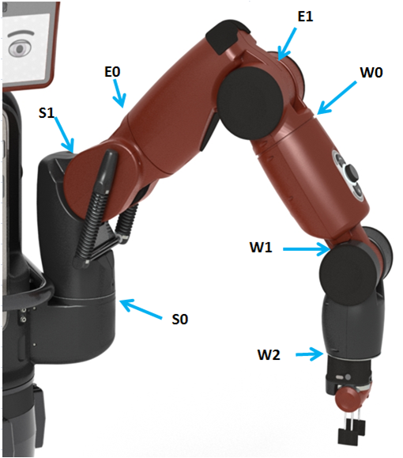
Representing the Arm’s Configuration
(q⁴)
The agent can sense each joint angle with proprioception.
The configuration is given by an ordered vector of joint angles $q= \left\langle q^{1}, q^{2},⋯,q^{7}\right\rangle$.
The configuration stored in a node $n_{i}$ will be denoted $q_{i}$ $= \left\langle q_{i}^{1},q_{i}^{2},⋯,q_{i}^{7}\right\rangle$.
(q³)
(q⁵)
(q²)
(q⁶)
(q¹)
(q⁷)
Image source: https://sdk.rethinkrobotics.com/wiki/Hardware_Specifications
Notes:
7 rotational joints, 2 shoulder, 2 elbow, and 3 wrist
Proximal to distal ordering

Slide 13
The Agent’s Vision
The agent can observe the environment at any time.
Images are captured with a single RGB-D camera with a fixed perspective.
Incorporate components of other models to consider changeable gaze
(Hulse et al., 2010), (Jamone et al., 2012, 2014)
Simple representations for the hand and other objects can be identified.
Binary image masks, centers, depth ranges, and orientations
Notes:
And this allows images to be recorded when the arm has a particular configuration

Slide 14
PPS Graph Nodes and Edges
Nodes represent poses visited during motor babbling.
These poses are safe and in view.
Stored configurations allow precise return to the same pose.
Stored visual data is used to decide which pose to return to.
Edges connect pairs of nodes with a feasible motion between them.
Motor babbling moves are feasible.
Moves shorter than the median length of motor babbling edges are assumed feasible.
Random exploration creates a PPS Graph of 3,000 nodes
117,717 edges
Notes:
2999 edges from motor babbling

Slide 15
Probabilistic Roadmaps (PRMs)
Our Peripersonal Space (PPS) Graph has a similar structure to a PRM.
A PRM represents the configuration space (Kavraki et al., 1996).
The PPS Graph is inspired by the Visual Roadmap (VRM).
Nodes store the configuration and associated perceptual information.
Intersections between arm percepts and object percepts suggest collisions.
(Ramaiah et al., 2015)
The PPS Graph has unique features:
Constructed during naturally plausible motor babbling.
Construction requires only limited sensory information without interpretation.
The agent must learn to use the stored information.
Notes:
Probabilistic roadmaps were introduced for use in Robotic Motion Planning
The Visual Roadmap also stored configurations and image data in the nodes

Slide 16
Building the PPS Graph with Motor Babbling
Notes:
The agent performs motor babbling in an open environment without objects present. The table is assumed to be in a fixed position and moves inside or below the surface are rejected. Each pose is generated by displacing each joint angle by a small random amount from the previous pose.
On the left you’ll see the node and edge added to the graph as the result of each random move, and on the right you’ll see the stored image for the node being added

Slide 17
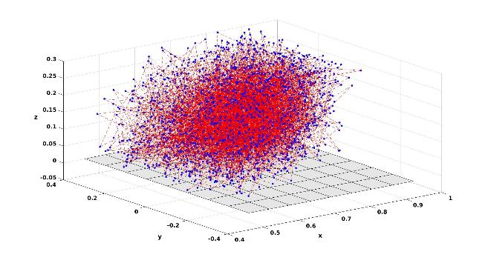
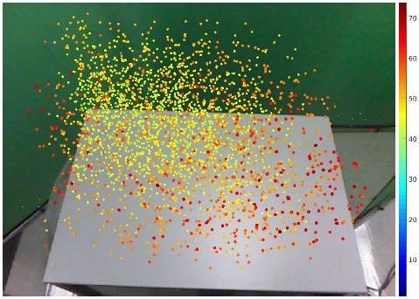
Visualizations of the PPS Graph after Motor Babbling is Completed
Nodes plotted at their (x,y,z) coordinate’s in Baxter’s default coordinate frame. For visualization only – not accessible to the agent.
Nodes plotted by their centers of mass in (u,v,d) image-space, as the agent sees them.

Slide 18
Learning to Reach
Notes:
Now that the agent has the capability to safely move throughout peripersonal space, it will observe the usual and unusual results of its moves and use these to define a reach action.

Slide 19
Observing the Unusual Bump Event
The agent performs move trajectories to random nodes.
The agent compares the “before” and “after” appearances of the object.
The typical result is no change to the object’s appearance.
In rare cases, the motion “bumps” the object and causes a significant change.
Move trajectory:
Before
Bump
Return trajectory:
After
Notes:
The agent can observe a mask for the object in the image taken before beginning the trajectory and after returning to the home node (this simplifies the image processing and rules out a difference in appearance because of an occlusion)

Slide 20
Differentiating Bumps from the Typical Result
$IOU\left(A,B\right)= \frac{\left|A ∩ B\right|}{\left|A ∪ B\right|}$
Clear typical and atypical clusters emerge
IOU ≈ 1 → No change
IOU << 1 → Bump
Notes:
For each trajectory, the agent calculates the Intersection over Union (IOU) between the before and after masks. The size of the intersection and union are the number of pixels in each.

Slide 21
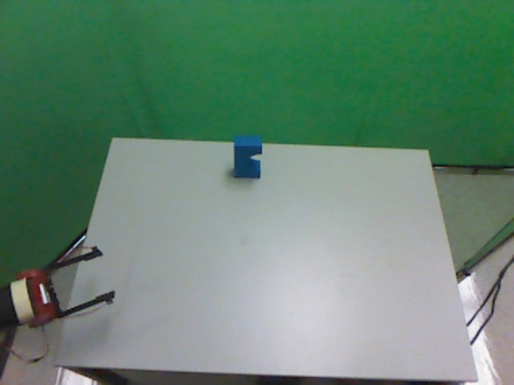
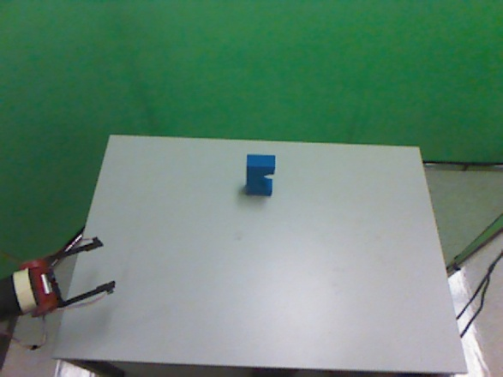
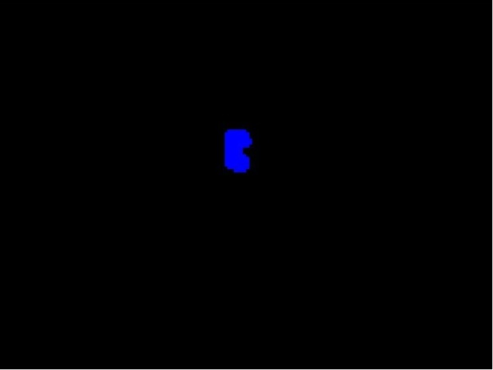
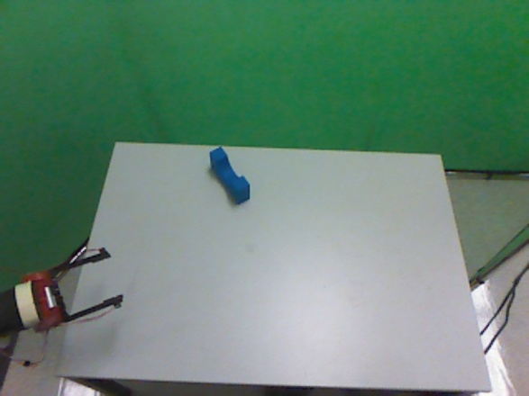
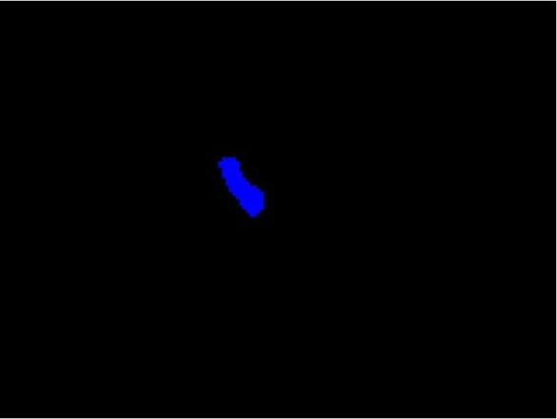
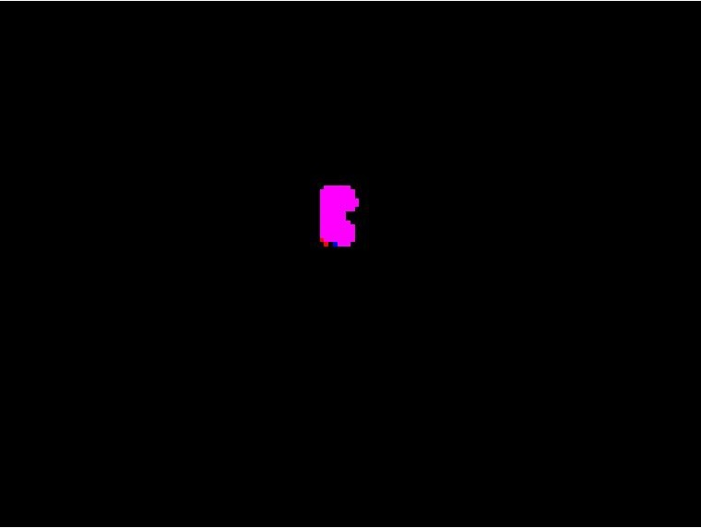
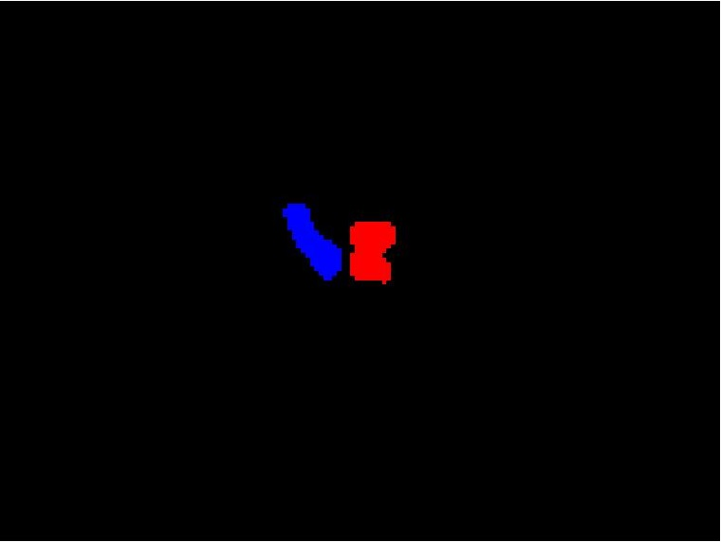
Examples of No Change and Bump Results
No Change (Typical, IOU ≈ 1)
Bump (Unusual, IOU << 1)
Before
After
Intersection
and Union

Slide 22
Planning a Reach Step 1: Observe the Target with the Hand at the Home Node
The target object’s mask and depth range are extracted from the current visual percepts.

Slide 23
Planning a Reach Step 2: Determine the Set of Final Node Candidates
Only 3 of 3000 nodes are reliable candidates
when the target is placed here.

Slide 24
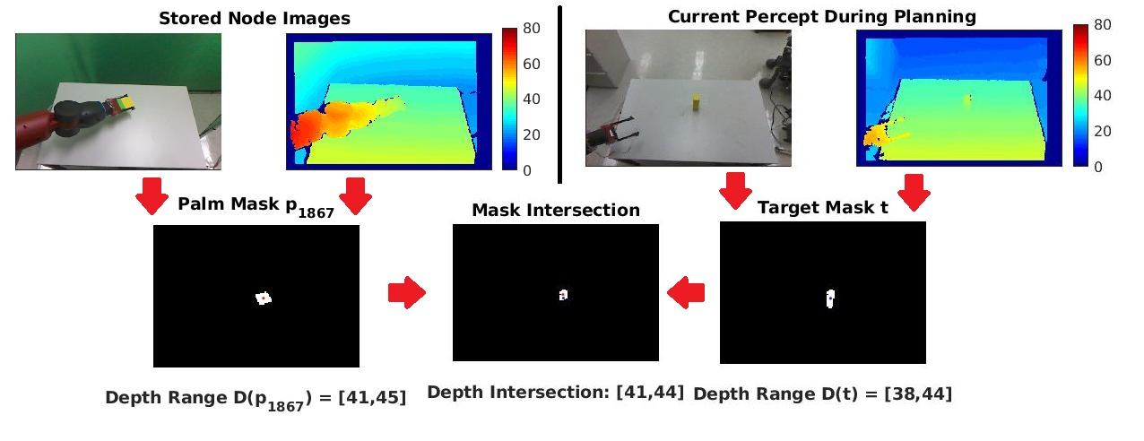
Determining the Candidacy of a Node using Intersection Features
This node has the most reliable type of intersection features. Both its mask and depth range intersect with the target’s. It will be included in the set of final node candidates.
Notes:
There are four possible types of intersection features, the masks could intersect or not and the depth ranges could intersect or not.

Slide 25
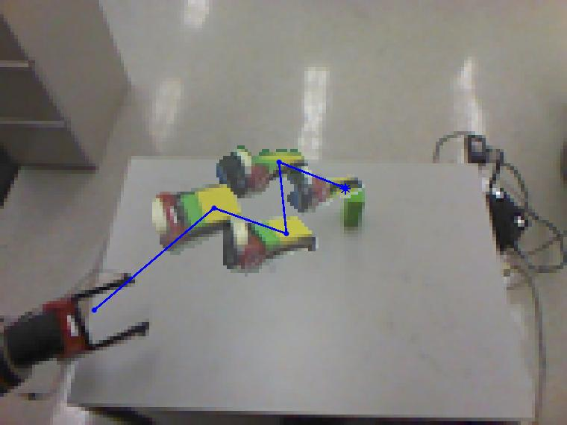
Planning a Reach Step 3: Find the Shortest Graph Path Trajectory to a Final Node Randomly Chosen from the Candidates
Numerous paths exist between the home node and the selected final node. The shortest in configuration space distance will be used to perform the reach.
52.5% of reaches planned in this way successfully bumped the object.

Slide 26
Why Aren’t All Reaches to these Final Node Candidates Successful?
Object representations overestimate the space they occupy.
This leads to some intersections that imply false positive collisions.
Changes caused by small collisions may not be observable.
Reaches should end with the candidate node closest to the target.
77.5% reliable
Can the agent reach closer than the nearest node?
Notes:
For both the hand and the target, the representation is a hull of the true object, treating it as occupying the full range of depths across the full mask. Very small intersections may correspond to small collisions that do not change the object significantly, so a bump will not be observed

Slide 27
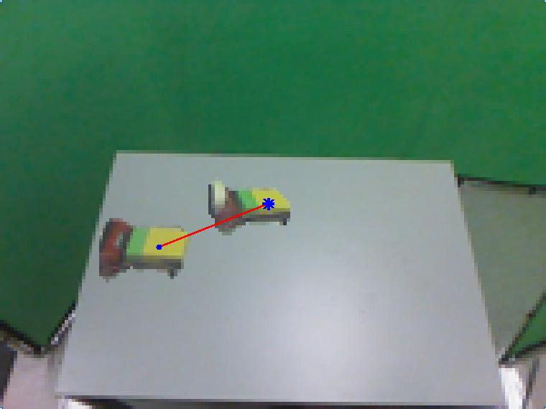
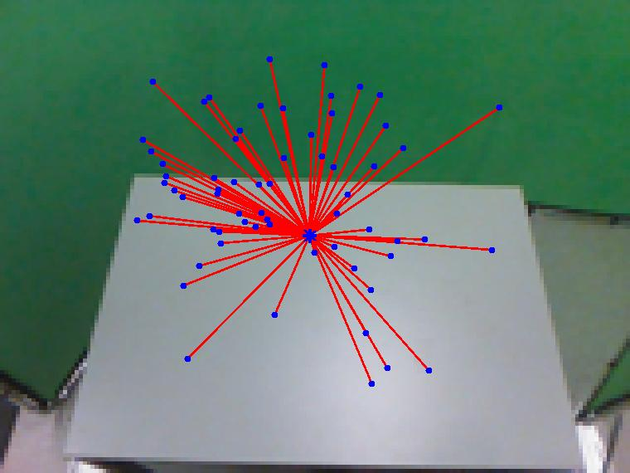
Estimating a Local Jacobian for the Neighborhood of a PPS Graph Node
Each neighbor $nj$ of a node $ni$ provides an example of:
A change in configuration space $∆q= q_{j}−q_{i}$
And the resulting change of the hand’s center position in image space $∆c= c_{j}−c_{i}$
The changes for all neighbors can be combined into matrices $∆Q$ and $∆C$.
The local Jacobian estimate $\hat{J}\left(n_{i}\right)$is the least squares solution of
$$∆Q \hat{J}\left(n_{i}\right)= ∆C$$
Notes:
The Jacobian is a generalization of a derivative to higher dimensional spaces.
In this case it will be a 7x3 matrix of partial derivatives that describe the change in each image-space coordinate for a unit change in each joint angle.

Slide 28
Using Local Jacobian Estimates to Extend the PPS Graph to a Locally Continuous Representation
$∆q \hat{J}\left(n_{i}\right)= ∆c$is a linear estimate and most accurate near the node${ n}_{i}$.
$\hat{J}\left(n_{i}\right)$ can be used to predict the change $∆c$ caused by a change $∆q$ from $q_{i}$.
${\hat{J}}^{+}\left(n_{i}\right)$ can be used to estimate the $∆q$ required to produce a desired $∆c$.
When reaching, the final node can be adjusted to match the target’s center.
The stored node image and current image of the target provide $∆c= c_{target}−c_{i}$.
The node stores its original arm configuration $q_{i}$.
The agent estimates the necessary change to the configuration $∆q= {∆c \hat{J}}^{+}\left(n_{i}\right)$.
The agent moves to${ q}_{i}+∆q$ instead of $q_{i}$ during the trajectory.
The hand’s center is expected to be zero distance from the target’s at this configuration.
Notes:
The pseudo-inverse of the local Jacobian matrix
Because we’re making an adjustment near the original position of the node, that estimate will be relatively accurate.

Slide 29
100% Reliable Reaching
The agent is now capable of causing observable (large) bumps with each reach attempt. These bump always occurred at the intended final node.

Slide 30
Our Model of the Learned Reach Action Matches Infant Behavior
Reach trajectories are sequences of jerky submotions.
(von Hofsten, 1991), (Thelen et al., 1993), (Berthier, 2011)
Reaches do not require current vision of the hand.
Before Clifton et al. (1993) the consensus was that infant reaches use visual servoing (Piaget, 1952).
Clifton et al. studied infant reaches without current vision of the hand.
Reaches for lit objects in the dark are equally successful (Clifton et al., 1993).
Reaches for lit objects in the dark use the same kinematics (Clifton et al., 1994).
In our model, reaches are planned using current vision of the object but only stored images of the hand.

Slide 31
Learning to Grasp

Slide 32
The Challenge of Observing Accidental Grasps
The usual result of a reach is a bump (100% reliable).
The unusual result is an accidental grasp.
An accidental grasp requires two low-probability events:
The grippers must surround the object during the trajectory.
The grippers must be closed at the correct time to firmly grip the object.
The agent must observe multiple grasp examples to begin learning.
The co-occurrence of these events by chance is prohibitively rare.

Slide 33
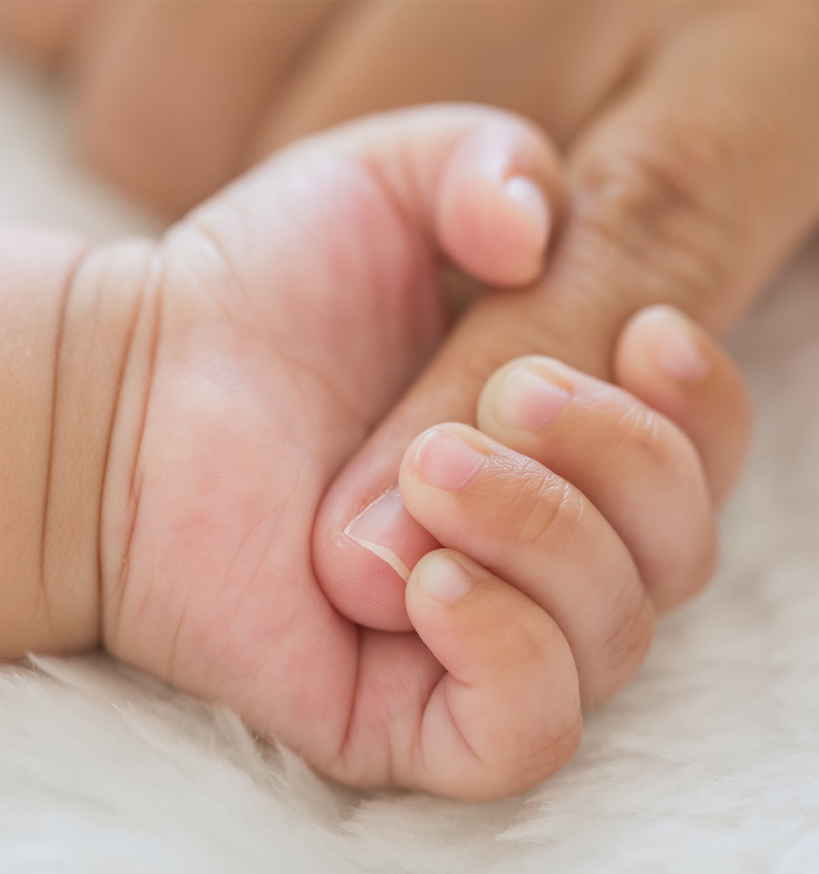
The Palmar Reflex
In human infants, the Palmar reflex causes the hand to close around an object pressed into the palm (Futagi et al., 2012).
We simulate the Palmar reflex with a break-beam sensor.
Closing the grippers is caused reflexively instead of by chance.
Observing accidental grasps is now tractable.
Image source: https://nashvilleparent.com/8-infant-reflexes-baby-s-born-with

Slide 34
The Gripper should be Fully Open during the Grasp Approach
Open grippers allow the Palmar reflex to be activated more often.

Slide 35
The Approach and Hand Orientation should be Perpendicular to the Target Major Axis
The agent uses two local Jacobian adjustments to create a final pose and a preshaping pose based on the most perpendicular final node candidate.

Slide 36
Additional Improvements to Grasp Reliability
The w2 joint should be set to orient the hand to surround the object.
The displacement of the final node from the target should be well-aligned with the orientation of the hand before adjustment.
TODO: Add results here
Grasp Method (All with open grippers and Palmar reflex) | Reliability
Move to a random node | 2.5%
Reach to a random final node candidate | 2.5%
Reach to the closest final node candidate | 5.0%
Reach to adjusted closest candidate | 12.5%
Approach vector perpendicular to target major axis | 35.0%
… and orient the hand with the wrist | 50.0%
… and select a final node with aligned displacement and orientation vectors | 57.5%
2x
Notes:
The agent learns that the smallest wrist joint can be used to rotate the hand without significantly changing its position, and that settings of w2 that produce desirable orientations can be based on previous successful grasps
If these vectors are already relatively aligned, the local Jacobian adjustment required will be smaller and tend to be more accurate.

Slide 37
Why Isn’t Grasping Fully Reliable?
The structure of the hand is not conducive to grasping.
The parallel grippers require very specific trajectories.
The inflexible hand cannot be reconfigured to improve a failing grasp.
The agent may need improved visual perception and representations.
The agent relies on distorted image space coordinates and object hulls.
Workspace representations or more detailed object models may be required.
Smooth and precise motions of late action learning may be necessary.

Slide 38
Learning to Ungrasp
With an object grasped, an attempt to…
Rotate any arm joint maintains the grasp
Decrease or slightly increase the gripper aperture maintains the grasp
Significantly increase the gripper aperture ends the grasp
An ungrasp is an unusual event
The agent learns that fully opening the grippers is 100% reliable

Slide 39
Learning to Place

Slide 40
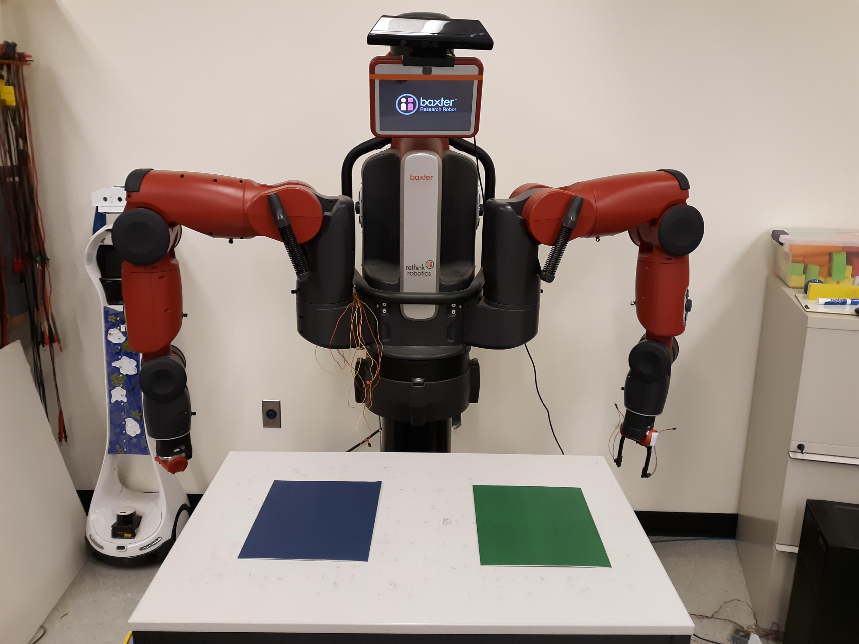
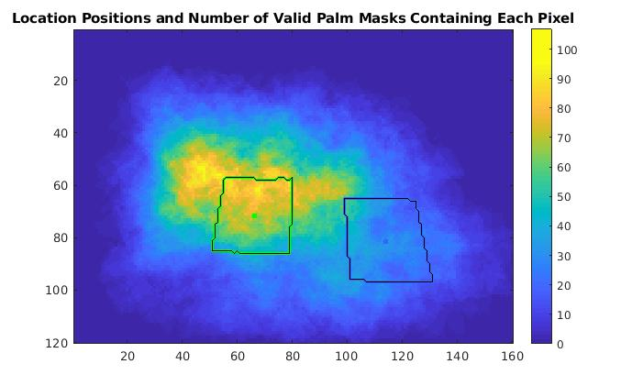
Representing Qualitative Locations
The agent defines two locations using visually distinct colored patches
Notes:
These locations are relatively large, but they are a good fit for the agent’s sensorimotor capabilities at this phase of development. As the agent becomes more skilled and its vision and control become more precise, it would be feasible to consider smaller locations.

Slide 41
Ungrasps that Placed into the Blue Location by Chance
14 (25.4%) out of 55
successful ungrasps
Notes:
The agent performed each ungrasping trial from a randomly selected node. Out of those ungrasping trials, 55 were successful, and of those successes 14 happened to place the block into the blue location.
You’ll notice from some of these images that the agent’s definition of “in” only requires any intersection with the location instead of being fully surrounded, and does not require a specific position or orientation. This definition can be used with the agent’s mask representation of the object, and a more precise definition could used as the agent becomes more skilled or has a more detailed model of the object.

Slide 42
Learning that Shorter Distances are More Reliable for Placing
The agent repeats the ungrasps that placed into the blue location.
Ungrasps performed at more distant nodes are less likely to be successful placements.
The agent learns to move to the node closest to the location before ungrasping.

Slide 43
Placing into the Blue Location from the Closest Node is 100% Reliable
Notes:
Now that the agent has learned that closer nodes tend to be more reliable, it can search the full PPS Graph for the node with the shortest center to center image space distance to the blue location. Placing into the blue location by ungrasping while at that node is 100% reliable.

Slide 44
This Policy is also 100% Reliable for the Green Location

Slide 45
Learning to Pick-and-Place

Slide 46
Performing the Pick-and-Place Sequence
Grasping a block satisfies the preconditions of the place action.
The agent attempts to move the block from one location to the other.
The pick-and-place action is 52.5% reliable.
Reliability is determined by the reliability of grasping.
Notes:
so a block may be grasped from the table and then placed on the table
All pick-and-place attempts where the grasp succeeds have a successful placement

Slide 47
Potential for Learning through Repetitive Play (Piaget, 1977), (Schmidhuber, 2011)
4x

Slide 48
Conclusion
We present the Peripersonal Space (PPS) Graph model.
Minimal required sensory capabilities and prior knowledge
Allows safe motion throughout PPS that provides experience
We demonstrate successful manipulation action learning.
All actions are defined by the agent based on observed unusual events.
Moving, reaching, ungrasping, and placing become fully reliable.
Grasping and pick-and-place become semi-reliable.
Our model predicts behaviors matching surprising observations of infants.
These early phase actions provide enriched experience that could make late phase reinforcement learning more efficient.

Slide 49
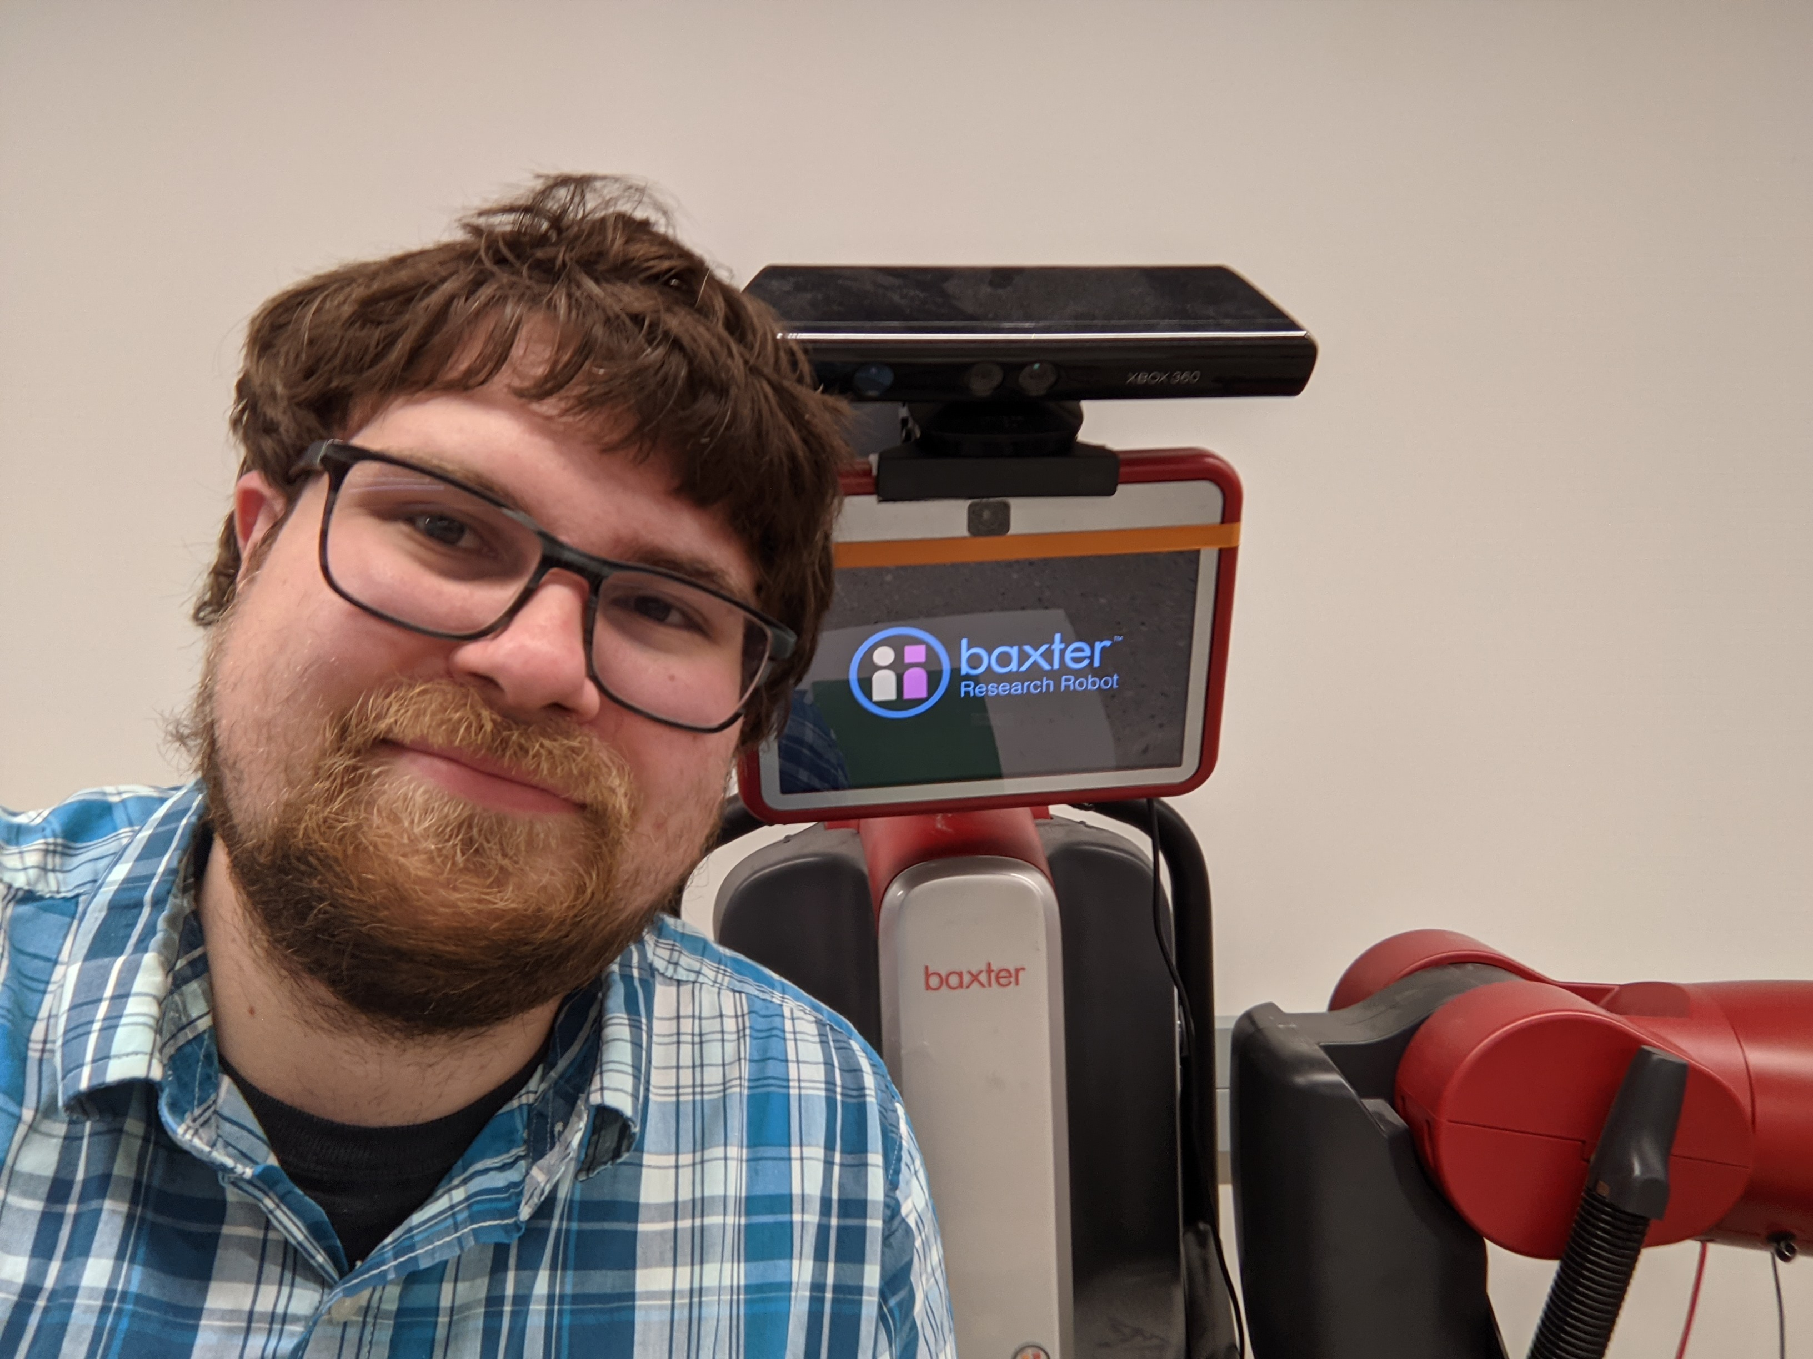
Thank you!
Questions?

Slide 50
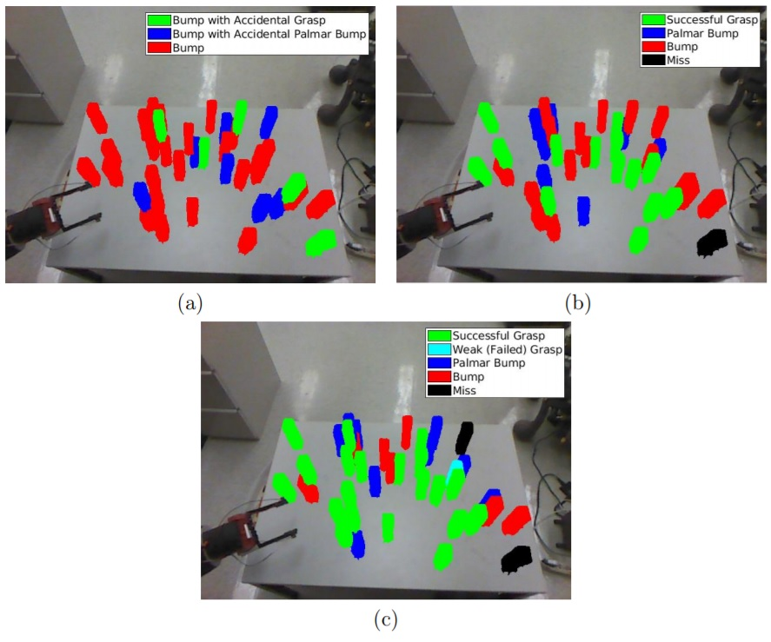

Slide 51
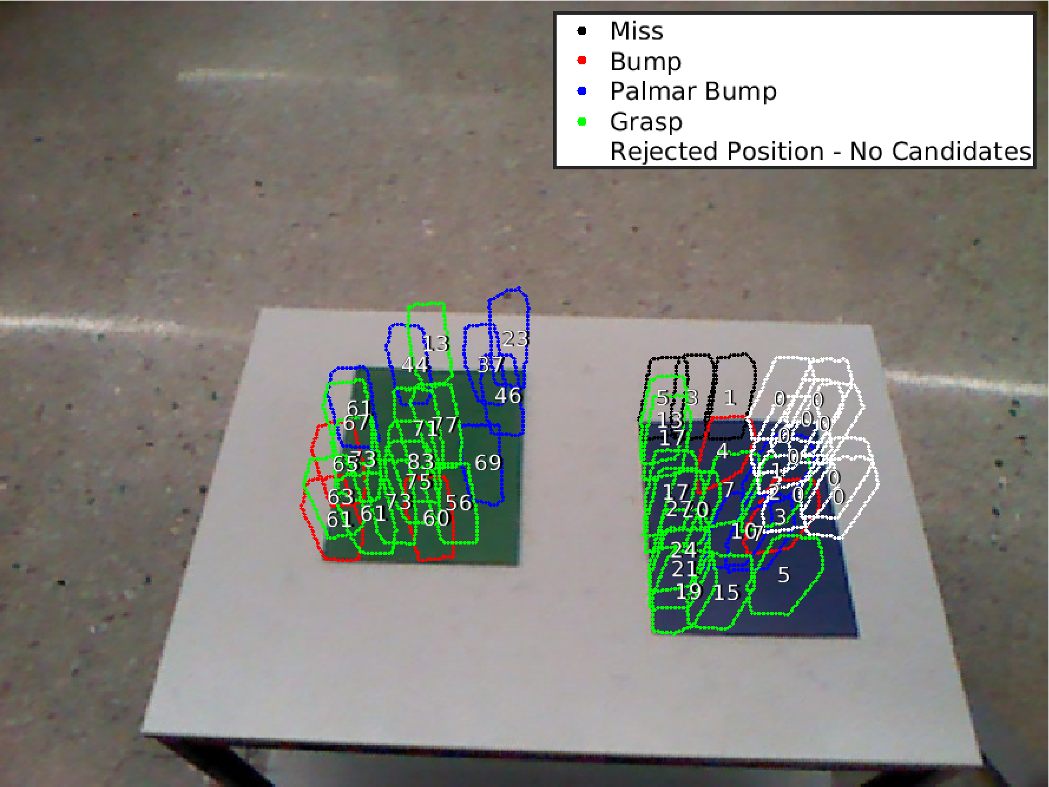

Slide 52
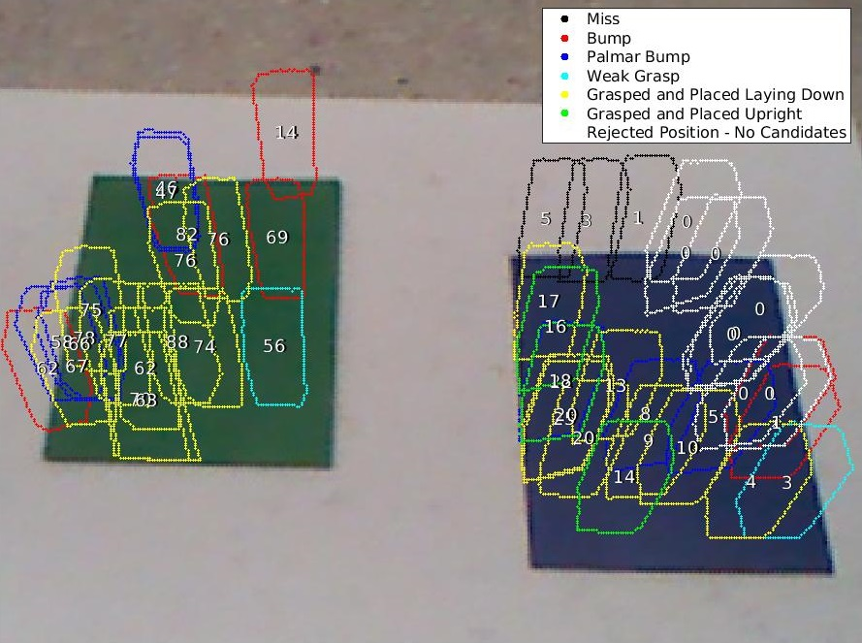

Slide 53
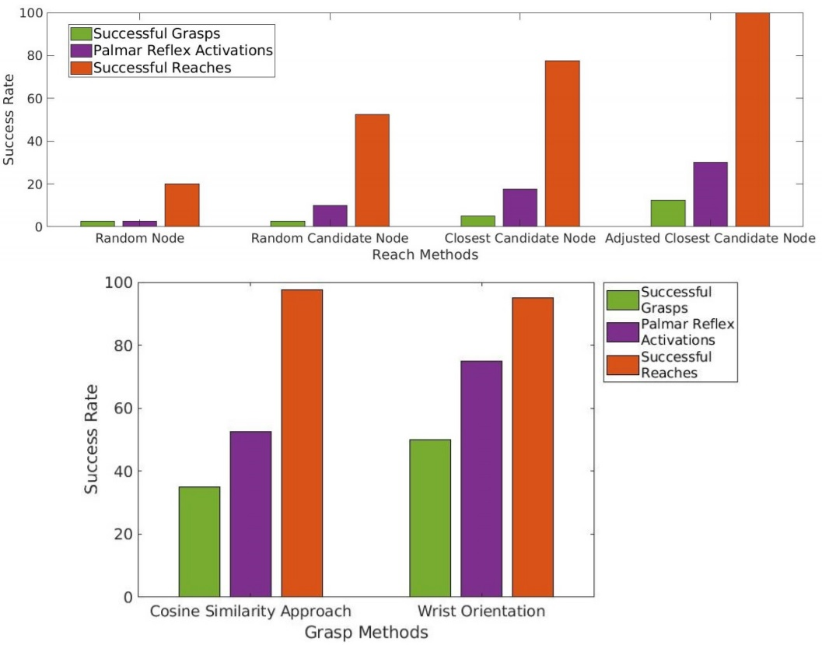

Slide 54
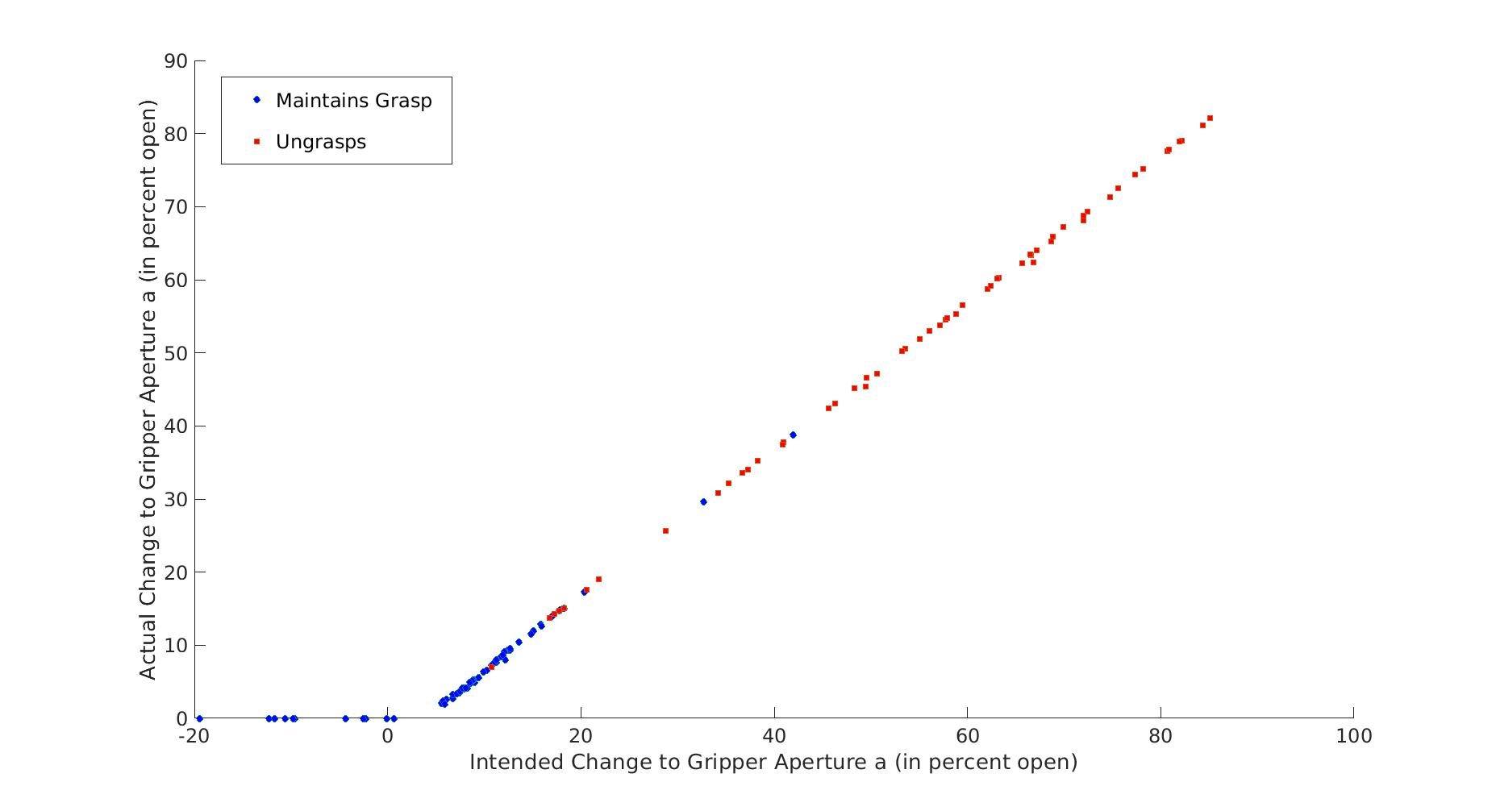

Slide 55
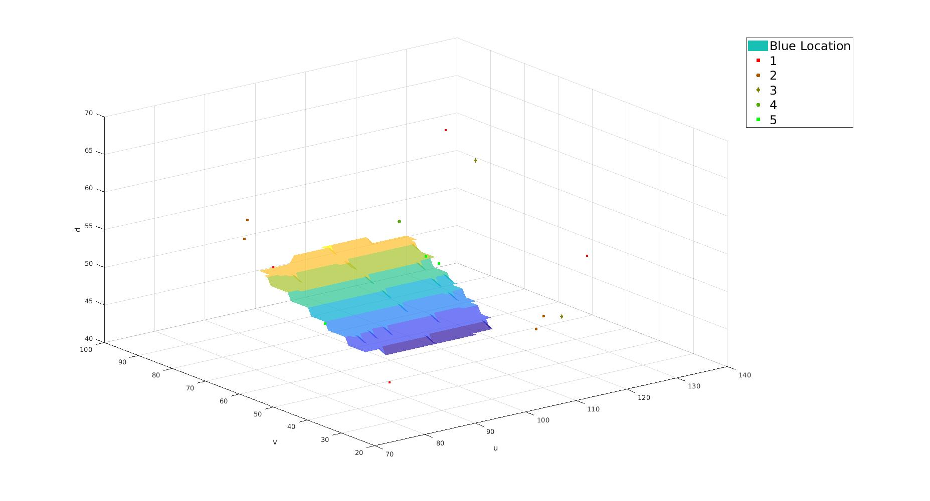

Slide 56
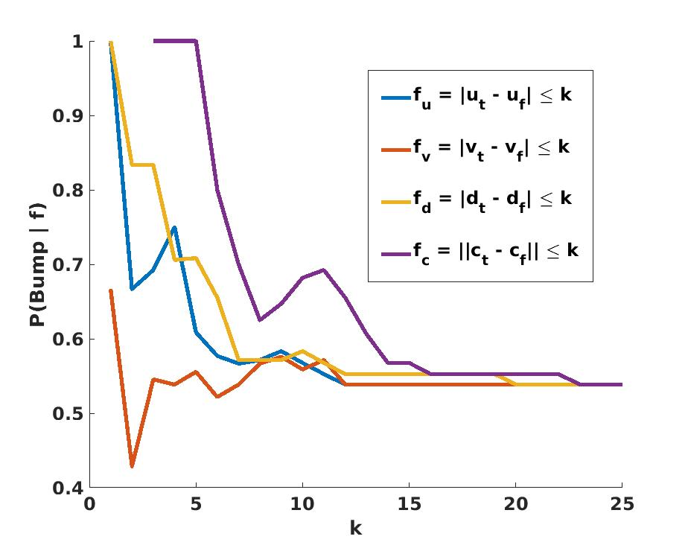

Slide 57
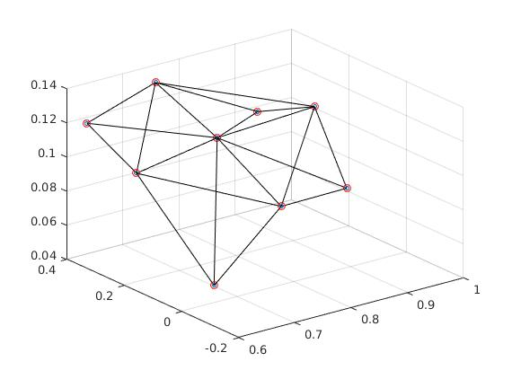
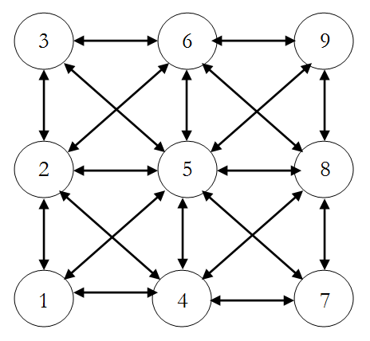

Slide 59
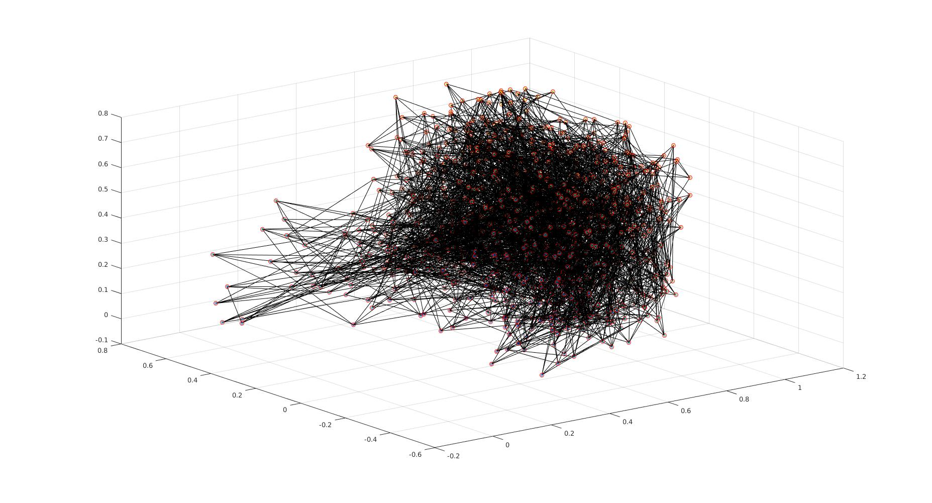

Slide 60
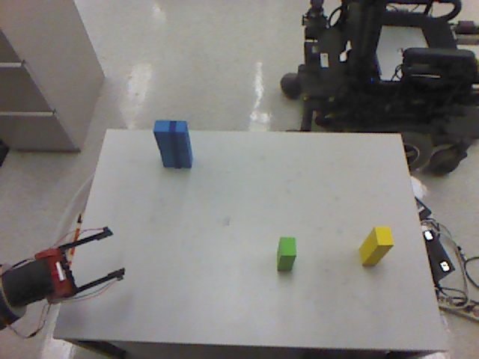

Slide 61
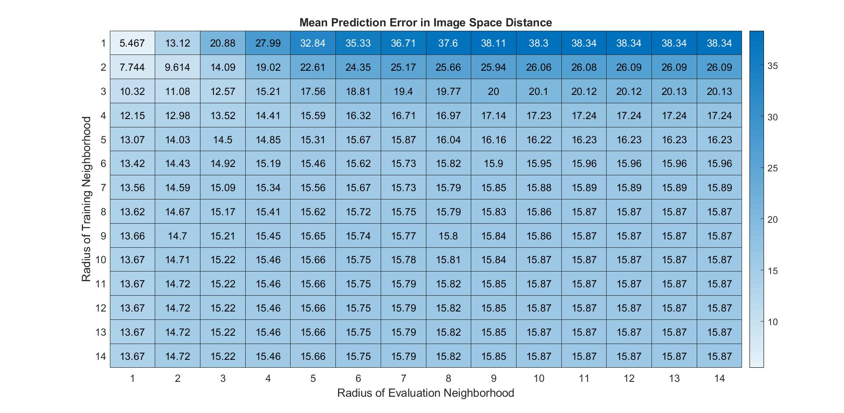

Slide 62
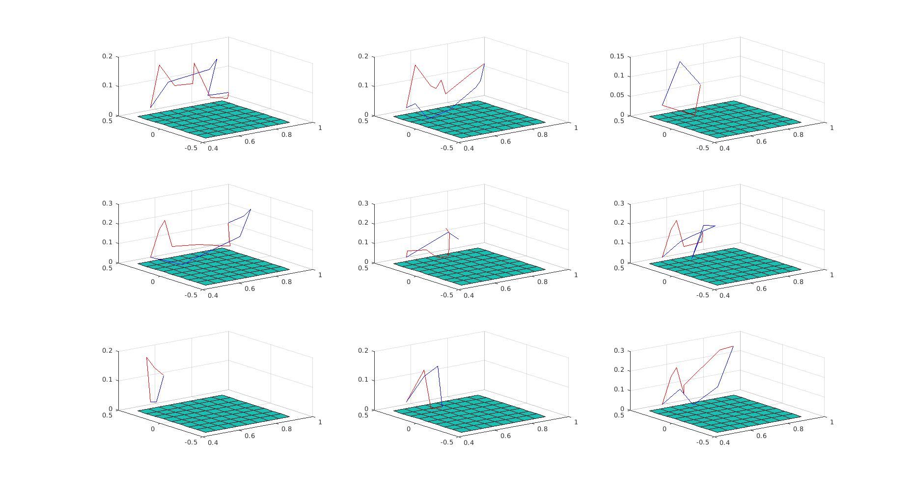

Slide 63
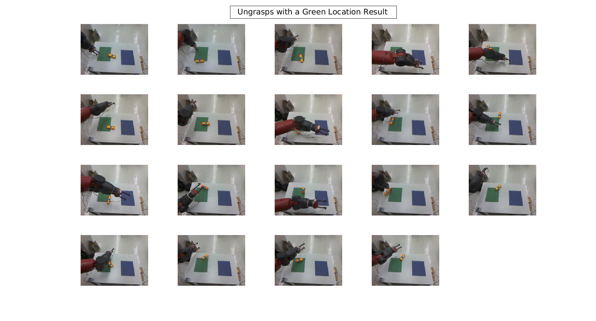

Slide 65
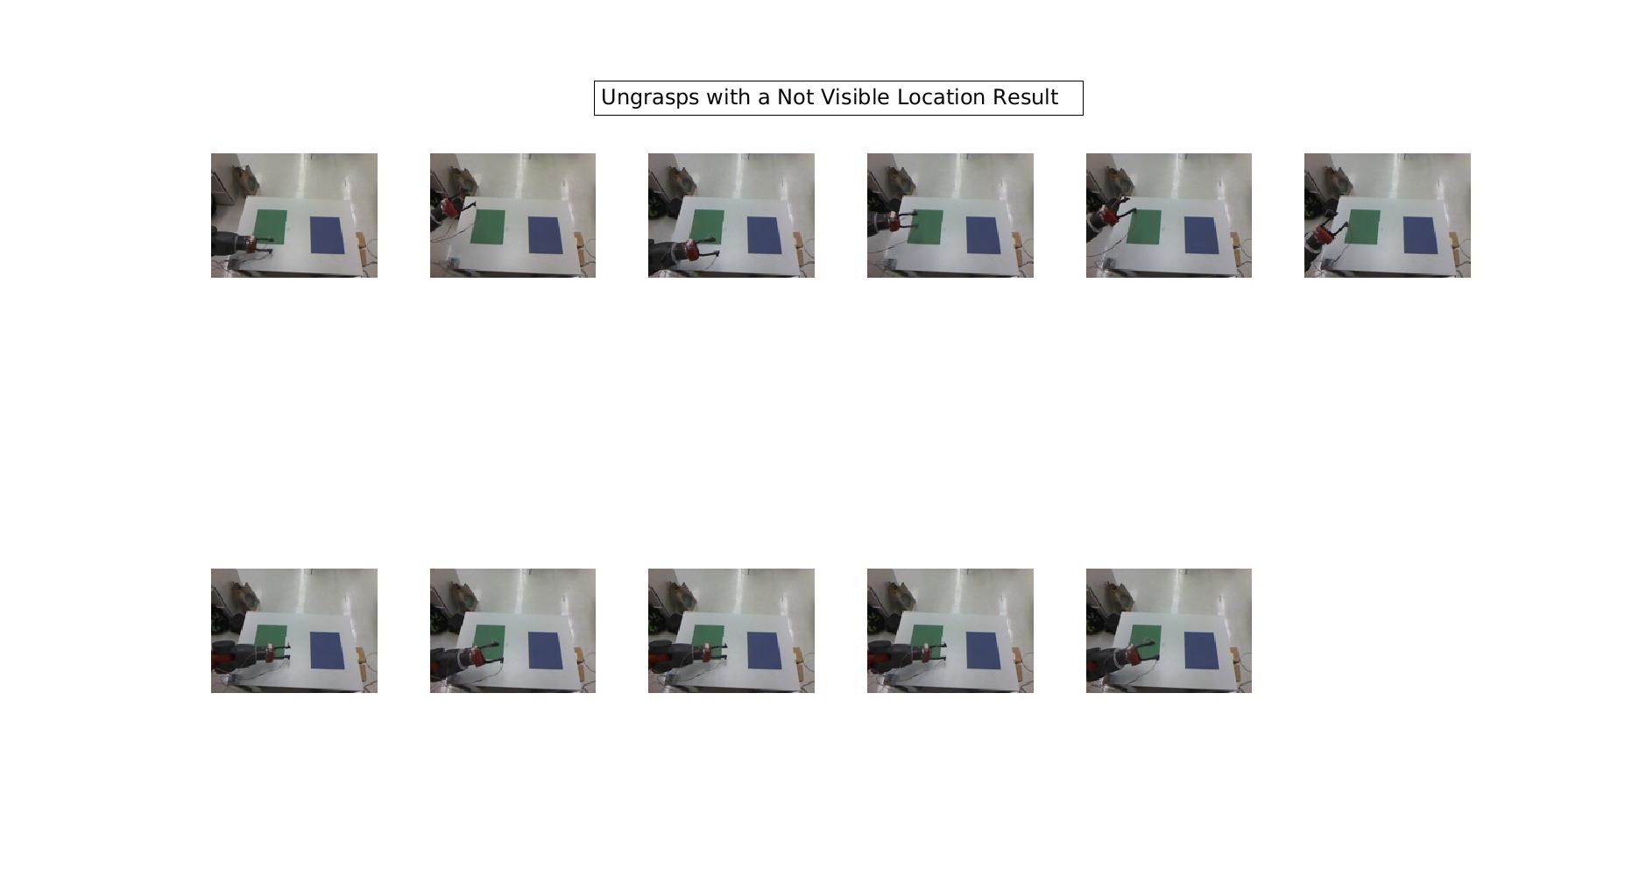

Slide 66
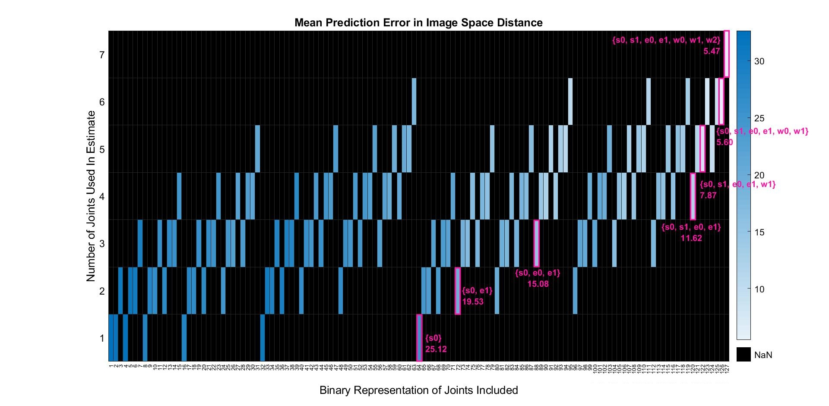

Slide 67
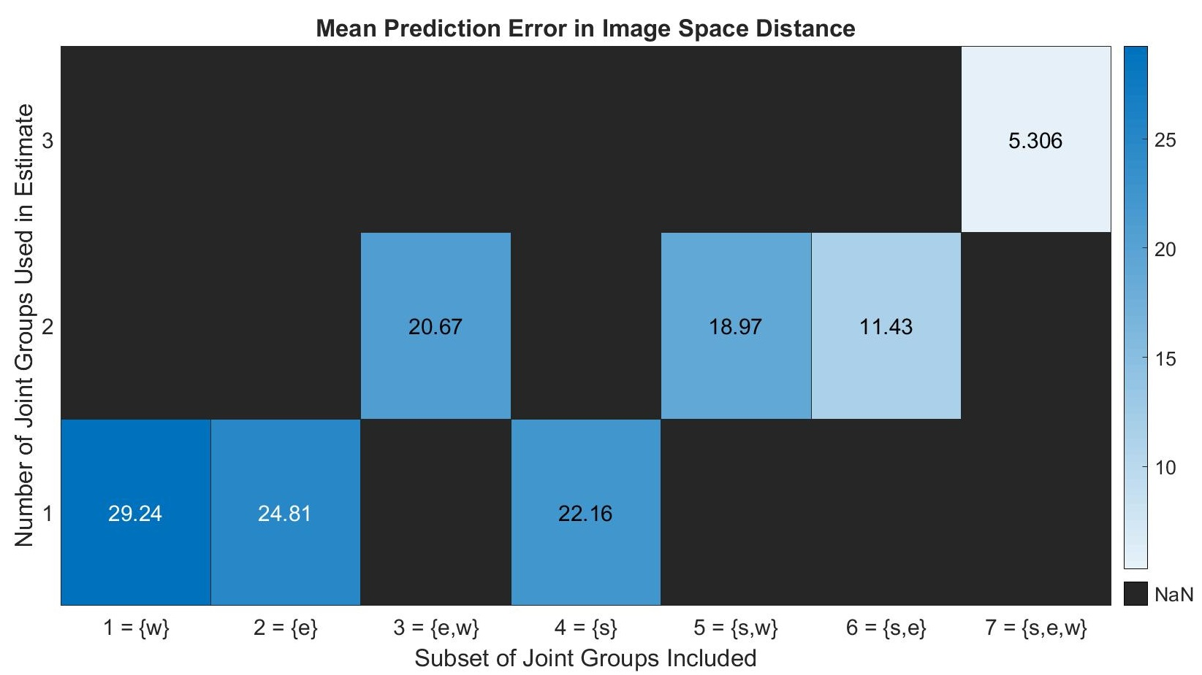

Slide 68
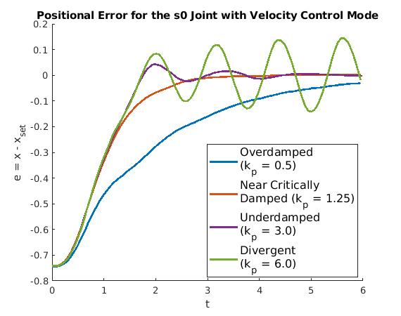
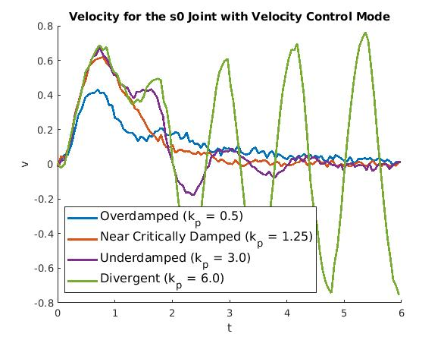
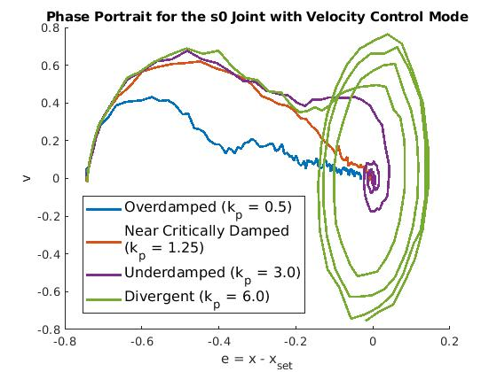
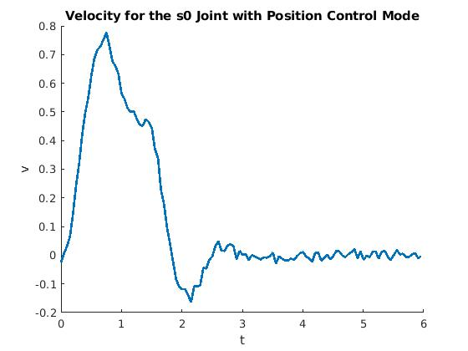
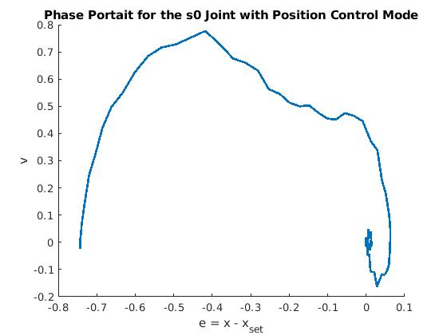
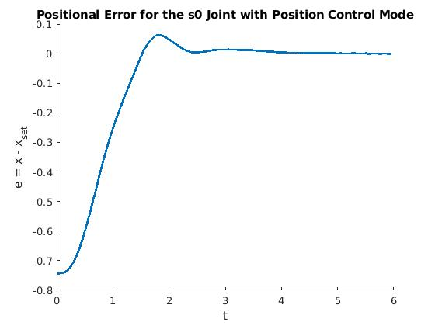

Slide 69
