Slide 1
Lecture 10:
Scales and Descriptors

Slide 2
Administrative
HW2 out, due 1 week from tomorrow:
Wednesday 2/19/2019, 11:59pm
HW3 out tomorrow, due 2 weeks from Friday:
Friday 2/27, 11:59pm

Slide 3
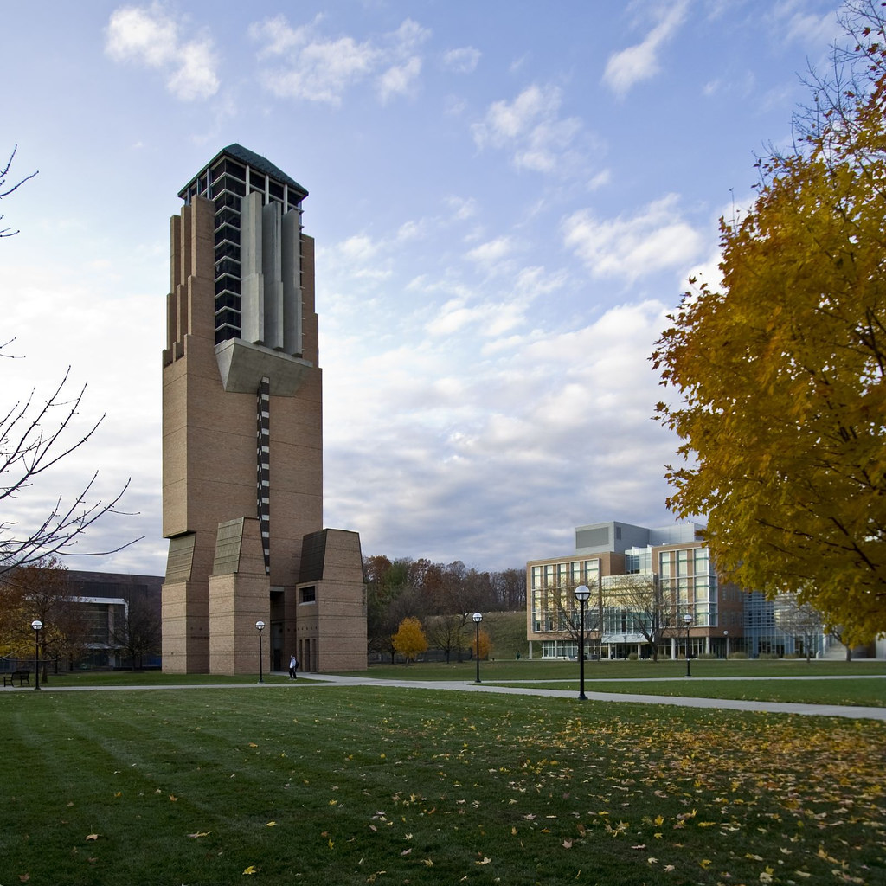
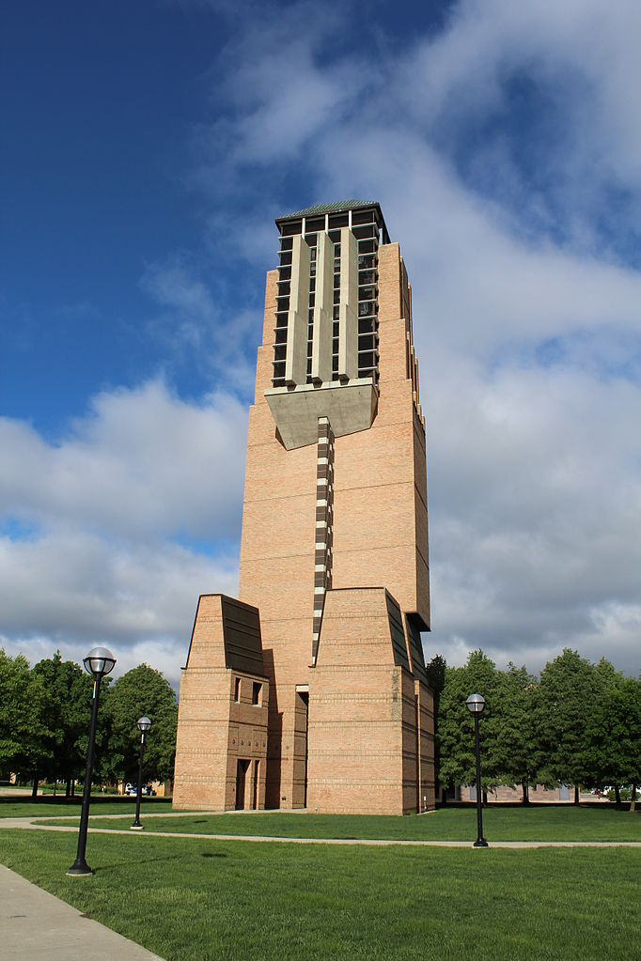
Last Time: Motivation
Are these pictures of the same object?
If so, how are they related?

Slide 4


Last Time: Finding + Matching
Finding and Matching
1: find corners+features
2: match based on local image data
Slide Credit: S. Lazebnik, original figure: M. Brown, D. Lowe

Slide 5
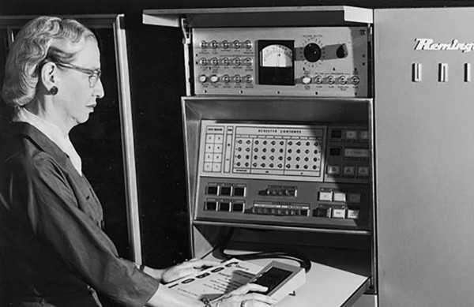
Last Time: Edges + Corners
Part 1: Finding Edges
Part 2: Finding Corners
Corner of
the glasses
Edge next to panel

Slide 6
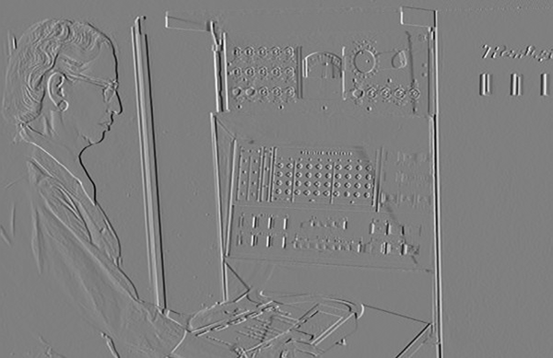
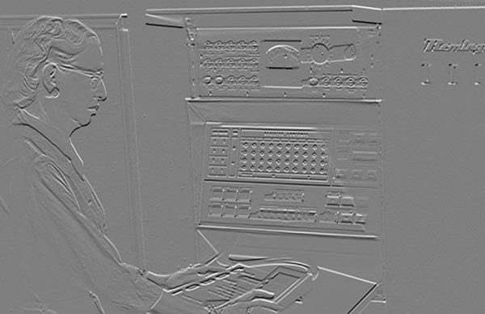
Last Time: Edges via Image Gradients
Compute derivatives Ix and Iy with filters
Ix
Iy

Slide 7
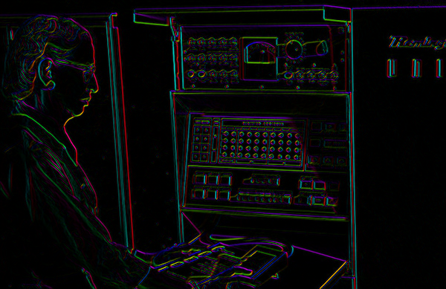

Last Time: Edges via Image Gradients
Gradient Direction: atan2(Ix, Iy)
Gradient Magnitude: sqrt(Ix² + Iy²)
I’m making the lightness equal to gradient magnitude

Slide 8

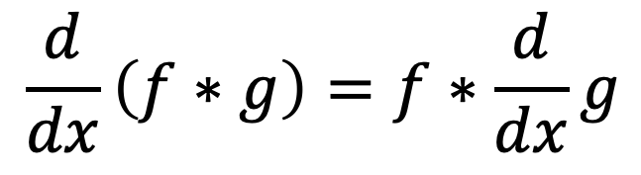
Last Time: Edges via Image Gradients
$$\frac{d}{dx}\left(f∗g\right)=f∗\frac{d}{dx}g$$
f
Slide Credit: S. Seitz

Slide 9

Last Time: Corners
Can localize the location, or any shift →
big intensity change.
“flat” region:
no change in all directions
“edge”:
no change along the edge direction
“corner”:
significant change in all directions
Diagram credit: S. Lazebnik

Slide 10
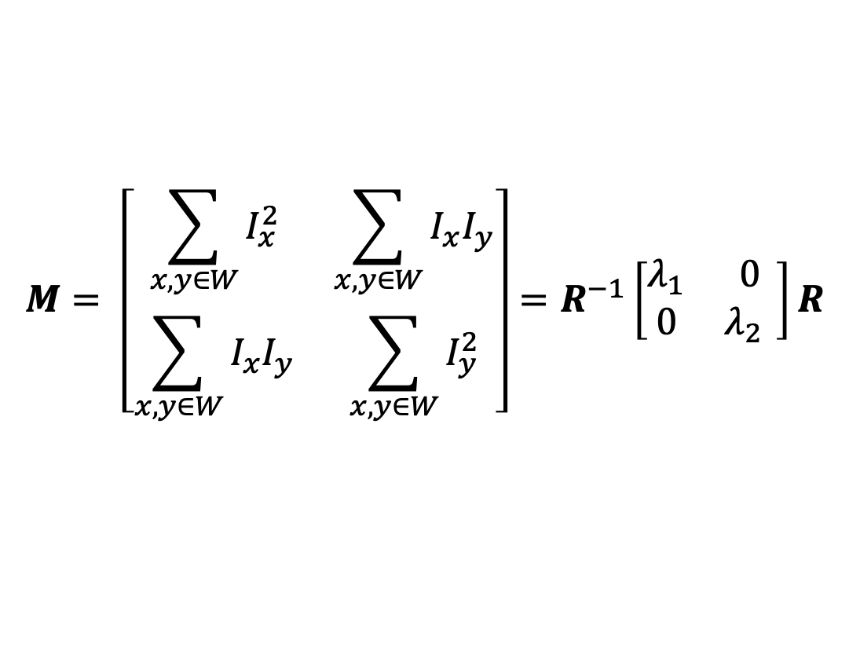
Last Time: Detecting Corners
By doing a taylor expansion of the image, the second moment matrix tells us how quickly the image changes and in which directions.
Can compute at each pixel
Directions
$$M= \left[\begin{matrix}\sum_{x,y∈W}{I_{x}^{2}} & \sum_{x,y∈W}{I_{x}I_{y}} \\ \sum_{x,y∈W}{I_{x}I_{y}} & \sum_{x,y∈W}{I_{y}^{2}}\end{matrix}\right]=R^{−1}\left[\begin{matrix}λ_{1} & 0 \\ 0 & λ_{2{ }}\end{matrix}\right]R$$
Amounts

Slide 11
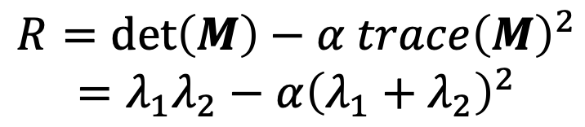
Last Time: Detecting Corners
“Edge”
R < 0
$$R=\det\left(M\right)−α trace{\left(M\right)}^{2}$$
$$=λ_{1}λ_{2}−α{\left(λ_{1}+λ_{2}\right)}^{2}$$
“Corner”
R > 0
α: constant (0.04 to 0.06)
|R| small
“Flat” region
“Edge”
R < 0
Slide credit: S. Lazebnik; Note: this refers to visualization ellipses, not original M ellipse. Other slides on the internet may vary

Slide 12
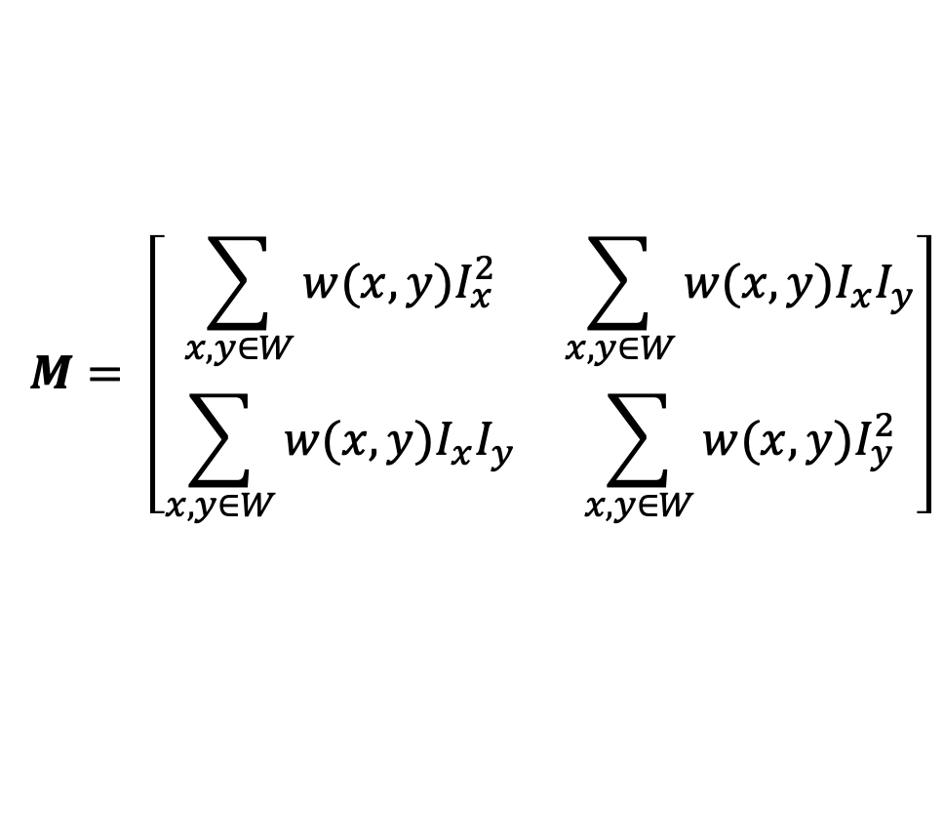
Harris Corner Detector
Compute partial derivatives Ix, Iy per pixel
Compute M at each pixel, using Gaussian weighting w
$$M= \left[\begin{matrix}\sum_{x,y∈W}{{w(x,y)I}_{x}^{2}} & \sum_{x,y∈W}{{w(x,y)I}_{x}I_{y}} \\ \sum_{x,y∈W}{{w(x,y)I}_{x}I_{y}} & \sum_{x,y∈W}{{w(x,y)I}_{y}^{2}}\end{matrix}\right]$$
C.Harris and M.Stephens. “A Combined Corner and Edge Detector.” Proceedings of the 4th Alvey Vision Conference: pages 147—151, 1988.
Slide credit: S. Lazebnik

Slide 13
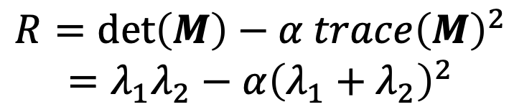
Harris Corner Detector
Compute partial derivatives Ix, Iy per pixel
Compute M at each pixel, using Gaussian weighting w
Compute response function R
$$R=\det\left(M\right)−α trace{\left(M\right)}^{2}$$
$$=λ_{1}λ_{2}−α{\left(λ_{1}+λ_{2}\right)}^{2}$$
C.Harris and M.Stephens. “A Combined Corner and Edge Detector.” Proceedings of the 4th Alvey Vision Conference: pages 147—151, 1988.
Slide credit: S. Lazebnik

Slide 14

Computing R
Slide credit: S. Lazebnik

Slide 15

Computing R
Slide credit: S. Lazebnik

Slide 16
Harris Corner Detector
Compute partial derivatives Ix, Iy per pixel
Compute M at each pixel, using Gaussian weighting w
Compute response function R
Threshold R
C.Harris and M.Stephens. “A Combined Corner and Edge Detector.” Proceedings of the 4th Alvey Vision Conference: pages 147—151, 1988.
Slide credit: S. Lazebnik

Slide 17

Harris Corner Detector
Slide credit: S. Lazebnik

Slide 18
Harris Corner Detector
Compute partial derivatives Ix, Iy per pixel
Compute M at each pixel, using Gaussian weighting w
Compute response function R
Threshold R
Take only local maxima
(Non-Maxima Suppression, NMS)
C.Harris and M.Stephens. “A Combined Corner and Edge Detector.” Proceedings of the 4th Alvey Vision Conference: pages 147—151, 1988.
Slide credit: S. Lazebnik

Slide 19
Harris Corner Detector: NMS
Local Maxima are pixels with a higher R value than their neighbors
R
threshold
x (image coordinate)

Slide 20
Harris Corner Detector
Slide credit: S. Lazebnik

Slide 21

Harris Corner Detector: Result
Slide credit: S. Lazebnik

Slide 22
Desirable Properties
If our detectors are repeatable, they should be:
Invariant to some things: image is transformed and corners remain the same: D(T(I)) = D(I)
Covariant/equivariant with some things: image is transformed and corners transform with it:
D(T(I)) = T(D(I))
Where I is an image, T is a transformation, and D is our detector
Slide credit: S. Lazebnik

Slide 23

Affine Intensity Change
$$I_{new}=aI_{old}+b$$
M only depends on derivatives, so b is irrelevant
But a scales derivatives and there’s a threshold
R
R
threshold
x (image coordinate)
x (image coordinate)
Partially invariant to affine intensity changes
Slide credit: S. Lazebnik

Slide 24
Image Translation
All done with convolution. Convolution is translation invariant.
Equivariant with translation
Slide credit: S. Lazebnik

Slide 25
Image Rotation
Rotations just cause the corner rotation to change. Eigenvalues remain the same.
Equivariant with rotation

Slide 26
Image Scaling
Corner
One pixel can become many pixels and vice-versa.
Not equivariant with scaling

Slide 27
Today
Fixing scaling by making detectors in both location and scale
Enabling matching between features by describing regions

Slide 28





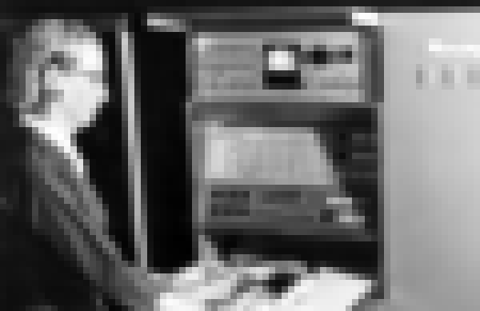
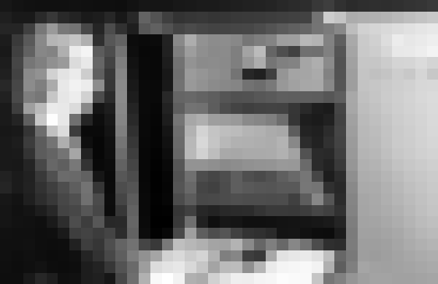
Key Idea: Scale
Left to right: each image is half-sized
Upsampled with big pixels below
1/2
1/2
1/2
Note: I’m also slightly blurring to prevent aliasing (https://en.wikipedia.org/wiki/Aliasing)

Slide 29
Key Idea: Scale
Left to right: each image is half-sized
If I apply a KxK filter, how much of the original image does it see in each image?
1/2
1/2
1/2
Note: I’m also slightly blurring to prevent aliasing (https://en.wikipedia.org/wiki/Aliasing)

Slide 30
Solution to Scales: Try them all!
Harris Detection
Harris Detection
Harris Detection
Harris Detection
See: Multi-Image Matching using Multi-Scale Oriented Patches, Brown et al. CVPR 2005

Slide 31
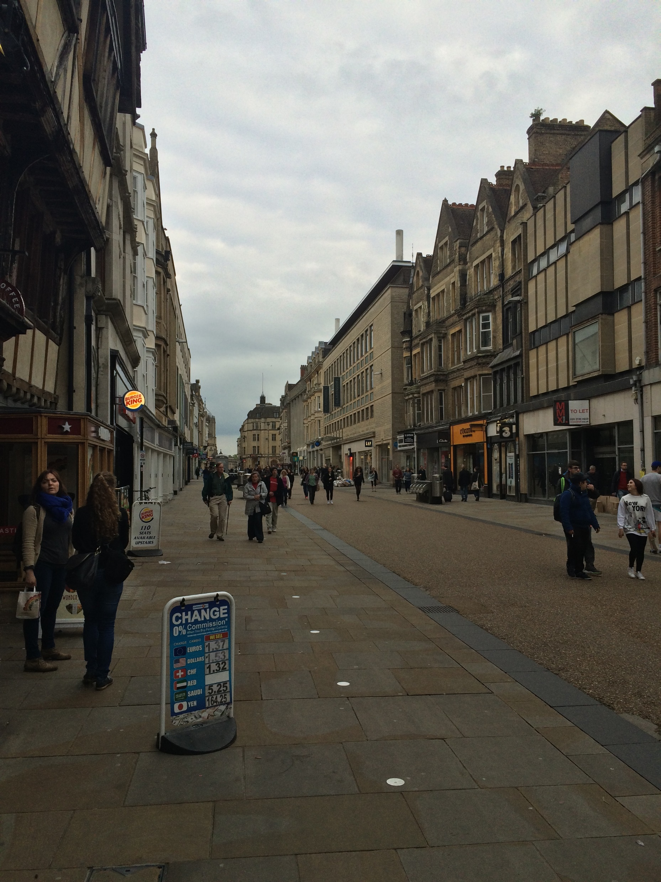
Aside: This is a common trick!
Given a 50x16 person detector, how do I detect:
(a) 250x80 (b) 150x48 (c) 100x32 (d) 25x8 people?
Sample people from image

Slide 32
Aside: This is a common trick!
Detecting all the people
The red box is a fixed size
Sample people from image

Slide 33
Aside: This is a common trick!
Detecting all the people
The red box is a fixed size
Sample people from image

Slide 34
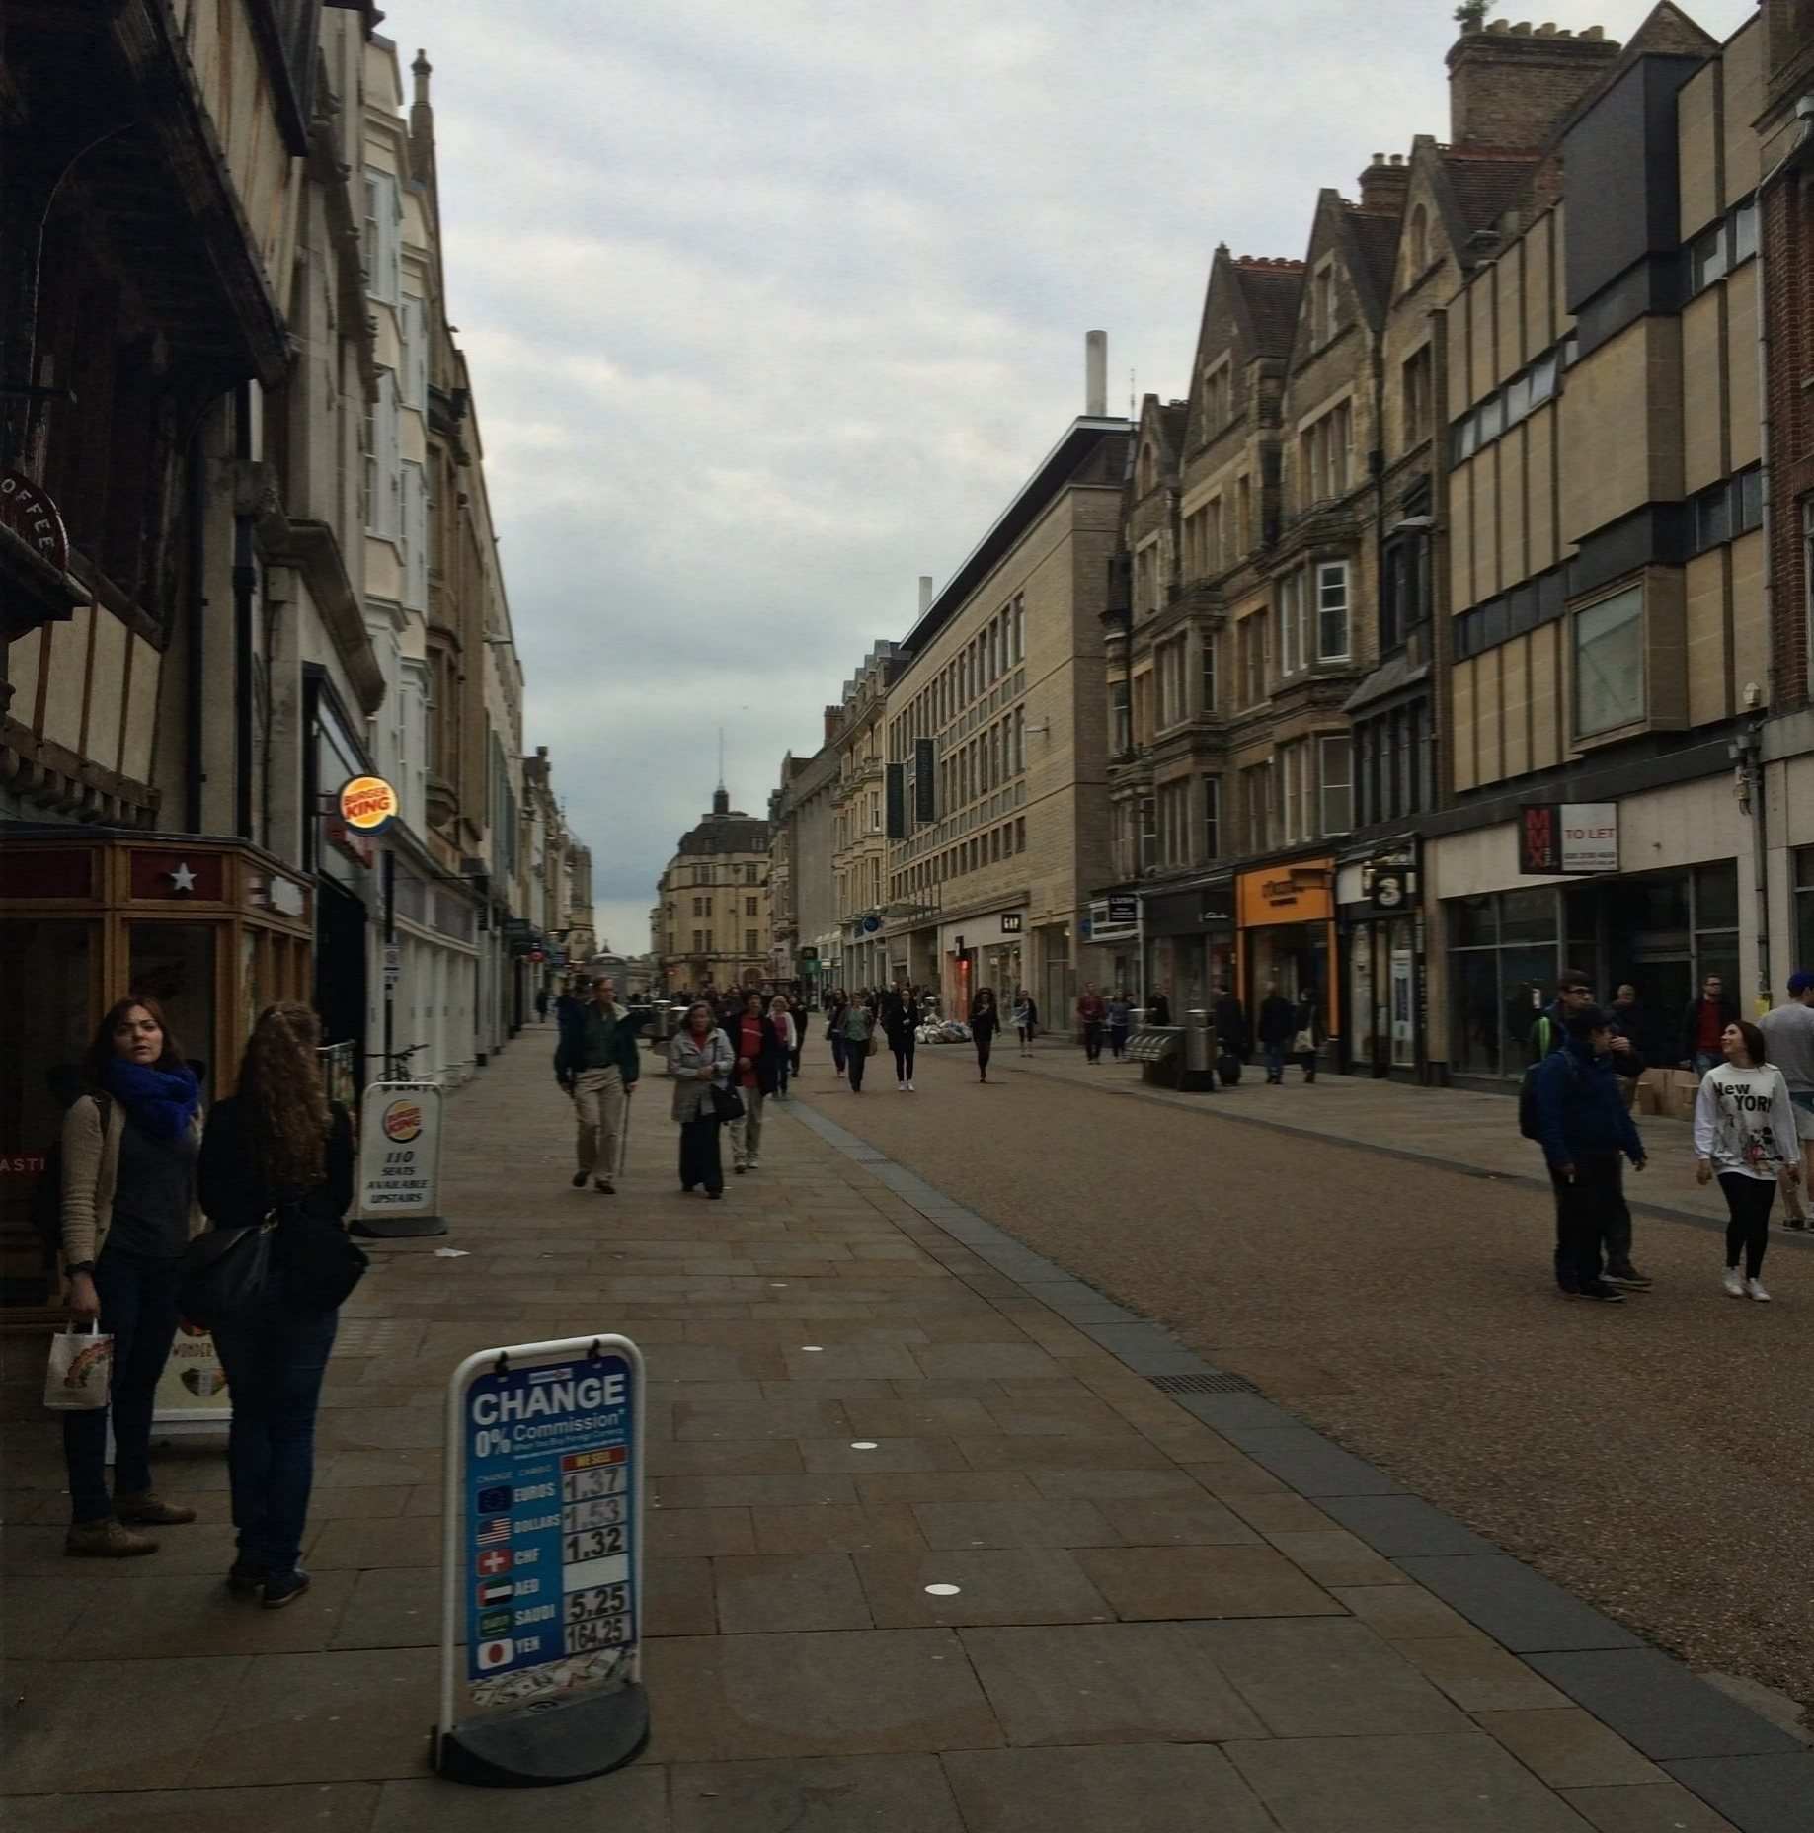
Aside: This is a common trick!
Detecting all the people
The red box is a fixed size
Sample people from image

Slide 35
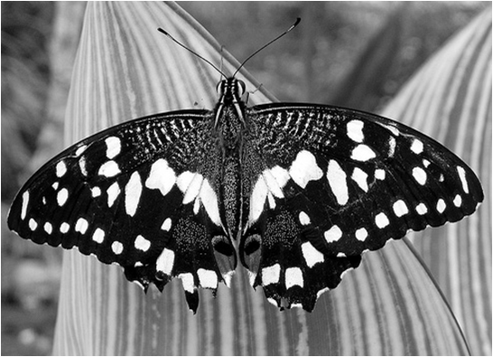
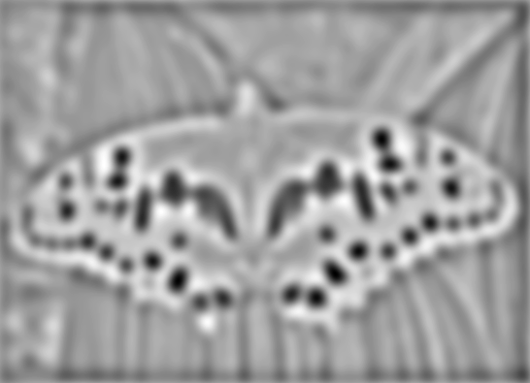



Blob Detection
Another detector (has some nice properties)
Minima
$$∗$$
$$=$$
Maxima
Find maxima and minima of blob filter response in scale and space
Slide credit: N. Snavely

Slide 36
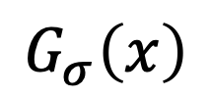
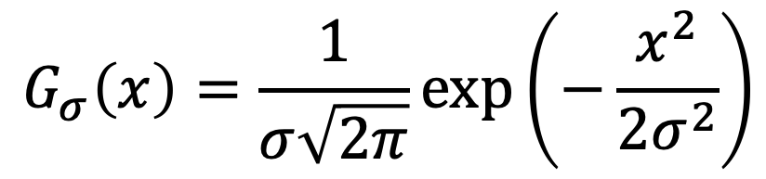
Gaussian Derivatives (1D)
$$G_{σ}\left(x\right)=\frac{1}{σ\sqrt{2π}}\exp\left(−\frac{x^{2}}{2σ^{2}}\right)$$
$$G_{σ}\left(x\right)$$

Slide 37
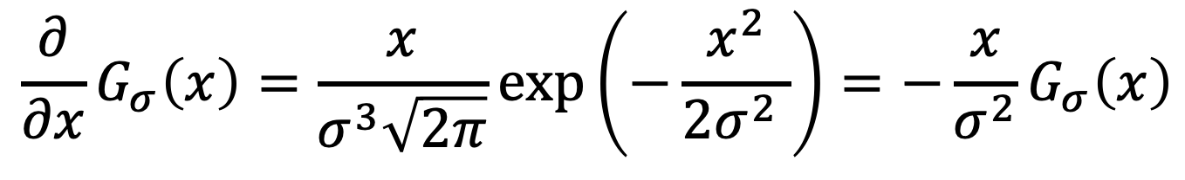
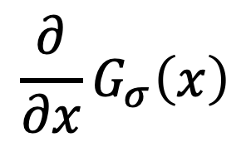
Gaussian Derivatives (1D)
$$\frac{∂}{∂x}G_{σ}\left(x\right)=\frac{x}{σ^{3}\sqrt{2π}}\exp\left(−\frac{x^{2}}{2σ^{2} }\right)=−\frac{x}{σ^{2}}G_{σ}\left(x\right)$$
$$\frac{∂}{∂x}G_{σ}\left(x\right)$$
$$G_{σ}\left(x\right)$$

Slide 38
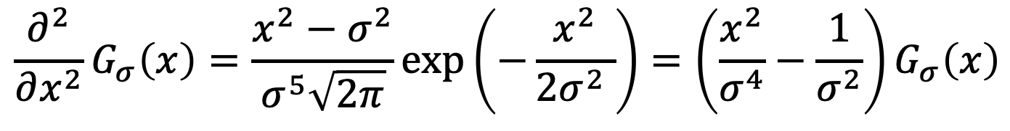
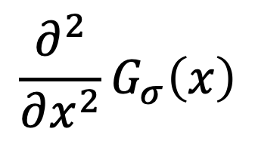
Gaussian Derivatives (1D)
$$\frac{∂^{2}}{∂x^{2}}G_{σ}\left(x\right)=\frac{x^{2}−σ^{2}}{σ^{5}\sqrt{2π}}\exp\left(−\frac{x^{2}}{2σ^{2} }\right)=\left(\frac{x^{2}}{σ^{4}}−\frac{1}{σ^{2}}\right)G_{σ}\left(x\right)$$
$$\frac{∂}{∂x}G_{σ}\left(x\right)$$
$$\frac{∂^{2}}{∂x^{2}}G_{σ}\left(x\right)$$
$$G_{σ}\left(x\right)$$

Slide 39


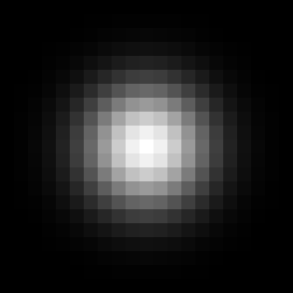


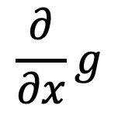
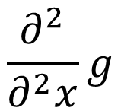
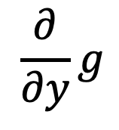
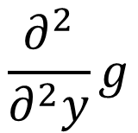
Gaussian Derivatives (2D)
1st Deriv
2nd Deriv
Gaussian
$$\frac{∂}{∂y}g$$
$$\frac{∂^{2}}{∂^{2}y}g$$
$$\frac{∂}{∂x}g$$
$$\frac{∂^{2}}{∂^{2}x}g$$

Slide 40

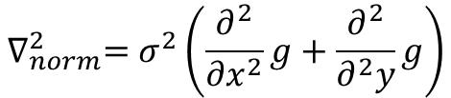
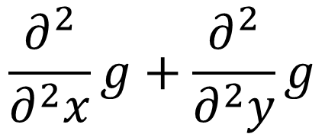
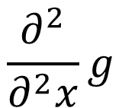
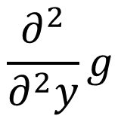
Laplace of Gaussian (2D)
$$\frac{∂^{2}}{∂^{2}x}g+\frac{∂^{2}}{∂^{2}y}g$$
$$\frac{∂^{2}}{∂^{2}y}g$$
+
$$\frac{∂^{2}}{∂^{2}x}g$$
$$∇_{norm}^{2}=σ^{2}\left(\frac{∂^{2}}{∂x^{2}}g+\frac{∂^{2}}{∂^{2}y}g\right)$$
Slight detail: for technical reasons, you need to scale the Laplacian.

Slide 41
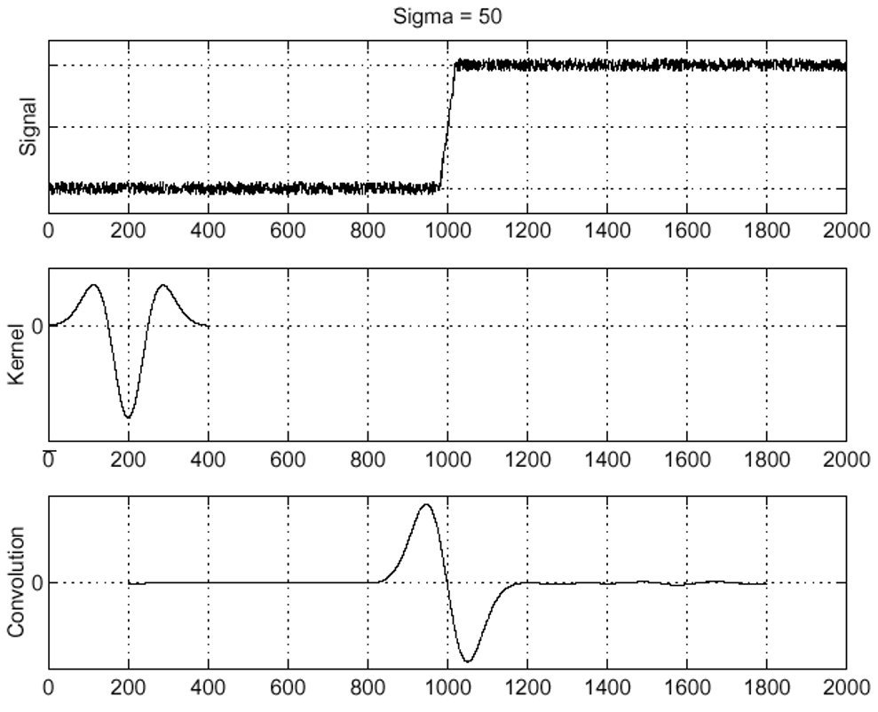

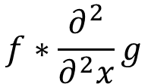
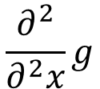
Edge Detection with Laplacian
$$f$$
Edge
$$\frac{∂^{2}}{∂^{2}x}g$$
Laplacian
Of Gaussian
$$f∗\frac{∂^{2}}{∂^{2}x}g$$
Edge =
Zero-crossing
Figure credit: S. Seitz

Slide 42
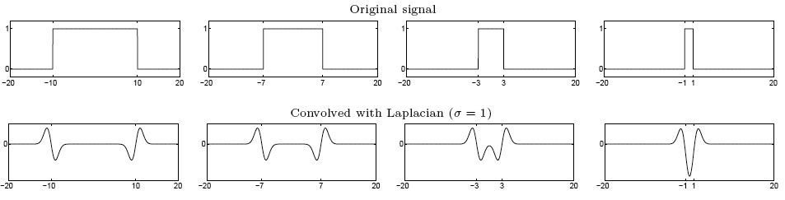
Blob Detection with Laplacian
Edge: zero-crossing
Blob = Two edges in opposite directions
When blob is just the right size, Laplacian gives a large absolute value
maximum
Figure credit: S. Lazebnik

Slide 43








Scale Selection with Laplacian
Given binary circle and Laplacian filter of scale σ, we can compute the response as a function of the scale.
$$Image$$
$$σ=2$$
$$σ=6$$
$$σ=10$$
Radius: 8
R: 0.02
R: 2.9
R: 1.8

Slide 44
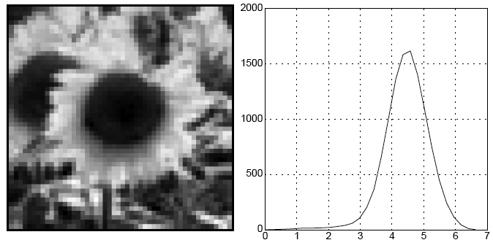
Characteristic Scale
Characteristic scale of a blob is the scale
that produces the maximum response
Image
Abs. Response
Slide credit: S. Lazebnik. For more, see: T. Lindeberg (1998). "Feature detection with automatic scale selection." International Journal of Computer Vision 30 (2): pp 77--116.

Slide 45
Blob Detection in Scale Space
Convolve image with scale-normalized Laplacian at several scales
Slide credit: S. Lazebnik

Slide 46
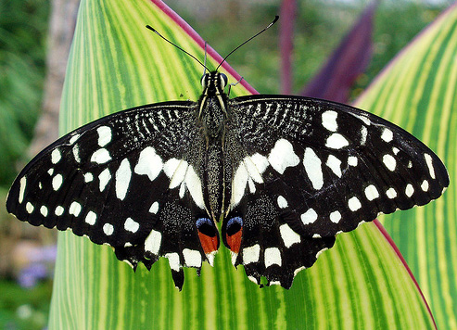
Blob Detection in Scale Space
Slide credit: S. Lazebnik

Slide 47
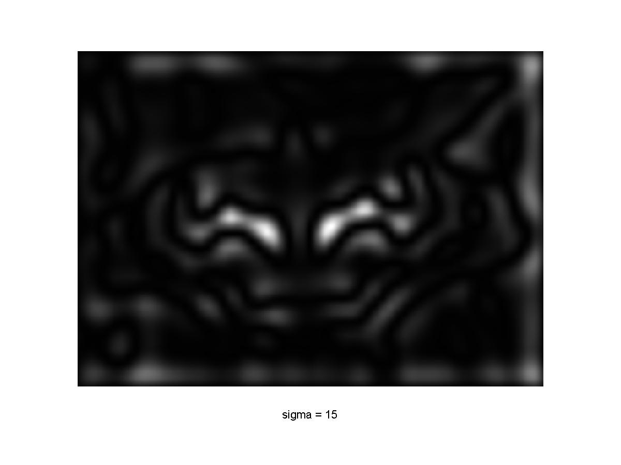
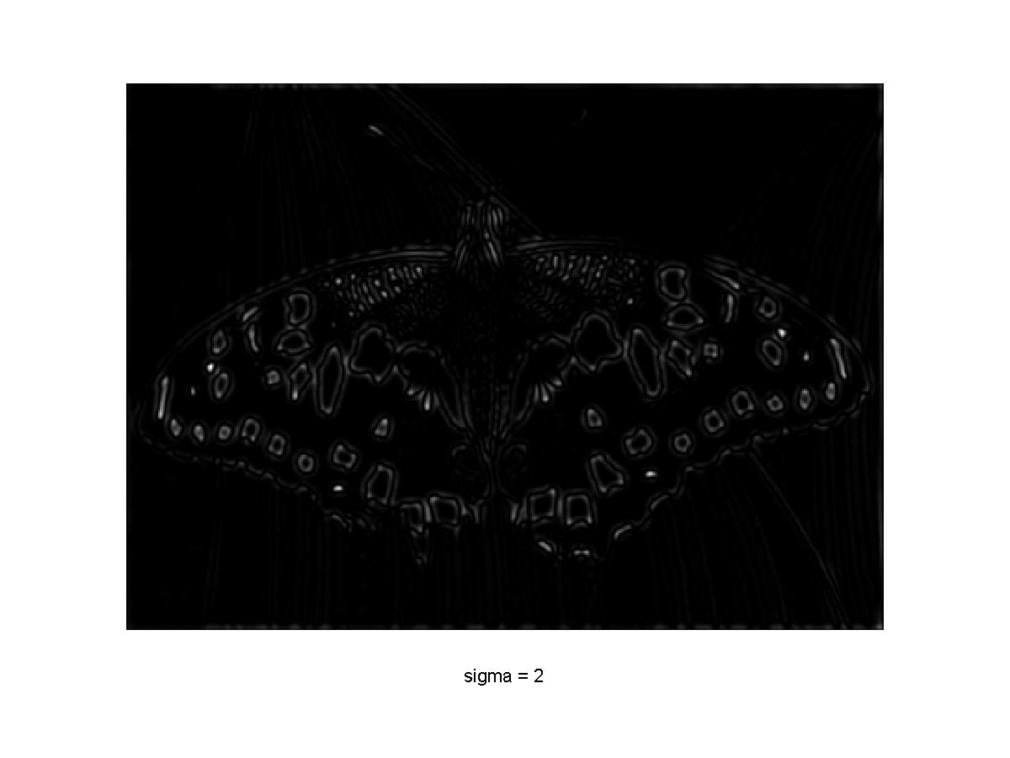
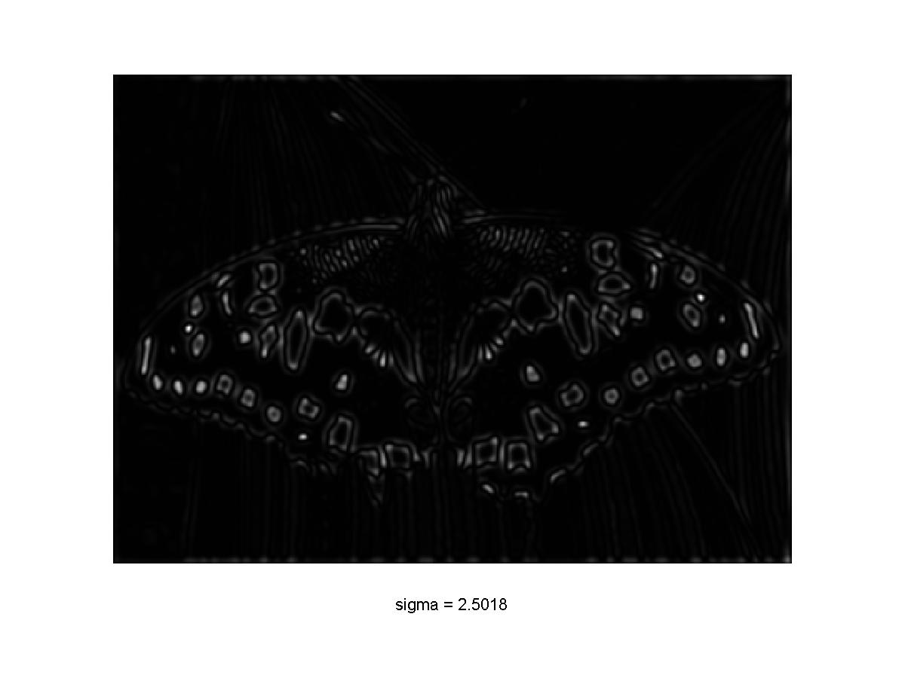
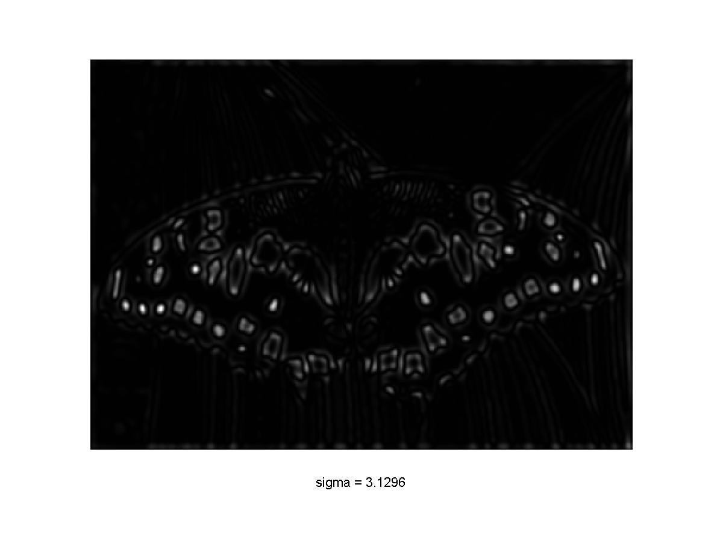
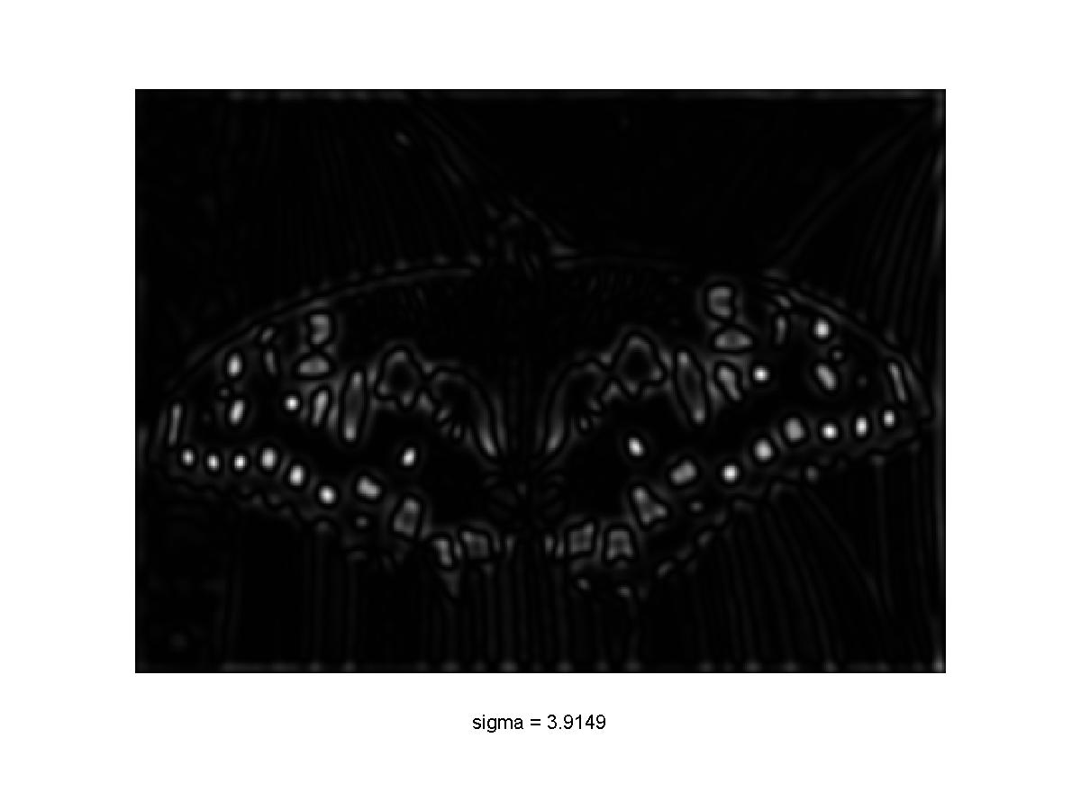
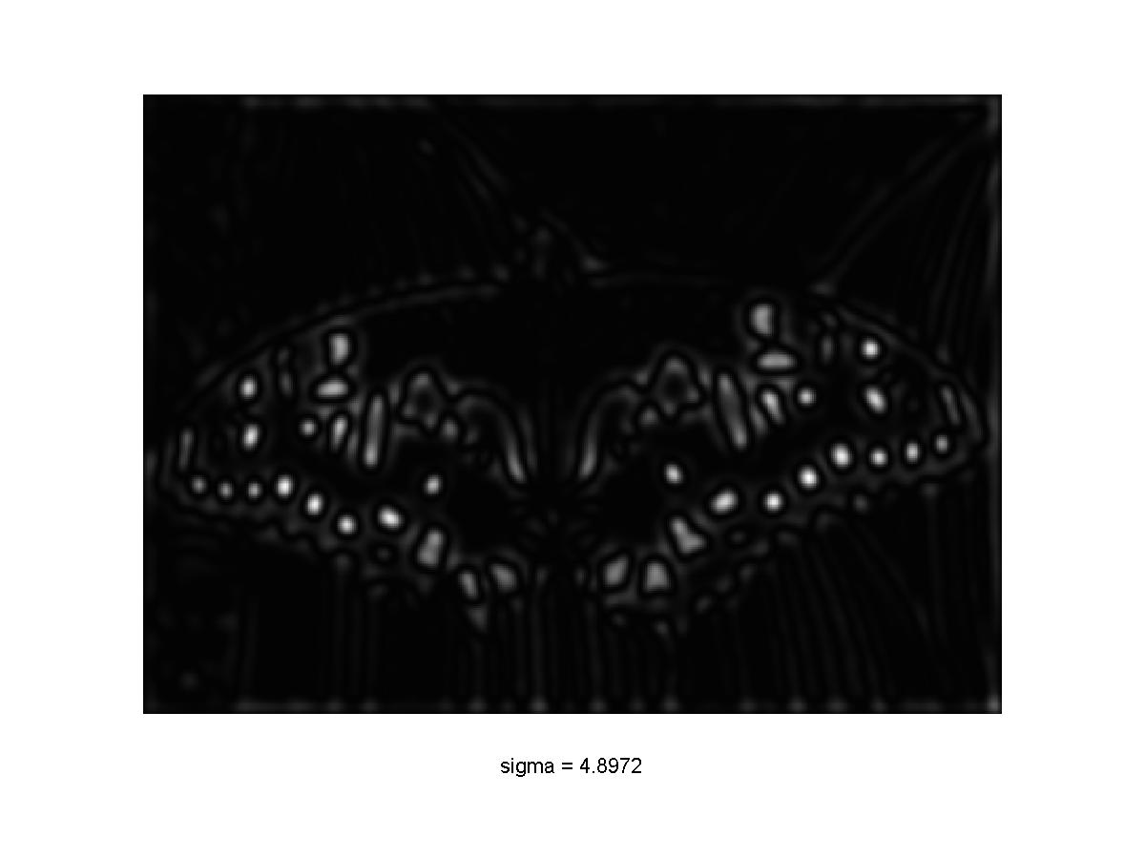

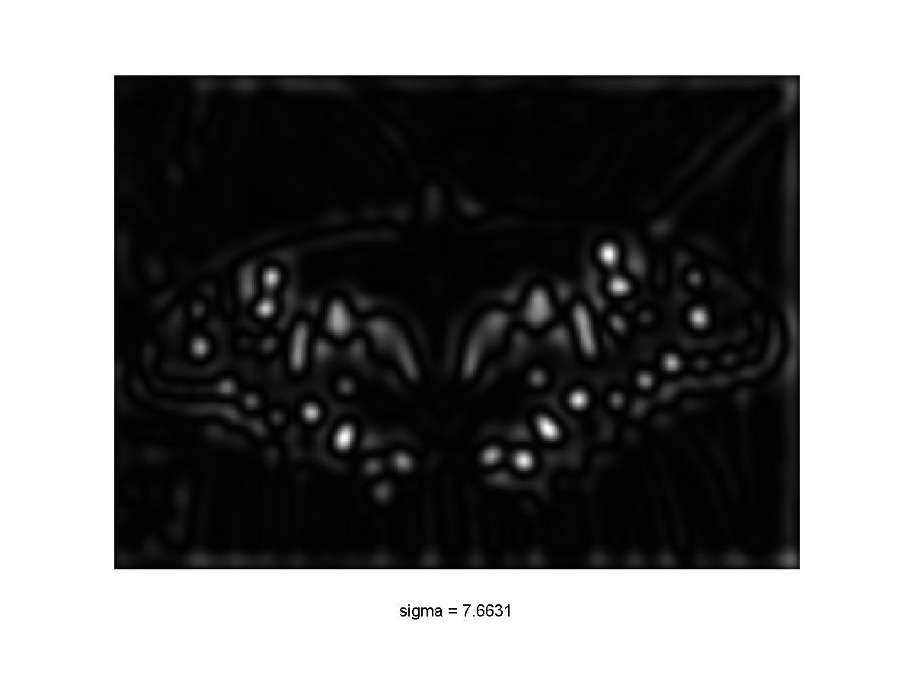
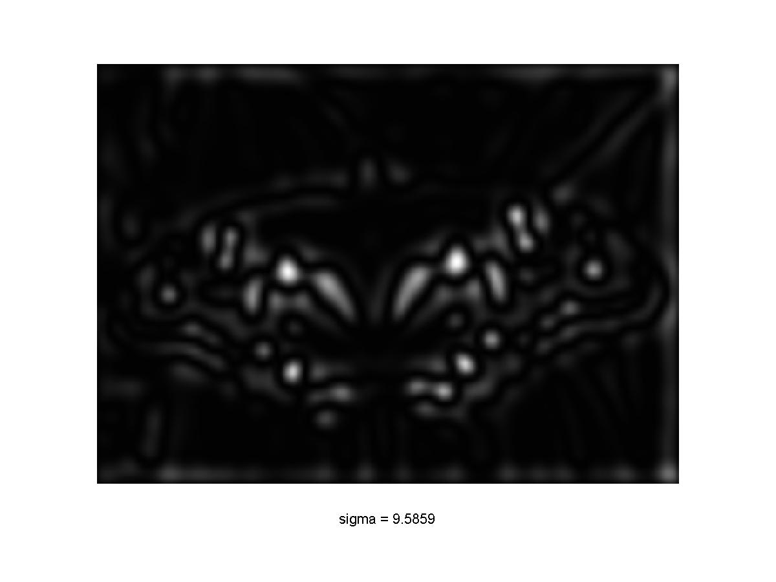
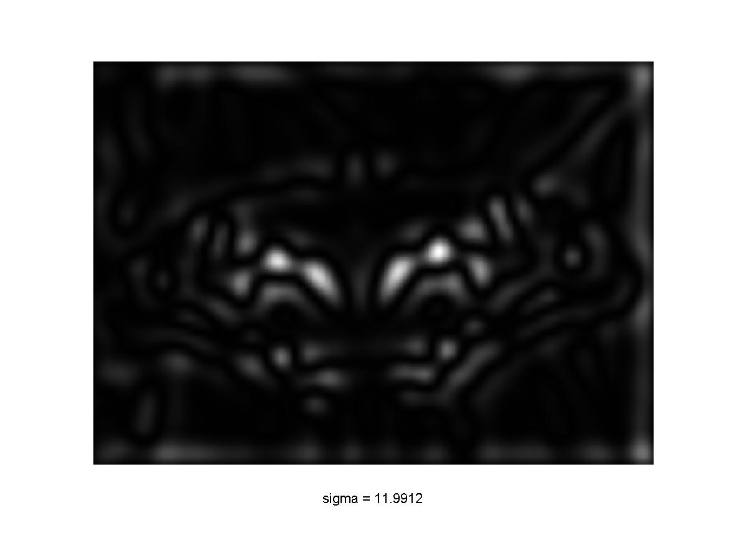
Blob Detection in Scale Space
Slide credit: S. Lazebnik

Slide 48
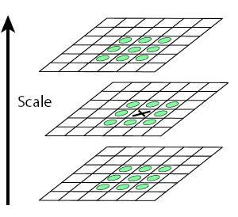
Blob Detection in Scale Space
Convolve image with scale-normalized Laplacian at several scales
Find local maxima and minima of squared Laplacian response in image+scale space
Slide credit: S. Lazebnik

Slide 49

Image and Scale Space
$$Image$$
$$σ=2$$
$$σ=6$$
$$σ=10$$
Radius: 8
R: 0.02
R: 2.9
R: 1.8

Slide 50
Image-Space Neighbors
Blue points are image-space neighbors
$$Image$$
$$σ=2$$
$$σ=6$$
$$σ=10$$
Radius: 8
R: 0.02
R: 2.9
R: 1.8

Slide 51
Scale Space Neighbors
Red points are neighbors in scale space
$$Image$$
$$σ=2$$
$$σ=6$$
$$σ=10$$
Radius: 8
R: 0.02
R: 2.9
R: 1.8

Slide 52
Local Maxima in Scale and Image
Green point is a local maxima in both image and scale space if:
it is larger than its image-space neighbors (blue)
and larger than its scale-space neighbors (red)
$$Image$$
$$σ=2$$
$$σ=6$$
$$σ=10$$
Radius: 8
R: 0.02
R: 2.9
R: 1.8

Slide 53
Blob Detection in Scale Space
Slide credit: S. Lazebnik

Slide 54
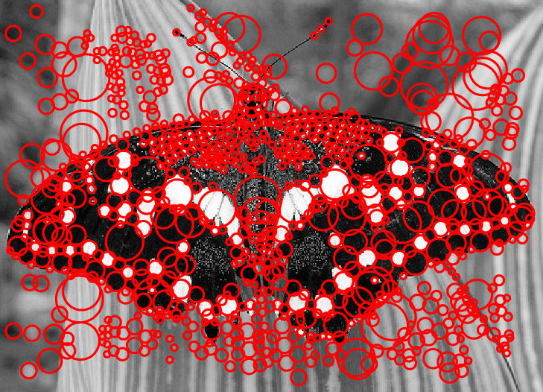
Blob Detection in Scale Space
Slide credit: S. Lazebnik

Slide 55
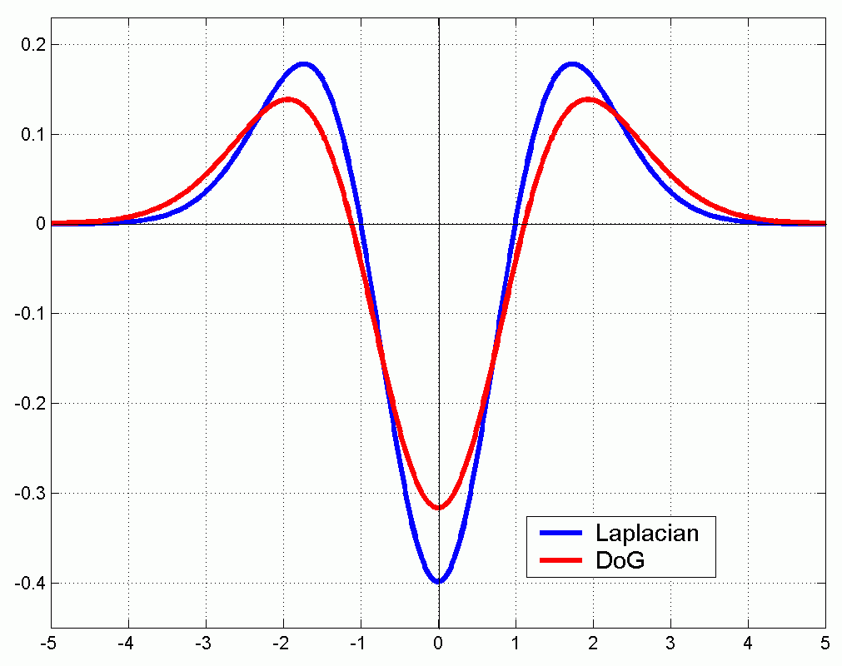
Efficient Implementation
Approximating the Laplacian with a difference of Gaussians:
(Laplacian)
(Difference of Gaussians)
Gaussian is separable, so cheaper to compute!
Slide credit: S. Lazebnik

Slide 56
Efficient Implementation
Gaussian, sigma=2
Downsample by 2x
Gaussian, sigma=1
Downsample by 2x
Original Image
Save computation by downsampling before blurring

Slide 57

Efficient Implementation
David G. Lowe. "Distinctive image features from scale-invariant keypoints.” IJCV 60 (2), pp. 91-110, 2004.
Slide credit: S. Lazebnik

Slide 58
Recall Two Problems for Today:
Fixing scaling by making detectors in both location and scale
Enabling matching between features by describing regions

Slide 59

Problem 1 Solved!
How do we deal with scales: try them all
Why is this efficient?
Vast majority of effort is in the first and second scales
$$1+ \frac{1}{4}+\frac{1}{16}+\frac{1}{64}+\frac{1}{4^{i}}…=\frac{4}{3}$$

Slide 60
Second Problem: Describing Features
Finding and Matching
1: find corners+features
2: match based on local image data
Slide Credit: S. Lazebnik, original figure: M. Brown, D. Lowe

Slide 61




Second Problem: Describing Features
Image – 40
1/2 size, rot. 45°
Lightened+40
Image
100x100 crop at Glasses

Slide 62
Second Problem: Describing Features
Once we’ve found a corner/blobs, we can’t just use the image nearby. What about:
Scale?
Rotation?
Additive light?

Slide 63
Handling Scale
Given characteristic scale (maximum Laplacian response), we can just rescale image
Slide credit: S. Lazebnik

Slide 64

Handling Rotation
Given window, can compute dominant orientation and then rotate image
Compute gradient direction at each pixel
Build a histogram of gradient directions in window
“y”
“x”
0
2
π
Find dominant direction from histogram
Rotate so dominant direction is up

Slide 65

Scale and Rotation
Keypoints at characteristic scales and dominant orientations
Picture credit: S. Lazebnik. Paper: David G. Lowe. "Distinctive image features from scale-invariant keypoints.” IJCV 60 (2), pp. 91-110, 2004.

Slide 66
Scale and Rotation
Keypoints at characteristic scales and dominant orientations
Rotate and set to common scale
j
Rotate and set to common scale
Picture credit: S. Lazebnik. Paper: David G. Lowe. "Distinctive image features from scale-invariant keypoints.” IJCV 60 (2), pp. 91-110, 2004.

Slide 67
Scale and Rotation
Now if we had two images of the same scene but different scale / rotation, we would find the same keypoints and set them to a common scale / rotation
Pixels of the rotated, rescaled patches should be the same!

Slide 68
Illumination, Out-of-plane rotation?
We would like to be able to match these two points
But the local patches look very different!
Idea: Instead of comparing the pixels, instead use a feature vector to describe the appearance of each patch

Slide 69

SIFT Descriptors
j
Normalize the rotation / scale of the patch
Compute gradient at each pixel
Divide into sub-patches (here 2x2, actually 4x4)
4. In each sub-patch, compute histogram of 8
gradient directions
5. Describe the patch with 4*4*8 = 128 numbers
Figure from David G. Lowe. "Distinctive image features from scale-invariant keypoints.” IJCV 60 (2), pp. 91-110, 2004.

Slide 70
SIFT Descriptors
j
Nice properties of SIFT:
Using gradients gives invariance to illumination
Using histograms of patches gives invariance to small shifts / rotations
Compactly describe local appearance of patches with 128-dim vector
Figure from David G. Lowe. "Distinctive image features from scale-invariant keypoints.” IJCV 60 (2), pp. 91-110, 2004.

Slide 71
SIFT Descriptors
In principle: build a histogram of the gradients
In reality: quite complicated
  Gaussian weighting: smooth response
  Normalization: reduces illumination effects
  Clamping
  Affine adaptation
Read the paper for all the gory details…
Figure from David G. Lowe. "Distinctive image features from scale-invariant keypoints.” IJCV 60 (2), pp. 91-110, 2004.

Slide 72


Properties of SIFT
Can handle: up to ~60 degree out-of-plane rotation, Changes of illumination
Fast and efficient and lots of code available
Slide credit: N. Snavely

Slide 73
Feature Descriptors
Think of feature as some non-linear filter that maps pixels to 128D feature
128D vector x
Distance between vectors gives us the visual appearance between patches
Photo credit: N. Snavely

Slide 74







SIFT Features: Instance Matching
$$\left\|x_{1}−x_{3}\right\|=1.22$$
$$x_{1}$$
$$x_{3}$$
$$x_{2}$$
$$\left\|x_{1}−x_{2}\right\|=0.61$$
Example credit: J. Hays

Slide 75







SIFT Features: Instance Matching
$$\left\|x_{4}−x_{5}\right\|=0.34$$
$$\left\|x_{4}−x_{6}\right\|=0.30$$
$$\left\|x_{4}−x_{6}\right\|=0.40$$
$$x_{4}$$
$$x_{5}$$
$$x_{6}$$
$$x_{7}$$
Example credit: J. Hays

Slide 76

2nd Nearest Neighbor Trick
Given a feature x, nearest neighbor to x is a good match, but distances can’t be thresholded.
Instead, find nearest neighbor and second nearest neighbor. This ratio is a good test for matches:
$$r=\frac{\left\|x_{q}−x_{1NN}\right\|}{\left\|x_{q}−x_{2NN}\right\|}$$

Slide 77

2nd Nearest Neighbor Trick
Figure from David G. Lowe. "Distinctive image features from scale-invariant keypoints.” IJCV 60 (2), pp. 91-110, 2004.

Slide 78
Recap
Finding and Matching
1: find corners+features
2: match based on local image data
Slide Credit: S. Lazebnik, original figure: M. Brown, D. Lowe

Slide 79

Next Task: Find a Transform
Find a transform that brings our matched features together!

