Slide 1
Lecture 6: Math Review II

Slide 2
Administrative
HW0 due tomorrow, 1/29 11:59pm
HW1 due 1 week from tomorrow, 2/5 11:59pm

Slide 3
Last Time: Floating Point Math
IEEE 754 Single Precision / Single / float32
8 bits
2¹²⁷ ≈ 10³⁸
23 bits
≈ 7 decimal digits
S
Exponent
Fraction
IEEE 754 Double Precision / Double / float64
11 bits
2¹⁰²³ ≈ 10³⁰⁸
52 bits
≈ 15 decimal digits
S
Exponent
Fraction

Slide 4
Last Time: Vectors
Scale (vector, scalar → vector)
Add (vector, vector → vector)
Magnitude (vector → scalar)
Dot product (vector, vector → scalar)
Dot products are projection / angles
Cross product (vector, vector → vector)
Vectors facing same direction have cross product 0
You can never mix vectors of different sizes

Slide 5
Matrices

Slide 6
Matrices
Horizontally concatenate n, m-dim column vectors and you get a mxn matrix A (here 2x3)
$$A=\left[v_{1},⋯,v_{n}\right]=\left[\begin{matrix}v_{1_{1}} & v_{2_{1}} & v_{3_{1}} \\ v_{1_{2}} & v_{2_{2}} & v_{3_{2}}\end{matrix}\right]$$
a
(scalar)
lowercase
undecorated
a
(vector)
lowercase
bold or arrow
A
(matrix)
uppercase
bold

Slide 7
Matrices
Horizontally concatenate n, m-dim column vectors and you get a mxn matrix A (here 2x3)
$$A=\left[v_{1},⋯,v_{n}\right]=\left[\begin{matrix}v_{1_{1}} & v_{2_{1}} & v_{3_{1}} \\ v_{1_{2}} & v_{2_{2}} & v_{3_{2}}\end{matrix}\right]$$
Watch out: In math, it’s common to treat D-dim vector as a Dx1 matrix (column vector); In numpy these are different things

Slide 8
Matrices
$${\left[\begin{matrix}a \\ b \\ c\end{matrix}\right]}^{T}=\left[\begin{matrix}a & b & c\end{matrix}\right]$$
Transpose: flip rows / columns
(3x1)^{T} = 1x3
Vertically concatenate m, n-dim row vectors
and you get a mxn matrix A (here 2x3)
$$A=\left[\begin{matrix}u_{1}^{T} \\ ⋮ \\ u_{n}^{T}\end{matrix}\right]=\left[\begin{matrix}u_{1_{1}} & u_{1_{2}} & u_{1_{3}} \\ u_{2_{1}} & u_{2_{2}} & u_{2_{3}}\end{matrix}\right]$$

Slide 9
Matrix-vector Product
$$y_{2x1}=A_{2x3}x_{3x1}$$
$$\left[\begin{matrix}x_{1} \\ x_{2} \\ x_{3}\end{matrix}\right]$$
$$\left[\begin{matrix}y_{1} \\ y_{2}\end{matrix}\right]=$$
$$\left[\begin{matrix}v_{1} & v_{2} & v_{3}\end{matrix}\right]$$
$$y=x_{1}v_{1}+x_{2}v_{2}+x_{3}v_{3}$$
Linear combination of columns of A

Slide 10
Matrix-vector Product
$$y_{2x1}=A_{2x3}x_{3x1}$$
3
$$\left[\begin{matrix}y_{1} \\ y_{2}\end{matrix}\right]=$$
$$\left[\begin{matrix}{ u}_{1}^{T} \\ u_{2}^{T}\end{matrix}\right]$$
$$x$$
3
$$y_{1}=u_{1}^{T}x$$
$$y_{2}=u_{2}^{T}x$$
Dot product between rows of A and x

Slide 11
Matrix Multiplication
Generally: A_{mn} and B_{np} yield product (AB)_{mp}
$$\left[\begin{matrix}− & a_{1}^{T} & − \\ & ⋮ & \\ − & a_{m}^{T} & −\end{matrix}\right]$$
$$\left[\begin{matrix}| & & | \\ b_{1} & ⋯ & b_{p} \\ | & & |\end{matrix}\right]$$
$$AB=$$
Yes – in A, I’m referring to the rows, and in B, I’m referring to the columns

Slide 12
Matrix Multiplication
Generally: A_{mn} and B_{np} yield product (AB)_{mp}
$$\left[\begin{matrix}| & & | \\ { b}_{1} & ⋯ & b_{p} \\ | & & |\end{matrix}\right]$$
$$AB_{ij}=a_{i}^{T}b_{j}$$
$$\left[\begin{matrix}− & a_{1}^{T} & − \\ & ⋮ & \\ − & a_{m}^{T} & −\end{matrix}\right]$$
$$\left[\begin{matrix}a_{1}^{T}b_{1} & ⋯ & a_{1}^{T}b_{p} \\ ⋮ & ⋱ & ⋮ \\ a_{m}^{T}b_{1} & ⋯ & a_{m}^{T}b_{p}\end{matrix}\right]$$
$$AB=$$

Slide 13
Matrix Multiplication
Dimensions must match
Dimensions must match
Dimensions must match
(Associative): ABx = (A)(Bx) = (AB)x
(Not Commutative): ABx ≠ (BA)x ≠ (BxA)

Slide 14
Two uses for Matrices
Storing things in a rectangular array (e.g. images)
Typical operations: element-wise operations, convolution (which we’ll cover later)
Atypical operations: almost anything you learned in a math linear algebra class
A linear operator that maps vectors to another space (Ax)
Typical/Atypical: reverse of above

Slide 15
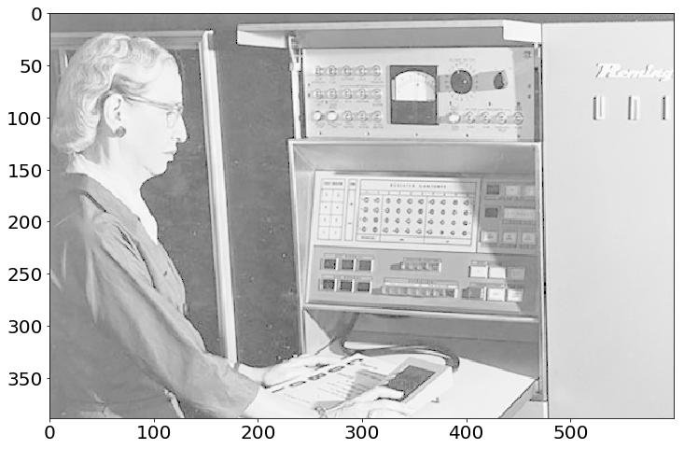
Images as Matrices
Suppose someone hands you this matrix.
What’s wrong with it?
No contrast!

Slide 16
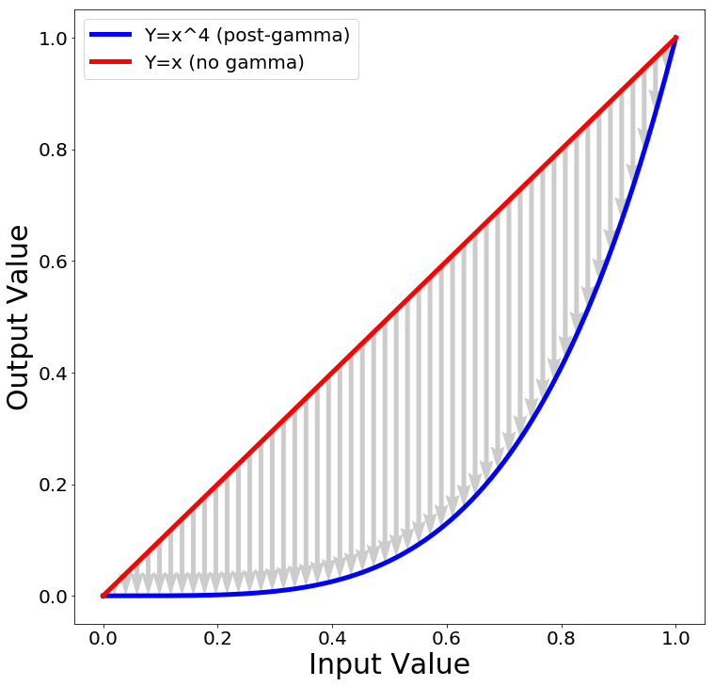
Contrast: Gamma Curve
Typical way to change the contrast is to apply a nonlinear correction
$${pixelvalue}^{γ}$$
The quantity $γ$ controls how much contrast gets added

Slide 17
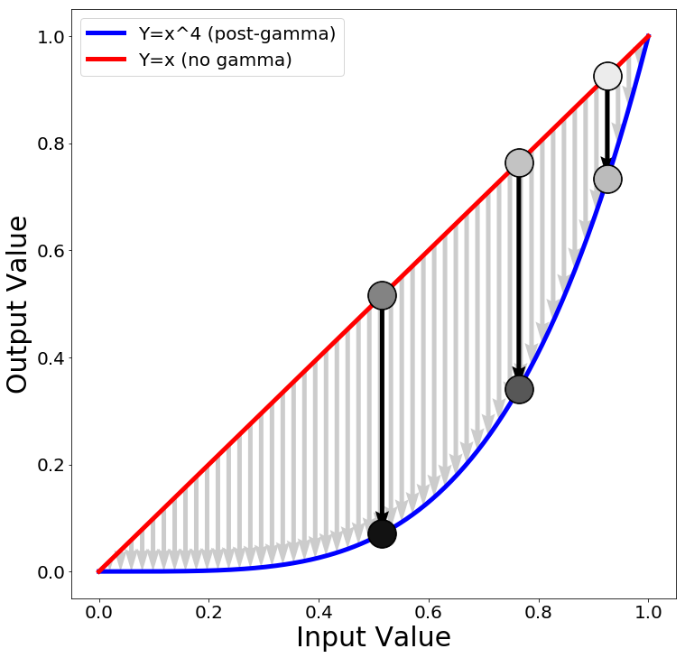
Contrast: Gamma Curve
Now the darkest regions (10th pctile) are much darker than the moderately dark regions (50th pctile).
90%
50%
new
90%
10%
new
50%
new 10%

Slide 18
Contrast: Gamma Correction

Slide 19
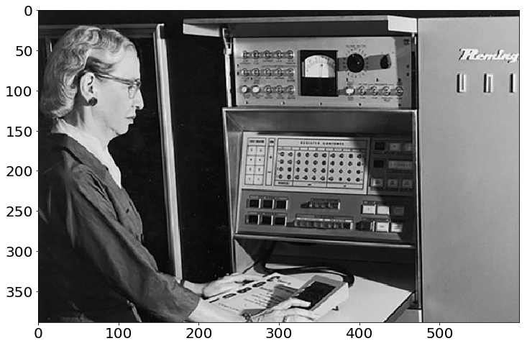
Contrast: Gamma Correction
Phew! Much Better.

Slide 20
Implementation
Python+Numpy (right way):
imNew = im**4
Python+Numpy (slow way – why? ):
imNew = np.zeros(im.shape)
for y in range(im.shape[0]):
for x in range(im.shape[1]):
imNew[y,x] = im[y,x]**expFactor

Slide 21
Elementwise Operations
Element-wise power – beware notation
$${\left(A^{p}\right)}_{ij}=A_{ij}^{p}$$
“Hadamard Product” / Element-wise multiplication
$${\left(A⊙B\right)}_{ij}=A_{ij}∗B_{ij}$$
Element-wise division
$${\left(A/B\right)}_{ij}=\frac{A_{ij}}{B_{ij}}$$

Slide 22
Sums Across Axes
$$A=\left[\begin{matrix}x_{1} & y_{1} \\ ⋮ & ⋮ \\ x_{n} & y_{n}\end{matrix}\right]$$
Suppose have Nx2 matrix A
$$Σ(A, 1)=\left[\begin{matrix}x_{1}+y_{1} \\ ⋮ \\ x_{n}+y_{n}\end{matrix}\right]$$
ND col. vec.
$$Σ(A, 0)=\left[\begin{matrix}\sum_{i=1}^{n}{x_{i}} & , \sum_{i=1}^{n}{y_{i}}\end{matrix}\right]$$
2D row vec
Note – libraries distinguish between N-D column vector and Nx1 matrix.

Slide 23
Operations they don’t teach
You Probably Saw Matrix Addition
$$\left[\begin{matrix}a & b \\ c & d\end{matrix}\right]+\left[\begin{matrix}e & f \\ g & h\end{matrix}\right]=$$
$$\left[\begin{matrix}a+e & b+f \\ c+g & d+h\end{matrix}\right]$$
What is this? FYI: e is a scalar
$$\left[\begin{matrix}a & b \\ c & d\end{matrix}\right]+e=$$
$$\left[\begin{matrix}a+e & b+e \\ c+e & d+e\end{matrix}\right]$$

Slide 24
Broadcasting
If you want to be pedantic and proper, you expand e by multiplying a matrix of 1s (denoted 1)
$$\left[\begin{matrix}a & b \\ c & d\end{matrix}\right]+e$$
$$=\left[\begin{matrix}a & b \\ c & d\end{matrix}\right]+1_{2x2}e$$
$$=\left[\begin{matrix}a & b \\ c & d\end{matrix}\right]+\left[\begin{matrix}e & e \\ e & e\end{matrix}\right]$$
Many smart matrix libraries do this automatically. This is the source of many bugs.

Slide 25
Broadcasting Example
Given: a nx2 matrix P and a 2D column vector v, Want: nx2 difference matrix D
$$P=\left[\begin{matrix}x_{1} & y_{1} \\ ⋮ & ⋮ \\ x_{n} & y_{n}\end{matrix}\right]$$
$$D=\left[\begin{matrix}x_{1}−a & y_{1}−b \\ ⋮ & ⋮ \\ x_{n}−a & y_{n}−b\end{matrix}\right]$$
$$v=\left[\begin{matrix}a \\ b\end{matrix}\right]$$
$$\left[\begin{matrix}x_{1} & y_{1} \\ ⋮ & ⋮ \\ x_{n} & y_{n}\end{matrix}\right]−$$
$$\left[\begin{matrix}a & b\end{matrix}\right]$$
Blue stuff is assumed / broadcast
$$P−v^{T}=$$
$$⋮$$
$$\left[\begin{matrix}a & b\end{matrix}\right]$$

Slide 26
Broadcasting Rules
Suppose we have numpy arrays x and y.
How will they broadcast?
Write down the shape of each array as a tuple of integers:
For example: x: (10,) y: (20, 10)
2. If they have different numbers of dimensions, prepend with ones until they have the same number of dimensions
For example: x: (10,) y: (20, 10) → x: (1, 10) y: (20, 10)
3. Compare each dimension. There are 3 cases:
(a) Dimension match. Everything is good
(b) Dimensions don’t match, but one is =1.
”Duplicate” the smaller array along that axis to match
(c) Dimensions don’t match, neither are =1. Error!

Slide 27
Broadcasting Examples
x = np.ones(10, 20)
y = np.ones(20)
z = x + y
print(z.shape)
x = np.ones(10, 20)
y = np.ones(10)
z = x + y
print(z.shape)
(10,20)
ERROR
x = np.ones(10, 20)
y = np.ones(10, 1)
z = x + y
print(z.shape)
x = np.ones(1, 20)
y = np.ones(10, 1)
z = x + y
print(z.shape)
(10,20)
(10,20)

Slide 28
Tensors
Scalar: Just one number
Vector: 1D list of numbers
Matrix: 2D grid of numbers
Tensor: N-dimensional grid of numbers (Lots of other meanings in math, physics)

Slide 29
Broadcasting with Tensors
The same broadcasting rules apply to tensors with any number of dimensions!
x = np.ones(30)
y = np.ones(20, 1)
z = np.ones(10, 1, 1)
w = x + y + z
print(w.shape)
(10, 20, 30)

Slide 30
Vectorization
Writing code without explicit loops: use broadcasting, matrix multiply, and other (optimized) numpy primitives instead

Slide 31
Vectorization Example
Suppose I represent each image as a 128-dimensional vector
I want to compute all the pairwise distances between {x₁, …, x_{N}} and {y₁, …, y_{M}} so I can find, for every x_{i} the nearest y_{j}
Identity:${\left\|x−y\right\|}_{ }^{2}={\left\|x\right\|}_{ }^{2}+{\left\|y\right\|}_{ }^{2}−2x^{T}y$
Or: ${\left\|x−y\right\|}_{ }^{ }={\left({\left\|x\right\|}_{ }^{2}+{\left\|y\right\|}_{ }^{2}−2x^{T}y\right)}^{1/2}$

Slide 32
Vectorization Example
$$X=\left[\begin{matrix}− & x_{1} & − \\ & ⋮ & \\ − & x_{N} & −\end{matrix}\right]$$
$$Y=\left[\begin{matrix}− & y_{1} & − \\ & ⋮ & \\ − & y_{M} & −\end{matrix}\right]$$
$$Y^{T}=\left[\begin{matrix}| & & | \\ y_{1} & ⋯ & y_{M} \\ | & & |\end{matrix}\right]$$
$$Σ\left(X^{2},1\right)=\left[\begin{matrix}{\left\|x_{1}\right\|}^{2} \\ ⋮ \\ {\left\|x_{N}\right\|}^{2}\end{matrix}\right]$$
Compute a Nx1 vector of norms
(can also do Mx1)
Compute a NxM matrix of dot products
$${\left(XY^{T}\right)}_{ij}=x_{i}^{T}y_{j}$$

Slide 33
Vectorization Example
$$D={\left(Σ\left(X^{2},1\right)+Σ{\left(Y^{2},1\right)}^{T}−2XY^{T}\right)}^{1/2}$$
$$\left[\begin{matrix}{\left\|x_{1}\right\|}^{2} \\ ⋮ \\ {\left\|x_{N}\right\|}^{2}\end{matrix}\right]$$
$$+\left[\begin{matrix}{\left\|y_{1}\right\|}^{2} & ⋯ & {\left\|y_{M}\right\|}^{2}\end{matrix}\right]$$
$$\left[\begin{matrix}{\left\|x_{1}\right\|}^{2}+{\left\|y_{1}\right\|}^{2} & ⋯ & {\left\|x_{1}\right\|}^{2}+{\left\|y_{M}\right\|}^{2} \\ ⋮ & ⋱ & ⋮ \\ {\left\|x_{N}\right\|}^{2}+{\left\|y_{1}\right\|}^{2} & ⋯ & {\left\|x_{N}\right\|}^{2}+{\left\|y_{M}\right\|}^{2}\end{matrix}\right]$$
Why?
$${\left(Σ\left(X^{2},1\right)+Σ{\left(Y^{2},1\right)}^{T}\right)}_{ij}={\left\|x_{i}\right\|}^{2}+{\left\|y_{j}\right\|}^{2}$$

Slide 34
Vectorization Example
$$D={\left(Σ\left(X^{2},1\right)+Σ{\left(Y^{2},1\right)}^{T}−2XY^{T}\right)}^{1/2}$$
$$D_{ij}={\left\|x_{i}\right\|}^{2}+{\left\|y_{j}\right\|}^{2}+ 2x^{T}y$$
Numpy code:
XNorm = np.sum(X**2,axis=1,keepdims=True)
YNorm = np.sum(Y**2,axis=1,keepdims=True)
D = (XNorm+YNorm.T-2*np.dot(X,Y.T))**0.5
Get in the habit of thinking about shapes as tuples.
Suppose X is (N, D), Y is (M, D):

Slide 35
Vectorization Example
$$D={\left(Σ\left(X^{2},1\right)+Σ{\left(Y^{2},1\right)}^{T}−2XY^{T}\right)}^{1/2}$$
$$D_{ij}={\left\|x_{i}\right\|}^{2}+{\left\|y_{j}\right\|}^{2}+ 2x^{T}y$$
(N, 1)
Numpy code:
XNorm = np.sum(X**2,axis=1,keepdims=True)
YNorm = np.sum(Y**2,axis=1,keepdims=True)
D = (XNorm+YNorm.T-2*np.dot(X,Y.T))**0.5
Get in the habit of thinking about shapes as tuples.
Suppose X is (N, D), Y is (M, D):

Slide 36
Vectorization Example
$$D={\left(Σ\left(X^{2},1\right)+Σ{\left(Y^{2},1\right)}^{T}−2XY^{T}\right)}^{1/2}$$
$$D_{ij}={\left\|x_{i}\right\|}^{2}+{\left\|y_{j}\right\|}^{2}+ 2x^{T}y$$
(N, 1)
(M, 1)
Numpy code:
XNorm = np.sum(X**2,axis=1,keepdims=True)
YNorm = np.sum(Y**2,axis=1,keepdims=True)
D = (XNorm+YNorm.T-2*np.dot(X,Y.T))**0.5
Get in the habit of thinking about shapes as tuples.
Suppose X is (N, D), Y is (M, D):

Slide 37
Vectorization Example
$$D={\left(Σ\left(X^{2},1\right)+Σ{\left(Y^{2},1\right)}^{T}−2XY^{T}\right)}^{1/2}$$
$$D_{ij}={\left\|x_{i}\right\|}^{2}+{\left\|y_{j}\right\|}^{2}+ 2x^{T}y$$
(N, 1)
(M, 1)
(N, M)
Numpy code:
XNorm = np.sum(X**2,axis=1,keepdims=True)
YNorm = np.sum(Y**2,axis=1,keepdims=True)
D = (XNorm+YNorm.T-2*np.dot(X,Y.T))**0.5
Get in the habit of thinking about shapes as tuples.
Suppose X is (N, D), Y is (M, D):

Slide 38
Vectorization Example
$$D={\left(Σ\left(X^{2},1\right)+Σ{\left(Y^{2},1\right)}^{T}−2XY^{T}\right)}^{1/2}$$
$$D_{ij}={\left\|x_{i}\right\|}^{2}+{\left\|y_{j}\right\|}^{2}+ 2x^{T}y$$
(N, 1)
(M, 1)
(N, M)
(N, M)
Numpy code:
XNorm = np.sum(X**2,axis=1,keepdims=True)
YNorm = np.sum(Y**2,axis=1,keepdims=True)
D = (XNorm+YNorm.T-2*np.dot(X,Y.T))**0.5
Get in the habit of thinking about shapes as tuples.
Suppose X is (N, D), Y is (M, D):

Slide 39
Vectorization Example
$$D={\left(Σ\left(X^{2},1\right)+Σ{\left(Y^{2},1\right)}^{T}−2XY^{T}\right)}^{1/2}$$
$$D_{ij}={\left\|x_{i}\right\|}^{2}+{\left\|y_{j}\right\|}^{2}+ 2x^{T}y$$
(N, 1)
(M, 1)
(N, M)
(N, M)
Numpy code:
XNorm = np.sum(X**2,axis=1,keepdims=True)
YNorm = np.sum(Y**2,axis=1,keepdims=True)
D = (XNorm+YNorm.T-2*np.dot(X,Y.T))**0.5
Get in the habit of thinking about shapes as tuples.
Suppose X is (N, D), Y is (M, D):

Slide 40
Vectorization Example
$$D={\left(Σ\left(X^{2},1\right)+Σ{\left(Y^{2},1\right)}^{T}−2XY^{T}\right)}^{1/2}$$
$$D_{ij}={\left\|x_{i}\right\|}^{2}+{\left\|y_{j}\right\|}^{2}+ 2x^{T}y$$
(N, 1)
(M, 1)
(N, M)
(N, M)
Numpy code:
XNorm = np.sum(X**2,axis=1,keepdims=True)
YNorm = np.sum(Y**2,axis=1,keepdims=True)
D = (XNorm+YNorm.T-2*np.dot(X,Y.T))**0.5
Get in the habit of thinking about shapes as tuples.
Suppose X is (N, D), Y is (M, D):

Slide 41
Vectorization Example
$$D={\left(Σ\left(X^{2},1\right)+Σ{\left(Y^{2},1\right)}^{T}−2XY^{T}\right)}^{1/2}$$
$$D_{ij}={\left\|x_{i}\right\|}^{2}+{\left\|y_{j}\right\|}^{2}+ 2x^{T}y$$
Numpy code:
XNorm = np.sum(X**2,axis=1,keepdims=True)
YNorm = np.sum(Y**2,axis=1,keepdims=True)
D = (XNorm+YNorm.T-2*np.dot(X,Y.T))**0.5
*May have to make sure this is at least 0 (sometimes roundoff issues happen)

Slide 42
Does Vectorization Matter?
Computing pairwise distances between 300 and 400 128-dimensional vectors
for x in X, for y in Y, using native python: 9s
for x in X, for y in Y, using numpy to compute distance: 0.8s
vectorized: 0.0045s (~2000x faster than 1, 175x faster than 2)
Expressing things in primitives that are optimized is usually faster
Even more important with special hardware like GPUs or TPUs!

Slide 43
Linear Algebra

Slide 44
Linear Independence
A set of vectors is linearly independent if you can’t write one as a linear combination of the others.
$$a=\left[\begin{matrix}0 \\ 0 \\ 2\end{matrix}\right]$$
$$b=\left[\begin{matrix}0 \\ 6 \\ 0\end{matrix}\right]$$
$$c=\left[\begin{matrix}5 \\ 0 \\ 0\end{matrix}\right]$$
Suppose:
$$x=\left[\begin{matrix}0 \\ 0 \\ 4\end{matrix}\right]=$$
$$y=\left[\begin{matrix}0 \\ −2 \\ 1\end{matrix}\right]=$$
$$\frac{1}{2}a−\frac{1}{3}b$$
Is the set {a,b,c} linearly independent?
Is the set {a,b,x} linearly independent?
Max # of independent 3D vectors?

Slide 45
Span
Span: all linear combinations of a set of vectors
Span({ }) =
Span({[0,2]}) = ?
All vertical lines through origin =
$$\left\{λ\left[0,1\right]:λ∈R\right\}$$
Is blue in {red}’s span?

Slide 46
Span
Span: all linear combinations of a set of vectors
Span({ , }) = ?

Slide 47
Span
Span: all linear combinations of a set of vectors
Span({ , }) = ?

Slide 48
Matrix-Vector Product
$$Ax=\left[\begin{matrix}| & & | \\ c_{1} & ⋯ & c_{n} \\ | & & |\end{matrix}\right]x$$
Right-multiplying A by x mixes columns of A according to entries of x
The output space of f(x) = Ax is constrained to be the span of the columns of A.
Can’t output things you can’t construct out of your columns

Slide 49
An Intuition
$$y=Ax=\left[\begin{matrix}| & | & | \\ c_{1} & c_{2} & c_{n} \\ | & | & |\end{matrix}\right]\left[\begin{matrix}x_{1} \\ x_{2} \\ x_{3}\end{matrix}\right]$$
y
y₁
x
y₂
Ax
x₁
x₂
x₃
y₃
x – knobs on machine (e.g., fuel, brakes)
y – state of the world (e.g., where you are)
A – machine (e.g., your car)

Slide 50
Linear Independence
Suppose the columns of 3x3 matrix A are not linearly independent (c₁, αc₁, c₂ for instance)
$$y=Ax=\left[\begin{matrix}| & | & | \\ c_{1} & {αc}_{1} & c_{2} \\ | & | & |\end{matrix}\right]\left[\begin{matrix}x_{1} \\ x_{2} \\ x_{3}\end{matrix}\right]$$
$$y=x_{1}c_{1}+αx_{2}c_{1}+x_{3}c_{2}$$
$$y=\left(x_{1}+αx_{2}\right)c_{1}+x_{3}c_{2}$$

Slide 51
Linear Independence Intuition
Knobs of x are redundant. Even if y has 3 outputs, you can only control it in two directions
$$y=\left(x_{1}+αx_{2}\right)c_{1}+x_{3}c_{2}$$
y
y₁
x
y₂
Ax
x₁
x₂
x₃
y₃

Slide 52
Linear Independence
$$Ax=\left(x_{1}+αx_{2}\right)c_{1}+x_{3}c_{2}$$
Recall:
$$y=A\left[\begin{matrix}x_{1}+β \\ x_{2}−β/α \\ x_{3}\end{matrix}\right]$$
$$=\left(x_{1}+β+αx_{2}−α\frac{β}{α}\right)c_{1}+x_{3}c_{2}$$
Can write y an infinite number of ways by adding $β$ to x₁ and subtracting $\frac{β}{α}$from x₂
Or, given a vector y there’s not a unique vector x s.t. y =Ax
Not all y have a corresponding x s.t. y=Ax (assuming $c_{1}$ and $c_{1}$have dimension >= 3)

Slide 53
Linear Independence
$$Ax=\left(x_{1}+αx_{2}\right)c_{1}+x_{3}c_{2}$$
$$y=A\left[\begin{matrix}β \\ −β/α \\ 0\end{matrix}\right]$$
$$=\left(β−α\frac{β}{α}\right)c_{1}+0c_{2}$$
What else can we cancel out?
An infinite number of non-zero vectors x can map to a zero-vector y
Called the right null-space of A.

Slide 54
Rank
Rank of a nxn matrix A – number of linearly independent columns (or rows) of A / the dimension of the span of the columns
Matrices with full rank (n x n, rank n) behave nicely: can be inverted, span the full output space, are one-to-one.
Matrices with full rank are machines where every knob is useful and every output state can be made by the machine

Slide 55
Matrix Inverses
Given $y=Ax$, y is a linear combination of columns of A proportional to x. If A is full-rank, we should be able to invert this mapping.
Given some y (output) and A, what x (inputs) produced it?
x = A⁻¹y
Note: if you don’t need to compute it, never ever compute it. Solving for x is much faster and stable than obtaining A⁻¹.
Bad: y = np.linalg.inv(A).dot(y) Good: y = np.linalg.solve(A, y)

Slide 56
Symmetric Matrices
Symmetric: $A^{T}=A$ or $A_{ij}=A_{ji}$
Have lots of special properties
$$\left[\begin{matrix}a_{11} & a_{12} & a_{13} \\ a_{21} & a_{22} & a_{23} \\ a_{31} & a_{32} & a_{33}\end{matrix}\right]$$
Any matrix of the form ${A=X}^{T}X$ is symmetric.
Quick check:
$$A^{T}={\left(X^{T}X\right)}^{T}$$
$$A^{T}=X^{T}{\left(X^{T}\right)}^{T}$$
$$A^{T}=X^{T}X$$

Slide 57
Special Matrices: Rotations
$$\left[\begin{matrix}r_{11} & r_{12} & r_{13} \\ r_{21} & r_{22} & r_{23} \\ r_{31} & r_{32} & r_{33}\end{matrix}\right]$$
Rotation matrices $R$ rotate vectors and do not change vector L2 norms (${\left\|Rx\right\|}_{2}={\left\|x\right\|}_{2}$)
Every row/column is unit norm
Every row is linearly independent
Transpose is inverse $RR^{T}=R^{T}R=I$
Determinant is 1 (otherwise it’s also a coordinate flip/reflection), eigenvalues are 1

Slide 58
Next Time: More Linear Algebra + Image Filtering

