Slide 1
Lecture 5: Math Review I

Slide 2
Administrative
HW0 due Wednesday 1/29 (1 week from yesterday)
HW1 out yesterday,
due Wednesday 2/5
(3 weeks from yesterday)

Slide 3
Floating Point Arithmetic

Slide 4
This Lecture and Next: Math
Two goals for the next two classes:
Math with computers ≠ Math
Practical math you need to know but may not have been taught

Slide 5
This Lecture and Next: Goal
Not a “Linear algebra in two lectures” – that’s impossible.
Some of this you should know!
Aimed at reviving your knowledge and plugging any gaps
Aimed at giving you intuitions

Slide 6
Adding Numbers
1 + 1 = ?
Suppose $x_{i}$ is normally distributed with mean $μ$ and standard deviation $σ$ for $1≤i≤N$
How is the average, or $\hat{μ}=\frac{1}{N}\sum_{i=1}^{N}{x_{i}}$, distributed (qualitatively), in terms of variance?
The Free Drinks in Vegas Theorem: $\hat{μ}$ has mean $μ$ and standard deviation $\frac{σ}{\sqrt{N}}$ .

Slide 7
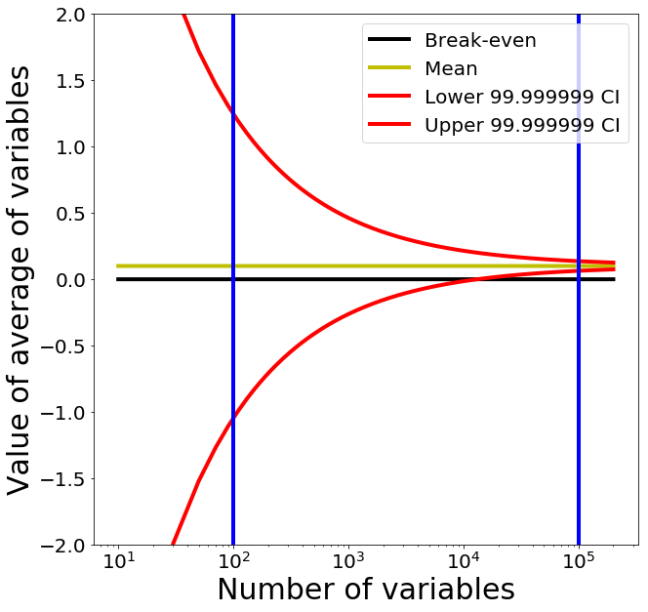
Free Drinks in Vegas
Each game/variable has mean $0.10, std $2
100K games is guaranteed profit: 99.999999% lowest value is $0.064.
$0.01 for drinks
$0.054 for profits
100 games is uncertain and fun!

Slide 8
Let’s make it big
What should happen qualitatively?
Theory says that the average is distributed with mean 31 and standard deviation $\frac{1}{\sqrt{50M}}≈\left({10}^{−5}\right)$
What will happen?
Reality: 17.47

Slide 9
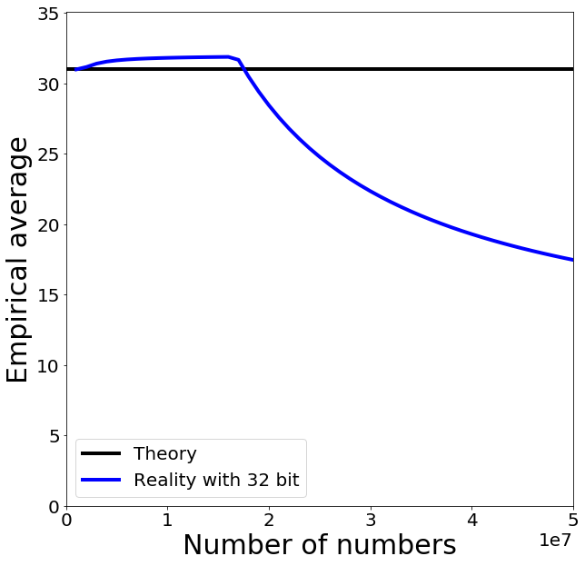
Trying it out
Hmm.
Hmm.

Slide 10
What is a number?
2⁷
2⁶
2⁵
2⁴
2³
2²
2¹
2⁰
1
0
1
1
1
0
0
1
185
128 + 32 + 16 + 8 + 1 =
185

Slide 11
Adding two numbers
2⁸
2⁷
2⁶
2⁵
2⁴
2³
2²
2¹
2⁰
1
0
1
1
1
0
0
1
185
0
1
1
0
1
0
0
1
105
1
0
0
1
0
0
0
1
0
34
Carry
Flag
Result
“Integers” on a computer are integers modulo 2^{k}

Slide 12
Some Gotchas
32 + (3 / 4) x 40 =
32
Why?
32 + (3 x 40) / 4 =
62
Underflow
No Underflow
32 + (3 / 4) x 40 =
32 + 0 x 40 =
32 + 0 =
32
32 + (3 x 40) / 4 =
32 + 120 / 4 =
32 + 30 =
62
Ok – you have to multiply before dividing

Slide 13
Some Gotchas
Should be: 9x4=36
32 + (9 x 40) / 10 =
math
68
42
uint8
32 + (9 x 40) / 10 =
Overflow
32 + 9 x 40 / 10 =
32 + 104 / 10 =
Why 104?
9 x 40 = 360
360 % 256 = 104
32 + 10 =
42

Slide 14
What is a number?
2⁷
2⁶
2⁵
2⁴
2³
2²
2¹
2⁰
1
0
1
1
1
0
0
1
185
How can we do fractions?
2⁵
2⁴
2³
2²
2¹
2⁰
2⁻¹
2⁻²
1
0
1
1
1
0
0
1
45.25
45
0.25

Slide 15
Fixed-Point Arithmetic
2⁵
2⁴
2³
2²
2¹
2⁰
2⁻¹
2⁻²
1
0
1
1
1
0
0
1
45.25
What’s the largest number we can represent?
63.75 – Why?
How precisely can we measure at 63?
0.25
How precisely can we measure at 0?
0.25
Fine for many purposes but for science, seems silly

Slide 16
Floating Point Numbers
Sign (S)
Exponent (E)
Fraction (F)
1
0
1
1
1
0
0
1
1
7
1
-1
2⁷⁻⁷ = 2⁰ =1
1+1/8 = 1.125
$$\left(−1^{S}\right)\left(2^{E+bias}\right)\left(1+\frac{F}{2^{3}}\right)$$
Bias: allows exponent to be negative (bias = -127 for float32)
Note: fraction = significant = mantissa; exponents of all ones or all zeros are special numbers

Slide 17
Floating Point Numbers
Fraction
0/8
0
0
0
-2⁰ x 1.00 = -1
1/8
0
0
1
-2⁰ x 1.125 = -1.125
Sign
Exponent
2/8
0
1
0
-2⁰ x 1.25 = -1.25
1
0
1
1
1
…
-1
7-7=0
*(-bias)*
1
1
0
6/8
-2⁰ x 1.75 = -1.75
7/8
1
1
1
-2⁰ x 1.875 = -1.875

Slide 18
Floating Point Numbers
Fraction
0/8
0
0
0
-2² x 1.00 = -4
1/8
0
0
1
-2² x 1.125 = -4.5
Sign
Exponent
2/8
0
1
0
-2² x 1.25 = -5
1
1
0
0
1
…
-1
9-7=2
*(-bias)*
1
1
0
6/8
-2² x 1.75 = -7
7/8
1
1
1
-2² x 1.875 = -7.5

Slide 19
Floating Point Numbers
Fraction
Sign
Exponent
0
0
0
-2⁰ x 1.00 = -1
1
0
1
1
1
0
0
1
-2⁰ x 1.125 = -1.125
0
0
0
-2² x 1.00 = -4
1
1
0
0
1
0
0
1
-2² x 1.125 = -4.5
Gap between numbers is relative, not absolute

Slide 20
Adding Floating Point Numbers
Sign
Exponent
Fraction
1
0
1
1
0
0
0
0
-2⁻¹ x 1.00 = -0.5
1
1
0
0
1
0
0
0
-2² x 1.00 = -4
1
1
0
0
1
0
0
1
-2² x 1.125 = -4.5
Actual implementation is complex

Slide 21
Adding Floating Point Numbers
Sign
Exponent
Fraction
1
0
1
0
0
0
0
0
-2⁻³ x 1.00 = -0.125
1
1
0
0
1
0
0
0
-2² x 1.00 = -4
-2² x 1.03125 = -4.125
1
1
0
0
1
0
0
0
-2² x 1.00 = -4
?
1
1
0
0
1
0
0
1
-2² x 1.125 = -4.5

Slide 22
Adding Floating Point Numbers
Sign
Exponent
Fraction
1
0
1
0
0
0
0
0
-2⁻³ x 1.00 = -0.125
1
1
0
0
1
0
0
0
-2² x 1.00 = -4
-2² x 1.03125 = -4.125
1
1
0
0
1
0
0
0
-2² x 1.00 = -4
For a and b, these can happen
a + b = a a+b-a ≠ b

Slide 23
Real Floating Point Numbers
IEEE 754 Single Precision / Single / float32
8 bits
2¹²⁷ ≈ 10³⁸
23 bits
≈ 7 decimal digits
S
Exponent
Fraction
IEEE 754 Double Precision / Double / float64
11 bits
2¹⁰²³ ≈ 10³⁰⁸
52 bits
≈ 15 decimal digits
S
Exponent
Fraction

Slide 24
Real Floating Point Numbers
IEEE 754 Half Precision / Half / float16
5 bits
2³² ≈ 10⁹
10 bits
≈ 3 decimal digits
S
Exponent
Fraction
Brain Floating Point / bfloat16
8 bits
2¹²⁷ ≈ 10³⁸
7 bits
≈ 2 decimal digits
S
Exponent
Fraction
Same range as FP32, but reduced precision

Slide 25
Trying it out
Roundoff error occurs
a+b=a -> numerator is stuck, denominator isn’t

Slide 26
Things to Remember
Computer numbers aren’t math numbers
Overflow, accidental zeros, roundoff error, and basic equalities are almost certainly incorrect for some values
Floating point defaults and numpy try to protect you.
Generally safe to use a double and use built-in-functions in numpy (not necessarily others!)
Spooky behavior = look for numerical issues

Slide 27
Vectors

Slide 28
Vectors
[2,3] =
2 x [1,0]
+ 3 x [0,1]
2 x
+ 3 x
2 x
e₁
+ 3 x
e₂
x = [2,3]
Can be arbitrary # of dimensions
(typically denoted R^{n})

Slide 29
Scaling Vectors
2x = [4,6]
Can scale vector by a scalar
Scalar = single number
Dimensions changed independently
Changes magnitude / length, does not change direction.
x = [2,3]

Slide 30
Adding Vectors
Can add vectors
Dimensions changed independently
Order irrelevant
Can change direction and magnitude
x = [2,3]
x+y = [5,4]
y = [3,1]

Slide 31
Scaling and Adding
2x+y = [7,7]
Can do both at the same time
x = [2,3]
y = [3,1]

Slide 32
Measuring Length
Magnitude / length / (L2) norm of vector
$$\left\|x\right\|={\left\|x\right\|}_{2}={\left(\sum_{i}^{n}{x_{i}^{2}}\right)}^{1/2}$$
x = [2,3]
There are other norms; assume L2 unless told otherwise
$${\left\|x\right\|}_{2}=\sqrt{13}$$
y = [3,1]
$${\left\|y\right\|}_{2}=\sqrt{10}$$
Why?

Slide 33
Normalizing a Vector
Diving by norm gives something on the unit sphere (all vectors with length 1)
x = [2,3]
$$x^{′}=x/{\left\|x\right\|}_{2}$$
y = [3,1]
$$y^{′}=y/{\left\|y\right\|}_{2}$$

Slide 34
Dot Products
$$x⋅y=\sum_{i=1}^{n}{x_{i}y_{i} }=x^{T}y$$
$$x⋅y=\cos\left(θ\right)\left\|x\right\|\left\|y\right\|$$
What happens with normalized / unit vectors?
$$x^{′}$$
$$θ$$
$$y^{′}$$

Slide 35
Dot Products
$$x⋅y=\sum_{i}^{n}{x_{i}y_{i}}$$
$$x=[2,3]$$
What’s $x⋅e_{1}$, $x⋅e_{2}$?
Ans: $x⋅e_{1}=2$ ; $x⋅e_{2}=3$
Dot product is projection
Amount of x that’s also pointing in direction of y
$$e_{1}$$
$$e_{2}$$

Slide 36
Dot Products
$$x⋅y=\sum_{i}^{n}{x_{i}y_{i}}$$
$$x=[2,3]$$
What’s $x⋅x$ ?
Ans: $x⋅x=∑x_{i}x_{i}={\left\|x\right\|}_{2}^{2}$

Slide 37
Special Angles
$$\left[\begin{matrix}1 \\ 0\end{matrix}\right]⋅\left[\begin{matrix}0 \\ 1\end{matrix}\right]=0∗1+1∗0=0$$
$$x$$
Perpendicular / orthogonal vectors have dot product 0 irrespective of their magnitude
$$x^{′}$$
$$θ$$
$$y^{′}$$
$$y$$

Slide 38
Special Angles
$$\left[\begin{matrix}x_{1} \\ x_{2}\end{matrix}\right]⋅\left[\begin{matrix}y_{1} \\ y_{2}\end{matrix}\right]=x_{1}y_{1}+x_{2}y_{2}=0$$
$$x$$
Perpendicular / orthogonal vectors have dot product 0 irrespective of their magnitude
$$x^{′}$$
$$θ$$
$$y$$
$$y^{′}$$

Slide 39
Orthogonal Vectors
$$x=[2,3]$$
Geometrically, what’s the set of vectors that are orthogonal to x?
A line [3,-2]

Slide 40
Orthogonal Vectors
$$x$$
What’s the set of vectors that are orthogonal to x = [5,0,0]?
A plane/2D space of vectors/any vector $[0,a,b]$
What’s the set of vectors that are orthogonal to x and y = [0,5,0]?
A line/1D space of vectors/any vector $[0,0,b]$
Ambiguity in sign and magnitude
$$x$$
$$y$$

Slide 41
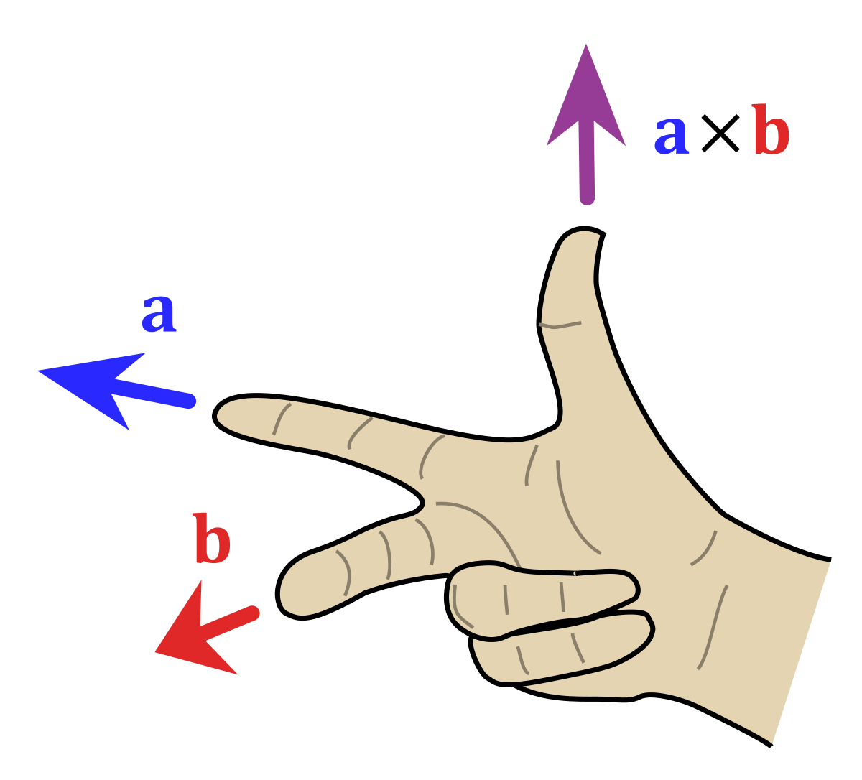
Cross Product
Set $\{z:z⋅x=0, z⋅y=0\}$ has an ambiguity in sign and magnitude
Cross product $x×y$ is: (1) orthogonal to x, y (2) has sign given by right hand rule and (3) has magnitude given by area of parallelogram of x and y
Important: if x and y are the same direction or either is 0, then $x×y=0$
Only in 3D!
(See wedge product for D != 3)
$$x$$
$$y$$
$$x×y$$
Image credit: Wikipedia.org

Slide 42
Operations You Should Know
Scale (vector, scalar → vector)
Add (vector, vector → vector)
Magnitude (vector → scalar)
Dot product (vector, vector → scalar)
Dot products are projection / angles
Cross product (vector, vector → vector)
Vectors facing same direction have cross product 0
You can never mix vectors of different sizes

Slide 43
Next Time: Matrices, Vectorization, Linear Algebra

