Slide 1
Lecture 2: Cameras I

Slide 2
Administrative
HW0 is released, will be due Friday 1/24 at 11:59pm

Slide 3
This week: How do images form?
Computer Vision: Writing software to understand images
Photography: Capturing images of the real world
Computer Graphics: Writing software to generate images

Slide 4
Let’s take a picture!
Photosensitive Material
Idea 1: Just use film
Result: Junk
Slide inspired by S. Seitz; image from Michigan Engineering

Slide 5
Let’s take a picture!
Photosensitive Material
Idea 2: add a barrier
Slide inspired by S. Seitz; image from Michigan Engineering

Slide 6
Let’s take a picture!
Photosensitive Material
Idea 2: add a barrier
Slide inspired by S. Seitz; image from Michigan Engineering

Slide 7
Let’s take a picture!
Photosensitive Material
Film captures all the rays going through a point (a pencil of rays).
Result: good in theory!
Slide inspired by S. Seitz; image from Michigan Engineering

Slide 8
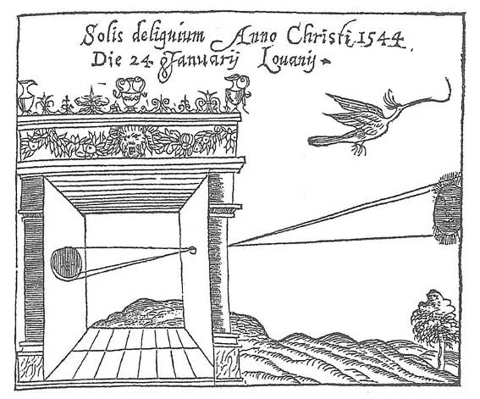
Camera Obscura
Basic principle known to Mozi (470-390 BCE), Aristotle (384-322 BCE)
Drawing aid for artists: described by Leonardo da Vinci (1452-1519)
Gemma Frisius, 1558
Source: A. Efros
Notes:
Mozi = Chinese Philosopher

Slide 9
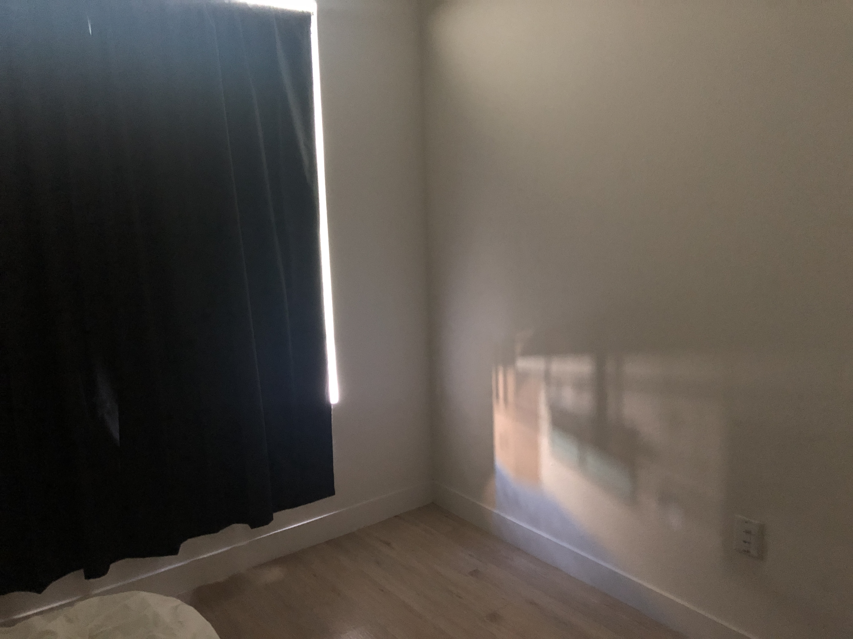
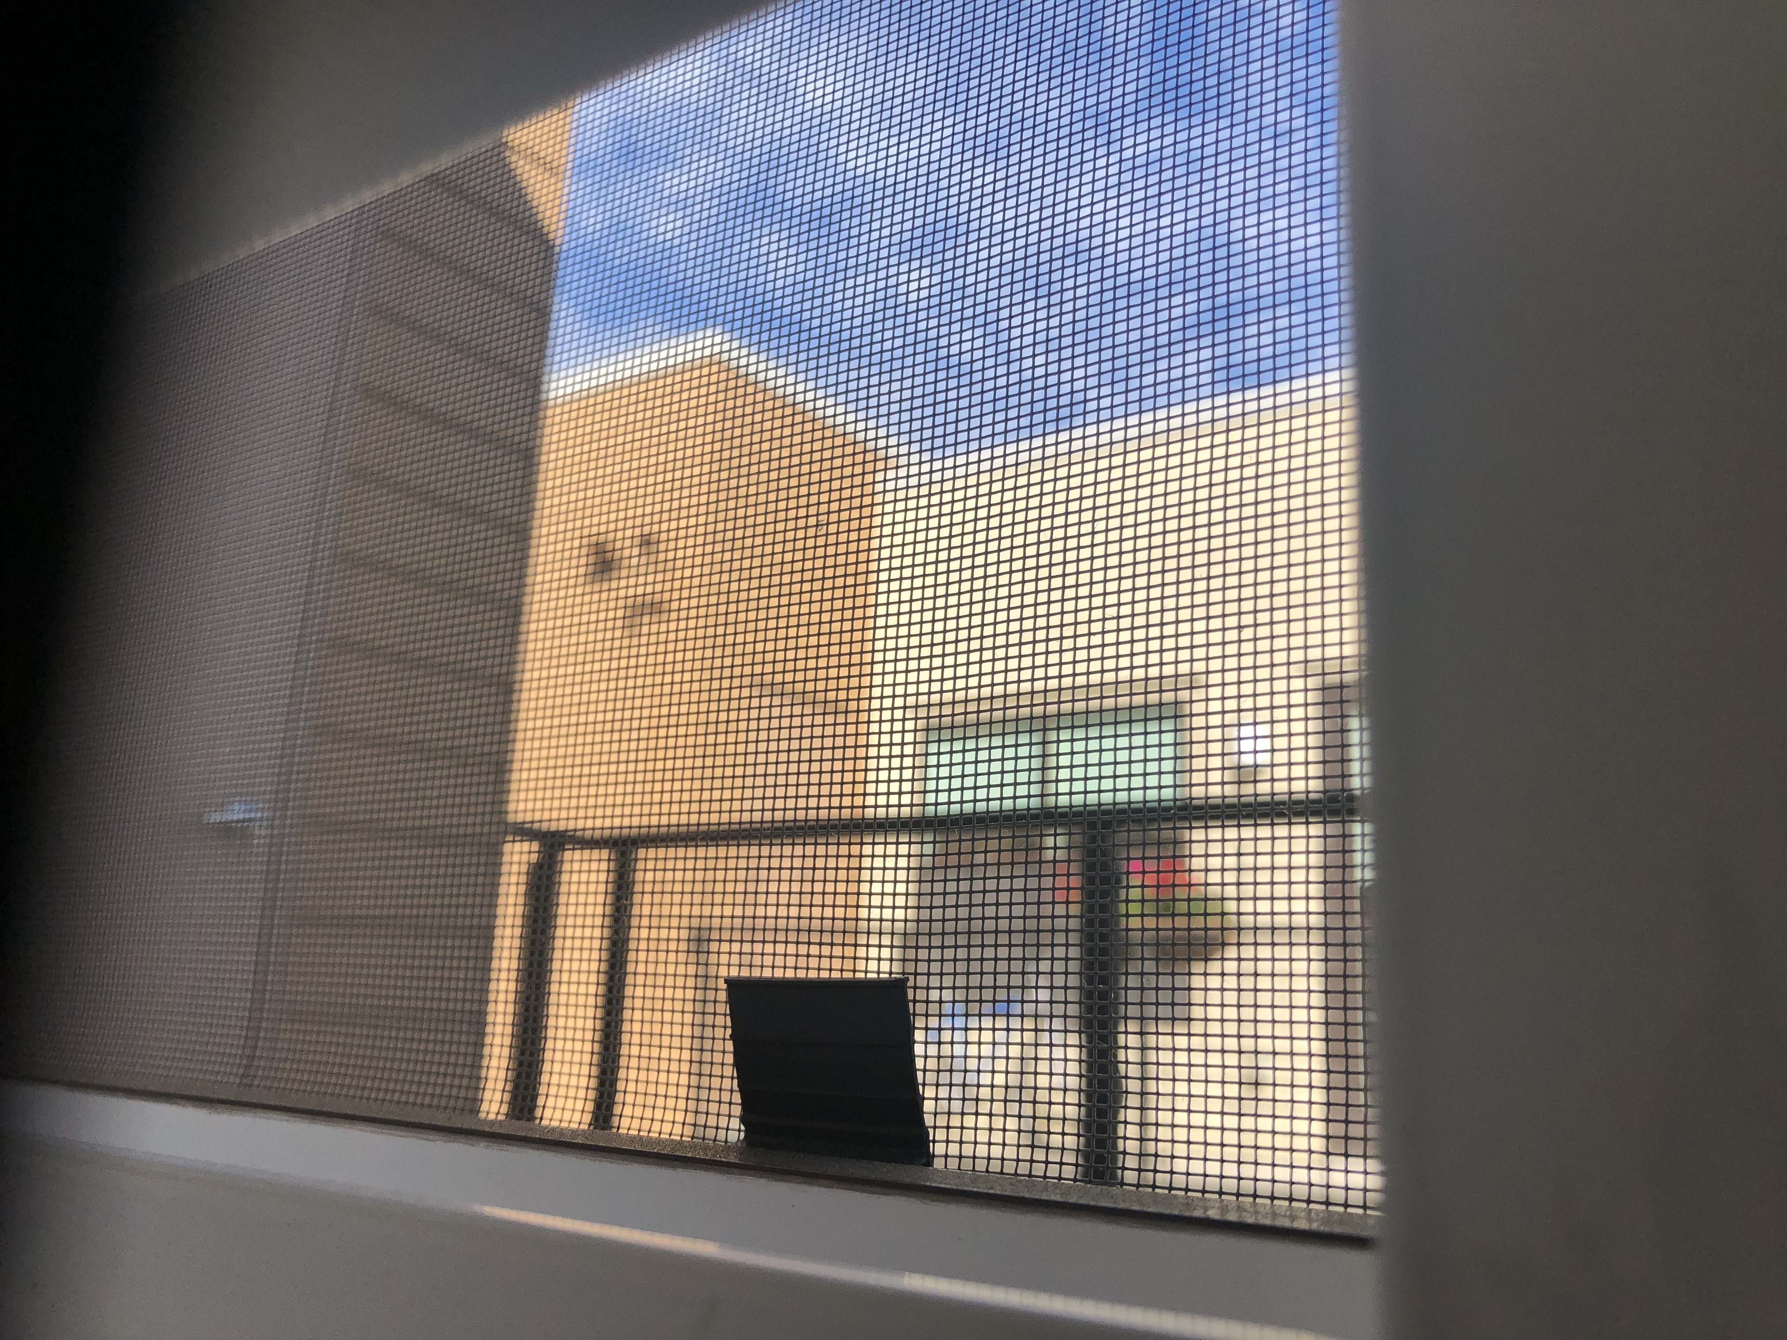
Camera Obscura
My bedroom with blackout curtains
The view out the window
Image credit: Justin Johnson, 9/29/2018

Slide 10
Camera Obscura
Useful for viewing solar eclipses!
Put your eye here
Pinhole: aluminum foil with a tiny hole

Slide 11
Camera Obscura
Useful for viewing solar eclipses!
Put your eye here
Pinhole: aluminum foil with a tiny hole
Me on 8/21/2017

Slide 12
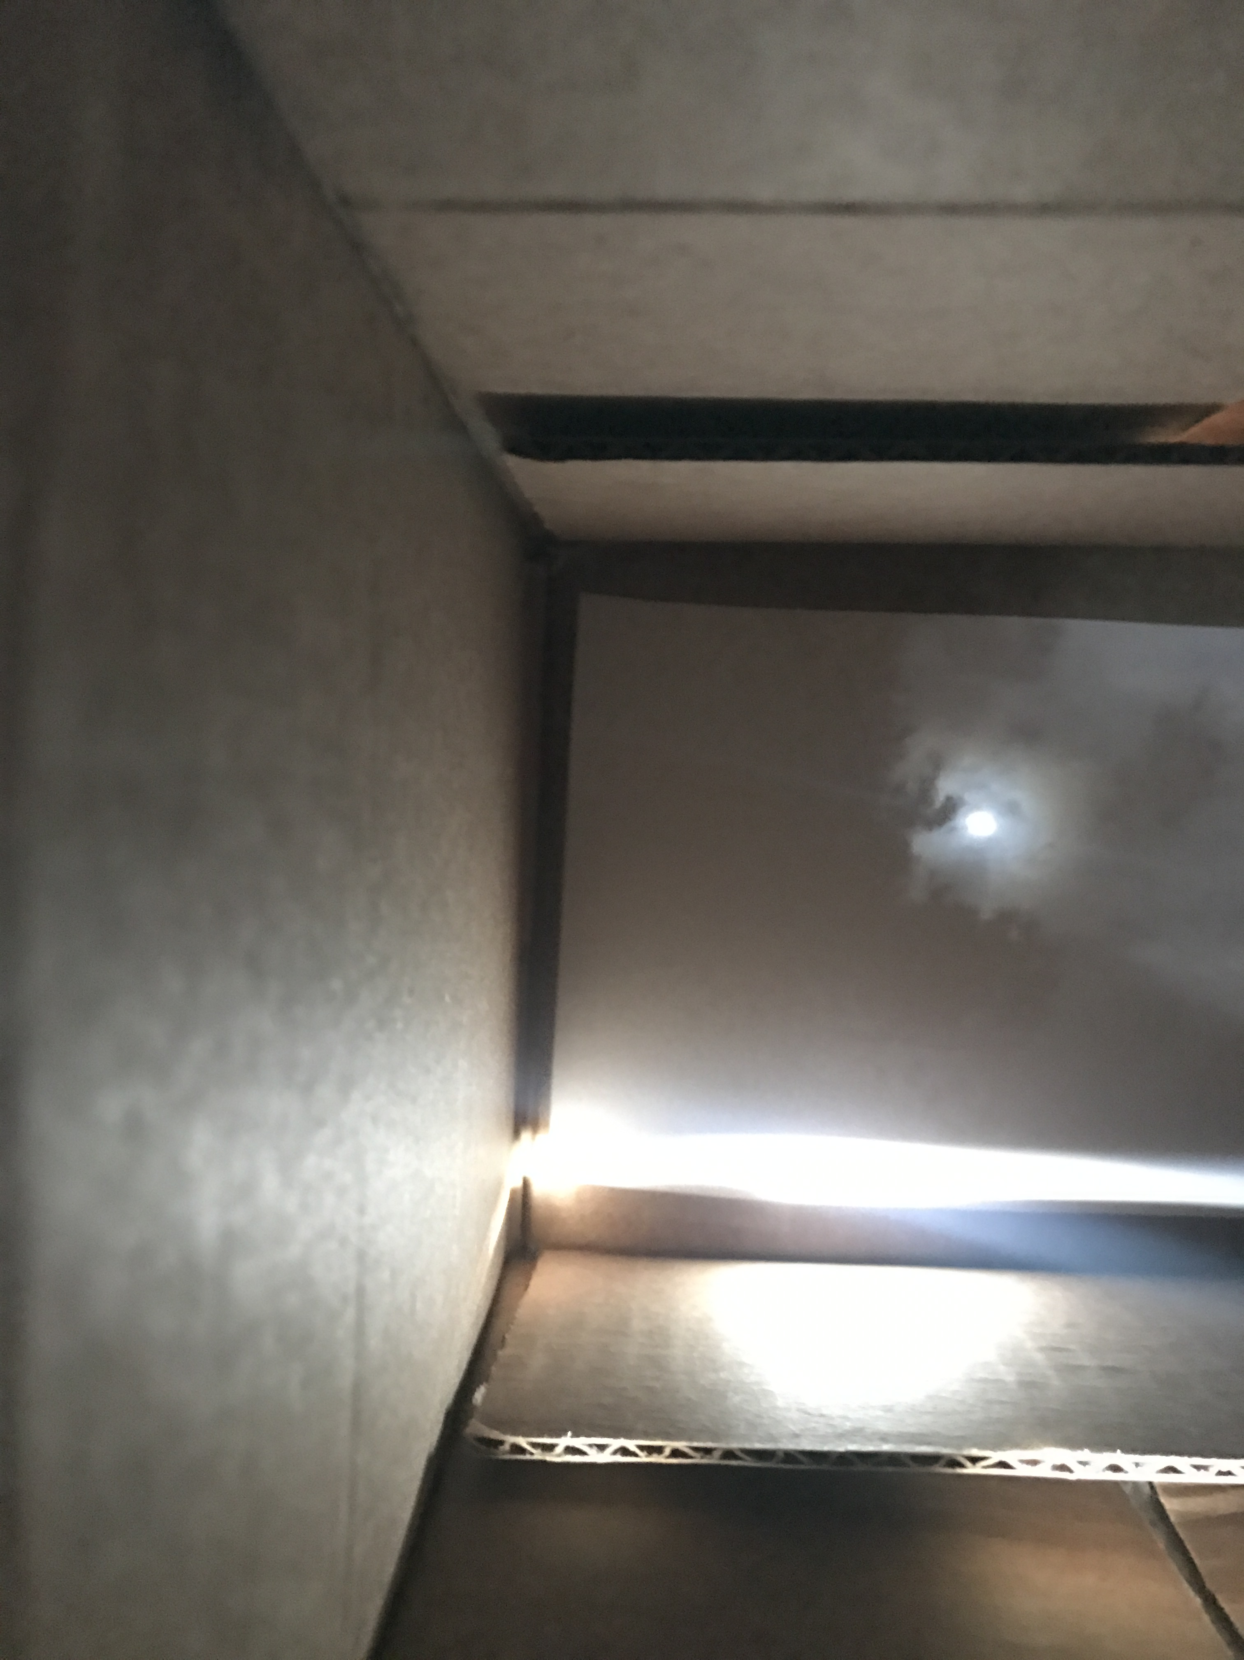
Camera Obscura
Useful for viewing solar eclipses!
Photo of the sun
View in the box
Me on 8/21/2017

Slide 13
Projection
X
P
O
How do we find the projection P of a point X?
Form visual ray from X to camera center and intersect it with camera plane
Source: L Lazebnik

Slide 14
Projection
X
X’
P
O
Both X and X’ project to P. Which appears in the image?
Are there points for which projection is undefined?
Source: L Lazebnik

Slide 15
Aside: Remember Trigonometry?
d
b
θ
θ
c
a
$$\frac{a}{b}=\frac{d}{c}$$
$$a=\frac{bd}{c}$$

Slide 16
Projection
Focal length
f
y
X (x,y,z)
O
z
P
x
Coordinate system: O is origin, XY in image, Z sticks out.
XY is image plane, Z is optical axis.
(x,y,z) projects to (fx/z,fy/z) via similar triangles
Source: L Lazebnik
Source: L Lazebnik

Slide 17
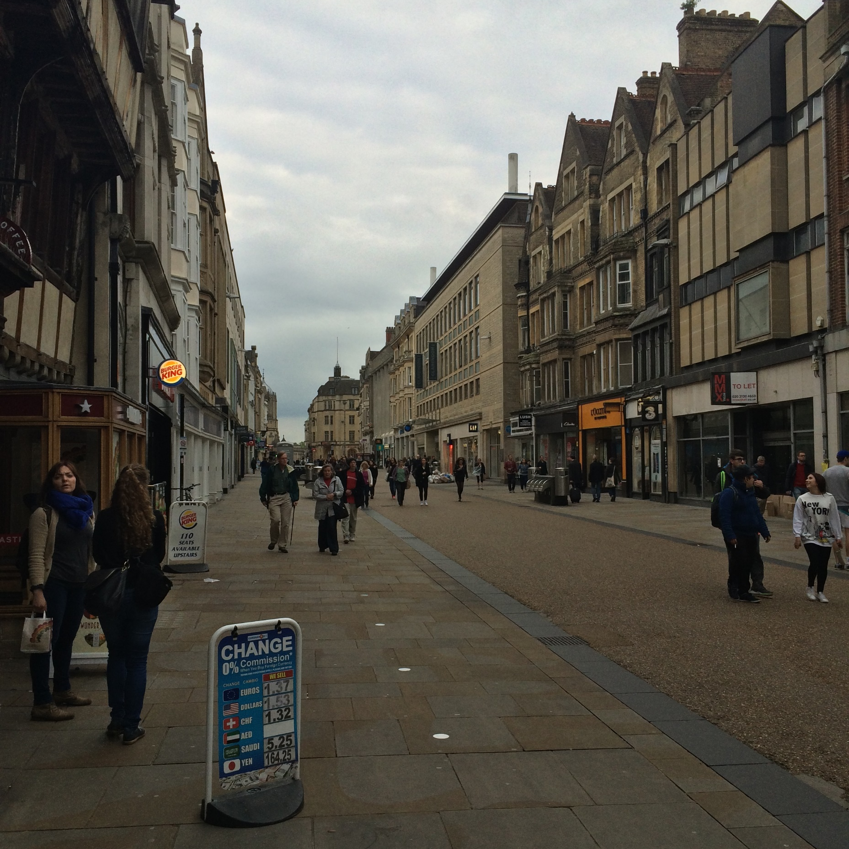
Facts about Projection
3D lines project to 2D lines
The projection of any 3D parallel lines converge at a vanishing point
Distant objects are smaller
List of properties from M. Hebert

Slide 18
Facts about Projection
Let’s try some fake images

Slide 19
Facts about Projection
Slide by Steve Seitz

Slide 20
Facts about Projection
Slide by Steve Seitz

Slide 21
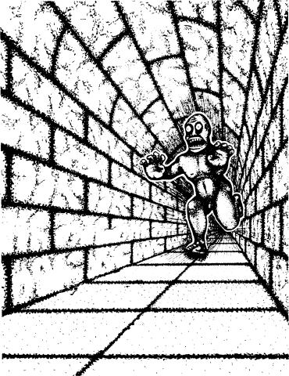
Facts about Projection
Illusion Credit: RN Shepard, Mind Sights: Original Visual Illusions, Ambiguities, and other Anomalies

Slide 22
What is lost under projection?
Is she shorter or further away?
1
Are the green lines we see parallel / perpendicular / neither to the red line?
4
2
3
Inspired by D. Hoiem slide

Slide 23
What is lost under projection?
Is she shorter or further away?
1
Are the green lines we see parallel / perpendicular / neither to the red line?
4
2
3
Inspired by D. Hoiem slide

Slide 24
What is lost under projection?
Be careful of drawing conclusions:
Projection of 3D line is 2D line; NOT 2D line is 3D line.
Can you think of a counter-example (a 2D line that is not a 3D line)?
Projections of parallel 3D lines converge at VP; NOT any pair of lines that converge are parallel in 3D.
Can you think of a counter-example?

Slide 25
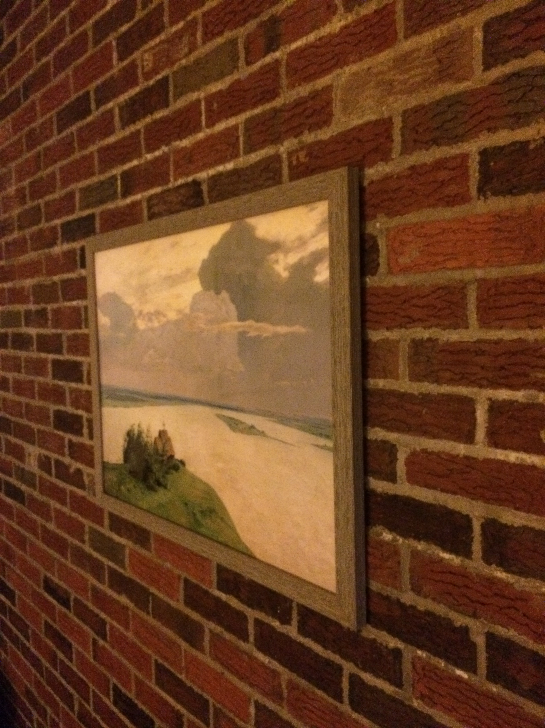
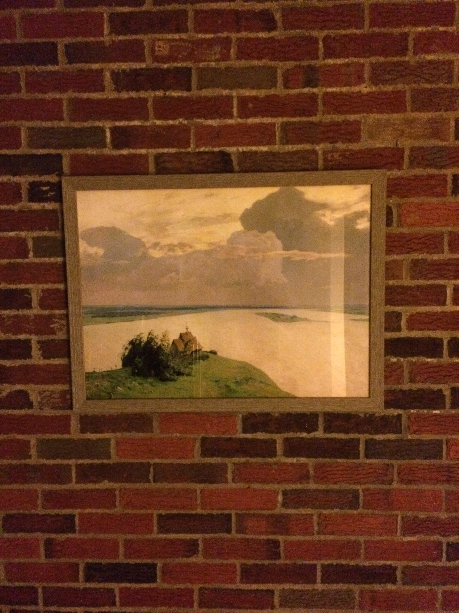
Do we always get perspective?

Slide 26
Do we always get perspective?
Y location of blue and orange dots in image:
$$\frac{fy}{z_{2}}$$
$$\frac{fy}{z_{1}}$$
$$\frac{fy}{z}$$
$$\frac{fy}{z}$$

Slide 27
Do we always get perspective?
When plane is fronto-parallel (parallel to camera plane), everything is:
scaled by f/z
otherwise is preserved.

Slide 28
Why is this useful?
Things looking different when viewed from different angles seems like a nuisance. It’s also a cue. Why?

Slide 29
Projection
f
y
X
P
O
z
x
(x,y,z) → (fx/z,fy/z)
I promised you linear algebra: is this linear?
Nope: division by z is non-linear
(and risks division by 0)
Adapted from S. Seitz slide

Slide 30
Homogeneous Coordinates (2D)
Trick: add a dimension!
This also clears up lots of nasty special cases
Physical
Point
Homogeneous
Point
Physical
Point
$$\left[\begin{matrix}u \\ v \\ w\end{matrix}\right]$$
$$\left[\begin{matrix}x \\ y\end{matrix}\right]$$
$$\left[\begin{matrix}u/w \\ v/w\end{matrix}\right]$$
Concat
w=1
Divide by w
What if w = 0?
Adapted from M. Hebert slide

Slide 31
Homogenous Coordinates
λ[x,y,w]
Triple /
Equivalent
Double /
Equals
[x,y,w]
$$\left[\begin{matrix}u \\ v \\ w\end{matrix}\right]≡\left[\begin{matrix}u^{′} \\ v^{′} \\ w^{′}\end{matrix}\right] ↔ \left[\begin{matrix}u \\ v \\ w\end{matrix}\right]=λ\left[\begin{matrix}u^{′} \\ v^{′} \\ w^{′}\end{matrix}\right]$$
y
$$λ≠0$$
z
Two homogeneous coordinates are equivalent if they are proportional to each other. Not = !
x

Slide 32
Benefits of Homogenous Coords
General equation of 2D line:
$$ax+by+c=0$$
Homogeneous Coordinates
$$l^{T}p=0, l= \left[\begin{matrix}a \\ b \\ c\end{matrix}\right], p= \left[\begin{matrix}x \\ y \\ 1\end{matrix}\right]$$
Slide from M. Hebert

Slide 33
Benefits of Homogenous Coords
Lines (3D) and points (2D → 3D) are now the same dimension.
Use the cross (x) and dot product for:
Point p on line l: l^{T}p = 0
Intersection of lines l and m: l x m
Line through two points p and q: p x q
Parallel lines, vertical lines become easy (compared to y=mx+b)

Slide 34
Benefits of Homogenous Coords
What’s the intersection?
0x + 1y - 2 = 0
1x + 0y - 1 = 0
[0,1,-2] x [1,0,-1] = [-1,-2,-1]
Converting back (divide by -1)
(1,2)

Slide 35
Benefits of Homogenous Coords
0x + 1y - 3 = 0
0x + 1y - 2 = 0
0x + 1y - 1 = 0
Intersection of y=2, y=1
[0,1,-2] x [0,1,-1] = [1,0,0]
Does it lie on y=3? Intuitively?
[0,1,-3]^{T}[1,0,0] = 0

Slide 36
Benefits of Homogenous Coords
Translation is now linear / matrix-multiply
$$\left[\begin{matrix}u′ \\ v′ \\ w′\end{matrix}\right]=\left[\begin{matrix}1 & 0 & t_{x} \\ 0 & 1 & t_{y} \\ 0 & 0 & 1\end{matrix}\right]\left[\begin{matrix}u \\ v \\ 1\end{matrix}\right]$$
$$=\left[\begin{matrix}u+t_{x} \\ v+t_{y} \\ 1\end{matrix}\right]$$
If w = 1
$$\left[\begin{matrix}u′ \\ v′ \\ w′\end{matrix}\right]=\left[\begin{matrix}1 & 0 & t_{x} \\ 0 & 1 & t_{y} \\ 0 & 0 & 1\end{matrix}\right]\left[\begin{matrix}u \\ v \\ w\end{matrix}\right]$$
$$=\left[\begin{matrix}u+wt_{x} \\ v+{wt}_{y} \\ w\end{matrix}\right]$$
Generically
Rigid body transforms (rot + trans) now linear
$$\left[\begin{matrix}u′ \\ v′ \\ w′\end{matrix}\right]=\left[\begin{matrix}r_{11} & r_{12} & t_{x} \\ r_{21} & r_{22} & t_{y} \\ 0 & 0 & 1\end{matrix}\right]\left[\begin{matrix}u \\ v \\ w\end{matrix}\right]$$

Slide 37
3D Homogenous Coordinates
Same story: add a coordinate, things are equivalent if they’re proportional
$$\left[\begin{matrix}u \\ v \\ w \\ t\end{matrix}\right]$$
$$\left[\begin{matrix}u/t \\ v/t \\ w/t\end{matrix}\right]$$
$$\left[\begin{matrix}x \\ y \\ z\end{matrix}\right]$$

Slide 38
Projection Matrix
Projection (x, y, z) -> (fx/z, fy/z) is matrix multiplication
f
O
Slide inspired from L. Lazebnik

Slide 39
Projection Matrix
Projection (x, y, z) -> (fx/z, fy/z) is matrix multiplication
f
O
$$\left[\begin{matrix}f & 0 & 0 & 0 \\ 0 & f & 0 & 0 \\ 0 & 0 & 1 & 0\end{matrix}\right]\left[\begin{matrix}x \\ y \\ z \\ 1\end{matrix}\right]=\left[\begin{matrix}fx \\ fy \\ z\end{matrix}\right]≡\left[\begin{matrix}fx/z \\ \begin{aligned}fy/z \\ 1\end{aligned}\end{matrix}\right]$$
3D homogenous point
2D homogenous point
Slide inspired from L. Lazebnik

Slide 40
Projection Matrix
Projection (x, y, z) -> (fx/z, fy/z) is matrix multiplication
f
O
$$\left[\begin{matrix}f & 0 & 0 & 0 \\ 0 & f & 0 & 0 \\ 0 & 0 & 1 & 0\end{matrix}\right]\left[\begin{matrix}x \\ y \\ z \\ 1\end{matrix}\right]=\left[\begin{matrix}fx \\ fy \\ z\end{matrix}\right]≡\left[\begin{matrix}fx/z \\ \begin{aligned}fy/z \\ 1\end{aligned}\end{matrix}\right]$$
3D homogenous point
2D homogenous point
Slide inspired from L. Lazebnik

Slide 41
Projection Matrix
Projection (x, y, z) -> (fx/z, fy/z) is matrix multiplication
f
O
$$\left[\begin{matrix}f & 0 & 0 & 0 \\ 0 & f & 0 & 0 \\ 0 & 0 & 1 & 0\end{matrix}\right]\left[\begin{matrix}x \\ y \\ z \\ 1\end{matrix}\right]=\left[\begin{matrix}fx \\ fy \\ z\end{matrix}\right]≡\left[\begin{matrix}fx/z \\ \begin{aligned}fy/z \\ 1\end{aligned}\end{matrix}\right]$$
3D homogenous point
2D homogenous point
Slide inspired from L. Lazebnik

Slide 42
Projection Matrix
Projection (x, y, z) -> (fx/z, fy/z) is matrix multiplication
f
O
$$\left[\begin{matrix}f & 0 & 0 & 0 \\ 0 & f & 0 & 0 \\ 0 & 0 & 1 & 0\end{matrix}\right]\left[\begin{matrix}x \\ y \\ z \\ 1\end{matrix}\right]=\left[\begin{matrix}fx \\ fy \\ z\end{matrix}\right]≡\left[\begin{matrix}fx/z \\ \begin{aligned}fy/z \\ 1\end{aligned}\end{matrix}\right]$$
3D homogenous point
2D homogenous point
Slide inspired from L. Lazebnik

Slide 43
Typical Perspective Model
P: 2D homogeneous point (3D)
X: 3d homogeneous point (4D)
$$P≡\begin{matrix}\left[\begin{matrix}f & 0 & u_{0} \\ 0 & f & v_{0} \\ 0 & 0 & 1\end{matrix}\right] & \left[\begin{matrix}R_{3x3} & t_{3x1}\end{matrix}\right]\end{matrix} X_{4x1}$$

Slide 44
Typical Perspective Model
R: rotation between world system and camera
t: translation between world system and camera
$$P≡\begin{matrix}\left[\begin{matrix}f & 0 & u_{0} \\ 0 & f & v_{0} \\ 0 & 0 & 1\end{matrix}\right] & \left[\begin{matrix}R_{3x3} & t_{3x1}\end{matrix}\right]\end{matrix} X_{4x1}$$

Slide 45
Typical Perspective Model
f focal length
u0,v0: principal point (image coords of camera origin on retina)
$$P≡\begin{matrix}\left[\begin{matrix}f & 0 & u_{0} \\ 0 & f & v_{0} \\ 0 & 0 & 1\end{matrix}\right] & \left[\begin{matrix}R_{3x3} & t_{3x1}\end{matrix}\right]\end{matrix} X_{4x1}$$

Slide 46
Typical Perspective Model
Intrinsic Matrix K
Extrinsic Matrix [R,t]
$$P≡\begin{matrix}\left[\begin{matrix}f & 0 & u_{0} \\ 0 & f & v_{0} \\ 0 & 0 & 1\end{matrix}\right] & \left[\begin{matrix}R_{3x3} & t_{3x1}\end{matrix}\right]\end{matrix} X_{4x1}$$
$$P≡K\left[R | t\right]X≡M_{3x4}X_{4x1}$$
Nice interactive demo: http://ksimek.github.io/2012/08/22/extrinsic/

Slide 47
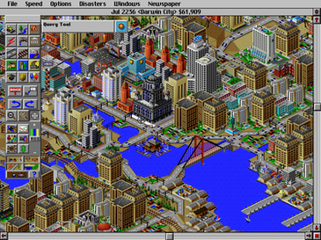
Other Cameras: Orthographic
Orthographic Camera (z infinite)
$$P=\begin{matrix}\left[\begin{matrix}1 & 0 & 0 \\ 0 & 1 & 0 \\ 0 & 0 & 0\end{matrix}\right] & X_{3x1}\end{matrix}$$
Image Credit: Wikipedia

Slide 48
Other Cameras: Orthographic
Why does this make things easy and why is this popular in old games?
$$P=\begin{matrix}\left[\begin{matrix}1 & 0 & 0 \\ 0 & 1 & 0 \\ 0 & 0 & 0\end{matrix}\right] & \left[\begin{matrix}x \\ y \\ z\end{matrix}\right]\end{matrix}$$

Slide 49
Next Time: More Cameras

