Slide 1
Stereo
EECS 442 – David Fouhey and Justin Johnson
Winter 2021, University of Michigan
https://web.eecs.umich.edu/~justincj/teaching/eecs442/WI2021/

Slide 2
Updates
Project discussions this week. Not mandatory, but could be useful!
Check your grades from earlier assignments. If you lost 50% of the grade because you submitted a .rar instead of a .zip, talk to us.

Slide 3
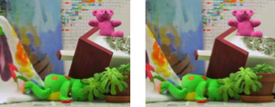

Two-View Stereo
Slide credit: S. Seitz

Slide 4
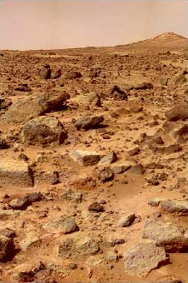
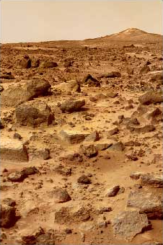
Stereo
Slide credit: S. Lazebnik

Slide 5
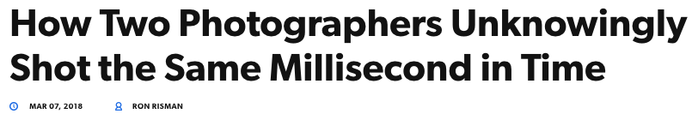

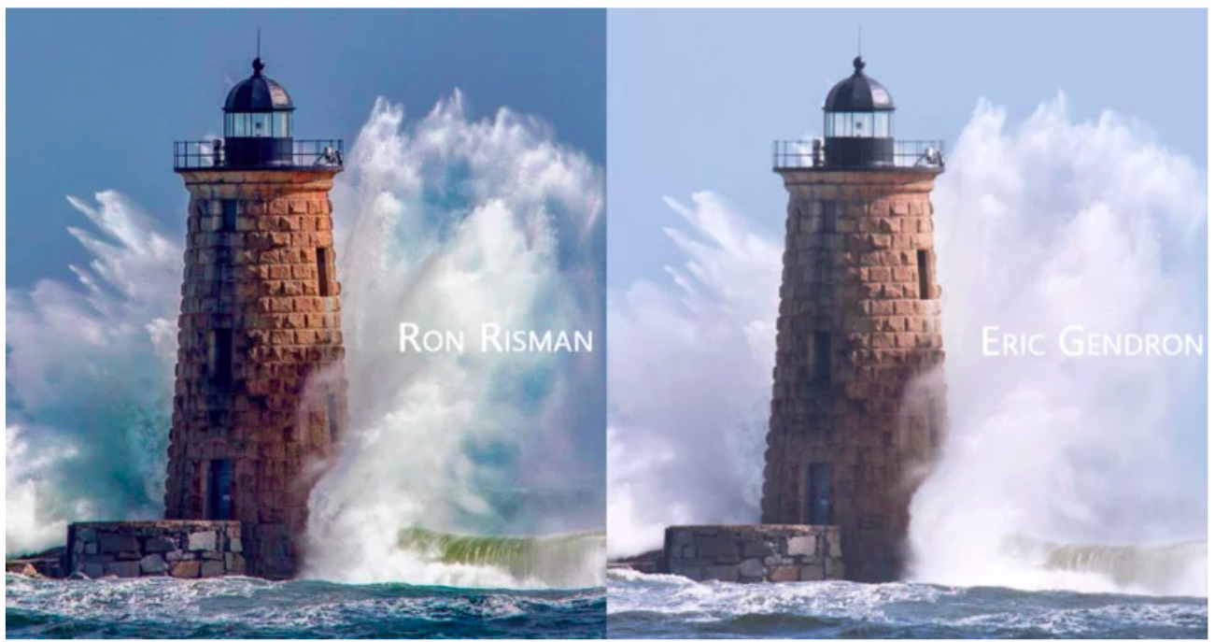
https://petapixel.com/2018/03/07/two-photographers-unknowingly-shot-millisecond-time/

Slide 6
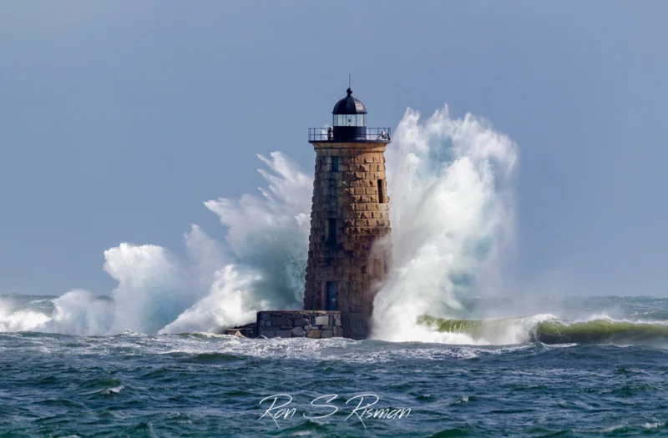
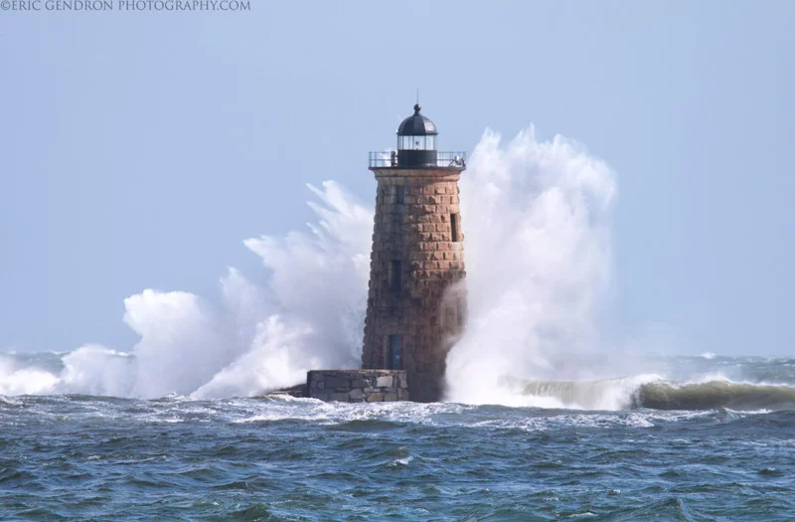
https://petapixel.com/2018/03/07/two-photographers-unknowingly-shot-millisecond-time/

Slide 7
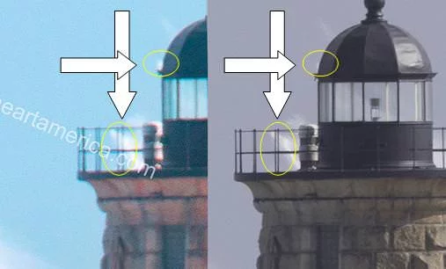
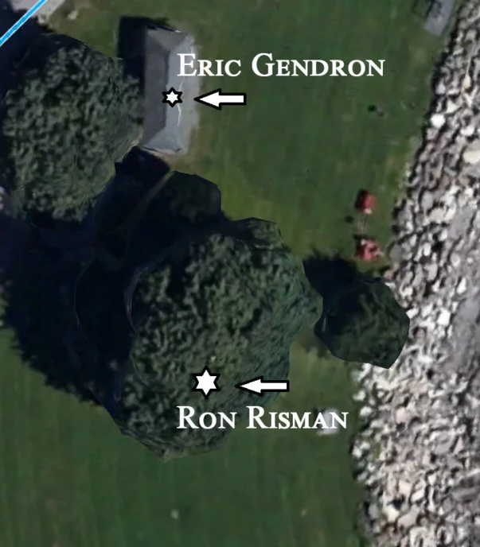
https://petapixel.com/2018/03/07/two-photographers-unknowingly-shot-millisecond-time/

Slide 8
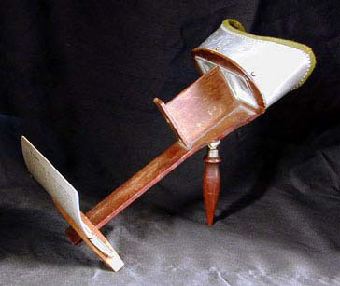
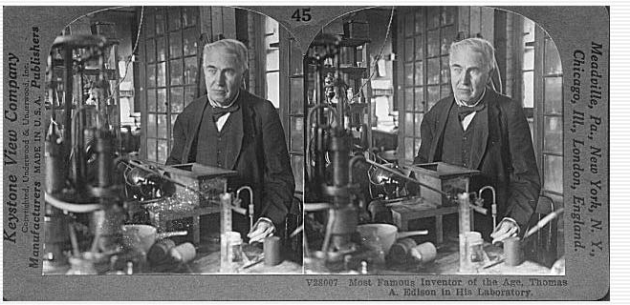
Stereograms
Humans can fuse pairs of images to get a sensation of depth
Stereograms: Invented by Sir Charles Wheatstone, 1838
Slide credit: S. Lazebnik

Slide 9
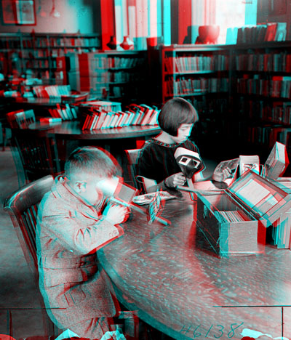
Stereograms
Slide credit: S. Lazebnik

Slide 10
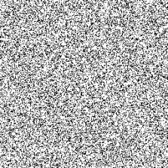
Stereograms
What about this?
Slide Credit: S. Lazebnik, but idea of random dot sterogram is due to B. Julesz
Notes:
Now take it away. And count to 3…

Slide 11
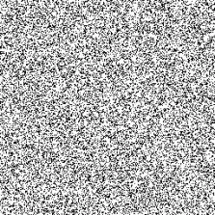
Stereograms
Bela Julesz: Random Dot Stereogram
Shows that stereo can operate without recognition
Slide Credit: S. Lazebnik, but idea of random dot sterogram is due to B. Julesz
Notes:
Now take it away. And count to 3…

Slide 12
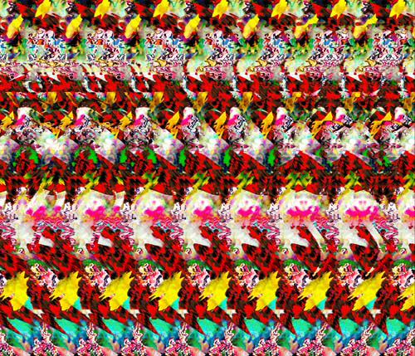
Stereograms
Humans can fuse pairs of images to get a sensation of depth
Autostereograms: www.magiceye.com
Slide credit: S. Lazebnik

Slide 13
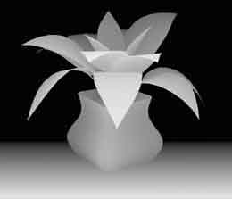
Stereograms
Humans can fuse pairs of images to get a sensation of depth
Autostereograms: www.magiceye.com
Slide credit: S. Lazebnik

Slide 14



Problem formulation
Given a calibrated binocular stereo pair, fuse it to produce a depth image
image 1
image 2
Dense depth map
Slide credit: S. Lazebnik

Slide 15

Basic stereo matching algorithm
For each pixel in the first image
  Find corresponding epipolar line in the right image
  Examine all pixels on the epipolar line and pick the best match
  Triangulate the matches to get depth information
Simplest case: epipolar lines = corresponding scanlines
  When does this happen?
Slide credit: S. Lazebnik

Slide 16
Simplest Case: Parallel images
Image planes of cameras are parallel to each other and to the baseline
Camera centers are at same height
Focal lengths the same
Slide credit: S. Lazebnik

Slide 17
Simplest Case: Parallel images
Image planes of cameras are parallel to each other and to the baseline
Camera centers are at same height
Focal lengths the same
Then epipolar lines fall along the horizontal scan lines of the images
Slide credit: S. Lazebnik

Slide 18


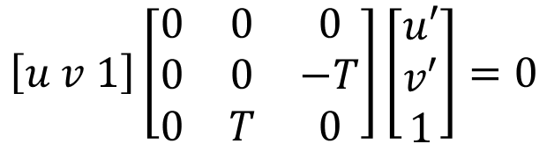

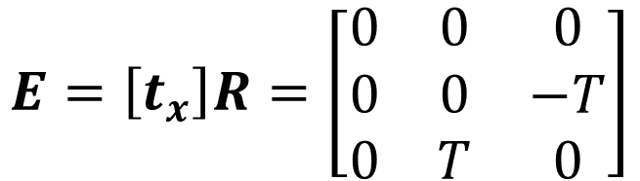



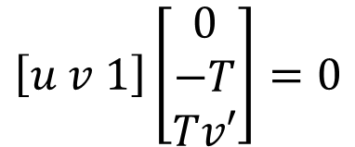
Essential matrix for parallel images
$$pEp^{′}=0$$
$$E= \left[t_{x}\right]R$$
What’s R?
What’s t?
p
$$R=I$$
$$t=[T,0,0]$$
p'
y
$$E=\left[t_{x}\right]R=\left[\begin{matrix}0 & 0 & 0 \\ 0 & 0 & −T \\ 0 & T & 0\end{matrix}\right]$$
z
T
x
$$\left[u v 1\right]\left[\begin{matrix}0 & 0 & 0 \\ 0 & 0 & −T \\ 0 & T & 0\end{matrix}\right]\left[\begin{matrix}u′ \\ v′ \\ 1\end{matrix}\right]=0$$
$$\left[u v 1\right]\left[\begin{matrix}0 \\ −T \\ Tv′\end{matrix}\right]=0$$
$$−Tv+Tv′=0$$
$$Tv′=Tv$$
The y-coordinates of corresponding points are the same!
Slide credit: S. Lazebnik

Slide 19
Stereo image rectification
Slide credit: S. Lazebnik

Slide 20
Stereo image rectification
Reproject image planes onto a common plane parallel to the line between optical centers
C. Loop and Z. Zhang. Computing Rectifying Homographies for Stereo Vision. CVPR 1999
Slide credit: S. Lazebnik

Slide 21
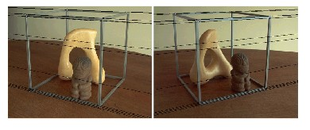
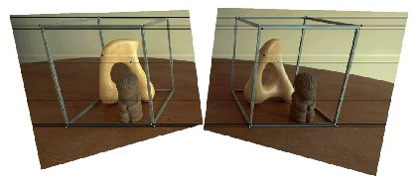
Rectification example
Slide credit: S. Lazebnik

Slide 22
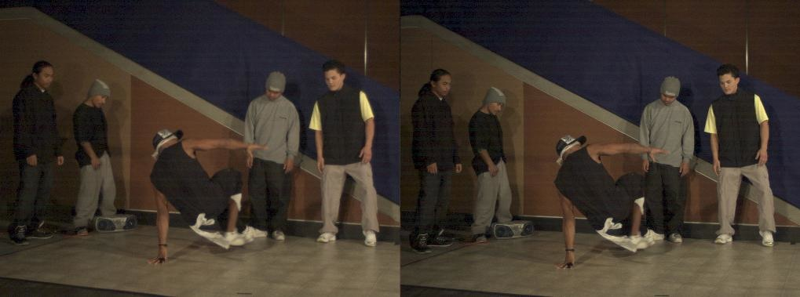
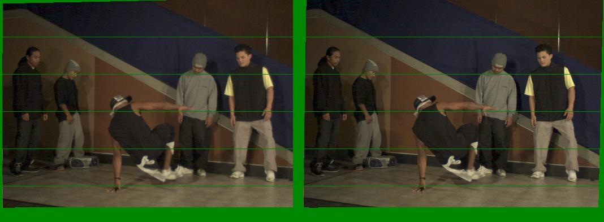
Another rectification example
Unrectified
Rectified
Slide credit: S. Lazebnik

Slide 23
Basic stereo matching algorithm
If necessary, rectify the two stereo images to transform epipolar lines into scanlines
For each pixel in the first image
  Find corresponding epipolar line in the right image
  Examine all pixels on the epipolar line and pick the best match
Slide credit: S. Lazebnik

Slide 24


Correspondence Search
Left
Right
scanline
Matching cost
disparity
Slide window along the right scanline, compare contents of that window with reference window on left
Matching cost: SSD or normalized correlation
Slide credit: S. Lazebnik

Slide 25
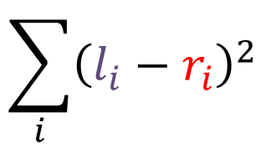
Correspondence Search
Left
Right
scanline
Matching cost
Sum of squared differences
$$\sum_{i}{{\left(l_{i}−r_{i}\right)}^{2}}$$
Disparity
Slide credit: S. Lazebnik

Slide 26
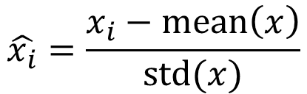
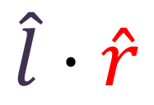
Correspondence Search
Left
Right
scanline
Matching cost
Normalized correlation
$$\hat{x_{i}}=\frac{x_{i}−mean\left(x\right)}{std(x)}$$
$$\hat{l}⋅\hat{r}$$
Disparity
Slide credit: S. Lazebnik

Slide 27
Basic stereo matching algorithm
If necessary, rectify the two stereo images to transform epipolar lines into scanlines
For each pixel x in the first image
  Find corresponding epipolar scanline in the right image
  Examine all pixels on the scanline and pick the best match x’
  Triangulate the matches to get depth information
Slide credit: S. Lazebnik

Slide 28
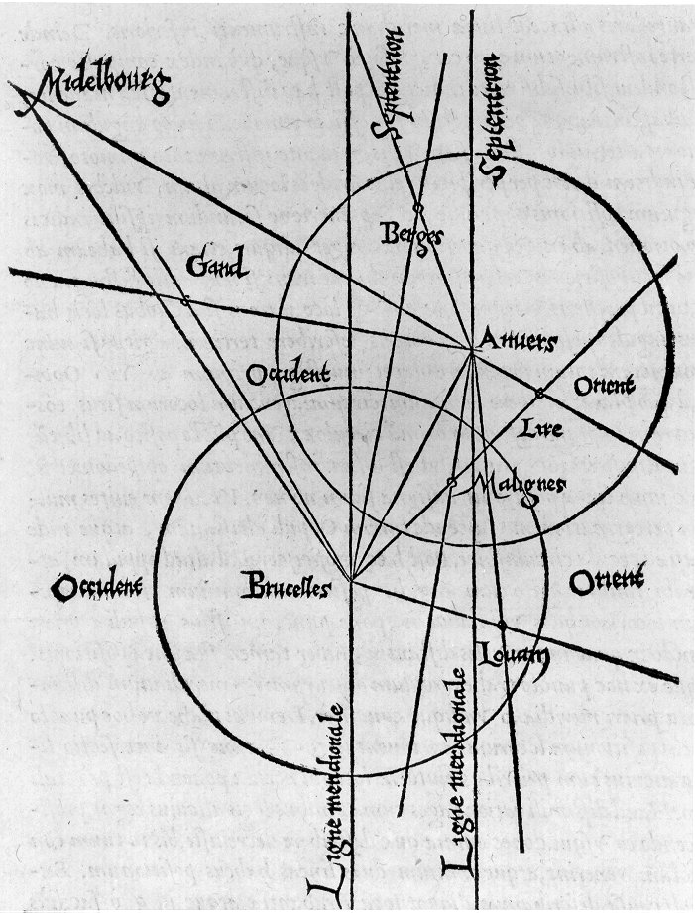
Triangulation: Older History
From Wikipedia: Gemma Frisius's 1533 diagram introducing the idea of triangulation into the science of surveying. Having established a baseline, e.g. the cities of Brussels and Antwerp, the location of other cities, e.g. Middelburg, Ghent etc., can be found by taking a compass direction from each end of the baseline, and plotting where the two directions cross. This was only a theoretical presentation of the concept — due to topographical restrictions, it is impossible to see Middelburg from either Brussels or Antwerp. Nevertheless, the figure soon became well known all across Europe.
Slide credit: S. Lazebnik

Slide 29
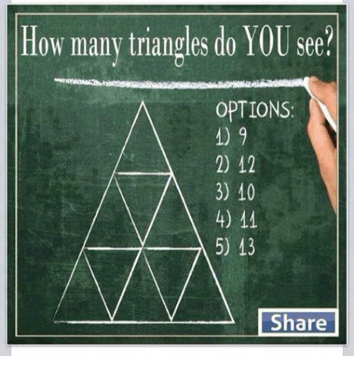
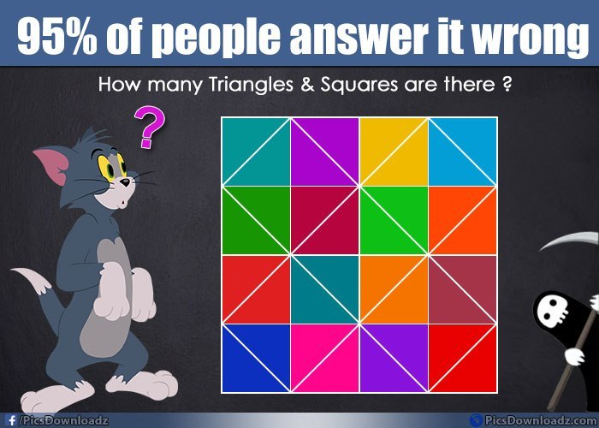

Triangulation: Modern History

Slide 30
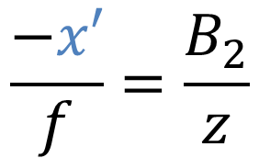
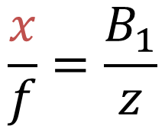
Depth from disparity
$$\frac{x}{f}=\frac{B_{1}}{z}$$
By similar triangles
x
z
x'
$$\frac{−x′}{f}=\frac{B_{2}}{z}$$
f
f
B₁
B₂
Similarly by
similar triangles
o
o'
Diagram adapted from S. Lazebnik

Slide 31
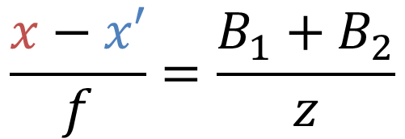

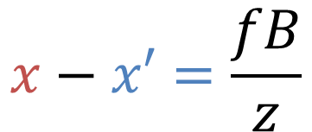
Depth from disparity
$$\frac{x}{f}=\frac{B_{1}}{z}$$
$$\frac{−x′}{f}=\frac{B_{2}}{z}$$
Add them
z
$$\frac{x−x′}{f}=\frac{B_{1}+B_{2}}{z}$$
x
x'
f
f
B₁
B₂
$$x−x′=\frac{fB}{z}$$
o
Baseline B
B=B₁+B₂
o'
Disparity
Diagram adapted from S. Lazebnik

Slide 32

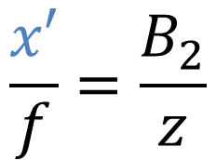
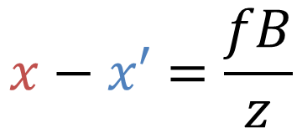
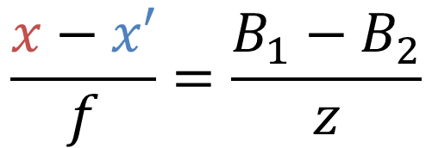
Depth from disparity
$$\frac{x}{f}=\frac{B_{1}}{z}$$
$$\frac{x′}{f}=\frac{B_{2}}{z}$$
Subtract them
z
$$\frac{x−x′}{f}=\frac{B_{1}−B_{2}}{z}$$
x
x'
f
f
B
$$x−x′=\frac{fB}{z}$$
o
o'
B₁
B₂
Diagram adapted from S. Lazebnik

Slide 33
Basic stereo matching algorithm
If necessary, rectify the two stereo images to transform epipolar lines into scanlines
For each pixel x in the first image
  Find corresponding epipolar scanline in the right image
  Examine all pixels on the scanline and pick the best match x’
  Compute disparity x–x’ and set depth(x) = B*f/(x–x’)
Slide credit: S. Lazebnik

Slide 34

Failures of Correspondence Search
Textureless regions. Why?
?
?
?
?
Image credit: S. Lazebnik

Slide 35

Failures of Correspondence Search
Repeated Patterns. Why?
?
?
Image credit: S. Lazebnik

Slide 36
Failures of Correspondence Search
Specular Surfaces. Why?
Image credit: S. Lazebnik

Slide 37


Effect of window size
W = 3
W = 20
  Smaller window
    More detail
    - More noise
  Larger window
    Smoother disparity maps
    - Less detail
Image credit: S. Lazebnik
Notes:
smaller window: more detail, more noise
bigger window: less noise, more detail

Slide 38



Results with window search
Data
Window-based matching
Ground truth
Image credit: S. Lazebnik

Slide 39

Better methods exist...
Graph cuts
Ground truth
  Y. Boykov, O. Veksler, and R. Zabih, Fast Approximate Energy Minimization via Graph Cuts, PAMI 2001
    For the latest and greatest: http://www.middlebury.edu/stereo/
Image credit: S. Lazebnik

Slide 40
Improving Window-based Matching
Similarity is local (each window independent)
Need non-local correspondence constraints / cues.

Slide 41
Uniqueness
Each point in one image should match at most one point in other image.
When might this not be true?
o
o'

Slide 42
Ordering
Corresponding points should be in same order
a
b
c
abc
abc
o
o'

Slide 43
Ordering
Not always true!
a
b
c
d
abdc
adbc
o
o'

Slide 44
Smoothness
We expect disparity values to change slowly (for the most part)
When is this not true?

Slide 45
Scanline Stereo
Try to coherently match pixels on the entire scanline
Different scanlines are optimized (by dynamic programming) independently
Left image
Right image
Slide credit: S. Lazebnik

Slide 46
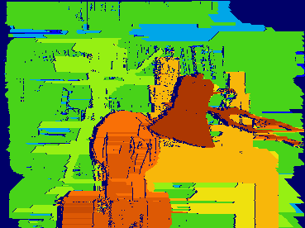
Coherent Stereo on 2D Grid
Scanline stereo generates streaking artifacts
Can’t use dynamic programming to find spatially coherent disparities on a 2D grid
Slide credit: S. Lazebnik

Slide 47
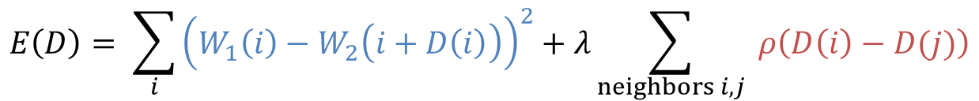
Stereo Matching as Optimization
I₁
I₂
D
W₁(i )
W₂(i+D(i ))
D(i )
$$E\left(D\right)= \sum_{i}{{\left(W_{1}\left(i\right)−W_{2}\left(i+D\left(i\right)\right)\right)}^{2}+λ\sum_{neighbors i,j}{ ρ\left(D\left(i\right)−D(j)\right)}}$$
Data term
Smoothness term
Solvable by graph cuts for certain smoothnesses ρ
  Y. Boykov, O. Veksler, and R. Zabih, Fast Approximate Energy Minimization via Graph Cuts, PAMI 2001
Slide credit: S. Lazebnik

Slide 48
Is This Doable by Deep Network?
I₁
I₂
D
W₁(i )
W₂(i+D(i ))
D(i )
$$E\left(D\right)= \sum_{i}{{\left(W_{1}\left(i\right)−W_{2}\left(i+D\left(i\right)\right)\right)}^{2}+λ\sum_{neighbors i,j}{ ρ\left(D\left(i\right)−D(j)\right)}}$$
Data term
Smoothness term
Easy solution: replace the data term with a network

Slide 49
Deep Learning For Stereo
Feed in two images to identical networks, concatenate outputs, learn multilayer perception
Slow: why?
…
P(match)
Same weights

Slide 50



Deep Learning For Stereo
Normalize outputs; treat dot product as prediction of match/no match
Fast: why?
$$x/\left\|x\right\|$$
svm/hinge loss
Same weights
$$x^{T}x′$$
$$x′/\left\|x′\right\|$$

Slide 51
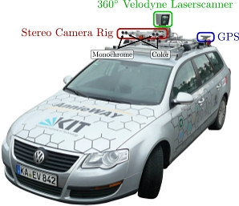
Stereo datasets
Middlebury stereo datasets
KITTI
Synthetic data?
Slide credit: S. Lazebnik

Slide 52
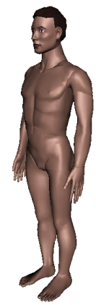
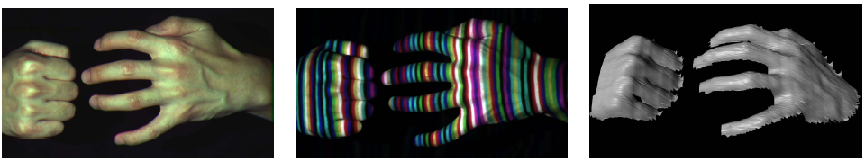
Active stereo with structured light
Project “structured” light patterns onto the object
  Simplifies the correspondence problem
  Allows us to use only one camera
camera
projector
L. Zhang, B. Curless, and S. M. Seitz. Rapid Shape Acquisition Using Color Structured Light and Multi-pass Dynamic Programming. 3DPVT 2002
Slide credit:
S. Lazebnik

Slide 53
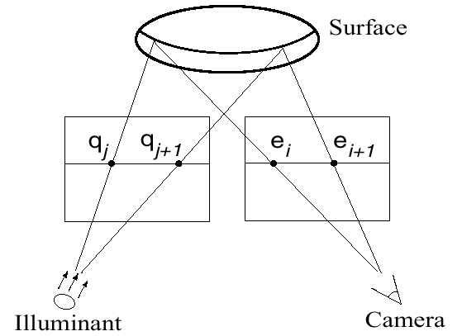
Active stereo with structured light
L. Zhang, B. Curless, and S. M. Seitz. Rapid Shape Acquisition Using Color Structured Light and Multi-pass Dynamic Programming. 3DPVT 2002
Slide credit:
S. Lazebnik

Slide 54
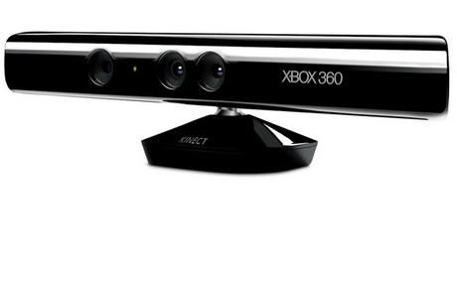
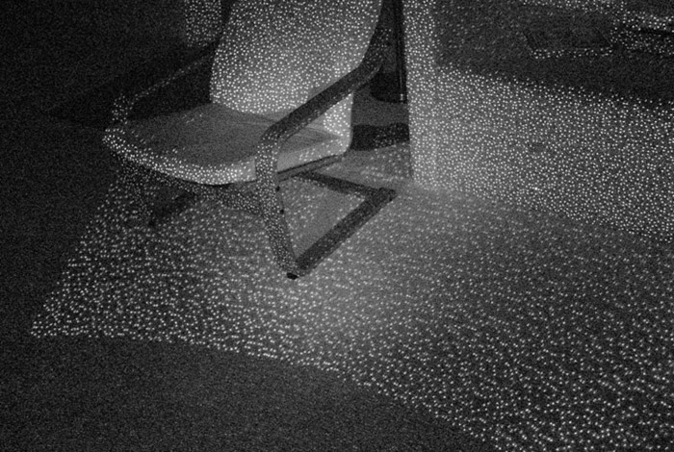
Kinect: Structured infrared light
http://bbzippo.wordpress.com/2010/11/28/kinect-in-infrared/
Slide credit:
S. Lazebnik

Slide 55
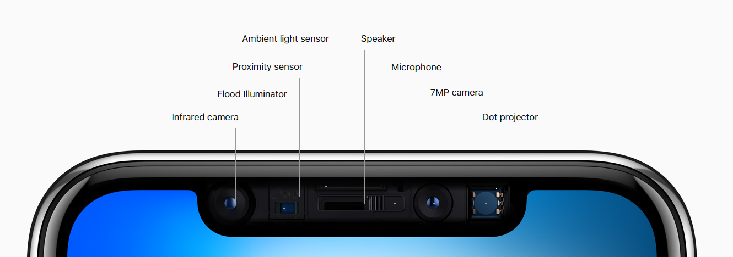
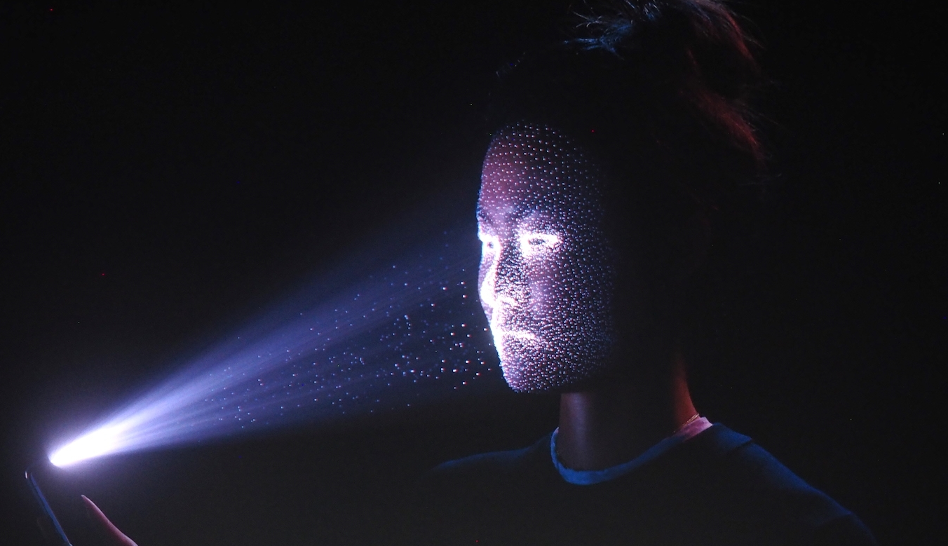
Apple TrueDepth
https://www.cnet.com/news/apple-face-id-truedepth-how-it-works/
Slide credit:
S. Lazebnik

Slide 56

Laser scanning
Digital Michelangelo Project
Levoy et al.
http://graphics.stanford.edu/projects/mich/
Optical triangulation
  Project a single stripe of laser light
  Scan it across the surface of the object
  This is a very precise version of structured light scanning
Slide credit:
S. Lazebnik
Source: S. Seitz

Slide 57
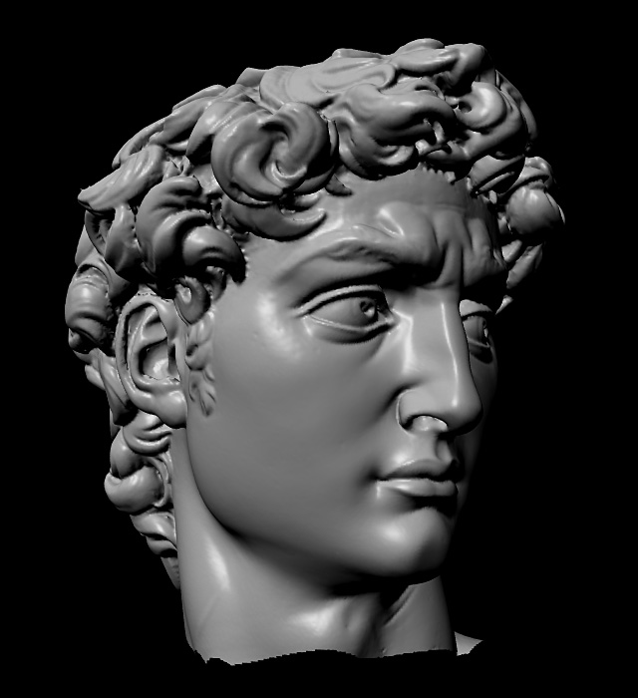
Laser scanned models
The Digital Michelangelo Project, Levoy et al.
Source: S. Seitz

Slide 58
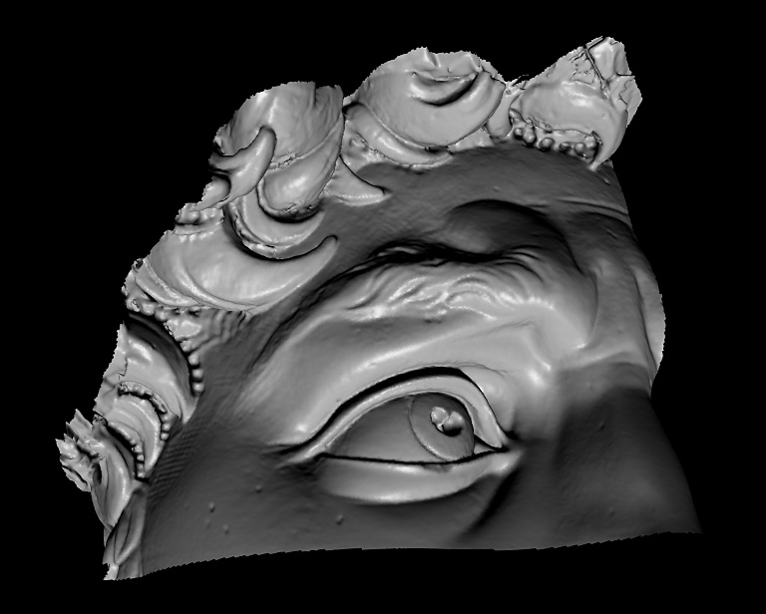
Laser scanned models
The Digital Michelangelo Project, Levoy et al.
Source: S. Seitz

Slide 59
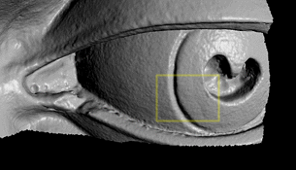
Laser scanned models
The Digital Michelangelo Project, Levoy et al.
Source: S. Seitz

Slide 60
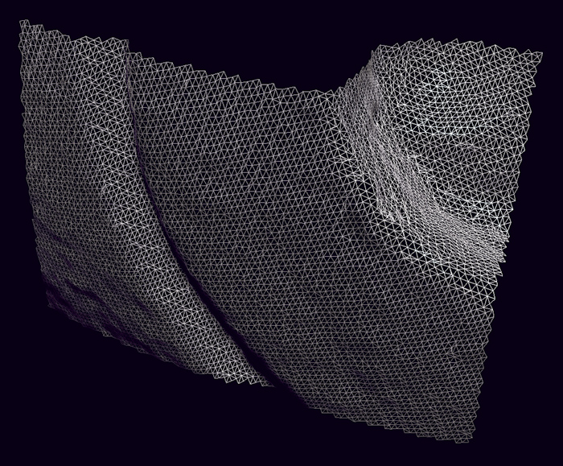
Laser scanned models
1.0 mm resolution (56 million triangles)
The Digital Michelangelo Project, Levoy et al.
Source: S. Seitz

Slide 61

Aligning range images
One range scan not enough for complex surfaces
Need techniques to register multiple range images
B. Curless and M. Levoy, A Volumetric Method for Building Complex Models from Range Images, SIGGRAPH 1996

Slide 63
Bonus

Slide 64
“Shortest paths” for scan-line stereo
Left image
Right image
Right
occlusion
q
Left occlusion
correspondence
t
s
p
  Can be implemented with dynamic programming
  Ohta & Kanade ’85, Cox et al. ‘96
Slide credit: Y. Boykov

