Slide 1
Lecture 19:
Optical Flow
*This slide deck was copied wholesale from David’s FA2019 442

Slide 2
Administrative: Homework
HW4 due yesterday, March 29
HW5 Released, due Friday April 9, 11:59pm ET

Slide 3
Administrative: Project Proposal
Project Proposal due Monday 4/5/2021
We’ve prepared six recommended projects
https://docs.google.com/document/d/1a2RY4_7s7DEiyXF_qsIKZCTTAzyLaXKgTBtV8MumTfg/edit
3-5 People per group
Prepare a 1 page PDF; see details on course website
Submit once per group to Gradescope
Also fill out Google Form to register your project: https://forms.gle/YhcEWfD9Y5cTFBa4A
If you still need a group: Project matching form
https://docs.google.com/forms/d/e/1FAIpQLSfapvf4y1kx0Yg2cCY4dxTYf-Y_cF2NR_DC74whS34CHXh-Fw/viewform

Slide 4
Today: Optical Flow

Slide 5

https://www.youtube.com/watch?v=G3QrhdfLCO8

Slide 6
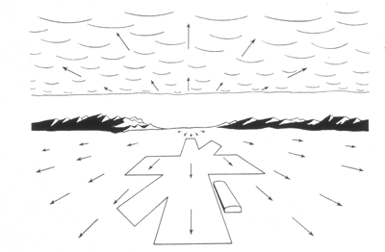
Optical Flow
Idea first introduced by psychologist JJ Gibson in ~1940s to describe how to perceive opportunities for motion
Image Credit: Gibson

Slide 7
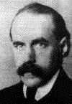
Motion Perception
Gestalt psychology
Max Wertheimer 1880-1943
Slide Credit: S. Lazebnik

Slide 8
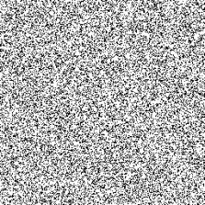
Motion and perceptual organization
Sometimes motion is the only cue
Slide Credit: S. Lazebnik, but idea of random dot sterogram is due to B. Julesz
Notes:
Now take it away. And count to 3…

Slide 9
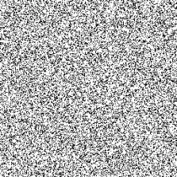
Motion and perceptual organization
Sometimes motion is the only cue
Slide Credit: S. Lazebnik, but idea of random dot sterogram is due to B. Julesz
Notes:
Now take it away. And count to 3…

Slide 10
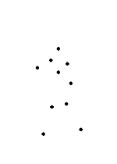
Motion and perceptual organization
Even impoverished motion data can create a strong percept
Slide Credit: S. Lazebnik

Slide 11
Motion and perceptual organization
Even impoverished motion data can create a strong percept
Slide Credit: S. Lazebnik

Slide 12
Video
Video: sequence of frames over time
Image is function of space (x,y) and time t
(and channel c)
I(x,y,c,t)
x,y – location
c – channel
t – time
y
t
x

Slide 13
Problem Definition: Optical Flow
I(x,y,t)
I(x,y,t+1)
Want to estimate pixel motion from
image I(x,y,t) to image I(x,y,t+1)

Slide 14
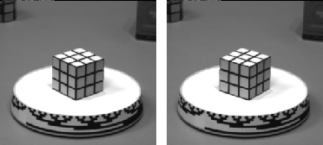
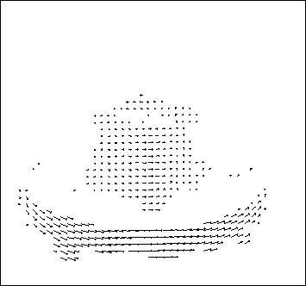
Optical flow
Optical flow is the apparent motion of objects
May be different from actual motion: Imagine a moving shadow on a stationary object
Will start by estimating motion of each pixel separately
Then will consider motion of entire image

Slide 15
Optical Flow
I(x,y,t)
I(x,y,t+1)
Solve correspondence problem: given pixel at time t, find nearby pixels of the same color at time t+1
Key assumptions:
Color/brightness constancy: point at time t looks same at time t+1
Small motion: points do not move very far

Slide 16
Optical Flow
(x,y)
displacement = (u,v)
(x+u,y+v)
I(x,y,t)
I(x,y,t+1)
Brightness
constancy:
$$I\left(x,y,t\right)=I(x+u,y+v,t+1)$$
Wrong way to do things: brute force match

Slide 17
Optical Flow
(x,y)
displacement = (u,v)
(x+u,y+v)
I(x,y,t)
I(x,y,t+1)
Brightness
constancy:
$$I\left(x,y,t\right)=I(x+u,y+v,t+1)$$
Recall Taylor
Expansion:
$$I\left(x+u,y+v,t\right)=I\left(x,y,t\right)+I_{x}u+I_{y}v+…$$

Slide 18

Optical Flow Equation
$$I\left(x+u,y+v,t+1\right)=I(x,y,t)$$
$$0$$
$$≈I\left(x+u,y+v,t+1\right)−I(x,y,t)$$
Taylor
Expansion
$$=I\left(x,y,t+1\right)+I_{x}u+I_{y}v−I(x,y,t)$$
$$=I\left(x,y,t+1\right)−I(x,y,t)+I_{x}u+I_{y}v$$
If you had to guess, what would you call this?
Adapted from S. Lazebnik slides

Slide 19


Optical Flow Equation
$$I\left(x+u,y+v,t+1\right)=I(x,y,t)$$
$$0$$
$$≈I\left(x+u,y+v,t+1\right)−I(x,y,t)$$
Taylor
Expansion
$$=I\left(x,y,t+1\right)+I_{x}u+I_{y}v−I(x,y,t)$$
$$=I\left(x,y,t+1\right)−I(x,y,t)+I_{x}u+I_{y}v$$
$$=I_{t}+I_{x}u+I_{y}v$$
$$=I_{t}+∇I⋅[u,v]$$
When is this approximation exact?
[u,v] = [0,0]
When is it bad?
u or v big.
Adapted from S. Lazebnik slides

Slide 20
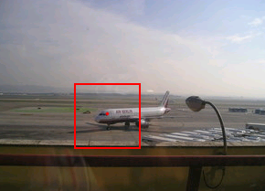
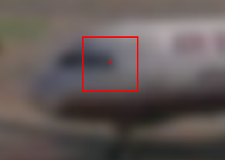
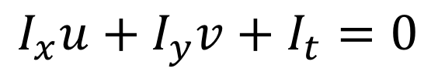
Optical Flow Equation
Brightness constancy equation
$$I_{x}u+I_{y}v+I_{t}=0$$
What do static image gradients have to do with motion estimation?
Slide Credit: S. Lazebnik

Slide 21

Brightness Constancy Example
$$I_{x}u+I_{y}v+I_{t}=0$$
t
t+1
t
t+1
It = 1-0 = 1
It = 0-1 = -1
@
Iy = 0
@
Iy = 0
Ix = 1-0 = 1
Ix = 1-0 = 1
What’s u?
What’s u?

Slide 22







Optical Flow Equation
Have:
$$I_{x}u+I_{y}v+I_{t}=0$$
$$I_{t}+∇I⋅[u,v]=0$$
How many equations and unknowns per pixel?
1 (single equation), 2 (u and v)
One nasty problem:
$$∇I$$
Suppose${∇I}^{T}\left[u^{′},v^{′}\right]=0$
$${I_{t}+∇I}^{T}\left[{u+u}^{′},{v+v}^{′}\right]=0$$
$$[u, v]$$
Can only identify the motion along gradient and not motion perpendicular to it
$$[u^{′}, v^{′}]$$
Adapted from S. Lazebnik slides

Slide 23
Aperture problem
Slide Credit: S. Lazebnik

Slide 24
Aperture problem
Slide Credit: S. Lazebnik

Slide 25
Aperture problem
Slide Credit: S. Lazebnik

Slide 26
Other Invisible Flow

Slide 27
Other Invisible Flow

Slide 28

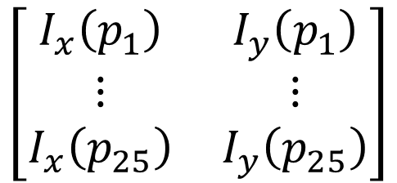

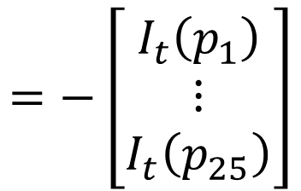
Solving Ambiguity – Lucas Kanade
2 unknowns [u,v], 1 eqn per pixel
How do we get more equations?
Assume spatial coherence: pixel’s neighbors have move together / have same [u,v]
5x5 window gives 25 new equations
$$I_{t}+I_{x}u+I_{y}v=0$$
$$\left[\begin{matrix}I_{x}\left(p_{1}\right) & I_{y}\left(p_{1}\right) \\ ⋮ & ⋮ \\ I_{x}\left(p_{25}\right) & I_{y}\left(p_{25}\right)\end{matrix}\right]$$
$$=−\left[\begin{matrix}I_{t}\left(p_{1}\right) \\ ⋮ \\ I_{t}\left(p_{25}\right)\end{matrix}\right]$$
$$\left[\begin{matrix}u \\ v\end{matrix}\right]$$
B. Lucas and T. Kanade. An iterative image registration technique with an application to stereo vision. In Proceedings of the International Joint Conference on Artificial Intelligence, pp. 674–679, 1981.

Slide 29







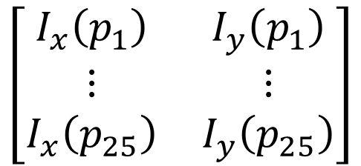
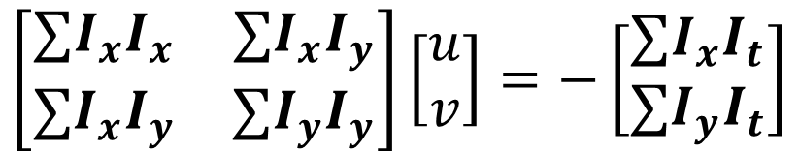


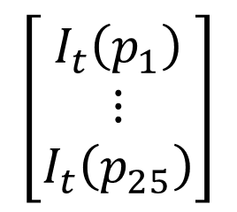





Solving for u, v
$$\left[\begin{matrix}I_{x}\left(p_{1}\right) & I_{y}\left(p_{1}\right) \\ ⋮ & ⋮ \\ I_{x}\left(p_{25}\right) & I_{y}\left(p_{25}\right)\end{matrix}\right]$$
$$\left[\begin{matrix}I_{t}\left(p_{1}\right) \\ ⋮ \\ I_{t}\left(p_{25}\right)\end{matrix}\right]$$
$$\left[\begin{matrix}u \\ v\end{matrix}\right]$$
$$=−$$
$$A$$
$$d$$
$$=$$
$$b$$
$$25x2$$
$$2x1$$
$$25x1$$
What’s the solution?
$$\left(A^{T}A\right)d=A^{T}b$$
$$→$$
$$d={{\left(A^{T}A\right)}^{−1}A}^{T}b$$
Intuitively, need to solve (sum over pixels in window)
$$\left[\begin{matrix}∑I_{x}I_{x} & ∑I_{x}I_{y} \\ ∑I_{x}I_{y} & ∑I_{y}I_{y}\end{matrix}\right]\left[\begin{matrix}u \\ v\end{matrix}\right]=−\left[\begin{matrix}∑I_{x}I_{t} \\ ∑I_{y}I_{t}\end{matrix}\right]$$
$$A^{T}A$$
$$A^{T}b$$
Adapted from S. Lazebnik slides

Slide 30

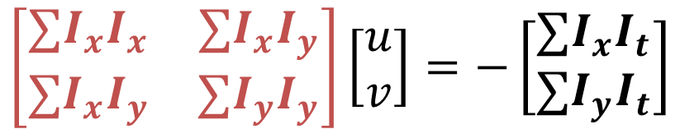

Solving for [u,v]
$$\left[\begin{matrix}∑I_{x}I_{x} & ∑I_{x}I_{y} \\ ∑I_{x}I_{y} & ∑I_{y}I_{y}\end{matrix}\right]\left[\begin{matrix}u \\ v\end{matrix}\right]=−\left[\begin{matrix}∑I_{x}I_{t} \\ ∑I_{y}I_{t}\end{matrix}\right]$$
$$A^{T}A$$
$$A^{T}b$$
What does this remind you of?
Harris corner detection!
When can we find [u,v]?
A^{T}A invertible: precisely equal brightness isn’t
A^{T}A not too small: noise + equal brightness
A^{T}A well-conditioned: |λ₁|/ |λ₂| not large (edge)
Adapted from S. Lazebnik slides

Slide 31
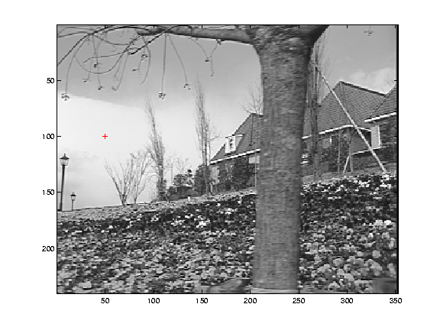
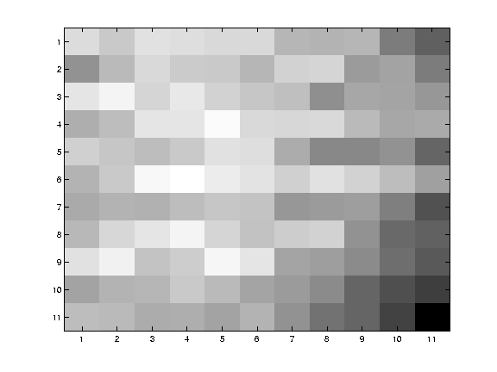
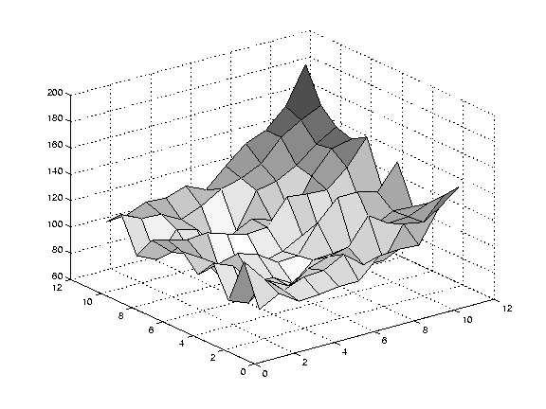
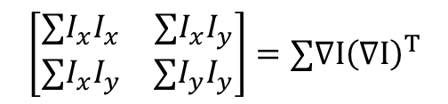
Low texture region
$$\left[\begin{matrix}∑I_{x}I_{x} & ∑I_{x}I_{y} \\ ∑I_{x}I_{y} & ∑I_{y}I_{y}\end{matrix}\right]=∑∇I{\left(∇I\right)}^{T}$$
gradients have small magnitude
small λ₁, small λ₂
Slide Credit: S. Lazebnik
Notes:
Can’t estimate motion here…nothing you can see moving.

Slide 32
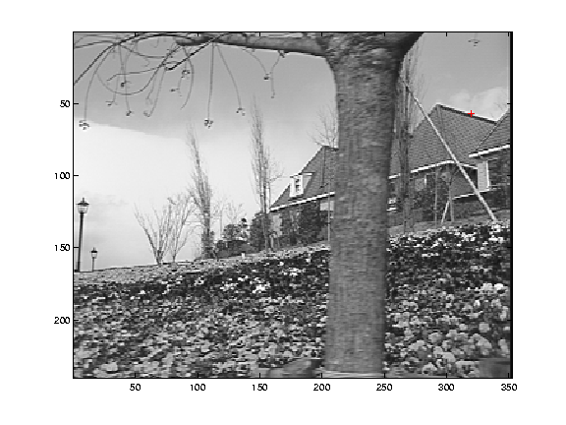
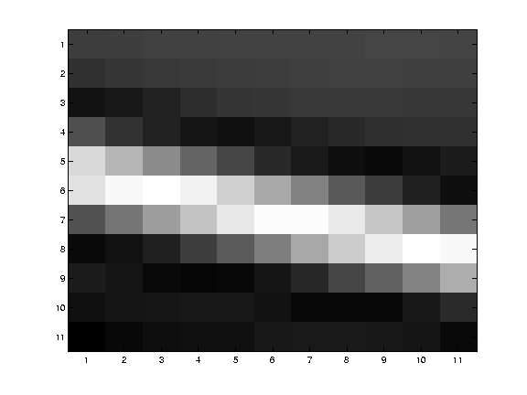
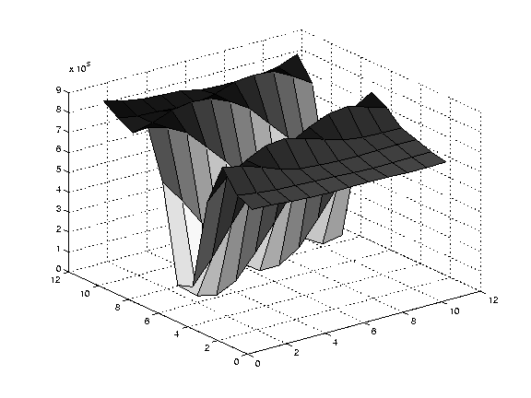
Edge
$$\left[\begin{matrix}∑I_{x}I_{x} & ∑I_{x}I_{y} \\ ∑I_{x}I_{y} & ∑I_{y}I_{y}\end{matrix}\right]=∑∇I{\left(∇I\right)}^{T}$$
large gradients, all the same
large λ₁, small λ₂
Slide Credit: S. Lazebnik
Notes:
On an edge you can estimate motion perpendicular to the edge but not along it.

Slide 33
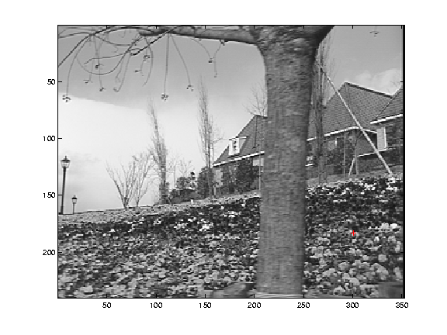
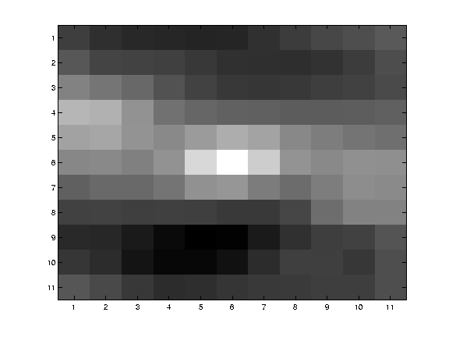
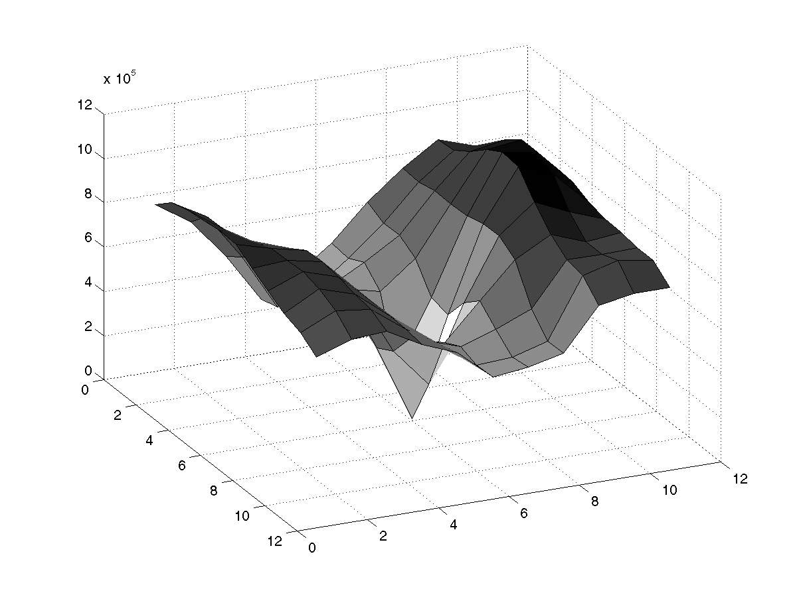
High texture region
$$\left[\begin{matrix}∑I_{x}I_{x} & ∑I_{x}I_{y} \\ ∑I_{x}I_{y} & ∑I_{y}I_{y}\end{matrix}\right]=∑∇I{\left(∇I\right)}^{T}$$
gradients are different, large magnitudes
large λ₁, large λ₂
Slide Credit: S. Lazebnik
Notes:
But on nice textured regions motion is well estimated because the gradient varies over the window.

Slide 34
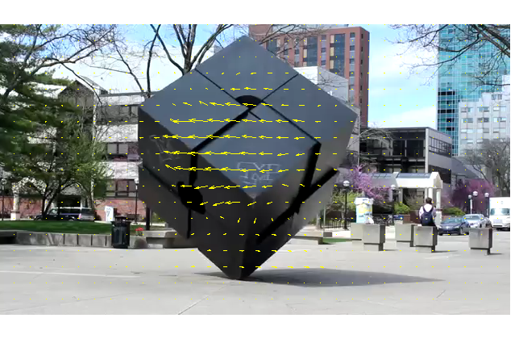
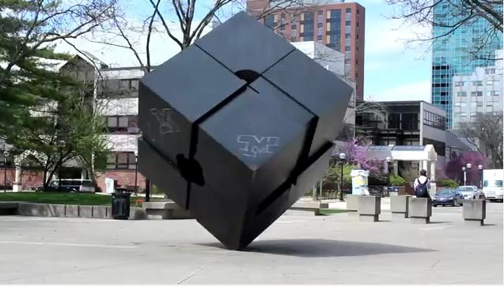

Lucas-Kanade flow example
Input frames
Output
Source: MATLAB Central File Exchange
Slide Credit: S. Lazebnik

Slide 35
Aperture problem Take 2
Slide Credit: S. Lazebnik

Slide 36
Aperture problem Take 2
Slide Credit: S. Lazebnik

Slide 37
For Comparison
Slide Credit: S. Lazebnik

Slide 38
For Comparison
Slide Credit: S. Lazebnik

Slide 39
So How Does This Fail?
Point doesn’t move like neighbors:
  Why would this happen?
  Figure out which points move together, then come back and fix.

Slide 40
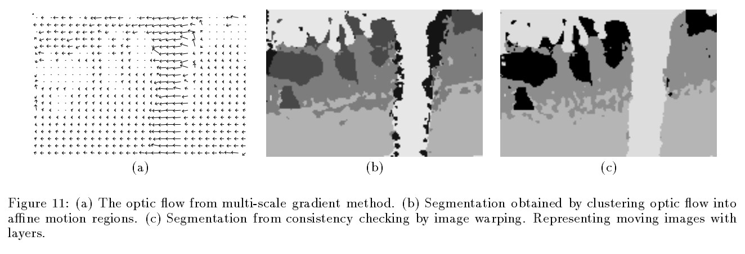
So How Does This Fail?
Point doesn’t move like neighbors:
  Why would this happen?
  Figure out which points move together, then come back and fix.
J. Wang and E. Adelson, Representing Moving Images with Layers, IEEE Transactions on Image Processing, 1994

Slide 41
So How Does This Fail?
Point doesn’t move like neighbors:
  Why would this happen?
  Figure out which points move together, then come back and fix.
Brightness constancy isn’t true
  Why would this happen?
  Solution: other form of matching (e.g. SIFT)
Taylor series is bad approximation
  Why would this happen?
  Solution: Make your pixels big

Slide 42
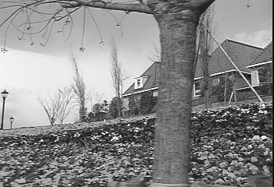
Revisiting small motions
Is this motion small enough?
  Probably not—it’s much larger than one pixel
  How might we solve this problem?
Slide credit: S. Lazebnik

Slide 43
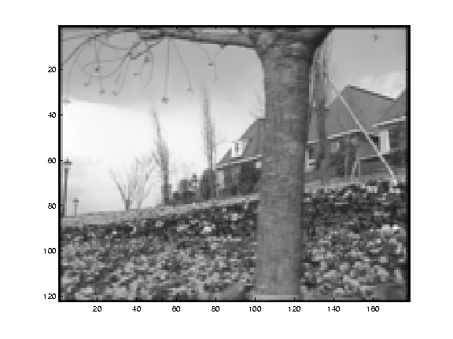
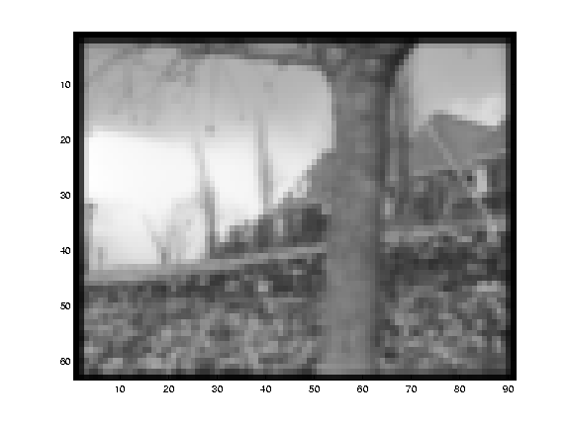
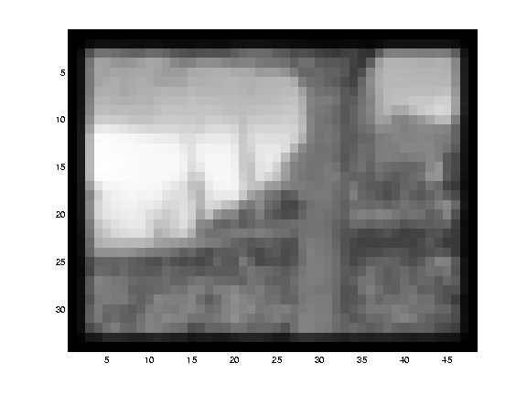
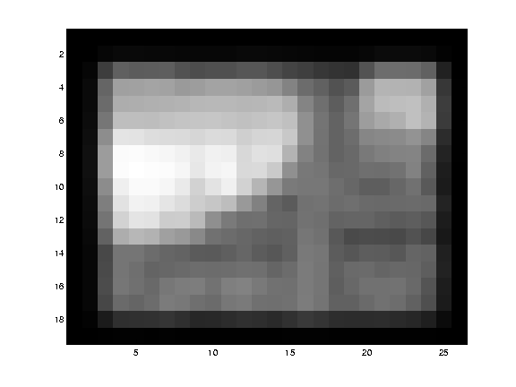
Reduce the resolution!
Slide credit: S. Lazebnik

Slide 44
Coarse-to-fine optical flow estimation
u=1.25px
u=2.5px
image 1
u=5px
image 2
image 1
Typically called Gaussian Pyramid
Slide credit: S. Lazebnik

Slide 45
Coarse-to-fine optical flow estimation
u=1.25px
u=2.5px
image 1
u=5px
image 2
image 1
Start at bottom or top to align?
Slide credit: S. Lazebnik

Slide 46
Coarse-to-fine optical flow estimation
Flow
Warp, Upsample
Flow
…
image 1
image 2
image 1
Slide credit: S. Lazebnik

Slide 47
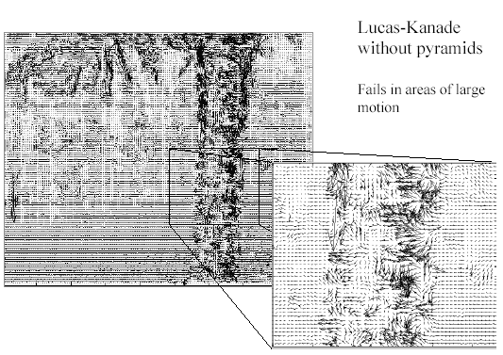
Optical Flow Results
Slide credit: S. Lazebnik

Slide 48
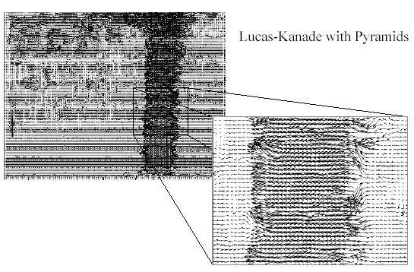
Optical Flow Results
Slide credit: S. Lazebnik

Slide 49
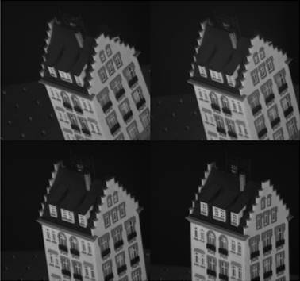
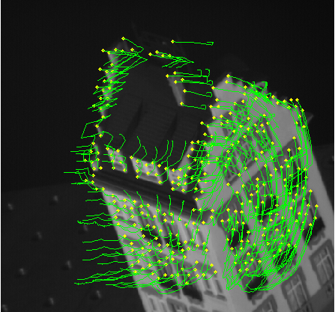
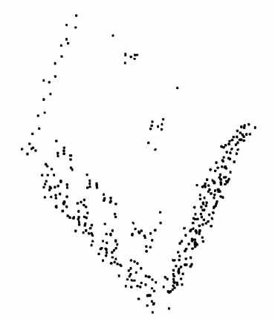
Application: Tracking
Would like tracks of where things move (e.g., for reconstruction)
C. Tomasi and T. Kanade. Shape and motion from image streams under orthography:
A factorization method. IJCV, 9(2):137-154, November 1992.

Slide 50
Application: Tracking
Which features should we track?
  Use eigenvalues of A^{T}A to find corners
Use flow to figure out [u,v] for each “track”
Register points to first frame by affine warp
J. Shi and C. Tomasi. Good Features to Track. CVPR 1994.

Slide 51
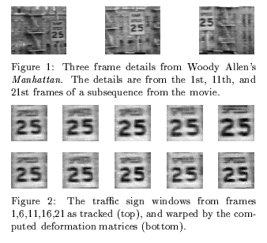
Tracking example
J. Shi and C. Tomasi. Good Features to Track. CVPR 1994.

Slide 52
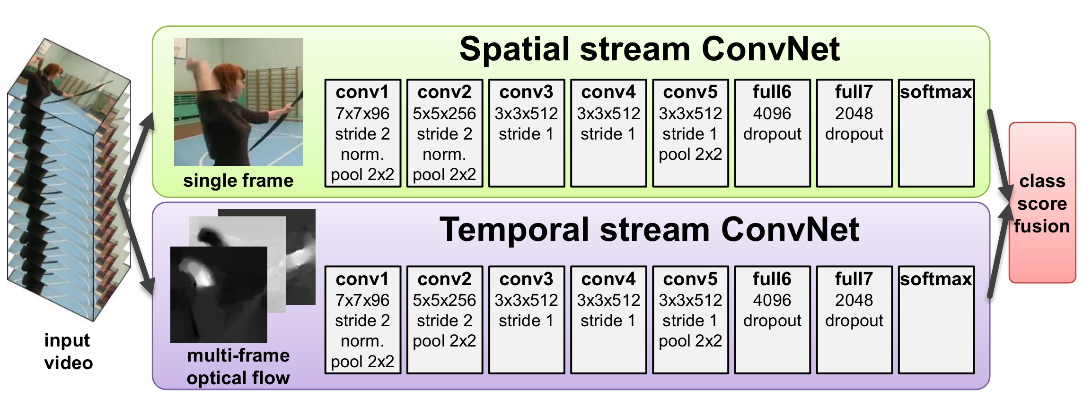
Application: Video Recognition
Optical Flow sometimes used as an input feature for video classification with CNNs
Simonyan and Zisserman, “Two-Stream Convolutional Networks for Action Recognition in Videos”, NeurIPS 2014

Slide 53
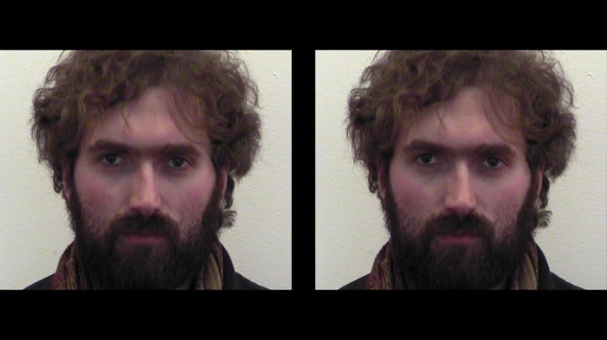
Application: Motion Magnification
Idea: take flow, magnify it
Liu et al, “Motion Magnification”, SIGGRAPH 2005

Slide 54
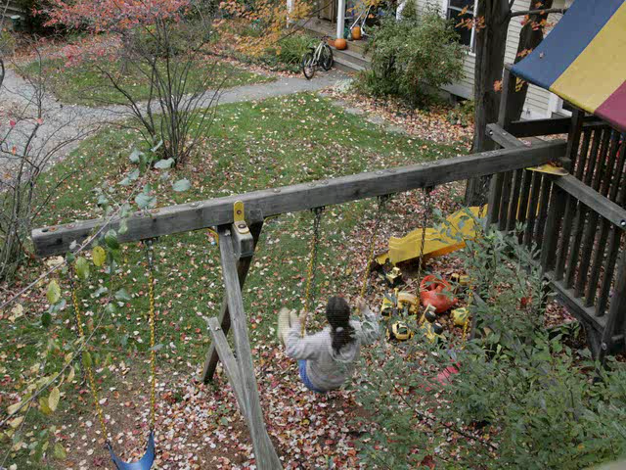
Application: Motion Magnification
Liu et al, “Motion Magnification”, SIGGRAPH 2005

Slide 55
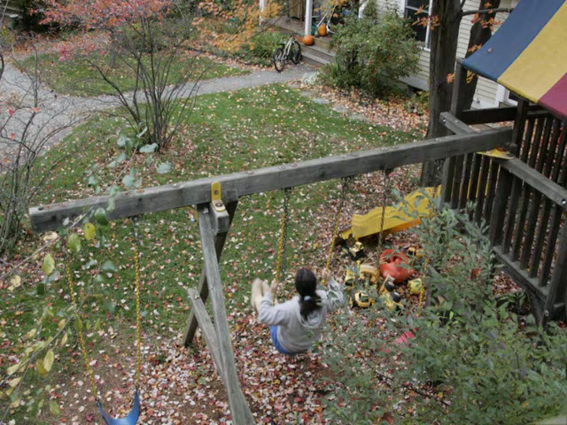
Application: Motion Magnification
Liu et al, “Motion Magnification”, SIGGRAPH 2005

Slide 56
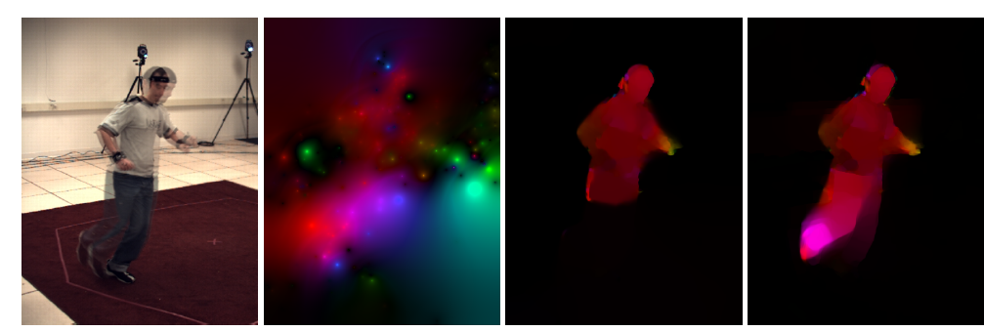
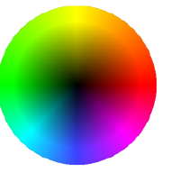
State-of-the-art optical flow, 2009
Start with something similar to Lucas-Kanade
+ gradient constancy
+ energy minimization with smoothing term
+ region matching
+ keypoint matching (long-range)
Region-based
+Pixel-based
+Keypoint-based
Large displacement optical flow, Brox et al., CVPR 2009

Slide 57
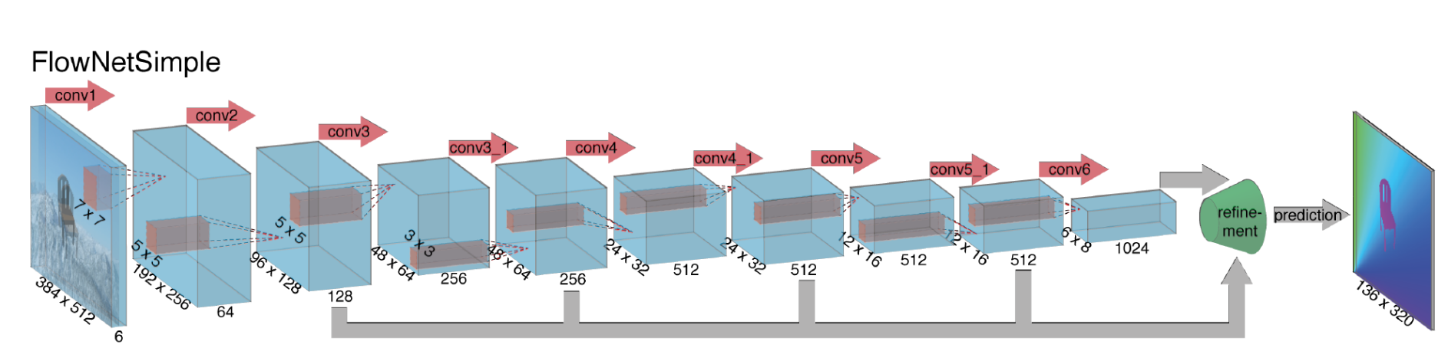
State-of-the-art optical flow
Input: 6 channel input (RGB @ t, RGB @ t+1)
Output: 2 channel input (u,v)
Current best methods are learned
Dosovitskiy*, Fischer*, et al, “FlowNet: Learning Optical Flow with Convolutional Networks”, ICCV 2015

Slide 58
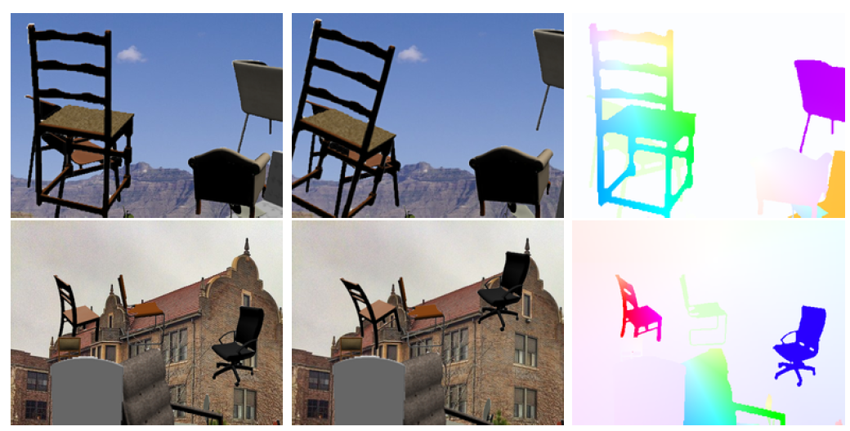
Training Data
Flying Chairs Dataset
Dosovitskiy*, Fischer*, et al, “FlowNet: Learning Optical Flow with Convolutional Networks”, ICCV 2015

Slide 59
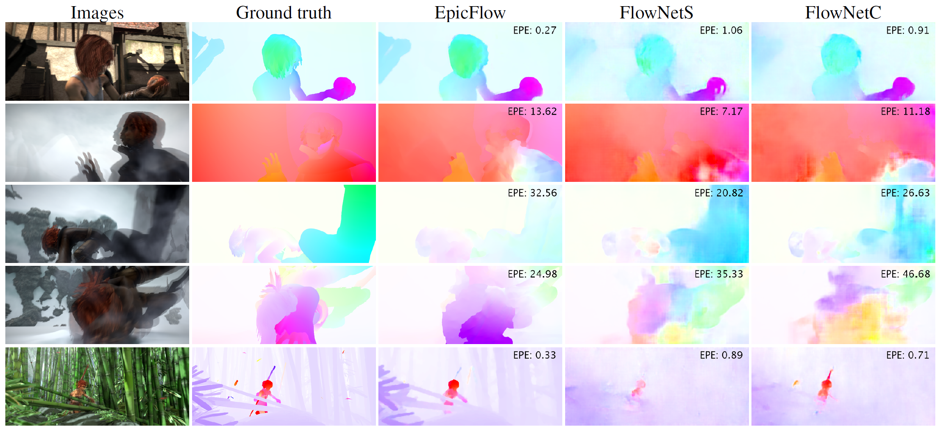
Deep Optical Flow
Results on Sintel (standard benchmark)
Dosovitskiy*, Fischer*, et al, “FlowNet: Learning Optical Flow with Convolutional Networks”, ICCV 2015

Slide 60
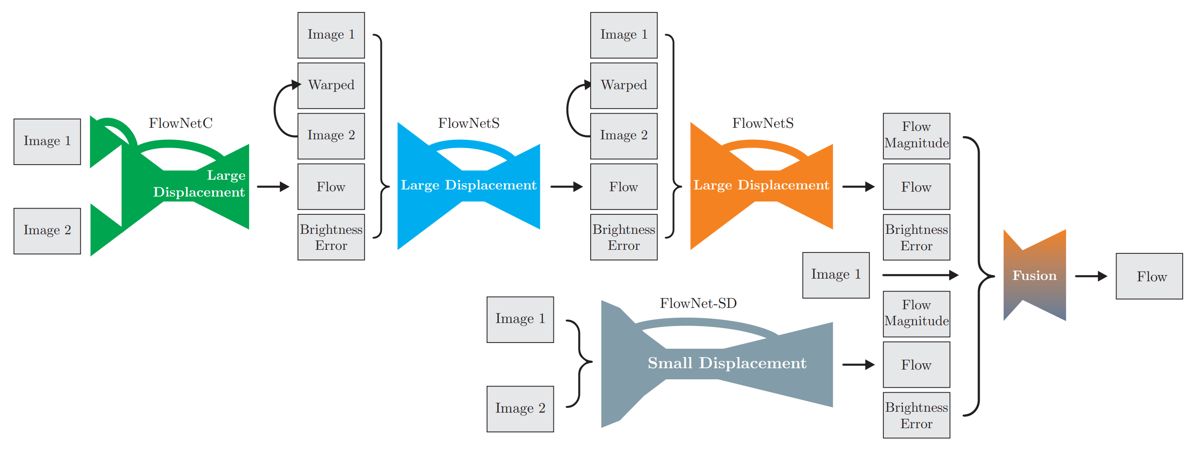
Deep Optical Flow
Deeper networks and more sophisticated architectures improve results
Ilg et al, “FlowNet 2.0: Evolution of Optical Flow Estimation with Deep Networks”, CVPR 2017

Slide 61

Deep Optical Flow
Deeper networks and more sophisticated architectures improve results
Ilg et al, “FlowNet 2.0: Evolution of Optical Flow Estimation with Deep Networks”, CVPR 2017

Slide 62
Recap: Optical Flow
Optical flow is the apparent motion of pixels in a video
Can be estimated using brightness consistency equations
Aperture problem: Flow might be ambiguous from a small window
Lucas-Kanade solves for 5x5 patches of flow
Image pyramids help with large motion
Applications: Tracking, video recognition, motion magnification

Slide 63
Next Time:
3D Vision + Calibration

