Slide 1
Lecture 15:
Convolutional Networks

Slide 2
Administrative

Slide 3
Last Time: Backpropagation
During the backward pass, each node in the graph receives upstream gradients and multiplies them by local gradients to compute downstream gradients
Represent complex expressions as computational graphs
Forward pass computes outputs
Backward pass computes gradients

Slide 4

Problem: So far our classifiers don’t respect the spatial structure of images!
Solution: Define new computational nodes that operate on images!

Slide 5
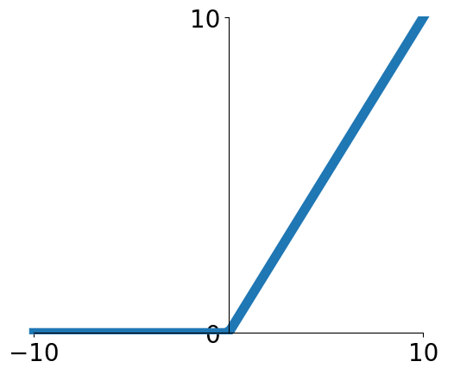
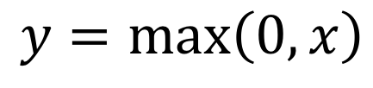
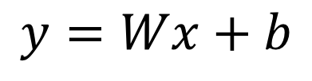
Components of a Fully-Connected Network
Fully-Connected Layers
Activation Function
$$y=Wx+b$$
$$y=\max\left(0,x\right)$$

Slide 6
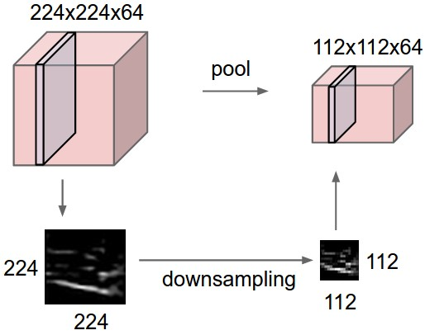
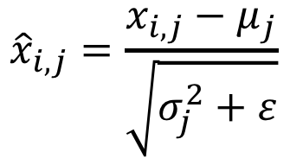
Components of a Convolutional Network
Fully-Connected Layers
Activation Function
$$y=Wx+b$$
$$y=\max\left(0,x\right)$$
Convolution Layers
Pooling Layers
Normalization
$${\hat{x}}_{i,j}=\frac{x_{i,j}−μ_{j}}{\sqrt{σ_{j}^{2}+ε}}$$

Slide 7
Components of a Convolutional Network
Fully-Connected Layers
Activation Function
$$y=Wx+b$$
$$y=\max\left(0,x\right)$$
Convolution Layers
Pooling Layers
Normalization
$${\hat{x}}_{i,j}=\frac{x_{i,j}−μ_{j}}{\sqrt{σ_{j}^{2}+ε}}$$

Slide 8
Fully-Connected Layer
32x32x3 image -> stretch to 3072 x 1
Input
Output
1
1
3072
10 x 3072
weights
10

Slide 9
Fully-Connected Layer
32x32x3 image -> stretch to 3072 x 1
Input
Output
1
1
3072
10 x 3072
weights
10
1 number:
the result of taking a dot product between a row of W and the input (a 3072-dimensional dot product)

Slide 10
Convolution Layer
3x32x32 image: preserve spatial structure
32
height
32
width
3
depth / channels

Slide 11
Convolution Layer
3x32x32 image
3x5x5 filter
Convolve the filter with the image: “slide over the image spatially, computing dot products”
32
height
32
width
3
depth / channels

Slide 12
Convolution Layer
Filters always extend the full depth of the input volume
3x32x32 image
3x5x5 filter
Convolve the filter with the image: “slide over the image spatially, computing dot products”
32
height
32
width
3
depth / channels

Slide 13

Convolution Layer
3x32x32 image
3x5x5 filter
1 number:
the result of taking a dot product between the filter and a small 3x5x5 chunk of the image
(i.e. 3*5*5 = 75-dimensional dot product + bias)
32
32
3
$$w^{T}x+b$$

Slide 14
Convolution Layer
1x28x28 activation map
3x32x32 image
3x5x5 filter
28
convolve (slide) over all spatial locations
32
28
32
1
3

Slide 15
Convolution Layer
1x28x28 activation map
3x32x32 image
3x5x5 filter
28
convolve (slide) over all spatial locations
32
28
32
1
3
Convolution Layer vs Image Filtering:
>1 input and output channels
Forget about convolution vs cross-correlation

Slide 16
Convolution Layer
two 1x28x28 activation map
3x32x32 image
Consider repeating with a second (green) filter:
3x5x5 filter
28
28
convolve (slide) over all spatial locations
32
28
32
1
1
3

Slide 17
Convolution Layer
6 activation maps,
each 1x28x28
3x32x32 image
Consider 6 filters, each 3x5x5
Convolution Layer
32
32
6x3x5x5 filters
Stack activations to get a 6x28x28 output image!
3

Slide 18
Convolution Layer
6 activation maps,
each 1x28x28
3x32x32 image
Also 6-dim bias vector:
Convolution Layer
32
32
6x3x5x5 filters
Stack activations to get a 6x28x28 output image!
3

Slide 19
Convolution Layer
28x28 grid, at each point a 6-dim vector
3x32x32 image
Also 6-dim bias vector:
Convolution Layer
32
32
6x3x5x5 filters
Stack activations to get a 6x28x28 output image!
3

Slide 20
Convolution Layer
2x6x28x28
Batch of outputs
2x3x32x32
Batch of images
Also 6-dim bias vector:
Convolution Layer
32
32
3
6x3x5x5 filters

Slide 21
Convolution Layer
N x C_{out} x H’ x W’
Batch of outputs
N x C_{in} x H x W
Batch of images
Bias: C_{out}-dim vector:
Convolution Layer
H
W
C_{out}
C_{in}
Weight:
C_{out} x C_{in}x K_{w} x K_{h}

Slide 22
Stacking Convolutions
32
28
26
….
Conv
Conv
Conv
W₁: 6x3x5x5
b₁: 6
W₂: 10x6x3x3
b₂: 10
W₃: 12x10x3x3
b₃: 12
32
28
26
3
6
10
Input:
N x 3 x 32 x 32
First hidden layer:
N x 6 x 28 x 28
Second hidden layer:
N x 10 x 26 x 26

Slide 23
Stacking Convolutions
Q: What happens if we stack two convolution layers?
32
28
26
….
Conv
Conv
Conv
W₁: 6x3x5x5
b₁: 6
W₂: 10x6x3x3
b₂: 10
W₃: 12x10x3x3
b₃: 12
32
28
26
3
6
10
Input:
N x 3 x 32 x 32
First hidden layer:
N x 6 x 28 x 28
Second hidden layer:
N x 10 x 26 x 26

Slide 24
Stacking Convolutions
(Recall y=W₂W₁x is a linear classifier)
Q: What happens if we stack two convolution layers?
A: It’s equivalent to just one convolution layer!
32
28
26
….
Conv
Conv
Conv
W₁: 6x3x5x5
b₁: 6
W₂: 10x6x3x3
b₂: 10
W₃: 12x10x3x3
b₃: 12
32
28
26
3
6
10
Input:
N x 3 x 32 x 32
First hidden layer:
N x 6 x 28 x 28
Second hidden layer:
N x 10 x 26 x 26

Slide 25
Stacking Convolutions
(Recall y=W₂W₁x is a linear classifier)
Q: What happens if we stack two convolution layers?
A: It’s equivalent to just one convolution layer!
32
28
26
….
Conv
ReLU
Conv
ReLU
Conv
ReLU
W₁: 6x3x5x5
b₁: 6
W₂: 10x6x3x3
b₂: 10
W₃: 12x10x3x3
b₃: 12
32
28
26
3
6
10
Input:
N x 3 x 32 x 32
First hidden layer:
N x 6 x 28 x 28
Second hidden layer:
N x 10 x 26 x 26
Solution: Add a nonlinearity between each conv layer

Slide 26
What do Conv Filters Learn?
32
28
26
….
Conv
ReLU
Conv
ReLU
Conv
ReLU
W₁: 6x3x5x5
b₁: 6
W₂: 10x6x3x3
b₂: 10
W₃: 12x10x3x3
b₃: 12
32
28
26
3
6
10
Input:
N x 3 x 32 x 32
First hidden layer:
N x 6 x 28 x 28
Second hidden layer:
N x 10 x 26 x 26

Slide 27

What do Conv Filters Learn?
Linear classifier:
One template per class
32
28
Conv
ReLU
W₁: 6x3x5x5
b₁: 6
32
28
3
6
Input:
N x 3 x 32 x 32
First hidden layer:
N x 6 x 28 x 28

Slide 28
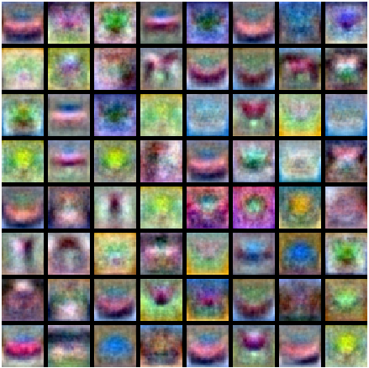
What do Conv Filters Learn?
MLP: Bank of whole-image templates
32
28
Conv
ReLU
W₁: 6x3x5x5
b₁: 6
32
28
3
6
Input:
N x 3 x 32 x 32
First hidden layer:
N x 6 x 28 x 28

Slide 29
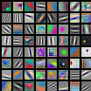
What do Conv Filters Learn?
First-layer conv filters: local image templates
(Often learns oriented edges, opposing colors)
32
28
Conv
ReLU
W₁: 6x3x5x5
b₁: 6
32
28
3
6
Input:
N x 3 x 32 x 32
First hidden layer:
N x 6 x 28 x 28
AlexNet: 64 filters, each 3x11x11

Slide 30
Convolution Spatial Dimensions
Input: 7x7
Filter: 3x3
Q: How big is output?
7
7

Slide 31
Convolution Spatial Dimensions
Input: 7x7
Filter: 3x3
Q: How big is output?
7
7

Slide 32
Convolution Spatial Dimensions
Input: 7x7
Filter: 3x3
Q: How big is output?
7
7

Slide 33
Convolution Spatial Dimensions
Input: 7x7
Filter: 3x3
Q: How big is output?
7
7

Slide 34
Convolution Spatial Dimensions
Input: 7x7
Filter: 3x3
Output: 5x5
7
7

Slide 35
Convolution Spatial Dimensions
Input: 7x7
Filter: 3x3
Output: 5x5
In general:
Input: W
Filter: K
Output: W – K + 1
Problem: Feature maps “shrink” with each layer!
7
7

Slide 36
Convolution Spatial Dimensions
Input: 7x7
Filter: 3x3
Output: 5x5
0 | 0 | 0 | 0 | 0 | 0 | 0 | 0 | 0
0 |  |  |  |  |  |  |  | 0
0 |  |  |  |  |  |  |  | 0
0 |  |  |  |  |  |  |  | 0
0 |  |  |  |  |  |  |  | 0
0 |  |  |  |  |  |  |  | 0
0 |  |  |  |  |  |  |  | 0
0 |  |  |  |  |  |  |  | 0
0 | 0 | 0 | 0 | 0 | 0 | 0 | 0 | 0
In general:
Input: W
Filter: K
Padding: P
Problem: Feature maps “shrink” with each layer!
Solution: padding
Add zeros around the input

Slide 37
Convolution Spatial Dimensions
Input: 7x7
Filter: 3x3
Output: 5x5
0 | 0 | 0 | 0 | 0 | 0 | 0 | 0 | 0
0 |  |  |  |  |  |  |  | 0
0 |  |  |  |  |  |  |  | 0
0 |  |  |  |  |  |  |  | 0
0 |  |  |  |  |  |  |  | 0
0 |  |  |  |  |  |  |  | 0
0 |  |  |  |  |  |  |  | 0
0 |  |  |  |  |  |  |  | 0
0 | 0 | 0 | 0 | 0 | 0 | 0 | 0 | 0
In general:
Input: W
Filter: K
Padding: P
Output: W – K + 1 + 2P
Very common: “same padding”
Set P = (K – 1) / 2
Then output size = input size

Slide 38
Receptive Fields
For convolution with kernel size K, each element in the output depends on a K x K receptive field in the input
Input
Output

Slide 39
Receptive Fields
Each successive convolution adds K – 1 to the receptive field size
With L layers the receptive field size is 1 + L * (K – 1)
Input
Output
Careful – ”receptive field in the input”
vs “receptive field in the previous layer”
Hopefully clear from context!

Slide 40
Receptive Fields
Each successive convolution adds K – 1 to the receptive field size
With L layers the receptive field size is 1 + L * (K – 1)
Input
Output
Problem: For large images we need many layers for each output to “see” the whole image image

Slide 41
Receptive Fields
Each successive convolution adds K – 1 to the receptive field size
With L layers the receptive field size is 1 + L * (K – 1)
Input
Output
Problem: For large images we need many layers for each output to “see” the whole image image
Solution: Downsample inside the network

Slide 42
Strided Convolution
Input: 7x7
Filter: 3x3
Stride: 2

Slide 43
Strided Convolution
Input: 7x7
Filter: 3x3
Stride: 2

Slide 44
Strided Convolution
Input: 7x7
Filter: 3x3
Stride: 2
Output: 3x3

Slide 45
Strided Convolution
Input: 7x7
Filter: 3x3
Stride: 2
Output: 3x3
In general:
Input: W
Filter: K
Padding: P
Stride: S
Output: (W – K + 2P) / S + 1

Slide 46
Convolution Example
Input volume: 3 x 32 x 32
10 5x5 filters with stride 1, pad 2
Output volume size: ?

Slide 47
Convolution Example
Input volume: 3 x 32 x 32
10 5x5 filters with stride 1, pad 2
Output volume size:
(32+2*2-5)/1+1 = 32 spatially, so
10 x 32 x 32

Slide 48
Convolution Example
Input volume: 3 x 32 x 32
10 5x5 filters with stride 1, pad 2
Output volume size: 10 x 32 x 32
Number of learnable parameters: ?

Slide 49
Convolution Example
Input volume: 3 x 32 x 32
10 5x5 filters with stride 1, pad 2
Output volume size: 10 x 32 x 32
Number of learnable parameters: 760
Parameters per filter: 3*5*5 + 1 (for bias) = 76
10 filters, so total is 10 * 76 = 760

Slide 50
Convolution Example
Input volume: 3 x 32 x 32
10 5x5 filters with stride 1, pad 2
Output volume size: 10 x 32 x 32
Number of learnable parameters: 760
Number of multiply-add operations: ?

Slide 51
Convolution Example
Input volume: 3 x 32 x 32
10 5x5 filters with stride 1, pad 2
Output volume size: 10 x 32 x 32
Number of learnable parameters: 760
Number of multiply-add operations: 768,000
10*32*32 = 10,240 outputs; each output is the inner product of two 3x5x5 tensors (75 elems); total = 75*10240 = 768K

Slide 52
Convolution Summary
Input: C_{in} x H x W
Hyperparameters:
Kernel size: K_{H} x K_{W}
Number filters: C_{out}
Padding: P
Stride: S
Weight matrix: C_{out} x C_{in} x K_{H} x K_{W} giving C_{out} filters of size C_{in} x K_{H} x K_{W}
Bias vector: C_{out}
Output size: C_{out} x H’ x W’ where:
H’ = (H – K + 2P) / S + 1
W’ = (W – K + 2P) / S + 1

Slide 53
Convolution Summary
Input: C_{in} x H x W
Hyperparameters:
Kernel size: K_{H} x K_{W}
Number filters: C_{out}
Padding: P
Stride: S
Weight matrix: C_{out} x C_{in} x K_{H} x K_{W} giving C_{out} filters of size C_{in} x K_{H} x K_{W}
Bias vector: C_{out}
Output size: C_{out} x H’ x W’ where:
H’ = (H – K + 2P) / S + 1
W’ = (W – K + 2P) / S + 1
Common settings:
K_{H} = K_{W} (Small square filters)
P = (K – 1) / 2 (”Same” padding)
C_{in}, C_{out} = 32, 64, 128, 256 (powers of 2)
K = 3, P = 1, S = 1 (3x3 conv)
K = 5, P = 2, S = 1 (5x5 conv)
K = 1, P = 0, S = 1 (1x1 conv)
K = 3, P = 1, S = 2 (Downsample by 2)

Slide 54
Other types of convolution
So far: 2D Convolution
Input: C_{in} x H x W
Weights: C_{out} x C_{in} x K x K
H
W
C_{in}

Slide 55
Other types of convolution
So far: 2D Convolution
1D Convolution
Input: C_{in} x H x W
Weights: C_{out} x C_{in} x K x K
Input: C_{in} x W
Weights: C_{out} x C_{in} x K
H
C_{in}
W
C_{in}
W

Slide 56
Other types of convolution
So far: 2D Convolution
3D Convolution
Input: C_{in} x H x W
Weights: C_{out} x C_{in} x K x K
Input: C_{in} x H x W x D
Weights: C_{out} x C_{in} x K x K x K
H
C_{in}-dim vector at each point in the volume
H
W
D
C_{in}
W

Slide 57
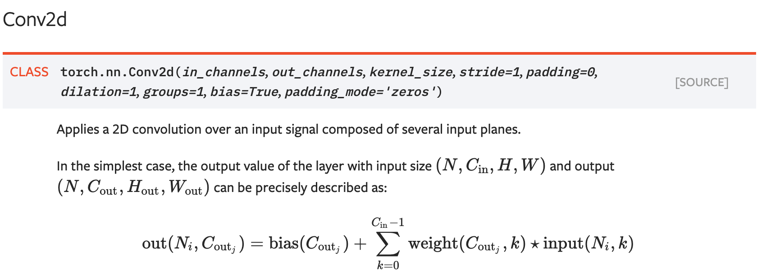
PyTorch Convolution Layer

Slide 58
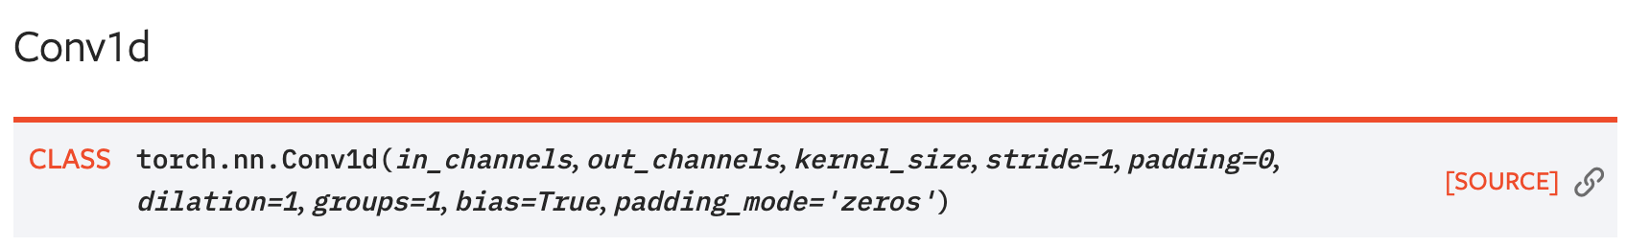
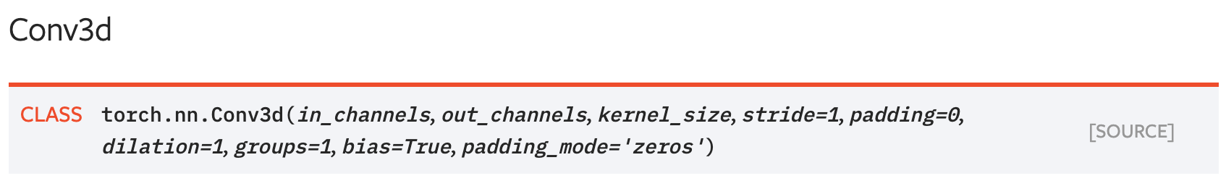
PyTorch Convolution Layers

Slide 59
Components of a Convolutional Network
Fully-Connected Layers
Activation Function
$$y=Wx+b$$
$$y=\max\left(0,x\right)$$
Convolution Layers
Pooling Layers
Normalization
$${\hat{x}}_{i,j}=\frac{x_{i,j}−μ_{j}}{\sqrt{σ_{j}^{2}+ε}}$$

Slide 60
Components of a Convolutional Network
Fully-Connected Layers
Activation Function
$$y=Wx+b$$
$$y=\max\left(0,x\right)$$
Convolution Layers
Pooling Layers
Normalization
$${\hat{x}}_{i,j}=\frac{x_{i,j}−μ_{j}}{\sqrt{σ_{j}^{2}+ε}}$$

Slide 61
Pooling Layers: Downampling
64 x 224 x 224
64 x 112 x 112
Hyperparameters:
Kernel Size
Stride
Pooling function

Slide 62
Max Pooling
64 x 224 x 224
Single depth slice
2 | 3 | 2 | 4
5 | 6 | 6 | 8
3 | 2 | 1 | 0
1 | 2 | 3 | 4
x
Max pooling with 2x2 kernel size and stride 2
6 | 8
3 | 4
Introduces invariance to small spatial shifts
No learnable parameters!
y

Slide 63
Average Pooling
64 x 224 x 224
Single depth slice
2 | 3 | 2 | 4
5 | 6 | 6 | 8
3 | 2 | 1 | 0
1 | 2 | 3 | 4
x
Avg pooling with 2x2 kernel size and stride 2
4 | 5
2 | 2
Introduces invariance to small spatial shifts
No learnable parameters!
y

Slide 64
Pooling Summary
Input: C x H x W
Hyperparameters:
Kernel size: K
Stride: S
Pooling function (max, avg)
Output: C x H’ x W’ where
H’ = (H – K) / S + 1
W’ = (W – K) / S + 1
Learnable parameters: None!
Common settings:
max, K = 2, S = 2
max, K = 3, S = 2 (AlexNet)

Slide 65
Components of a Convolutional Network
Fully-Connected Layers
Activation Function
$$y=Wx+b$$
$$y=\max\left(0,x\right)$$
Convolution Layers
Pooling Layers
Normalization
$${\hat{x}}_{i,j}=\frac{x_{i,j}−μ_{j}}{\sqrt{σ_{j}^{2}+ε}}$$

Slide 66
Components of a Convolutional Network
Fully-Connected Layers
Activation Function
$$y=Wx+b$$
$$y=\max\left(0,x\right)$$
Convolution Layers
Pooling Layers
Normalization
$${\hat{x}}_{i,j}=\frac{x_{i,j}−μ_{j}}{\sqrt{σ_{j}^{2}+ε}}$$

Slide 67
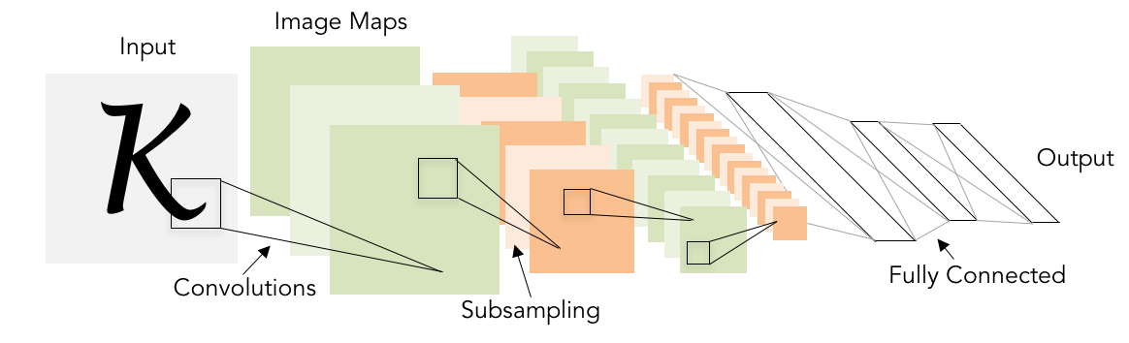
Convolutional Networks
Classic architecture:
[Conv, ReLU, Pool] x N, flatten, [FC, ReLU] x N, FC
Example: LeNet-5
Lecun et al, “Gradient-based learning applied to document recognition”, 1998

Slide 68
Example: LeNet-5
Layer | Output Size | Weight Size
Input | 1 x 28 x 28
Conv (C_{out}=20, K=5, P=2, S=1) | 20 x 28 x 28 | 20 x 1 x 5 x 5
ReLU | 20 x 28 x 28
MaxPool(K=2, S=2) | 20 x 14 x 14
Conv (C_{out}=50, K=5, P=2, S=1) | 50 x 14 x 14 | 50 x 20 x 5 x 5
ReLU | 50 x 14 x 14
MaxPool(K=2, S=2) | 50 x 7 x 7
Flatten | 2450
Linear (2450 -> 500) | 500 | 2450 x 500
ReLU | 500
Linear (500 -> 10) | 10 | 500 x 10
Lecun et al, “Gradient-based learning applied to document recognition”, 1998

Slide 69
Example: LeNet-5
Layer | Output Size | Weight Size
Input | 1 x 28 x 28
Conv (C_{out}=20, K=5, P=2, S=1) | 20 x 28 x 28 | 20 x 1 x 5 x 5
ReLU | 20 x 28 x 28
MaxPool(K=2, S=2) | 20 x 14 x 14
Conv (C_{out}=50, K=5, P=2, S=1) | 50 x 14 x 14 | 50 x 20 x 5 x 5
ReLU | 50 x 14 x 14
MaxPool(K=2, S=2) | 50 x 7 x 7
Flatten | 2450
Linear (2450 -> 500) | 500 | 2450 x 500
ReLU | 500
Linear (500 -> 10) | 10 | 500 x 10
Lecun et al, “Gradient-based learning applied to document recognition”, 1998

Slide 70
Example: LeNet-5
Layer | Output Size | Weight Size
Input | 1 x 28 x 28
Conv (C_{out}=20, K=5, P=2, S=1) | 20 x 28 x 28 | 20 x 1 x 5 x 5
ReLU | 20 x 28 x 28
MaxPool(K=2, S=2) | 20 x 14 x 14
Conv (C_{out}=50, K=5, P=2, S=1) | 50 x 14 x 14 | 50 x 20 x 5 x 5
ReLU | 50 x 14 x 14
MaxPool(K=2, S=2) | 50 x 7 x 7
Flatten | 2450
Linear (2450 -> 500) | 500 | 2450 x 500
ReLU | 500
Linear (500 -> 10) | 10 | 500 x 10
Lecun et al, “Gradient-based learning applied to document recognition”, 1998

Slide 71
Example: LeNet-5
Layer | Output Size | Weight Size
Input | 1 x 28 x 28
Conv (C_{out}=20, K=5, P=2, S=1) | 20 x 28 x 28 | 20 x 1 x 5 x 5
ReLU | 20 x 28 x 28
MaxPool(K=2, S=2) | 20 x 14 x 14
Conv (C_{out}=50, K=5, P=2, S=1) | 50 x 14 x 14 | 50 x 20 x 5 x 5
ReLU | 50 x 14 x 14
MaxPool(K=2, S=2) | 50 x 7 x 7
Flatten | 2450
Linear (2450 -> 500) | 500 | 2450 x 500
ReLU | 500
Linear (500 -> 10) | 10 | 500 x 10
Lecun et al, “Gradient-based learning applied to document recognition”, 1998

Slide 72
Example: LeNet-5
Layer | Output Size | Weight Size
Input | 1 x 28 x 28
Conv (C_{out}=20, K=5, P=2, S=1) | 20 x 28 x 28 | 20 x 1 x 5 x 5
ReLU | 20 x 28 x 28
MaxPool(K=2, S=2) | 20 x 14 x 14
Conv (C_{out}=50, K=5, P=2, S=1) | 50 x 14 x 14 | 50 x 20 x 5 x 5
ReLU | 50 x 14 x 14
MaxPool(K=2, S=2) | 50 x 7 x 7
Flatten | 2450
Linear (2450 -> 500) | 500 | 2450 x 500
ReLU | 500
Linear (500 -> 10) | 10 | 500 x 10
Lecun et al, “Gradient-based learning applied to document recognition”, 1998

Slide 73
Example: Lenet-5
Layer | Output Size | Weight Size
Input | 1 x 28 x 28
Conv (C_{out}=20, K=5, P=2, S=1) | 20 x 28 x 28 | 20 x 1 x 5 x 5
ReLU | 20 x 28 x 28
MaxPool(K=2, S=2) | 20 x 14 x 14
Conv (C_{out}=50, K=5, P=2, S=1) | 50 x 14 x 14 | 50 x 20 x 5 x 5
ReLU | 50 x 14 x 14
MaxPool(K=2, S=2) | 50 x 7 x 7
Flatten | 2450
Linear (2450 -> 500) | 500 | 2450 x 500
ReLU | 500
Linear (500 -> 10) | 10 | 500 x 10
Lecun et al, “Gradient-based learning applied to document recognition”, 1998

Slide 74
Example: Lenet-5
Layer | Output Size | Weight Size
Input | 1 x 28 x 28
Conv (C_{out}=20, K=5, P=2, S=1) | 20 x 28 x 28 | 20 x 1 x 5 x 5
ReLU | 20 x 28 x 28
MaxPool(K=2, S=2) | 20 x 14 x 14
Conv (C_{out}=50, K=5, P=2, S=1) | 50 x 14 x 14 | 50 x 20 x 5 x 5
ReLU | 50 x 14 x 14
MaxPool(K=2, S=2) | 50 x 7 x 7
Flatten | 2450
Linear (2450 -> 500) | 500 | 2450 x 500
ReLU | 500
Linear (500 -> 10) | 10 | 500 x 10
Lecun et al, “Gradient-based learning applied to document recognition”, 1998

Slide 75
Example: Lenet-5
Layer | Output Size | Weight Size
Input | 1 x 28 x 28
Conv (C_{out}=20, K=5, P=2, S=1) | 20 x 28 x 28 | 20 x 1 x 5 x 5
ReLU | 20 x 28 x 28
MaxPool(K=2, S=2) | 20 x 14 x 14
Conv (C_{out}=50, K=5, P=2, S=1) | 50 x 14 x 14 | 50 x 20 x 5 x 5
ReLU | 50 x 14 x 14
MaxPool(K=2, S=2) | 50 x 7 x 7
Flatten | 2450
Linear (2450 -> 500) | 500 | 2450 x 500
ReLU | 500
Linear (500 -> 10) | 10 | 500 x 10
Lecun et al, “Gradient-based learning applied to document recognition”, 1998

Slide 76
Example: Lenet-5
Layer | Output Size | Weight Size
Input | 1 x 28 x 28
Conv (C_{out}=20, K=5, P=2, S=1) | 20 x 28 x 28 | 20 x 1 x 5 x 5
ReLU | 20 x 28 x 28
MaxPool(K=2, S=2) | 20 x 14 x 14
Conv (C_{out}=50, K=5, P=2, S=1) | 50 x 14 x 14 | 50 x 20 x 5 x 5
ReLU | 50 x 14 x 14
MaxPool(K=2, S=2) | 50 x 7 x 7
Flatten | 2450
Linear (2450 -> 500) | 500 | 2450 x 500
ReLU | 500
Linear (500 -> 10) | 10 | 500 x 10
As we go through the network:
Spatial size decreases
(using pooling or strided conv)
Number of channels increases
(total “volume” is preserved!)
Lecun et al, “Gradient-based learning applied to document recognition”, 1998

Slide 77
Problem: Deep Networks very hard to train!

Slide 78
Components of a Convolutional Network
Fully-Connected Layers
Activation Function
$$y=Wx+b$$
$$y=\max\left(0,x\right)$$
Convolution Layers
Pooling Layers
Normalization
$${\hat{x}}_{i,j}=\frac{x_{i,j}−μ_{j}}{\sqrt{σ_{j}^{2}+ε}}$$

Slide 79
Batch Normalization
Idea: “Normalize” the outputs of each layer so they have zero mean and unit variance
Why? Helps reduce “internal covariate shift”, improves optimization
Ioffe and Szegedy, “Batch normalization: Accelerating deep network training by reducing internal covariate shift”, ICML 2015

Slide 80
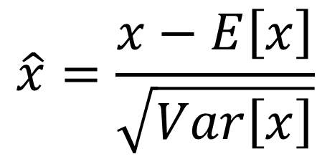
Batch Normalization
Idea: “Normalize” the outputs of each layer so they have zero mean and unit variance
Why? Helps reduce “internal covariate shift”, improves optimization
We can normalize a batch of activations like this:
$$\hat{x}=\frac{x−E\left[x\right]}{\sqrt{Var\left[x\right]}}$$
This is a differentiable function, so we can use it as an operator in our networks and backprop through it!
Ioffe and Szegedy, “Batch normalization: Accelerating deep network training by reducing internal covariate shift”, ICML 2015

Slide 81
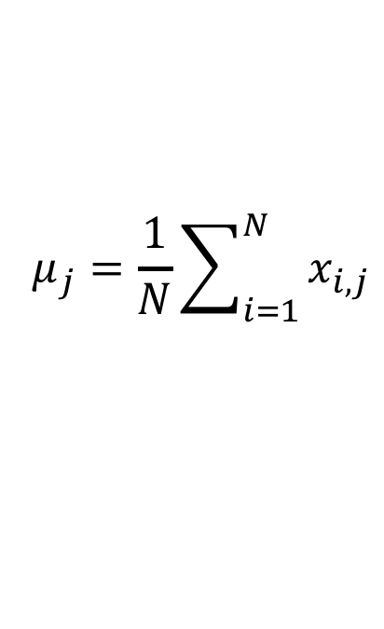

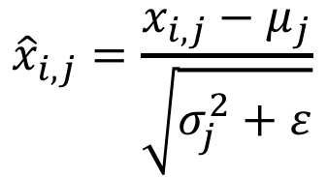
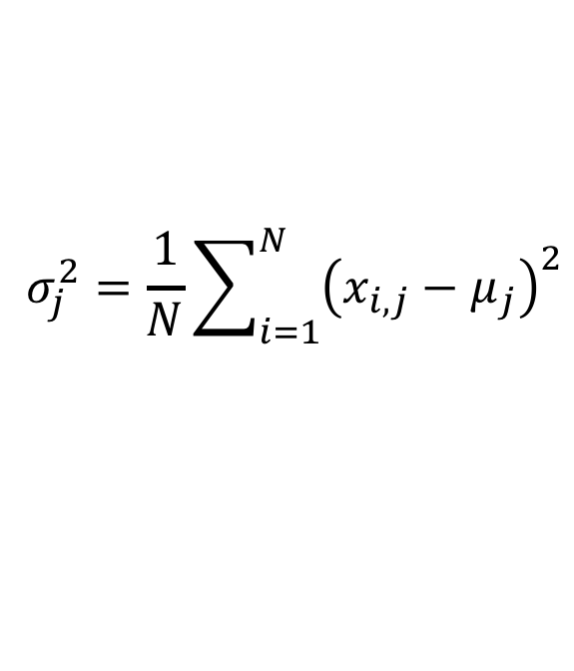
Batch Normalization
Input:
$$μ_{j}=\frac{1}{N}\sum_{i=1}^{N}{x_{i,j}}$$
Per-channel mean, shape is D
$$x∈ℝ^{N×D}$$
X
$$σ_{j}^{2}=\frac{1}{N}\sum_{i=1}^{N}{{\left(x_{i,j}−μ_{j}\right)}^{2}}$$
Per-channel std, shape is D
N
$${\hat{x}}_{i,j}=\frac{x_{i,j}−μ_{j}}{\sqrt{σ_{j}^{2}+ε}}$$
Normalized x,
Shape is N x D
D
Ioffe and Szegedy, “Batch normalization: Accelerating deep network training by reducing internal covariate shift”, ICML 2015

Slide 82
Batch Normalization
Input:
$$μ_{j}=\frac{1}{N}\sum_{i=1}^{N}{x_{i,j}}$$
Per-channel mean, shape is D
$$x∈ℝ^{N×D}$$
X
$$σ_{j}^{2}=\frac{1}{N}\sum_{i=1}^{N}{{\left(x_{i,j}−μ_{j}\right)}^{2}}$$
Per-channel std, shape is D
N
$${\hat{x}}_{i,j}=\frac{x_{i,j}−μ_{j}}{\sqrt{σ_{j}^{2}+ε}}$$
Normalized x,
Shape is N x D
D
Problem: What if zero-mean, unit variance is too restrictive?
Ioffe and Szegedy, “Batch normalization: Accelerating deep network training by reducing internal covariate shift”, ICML 2015

Slide 83
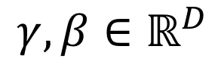

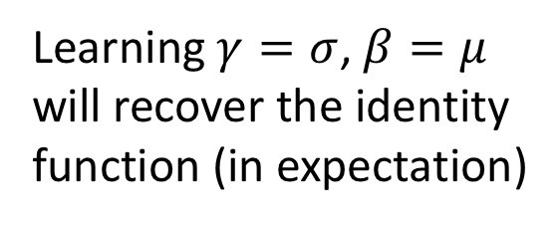
Batch Normalization
Input:
$$μ_{j}=\frac{1}{N}\sum_{i=1}^{N}{x_{i,j}}$$
Per-channel mean, shape is D
$$x∈ℝ^{N×D}$$
Learnable scale and shift parameters:
$$σ_{j}^{2}=\frac{1}{N}\sum_{i=1}^{N}{{\left(x_{i,j}−μ_{j}\right)}^{2}}$$
Per-channel std, shape is D
$$γ,β∈ℝ^{D}$$
$${\hat{x}}_{i,j}=\frac{x_{i,j}−μ_{j}}{\sqrt{σ_{j}^{2}+ε}}$$
Normalized x,
Shape is N x D
Learning $γ=σ$, $β=μ$
will recover the identity function (in expectation)
$$y_{i,j}=γ_{j}{\hat{x}}_{i,j}+β_{j}$$
Output,
Shape is N x D

Slide 84
Batch Normalization
Problem: Estimates depend on minibatch; can’t do this at test-time!
Input:
$$μ_{j}=\frac{1}{N}\sum_{i=1}^{N}{x_{i,j}}$$
Per-channel mean, shape is D
$$x∈ℝ^{N×D}$$
Learnable scale and shift parameters:
$$σ_{j}^{2}=\frac{1}{N}\sum_{i=1}^{N}{{\left(x_{i,j}−μ_{j}\right)}^{2}}$$
Per-channel std, shape is D
$$γ,β∈ℝ^{D}$$
$${\hat{x}}_{i,j}=\frac{x_{i,j}−μ_{j}}{\sqrt{σ_{j}^{2}+ε}}$$
Normalized x,
Shape is N x D
Learning $γ=σ$, $β=μ$
will recover the identity function (in expectation)
$$y_{i,j}=γ_{j}{\hat{x}}_{i,j}+β_{j}$$
Output,
Shape is N x D

Slide 85
Batch Normalization: Test-Time
(Running) average of
values seen during training
Input:
$$μ_{j}=\frac{1}{N}\sum_{i=1}^{N}{x_{i,j}}$$
Per-channel mean, shape is D
$$x∈ℝ^{N×D}$$
Learnable scale and shift parameters:
(Running) average of
values seen during training
$$σ_{j}^{2}=\frac{1}{N}\sum_{i=1}^{N}{{\left(x_{i,j}−μ_{j}\right)}^{2}}$$
Per-channel std, shape is D
$$γ,β∈ℝ^{D}$$
$${\hat{x}}_{i,j}=\frac{x_{i,j}−μ_{j}}{\sqrt{σ_{j}^{2}+ε}}$$
Normalized x,
Shape is N x D
Learning $γ=σ$, $β=μ$
will recover the identity function (in expectation)
$$y_{i,j}=γ_{j}{\hat{x}}_{i,j}+β_{j}$$
Output,
Shape is N x D

Slide 86
Batch Normalization: Test-Time
(Running) average of
values seen during training
Input:
$$μ_{j}=\frac{1}{N}\sum_{i=1}^{N}{x_{i,j}}$$
Per-channel mean, shape is D
$$x∈ℝ^{N×D}$$
Learnable scale and shift parameters:
(Running) average of
values seen during training
$$σ_{j}^{2}=\frac{1}{N}\sum_{i=1}^{N}{{\left(x_{i,j}−μ_{j}\right)}^{2}}$$
Per-channel std, shape is D
$$γ,β∈ℝ^{D}$$
$${\hat{x}}_{i,j}=\frac{x_{i,j}−μ_{j}}{\sqrt{σ_{j}^{2}+ε}}$$
Normalized x,
Shape is N x D
During testing batchnorm becomes a linear operator!
Can be fused with the previous fully-connected or conv layer
$$y_{i,j}=γ_{j}{\hat{x}}_{i,j}+β_{j}$$
Output,
Shape is N x D

Slide 87
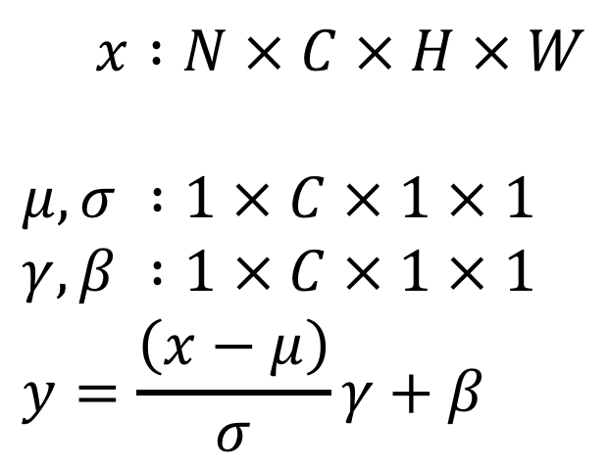
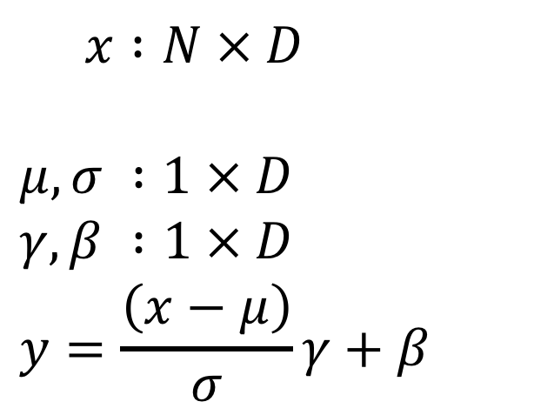
Batch Normalization for ConvNets
Batch Normalization for fully-connected networks
Batch Normalization for
convolutional networks
(Spatial Batchnorm, BatchNorm2D)
$x :N × D$
$$μ,σ :1 × D$$
$$γ,β :1 × D$$
$$y=\frac{\left(x−μ\right)}{σ}γ+β$$
$x :N × C × H × W$
$$μ,σ :1 × C × 1 × 1$$
$$γ,β :1 × C × 1 × 1$$
$$y=\frac{\left(x−μ\right)}{σ}γ+β$$
Normalize
Normalize

Slide 88
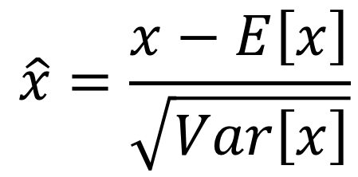
Batch Normalization
Conv
Usually inserted after Fully Connected or Convolutional layers, and before nonlinearity.
BN
ReLU
Conv
$$\hat{x}=\frac{x−E\left[x\right]}{\sqrt{Var\left[x\right]}}$$
BN
ReLU

Slide 89
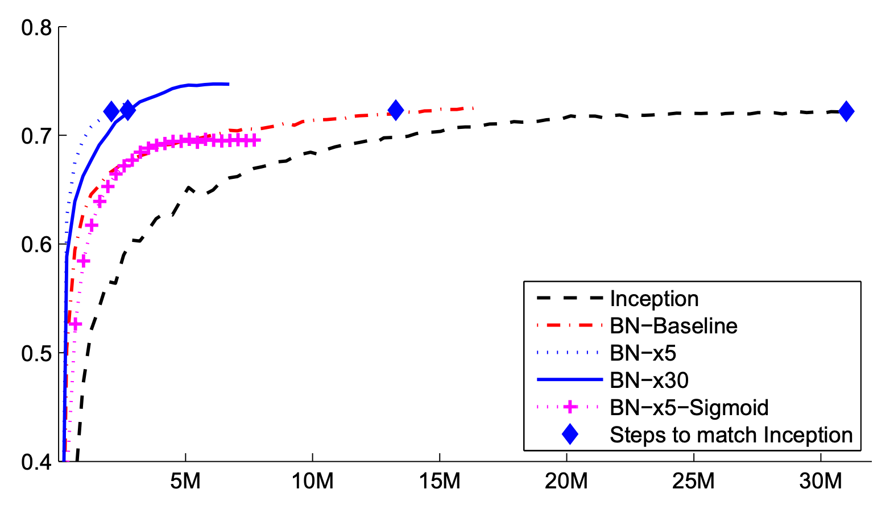
Batch Normalization
Makes deep networks much easier to train!
Allows higher learning rates, faster convergence
Networks become more robust to initialization
Acts as regularization during training
Free at test-time: can be fused with conv!
FC
BN
tanh
FC
BN
ImageNet accuracy
tanh
Training iterations

Slide 90
Batch Normalization
Makes deep networks much easier to train!
Allows higher learning rates, faster convergence
Networks become more robust to initialization
Acts as regularization during training
Free at test-time: can be fused with conv!
Not well-understood theoretically (yet)
Behaves differently during training and testing: this is a very common source of bugs!
FC
BN
tanh
FC
BN
tanh
Ioffe and Szegedy, “Batch normalization: Accelerating deep network training by reducing internal covariate shift”, ICML 2015

Slide 91
Components of a Convolutional Network
Fully-Connected Layers
Activation Function
$$y=Wx+b$$
$$y=\max\left(0,x\right)$$
Convolution Layers
Pooling Layers
Normalization
$${\hat{x}}_{i,j}=\frac{x_{i,j}−μ_{j}}{\sqrt{σ_{j}^{2}+ε}}$$

Slide 92
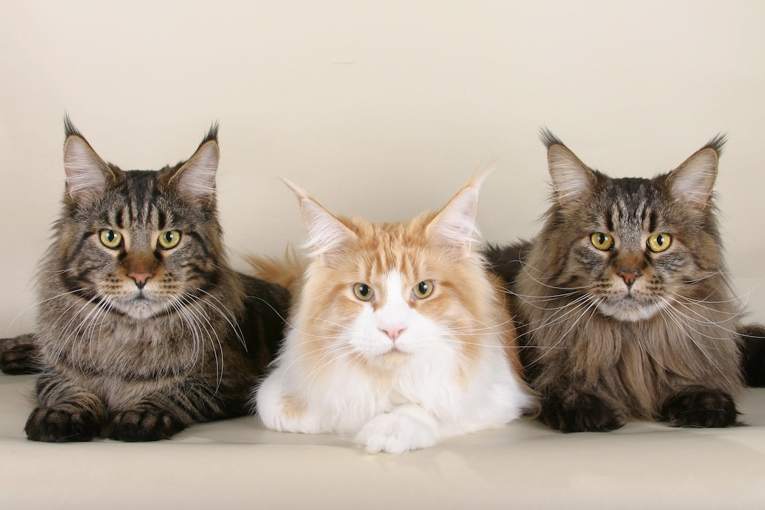
So Far: Image Classification
Cat
Cat image is CC0 public domain

Slide 93
What about Localizing Objects?
Cat
Cat
Cat
Cat image is CC0 public domain

Slide 94
Next time:
Detection + Segmentation

