Slide 1
Lecture 14:
Backpropagation

Slide 2
Administrative
HW3 due Wednesday 3/10, 11:59pm EST

Slide 3
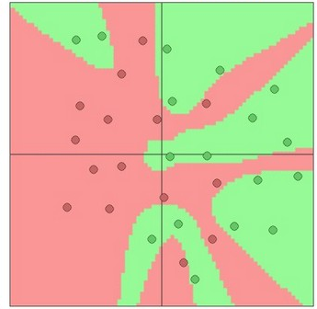
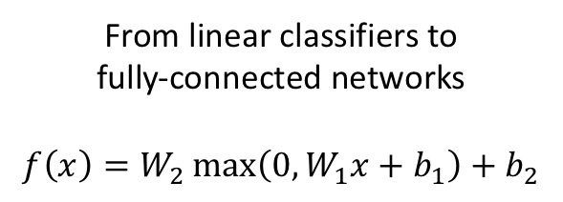
Last Time: Neural Networks
From linear classifiers to
fully-connected networks
$$f\left(x\right)=W_{2}\max\left(0,W_{1}x+b_{1}\right)+b_{2}$$
Space Warping

Slide 4
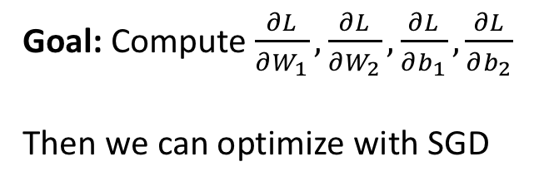
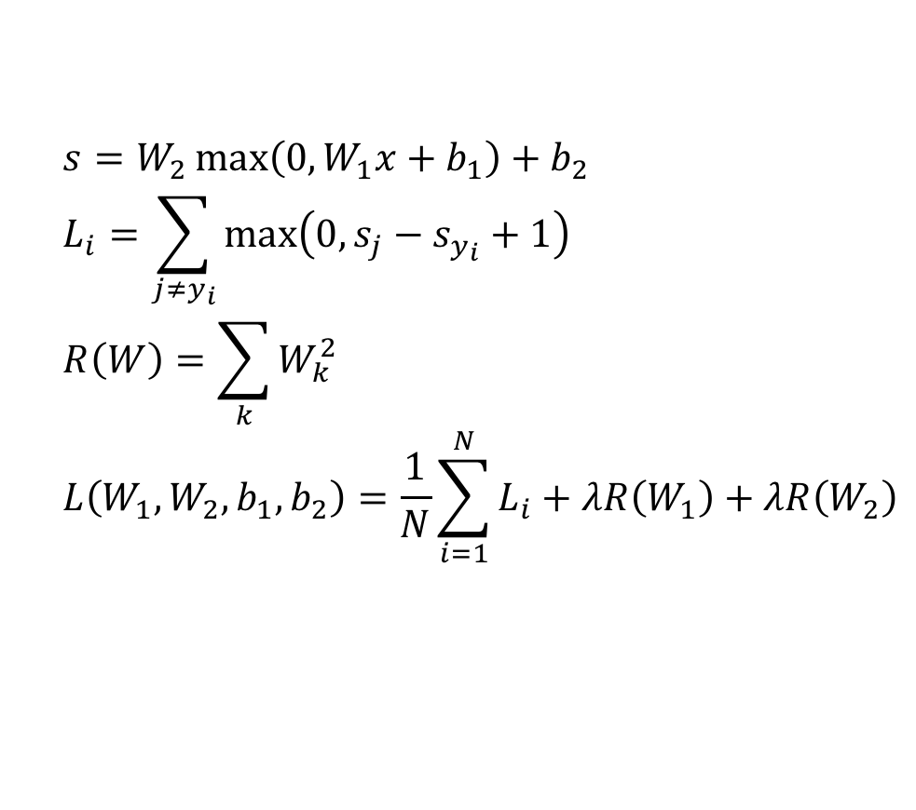
Problem: How to compute gradients?
$$s=W_{2}\max\left(0,W_{1}x+b_{1}\right)+b_{2}$$
$$L_{i}=\sum_{j≠y_{i}}{\max\left(0,s_{j}−s_{y_{i}}+1\right)}$$
$$R\left(W\right)=\sum_{k}{W_{k}^{2}}$$
$$L\left(W_{1},W_{2},b_{1},b_{2}\right)=\frac{1}{N}\sum_{i=1}^{N}{L_{i}}+λR\left(W_{1}\right)+λR\left(W_{2}\right)$$
Nonlinear score function
Per-element data loss
L2 Regularization
Total loss
Goal: Compute $\frac{∂L}{∂W_{1}},\frac{∂L}{∂W_{2}},\frac{∂L}{∂b_{1}},\frac{∂L}{∂b_{2}}$
Then we can optimize with SGD

Slide 5
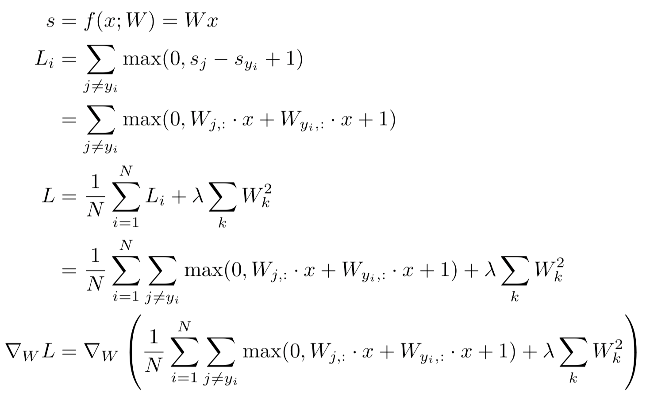
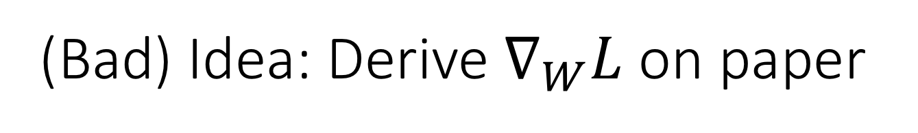
(Bad) Idea: Derive $∇_{W}L$ on paper
Problem: Very tedious: Lots of matrix calculus, need lots of paper
Problem: What if we want to change loss? E.g. use softmax instead of SVM? Need to re-derive from scratch. Not modular!
Problem: Not feasible for very complex models!

Slide 6
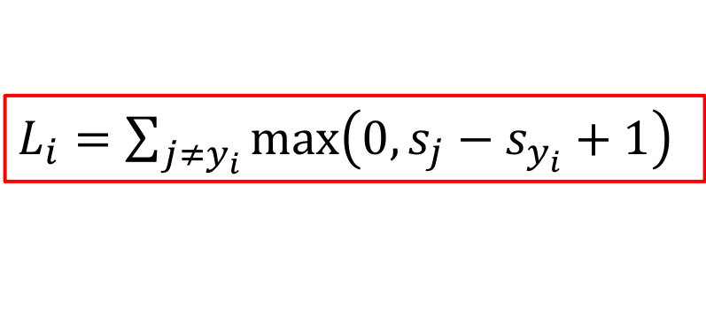


Better Idea: Computational Graphs
$$s=Wx$$
$L_{i}=\sum_{j≠y_{i}}{\max\left(0,s_{j}−s_{y_{i}}+1\right)}$
x
*
s (scores)
hinge loss
+
L
W
R
$$R\left(W\right)$$

Slide 7
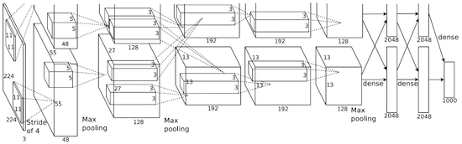
Deep Network (AlexNet)
input image
weights
loss

Slide 8
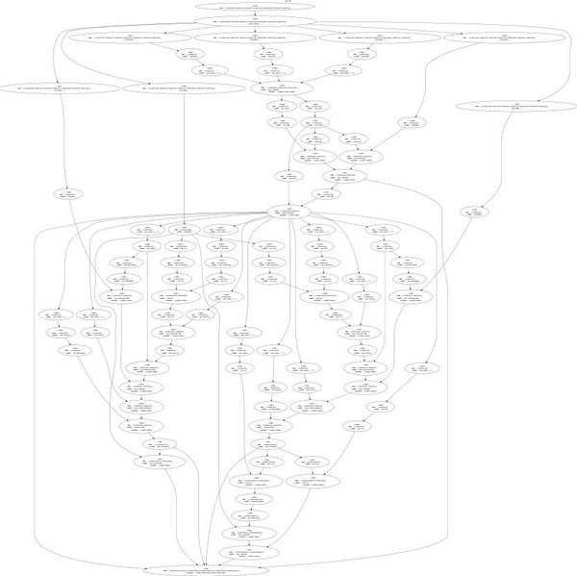
Neural Turing Machine
input image
loss
Graves et al, arXiv 2014
Figure reproduced with permission from a Twitter post by Andrej Karpathy.

Slide 9
Neural Turing Machine
Graves et al, arXiv 2014
Figure reproduced with permission from a Twitter post by Andrej Karpathy.

Slide 10
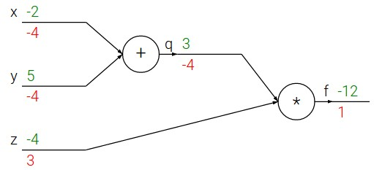

Backpropagation: Simple Example
$$f\left(x,y,z\right)=\left(x+y\right)⋅z$$

Slide 11
Backpropagation: Simple Example
$$f\left(x,y,z\right)=\left(x+y\right)⋅z$$
e.g. x = -2, y = 5, z = -4

Slide 12
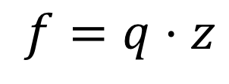
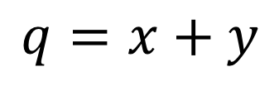
Backpropagation: Simple Example
$$f\left(x,y,z\right)=\left(x+y\right)⋅z$$
e.g. x = -2, y = 5, z = -4
1. Forward pass: Compute outputs
$$q=x+y$$
$$f=q⋅z$$

Slide 13
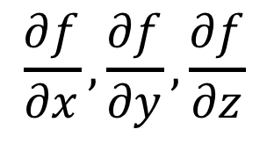
Backpropagation: Simple Example
$$f\left(x,y,z\right)=\left(x+y\right)⋅z$$
e.g. x = -2, y = 5, z = -4
1. Forward pass: Compute outputs
$$q=x+y$$
$$f=q⋅z$$
2. Backward pass: Compute derivatives
Want:
$$\frac{∂f}{∂x},\frac{∂f}{∂y},\frac{∂f}{∂z}$$

Slide 14
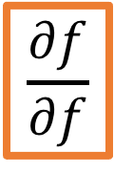
Backpropagation: Simple Example
$$f\left(x,y,z\right)=\left(x+y\right)⋅z$$
e.g. x = -2, y = 5, z = -4
1. Forward pass: Compute outputs
$$q=x+y$$
$$f=q⋅z$$
$$\frac{∂f}{∂f}$$
2. Backward pass: Compute derivatives
Want:
$$\frac{∂f}{∂x},\frac{∂f}{∂y},\frac{∂f}{∂z}$$

Slide 15
Backpropagation: Simple Example
$$f\left(x,y,z\right)=\left(x+y\right)⋅z$$
e.g. x = -2, y = 5, z = -4
1. Forward pass: Compute outputs
$$q=x+y$$
$$f=q⋅z$$
$$\frac{∂f}{∂f}$$
2. Backward pass: Compute derivatives
Want:
$$\frac{∂f}{∂x},\frac{∂f}{∂y},\frac{∂f}{∂z}$$

Slide 16
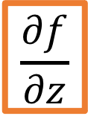
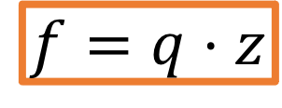
Backpropagation: Simple Example
$$f\left(x,y,z\right)=\left(x+y\right)⋅z$$
e.g. x = -2, y = 5, z = -4
1. Forward pass: Compute outputs
$$q=x+y$$
$$f=q⋅z$$
2. Backward pass: Compute derivatives
$$\frac{∂f}{∂z}$$
Want:
$$\frac{∂f}{∂x},\frac{∂f}{∂y},\frac{∂f}{∂z}$$

Slide 17
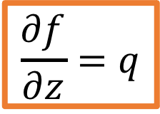
Backpropagation: Simple Example
$$f\left(x,y,z\right)=\left(x+y\right)⋅z$$
e.g. x = -2, y = 5, z = -4
1. Forward pass: Compute outputs
$$q=x+y$$
$$f=q⋅z$$
2. Backward pass: Compute derivatives
$$\frac{∂f}{∂z}=q$$
Want:
$$\frac{∂f}{∂x},\frac{∂f}{∂y},\frac{∂f}{∂z}$$

Slide 18
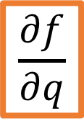
Backpropagation: Simple Example
$$f\left(x,y,z\right)=\left(x+y\right)⋅z$$
e.g. x = -2, y = 5, z = -4
1. Forward pass: Compute outputs
$$q=x+y$$
$$f=q⋅z$$
$$\frac{∂f}{∂q}$$
2. Backward pass: Compute derivatives
Want:
$$\frac{∂f}{∂x},\frac{∂f}{∂y},\frac{∂f}{∂z}$$

Slide 19
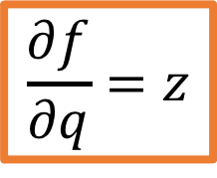
Backpropagation: Simple Example
$$f\left(x,y,z\right)=\left(x+y\right)⋅z$$
e.g. x = -2, y = 5, z = -4
1. Forward pass: Compute outputs
$$q=x+y$$
$$f=q⋅z$$
$$\frac{∂f}{∂q}=z$$
2. Backward pass: Compute derivatives
Want:
$$\frac{∂f}{∂x},\frac{∂f}{∂y},\frac{∂f}{∂z}$$

Slide 20
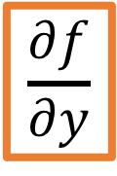
Backpropagation: Simple Example
$$f\left(x,y,z\right)=\left(x+y\right)⋅z$$
e.g. x = -2, y = 5, z = -4
1. Forward pass: Compute outputs
$$q=x+y$$
$$f=q⋅z$$
$$\frac{∂f}{∂y}$$
2. Backward pass: Compute derivatives
Want:
$$\frac{∂f}{∂x},\frac{∂f}{∂y},\frac{∂f}{∂z}$$

Slide 21
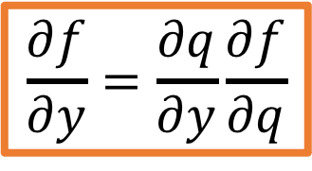
Backpropagation: Simple Example
$$f\left(x,y,z\right)=\left(x+y\right)⋅z$$
e.g. x = -2, y = 5, z = -4
1. Forward pass: Compute outputs
Chain Rule
$$q=x+y$$
$$f=q⋅z$$
$$\frac{∂f}{∂y}=\frac{∂q}{∂y}\frac{∂f}{∂q}$$
2. Backward pass: Compute derivatives
Want:
$$\frac{∂f}{∂x},\frac{∂f}{∂y},\frac{∂f}{∂z}$$

Slide 22
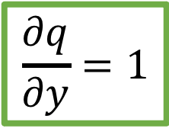
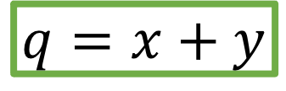
Backpropagation: Simple Example
$$f\left(x,y,z\right)=\left(x+y\right)⋅z$$
e.g. x = -2, y = 5, z = -4
1. Forward pass: Compute outputs
Chain Rule
$$q=x+y$$
$$f=q⋅z$$
$$\frac{∂f}{∂y}=\frac{∂q}{∂y}\frac{∂f}{∂q}$$
$$\frac{∂q}{∂y}=1$$
2. Backward pass: Compute derivatives
Want:
$$\frac{∂f}{∂x},\frac{∂f}{∂y},\frac{∂f}{∂z}$$
Downstream
Gradient
Local
Gradient
Upstream
Gradient

Slide 23
Backpropagation: Simple Example
$$f\left(x,y,z\right)=\left(x+y\right)⋅z$$
e.g. x = -2, y = 5, z = -4
1. Forward pass: Compute outputs
Chain Rule
$$q=x+y$$
$$f=q⋅z$$
$$\frac{∂f}{∂y}=\frac{∂q}{∂y}\frac{∂f}{∂q}$$
$$\frac{∂q}{∂y}=1$$
2. Backward pass: Compute derivatives
Want:
$$\frac{∂f}{∂x},\frac{∂f}{∂y},\frac{∂f}{∂z}$$
Downstream
Gradient
Local
Gradient
Upstream
Gradient

Slide 24
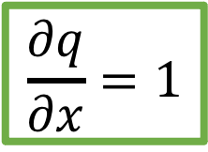
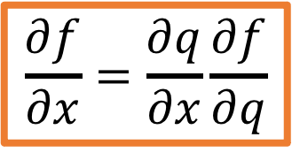
Backpropagation: Simple Example
$$f\left(x,y,z\right)=\left(x+y\right)⋅z$$
e.g. x = -2, y = 5, z = -4
1. Forward pass: Compute outputs
Chain Rule
$$q=x+y$$
$$f=q⋅z$$
$$\frac{∂f}{∂x}=\frac{∂q}{∂x}\frac{∂f}{∂q}$$
$$\frac{∂q}{∂x}=1$$
2. Backward pass: Compute derivatives
Want:
$$\frac{∂f}{∂x},\frac{∂f}{∂y},\frac{∂f}{∂z}$$
Downstream
Gradient
Local
Gradient
Upstream
Gradient

Slide 25
Backpropagation: Simple Example
$$f\left(x,y,z\right)=\left(x+y\right)⋅z$$
e.g. x = -2, y = 5, z = -4
1. Forward pass: Compute outputs
Chain Rule
$$q=x+y$$
$$f=q⋅z$$
$$\frac{∂f}{∂x}=\frac{∂q}{∂x}\frac{∂f}{∂q}$$
$$\frac{∂q}{∂x}=1$$
2. Backward pass: Compute derivatives
Want:
$$\frac{∂f}{∂x},\frac{∂f}{∂y},\frac{∂f}{∂z}$$
Downstream
Gradient
Local
Gradient
Upstream
Gradient

Slide 26



Forward Pass: Compute Outputs
$$x$$
f
$$z$$
$$y$$
Backward Pass: Compute Gradients

Slide 27
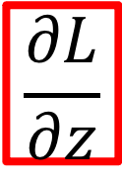
Forward Pass: Compute Outputs
$$x$$
f
$$z$$
$$\frac{∂L}{∂z}$$
$$y$$
Upstream gradient
Backward Pass: Compute Gradients

Slide 28


Forward Pass: Compute Outputs
$$x$$
f
$$\frac{∂z}{∂x}$$
$$z$$
$$\frac{∂z}{∂y}$$
Local gradients
$$\frac{∂L}{∂z}$$
$$y$$
Upstream gradient
Backward Pass: Compute Gradients

Slide 29
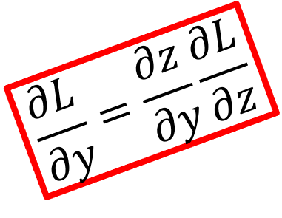
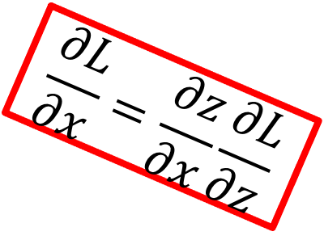
Forward Pass: Compute Outputs
$$x$$
f
$$\frac{∂L}{∂x}=\frac{∂z}{∂x}\frac{∂L}{∂z}$$
$$\frac{∂z}{∂x}$$
$$z$$
Downstream
gradients
$$\frac{∂z}{∂y}$$
Local gradients
$$\frac{∂L}{∂z}$$
$$y$$
$$\frac{∂L}{∂y}=\frac{∂z}{∂y}\frac{∂L}{∂z}$$
Upstream gradient
Backward Pass: Compute Gradients

Slide 30
Forward Pass: Compute Outputs
$$x$$
f
$$\frac{∂L}{∂x}=\frac{∂z}{∂x}\frac{∂L}{∂z}$$
$$\frac{∂z}{∂x}$$
$$z$$
Downstream
gradients
$$\frac{∂z}{∂y}$$
Local gradients
$$\frac{∂L}{∂z}$$
$$y$$
$$\frac{∂L}{∂y}=\frac{∂z}{∂y}\frac{∂L}{∂z}$$
Upstream gradient
Backward Pass: Compute Gradients

Slide 31
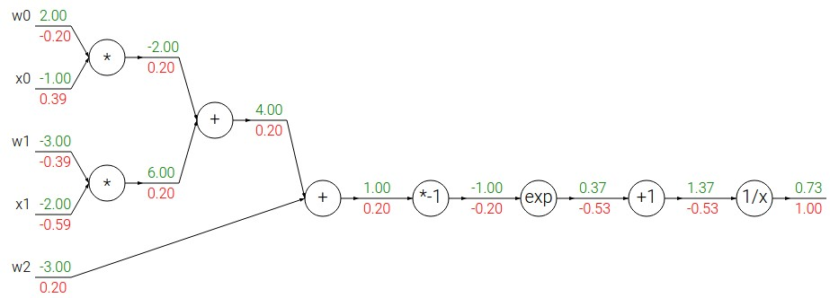
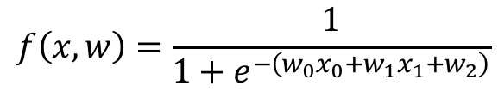
Another Example
$$f\left(x,w\right)=\frac{1}{1+e^{−\left(w_{0}x_{0}+w_{1}x_{1}+w_{2}\right)}}$$

Slide 32
Another Example
$$f\left(x,w\right)=\frac{1}{1+e^{−\left(w_{0}x_{0}+w_{1}x_{1}+w_{2}\right)}}$$
Forward pass: Compute outputs

Slide 33
Another Example
$$f\left(x,w\right)=\frac{1}{1+e^{−\left(w_{0}x_{0}+w_{1}x_{1}+w_{2}\right)}}$$
Backward pass: Compute gradients
Base Case

Slide 34
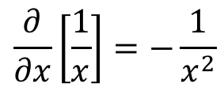
Another Example
$$f\left(x,w\right)=\frac{1}{1+e^{−\left(w_{0}x_{0}+w_{1}x_{1}+w_{2}\right)}}$$
Backward pass: Compute gradients
Local Gradient
$$\frac{∂}{∂x}\left[\frac{1}{x}\right]=−\frac{1}{x^{2}}$$
Downstream
Gradient
Upstream Gradient

Slide 35
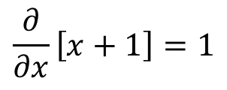
Another Example
$$f\left(x,w\right)=\frac{1}{1+e^{−\left(w_{0}x_{0}+w_{1}x_{1}+w_{2}\right)}}$$
Backward pass: Compute gradients
Local Gradient
$$\frac{∂}{∂x}\left[x+1\right]=1$$
Downstream
Gradient
Upstream Gradient

Slide 36
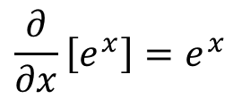
Another Example
$$f\left(x,w\right)=\frac{1}{1+e^{−\left(w_{0}x_{0}+w_{1}x_{1}+w_{2}\right)}}$$
Backward pass: Compute gradients
Local Gradient
$$\frac{∂}{∂x}\left[e^{x}\right]=e^{x}$$
Downstream
Gradient
Upstream Gradient

Slide 37
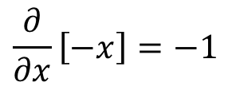
Another Example
$$f\left(x,w\right)=\frac{1}{1+e^{−\left(w_{0}x_{0}+w_{1}x_{1}+w_{2}\right)}}$$
Backward pass: Compute gradients
Local Gradient
$$\frac{∂}{∂x}\left[−x\right]=−1$$
Downstream
Gradient
Upstream Gradient

Slide 38
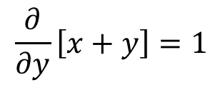

Another Example
$$f\left(x,w\right)=\frac{1}{1+e^{−\left(w_{0}x_{0}+w_{1}x_{1}+w_{2}\right)}}$$
Backward pass: Compute gradients
Local Gradient
$$\frac{∂}{∂x}\left[x+y\right]=1$$
$$\frac{∂}{∂y}\left[x+y\right]=1$$
Upstream Gradient
Downstream
Gradient

Slide 39
Another Example
$$f\left(x,w\right)=\frac{1}{1+e^{−\left(w_{0}x_{0}+w_{1}x_{1}+w_{2}\right)}}$$
Backward pass: Compute gradients
Local Gradient
$$\frac{∂}{∂x}\left[x+y\right]=1$$
$$\frac{∂}{∂y}\left[x+y\right]=1$$
Downstream
Gradient
Upstream Gradient

Slide 40
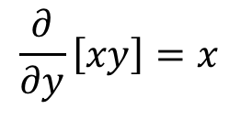

Another Example
$$f\left(x,w\right)=\frac{1}{1+e^{−\left(w_{0}x_{0}+w_{1}x_{1}+w_{2}\right)}}$$
Downstream
Gradient
Upstream Gradient
Backward pass: Compute gradients
Local Gradient
$$\frac{∂}{∂x}\left[xy\right]=y$$
$$\frac{∂}{∂y}\left[xy\right]=x$$

Slide 41
Another Example
$$f\left(x,w\right)=\frac{1}{1+e^{−\left(w_{0}x_{0}+w_{1}x_{1}+w_{2}\right)}}$$
Downstream
Gradient
Upstream Gradient
Backward pass: Compute gradients
Local Gradient
$$\frac{∂}{∂x}\left[xy\right]=y$$
$$\frac{∂}{∂y}\left[xy\right]=x$$

Slide 42
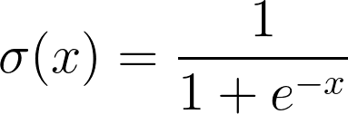
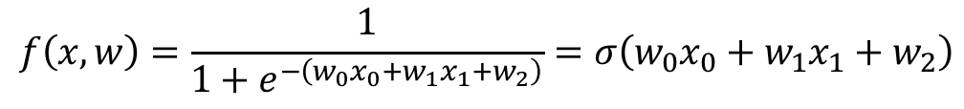
Another Example
$$f\left(x,w\right)=\frac{1}{1+e^{−\left(w_{0}x_{0}+w_{1}x_{1}+w_{2}\right)}}=σ\left(w_{0}x_{0}+w_{1}x_{1}+w_{2}\right)$$
Backward pass: Compute gradients
Computational graph is not unique: we can use primitives that have simple local gradients
Sigmoid

Slide 43
Another Example
$$f\left(x,w\right)=\frac{1}{1+e^{−\left(w_{0}x_{0}+w_{1}x_{1}+w_{2}\right)}}=σ\left(w_{0}x_{0}+w_{1}x_{1}+w_{2}\right)$$
Backward pass: Compute gradients
Computational graph is not unique: we can use primitives that have simple local gradients
Sigmoid
Sigmoid local gradient:
$$\frac{∂}{∂x}\left[σ\left(x\right)\right]=\frac{e^{−x}}{{\left(1+e^{−x}\right)}^{2}}=\left(\frac{1+e^{−x}−1}{1+e^{−x}}\right)\left(\frac{1}{1+e^{−x}}\right)=\left(1−σ\left(x\right)\right)σ\left(x\right)$$

Slide 44
Another Example
$$f\left(x,w\right)=\frac{1}{1+e^{−\left(w_{0}x_{0}+w_{1}x_{1}+w_{2}\right)}}=σ\left(w_{0}x_{0}+w_{1}x_{1}+w_{2}\right)$$
Backward pass: Compute gradients
Computational graph is not unique: we can use primitives that have simple local gradients
Sigmoid
[Downstream] = [Local] * [Upstream]
= (1 – 0.73) * 0.73 * 1.0 = 0.2
Sigmoid local gradient:
$$\frac{∂}{∂x}\left[σ\left(x\right)\right]=\frac{e^{−x}}{{\left(1+e^{−x}\right)}^{2}}=\left(\frac{1+e^{−x}−1}{1+e^{−x}}\right)\left(\frac{1}{1+e^{−x}}\right)=\left(1−σ\left(x\right)\right)σ\left(x\right)$$

Slide 45
Patterns in Gradient Flow
add gate: gradient distributor
3
2
7
+
4
2
2

Slide 46
Patterns in Gradient Flow
add gate: gradient distributor
3
2
7
+
4
2
2
copy gate: gradient adder
7
7
4
4+2=6
7
2

Slide 47
Patterns in Gradient Flow
add gate: gradient distributor
mul gate: “swap multiplier”
3
2
2
7
5*3=15
6
+
×
4
2
3
5
2
2*5=10
copy gate: gradient adder
7
7
4
4+2=6
7
2

Slide 48
Patterns in Gradient Flow
add gate: gradient distributor
mul gate: “swap multiplier”
3
2
2
7
5*3=15
6
+
×
4
2
3
5
2
2*5=10
copy gate: gradient adder
max gate: gradient router
7
4
7
4
0
5
max
9
4+2=6
7
5
2
9

Slide 49
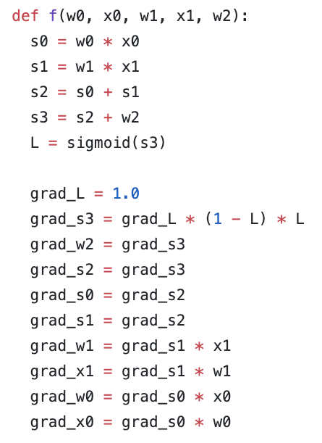
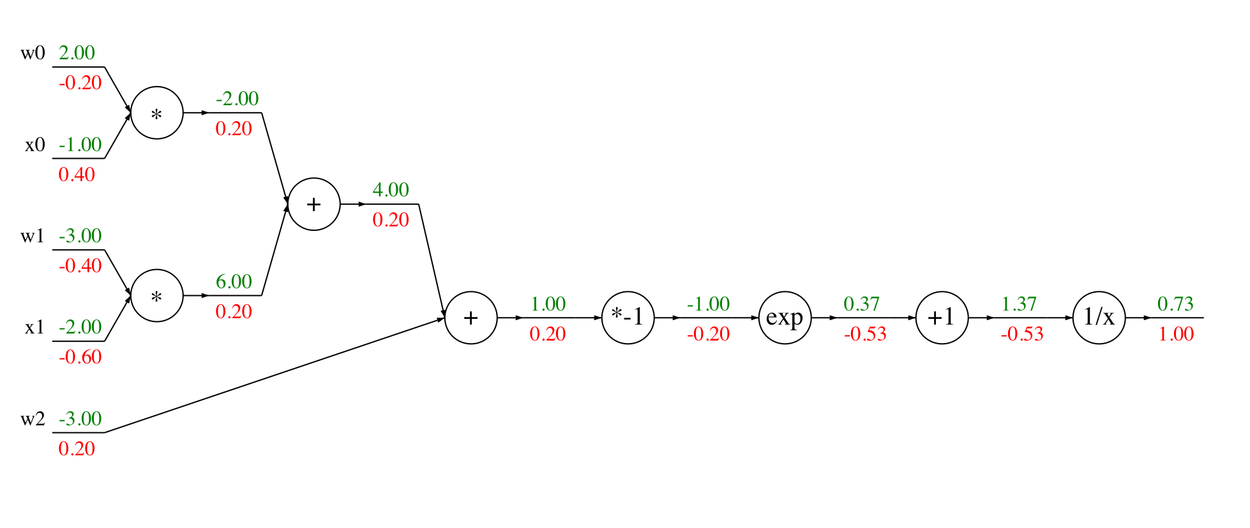
Implementation: ”Flat” Backprop
Forward pass:
Compute output

Slide 50
Implementation: ”Flat” Backprop
Forward pass:
Compute output
Backward pass:
Compute grads

Slide 51
Implementation: ”Flat” Backprop
Forward pass:
Compute output
Base case

Slide 52
Implementation: ”Flat” Backprop
Forward pass:
Compute output
Sigmoid

Slide 53
Implementation: ”Flat” Backprop
Forward pass:
Compute output
Add

Slide 54
Implementation: ”Flat” Backprop
Forward pass:
Compute output
Add

Slide 55
Implementation: ”Flat” Backprop
Forward pass:
Compute output
Multiply

Slide 56
Implementation: ”Flat” Backprop
Forward pass:
Compute output
Multiply

Slide 57
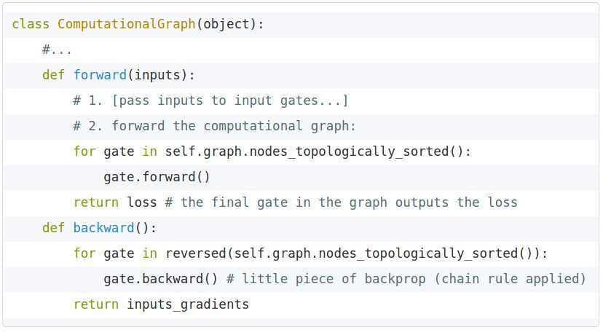

Implementation: Modular API
Graph (or Net) object (rough pseudo code)

Slide 58
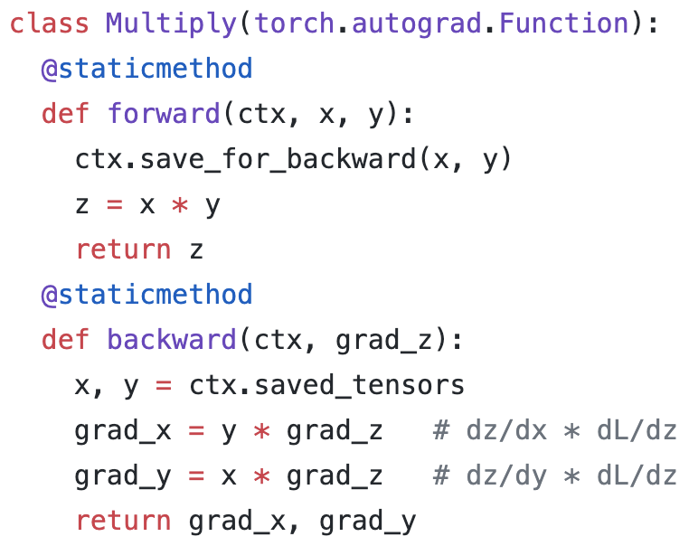
Example: PyTorch Autograd Functions
x
z
Need to stash some values for use in backward
*
y
(x,y,z are scalars)
Upstream gradient
Multiply upstream and local gradients

Slide 59
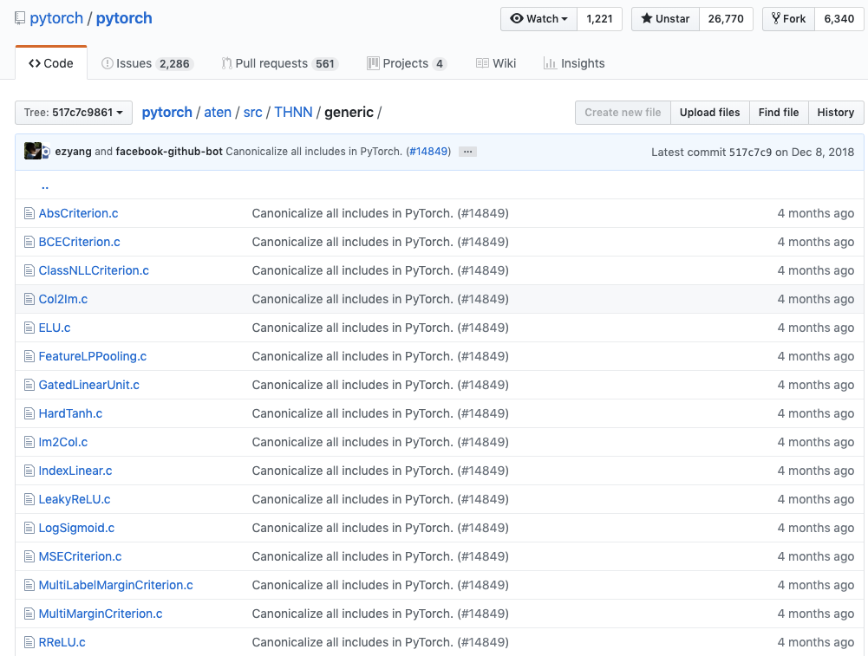
Example: PyTorch operators

Slide 60
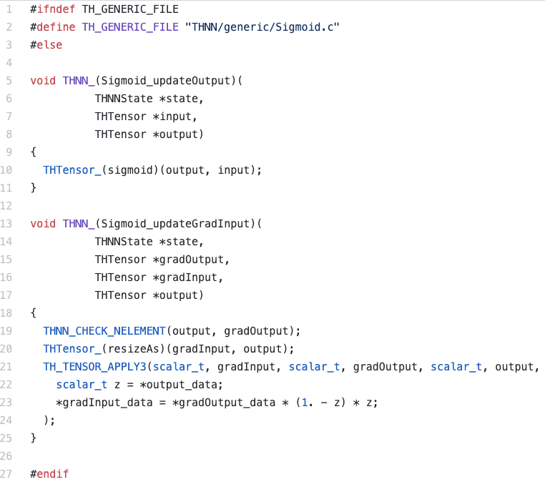
PyTorch sigmoid layer
Source

Slide 61
PyTorch sigmoid layer
Forward
Source

Slide 62
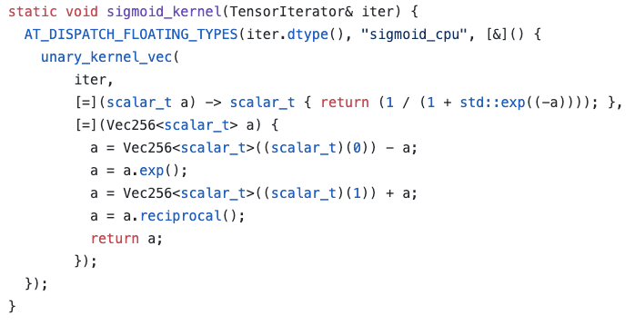
PyTorch sigmoid layer
Forward
Forward actually defined elsewhere...
Source

Slide 63
PyTorch sigmoid layer
Forward
Backward
Source

Slide 64
So far: Backprop with scalars
What about vector-valued functions?

Slide 65
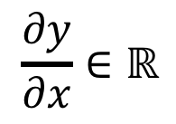

Recap: Vector Derivatives
$$x∈ℝ, y∈ℝ$$
Regular derivative:
$$\frac{∂y}{∂x}∈ℝ$$
If x changes by a small amount, how much will y change?

Slide 66


Recap: Vector Derivatives
$$x∈ℝ, y∈ℝ$$
$$x∈ℝ^{N}, y∈ℝ$$
Regular derivative:
Derivative is Gradient:
$$\frac{∂y}{∂x}∈ℝ$$
$$\frac{∂y}{∂x}∈ℝ^{N},$$
$${\left(\frac{∂y}{∂x}\right)}_{i}=\frac{∂y}{∂x_{i}}$$
If x changes by a small amount, how much will y change?
For each element of x, if it changes by a small amount then how much will y change?

Slide 67


Recap: Vector Derivatives
$$x∈ℝ, y∈ℝ$$
$$x∈ℝ^{N}, y∈ℝ$$
$$x∈ℝ^{N}, y∈ℝ^{M}$$
Regular derivative:
Derivative is Gradient:
Derivative is Jacobian:
$$\frac{∂y}{∂x}∈ℝ$$
$$\frac{∂y}{∂x}∈ℝ^{N},$$
$${\left(\frac{∂y}{∂x}\right)}_{i}=\frac{∂y}{∂x_{i}}$$
$$\frac{∂y}{∂x}∈ℝ^{N×M}$$
$${\left(\frac{∂y}{∂x}\right)}_{i,j}=\frac{∂y_{j}}{∂x_{i}}$$
If x changes by a small amount, how much will y change?
For each element of x, if it changes by a small amount then how much will y change?
For each element of x, if it changes by a small amount then how much will each element of y change?

Slide 68



Backprop with Vectors
D_{x}
Loss L still a scalar!
$$x$$
f
D_{x}
D_{z}
$$z$$
D_{y}
$$y$$
D_{y}

Slide 69

Backprop with Vectors
D_{x}
Loss L still a scalar!
$$x$$
f
D_{x}
D_{z}
$$z$$
$$\frac{∂L}{∂z}$$
D_{z}
D_{y}
$$y$$
Upstream Gradient
D_{y}
For each element of z, how much does it influence L?

Slide 70


Backprop with Vectors
D_{x}
Loss L still a scalar!
$$x$$
f
Local
Jacobian matrices
D_{x}
D_{z}
$$\frac{∂z}{∂x}$$
[D_{x} x D_{z}]
$$z$$
$$\frac{∂z}{∂y}$$
[D_{y} x D_{z}]
$$\frac{∂L}{∂z}$$
D_{z}
D_{y}
$$y$$
Upstream Gradient
D_{y}
For each element of z, how much does it influence L?

Slide 71


Backprop with Vectors
D_{x}
Loss L still a scalar!
$$x$$
f
Local
Jacobian matrices
D_{x}
$$\frac{∂L}{∂x}=\frac{∂z}{∂x}\frac{∂L}{∂z}$$
D_{z}
$$\frac{∂z}{∂x}$$
[D_{x} x D_{z}]
$$z$$
Downstream Gradients
Matrix-vector
multiply
$$\frac{∂z}{∂y}$$
[D_{y} x D_{z}]
$$\frac{∂L}{∂z}$$
D_{z}
D_{y}
$$y$$
$$\frac{∂L}{∂y}=\frac{∂z}{∂y}\frac{∂L}{∂z}$$
Upstream Gradient
D_{y}
For each element of z, how much does it influence L?

Slide 72
Backprop with Vectors
4D input x:
[ 1 ]
[ -2 ]
[ 3 ]
[ -1 ]
4D output y:
[ 1 ]
[ 0 ]
[ 3 ]
[ 0 ]
f(x) = max(0,x)
(elementwise)

Slide 73
Backprop with Vectors
4D input x:
[ 1 ]
[ -2 ]
[ 3 ]
[ -1 ]
4D output y:
[ 1 ]
[ 0 ]
[ 3 ]
[ 0 ]
f(x) = max(0,x)
(elementwise)
4D dL/dy:
[ 4 ]
[ -1 ]
[ 5 ]
[ 9 ]
Upstream
gradient

Slide 74
Backprop with Vectors
4D input x:
[ 1 ]
[ -2 ]
[ 3 ]
[ -1 ]
4D output y:
[ 1 ]
[ 0 ]
[ 3 ]
[ 0 ]
f(x) = max(0,x)
(elementwise)
Jacobian dy/dx
[ 1 0 0 0 ]
[ 0 0 0 0 ]
[ 0 0 1 0 ]
[ 0 0 0 0 ]
4D dL/dy:
[ 4 ]
[ -1 ]
[ 5 ]
[ 9 ]
Upstream
gradient

Slide 75
Backprop with Vectors
4D input x:
[ 1 ]
[ -2 ]
[ 3 ]
[ -1 ]
4D output y:
[ 1 ]
[ 0 ]
[ 3 ]
[ 0 ]
f(x) = max(0,x)
(elementwise)
[dy/dx] [dL/dy]
[ 1 0 0 0 ] [ 4 ]
[ 0 0 0 0 ] [ -1 ]
[ 0 0 1 0 ] [ 5 ]
[ 0 0 0 0 ] [ 9 ]
4D dL/dy:
[ 4 ]
[ -1 ]
[ 5 ]
[ 9 ]
Upstream
gradient

Slide 76
Backprop with Vectors
4D input x:
[ 1 ]
[ -2 ]
[ 3 ]
[ -1 ]
4D output y:
[ 1 ]
[ 0 ]
[ 3 ]
[ 0 ]
f(x) = max(0,x)
(elementwise)
4D dL/dx:
[ 4 ]
[ 0 ]
[ 5 ]
[ 0 ]
[dy/dx] [dL/dy]
[ 1 0 0 0 ] [ 4 ]
[ 0 0 0 0 ] [ -1 ]
[ 0 0 1 0 ] [ 5 ]
[ 0 0 0 0 ] [ 9 ]
4D dL/dy:
[ 4 ]
[ -1 ]
[ 5 ]
[ 9 ]
Upstream
gradient

Slide 77
Backprop with Vectors
Jacobian is sparse: off-diagonal entries all zero! Never explicitly form Jacobian; instead use implicit multiplication
4D input x:
[ 1 ]
[ -2 ]
[ 3 ]
[ -1 ]
4D output y:
[ 1 ]
[ 0 ]
[ 3 ]
[ 0 ]
f(x) = max(0,x)
(elementwise)
4D dL/dx:
[ 4 ]
[ 0 ]
[ 5 ]
[ 0 ]
[dy/dx] [dL/dy]
[ 1 0 0 0 ] [ 4 ]
[ 0 0 0 0 ] [ -1 ]
[ 0 0 1 0 ] [ 5 ]
[ 0 0 0 0 ] [ 9 ]
4D dL/dy:
[ 4 ]
[ -1 ]
[ 5 ]
[ 9 ]
Upstream
gradient

Slide 78

Backprop with Vectors
Jacobian is sparse: off-diagonal entries all zero! Never explicitly form Jacobian; instead use implicit multiplication
4D input x:
[ 1 ]
[ -2 ]
[ 3 ]
[ -1 ]
4D output y:
[ 1 ]
[ 0 ]
[ 3 ]
[ 0 ]
f(x) = max(0,x)
(elementwise)
4D dL/dx:
[ 4 ]
[ 0 ]
[ 5 ]
[ 0 ]
[dy/dx] [dL/dy]
4D dL/dy:
[ 4 ]
[ -1 ]
[ 5 ]
[ 9 ]
$${\left(\frac{∂L}{∂x}\right)}_{i}=\left\{\begin{aligned}{\left(\frac{∂L}{∂y}\right)}_{i}, if x_{i}>0 \\ 0, otherwise\end{aligned}\right.$$
Upstream
gradient

Slide 79



Backprop with Matrices (or Tensors):
[D_{x}×M_{x}]
$$x$$
[D_{x}×M_{x}]
$$z$$
[D_{y}×M_{y}]
$$y$$
[D_{y}×M_{y}]

Slide 80
Backprop with Matrices (or Tensors):
Loss L still a scalar!
[D_{x}×M_{x}]
$$x$$
dL/dx always has the same shape as x!
[D_{x}×M_{x}]
$$z$$
[D_{z}×M_{z}]
[D_{y}×M_{y}]
$$y$$
[D_{y}×M_{y}]

Slide 81

Backprop with Matrices (or Tensors):
Loss L still a scalar!
[D_{x}×M_{x}]
$$x$$
dL/dx always has the same shape as x!
[D_{x}×M_{x}]
$$z$$
[D_{z}×M_{z}]
[D_{y}×M_{y}]
$$\frac{∂L}{∂z}$$
[D_{z}×M_{z}]
$$y$$
Upstream gradient
[D_{y}×M_{y}]
For each element of z, how much does it influence L?

Slide 82


Backprop with Matrices (or Tensors):
Loss L still a scalar!
[D_{x}×M_{x}]
$$x$$
dL/dx always has the same shape as x!
Local
Jacobian matrices
[D_{x}×M_{x}]
$$\frac{∂z}{∂x}$$
[(D_{x}×M_{x})×(D_{z}×M_{z})]
[D_{z}×M_{z}]
$$z$$
$$\frac{∂z}{∂y}$$
[(D_{y}×M_{y})×(D_{z}×M_{z})]
[D_{y}×M_{y}]
$$\frac{∂L}{∂z}$$
[D_{z}×M_{z}]
$$y$$
Upstream gradient
[D_{y}×M_{y}]
For each element of y, how much does it influence each element of z?
For each element of z, how much does it influence L?

Slide 83


Backprop with Matrices (or Tensors):
Loss L still a scalar!
[D_{x}×M_{x}]
$$x$$
dL/dx always has the same shape as x!
Local
Jacobian matrices
[D_{x}×M_{x}]
$$\frac{∂L}{∂x}=\frac{∂z}{∂x}\frac{∂L}{∂z}$$
$$\frac{∂z}{∂x}$$
[(D_{x}×M_{x})×(D_{z}×M_{z})]
[D_{z}×M_{z}]
$$z$$
Matrix-vector
multiply
$$\frac{∂z}{∂y}$$
[(D_{y}×M_{y})×(D_{z}×M_{z})]
[D_{y}×M_{y}]
$$\frac{∂L}{∂z}$$
[D_{z}×M_{z}]
$$y$$
$$\frac{∂L}{∂y}=\frac{∂z}{∂y}\frac{∂L}{∂z}$$
Upstream gradient
[D_{y}×M_{y}]
For each element of y, how much does it influence each element of z?
For each element of z, how much does it influence L?

Slide 84

Example: Matrix Multiplication
y: [N×M]
[-1 -1 2 6 ]
[ 5 2 11 7 ]
x: [N×D]
[ 2 1 -3 ]
[ -3 4 2 ]
w: [D×M]
[ 3 2 1 -1]
[ 2 1 3 2]
[ 3 2 1 -2]
Matrix Multiply y = xw
$$y_{i,j}=\sum_{k}{x_{i,k}w_{k,j}}$$

Slide 85
Example: Matrix Multiplication
y: [N×M]
[-1 -1 2 6 ]
[ 5 2 11 7 ]
x: [N×D]
[ 2 1 -3 ]
[ -3 4 2 ]
w: [D×M]
[ 3 2 1 -1]
[ 2 1 3 2]
[ 3 2 1 -2]
Matrix Multiply y = xw
$$y_{i,j}=\sum_{k}{x_{i,k}w_{k,j}}$$
dL/dy: [N×M]
[ 2 3 -3 9 ]
[ -8 1 4 6 ]
dL/dx: [N×D]
[ 0 16 -9 ]
[-24 9 -30 ]
? ? ? ? ? ?

Slide 86
Example: Matrix Multiplication
y: [N×M]
[-1 -1 2 6 ]
[ 5 2 11 7 ]
x: [N×D]
[ 2 1 -3 ]
[ -3 4 2 ]
w: [D×M]
[ 3 2 1 -1]
[ 2 1 3 2]
[ 3 2 1 -2]
Matrix Multiply y = xw
$$y_{i,j}=\sum_{k}{x_{i,k}w_{k,j}}$$
dL/dy: [N×M]
[ 2 3 -3 9 ]
[ -8 1 4 6 ]
dL/dx: [N×D]
[ 0 16 -9 ]
[-24 9 -30 ]
? ? ? ? ? ?
Jacobians:
dy/dx: [(N×D)×(N×M)]
dy/dw: [(D×M)×(N×M)]
For a neural net we may have
N=64, D=M=4096
Each Jacobian takes 256 GB of memory! Must work with them implicitly!

Slide 87
Example: Matrix Multiplication
y: [N×M]
[-1 -1 2 6 ]
[ 5 2 11 7 ]
x: [N×D]
[ 2 1 -3 ]
[ -3 4 2 ]
w: [D×M]
[ 3 2 1 -1]
[ 2 1 3 2]
[ 3 2 1 -2]
Matrix Multiply y = xw
$$y_{i,j}=\sum_{k}{x_{i,k}w_{k,j}}$$
dL/dy: [N×M]
[ 2 3 -3 9 ]
[ -8 1 4 6 ]
dL/dx: [N×D]
[ 0 16 -9 ]
[-24 9 -30 ]
? ? ? ? ? ?
Local Gradient Slice:
dy/dx_{1,1}
[ ? ? ? ? ]
[ ? ? ? ? ]
dL/dx_{1,1}
= (dy/dx_{1,1}) · (dL/dy)

Slide 88
Example: Matrix Multiplication
y: [N×M]
[-1 -1 2 6 ]
[ 5 2 11 7 ]
x: [N×D]
[ 2 1 -3 ]
[ -3 4 2 ]
w: [D×M]
[ 3 2 1 -1]
[ 2 1 3 2]
[ 3 2 1 -2]
Matrix Multiply y = xw
$$y_{i,j}=\sum_{k}{x_{i,k}w_{k,j}}$$
dL/dy: [N×M]
[ 2 3 -3 9 ]
[ -8 1 4 6 ]
dL/dx: [N×D]
[ 0 16 -9 ]
[-24 9 -30 ]
? ? ? ? ? ?
Local Gradient Slice:
dy/dx_{1,1}
[ ? ? ? ? ]
[ ? ? ? ? ]
dy_{1,1}/dx_{1,1}
dL/dx_{1,1}
= (dy/dx_{1,1}) · (dL/dy)

Slide 89
Example: Matrix Multiplication
y: [N×M]
[-1 -1 2 6 ]
[ 5 2 11 7 ]
x: [N×D]
[ 2 1 -3 ]
[ -3 4 2 ]
w: [D×M]
[ 3 2 1 -1]
[ 2 1 3 2]
[ 3 2 1 -2]
Matrix Multiply y = xw
$$y_{i,j}=\sum_{k}{x_{i,k}w_{k,j}}$$
dL/dy: [N×M]
[ 2 3 -3 9 ]
[ -8 1 4 6 ]
dL/dx: [N×D]
[ 0 16 -9 ]
[-24 9 -30 ]
? ? ? ? ? ?
Local Gradient Slice:
dy/dx_{1,1}
[ ? ? ? ? ]
[ ? ? ? ? ]
dy_{1,1}/dx_{1,1}
dL/dx_{1,1}
= (dy/dx_{1,1}) · (dL/dy)
y_{1,1} = x_{1,1}w_{1,1} + x_{1,2}w_{2,1} + x_{1,3}w_{3,1}

Slide 90
Example: Matrix Multiplication
y: [N×M]
[-1 -1 2 6 ]
[ 5 2 11 7 ]
x: [N×D]
[ 2 1 -3 ]
[ -3 4 2 ]
w: [D×M]
[ 3 2 1 -1]
[ 2 1 3 2]
[ 3 2 1 -2]
Matrix Multiply y = xw
$$y_{i,j}=\sum_{k}{x_{i,k}w_{k,j}}$$
dL/dy: [N×M]
[ 2 3 -3 9 ]
[ -8 1 4 6 ]
dL/dx: [N×D]
[ 0 16 -9 ]
[-24 9 -30 ]
? ? ? ? ? ?
Local Gradient Slice:
dy/dx_{1,1}
[ 3 ? ? ? ]
[ ? ? ? ? ]
dy_{1,1}/dx_{1,1}
dL/dx_{1,1}
= (dy/dx_{1,1}) · (dL/dy)
y_{1,1} = x_{1,1}w_{1,1} + x_{1,2}w_{2,1} + x_{1,3}w_{3,1}
=> dy_{1,1}/dx_{1,1} = w_{1,1}

Slide 91
Example: Matrix Multiplication
y: [N×M]
[-1 -1 2 6 ]
[ 5 2 11 7 ]
x: [N×D]
[ 2 1 -3 ]
[ -3 4 2 ]
w: [D×M]
[ 3 2 1 -1]
[ 2 1 3 2]
[ 3 2 1 -2]
Matrix Multiply y = xw
$$y_{i,j}=\sum_{k}{x_{i,k}w_{k,j}}$$
dL/dy: [N×M]
[ 2 3 -3 9 ]
[ -8 1 4 6 ]
dL/dx: [N×D]
[ 0 16 -9 ]
[-24 9 -30 ]
? ? ? ? ? ?
Local Gradient Slice:
dy/dx_{1,1}
[ 3 ? ? ? ]
[ ? ? ? ? ]
dy_{1,2}/dx_{1,1}
dL/dx_{1,1}
= (dy/dx_{1,1}) · (dL/dy)

Slide 92
Example: Matrix Multiplication
y: [N×M]
[-1 -1 2 6 ]
[ 5 2 11 7 ]
x: [N×D]
[ 2 1 -3 ]
[ -3 4 2 ]
w: [D×M]
[ 3 2 1 -1]
[ 2 1 3 2]
[ 3 2 1 -2]
Matrix Multiply y = xw
$$y_{i,j}=\sum_{k}{x_{i,k}w_{k,j}}$$
dL/dy: [N×M]
[ 2 3 -3 9 ]
[ -8 1 4 6 ]
dL/dx: [N×D]
[ 0 16 -9 ]
[-24 9 -30 ]
? ? ? ? ? ?
Local Gradient Slice:
dy/dx_{1,1}
[ 3 ? ? ? ]
[ ? ? ? ? ]
dy_{1,2}/dx_{1,1}
dL/dx_{1,1}
= (dy/dx_{1,1}) · (dL/dy)
y_{1,2} = x_{1,1}w_{1,2} + x_{1,2}w_{2,2} + x_{1,3}w_{3,2}

Slide 93
Example: Matrix Multiplication
y: [N×M]
[-1 -1 2 6 ]
[ 5 2 11 7 ]
x: [N×D]
[ 2 1 -3 ]
[ -3 4 2 ]
w: [D×M]
[ 3 2 1 -1]
[ 2 1 3 2]
[ 3 2 1 -2]
Matrix Multiply y = xw
$$y_{i,j}=\sum_{k}{x_{i,k}w_{k,j}}$$
dL/dy: [N×M]
[ 2 3 -3 9 ]
[ -8 1 4 6 ]
dL/dx: [N×D]
[ 0 16 -9 ]
[-24 9 -30 ]
? ? ? ? ? ?
Local Gradient Slice:
dy/dx_{1,1}
[ 3 2 ? ? ]
[ ? ? ? ? ]
dy_{1,2}/dx_{1,1}
dL/dx_{1,1}
= (dy/dx_{1,1}) · (dL/dy)
y_{1,2} = x_{1,1}w_{1,2} + x_{1,2}w_{2,2} + x_{1,3}w_{3,2}
=> dy_{1,2}/dx_{1,1} = w_{1,2}

Slide 94
Example: Matrix Multiplication
y: [N×M]
[-1 -1 2 6 ]
[ 5 2 11 7 ]
x: [N×D]
[ 2 1 -3 ]
[ -3 4 2 ]
w: [D×M]
[ 3 2 1 -1]
[ 2 1 3 2]
[ 3 2 1 -2]
Matrix Multiply y = xw
$$y_{i,j}=\sum_{k}{x_{i,k}w_{k,j}}$$
dL/dy: [N×M]
[ 2 3 -3 9 ]
[ -8 1 4 6 ]
dL/dx: [N×D]
[ 0 16 -9 ]
[-24 9 -30 ]
? ? ? ? ? ?
Local Gradient Slice:
dy/dx_{1,1}
[ 3 2 1 -1 ]
[ ? ? ? ? ]
dy_{1,2}/dx_{1,1}
dL/dx_{1,1}
= (dy/dx_{1,1}) · (dL/dy)

Slide 95
Example: Matrix Multiplication
y: [N×M]
[-1 -1 2 6 ]
[ 5 2 11 7 ]
x: [N×D]
[ 2 1 -3 ]
[ -3 4 2 ]
w: [D×M]
[ 3 2 1 -1]
[ 2 1 3 2]
[ 3 2 1 -2]
Matrix Multiply y = xw
$$y_{i,j}=\sum_{k}{x_{i,k}w_{k,j}}$$
dL/dy: [N×M]
[ 2 3 -3 9 ]
[ -8 1 4 6 ]
dL/dx: [N×D]
[ 0 16 -9 ]
[-24 9 -30 ]
? ? ? ? ? ?
Local Gradient Slice:
dy/dx_{1,1}
[ 3 2 1 -1 ]
[ ? ? ? ? ]
dy_{1,2}/dx_{1,1}
dL/dx_{1,1}
= (dy/dx_{1,1}) · (dL/dy)
y_{2,1} = x_{2,1}w_{1,1} + x_{2,2}w_{2,1} + x_{2,3}w_{3,1}

Slide 96
Example: Matrix Multiplication
y: [N×M]
[-1 -1 2 6 ]
[ 5 2 11 7 ]
x: [N×D]
[ 2 1 -3 ]
[ -3 4 2 ]
w: [D×M]
[ 3 2 1 -1]
[ 2 1 3 2]
[ 3 2 1 -2]
Matrix Multiply y = xw
$$y_{i,j}=\sum_{k}{x_{i,k}w_{k,j}}$$
dL/dy: [N×M]
[ 2 3 -3 9 ]
[ -8 1 4 6 ]
dL/dx: [N×D]
[ 0 16 -9 ]
[-24 9 -30 ]
? ? ? ? ? ?
Local Gradient Slice:
dy/dx_{1,1}
[ 3 2 1 -1 ]
[ 0 ? ? ? ]
dy_{1,2}/dx_{1,1}
dL/dx_{1,1}
= (dy/dx_{1,1}) · (dL/dy)
y_{2,1} = x_{2,1}w_{1,1} + x_{2,2}w_{2,1} + x_{2,3}w_{3,1}
=> dy_{2,1}/dx_{1,1} = 0

Slide 97
Example: Matrix Multiplication
y: [N×M]
[-1 -1 2 6 ]
[ 5 2 11 7 ]
x: [N×D]
[ 2 1 -3 ]
[ -3 4 2 ]
w: [D×M]
[ 3 2 1 -1]
[ 2 1 3 2]
[ 3 2 1 -2]
Matrix Multiply y = xw
$$y_{i,j}=\sum_{k}{x_{i,k}w_{k,j}}$$
dL/dy: [N×M]
[ 2 3 -3 9 ]
[ -8 1 4 6 ]
dL/dx: [N×D]
[ 0 16 -9 ]
[-24 9 -30 ]
? ? ? ? ? ?
Local Gradient Slice:
dy/dx_{1,1}
[ 3 2 1 -1 ]
[ 0 0 0 0 ]
dy_{1,2}/dx_{1,1}
dL/dx_{1,1}
= (dy/dx_{1,1}) · (dL/dy)

Slide 98
Example: Matrix Multiplication
y: [N×M]
[-1 -1 2 6 ]
[ 5 2 11 7 ]
x: [N×D]
[ 2 1 -3 ]
[ -3 4 2 ]
w: [D×M]
[ 3 2 1 -1]
[ 2 1 3 2]
[ 3 2 1 -2]
Matrix Multiply y = xw
$$y_{i,j}=\sum_{k}{x_{i,k}w_{k,j}}$$
dL/dy: [N×M]
[ 2 3 -3 9 ]
[ -8 1 4 6 ]
dL/dx: [N×D]
[ 0 16 -9 ]
[-24 9 -30 ]
? ? ? ? ? ?
Local Gradient Slice:
dy/dx_{1,1}
[ 3 2 1 -1 ]
[ 0 0 0 0 ]
dL/dx_{1,1}
= (dy/dx_{1,1}) · (dL/dy)

Slide 99
Example: Matrix Multiplication
y: [N×M]
[-1 -1 2 6 ]
[ 5 2 11 7 ]
x: [N×D]
[ 2 1 -3 ]
[ -3 4 2 ]
w: [D×M]
[ 3 2 1 -1]
[ 2 1 3 2]
[ 3 2 1 -2]
Matrix Multiply y = xw
$$y_{i,j}=\sum_{k}{x_{i,k}w_{k,j}}$$
dL/dy: [N×M]
[ 2 3 -3 9 ]
[ -8 1 4 6 ]
dL/dx: [N×D]
[ 0 16 -9 ]
[-24 9 -30 ]
0 ? ? ? ? ?
Local Gradient Slice:
dy/dx_{1,1}
[ 3 2 1 -1 ]
[ 0 0 0 0 ]
dL/dx_{1,1}
= (dy/dx_{1,1}) · (dL/dy)
= (w_{1,:}) · (dL/dy_{1,:})
= 3*2 + 2*3 + 1*(-3) + (-1)*9 = 0

Slide 100
Example: Matrix Multiplication
y: [N×M]
[-1 -1 2 6 ]
[ 5 2 11 7 ]
x: [N×D]
[ 2 1 -3 ]
[ -3 4 2 ]
w: [D×M]
[ 3 2 1 -1]
[ 2 1 3 2]
[ 3 2 1 -2]
Matrix Multiply y = xw
$$y_{i,j}=\sum_{k}{x_{i,k}w_{k,j}}$$
dL/dy: [N×M]
[ 2 3 -3 9 ]
[ -8 1 4 6 ]
dL/dx: [N×D]
[ 0 16 -9 ]
[-24 9 -30 ]
0 ? ? ? ? -30
Local Gradient Slice:
dy/dx_{2,3}
[ 0 0 0 0 ]
[ 3 2 1 -2 ]
dL/dx_{2,3}
= (dy/dx_{2,3}) · (dL/dy)

Slide 101
Example: Matrix Multiplication
y: [N×M]
[-1 -1 2 6 ]
[ 5 2 11 7 ]
x: [N×D]
[ 2 1 -3 ]
[ -3 4 2 ]
w: [D×M]
[ 3 2 1 -1]
[ 2 1 3 2]
[ 3 2 1 -2]
Matrix Multiply y = xw
$$y_{i,j}=\sum_{k}{x_{i,k}w_{k,j}}$$
dL/dy: [N×M]
[ 2 3 -3 9 ]
[ -8 1 4 6 ]
dL/dx: [N×D]
[ 0 16 -9 ]
[-24 9 -30 ]
0 ? ? ? ? -30
Local Gradient Slice:
dy/dx_{2,3}
[ 0 0 0 0 ]
[ 3 2 1 -2 ]
dL/dx_{2,3}
= (dy/dx_{2,3}) · (dL/dy)
= (w_{3,:}) · (dL/dy_{2,:})
= 3*(-8) + 2*1 + 1*4 + (-2)*6 = -30

Slide 102
Example: Matrix Multiplication
y: [N×M]
[-1 -1 2 6 ]
[ 5 2 11 7 ]
x: [N×D]
[ 2 1 -3 ]
[ -3 4 2 ]
w: [D×M]
[ 3 2 1 -1]
[ 2 1 3 2]
[ 3 2 1 -2]
Matrix Multiply y = xw
$$y_{i,j}=\sum_{k}{x_{i,k}w_{k,j}}$$
dL/dy: [N×M]
[ 2 3 -3 9 ]
[ -8 1 4 6 ]
dL/dx: [N×D]
[ 0 16 -9 ]
[-24 9 -30 ]
dL/dx_{i,j}
= (dy/dx_{i,j}) · (dL/dy)
= (w_{j,:}) · (dL/dy_{i,:})

Slide 103
Example: Matrix Multiplication
y: [N×M]
[-1 -1 2 6 ]
[ 5 2 11 7 ]
x: [N×D]
[ 2 1 -3 ]
[ -3 4 2 ]
w: [D×M]
[ 3 2 1 -1]
[ 2 1 3 2]
[ 3 2 1 -2]
Matrix Multiply y = xw
$$y_{i,j}=\sum_{k}{x_{i,k}w_{k,j}}$$
dL/dy: [N×M]
[ 2 3 -3 9 ]
[ -8 1 4 6 ]
dL/dx: [N×D]
[ 0 16 -9 ]
[-24 9 -30 ]
dL/dx = (dL/dy) w^{T}
[N x D] [N x M] [M x D]
Easy way to remember:
It’s the only way the shapes work out!
dL/dx_{i,j}
= (dy/dx_{i,j}) · (dL/dy)
= (w_{j,:}) · (dL/dy_{i,:})

Slide 104
Example: Matrix Multiplication
y: [N×M]
[-1 -1 2 6 ]
[ 5 2 11 7 ]
x: [N×D]
[ 2 1 -3 ]
[ -3 4 2 ]
w: [D×M]
[ 3 2 1 -1]
[ 2 1 3 2]
[ 3 2 1 -2]
Matrix Multiply y = xw
$$y_{i,j}=\sum_{k}{x_{i,k}w_{k,j}}$$
dL/dy: [N×M]
[ 2 3 -3 9 ]
[ -8 1 4 6 ]
dL/dx: [N×D]
[ 0 16 -9 ]
[-24 9 -30 ]
dL/dx = (dL/dy) w^{T}
[N x D] [N x M] [M x D]
Easy way to remember:
It’s the only way the shapes work out!
dL/dw = x^{T} (dL/dy)
[D x M] [D x N] [N x M]

Slide 105
Example: Matrix Multiplication
See also: My notes for a derivation of backprop for matrix multiplication
https://web.eecs.umich.edu/~justincj/teaching/eecs442/notes/linear-backprop.html

Slide 106
Recap
Computational graphs are a useful data structure for organizing computation
Backpropagation lets us compute compute gradients in a computational graph
Flat backprop code has a backward pass that ”mirrors” the forward pass
Modular backprop code composes pairs of forward and backward functions
Backprop extends to vector and tensor-valued functions

Slide 107


Problem: So far our classifiers don’t respect the spatial structure of images!
f(x,W) = Wx

Slide 108
Next time:
Convolutional Neural Networks

