Slide 1
Lecture 10: Intro to Machine Learning

Slide 2
Administrative
HW2 due Friday 2/26

Slide 3
Next ~10 lectures
Machine Learning (ML) + Deep Learning (DL) crash course
I can’t cover everything
ML really won’t solve all problems and is incredibly dangerous if misused
But ML is a powerful tool and not going away

Slide 4
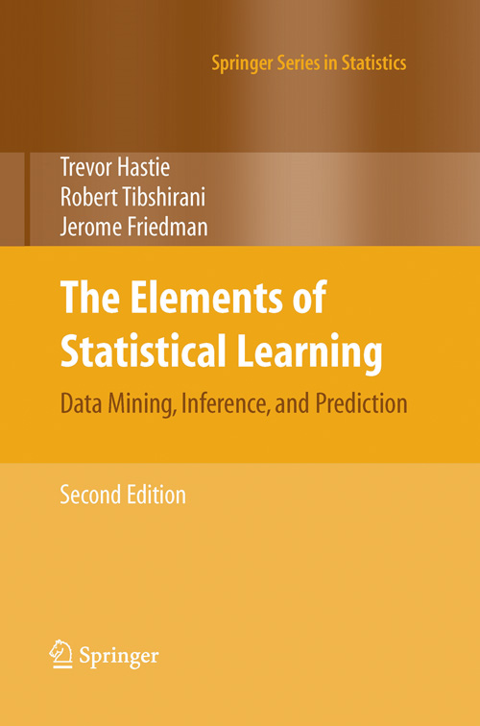
Pointers
The Elements of Statistical Learning
Hastie, Tibshirani, Friedman https://web.stanford.edu/~hastie/ElemStatLearn/
Deep Learning
Goodfellow, Bengio, Courville
https://www.deeplearningbook.org/

Slide 5
Machine Learning
Algorithms that learn from data

Slide 6
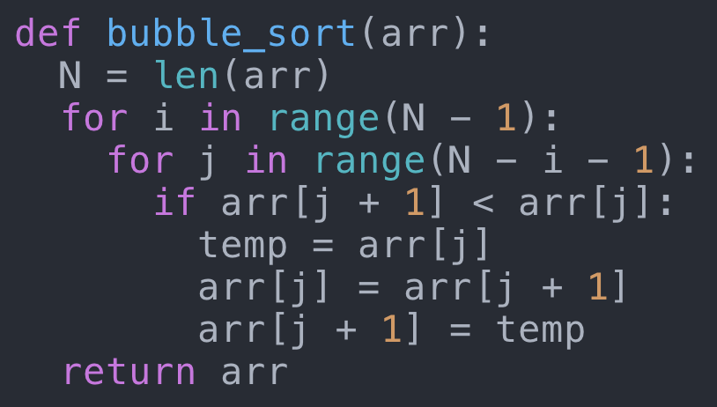
Machine Learning vs Programming
Traditional Programming
Human
Input
Algorithm
Output
Works well for sorting numbers

Slide 7
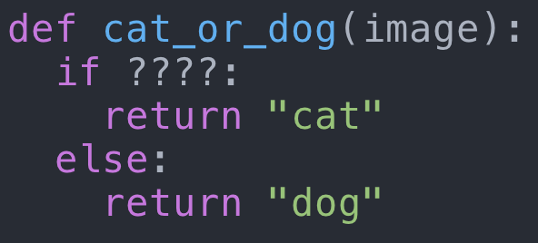
Machine Learning vs Programming
Traditional Programming
Human
Input
Algorithm
Output
Much harder for some problems

Slide 8
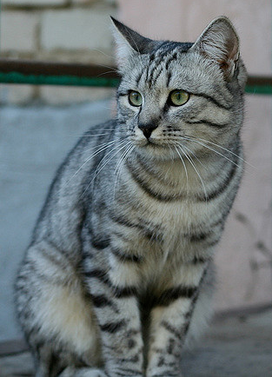
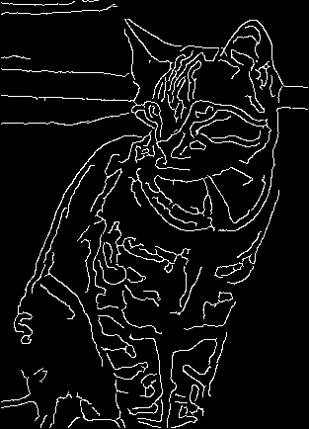
Machine Learning vs Programming
Traditional Programming
Human
Input
Algorithm
Output
Look for ears, whiskers, etc
Find edges
Problems:
Very brittle
What about car vs truck?

Slide 9
Machine Learning vs Programming
Traditional Programming
Human
“Software 1.0”
Input
Algorithm
Output
Machine Learning
Human
“Software 2.0”
Data
Algorithm
Input
Model
Output
https://medium.com/@karpathy/software-2-0-a64152b37c35

Slide 10
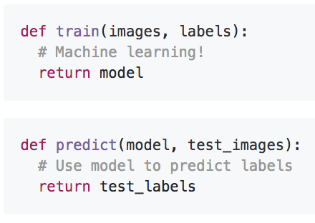
Machine Learning: Data-Driven Approach
Collect a large set of data
Use Machine Learning to train a model
Evaluate the model on new data
Example training set

Slide 11
Supervised vs Unsupervised Learning
Supervised Learning
Data: (x, y)
x is input / feature
y is label / target
Goal: Learn a function to map x -> y

Slide 12
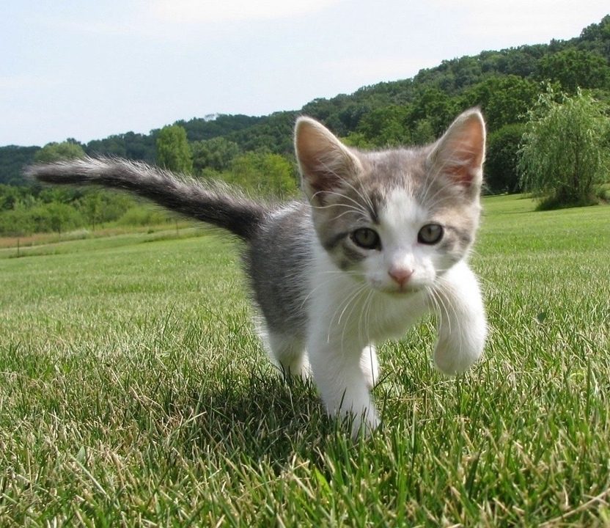
Supervised vs Unsupervised Learning
Supervised Learning
Data: (x, y)
x is input / feature
y is label / target
Goal: Learn a function to map x -> y
Image Classification:
Predict a discrete category
x
y
Cat
Dog
Monkey
Cat image is CC0 public domain
Dog image is CC0 Public Domain
Monkey image is CC0 Public Domain

Slide 13
Supervised vs Unsupervised Learning
Supervised Learning
Data: (x, y)
x is input / feature
y is label / target
Goal: Learn a function to map x -> y
Image Regression:
Predict a continuous value
x
y
2 lbs
25 lbs
35 lbs
Cat image is CC0 public domain
Dog image is CC0 Public Domain
Monkey image is CC0 Public Domain

Slide 14
Supervised vs Unsupervised Learning
Supervised Learning
Data: (x, y)
x is input / feature
y is label / target
Goal: Learn a function to map x -> y
Image Captioning:
Predict a sequence of words
x
y
“A white and gray kitten on grass”
“White and orange dog with a red leash in the woods”
“A monkey sitting in front of rocks”
Cat image is CC0 public domain
Dog image is CC0 Public Domain
Monkey image is CC0 Public Domain

Slide 15
Supervised vs Unsupervised Learning
Supervised Learning
Data: (x, y)
x is input / feature
y is label / target
Goal: Learn a function to map x -> y
Unsupervised Learning
Data: x
Just data, no labels!
Goal: Learn underlying structure in the data

Slide 16
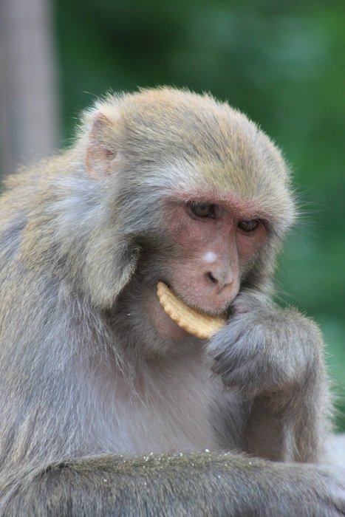
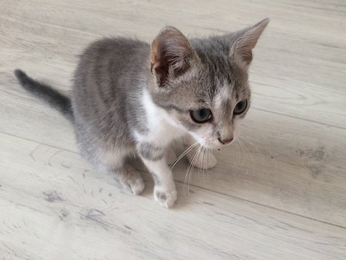
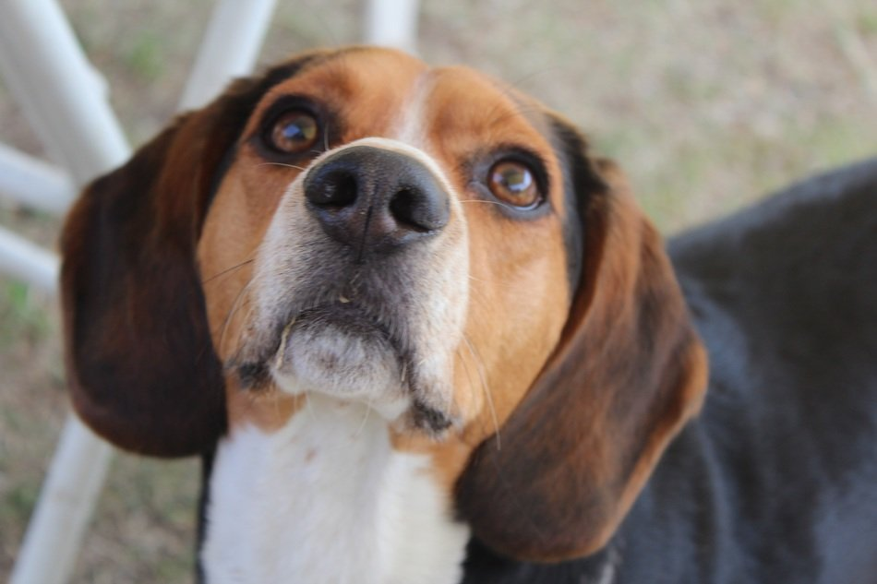
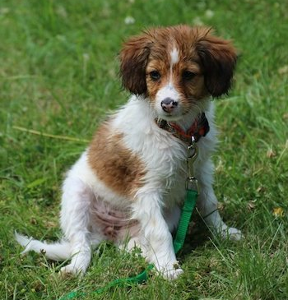
Supervised vs Unsupervised Learning
Clustering:
Group similar images
Unsupervised Learning
Data: x
Just data, no labels!
Goal: Learn underlying structure in the data
1
1
3
2
2
2
3
1
Cat image is CC0 public domain
Dog image is CC0 Public Domain
Monkey image is CC0 Public Domain
Cat image is CC0 public domain
Monkey Image is CC0 public domain
Cat image is CC0 public domain
Dog image is CC0 public domain
Dog image is CC0 public domain

Slide 17
Supervised vs Unsupervised Learning
Dimensionality Reduction:
Project to subspace
Unsupervised Learning
Data: x
Just data, no labels!
Goal: Learn underlying structure in the data
Images:
256x256x3
Projections:
2-dimensional

Slide 18
ML Problems in Vision
Supervised
(Inputs+Labels)
Unsupervised
(Just Data)
Discrete
Output
Classification/
Categorization
Clustering
Continuous
Output
Dimensionality
Reduction
Regression
Slide adapted from J. Hays

Slide 19
First Machine Learning Algorithm: Least Squares Linear Regression

Slide 20
Least Squares Linear Regression

Slide 21
Least Squares Linear Regression
“Regression” = supervised learning with continuous outputs
Data:
$$\left(x_{1},y_{1}\right), \left(x_{2},y_{2}\right), …\left(x_{N},y_{N}\right)$$
$$x_{i},y_{i}∈ℝ$$
y
$$\left(x_{2},y_{2}\right)$$
$$\left(x_{1},y_{1}\right)$$
$$\left(x_{4},y_{4}\right)$$
$$\left(x_{3},y_{3}\right)$$
x

Slide 22
Least Squares Linear Regression
“Linear” = Our model is a line
Data:
$$\left(x_{1},y_{1}\right), \left(x_{2},y_{2}\right), …\left(x_{N},y_{N}\right)$$
$$x_{i},y_{i}∈ℝ$$
y
$$\left(x_{2},y_{2}\right)$$
Model: $y=mx+b$
Or: $x=\left(x,1\right);w=\left(m,b\right)$
$$y=w⋅x$$
$$\left(x_{1},y_{1}\right)$$
$$\left(x_{4},y_{4}\right)$$
$$\left(x_{3},y_{3}\right)$$
x

Slide 23
Least Squares Linear Regression
“Least squares” = Find the line that minimizes squared error
Data:
$$\left(x_{1},y_{1}\right), \left(x_{2},y_{2}\right), …\left(x_{N},y_{N}\right)$$
$$x_{i},y_{i}∈ℝ$$
y
$$\left(x_{2},y_{2}\right)$$
$$y_{2}−w⋅x_{3}$$
Model: $y=mx+b$
Or: $x=\left(x,1\right);w=\left(m,b\right)$
$$y=w⋅x$$
$$\left(x_{1},y_{1}\right)$$
$$\left(x_{4},y_{4}\right)$$
$$\left(x_{3},y_{3}\right)$$
Training:
$$w^{∗}=\arg{\min_{w}{\sum_{i=1}^{N}{{\left(y_{i}−w⋅x_{i}\right)}^{2}}}}$$
x

Slide 24
Solving Least Squares
$$w^{∗}=\arg{\min_{w}{\sum_{i=1}^{N}{{\left(y_{i}−w⋅x_{i}\right)}^{2}}}}$$
$$=\arg{\min_{w}{{\left\|y−Xw\right\|}^{2} }}$$
Output:
Vector of shape (N,)
Inputs:
Matrix of shape (N, 2)
Weights:
Vector of shape (2,)
$$y= \left[\begin{matrix}y_{1} \\ ⋮ \\ y_{N}\end{matrix}\right]$$
$$X= \left[\begin{matrix}x_{1} & 1 \\ ⋮ & ⋮ \\ x_{N} & 1\end{matrix}\right]$$
$$w= \left[\begin{matrix}m \\ b\end{matrix}\right]$$
Solution: $w^{∗}={\left(X^{T}X\right)}^{−1}X^{T}y$

Slide 25
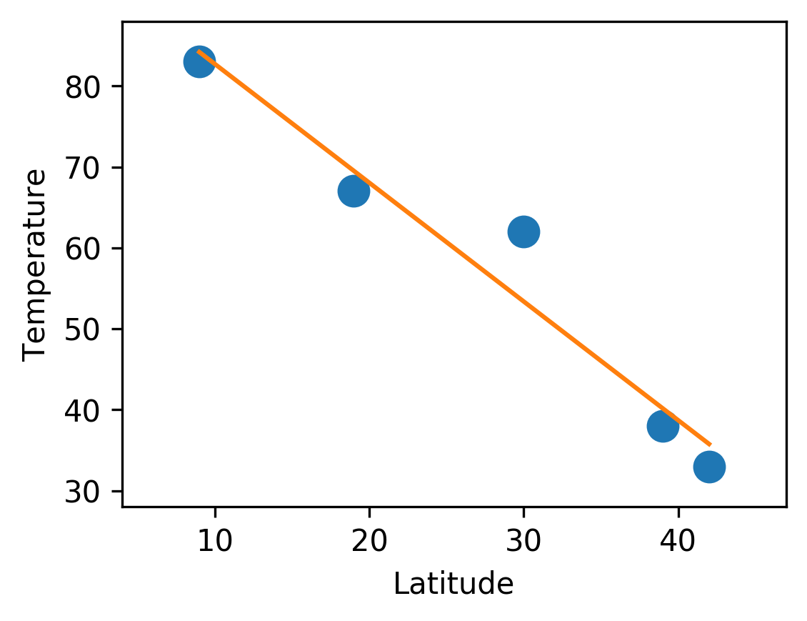
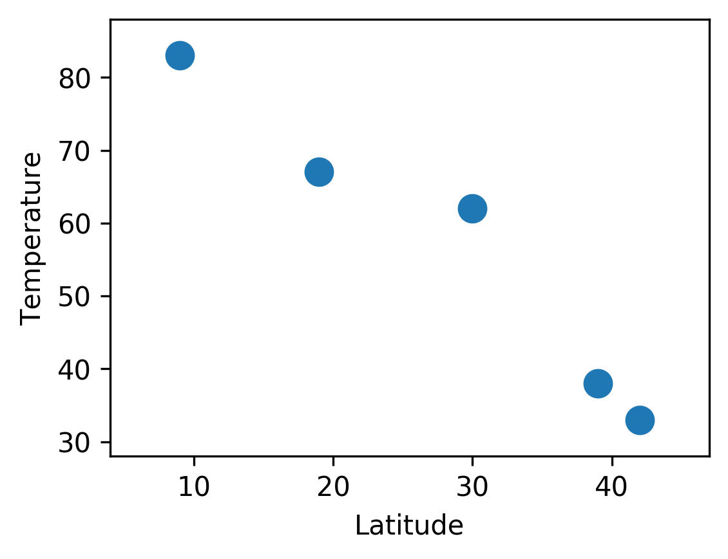
Example: A Bad Weather Model
Given latitude, predict temperature by fitting a line
City
Latitude (°)
Temp (F)
Training
Ann Arbor
42
33
$$X_{5x2}=\left[\begin{matrix}\begin{aligned}42 \\ 39 \\ 30 \\ 19 \\ 9\end{aligned} & \begin{aligned}1 \\ 1 \\ 1 \\ 1 \\ 1\end{aligned}\end{matrix}\right]$$
$$y_{5x1}=\left[\begin{aligned}33 \\ 38 \\ 62 \\ 67 \\ 83\end{aligned}\right]$$
Washington, DC
39
38
Austin, TX
30
62
Mexico City
19
67
Panama City
9
83
$${\left(X^{T}X\right)}^{−1}X^{T}y$$
$$w_{2x1}=\left[\begin{aligned}−1.47 \\ 97\end{aligned}\right]$$
Temp = -1.47*Lat + 97

Slide 26
Example: A Bad Weather Model
Given latitude, predict temperature by fitting a line
City
Latitude (°)
Temp (F)
Prediction
Error
Ann Arbor
42
33
35.3
2.3
Washington, DC
39
38
39.7
1.7
Seems good!
Austin, TX
30
62
52.9
10.9
Mexico City
19
67
69.1
2.1
Panama City
9
83
83.8
0.8
Problem: In ML we don’t care about training set performance; we want models that generalize to new data

Slide 27
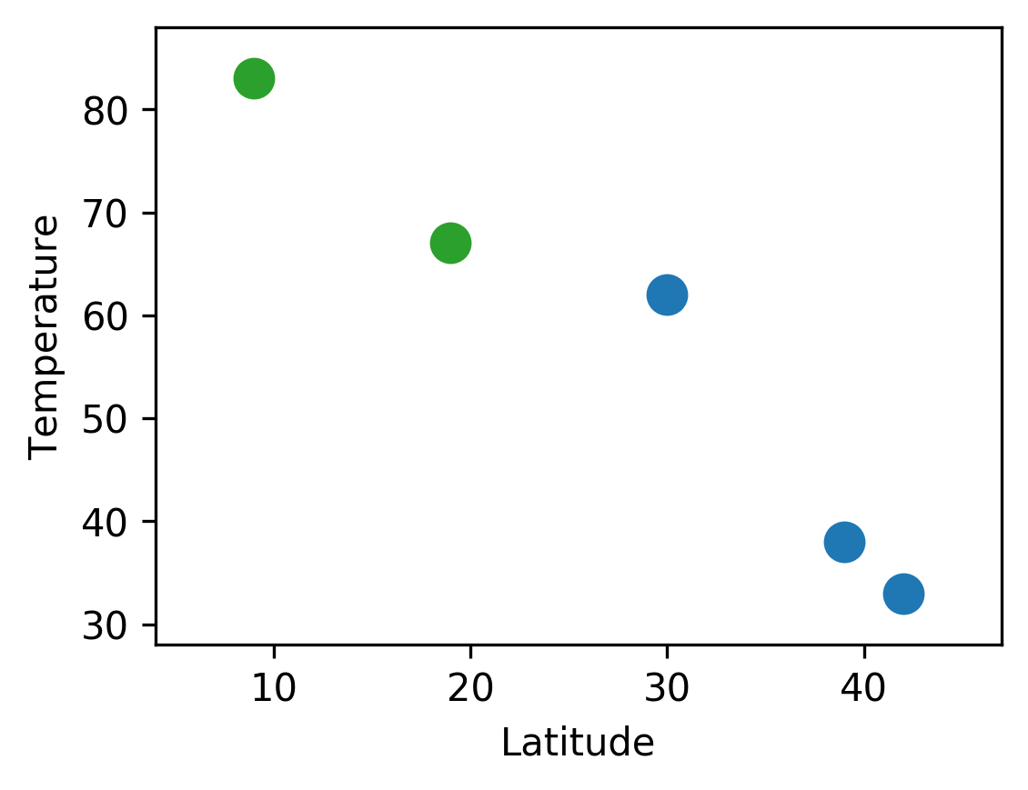
Example: A Bad Weather Model
Given latitude, predict temperature by fitting a line
City
Latitude (°)
Temp (F)
Ann Arbor
42
33
Train
Washington, DC
39
38
Austin, TX
30
62
Mexico City
19
67
Test
Panama City
9
83
Problem: In ML we don’t care about training set performance; we want models that generalize to new data
Solution: Split dataset into train and test sets

Slide 28
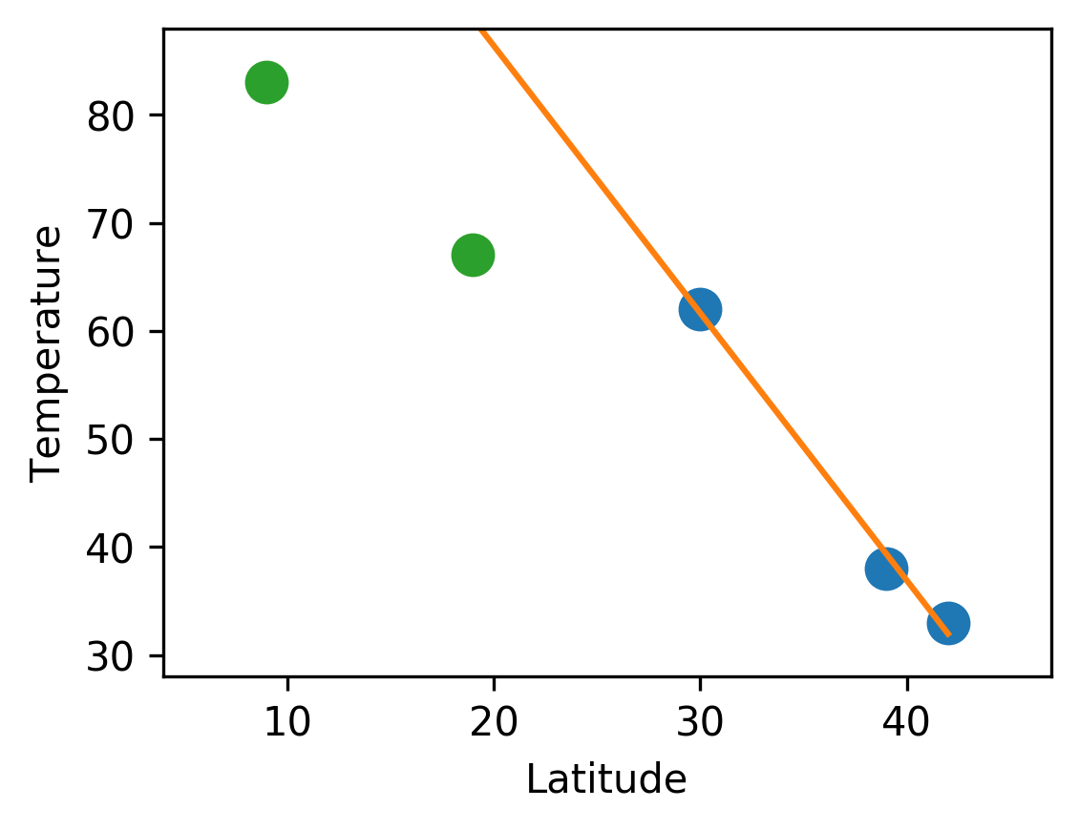
Example: A Bad Weather Model
Given latitude, predict temperature by fitting a line
City
Latitude (°)
Temp (F)
Prediction
Error
Ann Arbor
42
33
31.9
1.0
Train
Washington, DC
39
38
39.4
1.4
Problem: Low error on train, high error on test
Austin, TX
30
62
61.7
0.3
Mexico City
19
67
88.9
21.9
Test
Panama City
9
83
113.6
30.6
Problem: In ML we don’t care about training set performance; we want models that generalize to new data
Solution: Split dataset into train and test sets
Fit on train set, evaluate on both

Slide 29
Overfitting, Underfitting, Regularization
Overfitting: Model fits noise in the training set and doesn’t generalize well to new data
Model is too flexible
Test data
Training data

Slide 30
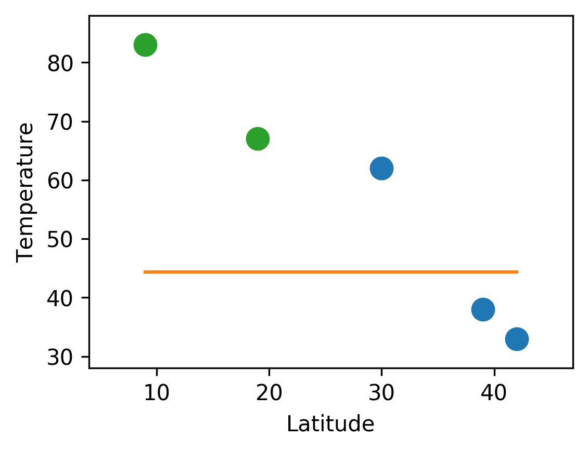
Overfitting, Underfitting, Regularization
Overfitting: Model fits noise in the training set and doesn’t generalize well to new data
Model is too flexible
Underfitting: Model doesn’t fit the training data well, high error on both train and test
Model is not flexible enough
Test data
Training data

Slide 31
Overfitting, Underfitting, Regularization
Overfitting: Model fits noise in the training set and doesn’t generalize well to new data
Model is too flexible
Regularization: Penalize model complexity to prevent overfitting and improve generalization
Underfitting: Model doesn’t fit the training data well, high error on both train and test
Model is not flexible enough
Least Squares
Test data
Training data
$$\arg{\min_{w}{{\left\|y−Xw\right\|}^{2} }}$$
L2-Regularized Least Squares
$$\arg{\min_{w}{{\left\|y−Xw\right\|}^{2}+{λ\left\|w\right\|}^{2} }}$$
$$w^{∗}={\left(X^{T}X+λI\right)}^{−1}X^{T}y$$

Slide 32
Overfitting, Underfitting, Regularization
Overfitting: Model fits noise in the training set and doesn’t generalize well to new data
Model is too flexible
Regularization: Penalize model complexity to prevent overfitting and improve generalization
Underfitting: Model doesn’t fit the training data well, high error on both train and test
Model is not flexible enough
Least Squares
Test data
Training data
$$\arg{\min_{w}{{\left\|y−Xw\right\|}^{2} }}$$
L2-Regularized Least Squares
$$\arg{\min_{w}{{\left\|y−Xw\right\|}^{2}+{λ\left\|w\right\|}^{2} }}$$
Fit training data

Slide 33
Overfitting, Underfitting, Regularization
Overfitting: Model fits noise in the training set and doesn’t generalize well to new data
Model is too flexible
Regularization: Penalize model complexity to prevent overfitting and improve generalization
Underfitting: Model doesn’t fit the training data well, high error on both train and test
Model is not flexible enough
Least Squares
Test data
Training data
$$\arg{\min_{w}{{\left\|y−Xw\right\|}^{2} }}$$
L2-Regularized Least Squares
$$\arg{\min_{w}{{\left\|y−Xw\right\|}^{2}+{λ\left\|w\right\|}^{2} }}$$
Fit training data
Penalize complexity

Slide 34
Overfitting, Underfitting, Regularization
Overfitting: Model fits noise in the training set and doesn’t generalize well to new data
Model is too flexible
Regularization: Penalize model complexity to prevent overfitting and improve generalization
Underfitting: Model doesn’t fit the training data well, high error on both train and test
Model is not flexible enough
Least Squares
Test data
Training data
$$\arg{\min_{w}{{\left\|y−Xw\right\|}^{2} }}$$
L2-Regularized Least Squares
$$\arg{\min_{w}{{\left\|y−Xw\right\|}^{2}+{λ\left\|w\right\|}^{2} }}$$
Fit training data
Regularization Strength
Penalize complexity

Slide 35
Overfitting, Underfitting, Regularization
Overfitting: Model fits noise in the training set and doesn’t generalize well to new data
Model is too flexible
Regularization: Penalize model complexity to prevent overfitting and improve generalization
Underfitting: Model doesn’t fit the training data well, high error on both train and test
Model is not flexible enough
$λ=0.00$: No regularization; model overfits
Test data
Training data
L2-Regularized Least Squares
$$\arg{\min_{w}{{\left\|y−Xw\right\|}^{2}+{λ\left\|w\right\|}^{2} }}$$
Fit training data
Regularization Strength
Penalize complexity

Slide 36
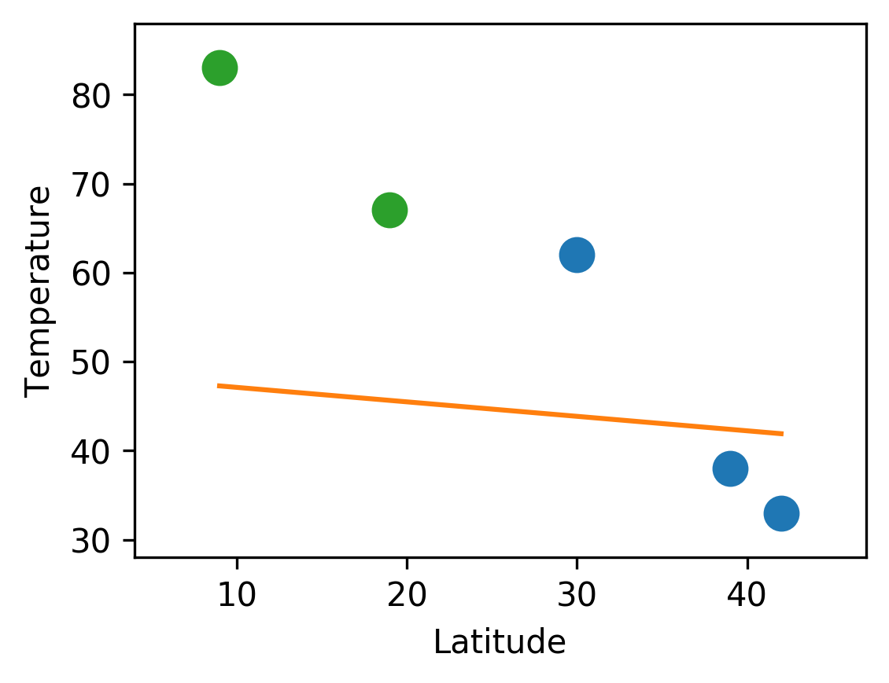
Overfitting, Underfitting, Regularization
Overfitting: Model fits noise in the training set and doesn’t generalize well to new data
Model is too flexible
Regularization: Penalize model complexity to prevent overfitting and improve generalization
Underfitting: Model doesn’t fit the training data well, high error on both train and test
Model is not flexible enough
$λ=0.00$: No regularization; model overfits
Test data
Training data
$λ=0.10$: Too much regularization, underfitting
L2-Regularized Least Squares
$$\arg{\min_{w}{{\left\|y−Xw\right\|}^{2}+{λ\left\|w\right\|}^{2} }}$$
Fit training data
Regularization Strength
Penalize complexity

Slide 37
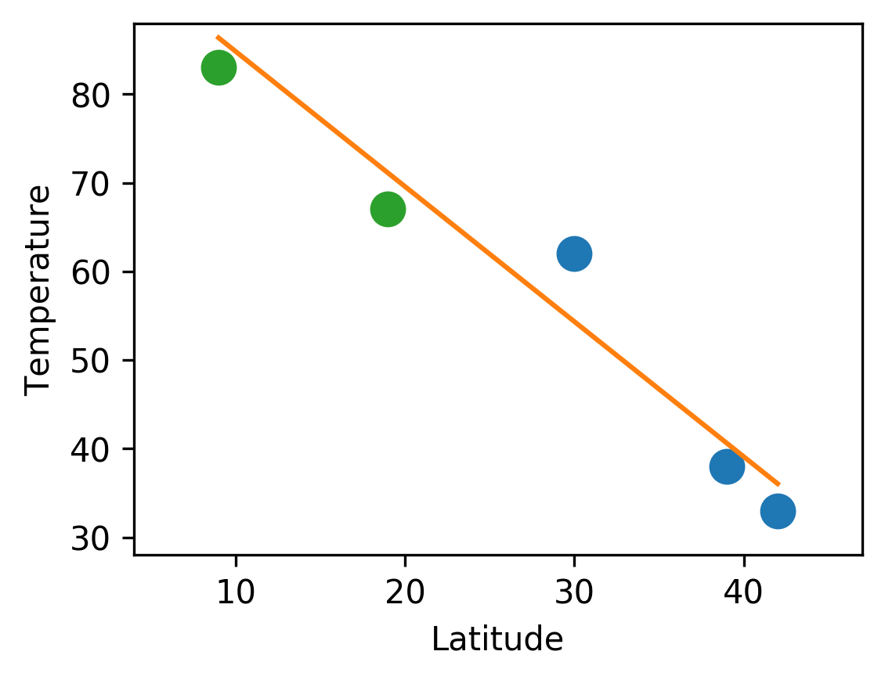
Overfitting, Underfitting, Regularization
Overfitting: Model fits noise in the training set and doesn’t generalize well to new data
Model is too flexible
Regularization: Penalize model complexity to prevent overfitting and improve generalization
Underfitting: Model doesn’t fit the training data well, high error on both train and test
Model is not flexible enough
$λ=0.00$: No regularization; model overfits
Test data
Training data
$λ=0.10$: Too much regularization, underfitting
$λ=0.02$: Just right! Good fit and generalization
L2-Regularized Least Squares
$$\arg{\min_{w}{{\left\|y−Xw\right\|}^{2}+{λ\left\|w\right\|}^{2} }}$$
Fit training data
Regularization Strength
Penalize complexity

Slide 38
Regularization
City
Latitude (°)
Temp (F)
Ann Arbor
42
33
Train
Washington, DC
39
38
Austin, TX
30
62
Mexico City
19
67
Test
Panama City
9
83
L2-Regularized Least Squares
$$\arg{\min_{w}{{\left\|y−Xw\right\|}^{2}+{λ\left\|w\right\|}^{2} }}$$
Fit training data
Regularization Strength
Penalize complexity

Slide 39
Regularization
No regularization
($λ=0$)
City
Latitude (°)
Temp (F)
Prediction
Error
Ann Arbor
42
33
31.9
1.0
Train
Washington, DC
39
38
39.4
1.4
Austin, TX
30
62
61.7
0.3
Mexico City
19
67
88.9
21.9
Test
Panama City
9
83
113.6
30.6
L2-Regularized Least Squares
$$\arg{\min_{w}{{\left\|y−Xw\right\|}^{2}+{λ\left\|w\right\|}^{2} }}$$
Fit training data
Regularization Strength
Penalize complexity

Slide 40
Regularization
No regularization
($λ=0$)
Regularized
($λ=0.02$)
City
Latitude (°)
Temp (F)
Prediction
Error
Prediction
Error
Ann Arbor
42
33
31.9
1.0
36.0
3.0
Train
Washington, DC
39
38
39.4
1.4
40.6
2.6
Austin, TX
30
62
61.7
0.3
54.3
7.7
Mexico City
19
67
88.9
21.9
71.1
4.1
Test
Panama City
9
83
113.6
30.6
86.4
3.4
L2-Regularized Least Squares
$$\arg{\min_{w}{{\left\|y−Xw\right\|}^{2}+{λ\left\|w\right\|}^{2} }}$$
Fit training data
Regularization Strength
Penalize complexity

Slide 41
Parameters and Hyperparameters
L2-Regularized Least Squares
$$\arg{\min_{w}{{\left\|y−Xw\right\|}^{2}+{λ\left\|w\right\|}^{2} }}$$
Parameter ($w$): Selected during training by fitting to training data
Hyperparameter ($λ$): Chosen before training, does not depend on training data
Question: How to choose hyperparameters?

Slide 42
Choosing Hyperparameters
Idea #1: Choose hyperparameters that work best on the data
BAD: λ =0 always works best on training data
Your Dataset
Idea #2: Split data into train and test, choose hyperparameters that work best on test data
BAD: No idea how we will perform on new data
train
test
Idea #3: Split data into train, val, and test; choose hyperparameters on val and evaluate on test
Better!
train
validation
test

Slide 43
Choosing Hyperparameters
Your Dataset
Idea #4: Cross-Validation: Split data into folds, try each fold as validation and average the results
fold 1
fold 2
fold 3
fold 4
fold 5
test
fold 1
fold 2
fold 3
fold 4
fold 5
test
fold 1
fold 2
fold 3
fold 4
fold 5
test
Useful for small datasets, but (unfortunately) not used too frequently in deep learning

Slide 44
Least Squares: Multiple Inputs
Instead of scalar inputs $x_{i}∈ℝ,$
common to have vector inputs $x_{i}∈ℝ^{D}$
Same equation as before, but terms have different shapes
$$w^{∗}=\arg{\min_{w}{\sum_{i=1}^{N}{{\left(y_{i}−w⋅x_{i}\right)}^{2}}}}$$
$$=\arg{\min_{w}{{\left\|y−Xw\right\|}^{2} }}$$
Output:
Vector of shape (N,)
Inputs:
Matrix of shape (N, D + 1)
Weights:
Vector of shape (D + 1,)
$$y= \left[\begin{matrix}y_{1} \\ ⋮ \\ y_{N}\end{matrix}\right]$$
$$X=\left[\begin{matrix}x_{1,1} & … & x_{1,D} & 1 \\ ⋮ & ⋱ & ⋮ & 1 \\ x_{N,1} & … & x_{N,D} & 1\end{matrix}\right]$$
$$w=\left[\begin{matrix}w_{1} \\ ⋮ \\ w_{D} \\ b\end{matrix}\right]$$
Solution: $w^{∗}={\left(X^{T}X\right)}^{−1}X^{T}y$

Slide 45
Least Squares: Many Outputs
Vector inputs $x_{i}∈ℝ^{D_{in}}$
Vector outputs $y_{i}∈ℝ^{D_{out}}$
Same equation as before, but terms have different shapes
$$W^{∗}=\arg{\min_{w}{\sum_{i=1}^{N}{{\left(y_{i}−Wx_{i}\right)}^{2}}}}$$
$$=\arg{\min_{W}{{\left\|Y−Xw\right\|}^{2} }}$$
Output:
Matrix of shape (N, D_{out})
Inputs:
Matrix of shape (N, D_{in} + 1)
Weights:
Matrix of shape (D_{in} + 1, D_{out})
$$X=\left[\begin{matrix}x_{1,1} & … & x_{1,D_{in}} & 1 \\ ⋮ & ⋱ & ⋮ & 1 \\ x_{N,1} & … & x_{N,D_{in}} & 1\end{matrix}\right]$$
$$W=\left[\begin{matrix}W_{1,1} & … & W_{D_{out}} \\ ⋮ & ⋱ & ⋮ \\ W_{D_{in},1} & … & W_{D_{in},D_{out}} \\ b_{1} & … & b_{D_{out}}\end{matrix}\right]$$
$$Y=\left[\begin{matrix}y_{1,1} & … & y_{1,D_{out}} \\ ⋮ & ⋱ & ⋮ \\ y_{N,1} & … & y_{N,D_{out}}\end{matrix}\right]$$
Solution: $W^{∗}={\left(X^{T}X\right)}^{−1}X^{T}Y$

Slide 46
Recap
Machine Learning is a form of data-driven programming
Supervised Learning maps inputs to outputs
Unsupervised Learning finds structure in unlabeled data
ML Example: Least Squares Linear Regression
Regularization can control overfitting and underfitting
Use the training set to choose parameters
Use the validation set to choose hyperparameters
Use the test set once to estimate generalization

Slide 47
Next Time: Linear Classifiers

