Slide 1
EECS 442
Computer Vision
Justin Johnson & David Fouhey
Winter 2021
https://web.eecs.umich.edu/~justincj/teaching/eecs442/WI2021/

Slide 2
Lecture 1: Introduction

Slide 3
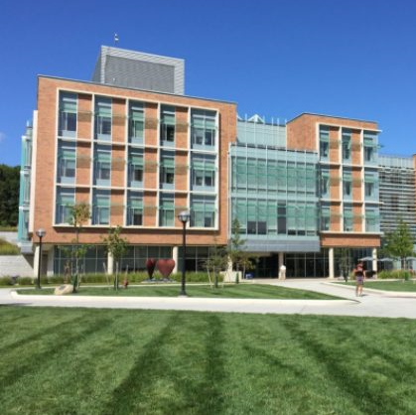
Goals of Computer Vision
Get a computer to understand

Slide 4
Goals of Computer Vision
Goal: Naming
Building
Person
Grass

Slide 5
Goals of Computer Vision
Goal: Naming
Bob and Betty Beyster Building
Justin Johnson
Lawngrass

Slide 6
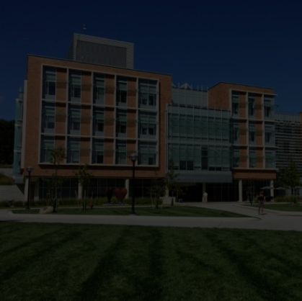
Goals of Computer Vision
Goal: Naming
The picture shows a building with many windows and grass in front of it. There is a person walking on the right…

Slide 7
Goals of Computer Vision
Goal: 3D Structure
∞

Slide 8
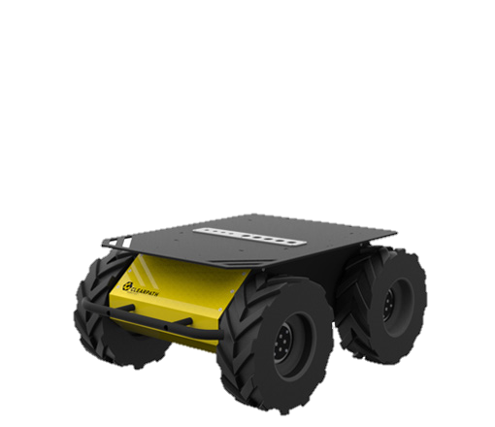
Goals of Computer Vision
Goal: Actions
What can I
do here?

Slide 9
Goals of Computer Vision
Goal: Matching

Slide 10
Something I’m excited about…

Slide 11
Generating Images
Karras et al, “Progressive Growing of GANs for Improved Quality, Stability, and Variation”, ICLR 2018

Slide 12
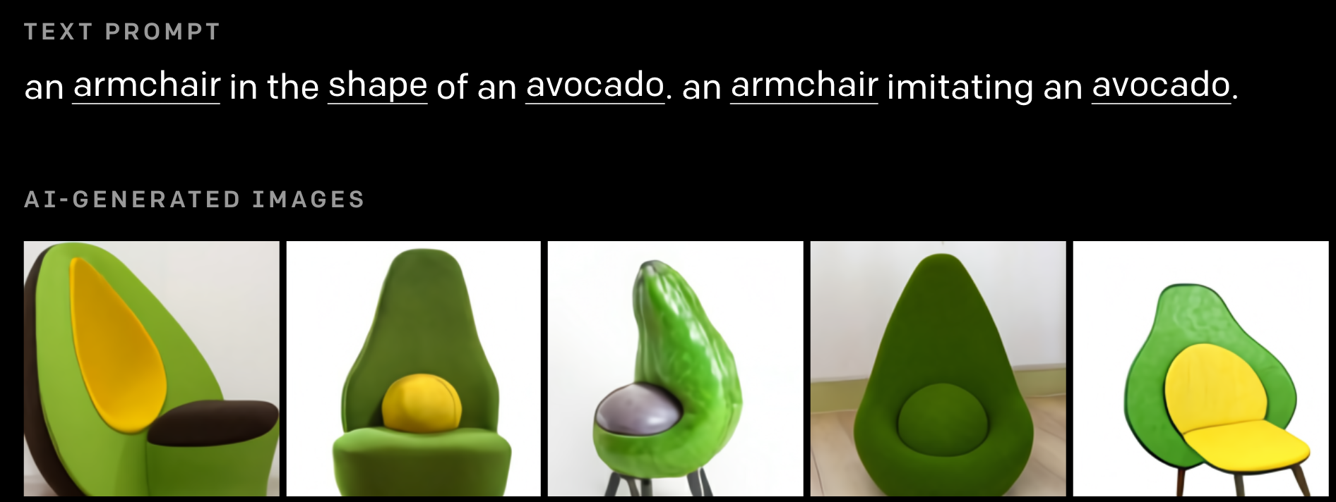
Generating Images from Language
Ramesh et al, “DALL·E: Creating Images from Text”, 2021. https://openai.com/blog/dall-e/

Slide 13
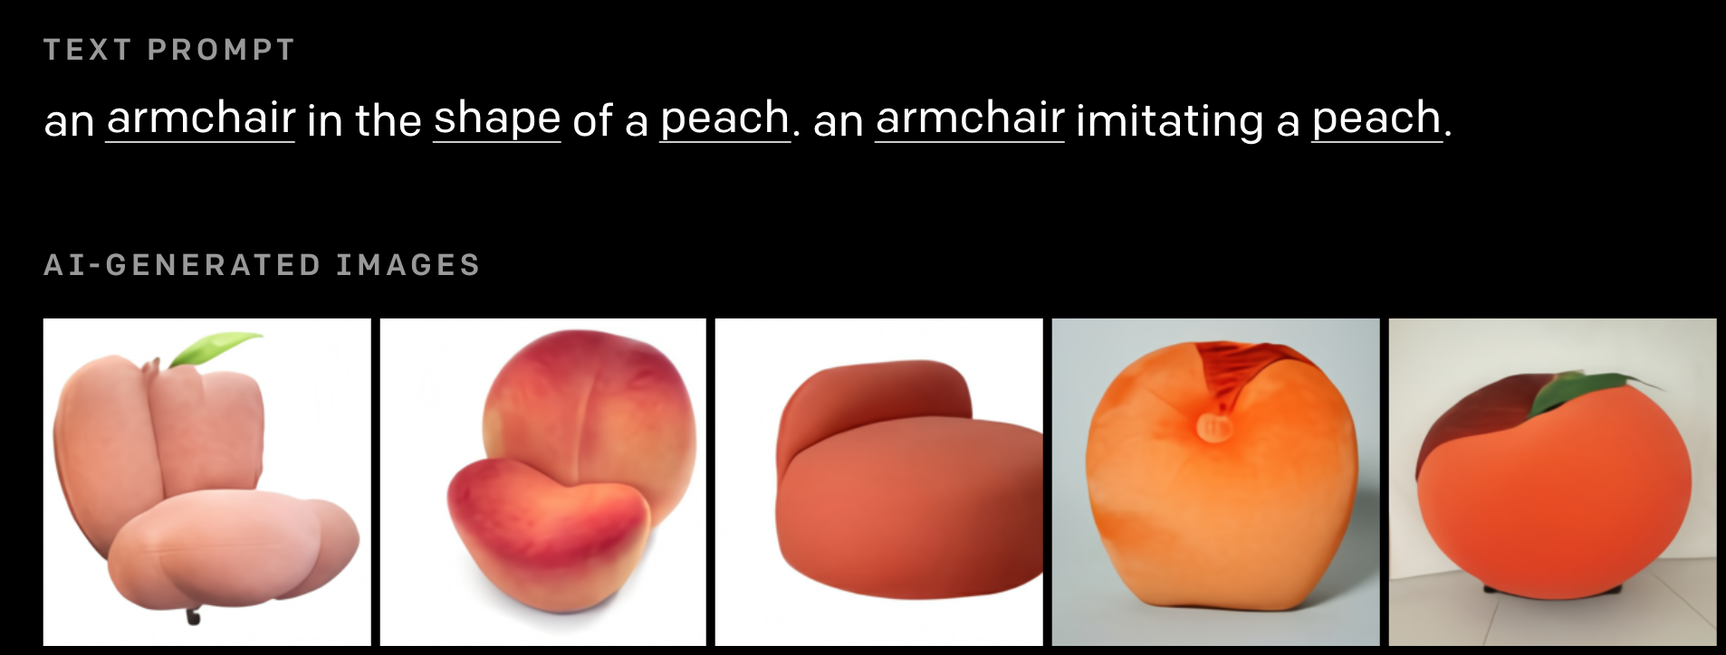
Generating Images from Language
Ramesh et al, “DALL·E: Creating Images from Text”, 2021. https://openai.com/blog/dall-e/

Slide 14
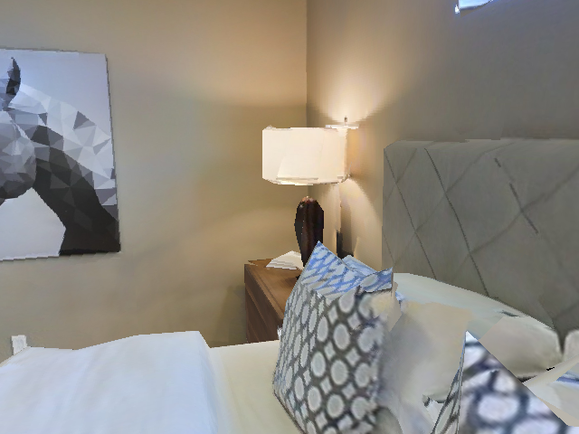
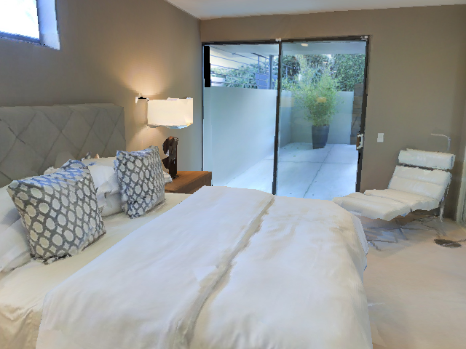
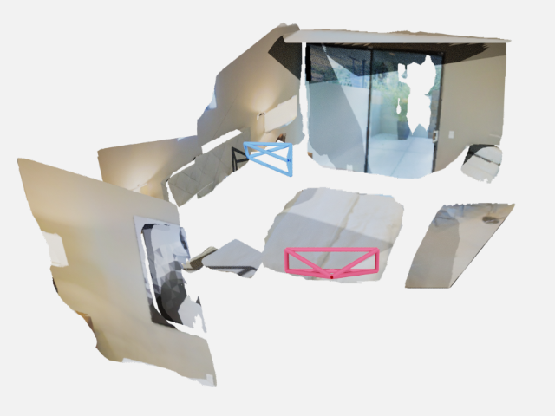
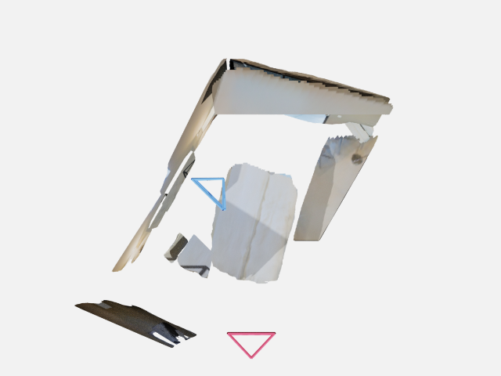
Reconstructing the 3D World

Slide 15
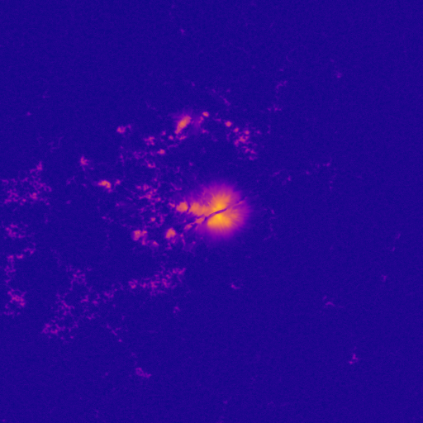
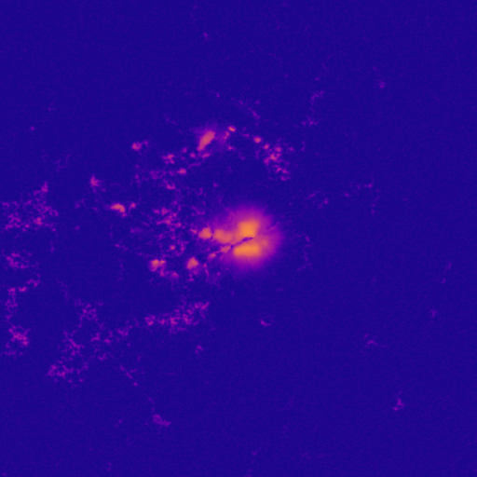
Giving People Tools
Roughly: as magnetic as MRI machine and as big as Venus
Traditional Technique:
30 min/image
Neural Network:
~4s / image

Slide 16
Why is this hard?
All of this stuff seems obvious and effortless!
Why do we need a whole subfield of CS for this?
Key Concept: We see with both our eyes and our brain

Slide 17
Why is this hard?

Slide 18
Why is this hard?

Slide 19
Why is this hard?

Slide 20
Why is this hard?
Problem: Semantic Gap

Slide 21
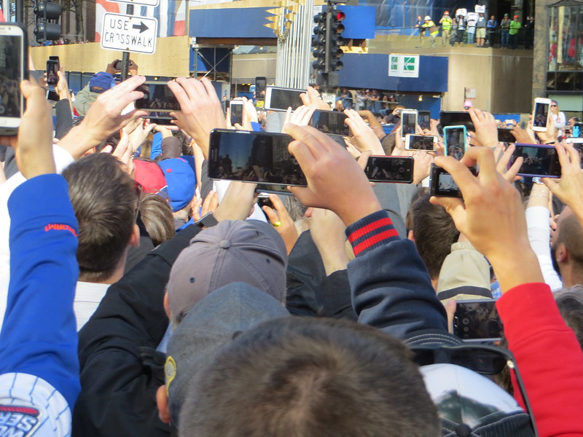
Why is it important?
Understand Web Data
Instagram: 100 million photos and videos uploaded per day
YouTube: 300 hours of video uploaded every minute
Looking at all content created in one day would take >50 years
This image by David Wilson is licensed under CC BY 2.0. No changes made.

Slide 22
Why is it important?
Autonomous Vehicles
This image is licensed under CC BY-SA 4.0. No changes made.

Slide 23
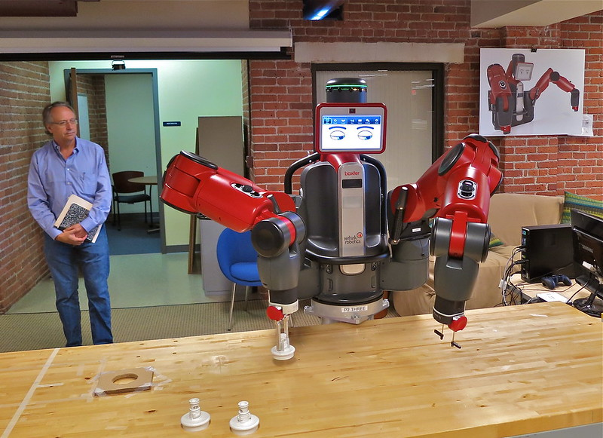
Why is it important?
Robotics
This image is licensed under a CC BY 2.0 license. No changes made.
Image source

Slide 24
Why is it important?
Augmented / Virtual Reality
This image is licensed under a CC BY-SA 4.0 license. No changes made.
This image is licensed under a CC BY-SA 3.0 IGO license. No changes made.

Slide 25
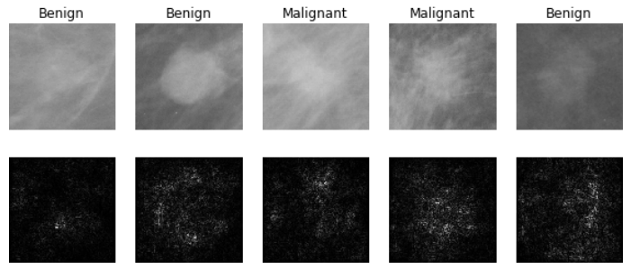
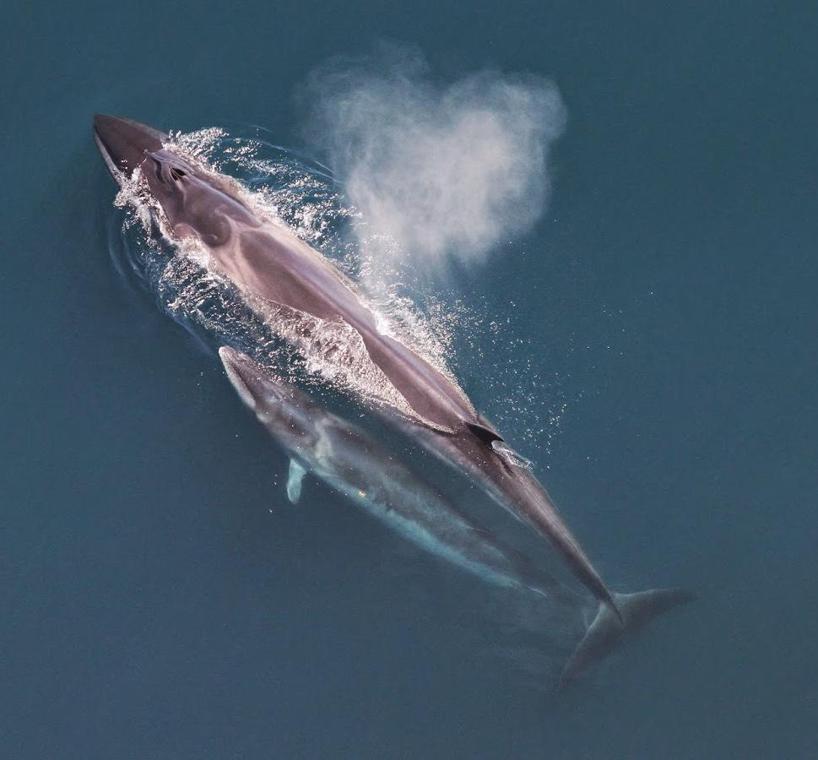
Why is it important?
Science and Medicine
Medical Imaging
Whale recognition
Levy et al, 2016 Figure reproduced with permission
Galaxy Classification
Kaggle Challenge
This image by Christin Khan is in the public domain and originally came from the U.S. NOAA.
Dieleman et al, 2014
From left to right: public domain by NASA, usage permitted by ESA/Hubble, public domain by NASA, and public domain.

Slide 26
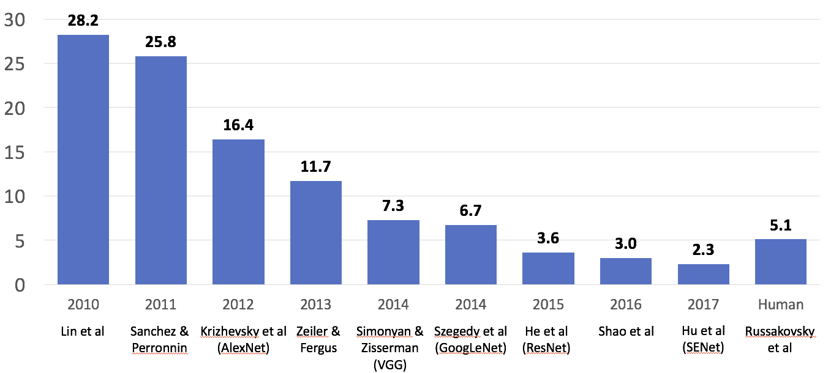
We have made great progress
Enter Deep Learning

Slide 27
Explosion of Computer Vision
Publications at top Computer Vision conference:
Number of submitted and accepted papers at CVPR

Slide 28
Despite our success, computer vision still has a long way to go.
Computer vision is far from solved!

Slide 29
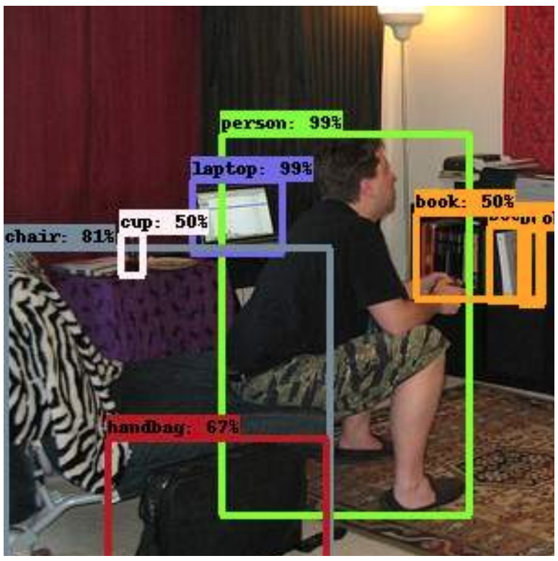
“The Elephant in the Room”
Modern object detectors seem to work well!
Rosenfeld et al, “The Elephant in the Room”, arXiv 2018

Slide 30
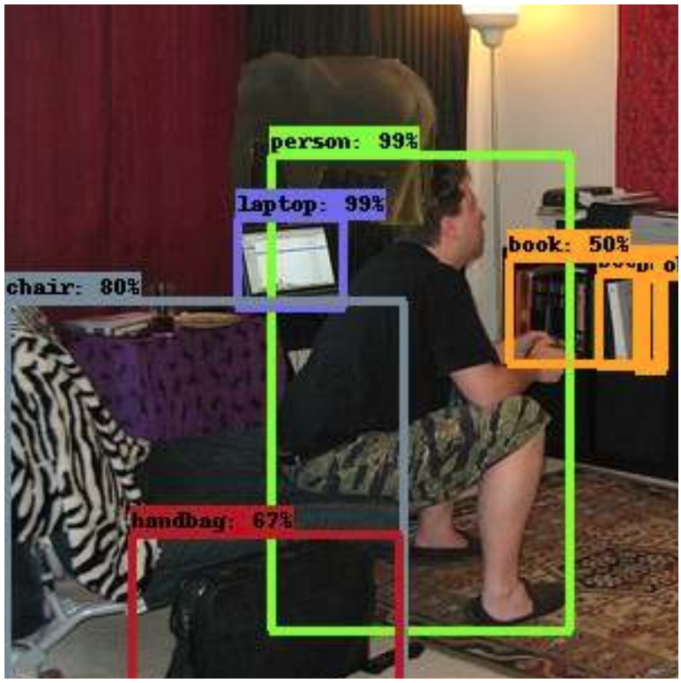
“The Elephant in the Room”
”Unusual” objects are often missed!
Computer Vision systems ”see” very differently than we do
Rosenfeld et al, “The Elephant in the Room”, arXiv 2018

Slide 31
This image is copyright-free United States government work
Example credit: Andrej Karpathy

Slide 32
Course Logistics

Slide 33
Meeting Times
Lecture:
Section 1: Tue / Thu 10:30am – 12:00pm on Zoom
Section 2: Tue / Thu 12:00pm – 1:30pm on Zoom
Office Hours
Lots of office hours! Schedule TBD
GSI Office Hours: Questions about homework, code
Faculty Office Hours: Prefer conceptual questions

Slide 34
Waitlist Policy
The waitlist is huge. We are limited by ability to hire course staff
Policies:
Talk to the EECS undergrad office – they have all the information
I do not reorder the waitlist –this leads to me making arbitrary decisions with limited information

Slide 35
Prerequisites
You absolutely need:
Programming: EECS 281
Linear Algebra (new): Math 214, 217, 296 or 417
Reach out to us if you have equivalent experience
We will have a one-lecture math refresher
You’ll have to learn: Numpy + PyTorch, a little tiny bit of continuous optimization

Slide 36
Prerequisites
Suppose K in R^{3x3}, x in R³ .Should know:
How do I calculate Kx?
When is K invertible?
What is x if Kx = λx for some λ?
What’s the set {y: x^{T}y = 0} geometrically?
You should also be able to remember some notion of a derivative

Slide 37
Websites
Course website: https://web.eecs.umich.edu/~justincj/teaching/eecs442/WI2021/
Piazza: https://piazza.com/class/umich/winter2021/eecs442
Canvas / Autograder for code submission
Gradescope for writeup submission

Slide 38
Piazza
Please ask questions on Piazza so we can answer the question once, officially, and quickly
We will monitor Piazza in a systematic way, but we do not guarantee instant response times
Please don’t ask questions about course material, homework, or logistics over email – those should all go to Piazza
If you have a sensitive or private issue, then email me / David directly

Slide 39
Textbooks
No required textbook.
Szeliski, Computer Vision: Algorithms and Applications, is a good reference and available online.
http://szeliski.org/Book/

Slide 40
Evaluation
Homework (76%)
Programming assignments in Python / numpy / Pytorch
HW0 is a numpy crash course (6%)
HW1-6 are guided mini-projects
HW1-5 are 12% each
HW6 is 10%
Project (24%)
Project Proposal (2%)
Virtual Project Showcase (8%)
Project Report (14%)

Slide 41
Homework Late Policy
Penalty: 1% per hour, rounded to nearest
Example:
Due: Midnight Mon. (1s after 11:59:59pm Mon)
Submitted at 12:15am Tue: No penalty!
Submitted at 6:50am Tue: 7% penalty (specifically 90% -> 83%)
Exceptions only for exceptional circumstances.
Everyone gets 72 free late hours, applied automatically

Slide 42
Copying: There are better options
Read the syllabus
Copying is usually painfully obvious and I don’t have many options
Submit it late (that’s why we have late days), half-working (that’s why we have partial credit), or take the zero on the homework – I guarantee you won’t care about one bad homework in a year
If you’re overwhelmed, talk to us

Slide 43
Course Project
Work in a team of 3-5 to do something cool
There will be a piazza thread for pairing up
Could be:
Applying vision to a problem you care about
Independent re-implementation of a paper
Trying to build and extend an approach
Should be 2 homeworks worth of work per person

Slide 44
First Homework: Numpy warmup
First homework is meant as an introduction / refresher to array programming with numpy
Will be released tomorrow, due in one week on Wednesday 1/27 11:59pm

Slide 45
And now to David: Camera Models

